Slide 1
Gunnison National Forest Agriculture
Mapping Spruce Beetle Outbreak Severity and Distribution in Gunnison National Forest Using Landsat and Integrative Spatial Modeling
Eric Rounds (Project Lead)
Sarah Carroll
Oliver Miltenberger
Peder Engelstad

Slide 2
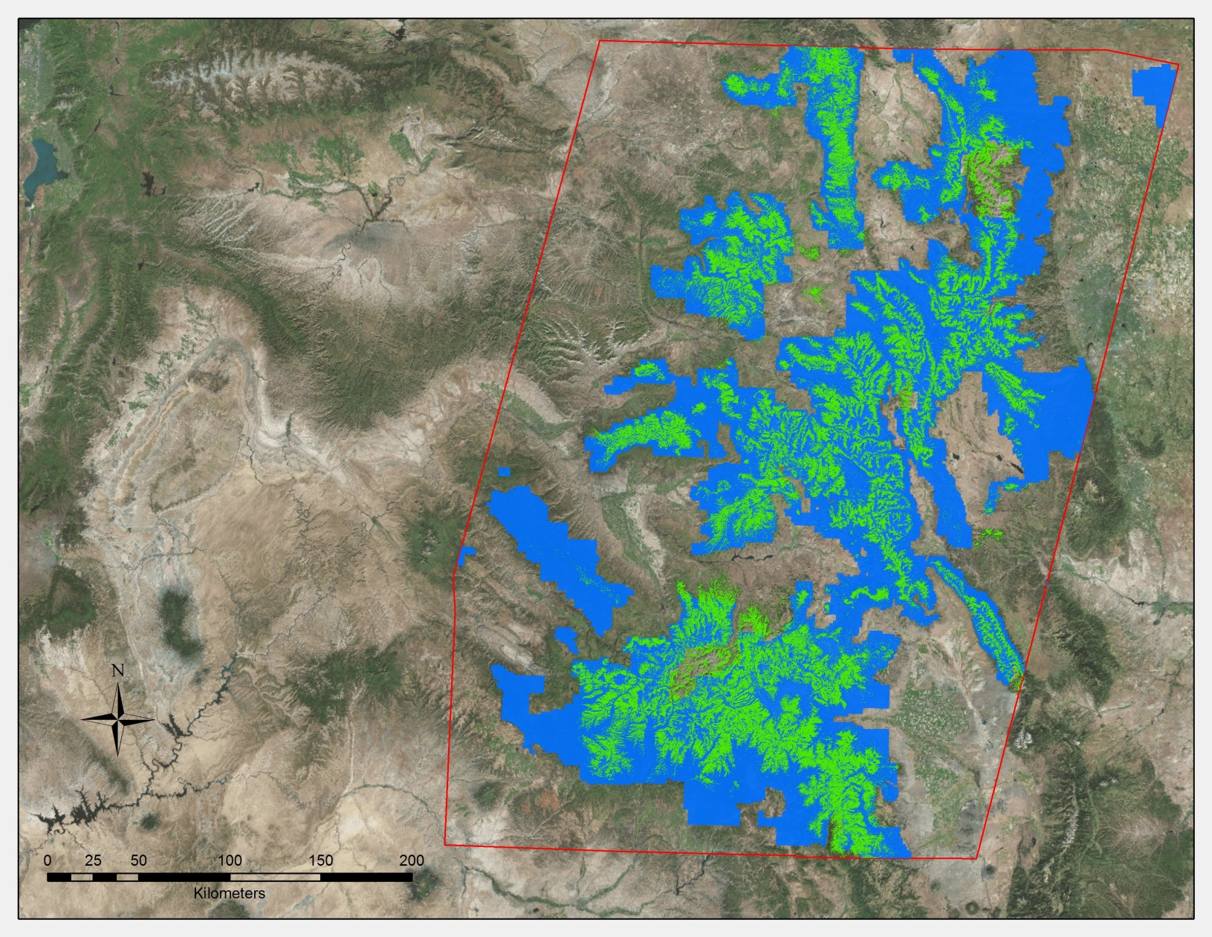
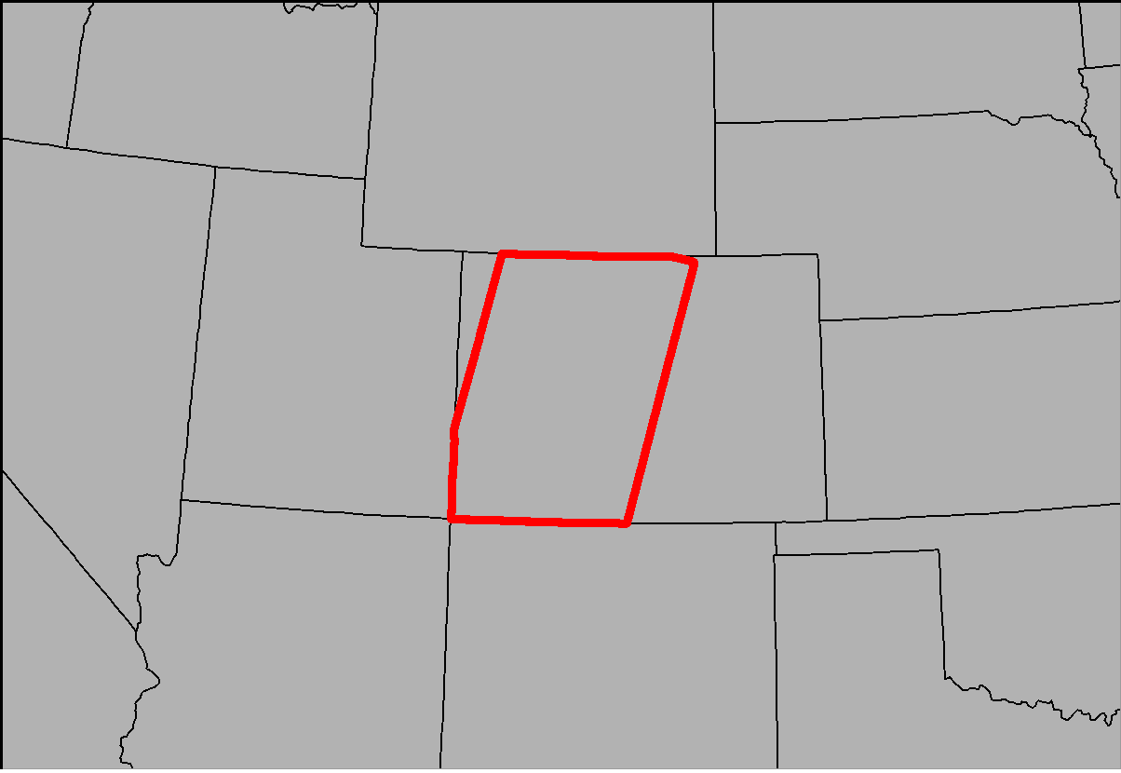
Study Area & Study Period
Location
Spruce-Fir Forests in Colorado
Time Period
September 2006 – October 2015
Legend
Spruce-Fir Forest
National Forest Lands
Study Area
Notes:
The study area stretches across more than 600 square kilometers of spruce-fir forests in western Colorado. The study is focused on spruce-fir communities dominated by Englemann spruce (Picea engelmannii), Douglas fir (Pseudotsuga menziesii), and subalpine fir (Abies lasiocarpa) in the subalpine zone (7,000-10,000 ft) of the Rocky Mountains.
The most recent USGS LANDFIRE Existing Vegetation Type dataset was used to narrow the study are to a specific forest type. To improve confidence in spruce tree presence, only the “Rocky Mountain Subalpine Dry-Mesic Spruce-Fir Forest and Woodland” and “Rocky Mountain Subalpine Dry-Mesic Spruce-Fir Forest and Woodland” classifications were used to build the forest layer.

Slide 3
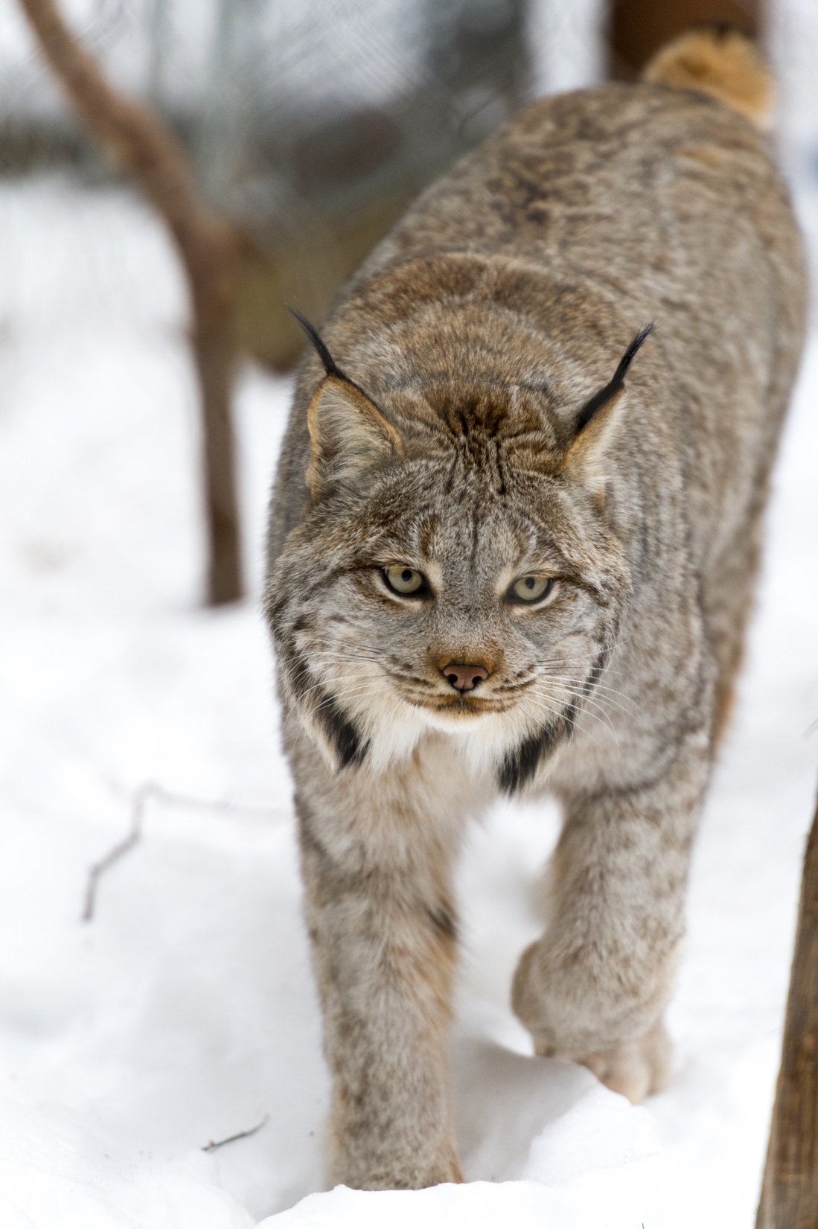
Objectives
Create spruce-fir mortality reference data using a objective, repeatable data collection method
Produce fine-scale maps of spruce-fir mortality extent and severity in Colorado’s spruce-fir forests
Inform forest management plans that address wildlife habitat analyses and biomass estimation
Image Credit: Eric Kilby
Notes:
Current United States Forest Service (USFS) Gunnison District monitoring of spruce beetle killed trees relies on rough, subjective estimates from annual aerial surveys. Due to the constraints of this qualitative survey method and a low number of ground truth plots, these surveys produce low resolution maps with minimal accuracy. This project aims to address gaps in spruce beetle outbreak mapping research and produce a dataset that will provide forest management professionals with the tools and information necessary to make adaptive and efficient management decisions, including wildlife habitat assessments and biomass estimation.
In order to produce these datasets, a more objective reference data collection method needs to be employed. One that is replicable and consistent from researcher to researcher.
Image Source: https://www.flickr.com/photos/ekilby/24600297443/

Slide 4
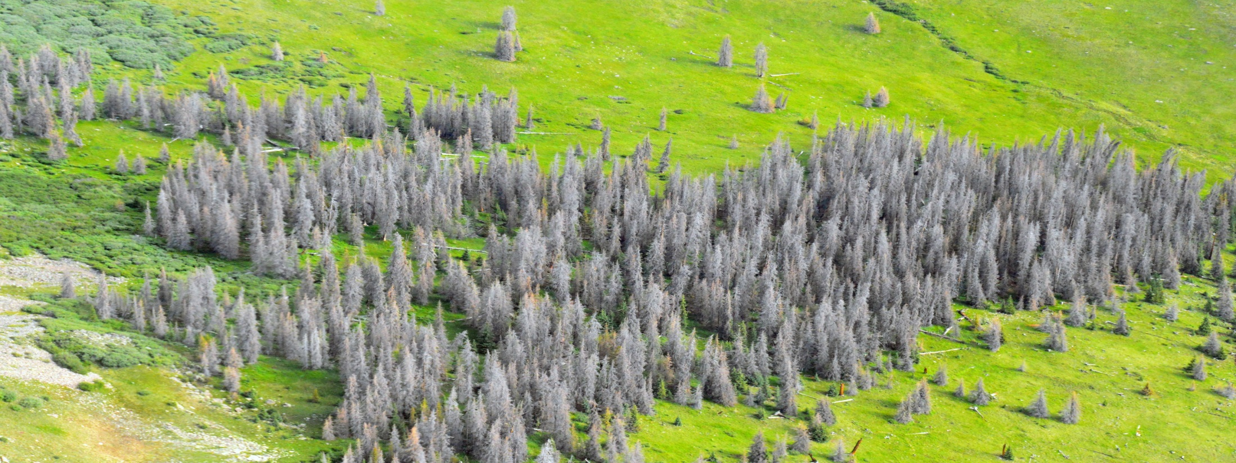
Image Credit: William M. Ciesla
Community Concerns
1.5 million acres of spruce forests in Colorado affected by spruce beetle since 1996
Reduction in habitat coverage and quality
Change in wildfire regimes and intensity
Hazards to recreational activity
Notes:
The spruce fir forests of Colorado provide recreational opportunities, natural resources, and critical habitat for multiple wildlife species, including the reintroduced Canadian lynx and endangered boreal toad. Since the late 90s, nearly 1.5 million acres of spruce-fir forests have been affected by spruce beetle outbreaks, causing widespread tree mortality. Though the beetles are native to Colorado, spruce beetle epidemics have become increasingly more frequent and severe in recent years, creating problems for land managers, recreators, and wildlife.
Image Source: http://www.forestryimages.org/browse/detail.cfm?imgnum=5540364

Slide 5



Earth Observations
Platform | Data Product | Resolution | Source
Landsat 8 | OLI | 30 meter | USGS Earth Explorer
Landsat 5 | TM | 30 meter | USGS Earth Explorer
SRTM | Digital Elevation Model | 30 meter | USGS Earth Explorer
Notes:
Raw bands from Landsat 5 and 8 were used to derive Tasseled-Cap Indices for brightness, greenness, and wetness. Other related indices used were normalized difference moisture index (NDMI) and normalized difference vegetation index (NDVI). A 30 meter digital elevation model (DEM) from SRTM was used for elevation data and to derive slope and aspect layers.

Slide 6
Methodology, Step One
Reference Data Creation
Imagery Processing
Model Processes
Inputs
Outputs
Classify Land Cover (live/dead trees) within 30m pixels using high resolution imagery
Calculate percent mortality of trees for each randomly selected pixel
Reference Data
Creating Model Inputs
Imagery Processing
Extract spectral values of stack layers that correspond to each reference data point
Stack Landsat imagery & topographic data and clip to study area
Notes:
The team employed a zero-inflated model that draws on spruce mortality reference data and a satellite imagery stack to create percent cover maps of spruce mortality. Preparing data for the zero-inflated model, involved two main phases. Step one involved a unique methodology, where 2400 30m² grids were overlaid on high resolution imagery. Each point in the grid was used to uniformly determine the presence or absence of spruce mortality. Topographic data and vegetation indices from Landsat 5 and 8 were downloaded from Earth Explorer and stacked into composite images. Spectral values were extracted from these images at each grid location.

Slide 7
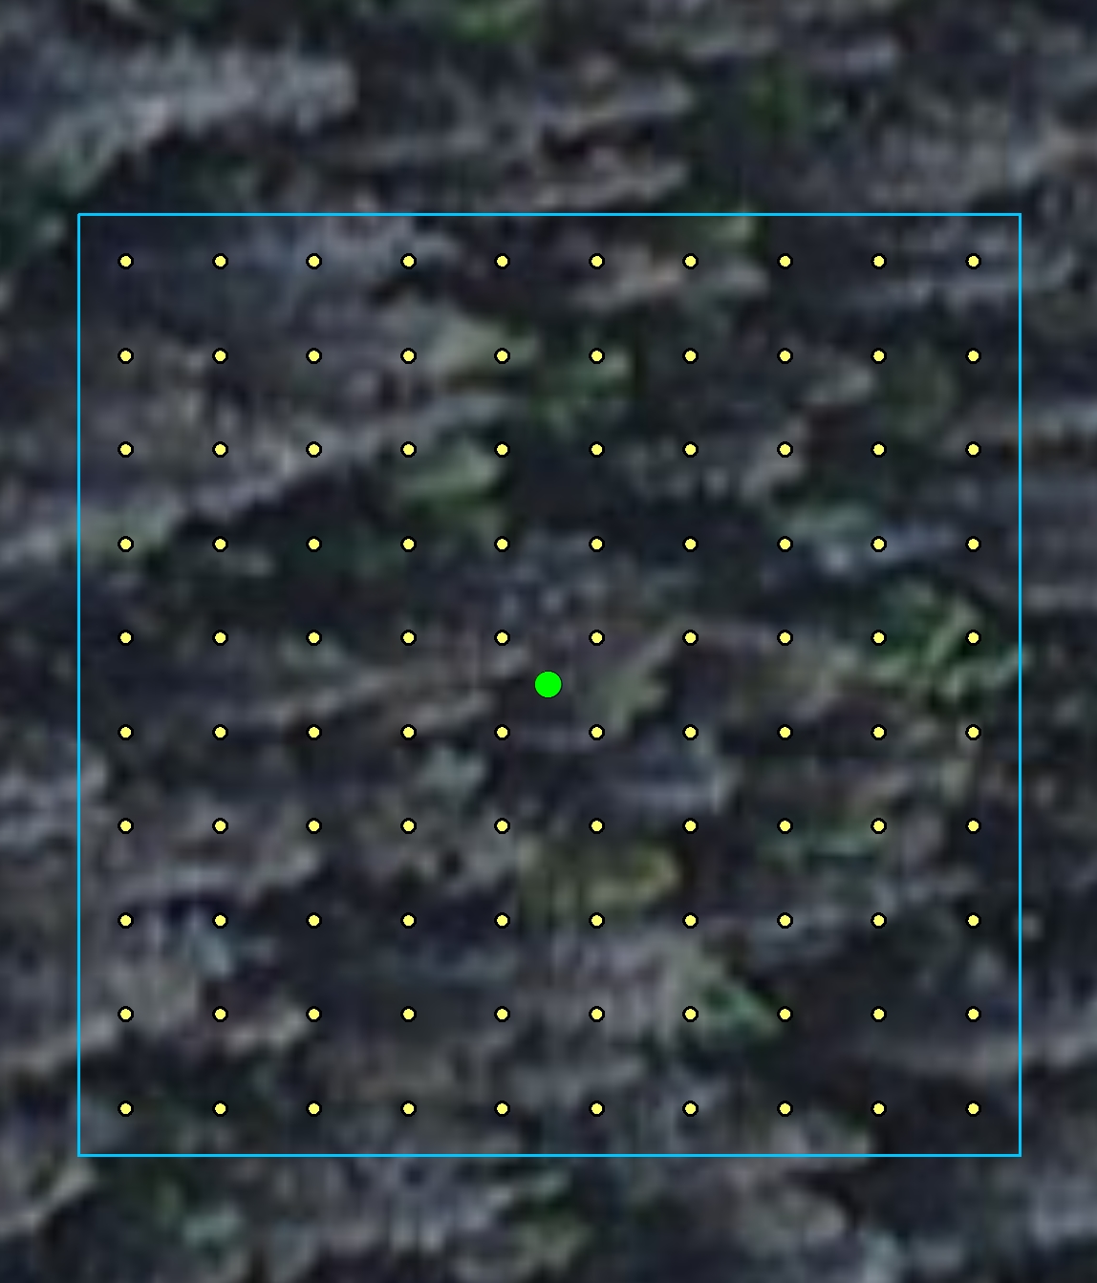
Reference Imagery
Microsoft & DigitalGlobe’s Advanced Ortho Aerial Program
Up to 50cm resolution
Available as “Imagery” basemap layer in ArcGIS
Team used 1:300 scale to calibrate classifications
Created custom grid within each sampling site.
Consulted with Dr. Rick Lawrence (ZI model author) about grid size. Recommended 10 x 10
240,000 individual classifications
Notes:
Image classification and reference data collection were performed using a 10 x 10 sampling grid created by the team using the “Imagery” basemap in ArcGIS. This basemap was developed by Microsoft and DigitalGlobe with resolutions up to 50 cm. To calibrate reference data across the team, a standardized scale of 1:300 was employed.
Each point in the grid was classified as one of the following, dead tree, living tree, living non-tree, or other (which included red phase trees, shadow, bare ground, and rock).
Base layer credit: ESRI, DigitalGlobe, GeoEye, Earthstar Geographics, CNES/Airbus DS, USDA, USGS, AEX, Getmapping, Aerogrid, IGN, IGP, swisstopo, and the GIS User Community

Slide 8
Methodology, Step Two
Reference Data Creation
Imagery Processing
Model Processes
Inputs
Outputs
Binary classification
Presence = 1
Absence = 0
Binary map of study area
Model Step 1
Percent Mortality & Spectral Values of reference points
Combine outputs to create final map of spruce-fir mortality in Colorado
Model Step 2
Continuous classification of study areas for each species
Continuous Map of Study Area
Notes:
Stacked image composites and the final input data files were modeled in RStudio with a two-step Zero-Inflated model. The reference data contained many points with a value of zero percent spruce mortality, and similar zero-laden vegetation cover datasets have been shown to bias results by incorrectly predicting absence and underestimating presence of the target vegetation cover. The zero-inflated modeling process minimizes these errors by modeling in two steps.
Step one involved modeling the reference data as a binary presence/absence prediction map in a Support Vector Machine (SVM) algorithm. This produced a binary map of mortality presence or absence for each pixel. In the second step, the reference data was fed to a Random Forest (RF) model to create a continuous prediction (i.e. percent mortality at the pixel level) map of mortality for the study area. The two associated maps were then combined to create a map of percent spruce mortality only in pixels that the binary model predicted presence of mortality. Any pixel predicted as having no spruce mortality in step 1 was reclassified as ‘no data’ and eliminated from the map. This process was repeated for all six Landsat scenes and the resulting six maps were mosaicked to create the final map displaying percent mortality at each pixel (30m resolution) for the entire study area.

Slide 9
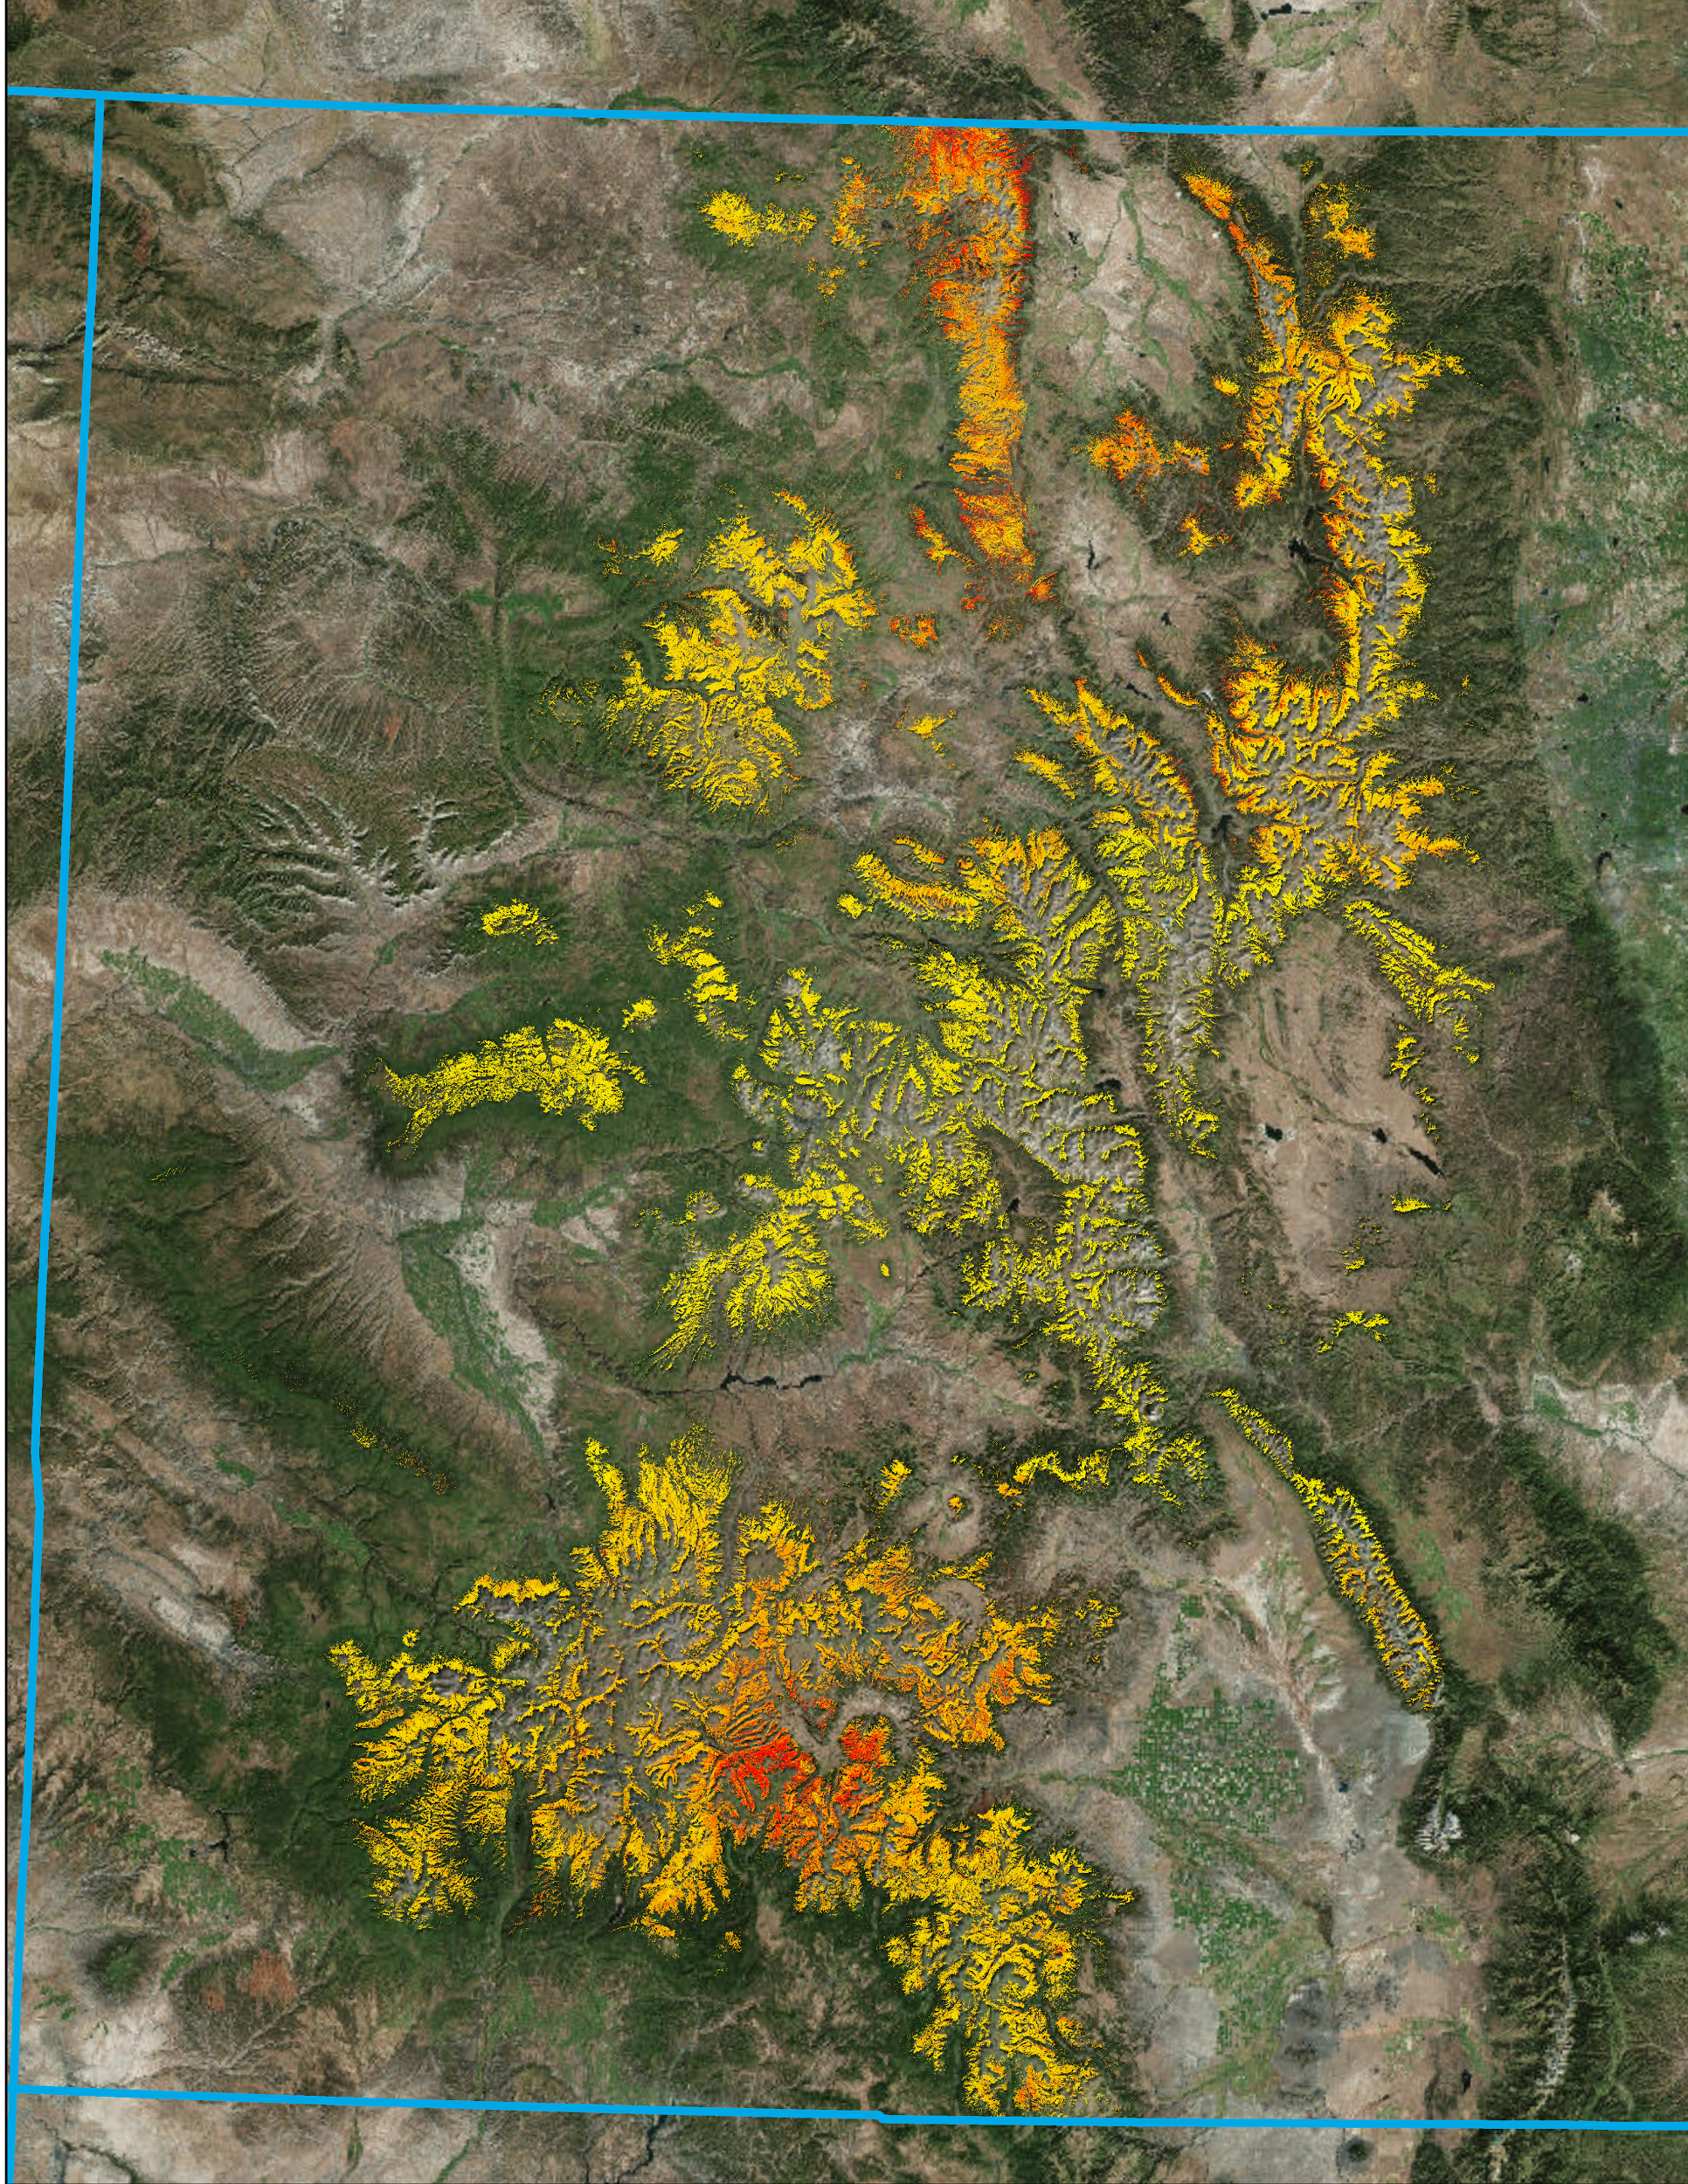
Colorado Spruce- Fir Forests
Mortality Percent Cover
Results and Conclusions
High: 61
Low: 1
Colorado State Boundary
Our final map products and results in context:
Comprehensive, quantitative landscape scale dataset
Percent cover of spruce mortality at 30 meter resolution
Novel methodology that is reasonably efficient and repeatable
Provides a baseline dataset of spruce mortality highlighting spruce beetle outbreaks for our project partners, land managers, and researchers that can be utilized in future studies and for decision support.
Notes:
The 2011 maps of spruce mortality in western Colorado that were produced with this methodology provide a baseline study to our project partners that can assist in further assessments of spruce mortality in Colorado forests.
Note 2
Base layer credit: ESRI, DigitalGlobe, GeoEye, Earthstar Geographics, CNES/Airbus DS, USDA, USGS, AEX, Getmapping, Aerogrid, IGN, IGP, swisstopo, and the GIS User Community

Slide 10
Errors and Uncertainty
Models were trained with mortality reference data and corresponding spectral values ( no spatial reference)
Model performance was evaluated with 10-fold cross validation and Wilcoxon’s signed-rank test statistics
Mean difference | P-value | RMSE
1.17 | 0.19 | 8.62
Notes:
What is shown here is the averaged value of the three most important statistics for evaluating model performance from the 6 scenes of data (model runs), and there was low variation across runs.
RMSE (root mean square error) which gives a measure of over/under predictions by the model. This was reasonably low, there were no extreme errors hiding in the predicted dataset.
P- value: for all runs the P V> .05, indicating that there is not a significant difference between observed values and those predicted by the model.
Mean difference: Difference between the mean percent mortality observed and the the mean of percent mortality predicted was fairly small, around 1 %

Slide 11
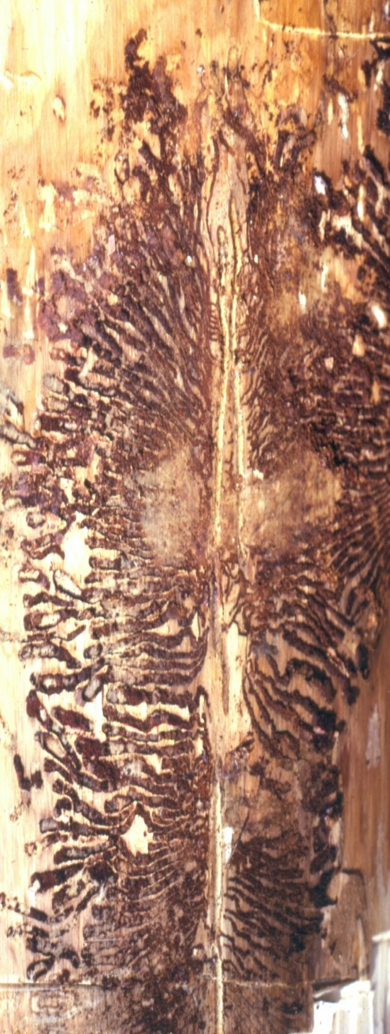
Future Directions
Produce percent spruce-fir mortality maps for recent years.
Independent validation dataset for spatial model outputs.
Utilize reference data collection methodology with new geospatial datasets.
Dataset and statistics feedback on Zero-Inflated model performance.
Image Credit: Darren Blackford
Notes:
Modeling mortality for more recent years would make it possible to analyze distribution and severity through time and thus provide more current information to project partners.
Future fieldwork could include independent validation of the model outputs on the physical landscape within known error rates.
These map and data products supplement existing data products available to land managers at the USFS and will be useful in further monitoring of spruce mortality as well as its impact on wildlife habitats.
The reference data creation methodology that we refined in this project can be utilized by a wide variety of land managers and researchers interested in creating new land cover datasets.
Finally, our datasets and statistics will be given to Dr. Rick Lawrence, our partner at Montana State University’s Spatial Sciences Center, in an effort to provide insights on how to improve the zero-inflated model’s overall performance.
Image Source: http://www.forestryimages.org/browse/detail.cfm?imgnum=2181027

Slide 12
Advisors
Dr. Paul Evangelista (Natural Resources Ecology Lab, Colorado State University)
Tony Vorster (Bioenergy Alliance Network of the Rockies)
Brian Woodward (DEVELOP – Fort Collins Center Lead)
Partners
Bioenergy Alliance Network of the Rockies (BANR). POC: Anthony Vorster
Montana State University, Spatial Sciences Center. POC: Dr. Rick Lawrence
Colorado State University, Natural Resource Ecology Laboratory (NREL). POC: Nick Young
USDA Forest Service, Gunnison Ranger District. POC: Matt Vasquez
USDA Forest Service, Rocky Mountain Research Station. POC: Dr. Mike Battaglia
Notes:
This project was made possible through support and mentorship of select individuals and organizations. We extend a kind thanks to the following advisors and partners.

