Slide 1
Using NOAA CDRs to Connect Phases of the El Niño Southern Oscillation (ENSO) with Precipitation across Hawaii and the U.S. Affiliated Pacific Islands (USAPI)
Pacific Water Resources
Jessica Sutton
Michael Kruk
Nicholas Luchetti
John Marra
Ethan Wright

Slide 2
Outline
Understanding ENSO
Effects of ENSO
Study Area
Research Objectives
Methodology
Results
Conclusions
Future Research

Slide 3
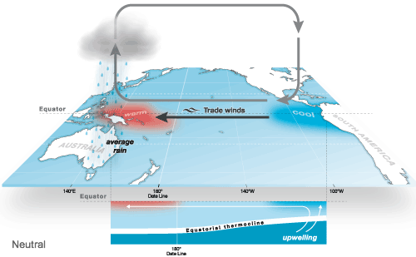
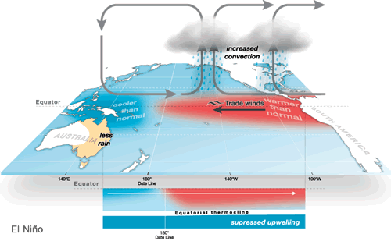
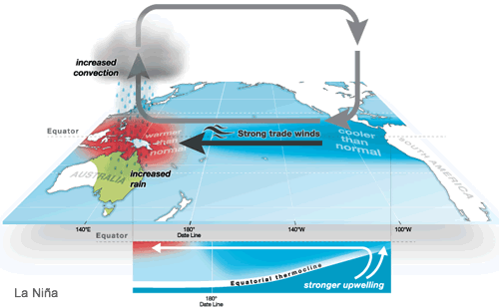
Understanding
ENSO
Interaction between the ocean and the atmosphere
ENSO influences global climate but strongest in Pacific
El Niño – cooler and drier in western Pacific
La Niña - warmer and wetter in western Pacific
Image Credit: http://www.bom.gov.au/

Slide 4
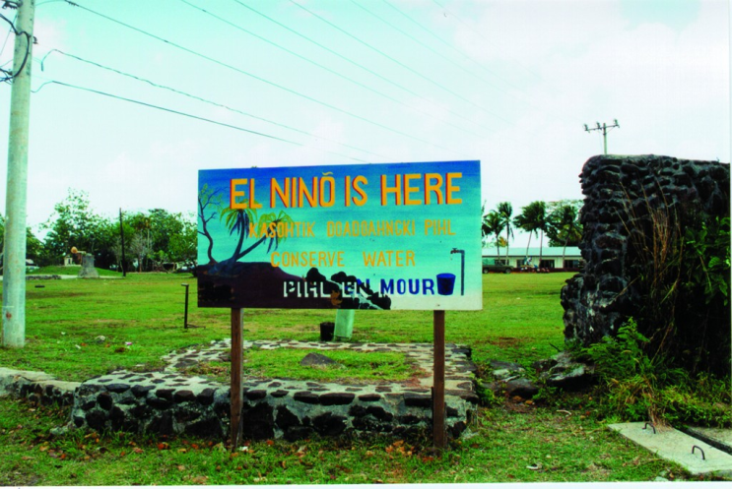
Image Credit: NPS
Effects of ENSO
Varies across the USAPI
El Niño
Crop losses
Water rationing
Wildfires
Loss of livestock
Changes in tropical cyclone tracks and frequency.
La Niña
Large surf and high tides influence surface and ground water.
Changes in precipitation patterns affect water resources.
Image Credit: NOAA National Weather Service Pacific Region, 1998

Slide 5
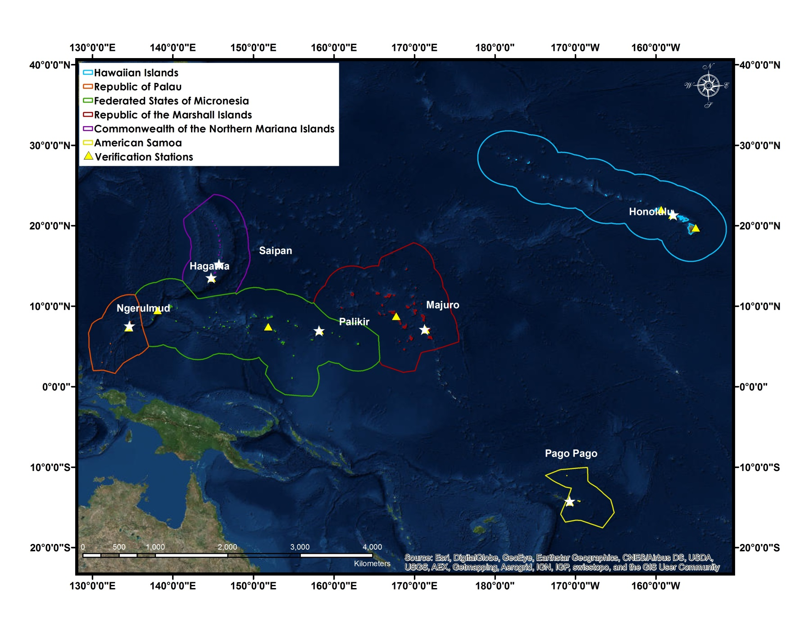
Study Area
Image Credit: Made in ArcGIS using basemap.

Slide 6
Provide an updated ENSO based climatology (1985-2014) of long-term precipitation patterns for each USAPI using the NOAA PERSIANN Climate Data Record (CDR)
Conduct verification analyses with in situ precipitation data
Determine the relationship between PERSIANN CDR precipitation and the seven ENSO phases
Determine precipitation ranges for each USAPI Exclusive Economic Zone (EEZ) during the seven ENSO phases
Research Objectives

Slide 7
PERSIANN CDR
Specifications
0.25° resolution
Global
Daily
Limitations

Slide 8
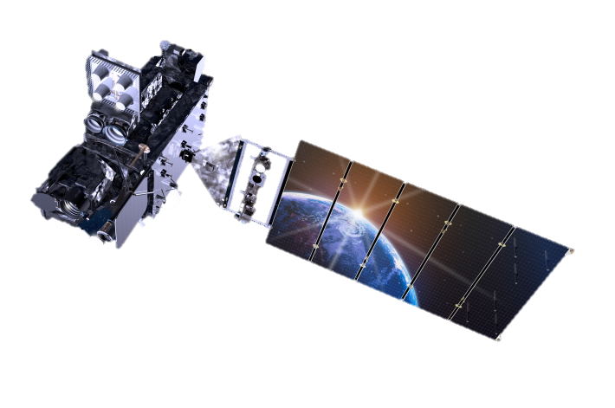
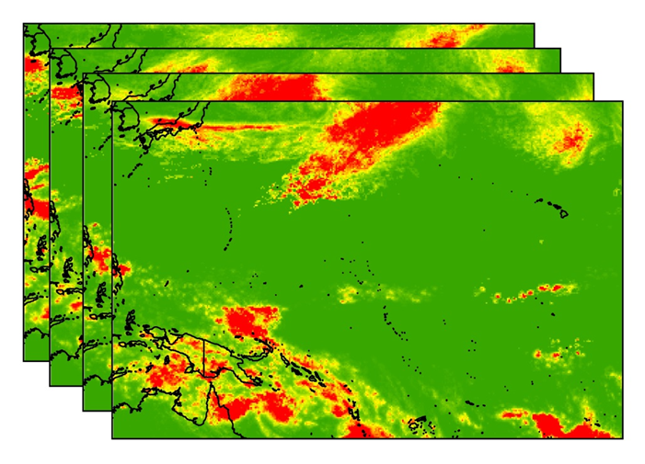
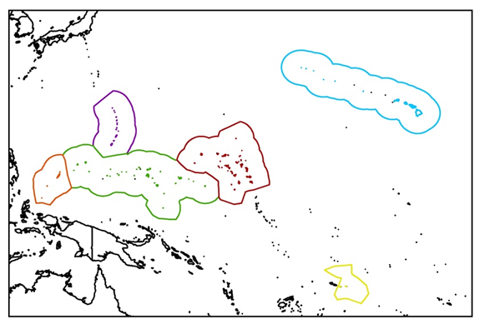
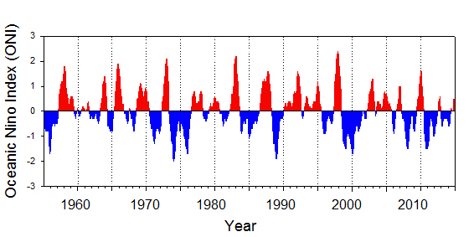
DATA PREPARATION & ANALYSIS
GLOBAL PERSIANN PRECIPITATION
MONTHLY
SEASONAL
YEARLY
sum
EXCLUSIVE ECONOMIC ZONES (EEZ)
Daily 0.25° resolution
Oceanic Niño Index (ONI)

Slide 9
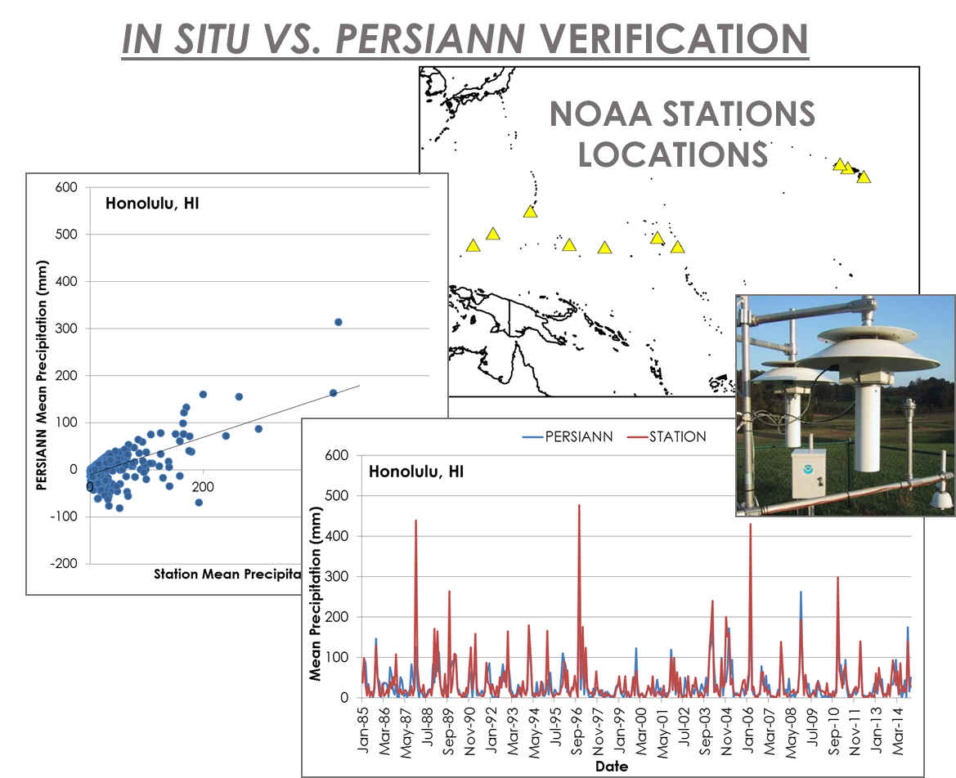

Slide 10
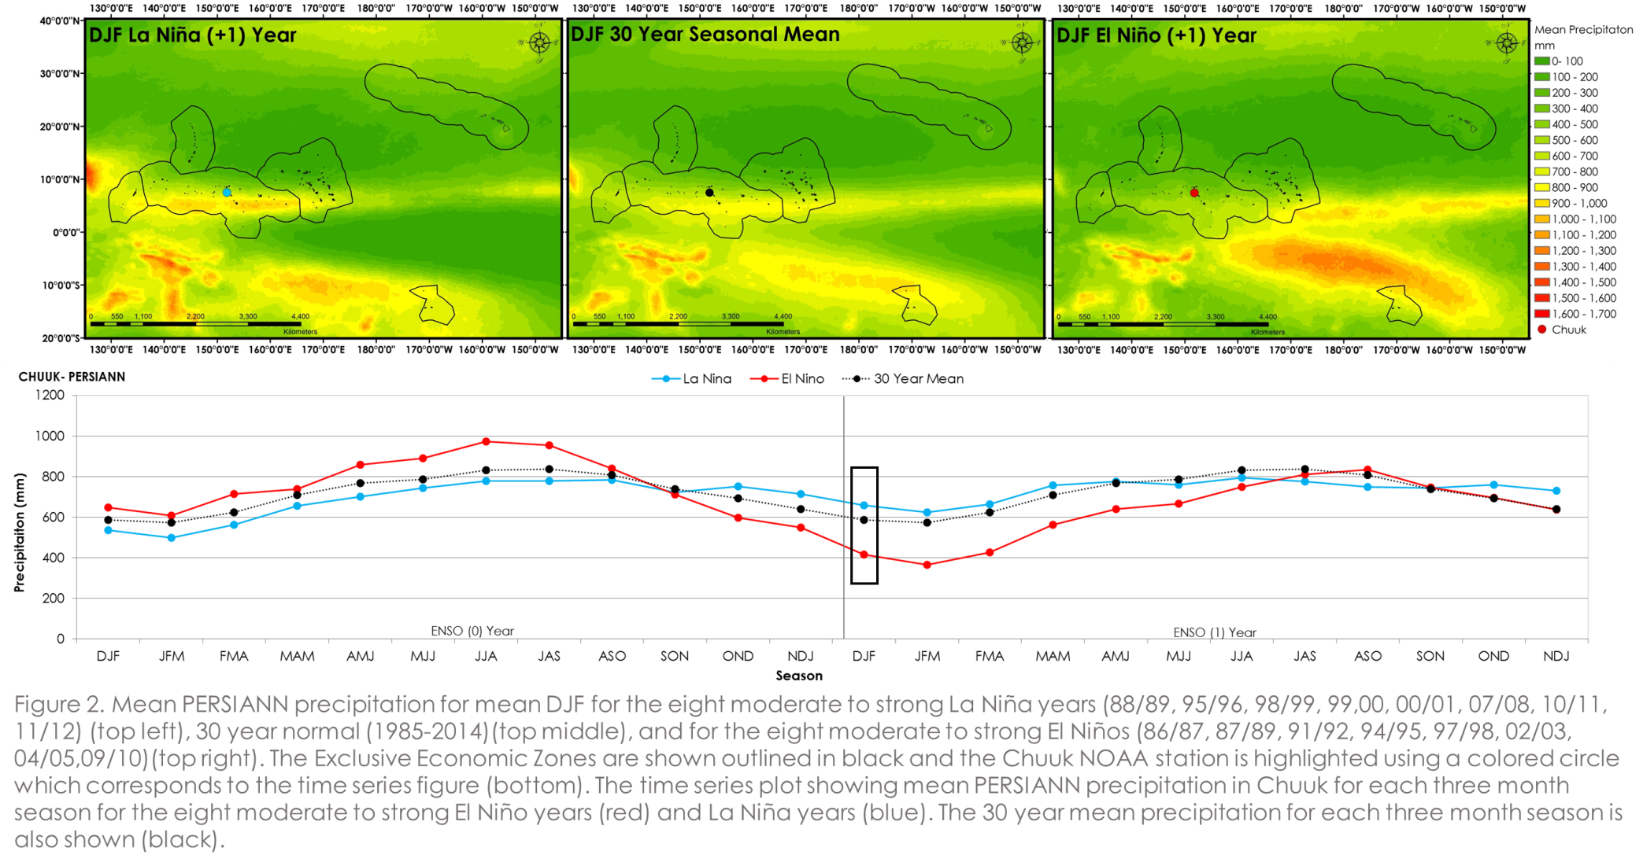
Results
Place holder for animation showing seasonal means and time series graph

Slide 11
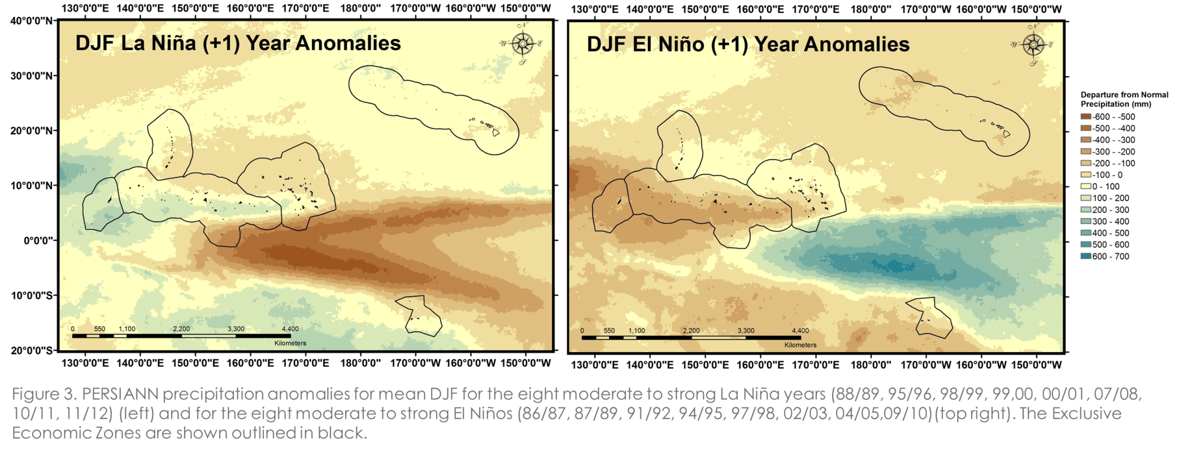
Results
Place holder for animation showing seasonal anomalies

Slide 12
Results
Place holder for maps of ENSO phases

Slide 13
Conclusions

Slide 14
Future Research
Compare CMORPH, TRMM, and PERSIANN precipitation data

Slide 15
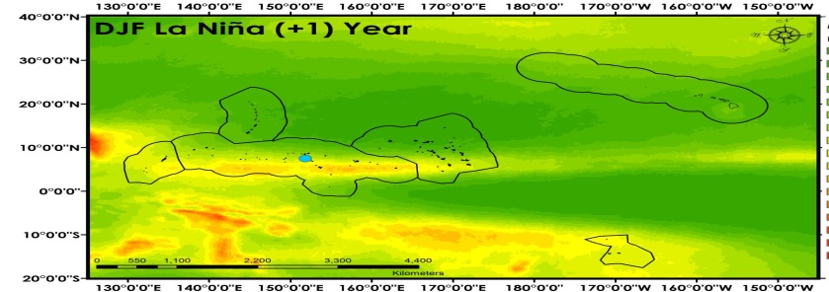
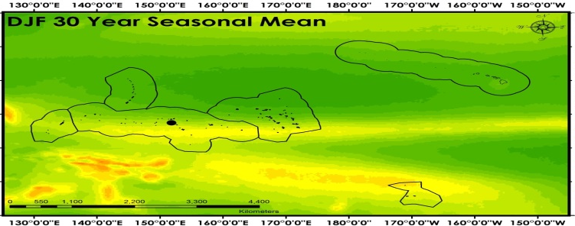
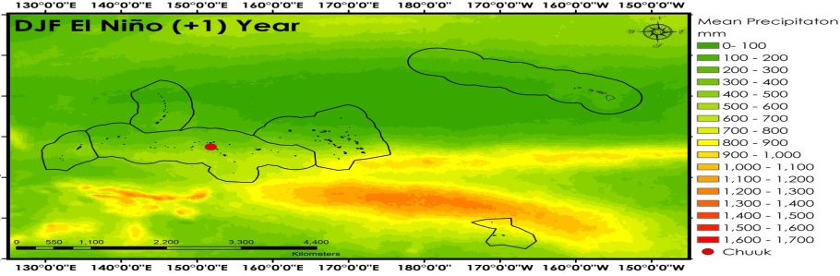
Advisors
Michael Kruk, Pacific Water Resources Product Development
John Marra, NOAA Region Climate Services
Partners
John Marra, NOAA Region Climate Services
Others
Figure 2. Mean PERSIANN precipitation for mean DJF for the eight moderate to strong La Niña years (88/89, 95/96, 98/99, 99,00, 00/01, 07/08, 10/11, 11/12) (top left), 30 year normal (1985-2014)(top middle), and for the eight moderate to strong El Niños (86/87, 87/89, 91/92, 94/95, 97/98, 02/03, 04/05,09/10)(top right). The Exclusive Economic Zones are shown outlined in black and the Chuuk NOAA station is highlighted using a colored circle which corresponds to the time series figure (bottom). The time series plot showing mean PERSIANN precipitation in Chuuk for each three month season for the eight moderate to strong El Niño years (red) and La Niña years (blue). The 30 year mean precipitation for each three month season is also shown (black).

