Slide 1
dnppy + GitHub
An Introduction to python programming and
software development for DEVELOP participants

Slide 2
Purpose
Support DEVELOP’s capacity building mission
Basic programming skills are increasingly valuable
Git is an industry best practice for software development
Improve institutional knowledge retention
Tools from past participants can be preserved and built upon
Put more power in the hands of participants
Softens the learning curve for people who want to learn code
Open the DEVELOP toolkit for public contribution and use
Open source software packages are almost self-marketing
Increase the utility and accessibility of NASA data
Directly supports NASA science directorate level goals

Slide 3
Strategy
Use dnppy as a collection of standardized python tools
Collection of building block style functions and classes for scalability
Make python programming resources more accessible to new programmers
You can access these resources from your future places of work or study
Managed through NASA GitHub group for high visibility
Can avoid excessive software release approval requests
Put github into project workflows
Much better collaborative code writing
Much better configuration management
Allows code contributions from the public
Persistent access allows more fluid partner handoffs and updates

Slide 4
dnppy
DEVELOP National Program
python package

Slide 5
Info + Reference
Collection of building block style functions and classes in python
Has a DEVELOPedia page with additional info
Maintained by class of Geoinformatics Fellows
Started in December of 2014
Planned updates at the end of each term

Slide 6
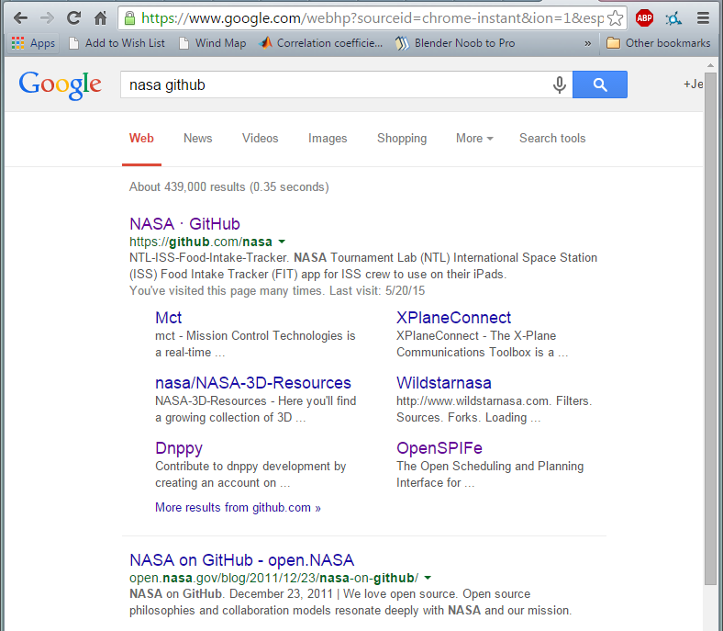
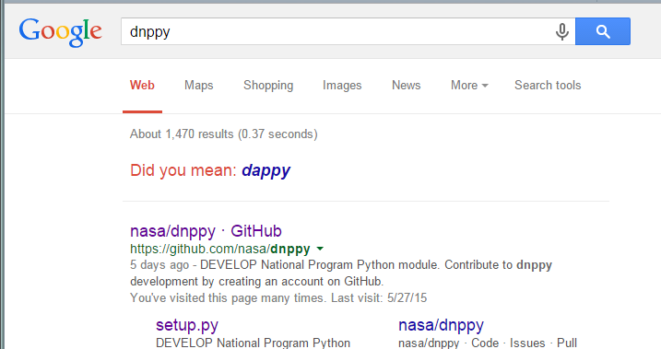
Access
Extremely easy to find
A GitHub account is not required to download and use dnppy
Admin rights are not required to install it

Slide 7
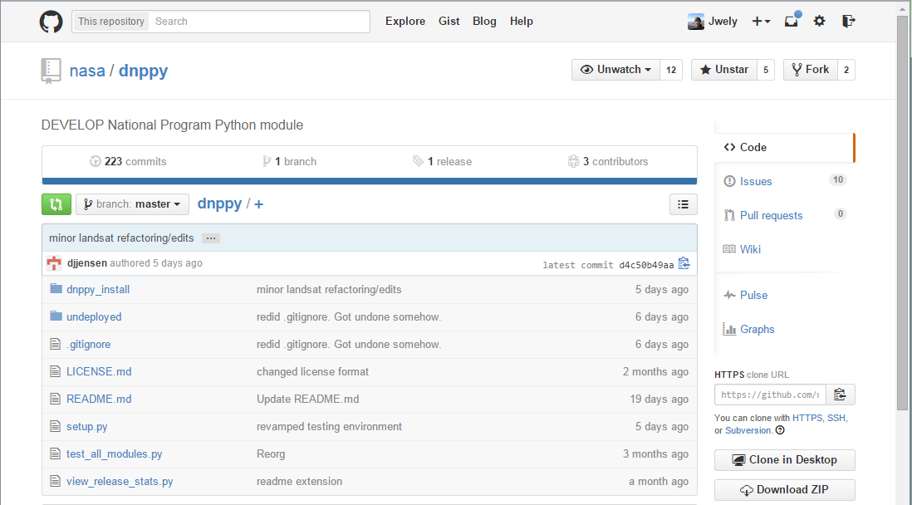
Navigation (Homepage)

Slide 8
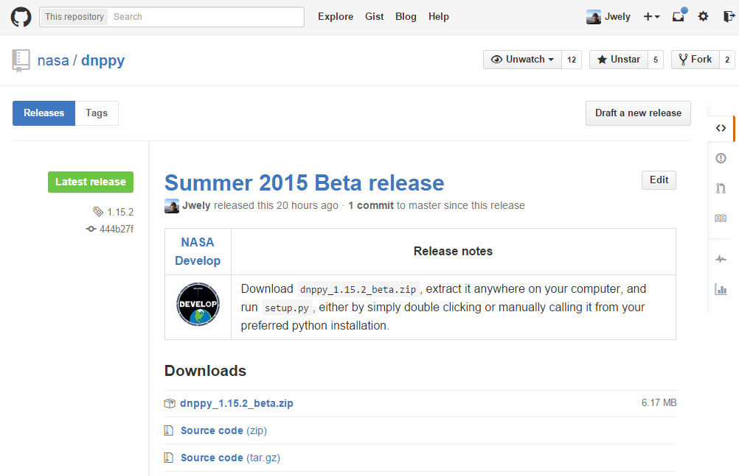
Download (Release Manager)

Slide 9
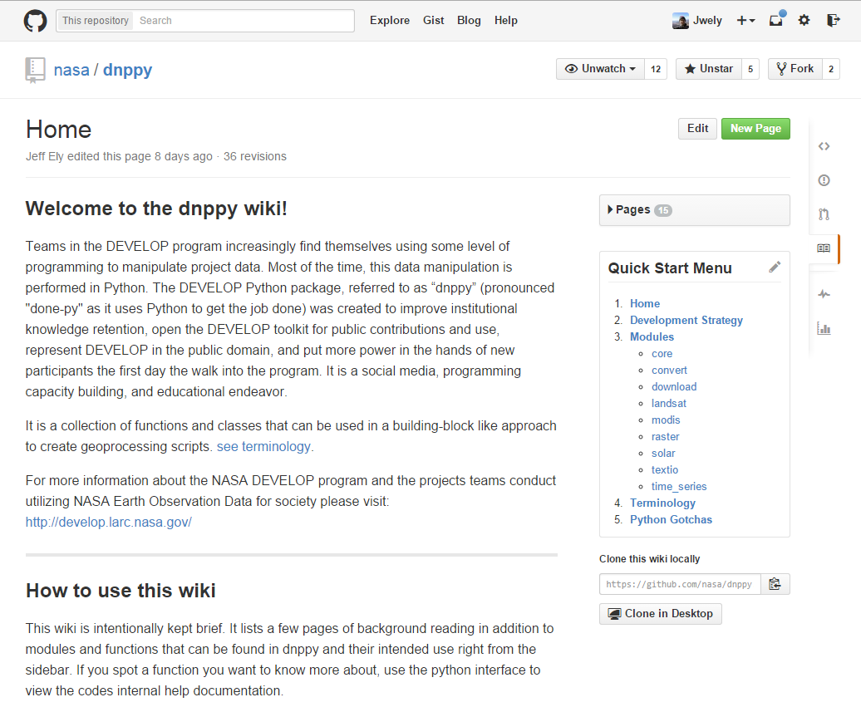
Wiki
Walkthrough style navigation
Covers some general python skill building topics
Cataloged by “module”
Primary discovery and learning resource for dnppy

Slide 10
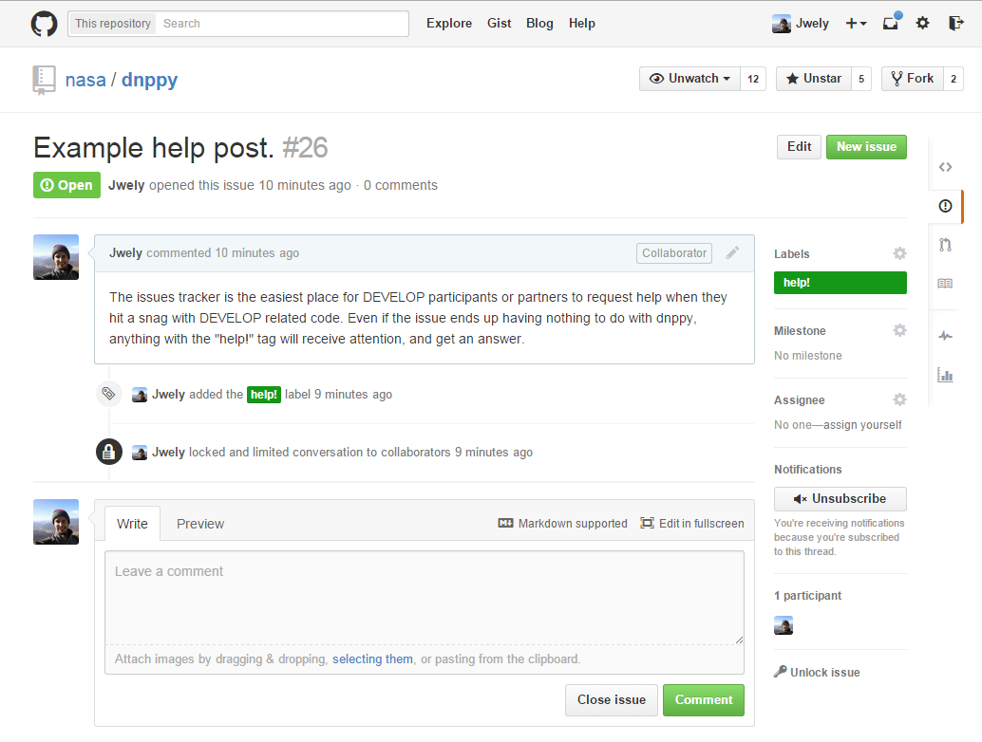
Issues
Help integrated into GitHub issue tracker
For requesting help, new functionality, reporting bugs, etc
Tightly integrated with code development
Use the tag when submitting help issues
help!

Slide 11
GitHub
Collaborative software
development

Slide 12
Info + Reference
This specific use of GitHub is intended for teams with substantial software component to their projects final products, and some introductory level programming skills already on the team.
Why should you use a version control system like Git?
Detailed guide on DEVELOPedia on the dnppy page
Several guides exist to help understand the concept of configuration management and version control systems like Git
Consult this cheat sheet for Git shell commands

Slide 13
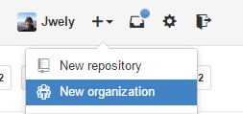
Setting up the team
Each team member creates a GitHub profile
Team lead forms a new organization
From the dnppy page, fork a copy for your organization
Download the GitHub Windows client on each team members PC and clone the organization copy of dnppy
Teams can create separate branches within their fork if they wish, but it is not necessary.

Slide 14
Adding your project
Add a project folder with the name “Node-Year-ProjectID” under \undeployed\proj_code\ in your local clone of dnppy

Slide 15
First commit
After the first file has been added, the option to “Commit” will appear in your GitHub desktop client
Fill out the commit fields, make the commit, then “sync” in the top right corner.
Team members will then be able to “sync” to update their repositories!

Slide 16
Development
Your team can continue to develop code in a full fledged Git environment, with all of its advantages
Frequent commits with good descriptions are the key to smooth software development
If you run into trouble, contact geoinformatics

Slide 17
End of term
Create a pull request and your teams project changes will be merged into to the original dnppy repository on the NASA page
Direct project partners to this master repository to access software products!

Slide 18
Tips
Please use a dnppy fork to share project code with partners. Do not create new repositories for project handoff code. A new repository requires a new NASA Software Release Approval (SRA) request, which can take several months to complete. If you believe your project should not be bundled into dnppy, contact geoinformatics for help with SRA
You are encouraged to create repositories on your personal GitHub account for personal learning exercises, but not project handoff software
Never ever put large datasets, especially raster data, in your git repository. Making a commit with excessively large files will irreversibly bloat your repository to unwieldy sizes. Git is intended for use with text data like code.

