Slide 1
MISSISSIPPI EMBAYMENT
Water Resources
Utilizing NASA Earth observations to Understand Groundwater Recharge in the Mississippi Regional Aquifer System
Lauren Mahoney
Brenna Hatch
Claire Villanueva-Weeks
Lauren Webster
California – JPL
Notes:
This DEVELOP JPL water resources project utilized Earth Observations to understand groundwater recharge in the Mississippi Embayment.

Slide 2
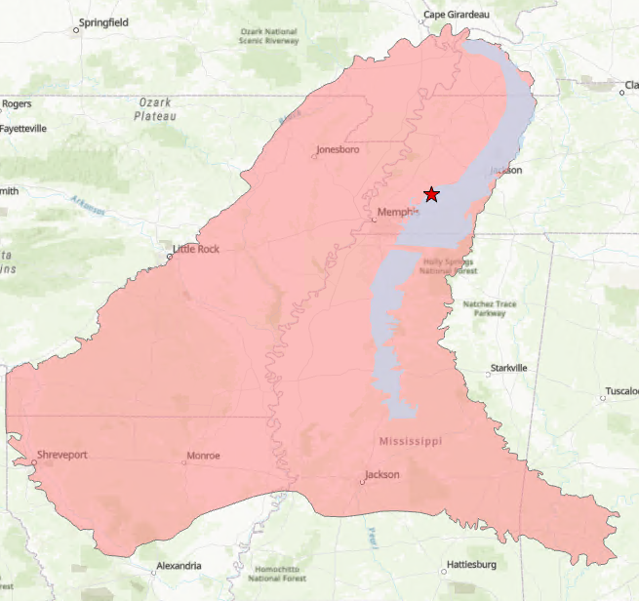
Project Location
Study Area
Mississippi Embayment
Special focus on Recharge Zone and Ford Plant
Study Period
2000-2021
Annual Averages
Blue Oval City (Ford Plant)
Memphis Sand Aquifer Recharge Zone
Mississippi Embayment
0​
60​
240​
360​
480​
Kilometers​
Notes:
Our project location focused on the Mississippi Embayment, paying special attention to the recharge zone of this embayment as well as the Ford plant, which is also known as the "Blue Oval City".
Blue Oval City Fun Facts:
A new mega campus for Ford Motor Company to build electric trucks
To be built on 4100 acres in Stanton, TN
Estimated to bring in roughly 6,000 new jobs to Tennessee
Production is expected to begin in 2025
Most expensive investment in Tennessee history, at $5.6 billion
Study Period
Groundwater recharge factors were averaged yearly for comparison and assessed for the time period of 2000 - 2021.
Credits for shapefiles:
Recharge zone: Parks(1990)
Mississippi Embayment: Jeff Brantly and Ron Seanor, USGS Louisiana Water Science Center, Mike Bradley and Jack Carmichael, USGS Tennessee Water Science Center, Heather Welch, Jeannie Barlow, and CLaire Rose, USGS Mississippi Water Science Center, Lafayette and ROlla Publishing Service Centers.
Basemap Credit: Esri, CGIAR, USGS, Esri HERE, Garmin, FAO, NOAA, USGS, EPA NPS

Slide 3
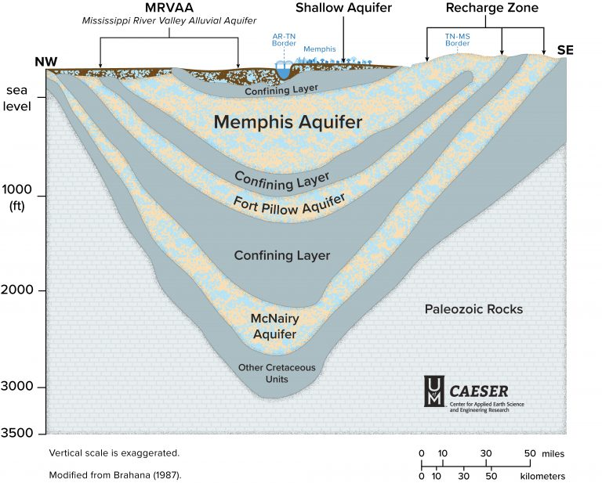
Geology of the Mississippi Embayment
Memphis Sand Aquifer is confined by a thick layer of clay
Recharge zone is the only place new rainwater replenishes the groundwater
Recharge is most efficient in areas where the Memphis sand is exposed
Water contained is
~2,000 – 3,000 years old
Image Credit: University of Memphis Center for Applied Earth Science and Engineering Research
Notes:
Image Source: https://caeser.memphis.edu/resources/memphis-aquifer (Provided by Sarah Houston, project partner and creator of image)
The Memphis Sand Aquifer is confined by a thick layer of clay which protects the historic groundwater from contaminants. The recharge zone of the aquifer is important for the replenishment of the groundwater and is the only place where rainwater can replenish the groundwater. Within this zone, there are outcrops of the "memphis sand" in which precipitation can most efficiently infiltrate to recharge the aquifer's groundwater. Breaches to the upper clay layer and threats to the outcrop areas of the memphis sand pose threat to the quality and quantity of the water within this aquifer.

Slide 4
Geology of the Mississippi Embayment
Memphis Sand Aquifer is confined by a thick layer of clay
Recharge zone is the only place new rainwater replenishes the groundwater
Recharge is most efficient in areas where the Memphis sand is exposed
Water contained is
~2,000 – 3,000 years old
Memphis Sand Aquifer Recharge Zone
Mississippi Alluvial Plain Extent
Mississippi Embayment
0
100
200
400
600
800
Kilometers​
Notes:
The Memphis Sand Aquifer is confined by a thick layer of clay which protects the historic groundwater from contaminants. The recharge zone of the aquifer is important for the replenishment of the groundwater and is the only place where rainwater can replenish the groundwater. Within this zone, there are outcrops of the "memphis sand" in which precipitation can most efficiently infiltrate to recharge the aquifer's groundwater. Breaches to the upper clay layer and threats to the outcrop areas of the memphis sand pose threat to the quality and quantity of the water within this aquifer.
Basemap Credits: Esri, HERE, Garmin, FAO, NOAA, USGS, EPA NPS

Slide 5
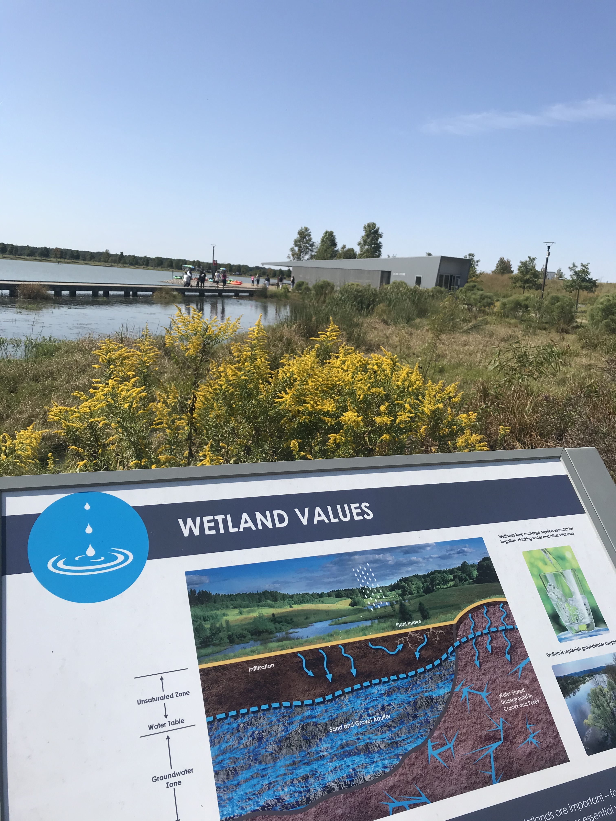
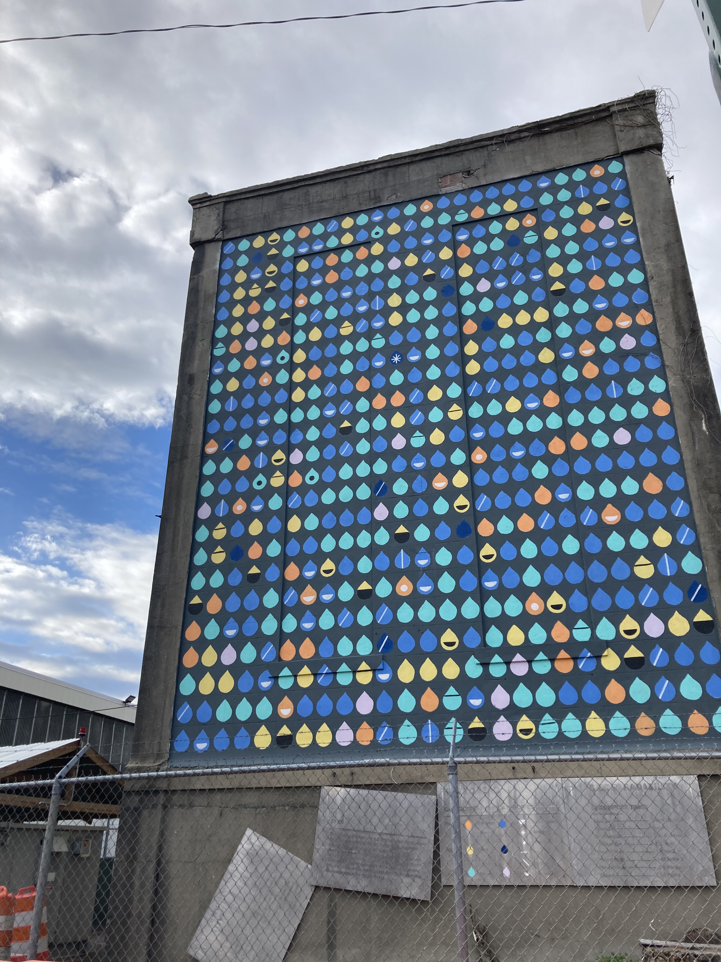
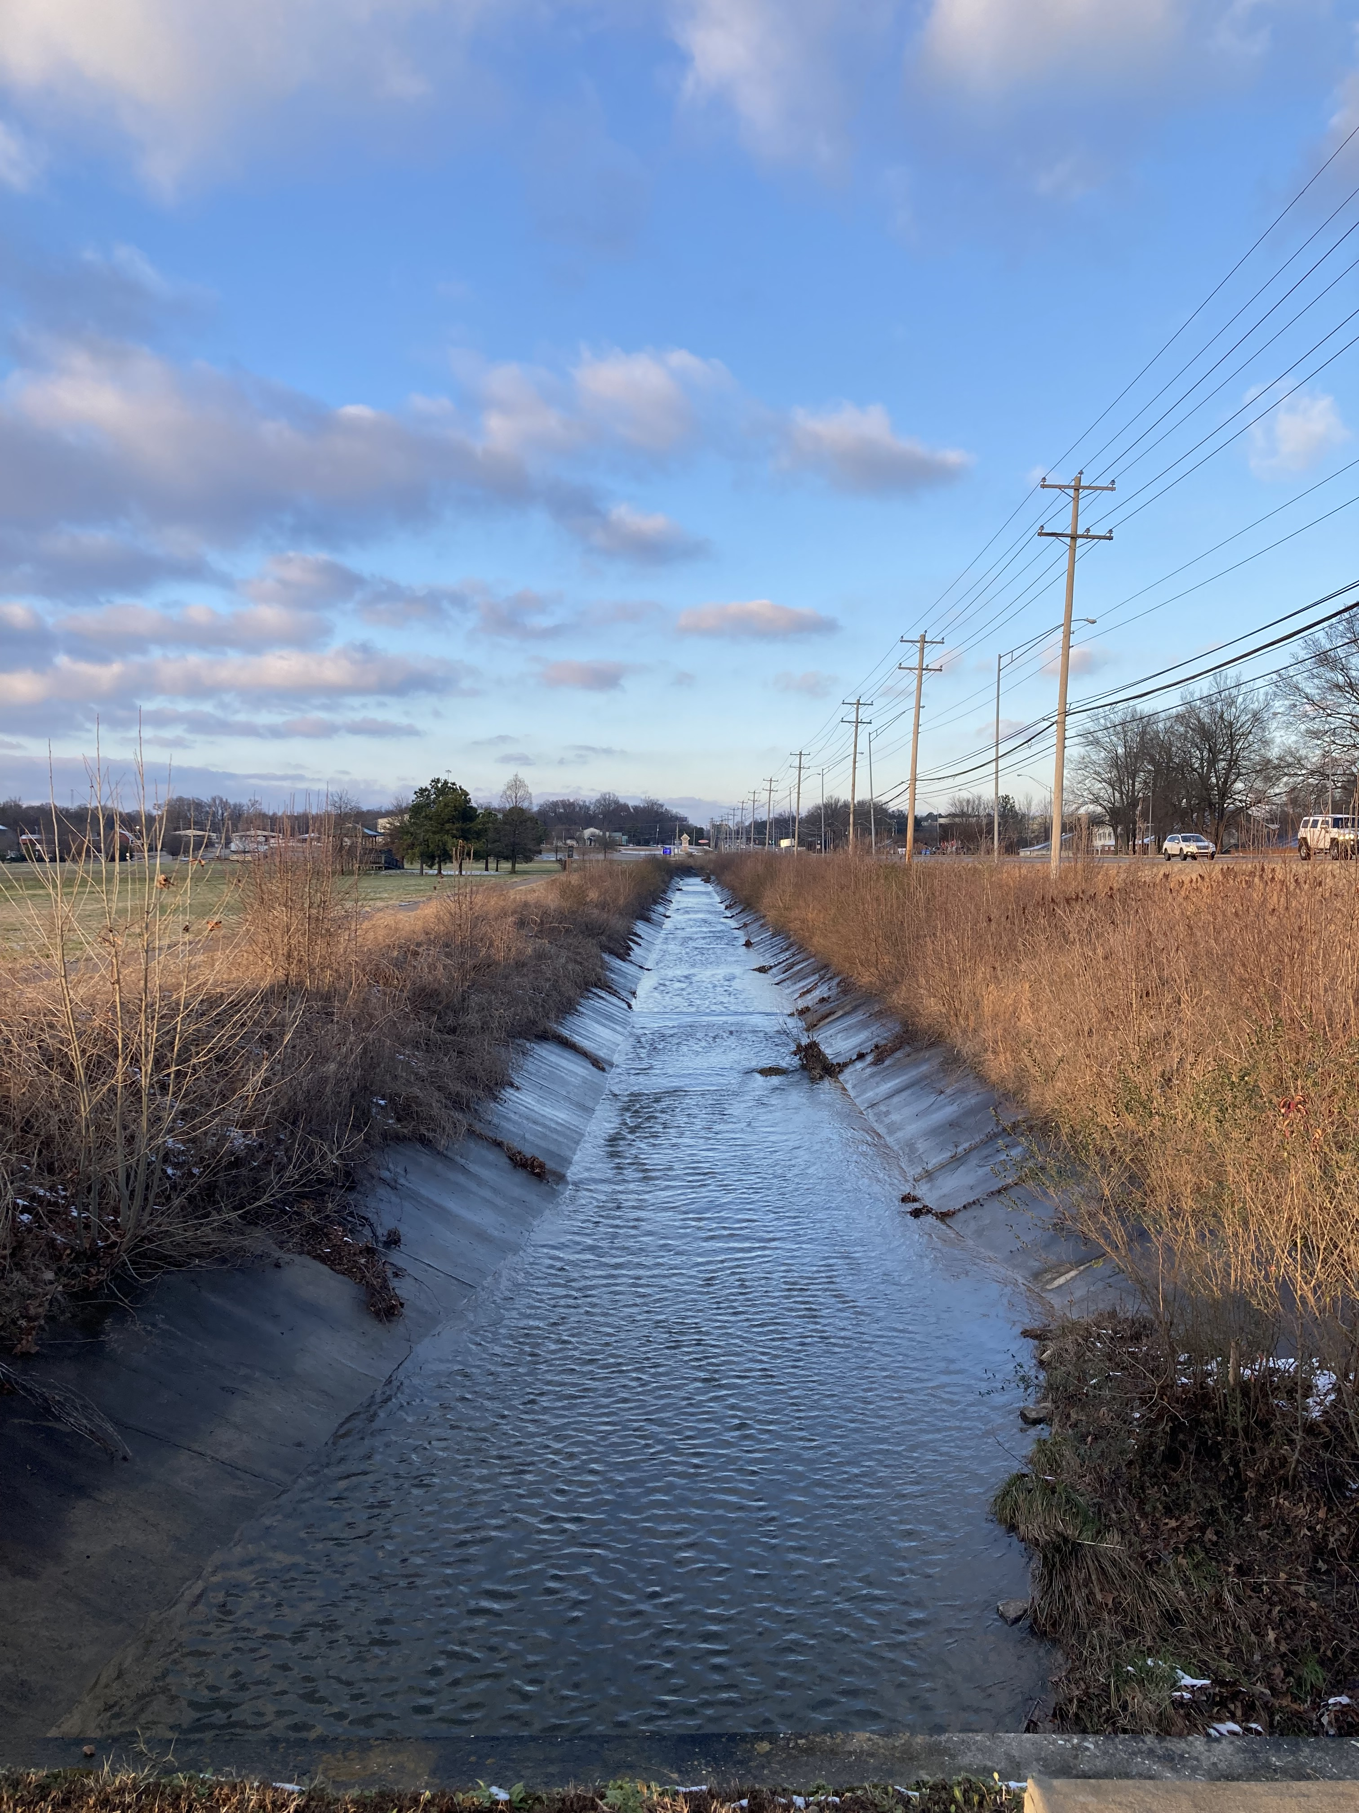
Project Partner
Protect Our Aquifer (POA)
Image Credit: Protect Our Aquifer
Notes:
Protect Our Aquifer (POA) is a science-based decision-making group that monitors use of Memphis Sand Aquifer and the larger aquifer system in Mississippi Embayment. POA is interested in examining factors critical to groundwater recharge to inform local policy and advocate for at risk communities. These factors include precipitation, evapotranspiration, landcover change and total water storage.
Image Source: https://www.protectouraquifer.org/ Provided by Sarah Houston, project partner

Slide 6
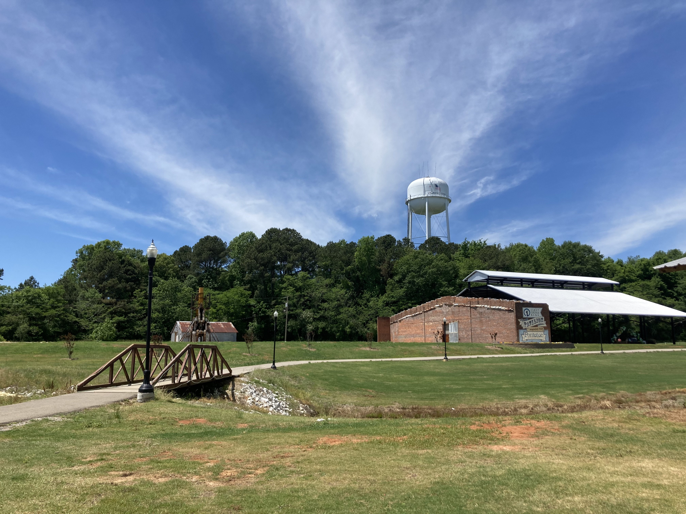
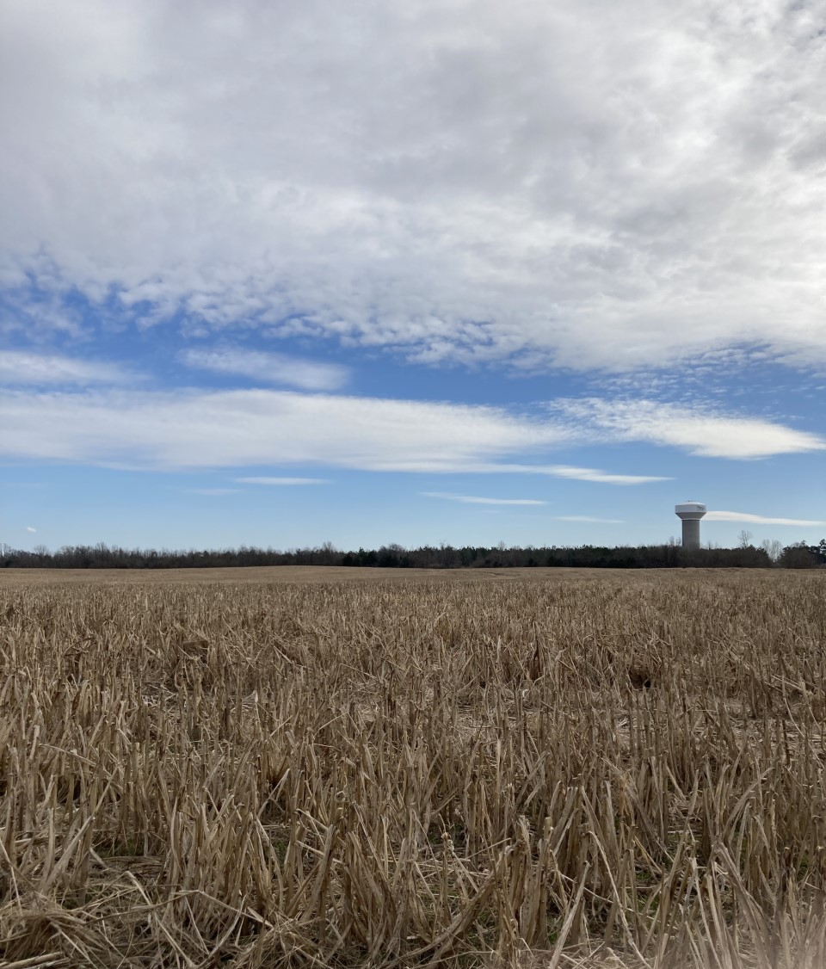
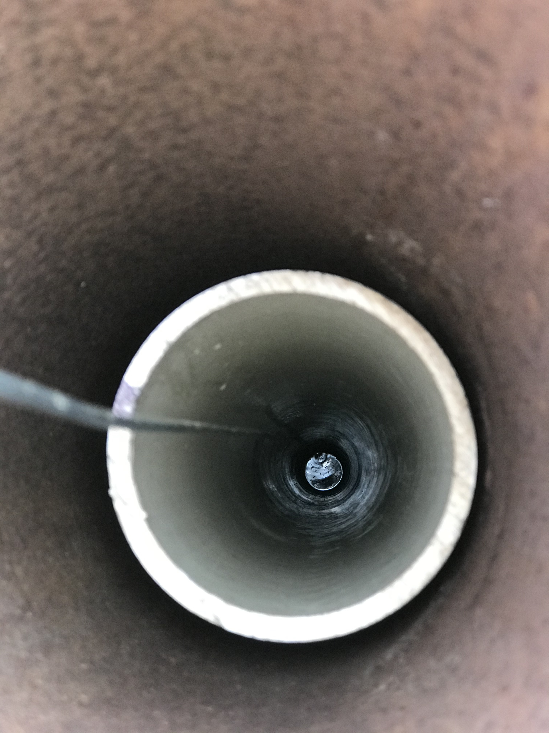
Community Concerns
Threats to the Historic Water Source
Reduced groundwater for the community
Threats to aquifer's recharge long-term
Unsustainable irrigation practices – increased pumpage and landcover use for agriculture
Infrastructure development – Ford Plant/Megasite
Image Credit: Protect Our Aquifer
Notes:
The water contained in this aquifer and it's ability to be recharged has raised community concerns about the possibility of reduced groundwater. Long term threats include unsustainable irrigation practices such as increased water pumping and landcover use by the agricultural industry which will likely contribute to reduced groundwater. Infrastructure development, specifically the massive Ford manufacturing site, also threatens the amount of groundwater availability to the community due to the land cover changes and increased water use associated with the construction and operation of the plant.
Image Source: https://www.protectouraquifer.org/ Provided by Sarah Houston, project partner

Slide 7
Objectives
Map and quantify changes in factors influential to groundwater recharge
Identify thriving areas of the ME recharge zone to prioritize for protection
Notes:
The first objective of this project was to map and quantify changes of factors influential to groundwater recharge, including precipitation, evapotranspiration, landcover, and total water storage. This would help us achieve our second objective - identify thriving areas of the Mississippi Embayment recharge zone. This thriving index would allow our project partner to identify areas to prioritize for protection.

Slide 8
Methods
Notes:
In the next section we will discuss the methods the team used to examine groundwater recharge factors and the creation of the thriving index.

Slide 9
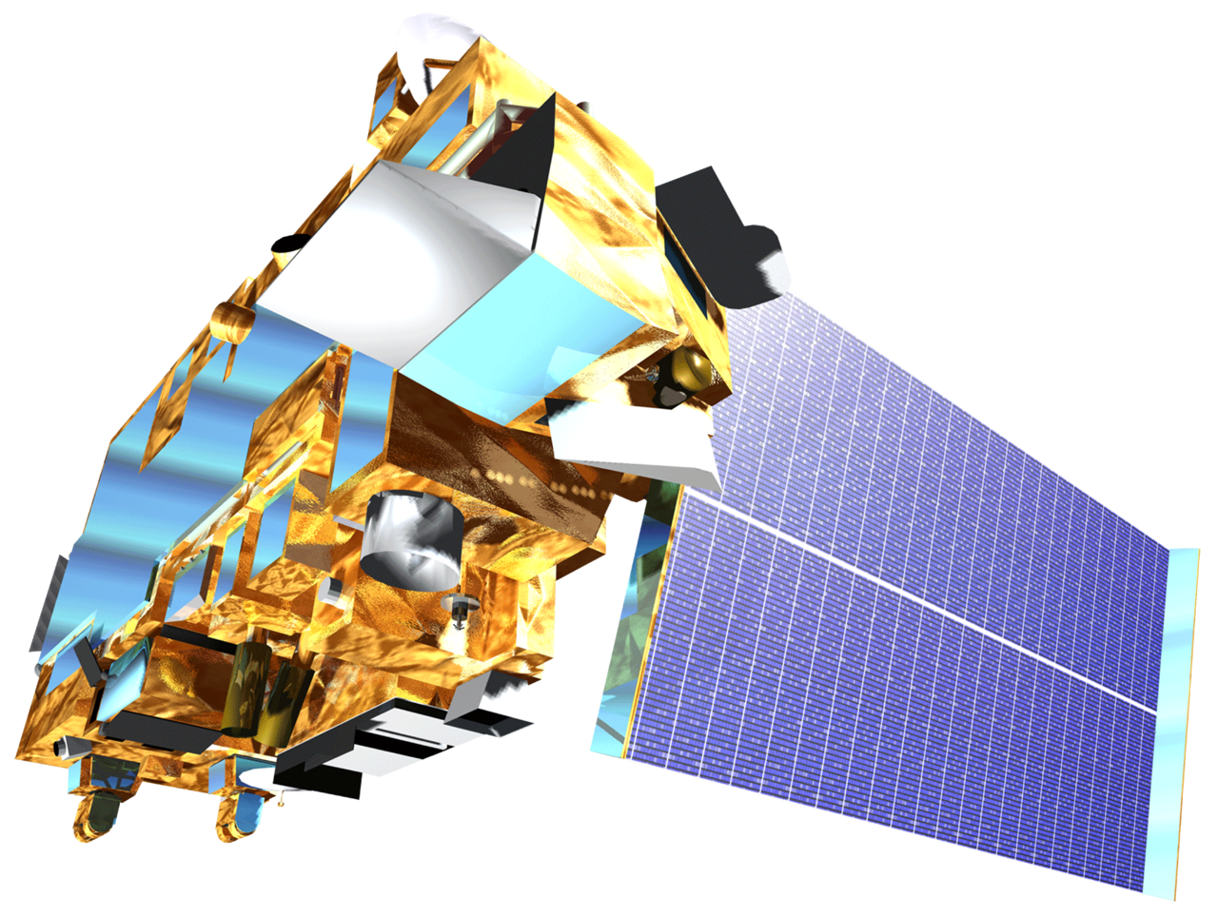
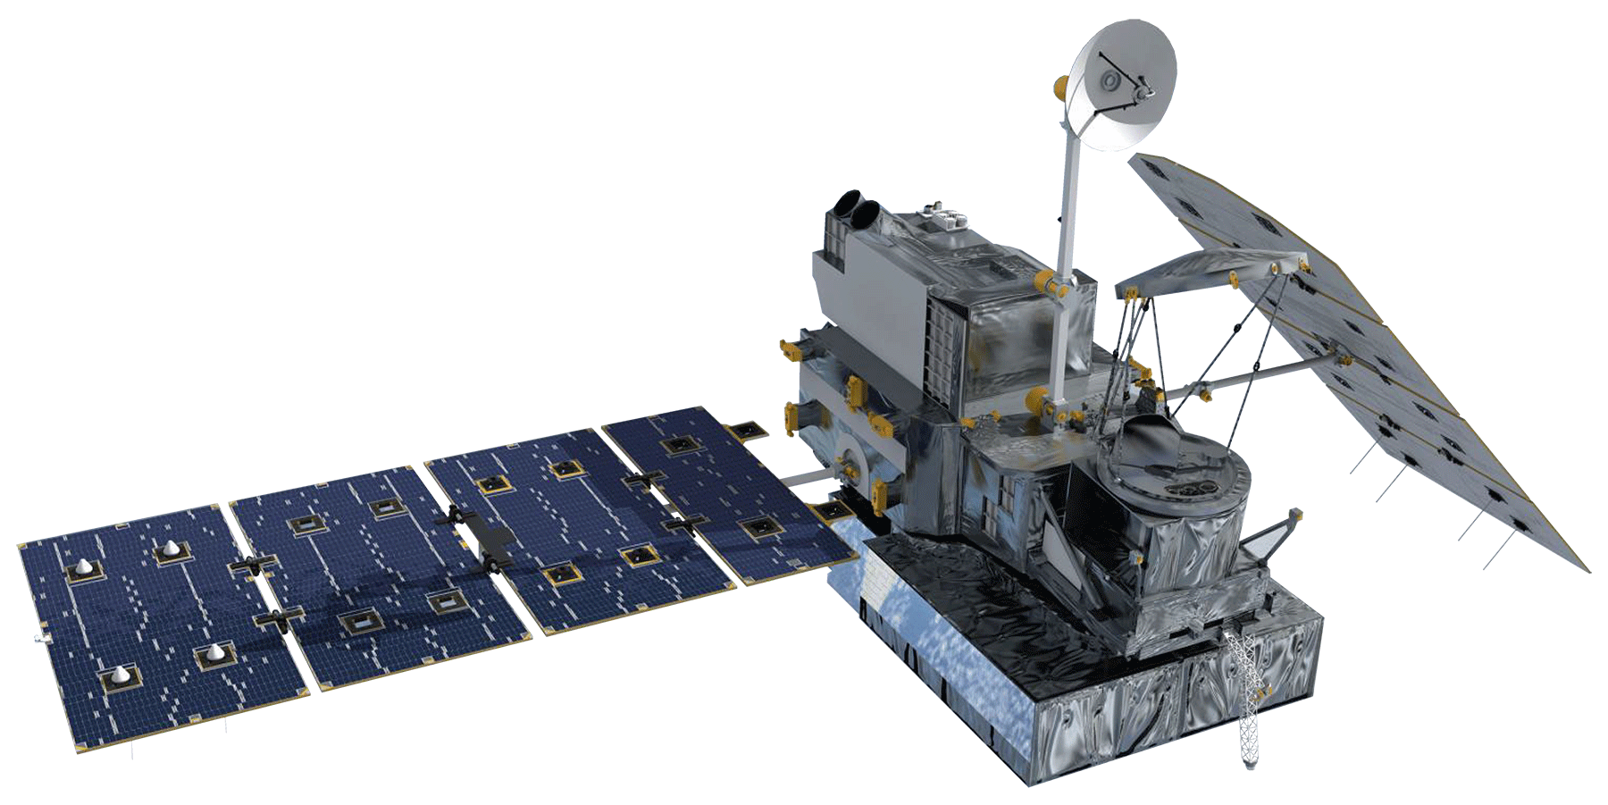
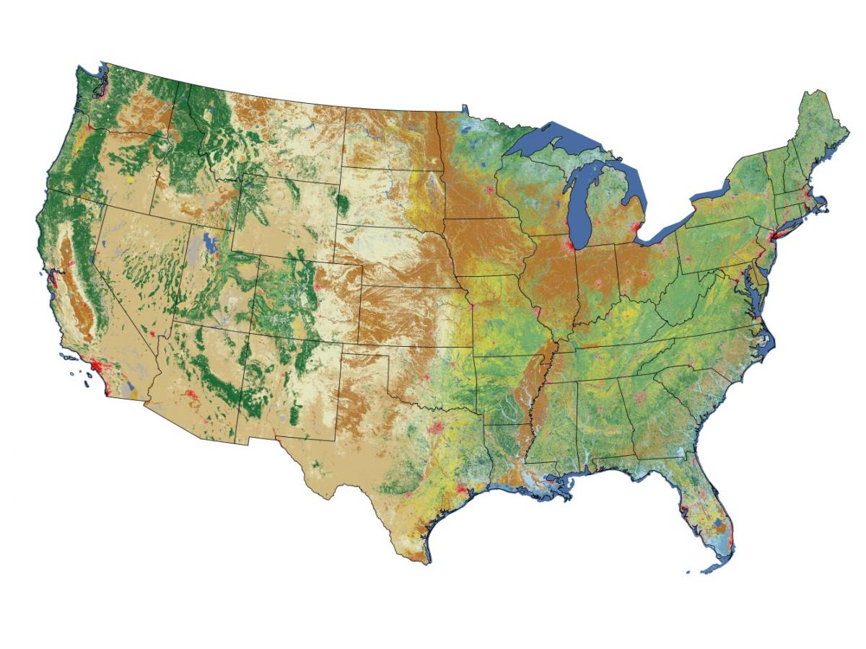
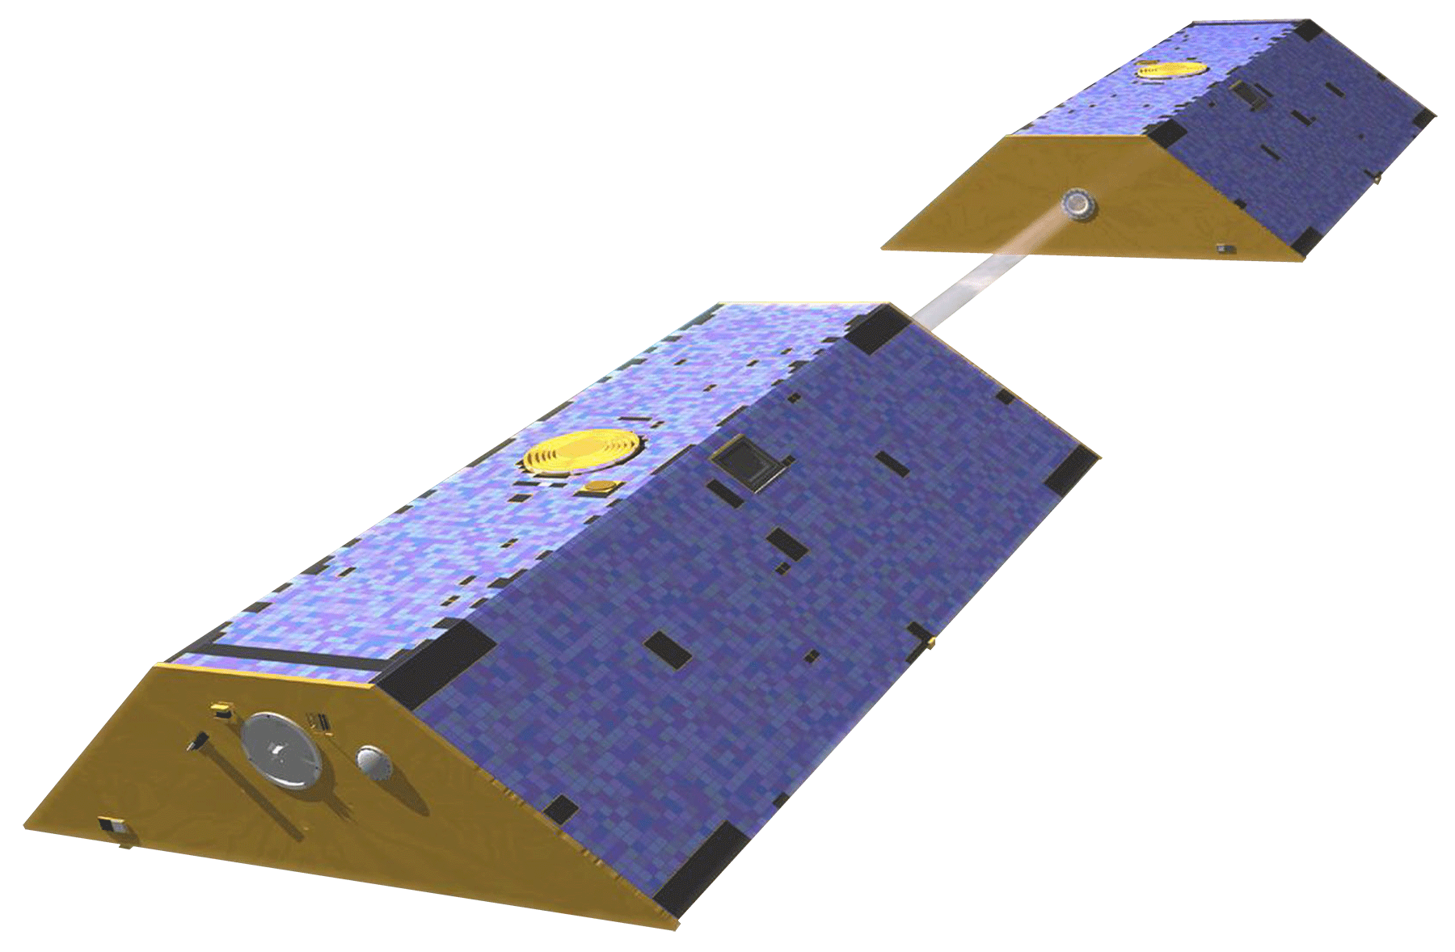
Groundwater Recharge Factors
Precipitation
Potential Evapo-transpiration
GPM
Terra MODIS
Landcover Change
Total Water Storage
NLCD
GRACE
Image Credit: USGS NLCD, NASA
Notes:
To understand groundwater recharge we first needed to look at total water storage to characterize and get background knowledge about the water table in the embayment. Our team utilized GRACE data to provide an understanding of how the water table has fluctuated from 2000 to 2021. We then looked at three critical groundwater recharge factors, Precipitation using GPM IMERG data, Potential Evapotranspiration using Terra MODIS, and landcover from the National Land Cover Dataset (NLCD). Evapotranspiration is the combination of evaporation from the Earth's surface and plant transpiration. Evapotranspiration can influence how much precipitation infiltrates to the subsurface as recharge or runs off as surface water.
NLCD
Image credit: USGS NLCD
Image source: https://eros.usgs.gov/doi-remote-sensing-activities/2011/usgs/national-land-cover-database-nlcd-delivers-update provided by USGS public domain
Satellite pictures
Image credit: NASA
Image source: https://www.devpedia.developexchange.com/dp/index.php?title=List_of_Satellite_Pictures Provided by DEVELOP

Slide 10
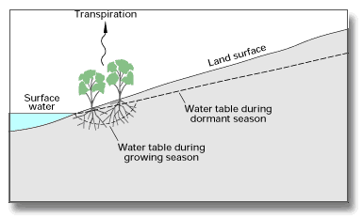
Data Processing: Total Water Storage
GRACE
Matlab
ArcGIS Pro
Image Credit: USGS
Notes:
To process GRACE data, netcdf files were processed in matlab. Qualily flagged values were removed and the data was scaled, regridded, and averaged yearly. Mothly and yearly averages were plotted in matlab. Data were exported into ArcGIS Pro for geospatial visualization
Image credit: USGS
Image source: USGS Evapotranspiration and the Water Cycle | U.S. Geological Survey (usgs.gov)

Slide 11
Data Processing: Recharge Factors
GPM IMERG
Precipitation
Matlab
Terra MODIS
Potential
Evapotranspiration
R-Studio
NLCD
Landcover
Google Earth Engine
ArcGIS Pro
Notes:
Data Processing for ET and PET
Terra MODIS ET and PET were downloaded from AppEEARS as geoTIFF for annual ET from 2000-2022
Imported into R ~ created a RasterStack from all tiffs to create one tiff
Mask function to get rid of fill values (areas that had ET urban and water) that were greater then 50,000 (kg/m^2/year) *update to mm/year as in convert these units
Applied scale factor .1 to the RasterStack (tiff)
Derive values from Raster to create time series
Create individual maps for ET and PET and created gif (if we get there)
Data Processing for Precipitation
TRMM/GPM IMERG data were downloaded from (…) and processed in Matlab from (.hncd?) to geotiff files
Imported into R ~ created a RasterStack from all tiffs to create one tiff
***Unkown step for processing? If needed
Apply scale factor (look up if there is one)
Derive values from Raster to create time series
Create individual maps for P for each year and create gif (if we get there)
##Problem to check if it is mean of P for that year or to do total P for one year like ET (which one is better what do they show?)
Data Processing for Landcover
1. Retrieve data from Google Earth Engine and re-visualize using modified classification based on NLCD Landcover classes.
2. Export geotiff of each year's landcover (8 images total) from GEE to drive.
3. Import geotiff into ArcGIS Pro to create finalized maps.

Slide 12
Thriving Index
Evaporative Stress Index (ESI)
Actual
Evapo-transpiration
(ET)
Potential
Evapo-transpiration
(PET)
1
Water
Balance
Precipitation
(P)
Actual
Evapo-transpiration
(ET)
2
Landcover Change
3
Notes:
There are three main components we are considering for the thriving index. The evaporative stress index, water balance, and landcover change.
The evaporative stress index or ESI is calculated from the actual evapotranspiration divided by the potential evapotranspiration.
Higher ESI values indicate that evapotranspiration is occurring efficiently, as the actual evapotranspiration is near the potential.
The water balance equation is calculated from the difference between precipitation and actual evapotranspiration.
When this difference is low, vegetation is evapotranspiring efficiently and is incorporated into the thriving index
Landcover such as alluvial planes, streams and forest lands are incorporated in the thriving index, streams help us understand where and how recharge may happen. Distinguishing certain land cover types that have specific conditions that would yield efficient groundwater recharge, such as forests, is valuable as well especially since deforestation was a problem in the study area

Slide 13
Results: Total Water Storage
Notes:
This section will cover the results found for Total Water Storage in the embayment.

Slide 14
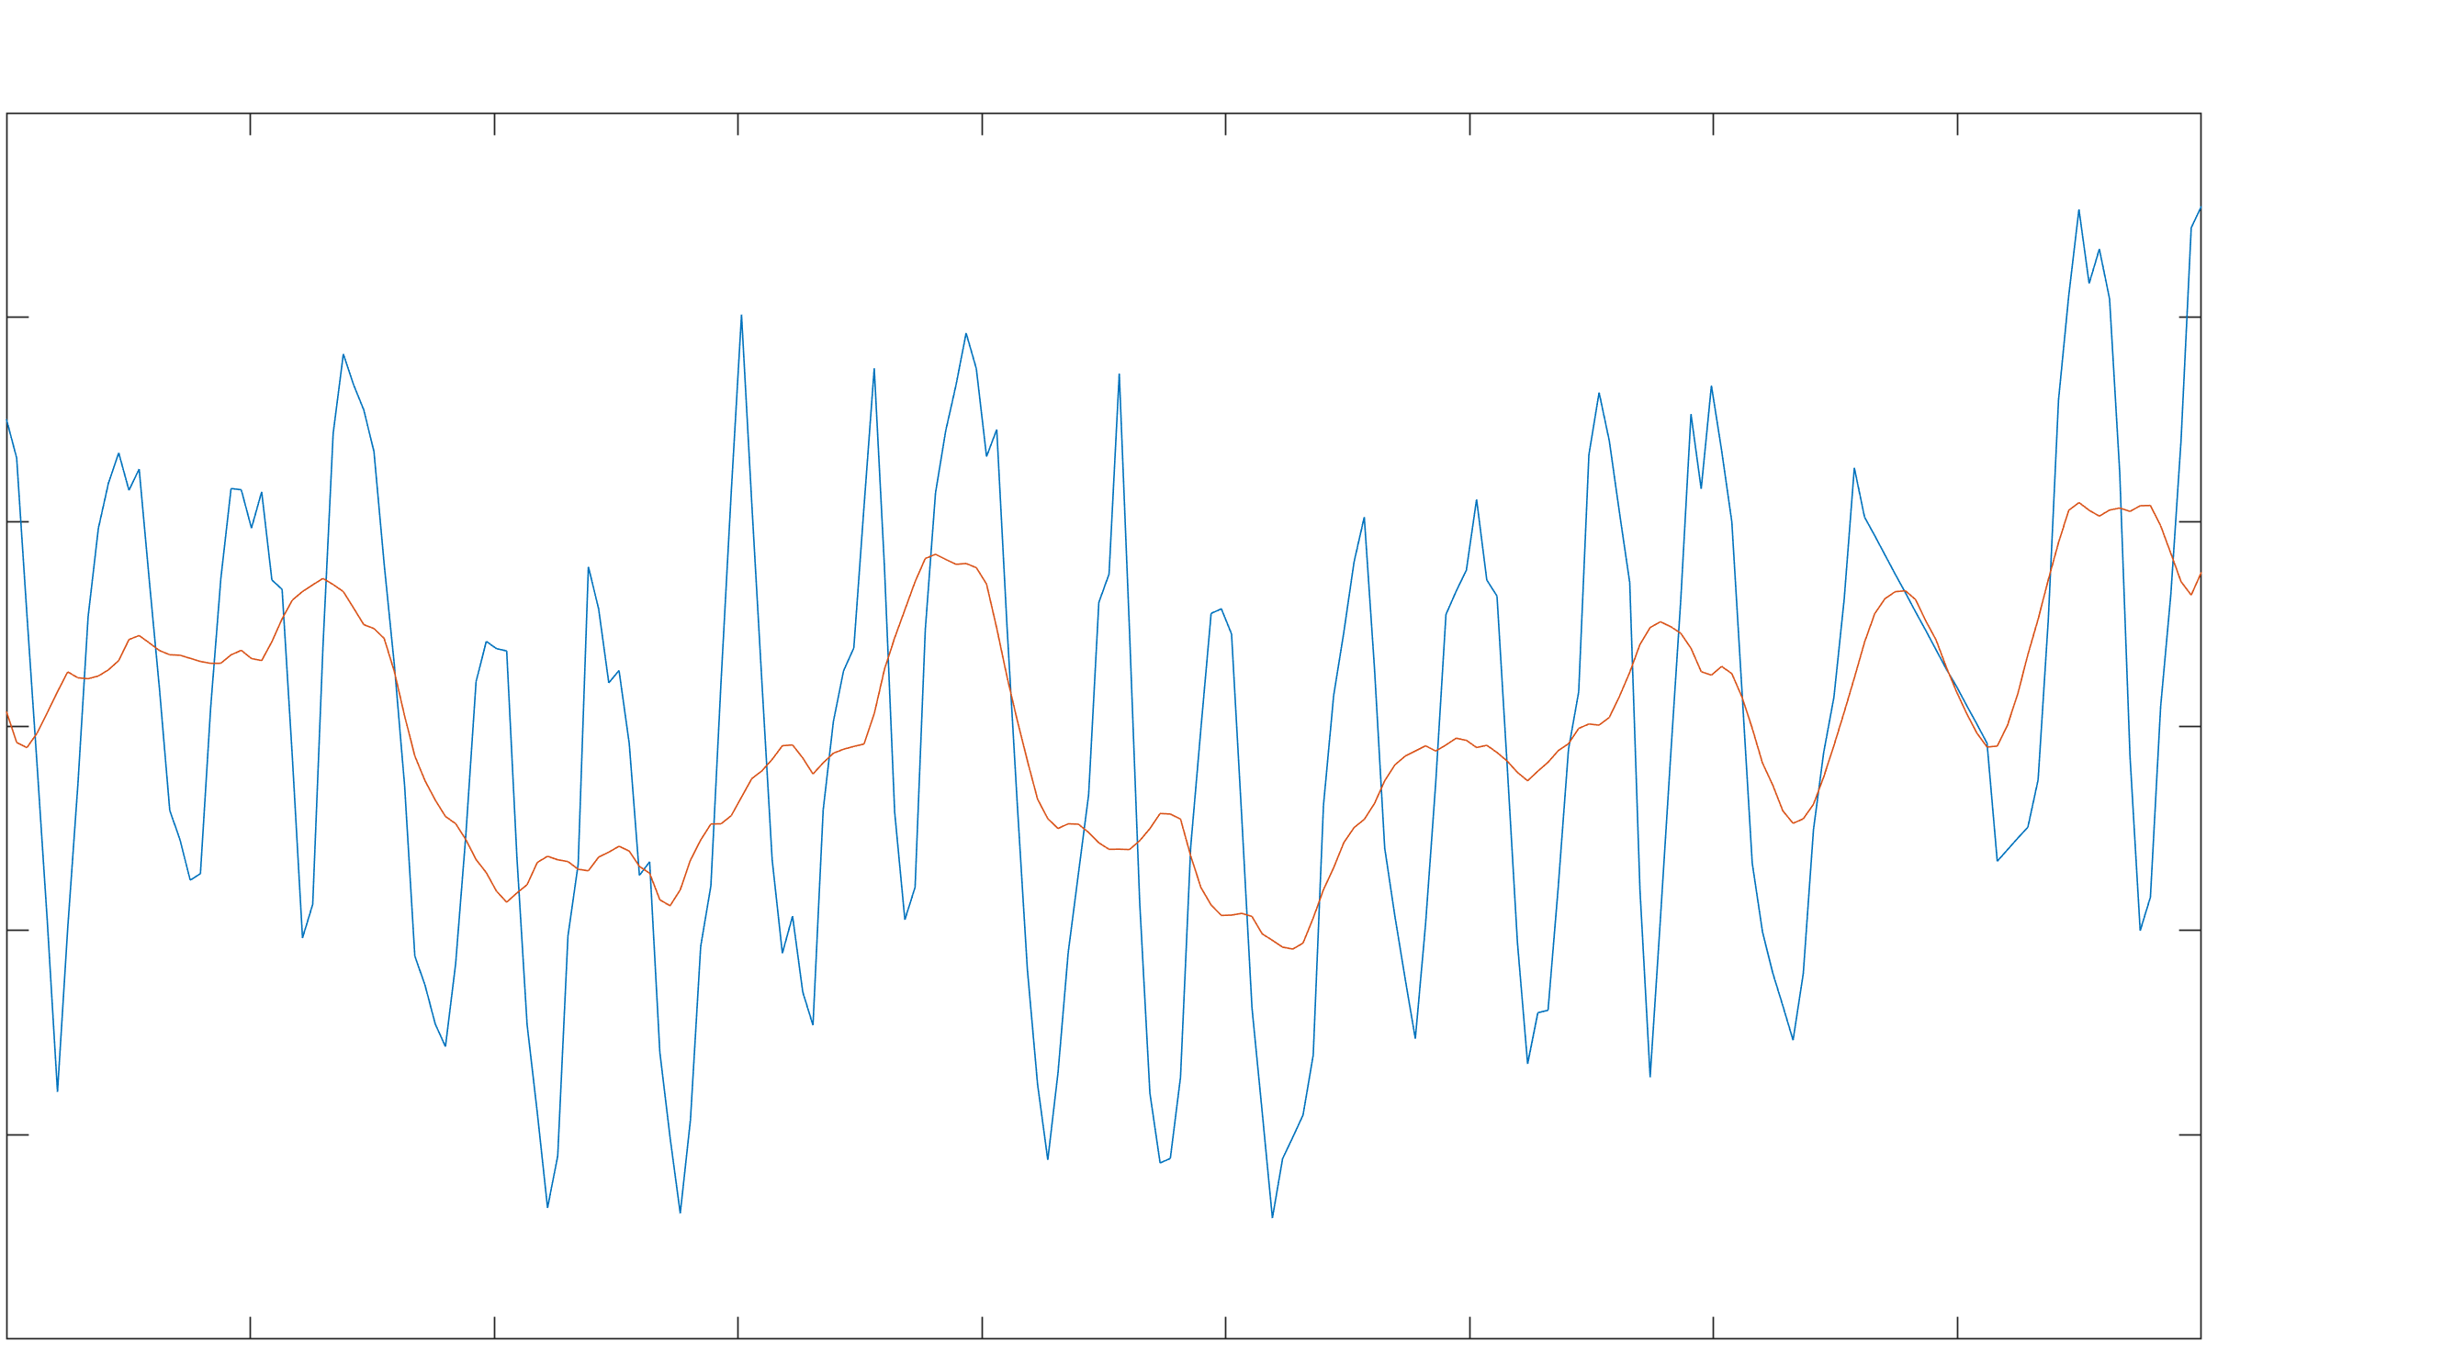
Total Water Storage Timeseries
Changes in Total Water Storage
30
Total Water Storage
Annual Moving Mean
20
10
0
Total Water Storage (cm)
-10
-20
-30
2018
2002
2004
2006
2008
2010
2012
2014
2016
2020
Year
Notes:
This time series depicts the average changes in total water storage in centimeters over the period of 2002-2020.
The blue line shows the monthly total water storage and the orange line shows the annual moving mean generated from an average of the 12 months of each year
Overall, the total water storage aligns to our expectations that the water table does not change much across the 20 year period, there are years where the water table rises above average and years where the water table is below average.
Some notable features are that seasonally Is clearly exhibited in the monthly total water storage and that drought events, such as the one in 2011, carry into effect in the year of 2012.

Slide 15
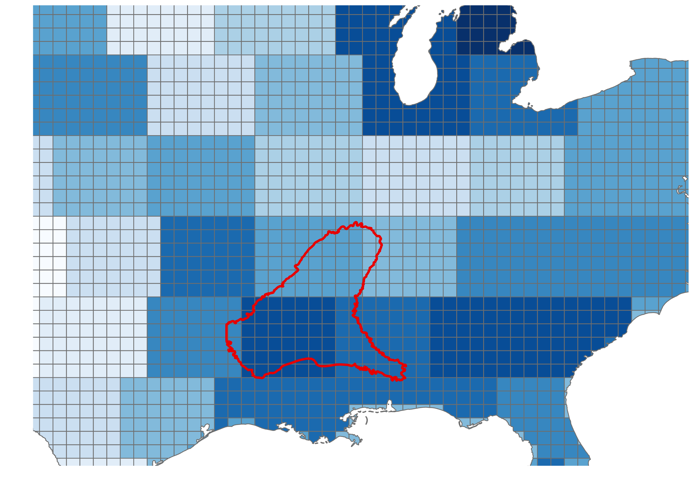
Total Water Storage
-18.208615 – -12.678213
-12.678212. – -6.128286
-6.128285 – -1.494265
-1.494264 – 0.681480
0.681481 – 2.713758
2.713759 – 5.370181
5.370182 – 7.636449
7.636450 – 10.916848
10.916849 – 14.747852
12.747853 – 24.858184
Mississippi Embayment
0
400
800
Notes:
This map depicts the averages changes in water storage In cm for the year 2021. Lighter blue values indicate reductions in the water table relative to the mean, and darker blue values indicate an increase of the water table. The ME is highlighted in red. Overall, observing the total water storage alone is not very informative due to its coarse resolution and the general nature of the data.

Slide 16
Results: Ground Water Factors
Notes:
In this section we will highlight groundwater factors results, including annual precipitation, evapotranspiration and potential evapotranspiration.

Slide 17
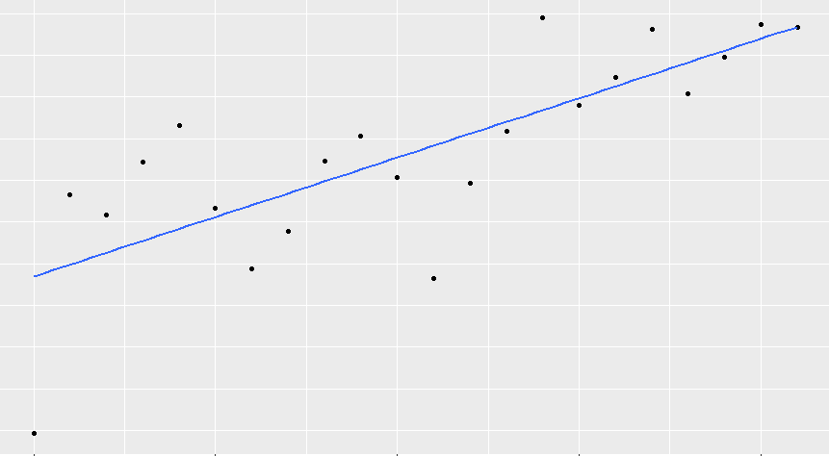
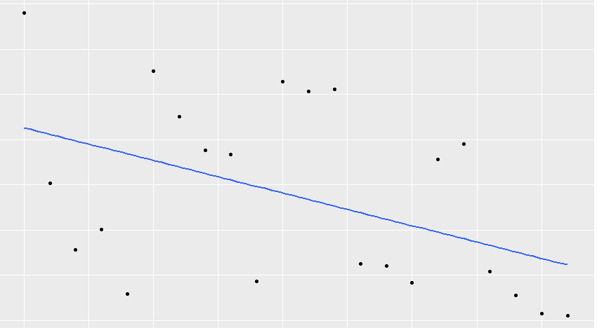
Annual ET and PET Timeseries
Average Annual Evapotranspiration 2000-2021
Average Annual Potential Evapotranspiration 2000-2021
R² = 0.59
p value = 3.09e-05
R² = 0.21
p value = 0.03233
1650
800
Mean ET (mm)
1600
Mean PET (mm)
700
1550
600
1500
2010
2000
2015
2000
2010
2020
2020
2015
2005
2005
Years
Years
Notes:
The average annual evapotranspiration show a clear increasing trend as it approaches 2021 with an R^2 value of 0.59 and p value of 3.09e-05.
The R^2 value for the average annual potential evapotranspiration is 0.21 and the p value is 0.032. Over the period of 2000-2021, PET is slightly trending downwards, but the R value and spread of the data indicate that this negative relationship is not strong.

Slide 18
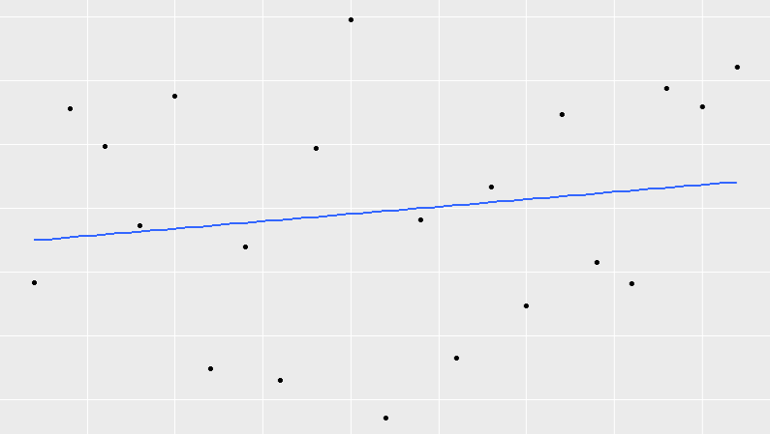
Annual Precipitation Timeseries
Average Annual Precipitation 2000-2021
2000
Mean Precipitation (mm)
1750
1500
2005
2015
2000
2010
2020
Years
Notes:
This plot depicts the annual precipitation timeseries. The precipitation does not significantly change over the time period and there is a weak upward trend throughout the period.

Slide 19
Landcover Change
Landcover Classification Types
Low Density Development
Mid Density Development
High Density Development
Grasslands
Pasture/Hay
Cultivated Crops
Deciduous Forest
Evergreen Forest
2001 Landcover in the Mississippi Embayment
2019 Landcover in the Mississippi Embayment
Mixed Forest
0
50
100
200
400
Wetlands
300
Kilometers​
Water
Major changes in forested areas, urban areas, pasture areas.
Notes:
Landcover classification based on NLCD 2019 release, modified for landcover types relevant to our region of interest for both 2001 and 2019. Major changes in both positive and negative directions can be seen for forested areas, urban areas, and pasture areas. In the circle in the Northeast of the embayment, we see increased forested areas in 2019 where previously there was more pasture, and increased urban sprawl in the Memphis area spreading outwards. We also see fluctuations in the circle in the Southwest of the embayment indicating both new growth and deforestation, with slightly more deforestation than new growth.

Slide 20
Results: Thriving Index
Notes:
In this section we will cover results that contributed to the creation of the thriving index, including results on the evaporative stress index, water balance, and landcover.

Slide 21
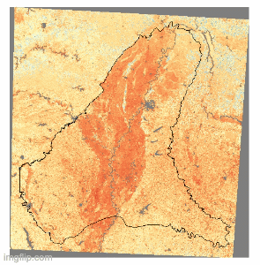
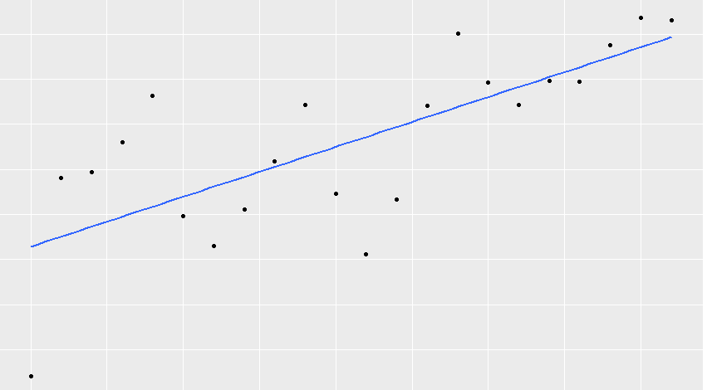
Annual Evaporative Stress Index (ESI)
Average Annual Evaporative Stress Index 2000-2021
0.55
ESI​
1.0
0.50
0.5
Mean ESI
0.45
0.0
0.40
R² = 0.53
p value = 0.0001197
2000
2005
2010
2015
2020
Years
Average Annual ESI 2000-2021
Notes:
Evaporative Stress Index for the years 2000 to 2021 shows dark shades of red indicate areas of high rates of water use and light shades of blue show areas of low rates of water use across the lands surface. Areas with higher ESI values show areas that are thriving. The increasing trend of the average annual ESI for 2000-2021 is explain 53% of the variance of the mean ESI throughout time and is significant.

Slide 22
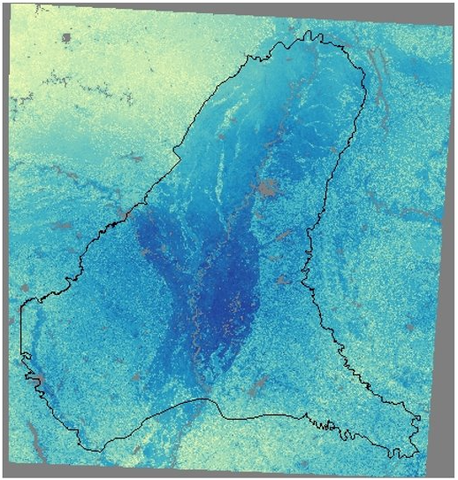
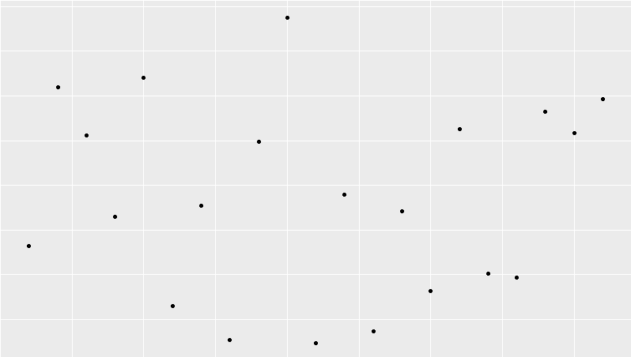
2019 Water Balance
Average Annual Water Balance 2001-2021
1400
1200
Mean Water Balance (mm)
1000
800
2000
2005
2010
2015
2020
Water Balance (mm/year)
Years
2000
Water Balance = Precipitation – Actual Evapotranspiration
1500
1000
0​
60​
240​
360​
480​
Kilometers​
500
Notes:
Overall, the annual mean precipitation is greater than the annual mean evapotranspiration inside the Mississippi Embayment in any given year. Excess precipitation in the form of runoff can directly recharge the aquifer in alluvial regions; outside of these areas, runoff can flow into stream systems and laterally recharge the aquifer.
A notably higher or lower water balance is apparent in some years during the time period. In 2010, water balance is high as precipitation is relatively large; while in 2011, water balance is low in response to a drought event.
2010 has a high water balance
The annual 2019 water balance shows areas that have high amounts of precipitation and low amounts of ET in dark blue. However due to fill values such as the urban areas and river these locations would be closer to the stream beds. Areas that show similar amount of precipitation and ET show that vegetation is using all the precipitation that is available. This water balance is displayed with high levels of ET and low amounts of precipitation in areas that are yellow. The trend of average annual water shows years of high amounts of precipitation and droughts.
Credits: Evapotranspiration and the Water Cycle | U.S. Geological Survey (usgs.gov)

Slide 23
Landcover: Streams and Alluvial (2019)
Mississippi Embayment Streams
Mississippi Alluvial Plain Extent
0
100
200
400
600
800
Kilometers​
Notes:
Where does the water go?
Vegetation using precip right away --> Precip high, high ET = close to zero
Precip high, ET low--> water going into streams = lateral recharge
Alluvial plain= sandy soil, good for vertical infiltration
Alluvial planes, in light blue, represent sandy or clay like areas of land where vertical infiltration of precipitation occurs and recharges the aquifer. Outside of these areas, when the water balance is higher, the aquifer is recharged laterally with runoff through stream systems.
Basemap Credits: Esri, HERE, Garmin, FAO, NOAA, USGS, EPA NPS

Slide 24
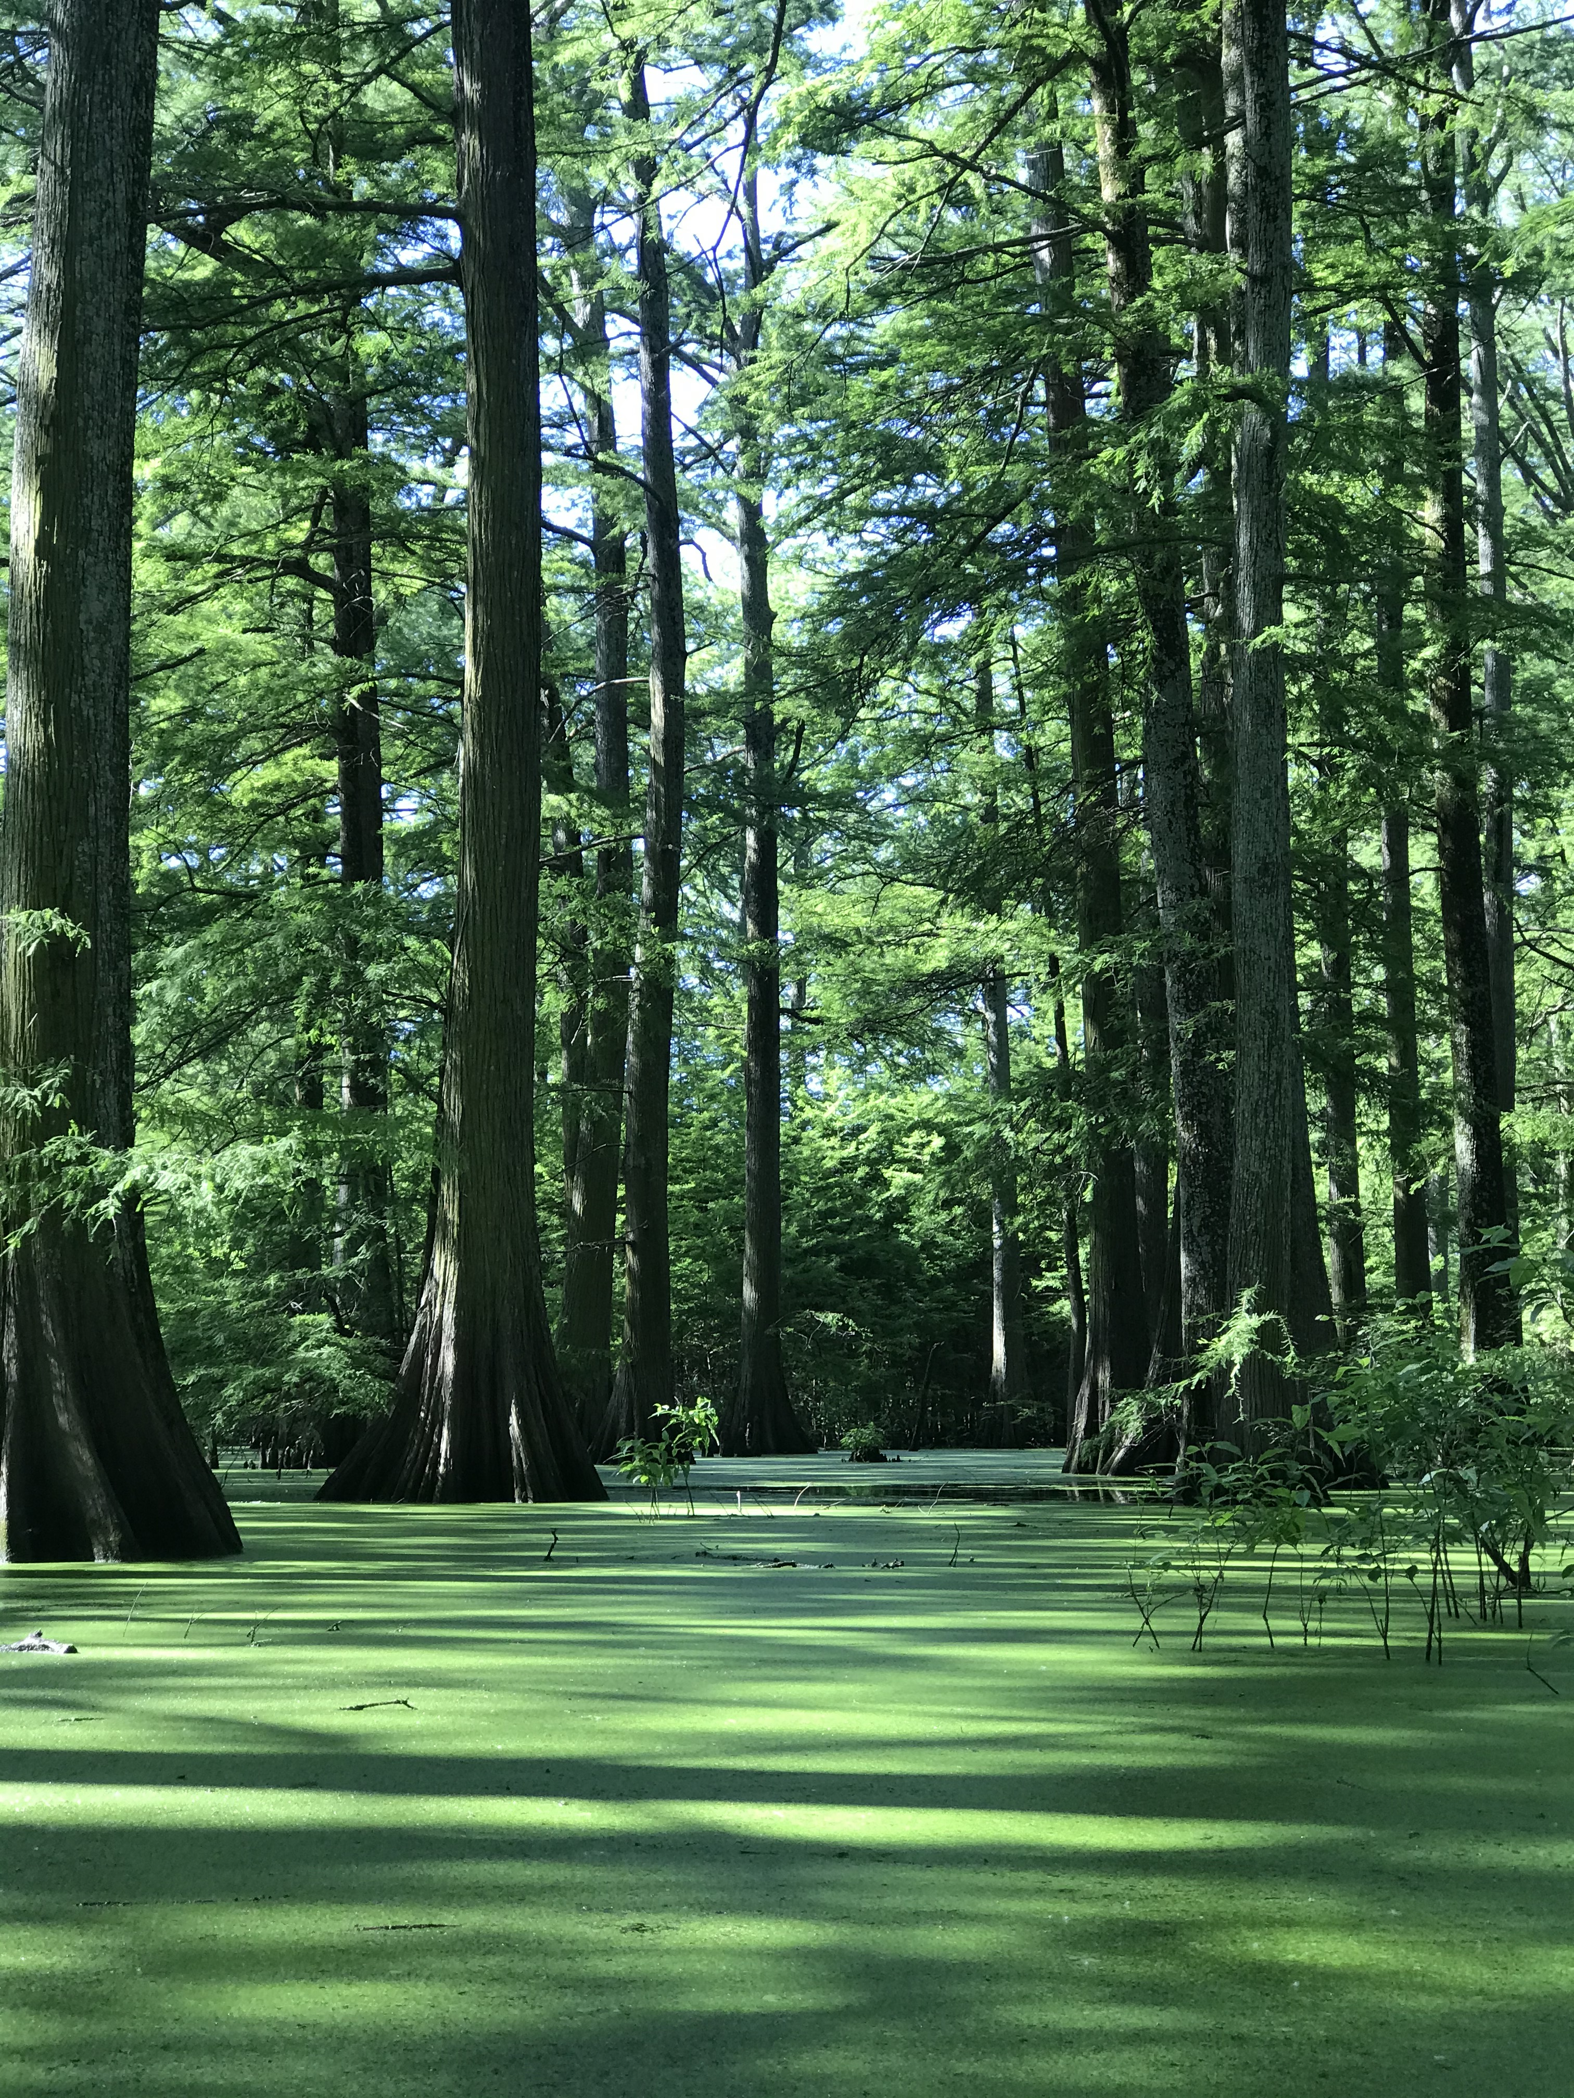
Conclusion
Thriving Index
The Thriving Index identifies areas to prioritize for conservation
POA will use the Thriving Index and expanded knowledge of groundwater recharge factors to inform local policy
Protection of thriving forested areas, especially apparent with increasing trends of deforestation and land development, can be supported with the Thriving Index
Image Credit: Protect Our Aquifer
Notes:
The Thriving Index identifies areas to prioritize for conservation
POA will use the Thriving Index and expanded knowledge of groundwater recharge factors to inform local policy
Protection of thriving forested areas, especially apparent with increasing trends of deforestation and land development, can be supported with the Thriving Index
Image credit: https://www.protectouraquifer.org/ Provided by Sarah Houston, project partner

Slide 25
ERRORS & UNCERTAINTIES
Potential sensor error producing bad pixels in ET/PET datasets
Effects of seasonality not adequately represented within annually averaged data
Utilizing a climatological average to gap fill precipitation data
Assumption that the generalized classifications in the NLCD dataset are adequately representative of our study area
Notes:
Potential errors and uncertainties source from a potential sensor error that could produce bad pixels in ET/PET datasets, the effects of seasonally not adequately represented or accounted for within annually averaged data, the ulitilization of climatological averages to gap fill precip data, and the assumption that the generalized classifications in the NLCD dataset are adequately representative of our study area

Slide 26
FUTURE WORK
Examine groundwater recharge factors on shorter-term scales to assess response to climate events
Employ finer-scaled ECOSTRESS data to observe groundwater recharge factors over shorter timescales and smaller areas
Validate Earth observations with in-situ data from well data, precipitation gauges, and flux towers for evapotranspiration
Notes:
In the future it would be beneficial to conduct shorter term analyses with ECOSTRESS to better understand the response to climate events and see finer resolution data. In addition, validating Earth Observations with in-situ data from well data, precipitation gauges and flux towers for evapotranspiration would be useful to examine in the future.

Slide 27
Partners:
Protect Our Aquifer (POA)
Sarah Houston- Executive Director
Ward Archer – President
Jim Kovarik – Board Member
Science Advisor:
Madeleine Pascolini-Campbell (NASA Jet Propulsion Laboratory, California Institute of Technology)
Kerry Cawse-Nicholson (NASA Jet Propulsion Laboratory, California Institute of Technology)
Benjamin Holt (NASA Jet Propulsion Laboratory, California Institute of Technology)
NASA DEVELOP:
Erica Carcelen (NASA DEVELOP JPL Fellow)

