Slide 1
2019 Summer
NATIONAL
ORIENTATION
MODULE 5. Team Responsibilities
Notes:
Your project Website Image should be placed behind the hexagon grid. An example image has been placed in this position for your reference. Delete the example image, insert your image, right click your image and select the “Send to Back” option. Position and adjust the size of your image so that it lines up with the provided margin rulers.

Slide 2
Project Team Responsibilities
Set goals and work towards them.
Complete all mandatory deliverables and weekly updates, as well as any optional deliverables the team decides.
Support Project Leads in submission of deliverables and reporting to Center Leads, who report to NPO.
Leave organized documentation of all research and contacts so the project and/or communication with end users may be continued in following terms.
Take initiative! Look at what else needs to be done when you have completed your assigned tasks.
Don’t feel bogged down by the chain of command – DEVELOP fosters open communication between all levels!
Network with other teams. Help others teams! Get help from other teams!
Have an open mind & learn from each other!

Slide 3
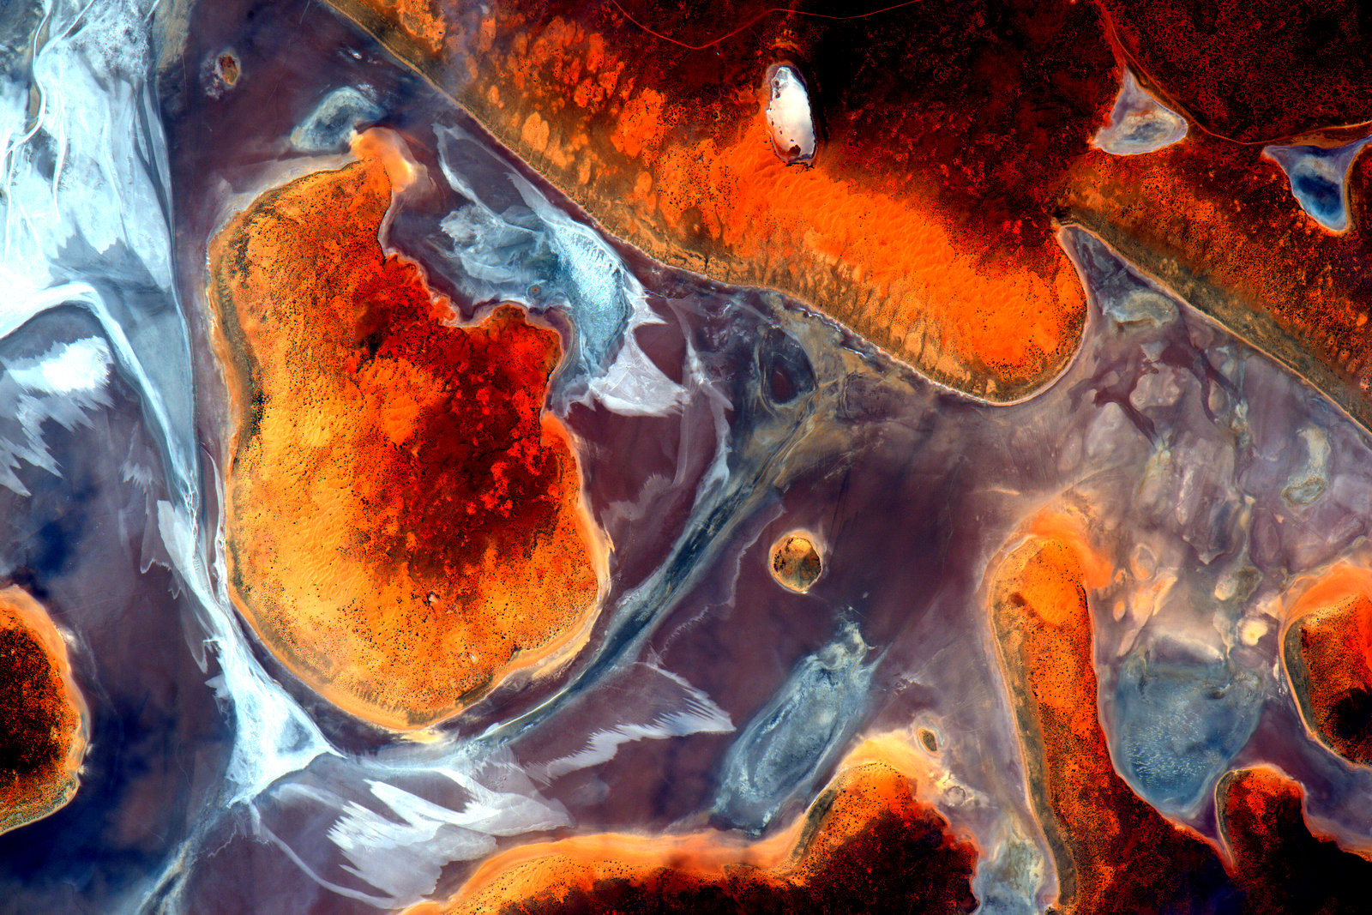
Scientific Integrity
“The iconic success of NASA is planted firmly on three foundational elements: innovation, inspiration, and integrity. While innovation and inspiration are visible through our endeavors and successes, it is our integrity – how we work, and our commitment to excellence and openness – that earns us the trust of the public and ensures our continued ability to inspire and innovate. Integrity is woven throughout the fabric of NASA. It has always been there. And each and every day, we recommit ourselves to keeping it there.”
Dr. Waleed Abdalati
Former NASA
Chief Scientist
NASA SI Policy: http://www.nasa.gov/pdf/611201main_NASA_SI_Policy_12_15_11.pdf

Slide 4
External Communication
The Project Lead typically serves as the main point of contact to NPO, science advisors, and partners through email communication, leading project-related telecons, and coordination of team meetings.
Emails relating to DEVELOP business or being sent to NASA personnel must be approved by your Center Lead.
Emails relating to your DEVELOP projects and being sent to international recipients should be reviewed by DEVELOP’s NPO before they are sent outside of DEVELOP.
CC your Center Lead when sending ALL project-related emails – this ensures continuity of communication and knowledge after the project ends.
Each team has access to a phone. If the phone rings, answer it nicely with something like: “DEVELOP Program, this is <name>. How may I help you?”
All participants should check their SSAI-provided email each day you are in the office.

Slide 5
Project Deliverables
DEVELOP places equal emphasis on research & analysis and communicating your results.
Substantial efforts are put forth in developing deliverables that not only communicate the work done at DEVELOP, but enhance participants’ skills: technical writing, coding, science communication, effective visualizations, video editing, etc.
Deliverables are your opportunity to communicate your project work. Each deliverable is an example of your accomplishments. Use them to your advantage!
All deliverables are important and used by DEVELOP in a variety of ways which we are laid out on following slides.
Best Practices:
Tackle deliverables incrementally – start them early
Identify a POC within the team for each deliverable
Reuse content from one deliverable for another – while each demonstrates your project in a different method of communication, many have shared core elements
All deliverables must be reviewed by your Center Lead before submitting to NPO
Build in time for Science Advisors to review as well
Always review the deliverable checklist to ensure your deliverables are on point prior to submission to NPO

Slide 6
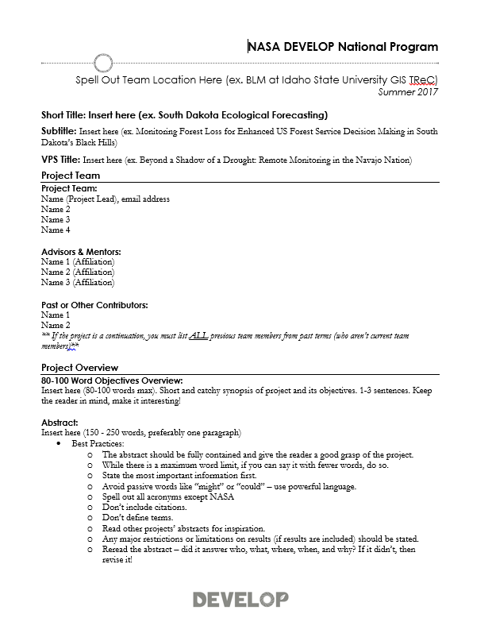
Project Deliverables
You’ll learn more about deliverables from the Project Coordination team’s Deliverables Tips & Tricks Webinar during week 2 but it’s never too early to start thinking about deliverables!
Things to start thinking about now:
Project Videos *This is different from previous DEVELOP terms*
If you are the final term of a multi-term project, your team is required to make a video. Not a multi-term project? Consider making a video as an optional deliverable! Are your partners involved in outreach or interested in having a short video that explains your DEVELOP Project – ask them in your early term partner calls!
Code/Tool
If your team wants to hand off a code or tool to partners, clarify the expectations and requirements necessary to make DEVELOP code open source. It must go through the software release process.
Ensure that they are aware that they will not receive the code at the end of the term. Adjust your project end products, if necessary!

Slide 7
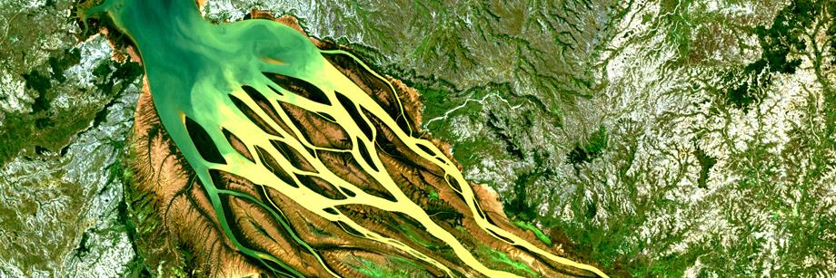
Software Release Authority
What is NASA’s Software Release Authority? It is NASA’s process for formally giving approval for software and tools to be released to the public for marketing, distribution, and use. All new “software” developed by NASA-funding must be made available through the Software Release Process, which coordinates export control review, intellectual property review, commercialization assessment, and software release actions, and determines if it meets NASA policies and guidelines.
Process involved:
Identify which projects are creating the types of tools that must go through SRA by means of the proposal and project summary deliverables.
To review the full process and steps involved - visit: www.devpedia.developexchange.com/dv/index.php?title=Open_Source_Software_Development_and_Release
Other considerations:
All software released through NASA DEVELOP will be released open source.
All software released through NASA DEVELOP will be distributed through the NASA DEVELOP GitHub account after Software Release Approval. Caution partners that this will not occur during the term.
For questions about this form, refer to DEVELOPedia: Open Source Software Development and Release or contact Jordan.
You CANNOT handoff any coding tools/short scripts the team created to a partner until the software release process has been completed.
You CANNOT include any lines of code in presentations or videos, even after completing SRA.

Slide 8
Deliverable Submission
The Project Coordination Team will work with you throughout the deliverable creation and submission process.
Each team has a designated PC Fellow to correspond with, as well as a set team of editors, throughout the whole term for continuity.
Any deliverable questions can be sent to: DEVELOP.ProjectCoordination@gmail.com
To submit:
By The Way
Over 15MB and too large for email? Send through Google Drive or NASA LFT. For those not at a NASA Center, request an LFT invite from Amanda.
Email
Amanda.L.Clayton@nasa.gov
DEVELOP.ProjectCoordination@gmail.com
File Nomenclature
YearTerm_Node_Team_Deliverable_Draft
Ex. 2019Spring_GA_EasternIndiaEcoII_Poster_FD
Node Acronyms:
AL, ARC, AZ, CO, GA, GSFC, ID, JPL, LaRC, MA, MSFC, NC
App Area Shorthand:
Ag, Disasters, Eco, Energy, HealthAQ, TI, Urban, Water
NASA LFT

Slide 9
Required Legal Statements
ALL deliverables and products created by teams need to include this short paragraph of legal statements:
“This material is based upon work supported by NASA through contract NNL16AA05C. Any mention of a commercial product, service, or activity in this material does not constitute NASA endorsement. Any opinions, findings, and conclusions or recommendations expressed in this material are those of the author(s) and do not necessarily reflect the views of the National Aeronautics and Space Administration and partner organizations.”

Slide 10
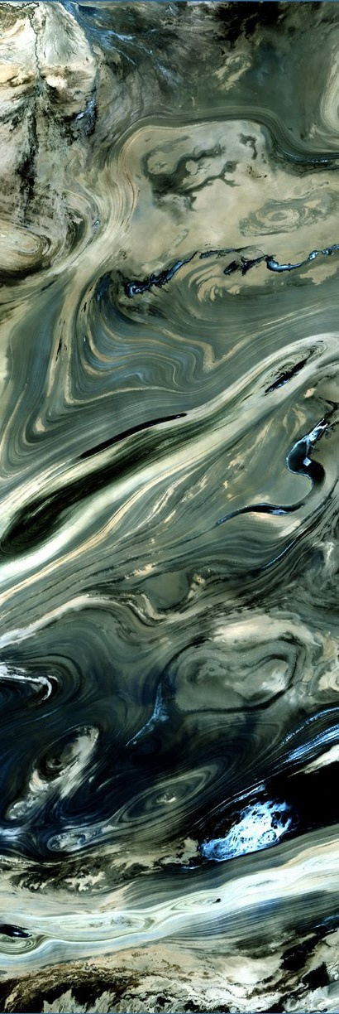
Export Control
Export Control is NASA’s program to ensure that scientific material being shared externally abides by federal regulations.
What does this mean to me? BEFORE sharing any materials outside DEVELOP, check with NPO. Some project materials can be shared without going through export control (map products, preliminary results, imagery, videos), others must gain NASA approval first (tech paper, poster, presentation). All external publications (ex. peer-review publications) and conference presentations must go gain these approvals. Amanda is your POC.
What is Export Control? The NASA Export Control Program is based on the philosophy: “We want to maximize the benefits of our international efforts while ensuring that we comply with U.S. export control laws and regulations”. It is the personal responsibility of each employee or contractor to pursue appropriate international activities involving transfers of technologies, software, and commodities. The Agency’s Export Control Program is the mechanism that provides checks and safeguards at key steps to help manage international activities and ensures that NASA works within Export Administration Regulations (Department of Commerce) and the International Traffic in Arms Regulations (Department of State), which could result in criminal, civil, or administrative enforcement actions against NASA, individual employees, and/or private contractors.
NASA Administrator’s Export Control Policy: "As a U.S. Government Agency on the forefront of technological development and international cooperation in the fields of space, aeronautics, and science, the National Aeronautics and Space Administration will strive to fulfill its mission for cooperative international research and civil space development in harmony with the export control laws and regulations of the United States. Due to heightened proliferation challenges facing the United States and the world, including risks posed by the spread of missile technologies and weapons of mass destruction, and in view of the significant criminal, civil, and administrative penalties that may affect the Agency and its employees as a result of a failure to comply with U.S. export control laws and regulations, it is the responsibility of every NASA official and employee to ensure that the export control policies of the United States, including nonproliferation objectives, are fully observed in the pursuit of NASA's international mission.“

Slide 11
Deliverable Deadlines to NPO
Week 1 – 6/6: Handbook Forms, Info Sheet, Personality Assessment, Entrance Personal Growth Assessment, DEVELOPedia Participant Page, Orientation Completed
Week 2 – No deliverables! (savor it)
Week 3 – 6/20: Project Summary RD
Week 4 – 6/27: Tech Paper RD
Week 5 – 7/5: Presentation RD
Week 6 – 7/11: Project Summary FD, Study Area Shapefile, Website/Summer Booklet Image
Week 7 – 7/18: Poster FD
Week 8 – 7/25: HQ Highlight & Flashtalk Presentation FD*
Week 9 – 8/1: Presentation FD, DEVELOPedia Project Page
Week 10 – 8/7: Exit PGA; 8/8: Tech Paper FD, Feedback Form, 8/8: Exit Survey
Note: See DEVELOPedia or the Deliverables Calendar for Project Video and Code deadlines, if applicable!
By The Way
Center Leads set a schedule for deliverables to be submitted to them for a first review prior to submission to NPO. This may be 1-4 days before the NPO deadlines.

Slide 12
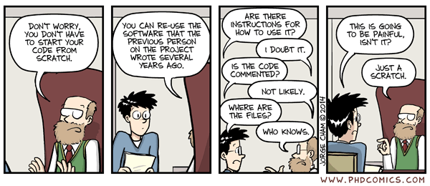
Why Use Best Practices?
Image Source: J. Cham. (2014, March 12). Comic number 1869. Piled Higher and Deeper . Retrieved from http://phdcomics.com/comics/archive_print.php?comicid=1689

Slide 13
Why Do Best Practices Matter?
Terms are only ten weeks long. Good data management practices allows Center Leads or second term teams to answer questions about methods and results.
DEVELOP may present your past project at a conference. Good data management practices allows presenters to create graphics and slides and to answer questions.
Teams often want to publish. Good data management practices are necessary for teams to write a materials and methods section.
Future DEVELOP project teams may want to build on your data and methods.
Best practices enhance the likelihood that your work will be reproducible.
Reasons why we don’t always follow best practices:
We haven’t learned best practices.
We are in a hurry. Projects are just ten weeks long.
We want to provide our partners with results.
We document our work at the end of the term when we may leave out important steps.
We only document what worked. But, science is also about what doesn’t work.

Slide 14
Data Management
"Data management is the development, execution and supervision of plans, policies, programs and practices that control, protect, deliver and enhance the value of data and information assets.”
Answers the questions:
Where did the original data come from?
What was done to the data?
Can I find the data again if needed?
Data should be well and consistently organized
Directory (folder) Structure
File Nomenclature
Analysis–Friendly Data
Documentation

Slide 15
Tip 1. Organize
Organize your team’s data using a directory structure
Segregate materials for a project into one directory:
Folders: data, methods, results, deliverables
Keep raw data separate
Include README files
Directory Structure Example
README files describe the contents of a folder, list the files in that folder, and provide metadata
They can be very useful in helping a new user navigate your directory
By The Way
This organizational approach applies equally to PCs, portable drives, or Google Drives.

Slide 16
Tip 2. Standardize
Standardize file nomenclature
File names should be:
Machine Readable:
Do not include special characters (%, $, &, etc.)
Use underscores instead of spaces
Example: 20171107_average_ndvi_by_census_tract.csv
Human Readable:
File names should briefly, but adequately, describe the contents of the file
It can be useful to note the version of the file by adding v1, v2 etc. in the file name
Bad Example: landcover_test2.tif
Good Example: 2016_Phoenix_landcover_v2.tif
If you are testing a process it’s easy to accumulate many different files that are essentially the same thing. Using a marker like “v2” can be helpful. However, once you figured out the correct process and produced the final version of file consider removing the “v2” tag and previous versions of the data.
File names should work well with default ordering
Example: Folder with daily land surface temperature files. Name the files so that they default in chronological order
Maintain Consistent Nomenclature
Use Open File Formats: CSV not XLSX

Slide 17
Tip 3. Analysis-Friendly Data
Data Tables can be either Wide or Long formats.
Each row is a unique observation
Each column is variable
DO NOT combine multiple variables in one column
A common exception: Date. It’s common to have multiple columns for Day, Month, Year or a Date column with consistent date information (i.e. Year-month-day: 1999-06-01
Census_TractID | Date | Year | Month | Metric | Value
51043 | 2012-06 | 2012 | 6 | Avg_LST | 38.20
51043 | 2012-06 | 2012 | 6 | Avg_NDVI | -0.16928
51043 | 2012-07 | 2012 | 7 | Avg_LST | 36.84
51043 | 2012-07 | 2012 | 7 | Avg_NDVI | 0.359118
51043 | 2012-09 | 2012 | 9 | Avg_LST | 33.65
51043 | 2012-09 | 2012 | 9 | Avg_NDVI | 0.693757
51045 | 2012-06 | 2012 | 6 | Avg_LST | 37.03
51045 | 2012-06 | 2012 | 6 | Avg_NDVI | 0.619561
51045 | 2012-07 | 2012 | 7 | Avg_LST | 44.04
51045 | 2012-07 | 2012 | 7 | Avg_NDVI | -0.93069
51045 | 2012-09 | 2012 | 9 | Avg_LST | 37.58
51045 | 2012-09 | 2012 | 9 | Avg_NDVI | 0.974952
Long
Wide
Census_TractID | Date | Year | Month | Avg_LST | Avg_NDVI
51043 | 2012-06 | 2012 | 6 | 38.20 | -0.16928
51043 | 2012-07 | 2012 | 7 | 36.84 | 0.359118
51043 | 2012-09 | 2012 | 9 | 33.65 | 0.693757
51045 | 2012-06 | 2012 | 6 | 37.03 | 0.619561
51045 | 2012-07 | 2012 | 7 | 44.04 | -0.93069
51045 | 2012-09 | 2012 | 9 | 37.58 | 0.974952

Slide 18
Tip 4. Document Data
Will it be possible for the reader of your tech paper to find the exact data used by your team?
Document the source of your data.
Keep a copy of all data used for analysis, results, images and tables.
Don’t just store the data on a drive. Add a document explaining what the data is, where it was obtained, and how it was used.
Document why you chose your data. Be specific.
Instead of “We used the least cloudy scene for each year in the study period”, try “We used the least cloudy scene for each year in the study period (Table A).”
Document any processing and/or modification of your data.
This includes clipping, reprojecting, cloud removal, etc.
DOCUMENT EVERYTHING! Documentation is the key to scientific reproducibility.
More info: https://gigascience.biomedcentral.com/articles/10.1186/s13742-016-0135-4

Slide 19
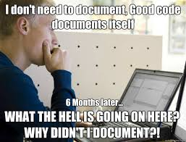
Tip 5. Document Code
Computational reproducibility is the ability to exactly reproduce results given the same data. This is why DEVELOP requires comments on code for software release.
Best Practices for Comment Code
Leave your self notes as you are working on your code. Example. ## Code below extracts files from the hdf. Running into an issue at line 43. Start there tomorrow.
Remove personal notes and clean up your comments once your code is finalized.
A reader should understand exactly what your code does, even if they aren’t familiar with your coding language. Every step should be explained.
Suggestion: Have another team read your code.
Things to consider:
Is your code well-commented?
Is your code stored in a way that it is available to future teams? https://github.com/NASA-DEVELOP or local node repository
Have you indicated your operating system(s), software dependencies, and the analytical software (and versions) that were used?
Did you use any unusual computer configurations or non-default parameters?
Is your data documented?
Need help? Contact Geoinformatics at DEVELOP.Geoinformatics@gmail.com

Slide 20
Tip 6. Document Methods
Documentation is vital in ensuring your work can be reproduced.
Document your decisions.
Why did you choose your methods? Are there better methods?
Keep a list of all equations or formulas.
Keep track of both failures and successes.
Document exact steps of final methods.
Example: Once you’ve figured out land cover classification in ENVI write down the exact steps and tools you used to complete the classification.
Think of this as a tutorial. Someone should be able to replicate your methods with this document. This can be an optional deliverable for your partner.
Teams can keep shared notes on Google Drive.
This will become the “Methods” section of the tech paper.

Slide 21
Overview
Tip 1: Organize Data Using a Directory Structure
Tip 2: Standardize File Nomenclature
Tip 3: Data Should be Analysis-Friendly
Tip 4: Document your Data
Tip 5: Document your Code
Tip 6: Document Your Methods
None of these processes are something you do once. It’s a continuous effort that should be discussed with your team multiple times during the term.
Project Success = Project Reproducibility

Slide 22
Quiz Time!
Who should you cc on all project-related emails?
If your team is creating code with the intent of handing it off to the partner, what approval process is required?
How do you submit deliverables?
Does each team have a designated PC Fellow representative and consistent editors throughout the term?
Are the NASA legal statements required on ALL deliverables?
If you want to present or publish DEVELOP project materials in the future, would they have to go through export control?

Slide 23
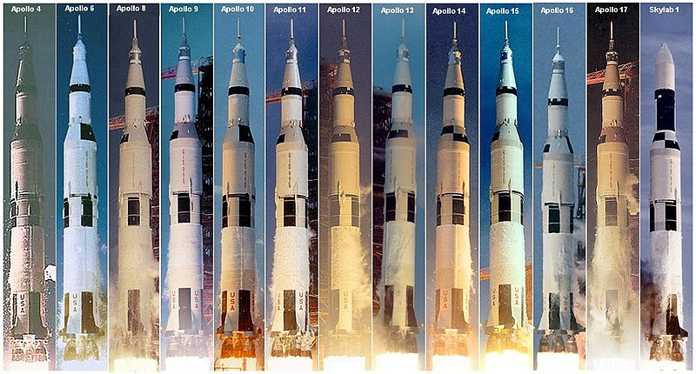
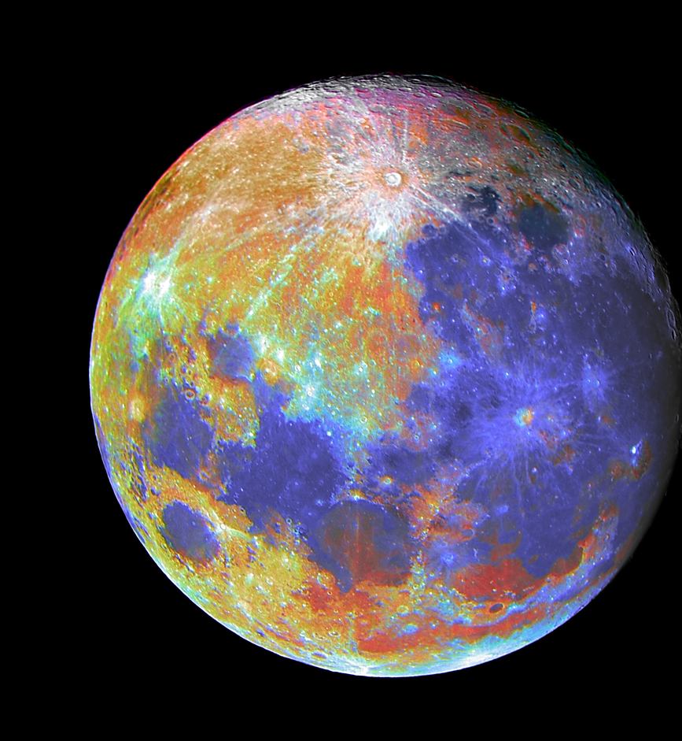
THANK YOU!
“A place for everything and everything in its place.”
-- Benjamin Franklin --
Notes:
Your project Website Image should be placed behind the hexagon grid. An example image has been placed in this position for your reference. Delete the example image, insert your image, right click your image and select the “Send to Back” option. Position and adjust the size of your image so that it lines up with the provided margin rulers.

