Slide 1
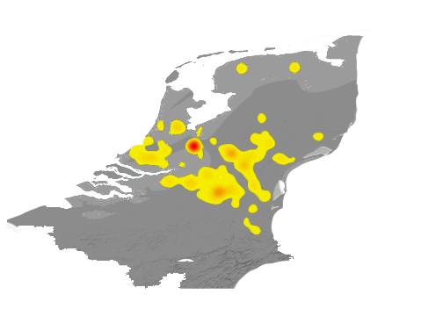
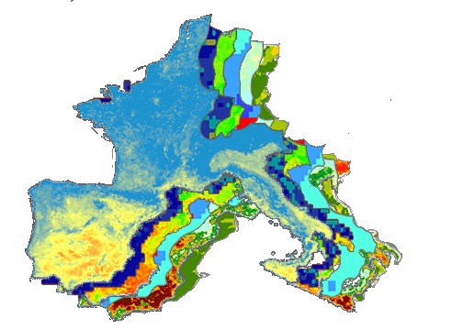
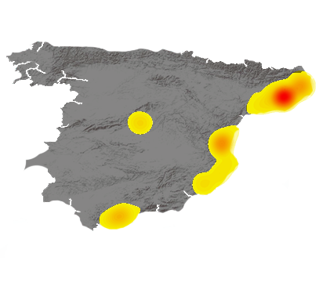
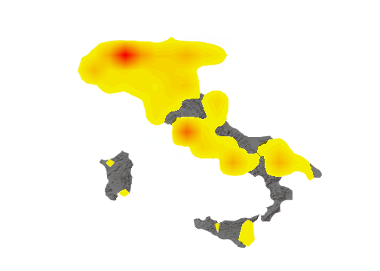
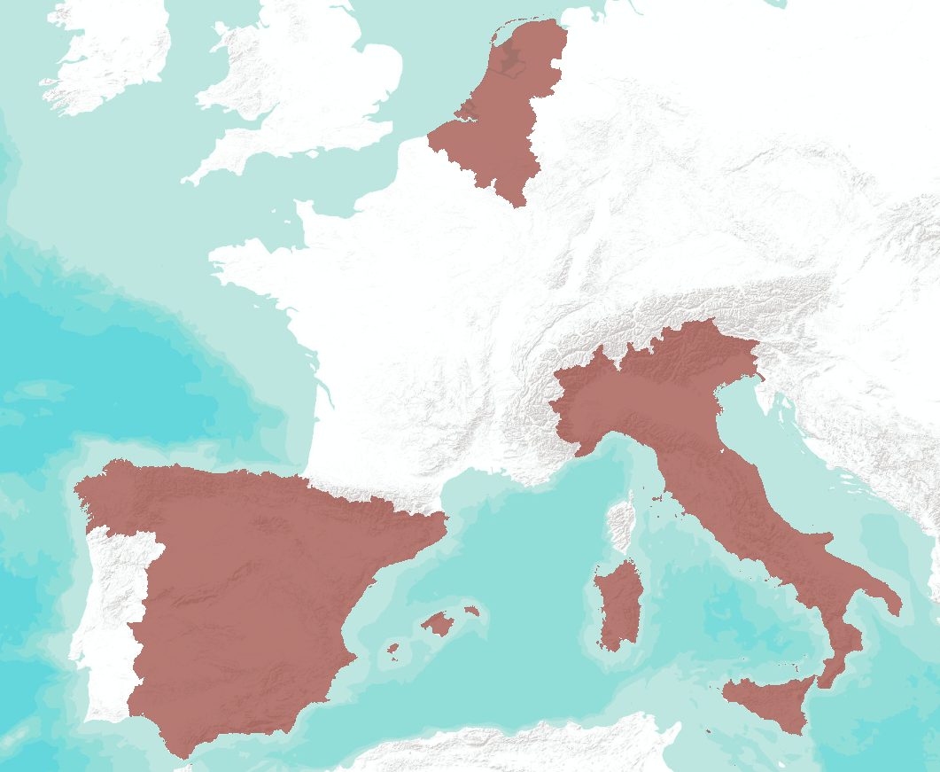
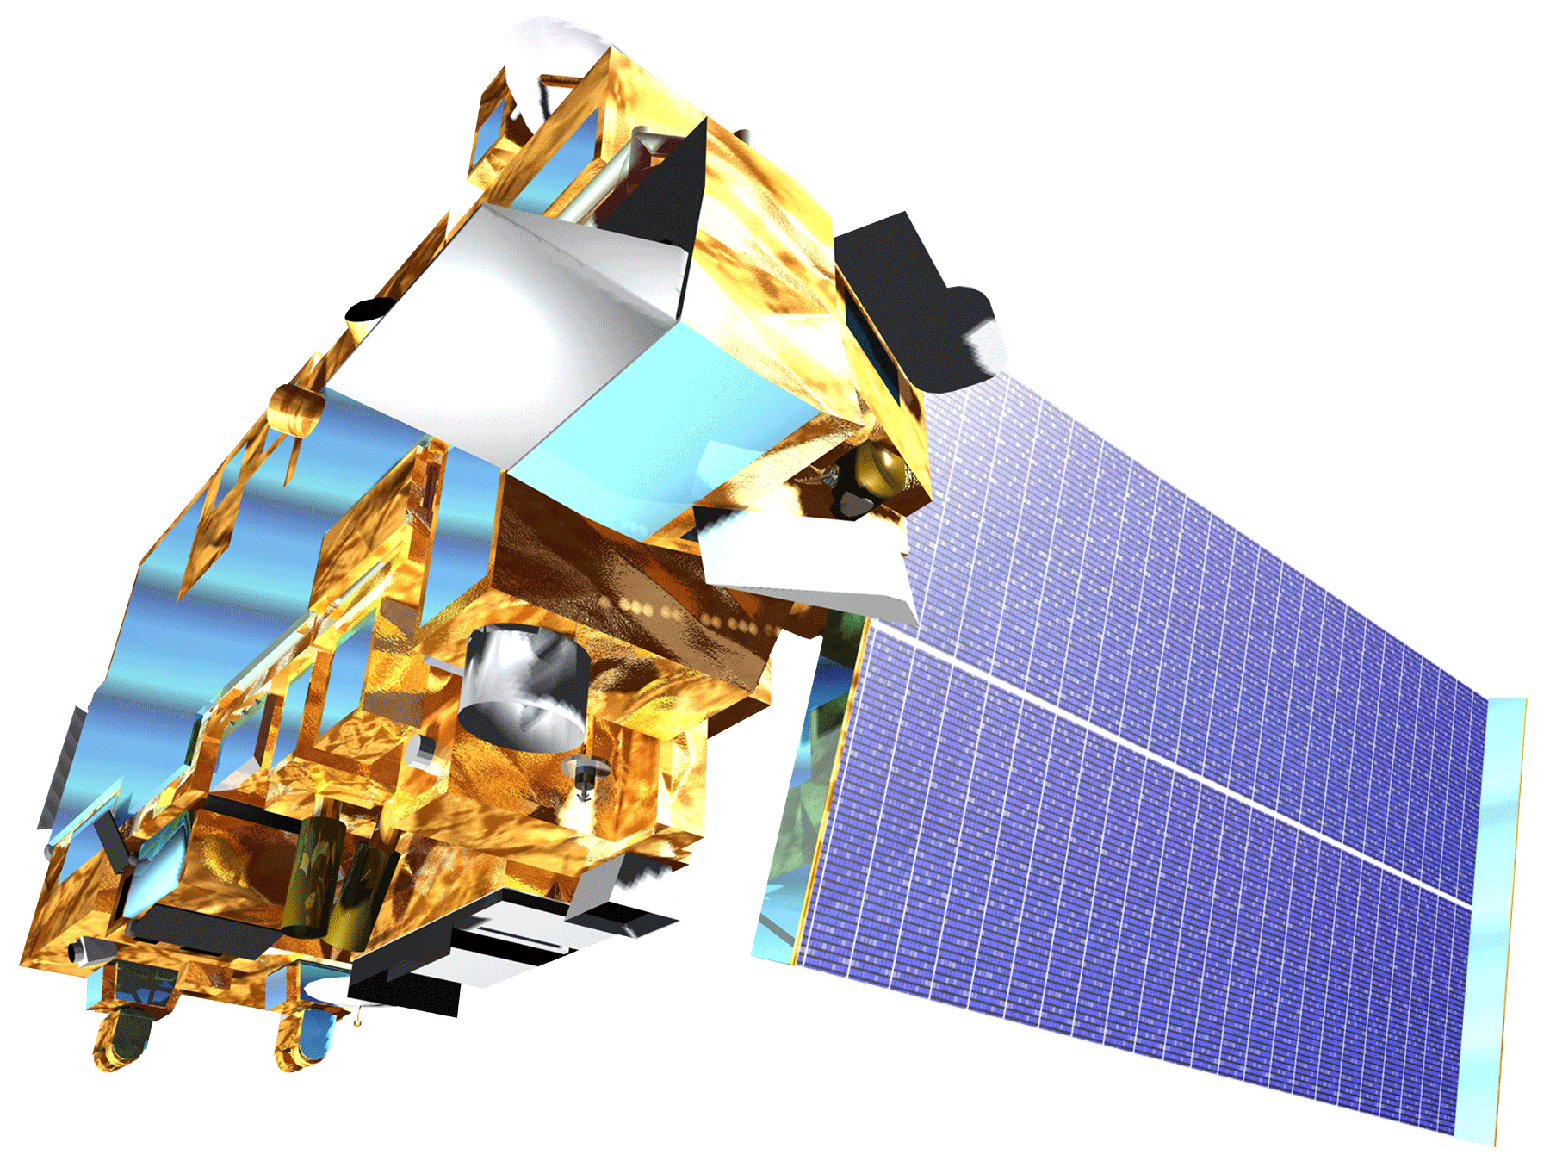
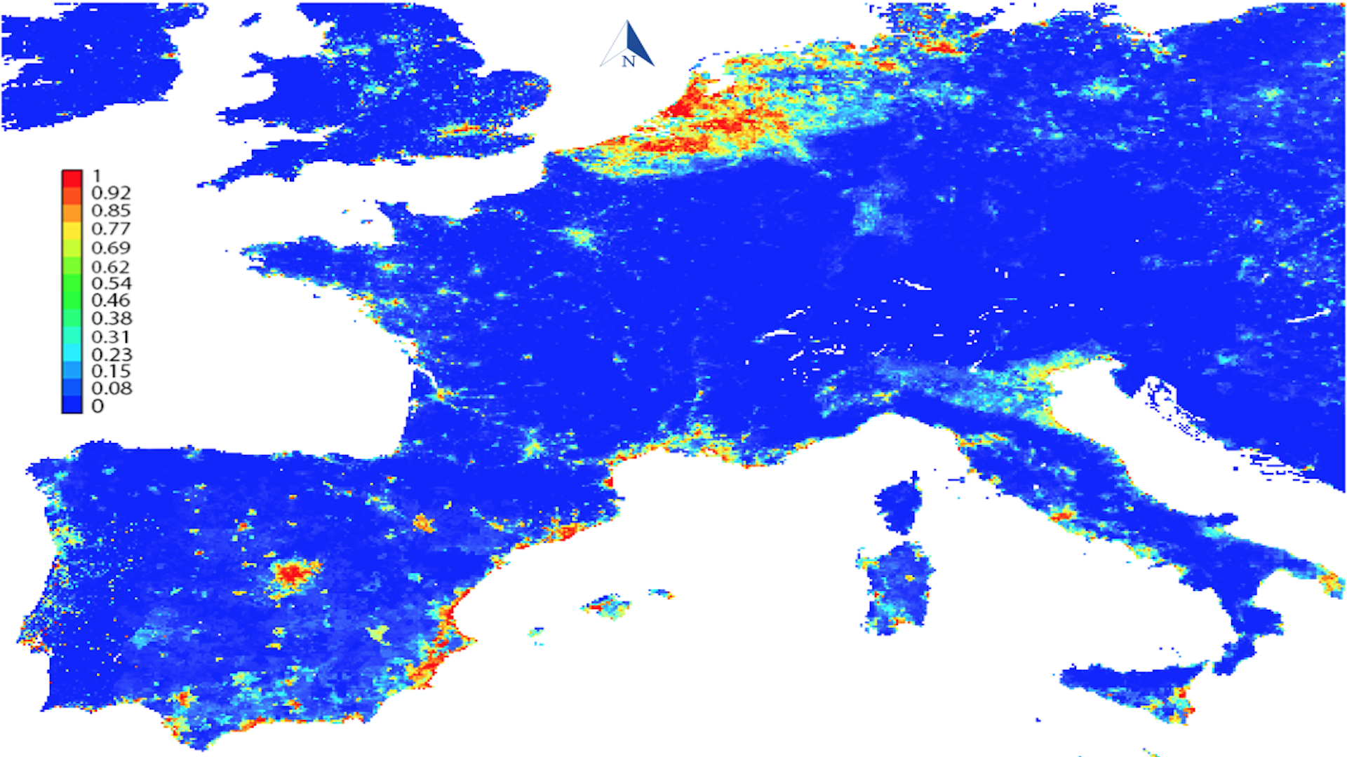
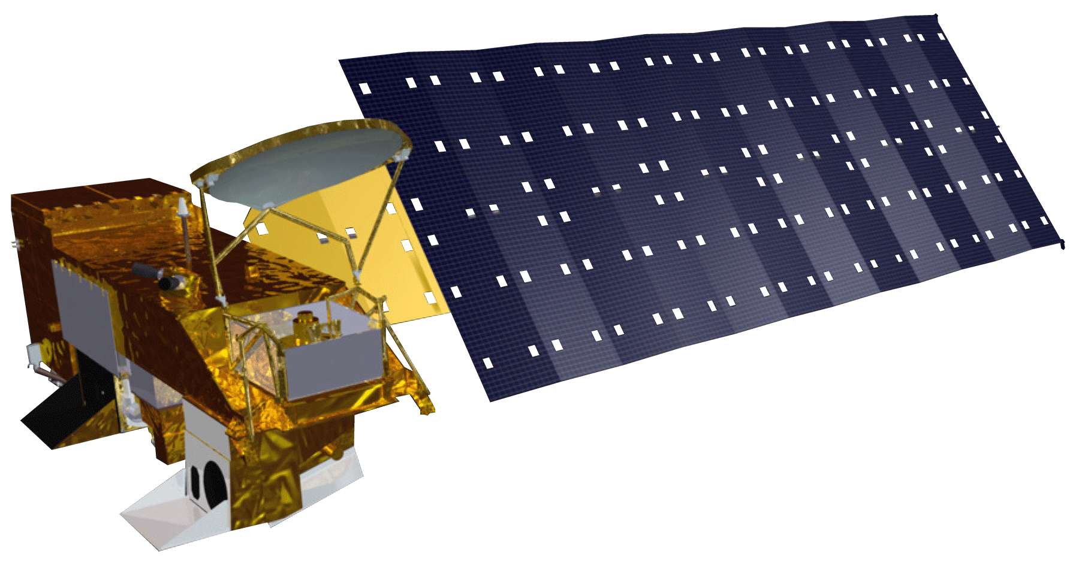
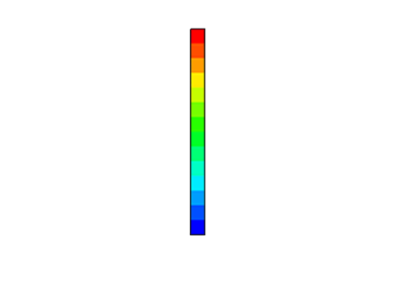
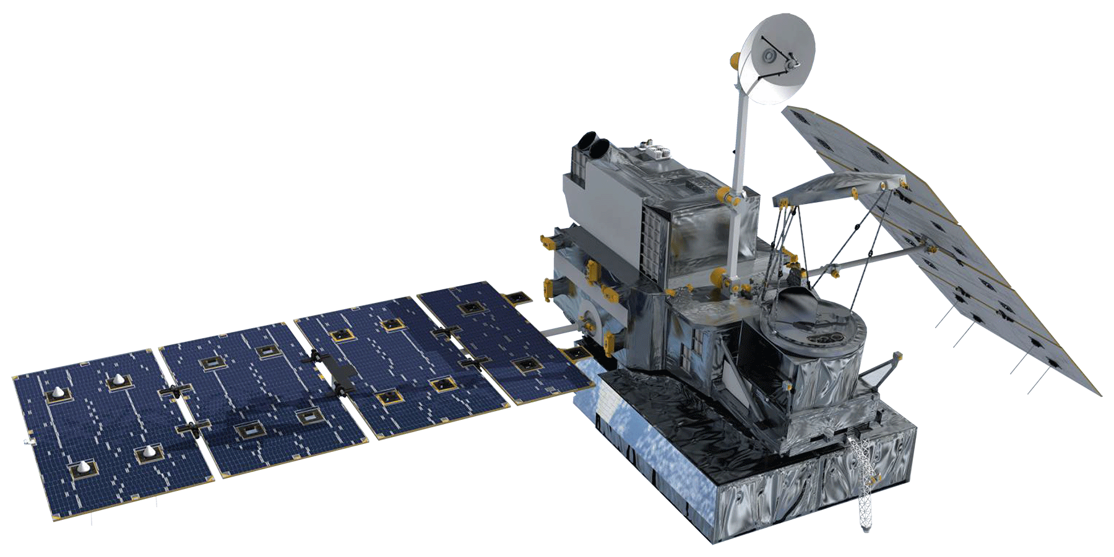
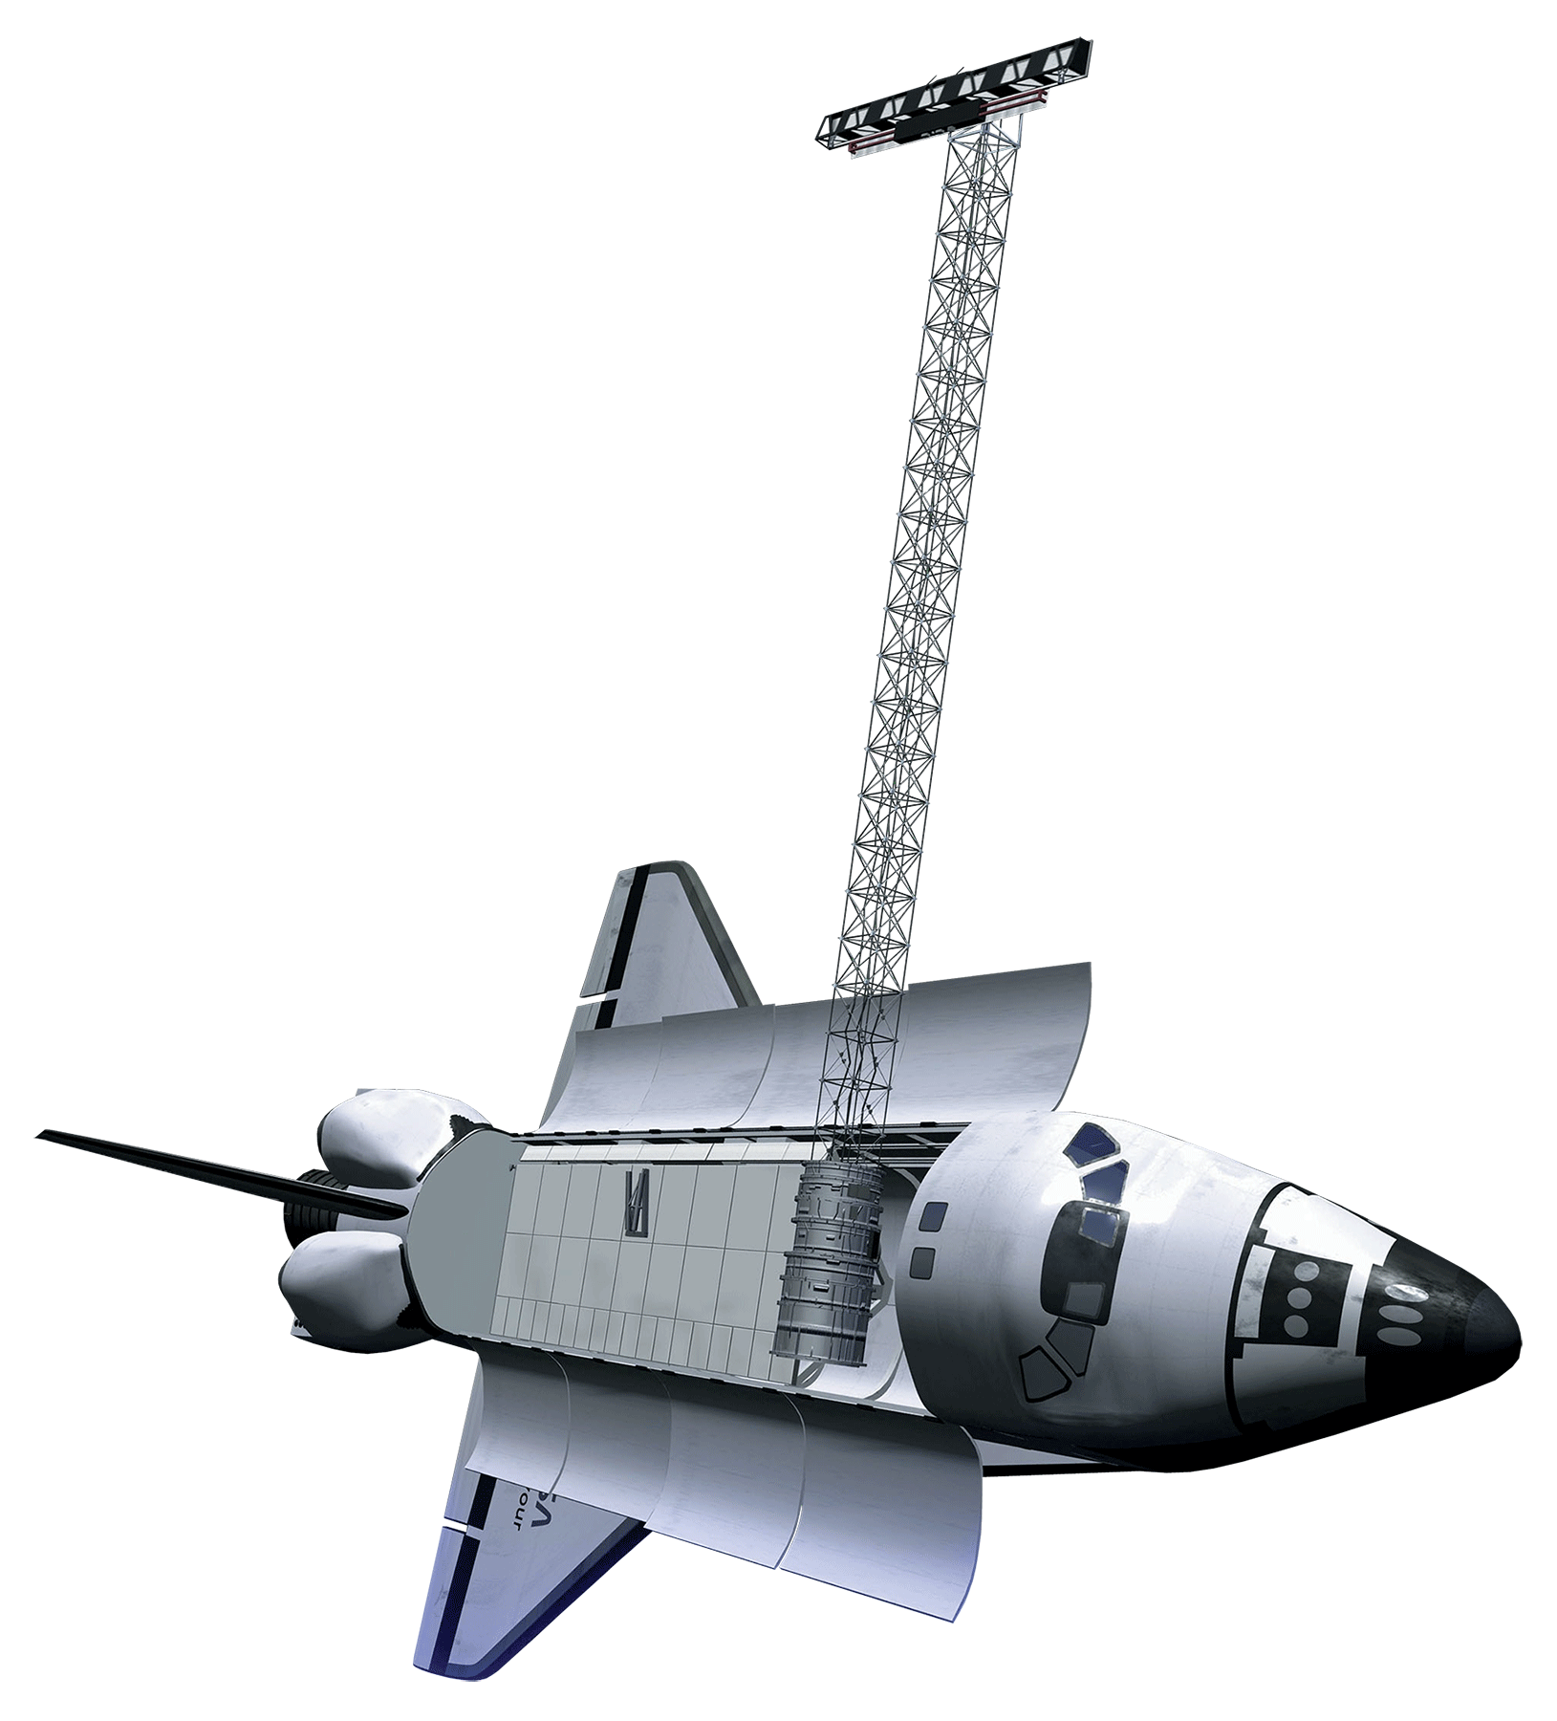
Monitoring Mosquito Abundance and Distribution to Assist Vector-Borne Disease Management in Western Europe
Abstract
Methodology
Vector-borne diseases, caused by pathogens and parasites, are transmitted through living organism carriers known as vectors. Mosquitoes, the most common disease vectors, transmit illnesses such as Zika, West Nile, chikungunya, malaria, dengue, and yellow fever, which affect millions of people across the world and kill more than one million people each year. While vector-borne disease outbreaks are difficult to predict, the Global Mosquito Alert Consortium strives to monitor and mitigate outbreaks through research and citizen science. This approach presents several challenges, including a lack of data standardization across different regions. The NASA DEVELOP team utilized NASA Earth observations and Global Mosquito Alert Consortium citizen science data from countries in Western Europe in order to create a methodology and habitat suitability map to improve prediction models for vector-borne diseases. The MaxEnt habitat modeling software was used to combine different environmental factors and citizen science data to determine which variables are correlated with the presence of mosquitoes. These products will be implemented in an interactive, open-source platform in the subsequent term for easier visualization and representation of habitat suitability.
Citizen Science Data
Environmental Factors
Hotspot Map
NASA Earth Observations
Objectives
Integrate NASA Earth observations with citizen science data in countries across Western Europe
Determine environmental variables that influence mosquito habitats and breeding grounds
Create a methodology to improve prediction models for vector-borne diseases
Visualize results through a habitat suitability map
Western Europe:
Belgium
Italy
The Netherlands
Spain
LST
Soil Moisture
NDVI
Humidity
Elevation
Precipitation
MaxEnt Habitat Suitability
Study Area
Earth Observations
Results
Western Europe Health & Air Quality
Terra
Aqua
Study Area
GPM
SRTM
Project Partners
Global Mosquito Alert Consortium
The Woodrow Wilson International Center for Scholars
Citizen Science Association
European Citizen Science Association
Institute for Global Environmental Strategies
Wageningen University
Sapienza Università Di Roma
200 mi
Conclusions
Mosquito activity occurrence is correlated with areas of high population density and low elevation.
Mosquito activity increases and is more widespread during the summer months.
The Global Mosquito Alert Consortium and participating organizations would benefit from standardizing citizen science data collection questionnaires in order to readily compare datasets across time and space.
Team Members
Acknowledgements
Gia Mancini
Project Lead
Douglas Gardiner
Victor Lenske
Sara Lubkin, PhD
Assaf Anyamba, PhD, Universities Space Research Association, NASA Goddard Space Flight Center
John Bolten, PhD, NASA Goddard Space Flight Center
John Palmer, PhD, Global Mosquito Alert Consortium
Anne Bowser, PhD, Woodrow Wilson International Center for Scholars
Greg Newman, PhD, Citizen Science Association
Martin Brocklehurst, European Citizen Science Association
Russanne Low, PhD, Institute for Global Environmental Strategies
Arnold van Vliet, PhD, and Sander Koenraadt, PhD, Wageningen University
Beniamino Caputo, PhD, and Alessandra Dellatorre, PhD, Sapienza Università Di Roma
Helen Plattner
Luisa Silva
Alison Thieme
Aaron Warga
Maryland – Goddard
Fall 2017

