Slide 1
Southern California Disasters II
Assessing the Effectiveness of Simulated HyspIRI Data for Use in USDA Forest Service Post-Fire Vegetation Assessment and Decision Support.
Heather Nicholson
Amber Todoroff
Madeline LeBoeuf

Slide 2
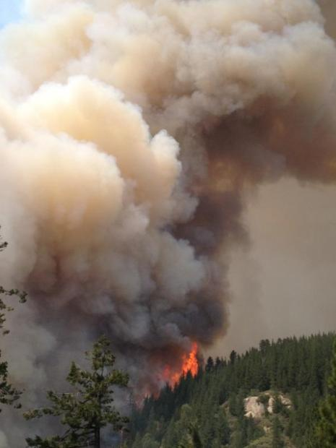
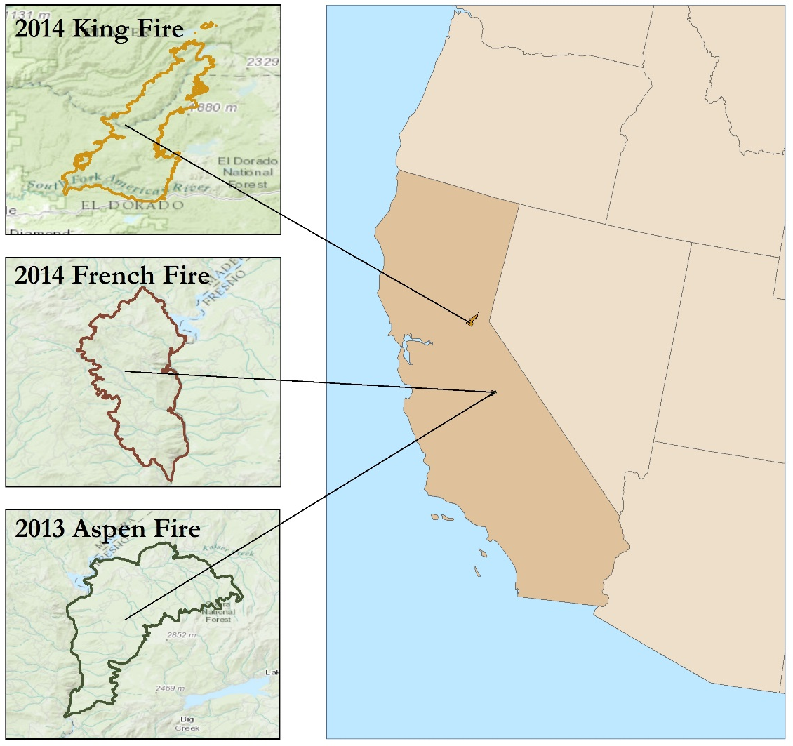
Community Concerns
Image Credit: Inciweb
Notes:
Image is of Aspen Fire http://inciweb.nwcg.gov/incident/photograph/3552/12/31930/

Slide 3
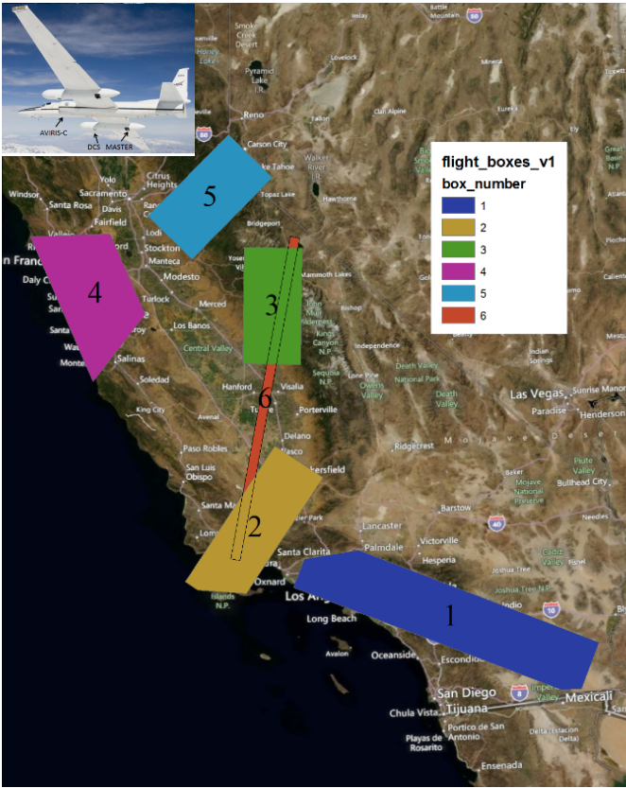
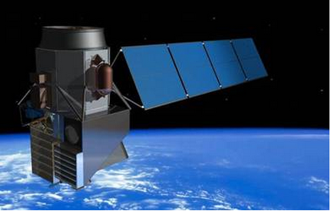
Simulated with AVIRIS and MASTER data
Image Credit: HyspIRI Mission Study, JPL
Image Credit: HyspIRI Mission Study, JPL
Notes:
Flight path ImageCredit: http://hyspiri.jpl.nasa.gov/downloads/2014_Workshop/day1/2_Pres_HyspIRI_WS14_Status_overview_20141013a.pdf
HyspIRI Image Credit: http://hyspiri.jpl.nasa.gov/

Slide 4
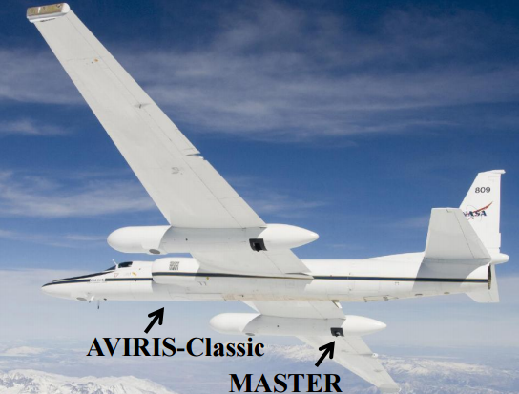
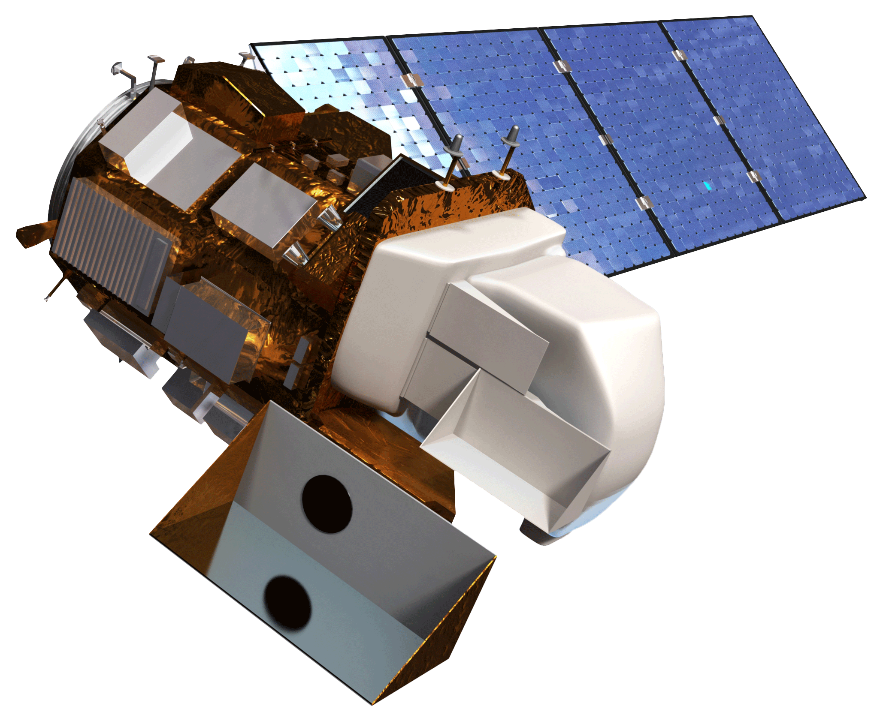
Methodology: Burn Severity Maps
$$NBR=\frac{NIR−LSWIR}{NIR+LSWIR}$$
$$\left.dNBR={1000(NBR}_{pre}− {NBR}_{post}\right)$$
$$RdNBR=\frac{dNBR}{\begin{aligned}&\sqrt{abs\left({NBR}_{pre}\right)} \\ & \end{aligned}}$$
Image Credit: HyspIRI Mission Study, JPL
$$NDSWIR=\frac{NIR−SWIR}{NIR+SWIR}$$
Notes:
ER -2 with AVIRIS and MASTER Image Credit: http://hyspiri.jpl.nasa.gov/downloads/2014_Workshop/day1/1_HyspIRI7thScienceWorkshop_HQUpdate_14Oct2014_Turner.pdf
Landsat 8 Image Credit: Provided by DEVELOP NPO

Slide 5
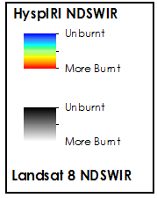
Rim Fire – HyspIRI Qualitative Analysis
Image Credit: SSC DEVELOP California Disasters 1 Summer 2014

Slide 6
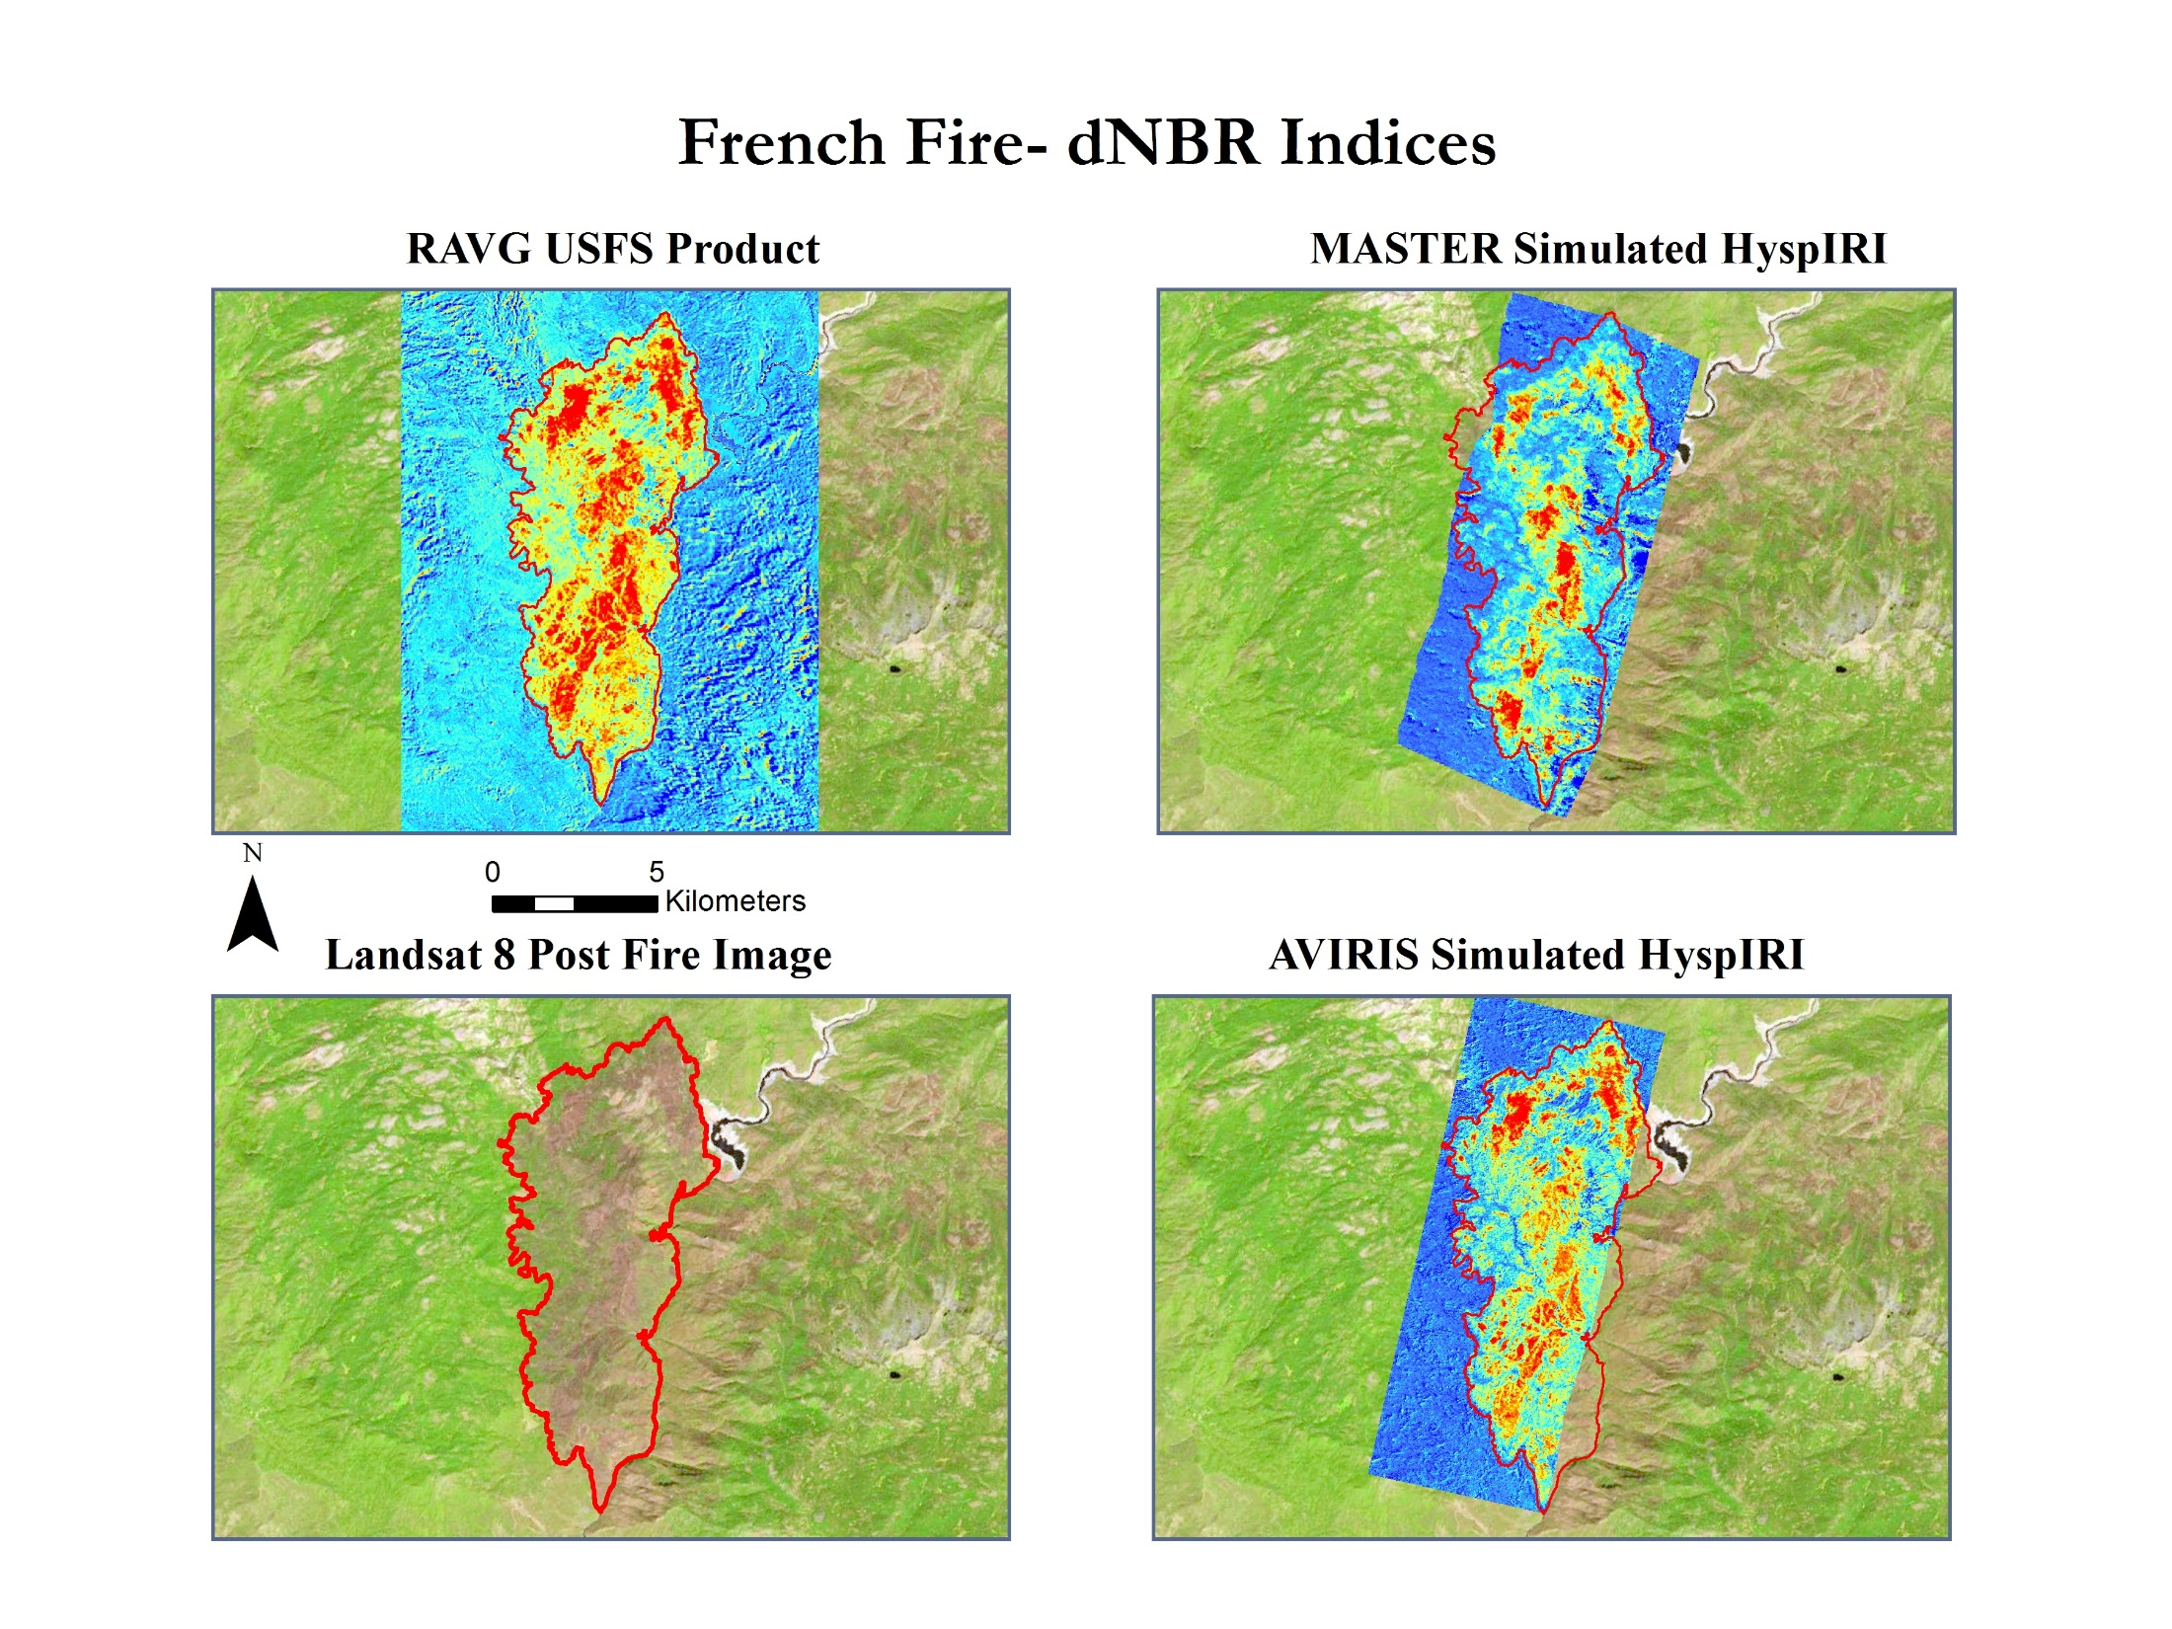
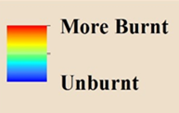
French Fire

Slide 7
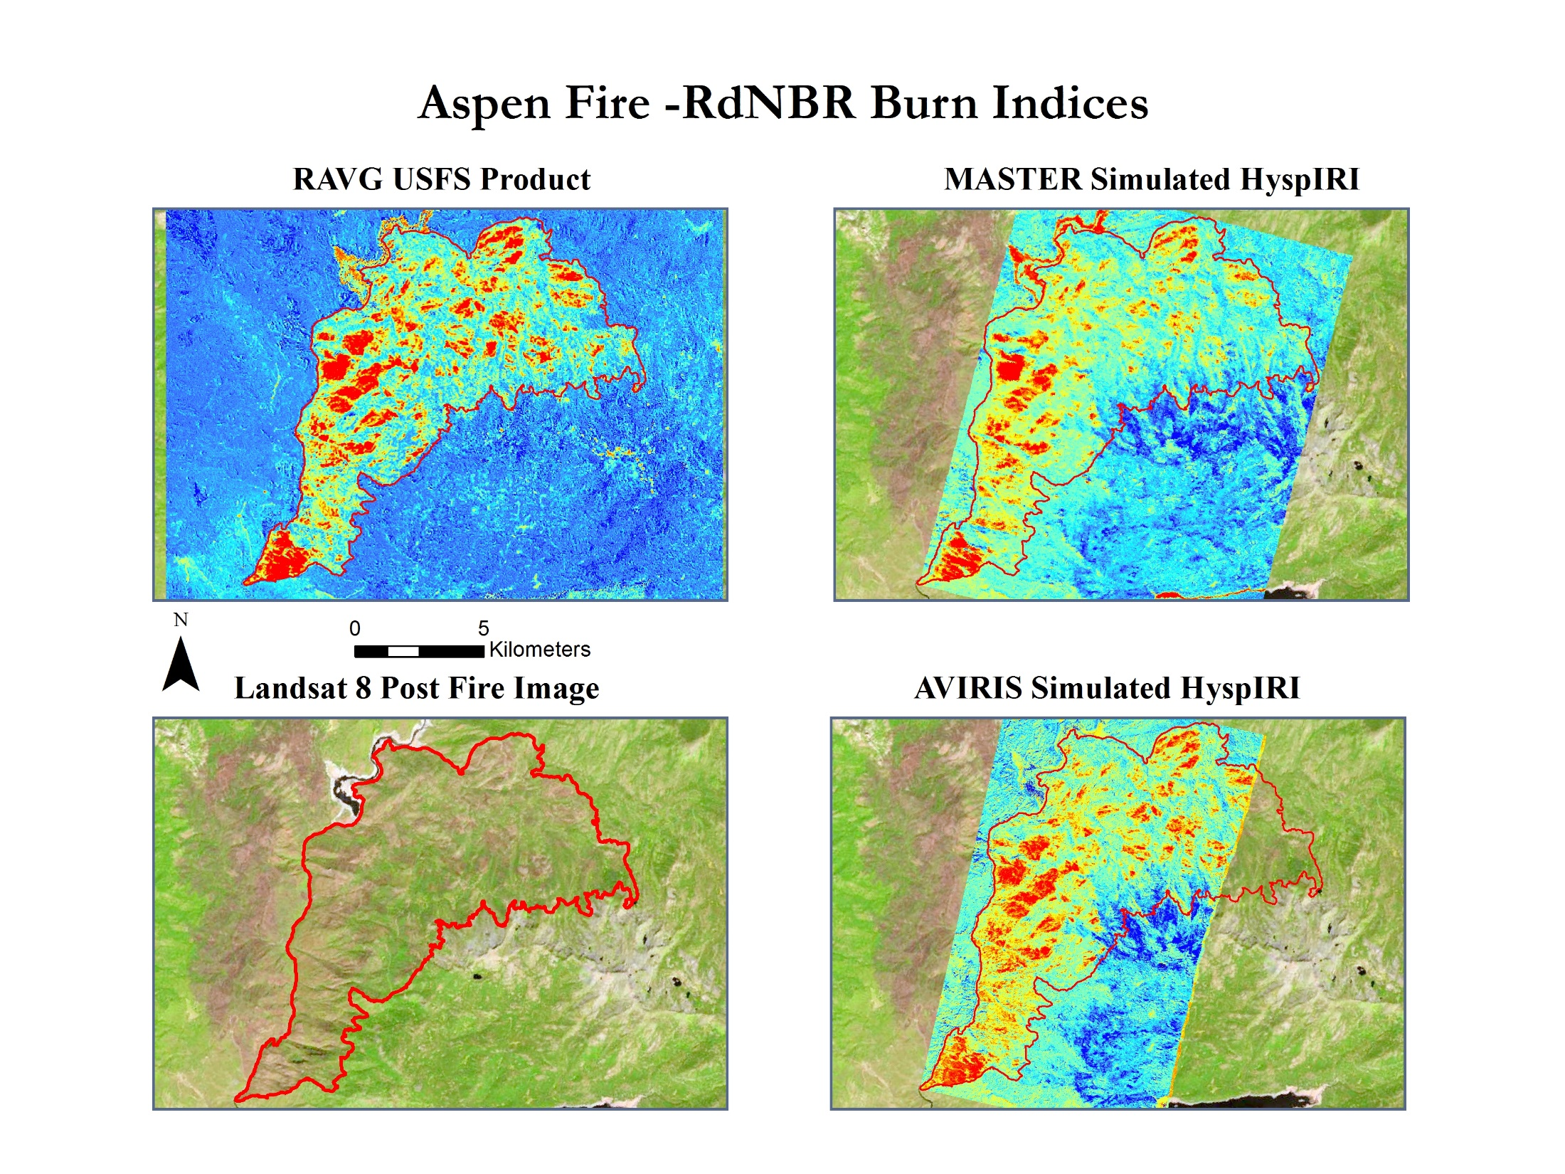
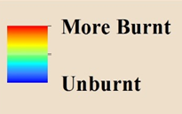
Aspen Fire

Slide 8
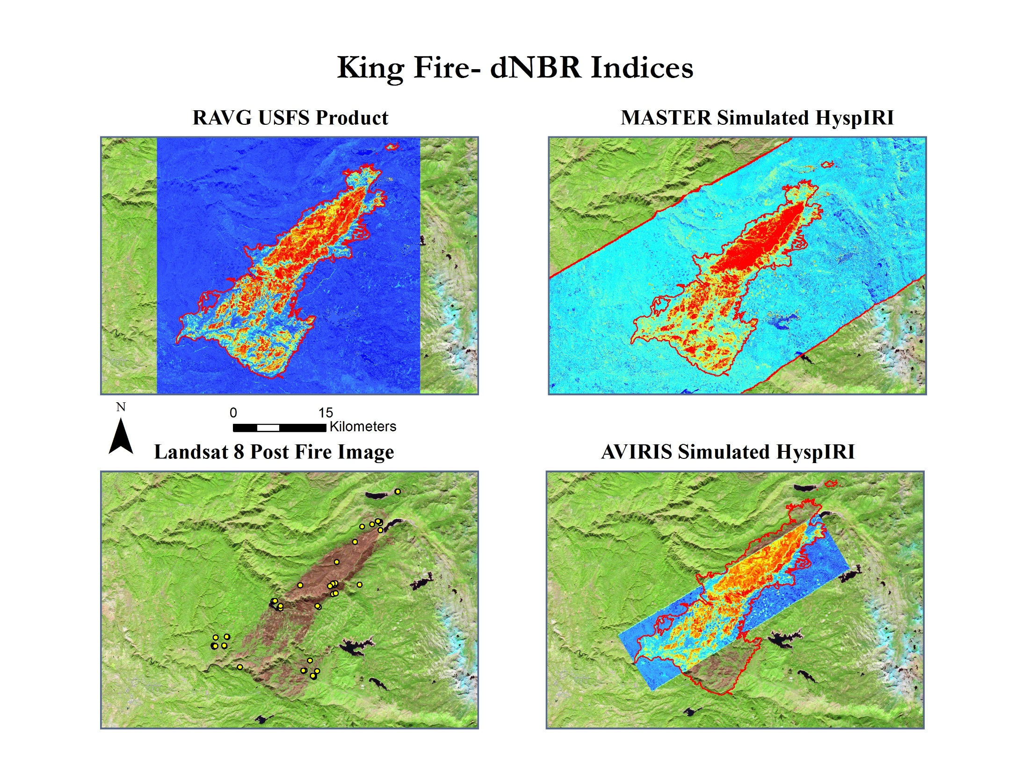
King Fire

Slide 9
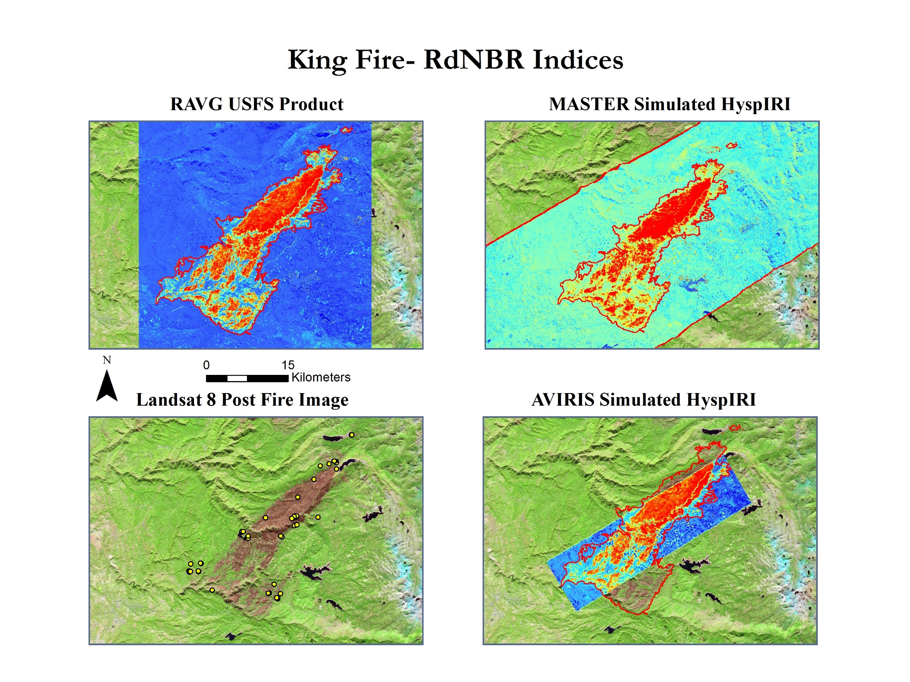
King Fire

Slide 10
Conclusions
Image Credit: Inciweb
Projects results indicate that HyspIRI offers a different representation of burn severity than current USFS products .
The HyspIRI and Landsat based burn severity products all showed high correlation with ground data on burn severity.
Project results provide evidence that future HyspIRI data will be valuable for forest service post-fire decision support.
Notes:
Photo is of the Aspen Fire
Image Source Website (http://inciweb.nwcg.gov/photos/CASNF/2013-07-24-1129-Aspen-Fire/picts/2013_07_28-10.10.19.904-CDT.jpeg)

