Slide 1
Glacier & Denali Space Weather
Enhancing Aurora Watch Planning at Glacier and Denali National Parks
Isabel Pullias
Elise Segal
Brent Bowler
Rachel Thompson
Virginia – Langley | Summer 2024
Notes:
Audience welcome and team introductions

Slide 2
Meet The Team
Isabel (Izzy) Pullias
Project Lead
Elise Segal
Rachel Thompson
Brent Bowler

Slide 3
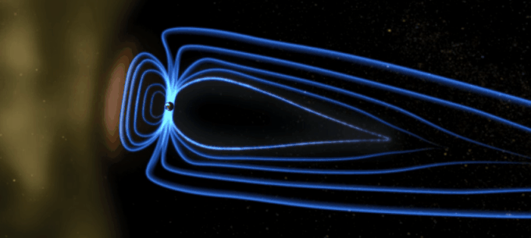
What is Aurora?
Image Credit: NASA GSVS
Notes:
The making of aurora happens from charged particles that flow from the sun. These highly charged particles interact with the magnetic field provided by Earth's core. It strips the magnetic field lines facing the sun and stretches the lines on the opposite side. The magnetic lines that were broken, reconnect and send the particles trapped in towards the Earth's poles. When the particles lose energy, they emit light, which we call aurora.
[Creation of Aurora Gif]
Image Credit: [NASA GSVS] [public domain]
Image Source: [https://www.theweathernetwork.com/en/news/science/space/surprise-solar-storm-sparks-auroras-could-continue-through-the-week ]

Slide 4
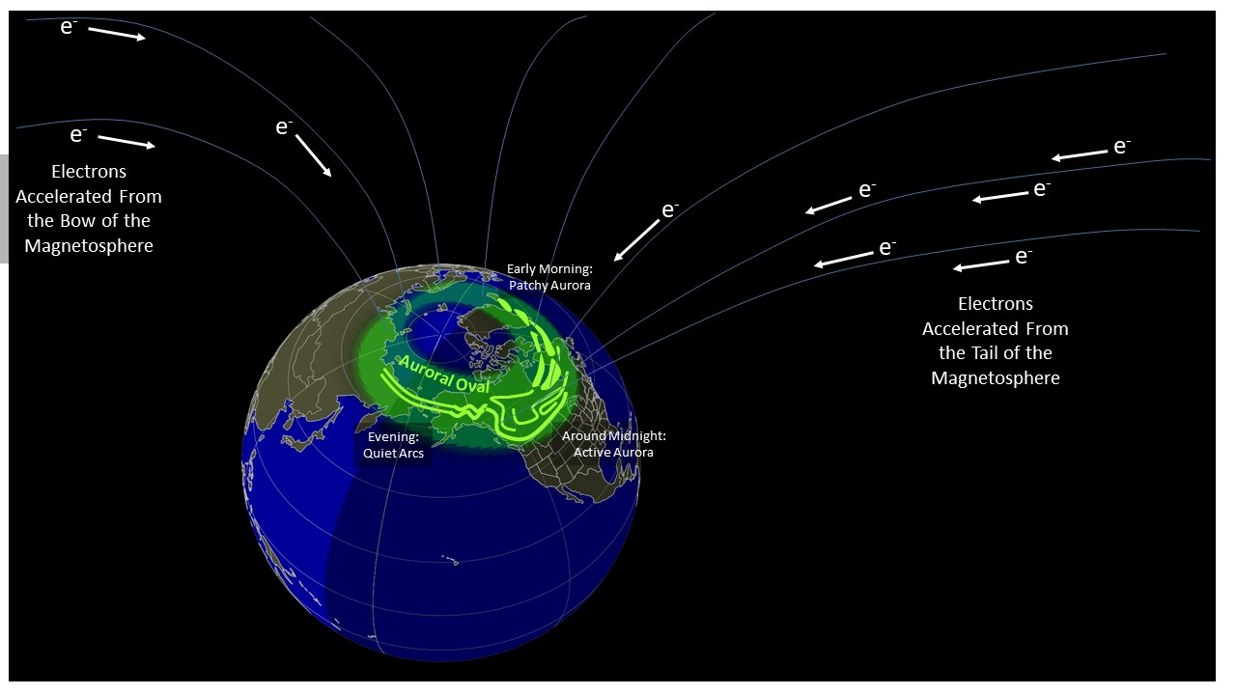
What is Aurora?
Image Credit: NOAA
Notes:
This image emphasizes the path of electrons in order to create the aurora oval. The electrons that originated from the sun interact with Earth's magnetic field and are accelerated from the tail of the magnetosphere towards Earths poles. Aurora viewing will depend on time of day.
[Aurora oval]
Image Credit:[NOAA][Public Domain]
Image Source:[https://www.swpc.noaa.gov/content/aurora-tutorial ]

Slide 5
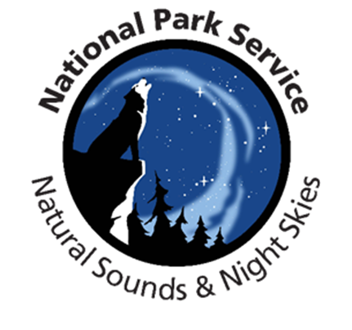
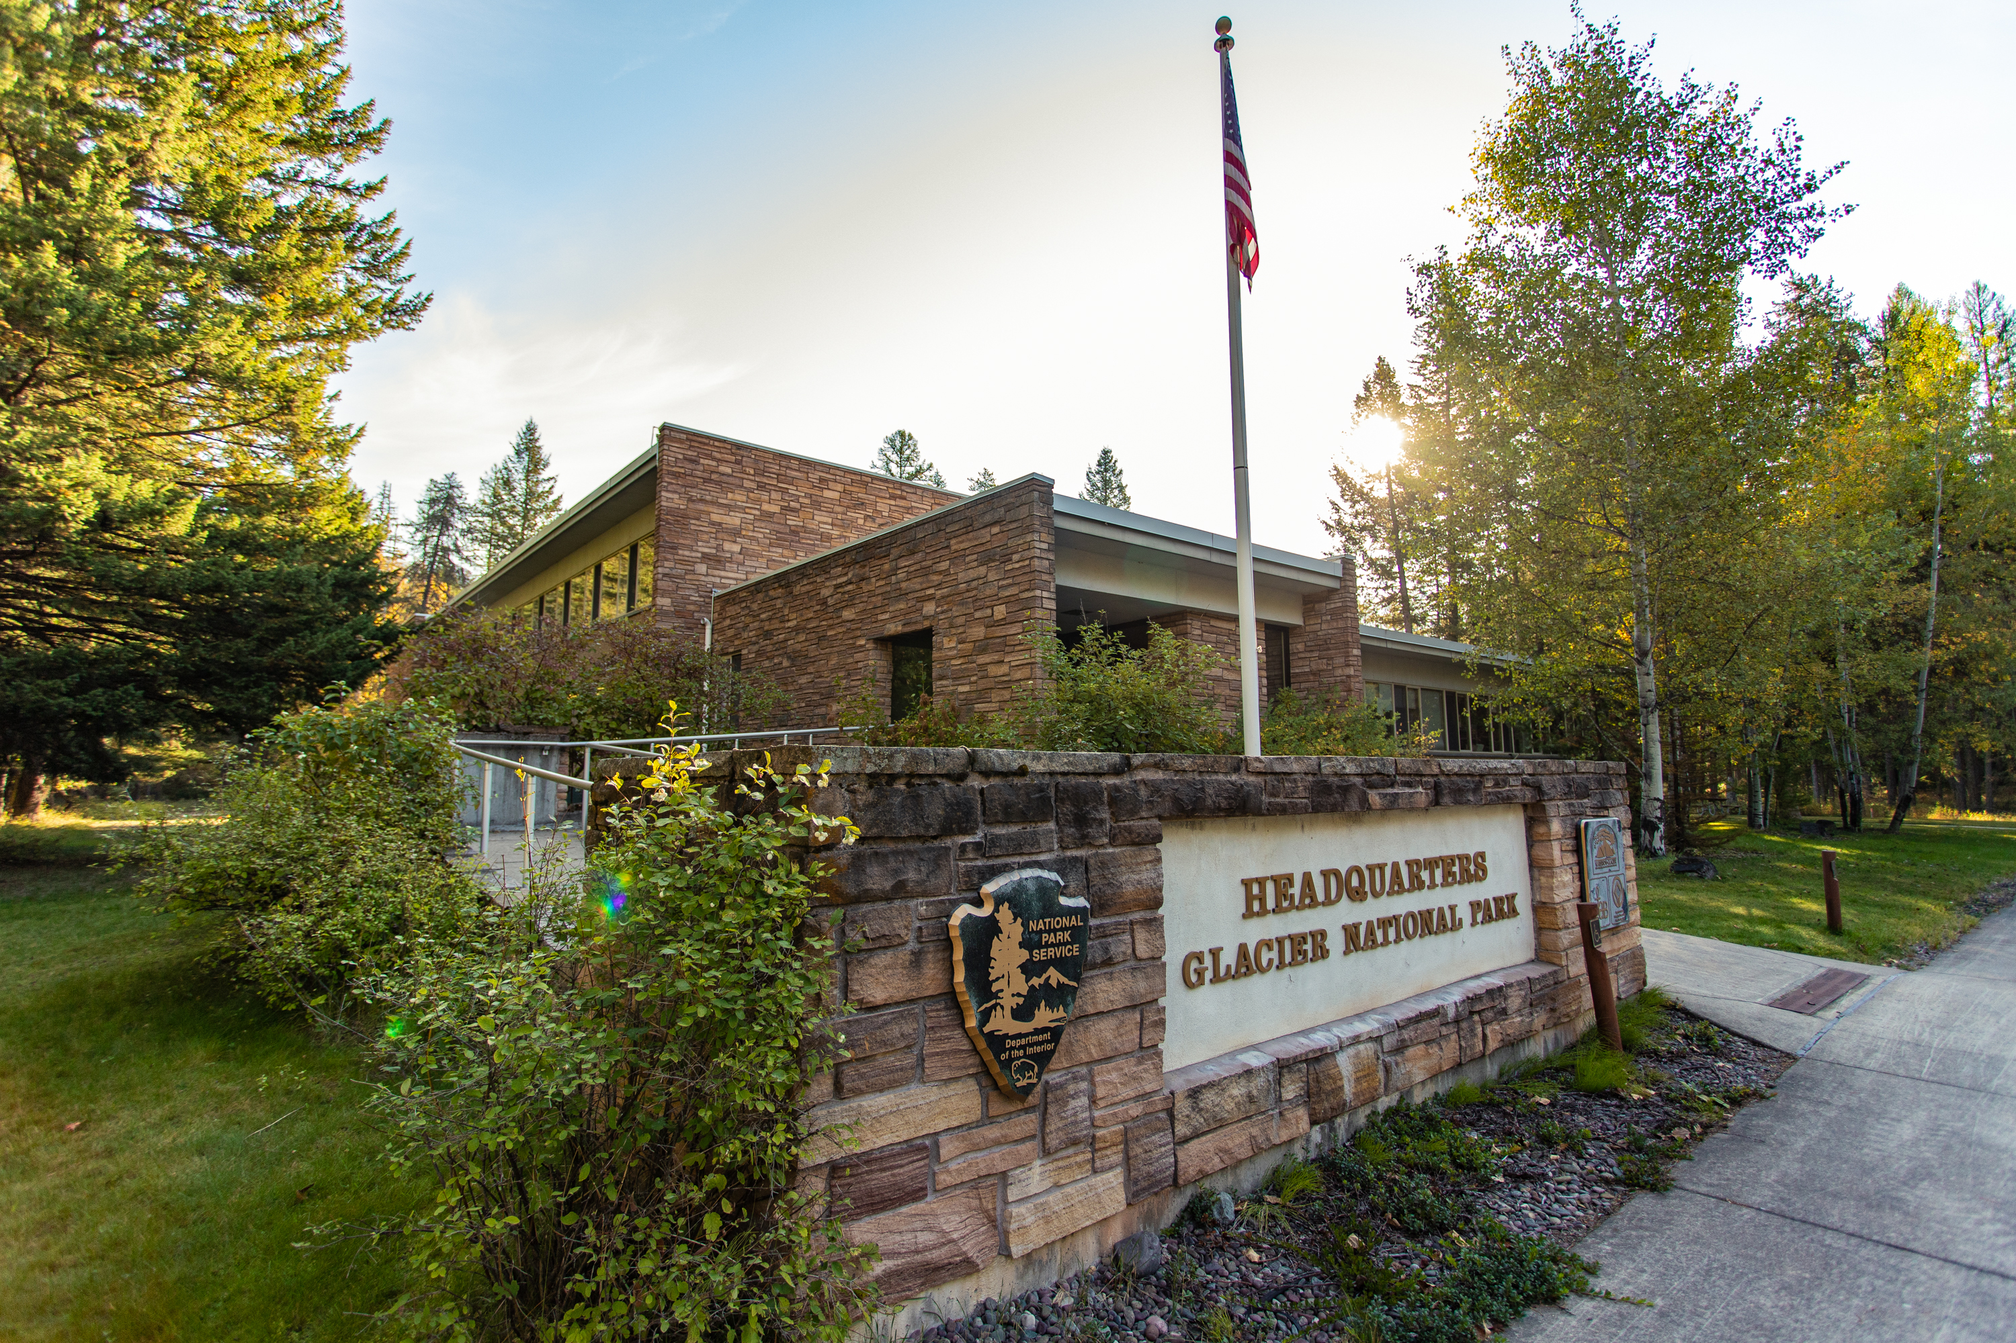
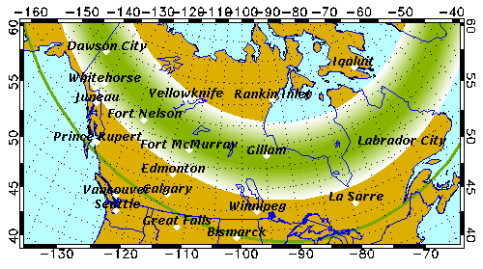
Project Partner
National Park Service, Glacier National Park
National Park Service, Natural Sounds and Night Skies Division
Partner uses the OVATION Prime model to determine if aurora will be visible at parks
Image Credit: National Park Service
Image Credit: University of Alaska Fairbanks Geophysical Institute
Notes:
*Our partners include Glacier National Park and the Natural Sounds and Night Skies Division. Both partners are a part of the National Park Service with Glacier’s main goal is to provide the best experience for its visitors which is why they showcase and emphasize over 700 miles of trails and natural beauties such as glaciers, alpine meadows, carved valleys and lakes. With about one million acres of land, Glacier is also one of North America's premier spots to view the Aurora Borealis AKA the Northern Lights. The Natural Sounds and Night Skies Division's goals include monitoring locations dedicated to being dark sky areas, they also monitor light pollution and make efforts to keep it to a minimum so that visitors can have the most visibility during aurora events.
----------Image Information Below----------
[Glacier National Park Headquarters Building]
Image Credit: [NPS] [public domain]
Image Source: [https://www.nps/media/photo/gallery-item.htm?pg=7658536&id=206bcc38-395c-4989-b715-407e67470045&gid=A77B42ED-9734-4196-A852-DFEC28671B19]
[University of Alaska Fairbanks North America Prediction Model]
Image Credit: [Oleksandr Panasovskyi from the Noun Project] [Attribution 4.0 International license]
Image Source: [https://www.gi.alaska.edu/monito[rs/aurora-forecast]

Slide 6
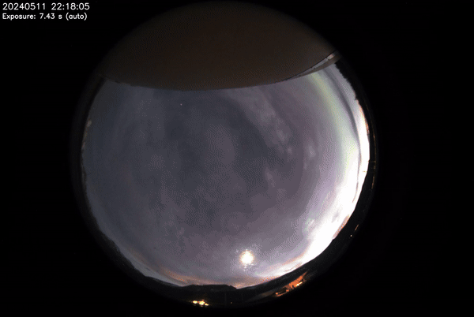
Community Concerns
Park visitors and the public have limited information concerning optimal viewing times
NPS wants to better delegate tasks to employees to manage park operations during aurora events
Image Credit: National Park Service
SkyCam footage at Glacier National Park provided by NPS Glacier Staff
Notes:
Park visitors come to Glacier and Denali National Parks at specific times throughout the year to view the aurora borealis. The most used method of projecting when a major aurora event will occur is by way of social media which is not often accurate. Being public friendly oriented, the NPS has stated that their main concern is not being able to provide helpful and educational resources to park visitors and the public about the characteristics of probable aurora event occurrences. They wish to learn about more accurate methods of examining Kp Indices to determine when an aurora event will occur and the best time to visit the park. They also are interested in whether this improved method of aurora predictability is a feasible option; however, data acquisition and processing has shown that AE index values are significantly more accurate than Kp index values. The NPS uses Kp index data and are only able to use these indices to compile an aurora forecast 27 days ahead and in 3-hour intervals, and as the oncoming solar maximum 2025-year approaches, it is important to have accurate information.
Park visitors have a limited amount of knowledge concerning optimal aurora event viewing times
The NPS uses current models based on Kp values alone, which are inaccurate when compared to AE values​
Helpful resources that educate the public about optimal aurora characteristics
Current models used by only provide 27-day 3-hour intervals
----------Image Information Below----------
[AllSky Camera Footage]
Image Credit: [Created by the team from footage sent by partner] [Used with permission]
Image Source: [National Park Service]

Slide 7
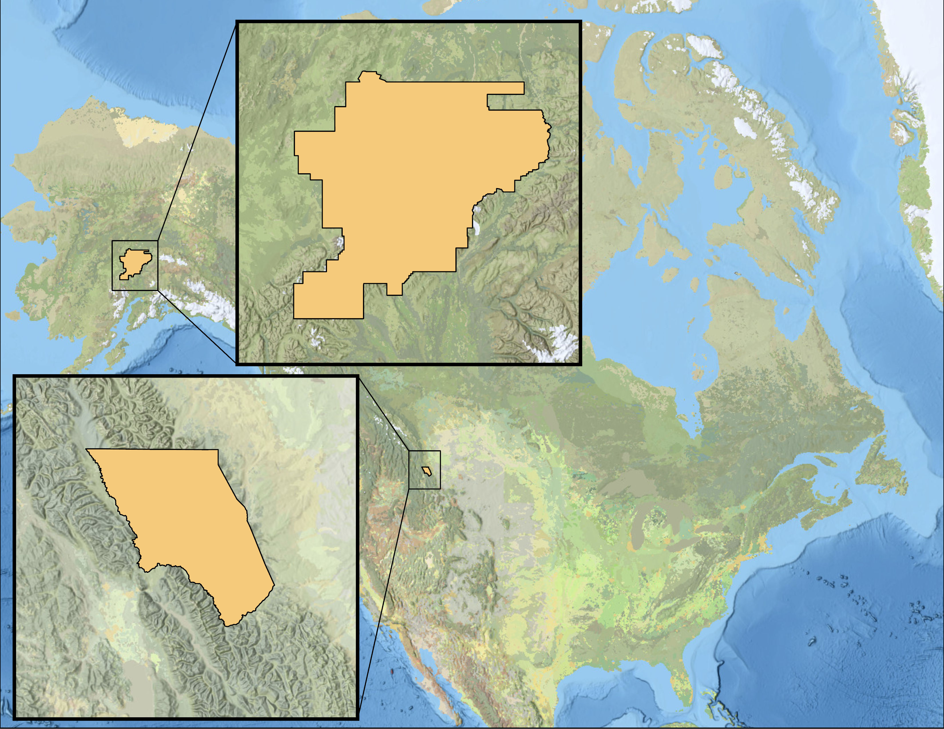
Study Area & Period
N
December 2019 – May 2024
Denali National Park and Preserve
0
375
750
1,500 Miles
ALASKA
Solar Cycle 25
Upcoming Solar maximum in 2025
Understand the aurora predictability at designated National Parks
100
Hudson
Bay
Miles
CANADA
National Park Boundaries
Glacier National Park
UNITED STATES
North American Basin
50
Miles
MEXICO
Basemap Credits: Esri, TomTom, FAO, NOAA, USGS
Notes:
*Our study area includes Denali and Glacier National Parks. Located in southern Alaska and Northern Montana, respectively. Our timeline for our observations is set between the start of the Solar Cyle in December 2019 to almost present day in May 2024. Our goal is to understand the predictability and visibility of the aurora at these National parks because of the highly anticipated solar maximum we are looking forward to in 2025.
Image Information
Credit: ArcGIS Pro Base map Sources: Esri, TomTom, FAO, NOAA, USGS

Slide 8
Project Objectives
1
Validate current aurora prediction methods
2
Explore new ways of forecasting aurora occurrences
3
Create educational tools and provide guidance to the NPS to better inform their visitors
Image Credit: frostnip907
Notes:
In order to meet the needs of the National Park Service and address the community concerns, the scope of the project really comes down to these three objectives. We started out by VALIDATING the partners current methods for predicting aurora and evaluating their accuracy. After establishing a baseline understanding of how accurate the partner's current practices are, we EXPLORED new methods of predicting aurora using Earth Observation data and a polar magnetic disturbance index. Finally, to align with the partner's goals of delivering something informative and digestible to their park visitors, we CREATED tools that simplify aurora down for the general public to optimize their understanding and viewing experience.
(Aurora image, cropped within PowerPoint)
Credit: frostnip907
Source: https://www.flickr.com/photos/frostnip/29407921676 CC BY-NC-SA 2.0

Slide 9
Methodology
Validate
Explore
Create
The current methods:
How accurate?
Conclude and Implement!
Alternatives?
End Products
Alaska Forecast
VIIRS Day Night Band
AE Index
Did we do better?
Charts
Kp Index
OVATION Prime 2.3
Viewing aurora from space ​
Using local polar disturbances​
Visualize the different models
How did we do?
Website Content
Statistical Analysis
Compare to current practices
User Friendly
Evaluate the
accuracy of current aurora indices
Put it to use!
Notes:
In coordination with the project objectives, our methodology reaches for the same goal of delivering a thorough scientific and statistical analysis of the current practices, while also focusing on delivering something that NPS and park visitors can implement into their aurora viewing experiences. Under VALIDATE, we want to evaluate the current practice of the parks, which is using a global magnetic disturbance index known as the Kp index, and a statistical model of the aurora oval known as OVATION Prime, both provided through the University of Alaska at Fairbanks website. We can evaluate these practices using simple statistical analysis, and compare the results to potential alternative methods for forecasting aurora. Exploring The VIIRS Day Night Band viewing of the aurora oval explores the feasibility of using remote sensing/earth observation data to observe aurora, which can be compared to the current statistical mapping of the aurora oval through OVATION. By exploring the Auroral Electrojet Index, or AE index, we can compare using local polar magnetic disturbances to the current practice of using a global magnetic disturbance, or Kp index.
After completing these analyses, we can return to the end user by CREATING digestible charts and website content that allows for aurora information to be implemented into NPS practices for understanding aurora and informing visitors.

Slide 10
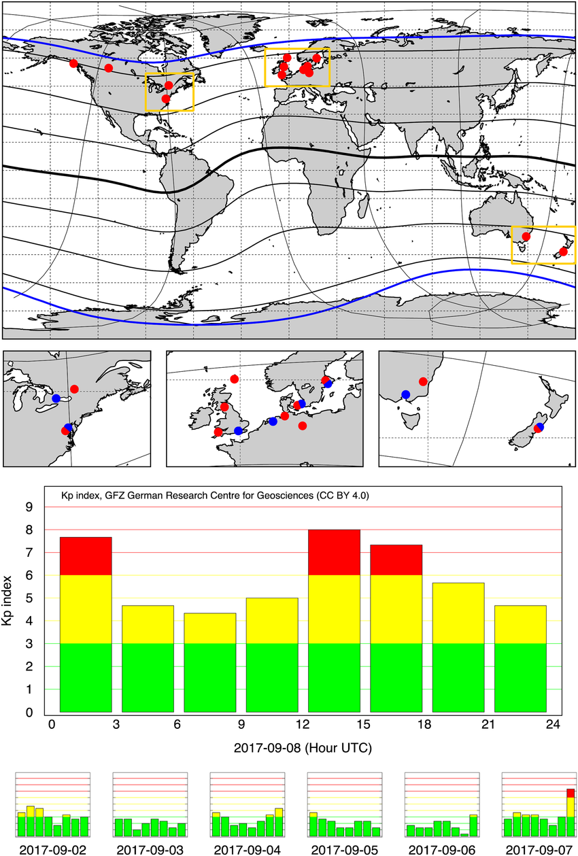
Predicting Aurora: Indices
Kp 13 Global Magnetometers
Kp Index
3-Hour Forecast
3-Day Forecast
27-Day Forecast
Global
Active Kp Magnetometers
Image Credit: Matzka et al., 2021
Inactive Kp Magnetometers
Notes:
Kp Index
Planetarische Kennziffer (Planetary K-Index)
Prediction of the level of storm based on eight ground-based magnetometers around the world.
13 global magnetometer measurements
Scale of 0-9
3 Hour, 3-day, 27-day forecast
Kp index stands for Planetary k-index in English. This value comes from measuring the disturbance that space weather has on Earth's magnetic field. This value comes from 13 global magnetometer measurements. Kp values range from 0-9, where the higher the number indicates the further south the aurora oval will be. Due to this value being global and averaged, it has long forecasted values at 3-hour, 3-day, & 27-day forecasts. The predicted values for Kp are found through various parts of NOAA. The observed values are found publicly at GFZ German Research Centre for Geosciences at Helmholtz Centre Potsdam database. The lines on the map represent magnetic coordinate lines.
----------Image Information Below----------
[Kp magnetometers]
Image Credit: [J. Matzka, C. Stolle, Y. Yamazaki, O. Bronkalla, A. Morschhauser] [License CC BY 4.0]
Image Source: [https://www.researchgate.net/figure/Upper-panels-World-map-of-the-13-current-Kp-stations-red-dots-see-also-Table2-with_fig2_350044969 ]
Image Source:[Matzka, J., Stolle, C., Yamazaki, Y., Bronkalla, O., & Morschhauser, A. (2021). The geomagnetic Kp index and derived indices of geomagnetic activity. Space Weather, 19(5). https://doi.org/10.1029/2020sw002641 ]

Slide 11
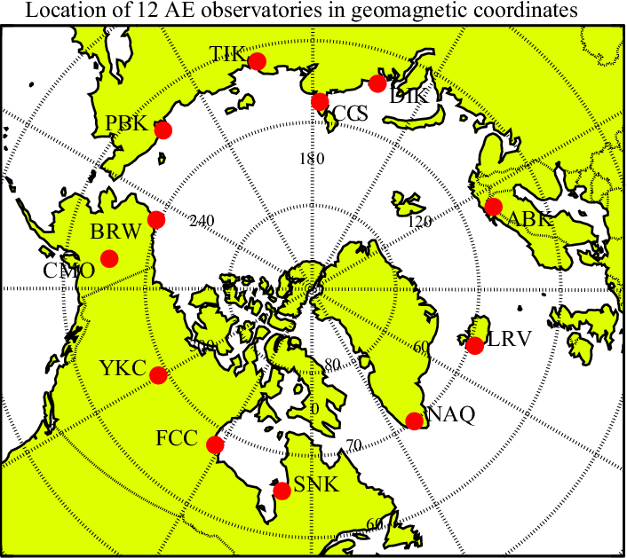
Predicting Aurora: Indices
AE 12 Polar Observatories
AE Index
1-Hour Forecast
POLAR
Active AE observatories
Image Credit: Tomita et al., 2011
Notes:
AE Index
Auroral Electrojet
Prediction of measure of auroral zone activity
Uses Real-time data
1 Hour Forecast
Described as "Polar" value
AE index stands for Auroral Electrojet. This value comes from measuring the disturbance that space weather has on Earth's magnetic field. AE uses real time data from Earth's magnetic field, causing this to have a small prediction time of one hour of forecasted time. By using data from geomagnetic disturbances from around the world along the auroral zone, these values are for the polar region only, indicating a stronger prediction value because the aurora is formed in the polar region. We find these predicted values in the LASP database. Which has archived data all the way back from 1945. The values although provided by Dr. Xinlin Li through LASP are originated by the Kyoto database.
----------Image Information Below----------
[AE observatories]
Image Credit: [S. Tomita, M. Nose, T. Iyemori, H. Toh, M. Takeda] [CC BY 3.0]
Image Source: [https://www.researchgate.net/figure/Location-of-the-current-AE-observatories-in-geomagnetic-coordinates-Latitude-circles-are_fig1_252231336 ]
Image Source: [Tomita, S., Nosé, M., Iyemori, T., Toh, H., Takeda, M., Matzka, J., Bjornsson, G., Saemundsson, T., Janzhura, A., Troshichev, O., & Schwarz, G. (2011). Magnetic local time dependence of geomagnetic disturbances contributing to the au and al indices. Annales Geophysicae, 29(4), 673–678. https://doi.org/10.5194/angeo-29-673-2011 ]

Slide 12
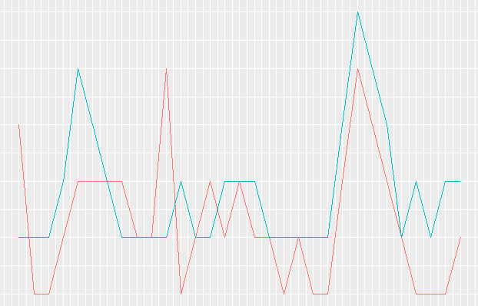
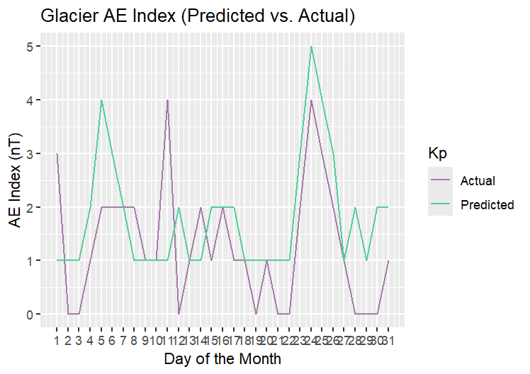
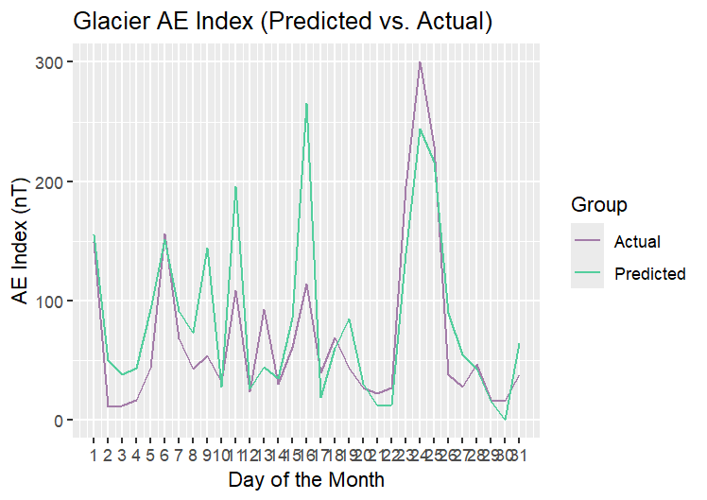
Predicted vs Actual Indices
Kp Index (6-hr Predicted vs. Actual)
AE Index (1-hr Predicted vs. Actual)
January 2019
300
200
100
0
January 2019
5
4
3
2
1
0
 | Actual
 | Predicted
 |  | Actual
 |  | Predicted
Kp Index
AE Index (nT)
1 | 2 | 3 | 4 | 5 | 6 | 7 | 8 | 9 | 10 | 11 | 12 | 13 | 14 | 15 | 16 | 17 | 18 | 19 | 20 | 21 | 22 | 23 | 24 | 25 | 26 | 27 | 28 | 29 | 30 | 31
1 | 2 | 3 | 4 | 5 | 6 | 7 | 8 | 9 | 10 | 11 | 12 | 13 | 14 | 15 | 16 | 17 | 18 | 19 | 20 | 21 | 22 | 23 | 24 | 25 | 26 | 27 | 28 | 29 | 30 | 31
Day of the Month
Day of the Month
Notes:
These graphs shows the predicted and actuals values of the Kp and AE Index for January 2019 at Glacier local midnight. The Kp predictions are for 6 hours in advanced and the AE predictions are for 1 hour in advance. Due to the variability possible with the AE index, the graph shows closer alignment of the predicted and actual values. Since Kp is limited on a scale of 0-9, there is more of a difference between the predicted and actual values.

Slide 13
Cohens Kappa Calculation
Glacier Kp Index (6-hr Predicted vs. Actual)
Probability that both models agree (p_{o}) | 0.522
Probability of models agreeing by random chance (p_{e}) | 0.266
Cohen's Kappa (κ) | 0.349
p_{o} = | Number of correct predictions
 | Total number of data points
p_{e}= | x | row[n] total | * | col[n] total
p_{e}= | Σ | row[n] total |  | col[n] total
p_{e}= | Σ | table total |  | table total
 | n=1
κ= | p_{o} – p_{e}
 | 1 – p_{e}
Notes:
We preformed statistical analyses to compare the predicted and actual indices values. Since the Kp Index is ordinal – meaning it is a ranked value – a linear regression cannot be preformed so we found the Cohen's kappa using the equations on the left. The Cohen's kappa shows the agreement between the predicted and actual values. The Cohen's kappa is 0.349, as it is greater than zero, the agreement occurred more than just random chance so we can say there is a fair agreement between the predicted and actual Kp values.
Denali Cohen's kappa: 0.356
Taken at local midnight time

Slide 14
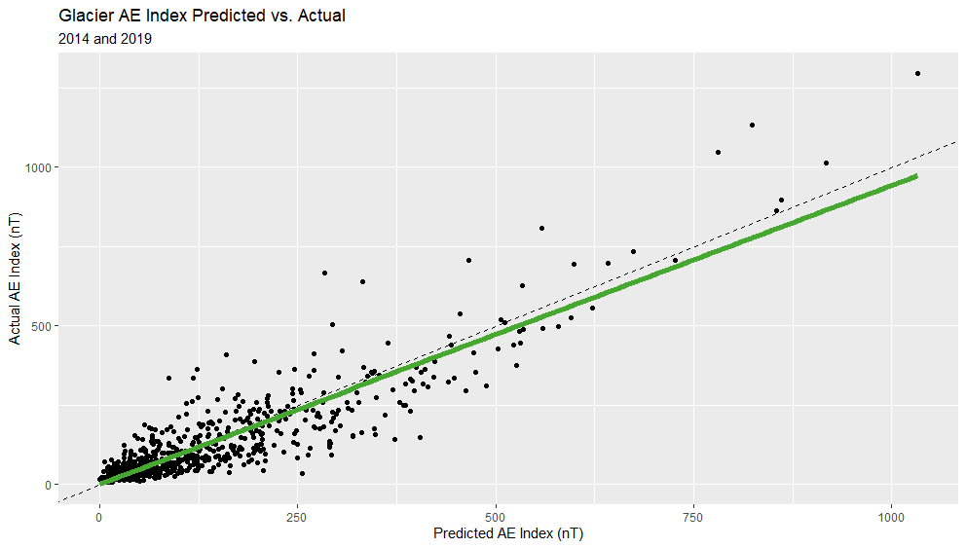
AE Index Correlation
Glacier AE Index (1-hr Predicted vs. Actual)
2014 and 2019
1000
500
0
R² = 0.81
y = 1.3 + 0.94x
Actual AE Index (nT)
0 | 250 | 500 | 750 | 1000
Predicted AE Index (nT)
Notes:
This graph shows the relationship between the predicted and the actual AE Index values for Glacier National Park at local midnight. After performing a linear regression we got a line very close to direct correlation shown as the dashed line, we received a r^2 value of .81. Since the r^2 value is so close to 1, we can say there is a strong correlation between the predicted AE values and the actual AE values meaning that the predicted AE Index is an accurate prediction tool for the aurora.
Denali - R^2: 0.71
Taken at local midnight time

Slide 15
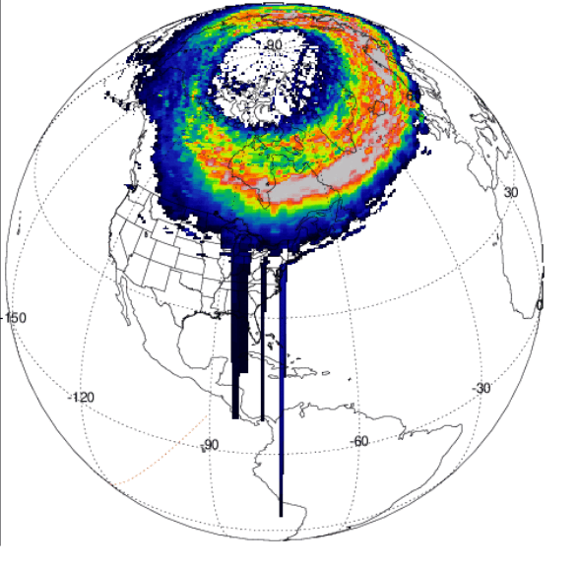
Predicting Aurora: Statistical Modeling
2024/05/11
OVATION Prime 2.3
ergs/cm²s
Maps the aurora oval as a statistical model
Based on approximate energy deposition (ergs/cm²s) of solar precipitation over a given area
8.00
4.00
0.00
Image Credit: iSWA; Newell et al., 2010
Notes:
Maps the aurora oval based on solar precipitation values
For our purposes we looked at the ovation with both the electrons and ions for the prediction model
Oval shows the probability of aurora occurring over a given area
Approximate energy deposition (ergs/cm2s) is directly proportional to aurora probability
E+I stands for electrons and ions. This example in ovation prime shows the electron and ion diffuse aurora. This type of aurora is generated by the precipitation of hot electrons.
Diffuse aurora is hazy aurora instead of discrete lines
----------Image Information Below----------
[Ovation Prime GIF]
Image Credit: [Integrated Space Weather Analysis-Community Coordinated Modeling Center] [Public Domain]
Image Source: [https://iswa.ccmc.gsfc.nasa.gov/IswaSystemWebApp/?layout=OvationPrime]
Newell, P. T., Sotirelis, T., & Wing, S. (2010). Seasonal variations in diffuse, monoenergetic, and Broadband Aurora. Journal of Geophysical Research: Space Physics, 115(A3). https://doi.org/10.1029/2009ja014805

Slide 16
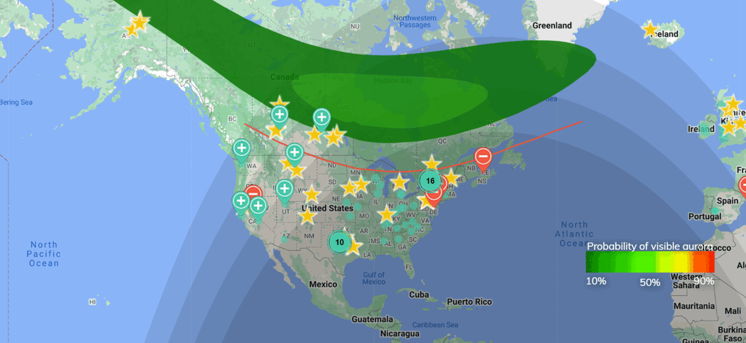
Predicting Aurora: Statistical Modeling
AuroraSaurus
Image Credit: AuroraSaurus, NASA
Citizen science project
Provides additional viewing of OVATION Prime model with viewing line estimate
Notes:
Improve real time tracking
Characterizes location and probability using Ovation Prime
Provides a view line estimate for viewing aurora from the ground
Citizens can report aurora sightings here to provide ground observation data
----------Image Information Below----------
[AuroraSaurus Platform]
Image Credit: [Created by team using AuroraSaurus Images] [Public Domain]
Image Source: [https://science.nasa.gov/science-research/heliophysics/AuroraSaurus-roars-during-historic-solar-storm/]

Slide 17
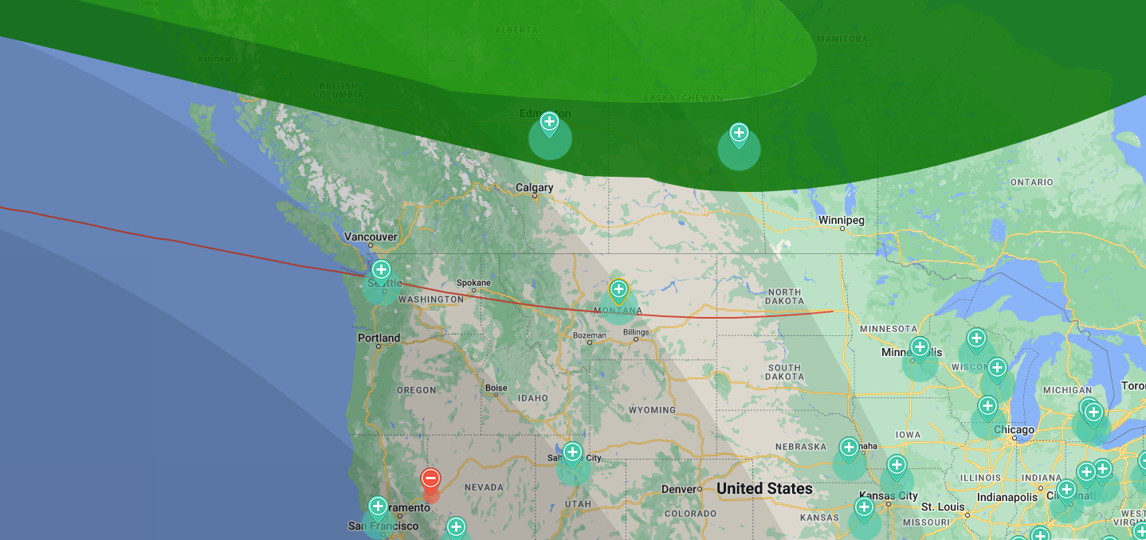
Classifying Aurora with OVATION: Glacier
Aurora visibility at Glacier occurs at Kp>4.
Example: Aurora Event at Kp 4
No: Park is outside of view line estimate and the OVATION oval (but Kp>4)
Possibly: Park is within view line estimate, but not in the OVATION oval
Yes: Park is within view line estimate and the OVATION oval
Image Credit: AuroraSaurus, NASA
Glacier National Park
Notes:
Because Glacier National Park sits outside of Earth's polar region (and often outside of the aurora oval), the aurora borealis only has the potential to be visible there at Kp indices of 4 or greater. This simplifies the data collection process so only Kp values greater than 4 are accounted for in Glacier. To classify aurora, we developed the following credentials for determining the possibility of viewing aurora. Pictured here is an example of an Aurora event that occurred at a Kp level of 4 on May 16th of this year at 5 AM local park time. As you can see, the park is above the view line estimate, but below the OVATION probability oval as provided by AuroraSaurus. This event would therefore be classified under "possibly," meaning aurora may be visible, but isn't probable to occur over the area by OVATION.
----------Image Information Below----------
[AuroraSaurus Platform]
Image Credit: [AuroraSaurus Citizen Science] [Public Domain]
Image Source: [https://science.nasa.gov/science-research/heliophysics/AuroraSaurus-roars-during-historic-solar-storm/]

Slide 18
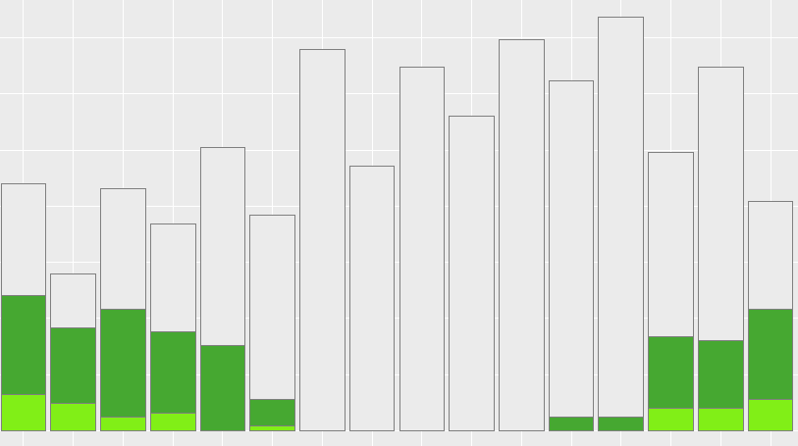
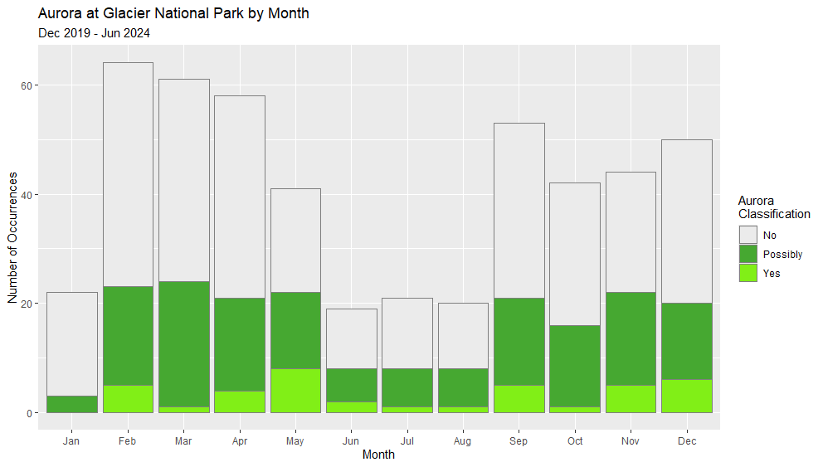
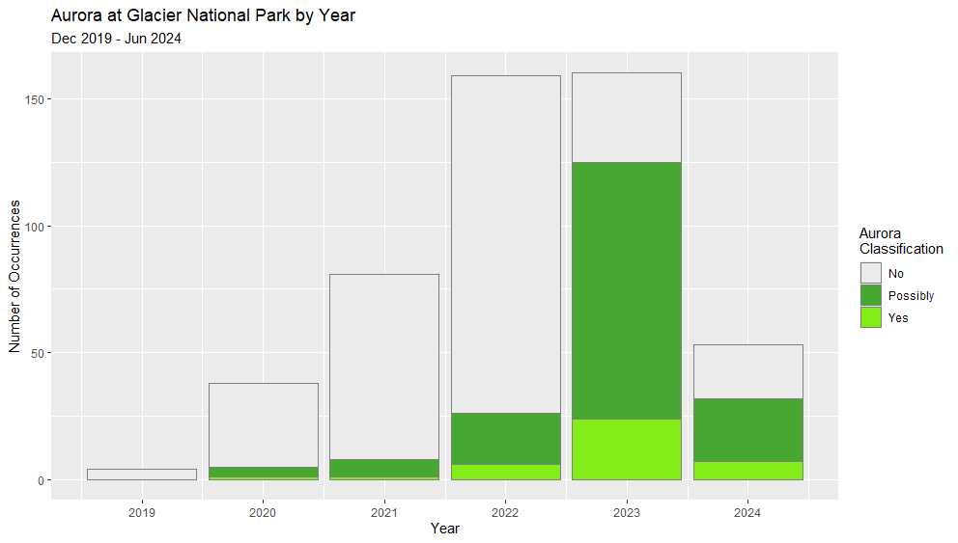
Results: OVATION in AuroraSaurus
Aurora at Glacier from AuroraSaurus by Time
75
50
25
0
 | Aurora
 | No
 | Possibly
 | Yes
Number of Occurrences
0:00 | 2:00 | 3:00 | 5:00 | 6:00 | 8:00 | 9:00 | 11:00 | 12:00 | 14:00 | 15:00 | 17:00 | 18:00 | 20:00 | 21:00 | 23:00
Time (Glacier Local Time)
Aurora at Glacier from AuroraSaurus by Month
Aurora at Glacier from AuroraSaurus by Year
60
40
20
0
150
100
50
0
 | Aurora
 | No
 | Possibly
 | Yes
 | Aurora
 | No
 | Possibly
 | Yes
Number of Occurrences
Number of Occurrences
Jan | Feb | Mar | Apr | May | Jun | Jul | Aug | Sep | Oct | Nov | Dec
2019 | 2020 | 2021 | 2022 | 2023 | 2024
Month
Year
Notes:
This data is all times that the Kp index was at or above 4 from Dec 2019 – May 2024 to reduce known nos. These graphs demonstrate the classification of aurora from AuroraSaurus over different time spans. In the first graph, we can see there is no aurora is the middle of the day as expected and these values were removed from the data set in the next graphs. It does show that the best chances to see the aurora is around midnight. The aurora by month graph shows peaks in the spring and fall, while a significant dip in the summer this is because there is more solar activity at the equinoxes which is known as the Russell-McPherron Effect. Lastly, more aurora events have been occurring as we reach the solar maximum and once reached it will decrease again (note that 2024 is low due to the year not being finished and 2019 being very low as data was only taken from 2019).

Slide 19
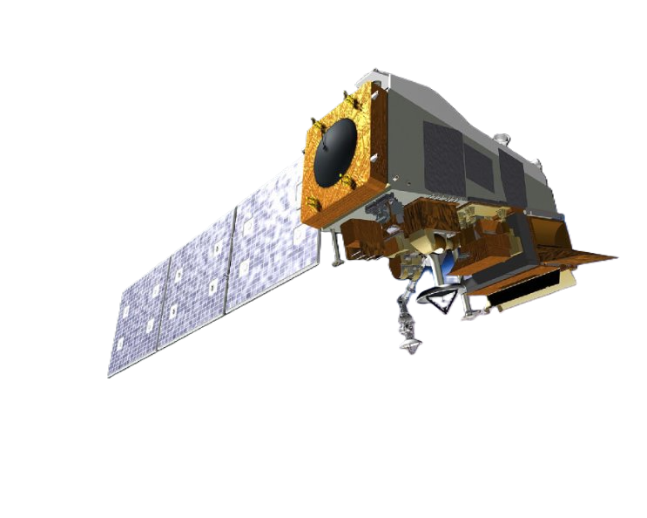
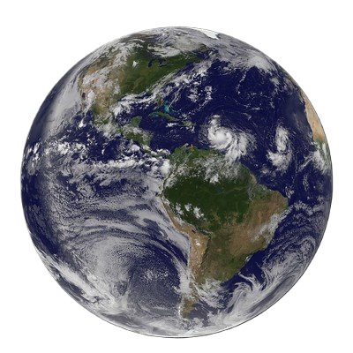
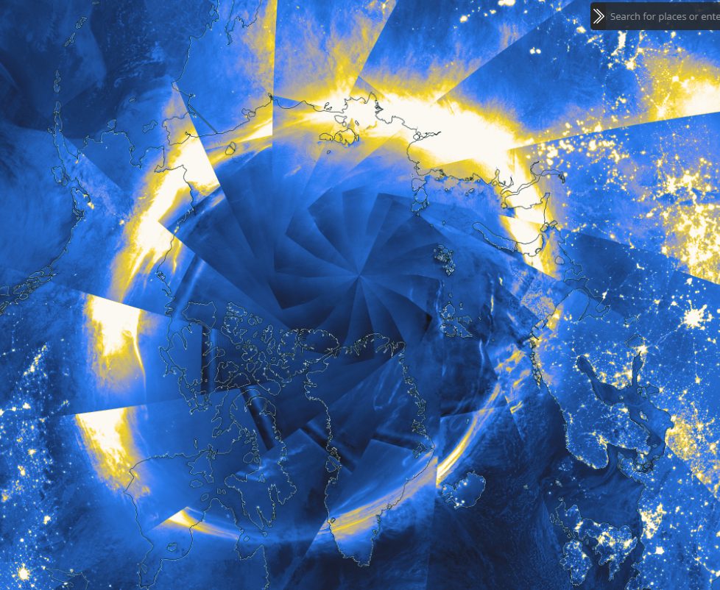
Predicting Aurora: Satellite Imagery
Satellite Imager
Suomi NPP VIIRS
Suomi NPP VIIRS provides Day/Night Band imagery
Shows aurora as concentrated light near polar regions
Allows for view of aurora from space
Image Credit: NOAA/NASA
Notes:
*To conclude the validation of the predictability of the aurora, we needed to combine Earth-based observations with the data that we have before collected. With using satellite Imagery such as Suomi NPP VIIRS we can see the northern lights from space and with Ground-Based aurora sightings provided by AuroraSaurus we concluded what days you will be able to see the Aurora defined by the established Kp index. The Artic view shown on the slide was discontinued in 2023, so we were not able to collect data after this year. Also, VIIRS collected data over Denali between 3-5 local Denali time as that is when the satellite would pass over.
Image Information #1: Earth
Image Credit: NOAA/NASA GOES Project, Flickr
Image Source: https://www.flickr.com/photos/gsfc/7839472240/
Image Information #2: Suomi NPP VIIRS Satellite Icon
Image Credit: NASA Suomi National Polar-orbiting Partnership
Image Source: https://www.eoportal.org/satellite-missions/suomi-npp-2020-2019
Image Information #3: Aurora Oval Satellite Imagery
Image Credit: screenshot taken my the team of the NASA Worldview data viewer. Imagery depicted is Suomi NPP VIIRS.

Slide 20
Results: VIIRS & OVATION Prime
Aurora Borealis at Denali National Park with Kp Index
Dec 2019 – Aug 2023
50
40
30
20
10
0
Confusion Matrix |  | OVATION Prime
 |  | Positive | Negative | Total
VIIRS | Positive | 72 | 130 | 202
 | Negative | 53 | 789 | 842
 | Total | 125 | 919 | 1044
Model
 | OVATION Prime
 | VIIRS
Number of Occurrences
Probability that both models agree | 0.825
Probability of models agreeing by random chance | 0.733
Cohen's Kappa | 0.343
0 | 1 | 2 | 3 | 4 | 5 | 6 | 7 | 8
Kp Index
Notes:
This graph showcases at which Kp Indices did the models show there was aurora at Denali National Park. Due to Denali's location, it usually falls in the auroral oval allowing aurora to be present even with a Kp Index of 0. The tables to the right shows the comparison of OVATION and VIIRS. The first is a confusion matrix showing when OVATION and VIIRS said that there was aurora (positive) and not (negative). The two models agreed 82.5% of the time for determining if there was aurora at Denali. Cohen's kappa describes the agreement between two models. A value over zero means the agreement present means there is a correlation between the two models as the models agreed more than just random chance. The Cohen's kappa value for OVATION and VIIRS is 0.343 meaning that there is fair agreement between the models for showing aurora in Denali National Park.
Note that the OVATION reported less positives than VIIRS which is due to OVATION being a prediction and modeling tool while VIIRS shows the true auroral oval.

Slide 21
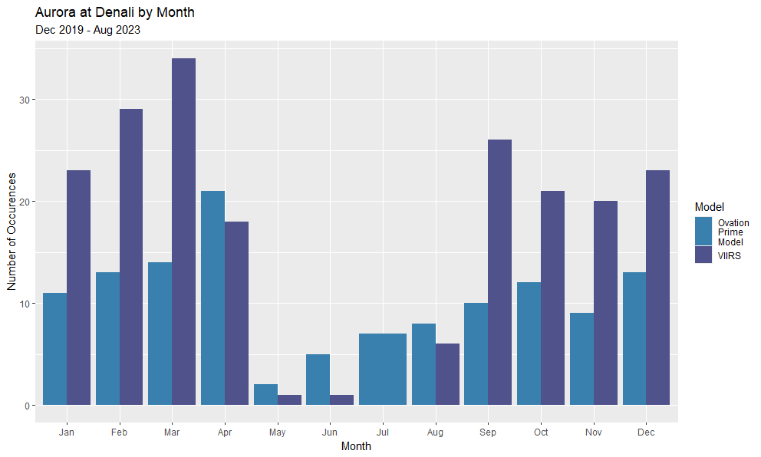
Results: VIIRS & OVATION Prime
Aurora Borealis at Denali National Park by Year
Aurora Borealis at Denali National Park by Month
80
60
40
20
0
Dec 2019 – Aug 2023
Dec 2019 – Aug 2023
30
20
10
0
Model
 | OVATION Prime
 | VIIRS
Model
 | OVATION Prime
 | VIIRS
Number of Occurrences
Number of Occurrences
2019 | 2020 | 2021 | 2022 | 2023
Jan | Feb | Mar | Apr | May | Jun | Jul | Aug | Sep | Oct | Nov | Dec
Year
Month
Notes:
These graphs show when the models showed aurora in Denali National Park. As seen, the occurrences of aurora increase over the years as we head into the solar maximum as expected since there is more solar activity showing the solar cycle. The data from 2023 is not complete as the VIIRS polar view stopped working in June of 2023. The aurora over the month shows clear peaks in the fall and springtime further demonstrates the Russell-McPherron Effect. However, it should be noted that while the models say there was some aurora in the summer, the sky is not dark enough most of the time for the aurora to be visible.

Slide 22
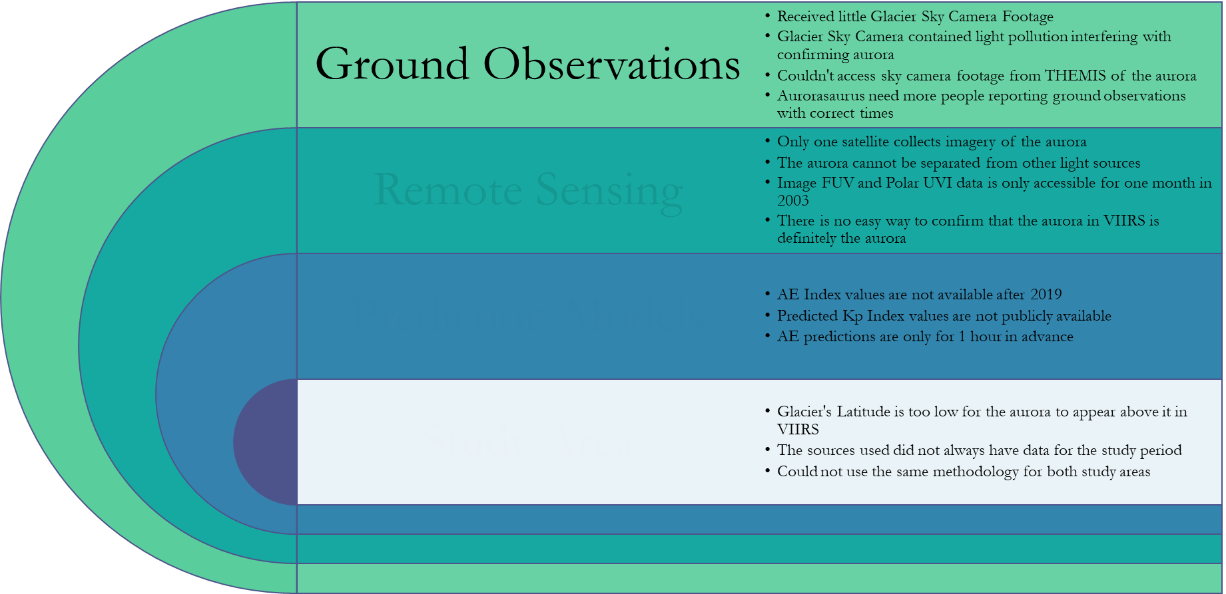
Limitations
Ground Observations | Glacier sky camera footage Light pollution | THEMIS access AuroraSaurus citizen input
Remote Sensing | Earth observation data for viewing aurora | Satellite orbit crosses parks at same times every day
Prediction Models | Public access to data Kp data organization | AE forecast is only 1-hour ahead
Study Area | Auroral oval latitude Study period | Parks outside of polar regions
Notes:
Ground Observations
Only received May 10–11 Glacier sky camera footage
Glacier Sky Camera contained light pollution interfering with confirming aurora
Couldn't access sky camera footage from THEMIS of the aurora
AuroraSaurus need more people reporting ground observations with correct times
Remote Sensing
Only one satellite collects imagery of the aurora current day - VIIRS
The aurora cannot be separated from other light sources
VIIRS is the day night band, so city lights, clouds, moonlight, or other light sources are present
Image FUV and Polar UVI data is only accessible for one month in 2003
Stopped operating in 2005
VIIRS data for Denali was only available from 3-5 am local time as that is when the satellites orbit would go over
There is no easy way to confirm that the aurora in VIIRS is the aurora due to the light pollution
No sensor designed specifically for the aurora
Determining aurora must be manual allowing human error to influence results
Prediction Models
AE Index values are not available after 2019
Recent data is still being edited to remove the errors
Past predicted Kp Index values are not publicly available
Had to get them for NOAA – inconsistences in time formatting received
AE predictions are only for 1 hour in advance
Can't predict far out allowing people to plan their day
Study Area
Glacier latitude is too low for the aurora to appear directly above it in VIIRS
The sources did not always have data for our study period
VIIRS stopped in June 2023 for Denali view and had off periods, OVATION shut down for a several month stretch,
Couldn't use the same methodology for Glacier and Denali
Could only use AuroraSaurus for Glacier

Slide 23
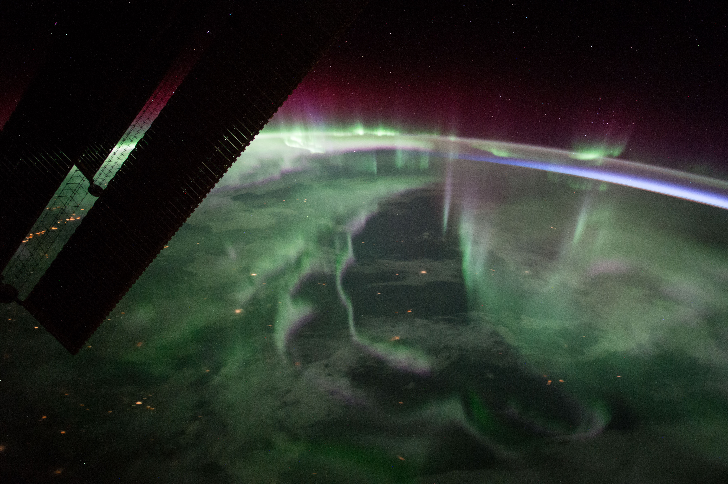
Conclusions
The NPS can use the AE index over the Kp index for short term predictions of aurora occurrences
VIIRS more accurately assesses the aurora over parks in polar regions
OVATION Prime is a valid prediction model for aurora
Using AE index and VIIRS data to predict aurora is feasible with certain limitations
Image Credit: International Space Station
Notes:
NPS can use the AE index over the Kp index (current practice) to predict aurora in the short term at midnight local time for both Glacier and Denali National Park.
OVATION Prime is valid by the previously published Russel-McPherron effect, which says aurora occurs most often during the spring and fall seasons. NPS can continue to use OVATION Prime as a prediction model, as well as expect more park visitors during these times of year.
The VIIRS Day/Night Band views aurora more accurately from space at park locations in polar regions (Denali, not Glacier). Over Denali National Park, aurora as seen through VIIRS lines up with the current prediction model (OVATION Prime) 82.5% of the time.
[Aurora image]
Image Credit:[International Space Station][Public Domain]
Image Source:[https://www.nasa.gov/image-article/festive-northern-lights/ ]

Slide 24
Feasibility & Partner Implementation
Feasible
Use the predicted AE Index
Use VIIRS to see the auroral oval
Not Feasible
Use long term Kp Index prediction
Use OVATION Prime for Glacier
Use OVATION Prime at Denali
Use AuroraSaurus for Glacier and Denali
Use Glacier’s sky camera
Use the Kp Index at Denali
Use VIIRS to see aurora at Glacier
Use VIIRS to map the extent of aurora visibility
Notes:
The predicted AE Index is feasible for the partners to use as we found a strong correlation between the predicted and actual AE values. Note that they are only short term (the next hour).
VIIRS can be used to see the auroral oval and due to Denali's location the auroral oval can be seen directly above Denali National Park. VIIRS can also be used to validate models if the aurora can be separated clearly to show the exact location of the oval.
OVATION Prime can be used at Denali as the model shows and predicts the auroral oval over Denali with the likelihood of seeing the aurora.
AuroraSaurus can be used be used to view OVATION Prime on a more user-friendly platform where the location can be zoomed in, and a view line estimate is present. Furthermore, AuroraSaurus can be used to predict and see the aurora at Glacier National Park.
Glacier's sky camera can be used for view the aurora at Glacier however we recommend moving it away from buildings and roads to reduce light pollution.
The 6hr forecast predictions were only fairly in agreement with actual Kp values, so longer term forecasts are inferred to be unreliable.
The Kp Index is not a reliable indicator of the aurora at Denali as seen above in the results, both VIIRS and OVATION Prime said there was aurora at all Kp indices even at Kp index 0.
Ovation Prime cannot be used for glacier as the model rarely has the oval reaching Glacier and when it does it is only the edge with a low probability.
VIIRS cannot be used to determine the aurora at glacier as it never shows the auroral oval over the park to confirm aurora.
VIIRS cannot be used to map the extent of the aurora as it can only show where the auroral oval is and not how far away from the oval the aurora can still be seen. This can be seen with Glacier as the auroral oval will never be over glacier, but we know that aurora can still be seen at Glacier. Furthermore, this is not feasible as there are several external factors that is collect by VIIRS such as clouds, city lights, moon light and haze that would interfere with trying to determine the aurora viewing area on VIIRS alone.

Slide 25
Project Partners
Debby Smith (Glacier National Park)
Sharolyn Anderson (Natural Sounds and Night Skies Division)
Tim Connors (Intermountain Regional Office)
Mark Biel (Glacier National Park)
Phil Wilson (Glacier National Park)
Science Advisors
Xia Cai (NASA Langley Research Center)
Yihua Zheng (NASA Goddard Space Flight Center, Community Coordinated Modeling Center)
Jamie Favors (NASA Headquarters)
Lisa Winters (NASA Headquarters)
Leads
Marisa Smedsrud (Project Coordination Fellow, Virginia – Langley)
Laramie Plott (Senior Fellow, Virginia – Langley)

