Slide 1
SARASOTA CLIMATE
Monitoring Heat and Assessing Heat Vulnerability to Identify Locations for Heat Mitigation Efforts in Sarasota, Florida
Will Hadley
Casmir Brown
Catherine Gallagher
Theresia Phoa
Georgia – Athens | Spring 2024
Notes:
Welcome to the spring 2024 Georgia node's virtual project presentation. Our project is titled "Sarasota Climate: Monitoring Heat and Assessing Heat Vulnerability to Identify Locations for Heat Mitigation Efforts in Sarasota, Florida". (Will Hadley, Catherine Gallagher, and Theresia Phoa briefly introduce themselves).

Slide 2
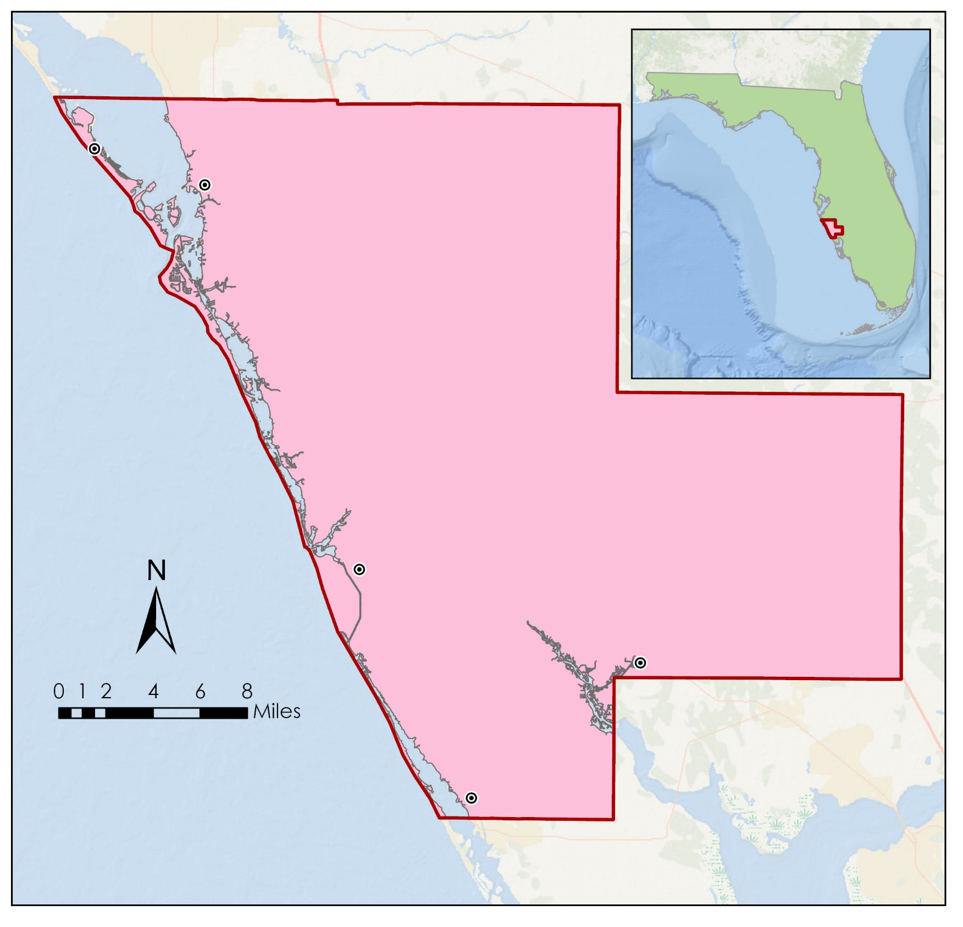
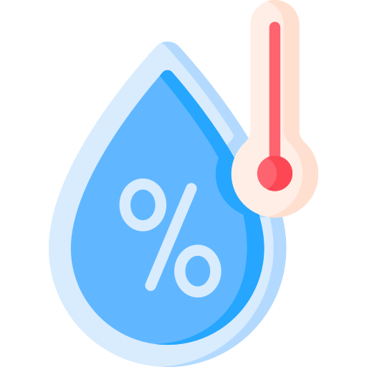
Study Area
Sarasota County, Florida
Study Period: Summer 2019-2023 (June to August)
Longboat Key
Sarasota
Florida
Gulf of Mexico
430,000+
residents
14.4% population growth
40% aged 65 & older
N
Sarasota County
Venice
0
1
2
4
6
8
Miles
North Port
Sarasota County Boundary
Englewood
Major Cities
250+ days of sunshine
Humid
Subtropical climate
Basemap credits: Esri, GEBCO, NOAA, National Geographic, Garmin, Geonames.org
Icon credits: Flaticon, Freepik
0
12
24
Notes:
This project focuses on our study area of Sarasota County, Florida, which is located in the western portion of the state along the Gulf of Mexico. Sarasota County is the 14th most populous county in Florida with a population size of 430,000. It is also the 9th most densely populated, and quickly growing at a rate of 14.4% between 2010 and 2020. Sarasota is also of particular interest in the context of the urban heat island effect because of its humid subtropical climate and large elderly population, a group particularly vulnerable to extreme heat.
Icons used under the FlatIcon Attribution license:
<a href="https://www.flaticon.com/free-icons/sunlight" title="sunlight icons">Sunlight icons created by Flat Icons - Flaticon</a>Copy
<a href="https://www.flaticon.com/free-icons/population" title="population icons">Population icons created by Freepik - Flaticon</a>Copy
<a href="https://www.flaticon.com/free-icons/old-people" title="old people icons">Old people icons created by Freepik - Flaticon</a>Copy
<a href="https://www.flaticon.com/free-icons/graph" title="graph icons">Graph icons created by Freepik - Flaticon</a>Copy

Slide 3
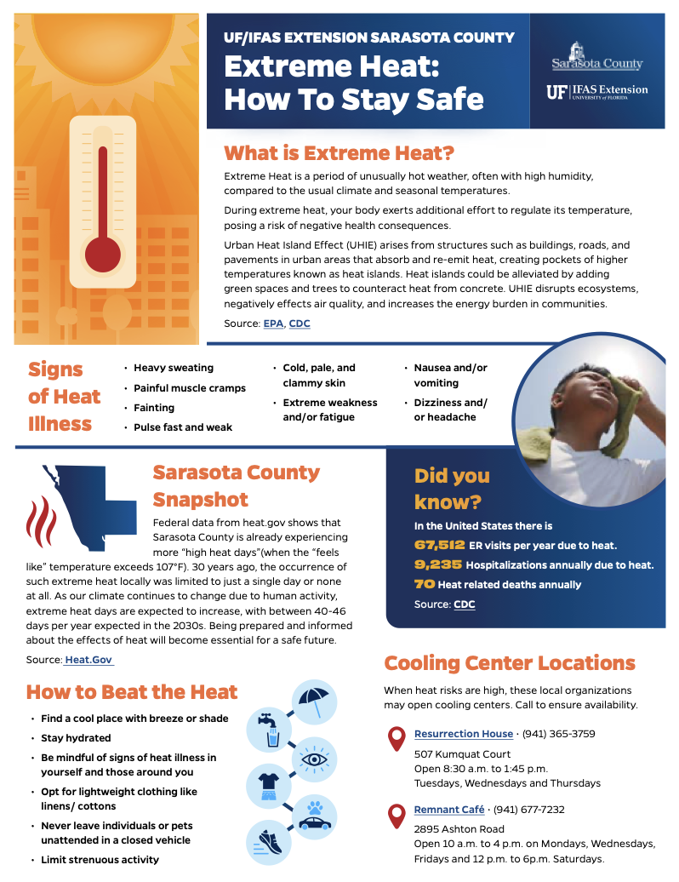
Partner
Sarasota County Univ. of Florida’s Institute of Food and Agricultural Sciences extension
A collaborative program between Sarasota County, the University of Florida, and the US Department of Agriculture. The program integrates expert research into community activities across 6 major areas:
4-H youth development
Agriculture
Gardening and landscaping
Natural resources
Nutrition and healthy living
Sustainability
Sarasota County Extreme Heat Outreach Poster
Image credit:
Sarasota County UF/IFAS Extension
The sustainability group is interested in identifying areas to kick-start extreme heat mitigation efforts, such as tree planting and building cooling centers.
Notes:
For this project, we worked with the Sarasota County, UF/IFAS Extension, which is a collaborative program between Sarasota County, the University of Florida, and the US Department of Agriculture, which works to integrate expert research into community activities across 6 major areas, including sustainability. In particular, we worked with Alia Garrett, the Sustainability outreach coordinator along with some of the GIS team for Sarasota County.
Image Credit: Sarasota County UF/IFAS Extension (Used with permission by the partners)
Image Source: Alia Garrett, Sarasota County Sustainability

Slide 4
Extreme Heat in Sarasota County
Since the 1970s, Sarasota has faced a significant rise in temperatures during the summer season.
+2.6°F
+5.9°F
Current Average Summer Temperature: 85°F
2023 was recorded as the warmest year with:
63 consecutive hot days (heat index HI > 100°F)
1 full week in August of HI ≥ 110°F
With climate change impacts becoming more evident,
the number of hot days might continually increase to 131 days per year around 2050!*
*Union of Concerned Scientists (2019), mid-century 2036-2065 estimates
Notes:
Our focus on extreme heat in Sarasota County reveals a concerning trend: Florida's climate, already warmer than much of the US due to its subtropical nature, somehow, it’s getting even hotter over time.
Since 1970, we've seen a significant increase in both daytime and nighttime temperatures during summer months (Climate Central).
Last year, 2023, was the hottest on record, with an unprecedented 63 days of heat index exceeding 100°, peaking in August with a week over 110°(NWS Tampa). (explain HI briefly: temperature+relative humidity)
Looking ahead, climate projections suggest Sarasota could face a staggering 131 extremely hot days annually by mid-century.
Icon Credits: Microsoft Office

Slide 5
Extreme Heat Impacts
Cities have started becoming heat traps due to the fast expansion of urban development. This phenomenon happens as a result of heat being absorbed and retained by buildings, roads, and other infrastructures which end up creating “heat islands” with temperatures noticeably higher than that in rural counterparts.
Several problems emerged from prolonged exposure of extreme heat:
Negative impacts on air quality and
exacerbation of respiratory conditions
(Lin et al., 2009)
Increased
numbers of
heat-related illness
(Faurie et al., 2022)
Higher energy consumption and
associated costs for cooling buildings
(Mendez-Lazaro et al., 2018)
Disproportionate heat exposure and risks
in low-income and underserved communities
(Hansen et al., 2013)
Notes:
We speculate the urban development in Sarasota County play a big role exacerbating this extreme heat issue.
We’ve seen that cities become "heat islands" because buildings, roads, and other structures absorb and hold onto heat, making cities much hotter than nearby rural areas.
Which cause a series of interrelated problems, including negative impacts on air quality, increased numbers of heat-related illness, higher energy consumption, and disproportionate heat exposure in low-income and underserved communities.
“Negative impacts on air quality and exacerbation of respiratory conditions”
Lin, Shao, et al. “Extreme high temperatures and hospital admissions for respiratory and cardiovascular diseases.” Epidemiology, vol. 20, no. 5, Sept. 2009, pp. 738–746, https://doi.org/10.1097/ede.0b013e3181ad5522.
“Increased number of heat-related illnesses”
Faurie, C., Varghese, B. M., Liu, J., & Bi, P. (2022). Association between high temperature and heatwaves with heat-related illnesses: A systematic review and meta-analysis. Science of The Total Environment, 852, 158332. https://doi.org/10.1016/j.scitotenv.2022.158332
“Higher energy costs and associated costs for cooling buildings:
Méndez-Lázaro, P., Muller-Karger, F. E., Otis, D., McCarthy, M. J., & Rodríguez, E. (2018). A heat vulnerability index to improve urban public health management in San Juan, Puerto Rico. International Journal of Biometeorology, 62, 709-722. https://doi.org/10.1007/s00484-017-1319-z
“Disproportionate heat exposure and risks in underserved communities”
Hansen, A., Bi, L., Saniotis, A., & Nitschke, M. (2013). Vulnerability to extreme heat and climate change: is ethnicity a factor?. Global Health Action. 6(1): 21364.

Slide 6
Objectives
1
Assess land surface temperature variance across Sarasota County
2
Explore the relationship between vulnerable populations and
severe heat
3
Visualize heat anomalies, heat mitigation capacity, and heat vulnerability to support community outreach
Notes:
In this project, we pursued several goals to understand urban heat in Sarasota County. First, we assessed the surface temperature variance across. Next, we explored the relationship between vulnerable populations and severe heat. Finally, we visualized some end products: heat anomalies, heat mitigation capacity, and heat vulnerability maps to support community outreach and identify high-risk areas.

Slide 7
Earth Observations
Landsat 8
Landsat 9
ISS
ECOsystem Spaceborne Thermal Radiometer Experiment on Space Station
ECOSTRESS
Operational Land Imager & Thermal Infrared Sensors
OLI - TIRS
Spatial resolution: 30 meters
Temporal revisitation: 16 days
Spatial resolution: 70 meters
Temporal revisitation: 1-7 days
Daytime LST, Albedo, Provisional Evapotranspiration
Nighttime LST
Image credit: NASA
Notes:
To do this, we used data from Landsat 8 and 9 (OLI + TIRS), which provided us with daytime land surface temperature, evapotranspiration, and albedo data. We also used the ISS EcoSTRESS system to access Nighttime LST data.
Image credit (left): NASA
Image source (left): https://landsat.gsfc.nasa.gov/wp-content/uploads/2021/12/ldcm_2012_COL-300x168-1.png
Image credit (middle): NASA
Image source (middle): https://landsat.gsfc.nasa.gov/wp-content/uploads/2016/10/Landsat9.png
Image credit (right): NASA
Image source (right): https://science.nasa.gov/wp-content/uploads/2023/05/iss.png

Slide 8
Methodology
Raw Data
Processing
Analysis
End Products
Earth Observations
AppEEARS
Find day LST for Sarasota and reference area, subtract for UHI
Urban Heat Anomaly Map of Sarasota
Nighttime LST
Jun-Aug
2019-23
ECOSTRESS
UHI Factor of Difference
Urban Heat Mitigation Priority Map
Landsat 8
Landsat 9
Daytime LST
GEE
Calculate Zonal Statistics by Tract
Socioeconomic and Environmental Variables
Evapotranspiration
HSM Model
InVESTModel
Individual Maps showing HVI and Certain Demo-
graphic Data
Population Density
Race
Age
Census Tracts
Join to
Census Tract
Income Level
Principal Component Analysis by Tract
Average Ground Measured Temp
Sarasota Bivariate Maps
Insurance Coverage
Land Cover
UHEAT 1.0
Notes:
The project as a whole had four stages: raw data collection, processing, analysis, and end products. The raw data step involves determining which variables would be useful in a HVI, which for this project included demographic data, such as race and age, remote sensing data, including land cover and average ground temperature, and the supplementary addition of health variables, which involves data such as asthma and COPD cases. The processing stage involves cutting down and formatting demographic data and creating LST and evapotranspiration maps, as well as connecting data to the actual census tracts for further investigation. Analysis involves feeding the previous data into models/ModelBuilder and calculating zonal statistics using the products, as well as using principal component analysis to further identify areas of highest vulnerability. Finally, the end products stage involves using the information garnered from analysis to draw final conclusions and to create a series of maps, posters, papers, etc.

Slide 9
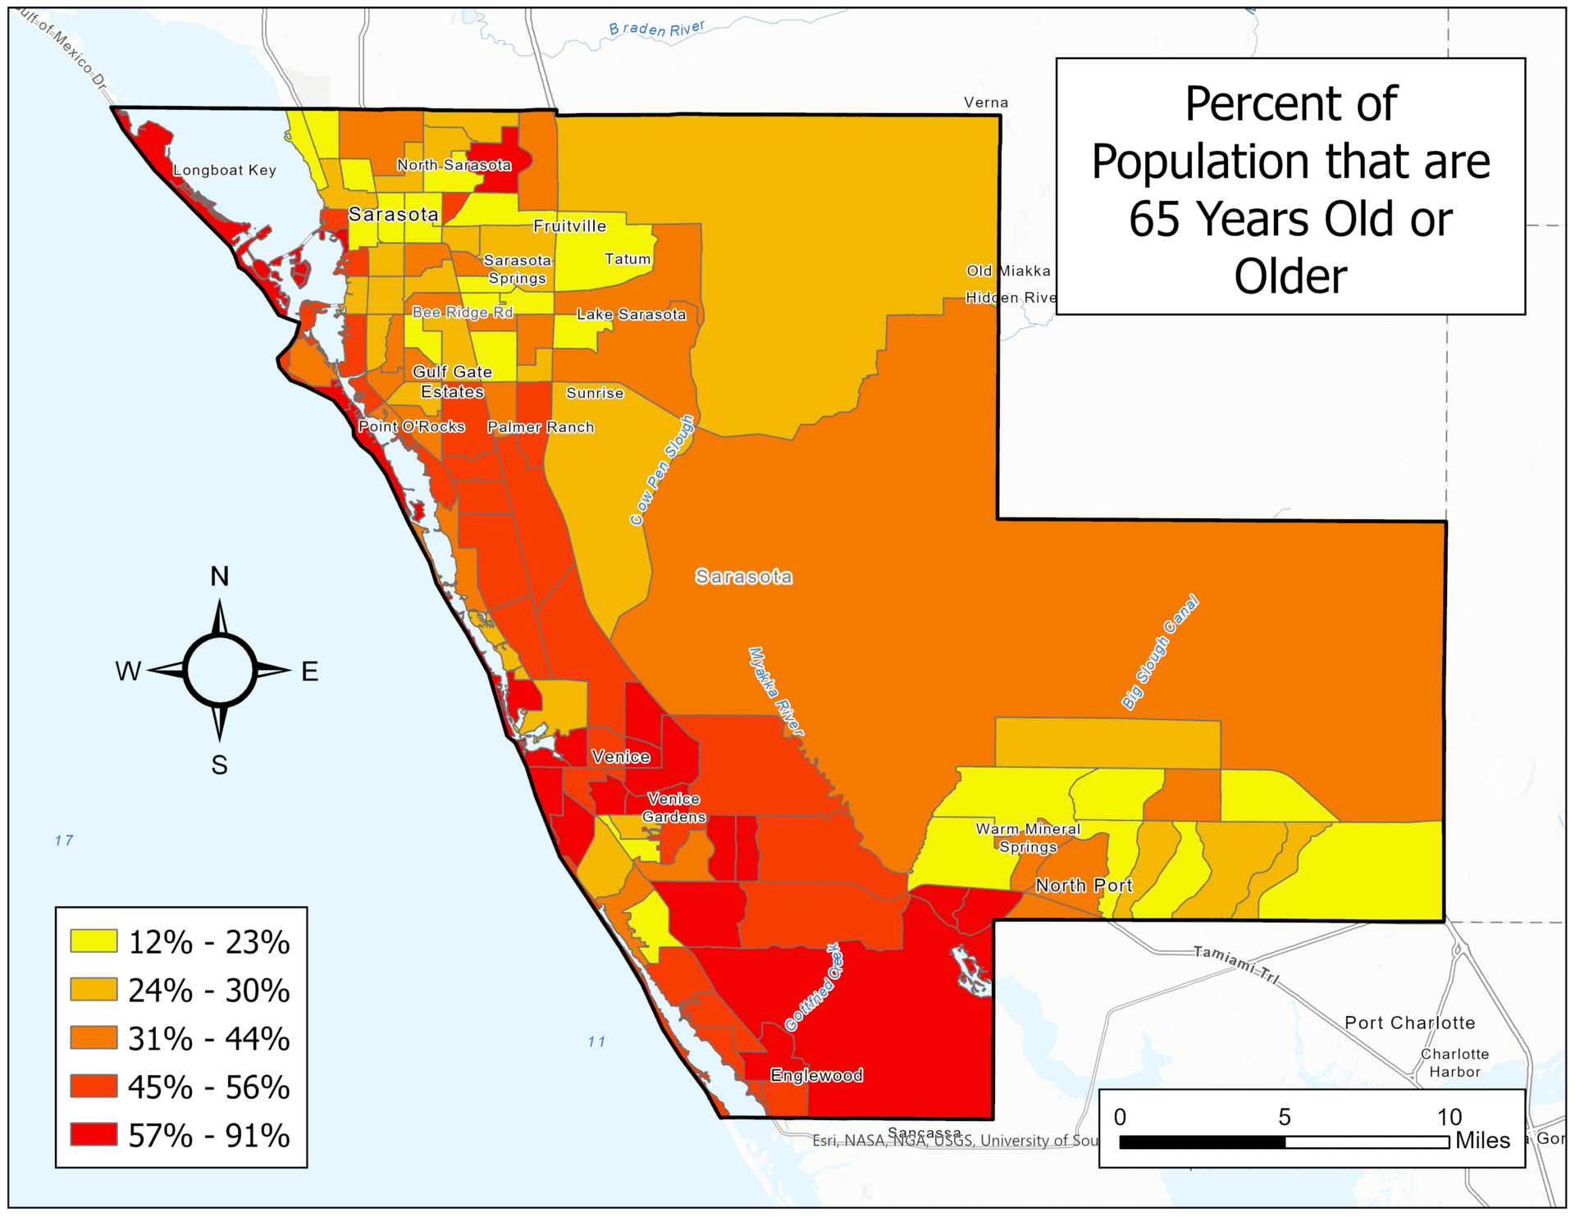
Demographic Data
Highest population density around Sarasota City, including a spike in North Sarasota, as well as the cities of North Port and Venice
Demographic risks (often) associated with age are clustered largely in the southern part of the county, while most other variables are centered mostly in the northeast
North Sarasota and North Port both reflect high percentages in almost every category
Poverty, Living Alone, Population with No Car, Unemployed, etc.
Both types of risks present
Basemap credits: Esri, TomTom, Garmin, FAO, NOAA, USGS, © OpenStreetMap contributors, and the GIS User Community
Notes:
Demographic patterns shift significantly depending on what specific variable is being investigated. Most of these factors fall within two groups: age-related risks and socioeconomic risks. Age risks include being 65 or older or under 5, while socioeconomic risks include being under the poverty line, unemployed. There are specific regions with particularly high demographic makeups that put them particularly at risk for heat hazards, especially compared to other tracts in the county. For example, in some areas of North Sarasota, the percentage of non-white inhabitants is almost 95 percent, while in other tracts, particularly in the southwest and along the coasts, that number is almost zero. Additionally, areas with a large amount of people under the poverty line (up to a third of the total) also include North Port, Northern Sarasota, and the largest central census tract.
Map Credits: Catherine Gallagher
Basemap credits: Esri, TomTom, Garmin, FAO, NOAA, USGS, © OpenStreetMap contributors, and the GIS User Community

Slide 10
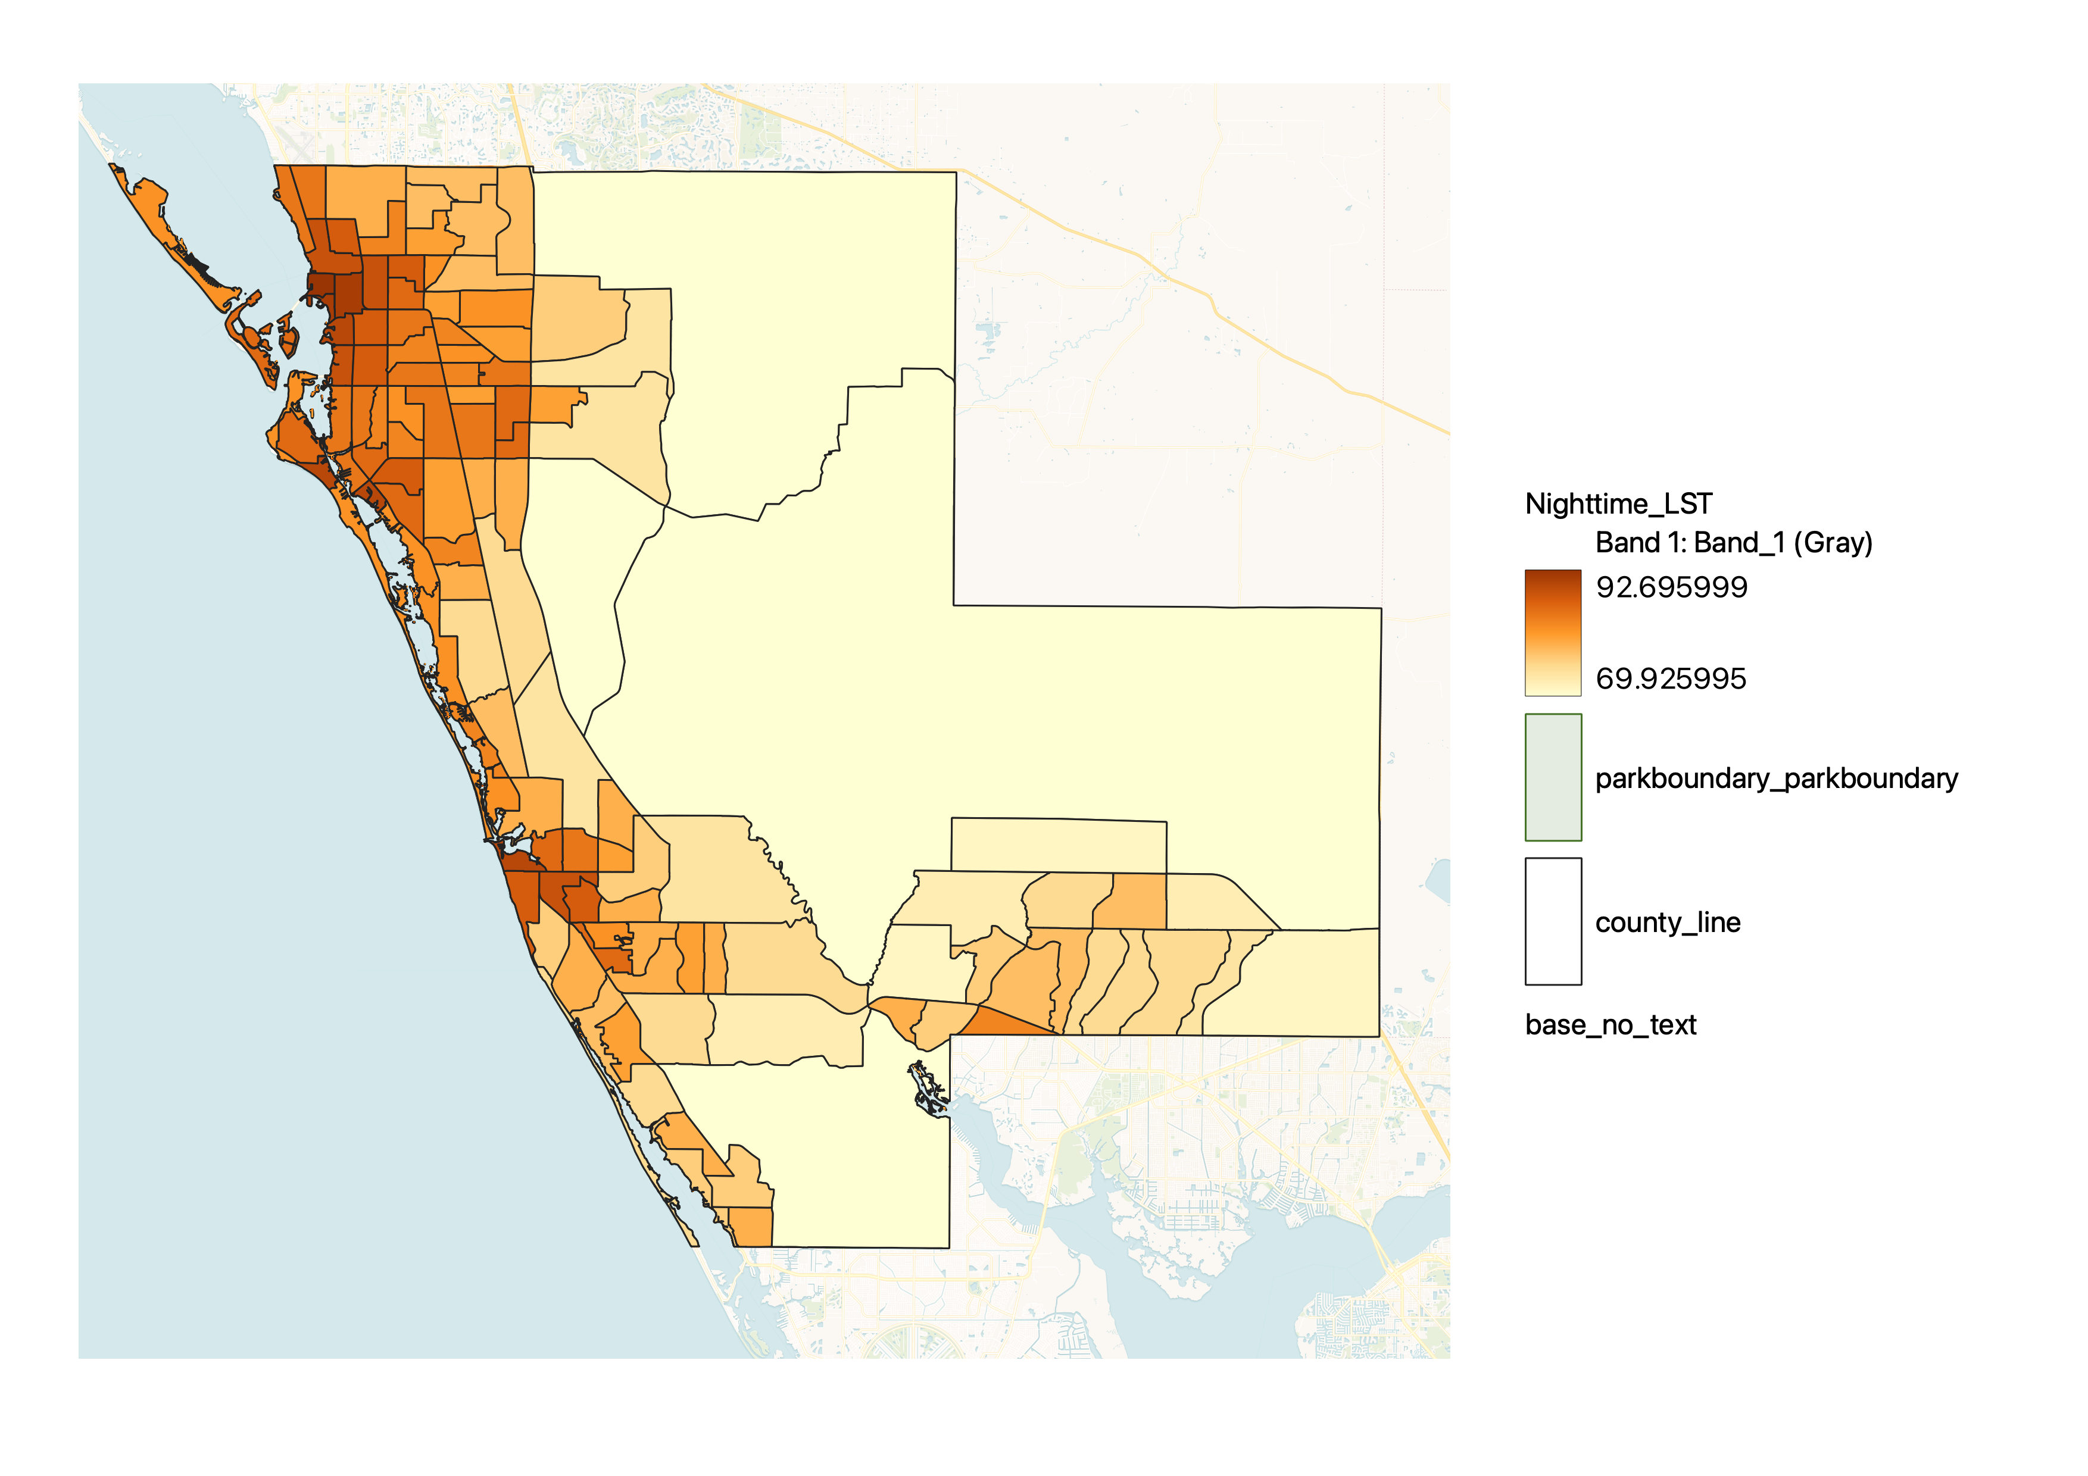
Land Cover
Percent Impervious Surface by Census Tract
Percent of Tree Canopy Cover by Census Tract
N
N
These two maps were derived from 2022 NOAA Coastal Change Program dataset with resolution
1m x 1m
2022 Impervious Surfaces
Impervious Surface (%)
2022 Tree Canopy Cover
Canopy Density (%)
70
0
1
2
4
6
8
67
0
1
2
4
6
8
Miles
Miles
1.1
Source: US Census Bureau, 2020, NOAA Coastal Change Analysis Program, 2022
13
Source: US Census Bureau, 2020, NOAA Coastal Change Analysis Program, 2022
Basemap credits: Esri, GEBCO, NOAA, National Geographic, Garmin, Geonames.org
Basemap credits: Esri, GEBCO, NOAA, National Geographic, Garmin, Geonames.org
The western side of the county is where most urban areas are located, which was shown from the higher density of impervious surfaces.
While the eastern side is where the state parks and pastures are located, depicted by the average ~ 35% of canopy cover.
Western side of the county is where the most urban areas located, which was shown from the higher density of impervious surface.
While the eastern side is where the state parks and pastures located, this was depicted from the average ~35% of canopy cover.
Notes:
Since we've talked about the human dimension of this urban heat assessment project, the following 2 slides will discuss environmental data.
After analyzing the latest NOAA C-CAP dataset, we found that nearly half of the county is heavily developed, with dense urban areas concentrated on the western side, characterized by high impervious surface density.
On the other hand, the eastern side is barely developed, but it has state parks and pastures, as indicated by an average canopy cover of approximately 35%.
One important thing to note is that the combined percentage of tree canopy and impervious cover doesn't sum up to 100%, which will help people to understand our next slide.

Slide 11
Land Surface Temperature
Daytime
Nighttime Cooling
Daytime LST were averaged from Landsat 8 and 9 images during Summer (June-August) of 2019-2023
Nighttime LST were averaged from ISS ECOSTRESS images during Summer (June-August) of 2019-2023
N
N
Median LST (°F)
LST Difference (°F)
116
0
61
-37.5
0
1
2
4
6
8
0
1
2
4
6
8
Miles
Miles
Notes:
Land surface temperature is the most important environmental metric in our assessment due to limited ground observation data countywide.
By utilizing Landsat for daytime LST and ECOSTRESS for nighttime LST, we've observed daytime temperatures can reach up to 116°F during summer on average, with some areas experiencing minimal nighttime cooling.
Surprisingly, some urban areas exhibit a significant decrease in nighttime LST, potentially attributed to canopy cover and light-colored roofs, while wetlands and water bodies remain warmer overnight but cooler than adjacent developed land during the day due to water's high heat capacity and developed surfaces' low albedo (how reflective a surface to solar radiation, this info available in the title slide).

Slide 12
Cooling Capacity Index
Cooling Capacity Index
1
0
Ability to dissipate heat based on:
Shade
Evapotranspiration
Biophysical properties
Distance from cooling islands
N
0
1
2
4
6
8
Miles
Basemap credits: Esri, NASA, TomTom, Garmin, FAO, NOAA, USGS, © OpenStreetMap contributors, and the GIS User Community
Notes:
From several input data mentioned in the previous files, we ran several models to map the heat vulnerability. The first one uses the InVEST Urban Cooling model, from which we obtained the cooling capacity index. It is a unitless binary index for "high cooling capacity" and "low cooling capacity”. An index value of 1 represents a strong ability to dissipate heat, whereas an index value of 0 represents a weak ability to dissipate heat. Cities – City of Sarasota, Venice, North Port, as well as the coastline – are less capable of cooling themselves than surrounding areas

Slide 13
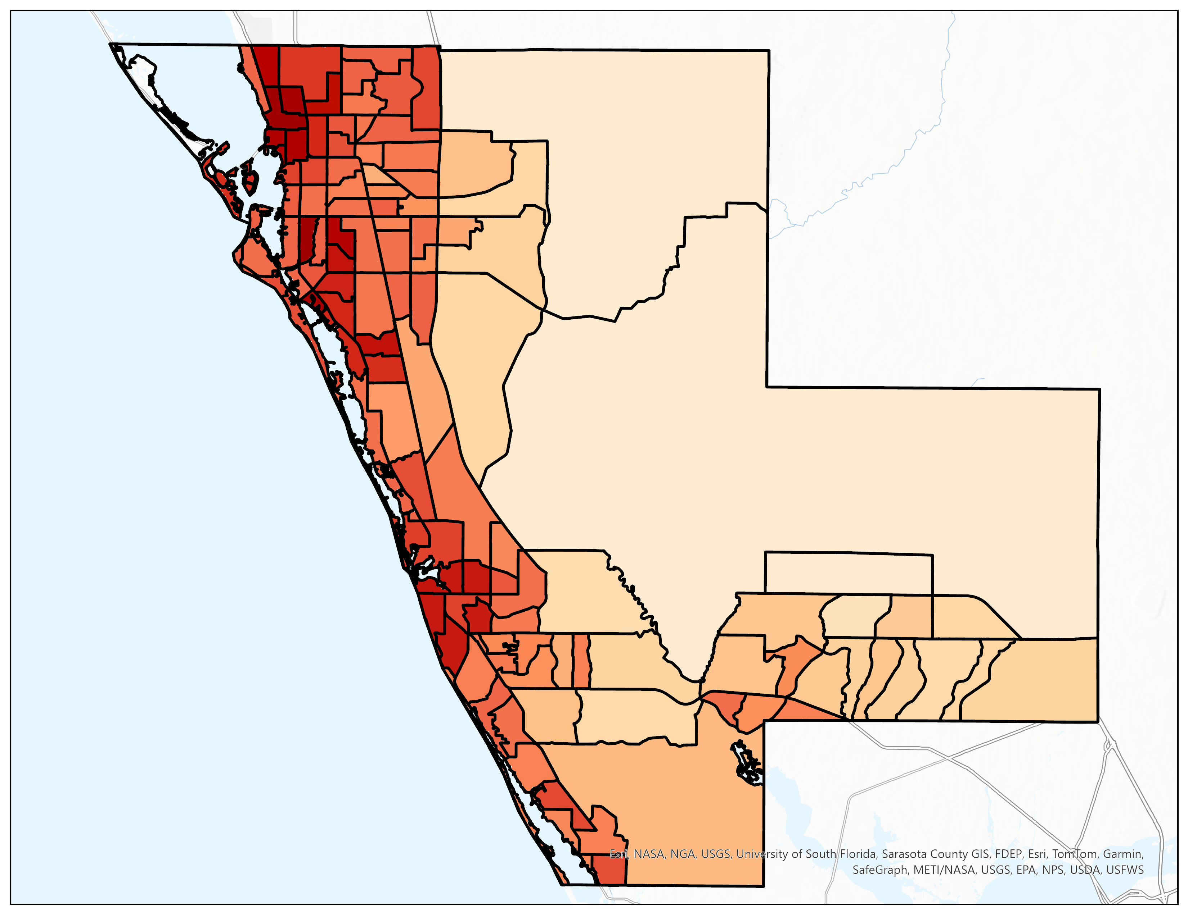
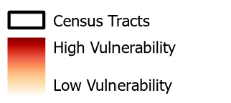
Heat Vulnerability (ArcGIS ModelBuilder)
Heat Vulnerability in Sarasota County, Florida
Demographic Data
Land Cover Data
Remote Sensing Data
N
Rescale by Function
Weighted Sum
0
1
2
4
6
8
Miles
Census Tracts
Overall Heat Vulnerability
High Vulnerability
Low Vulnerability
Notes:
The data used to create this Heat Vulnerability map fall into three sections: demographic, land cover, and remote sensing/climatological data. The demographic data was picked from past literature on Heat Vulnerability Indexes, heat hazards, and sociological responses to disasters/risk and weighted based on prevalence of variable in literature; the land cover data was sourced from the NLCD and subsequently weighted based on degree of development based on information on UHI from literature review. Finally, remote sensing data was sourced from from Landsat (GEE) and ISS (Ecostress) data and weighted based on climatological factors contributing to UHI (based on information from literature review).

Slide 14
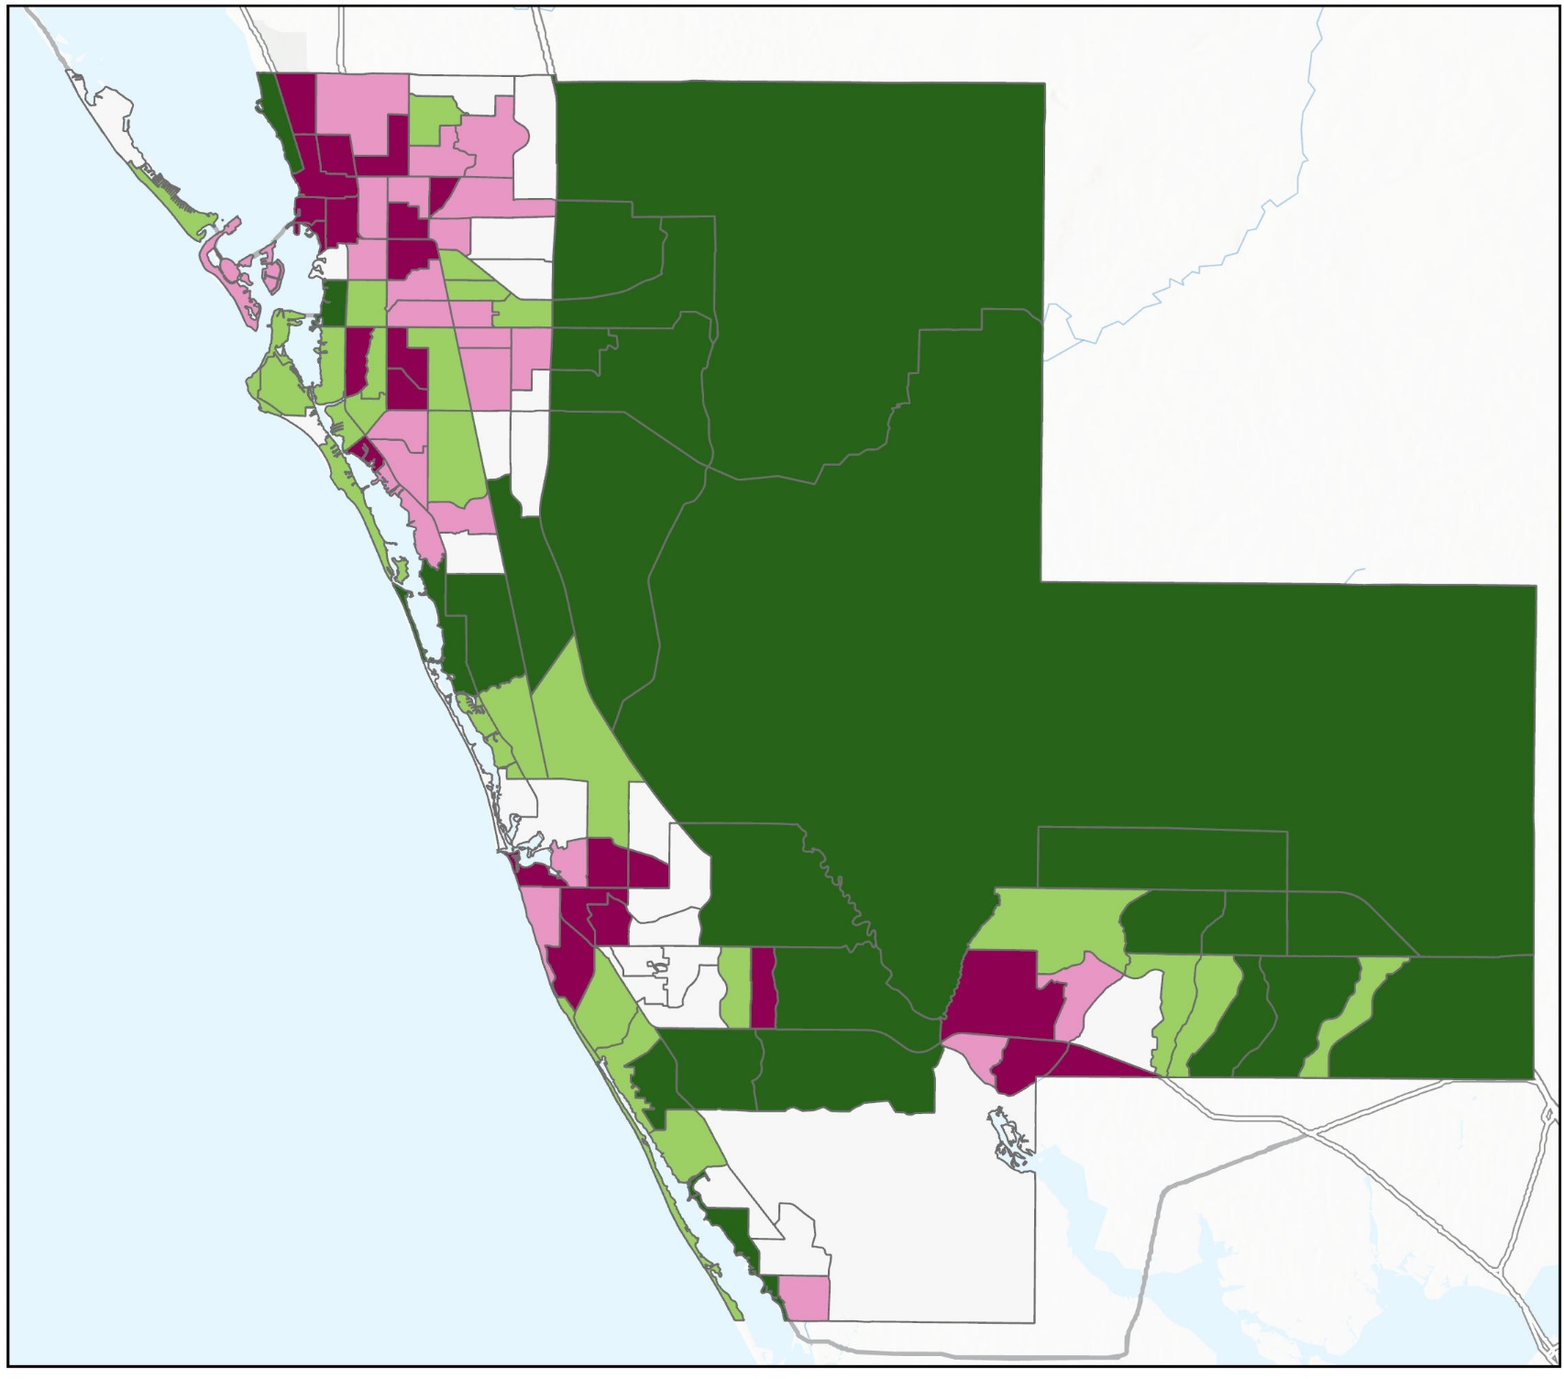
Heat Exposure (PC Analysis)
Environmental (5 Variables):
Daytime LST, Nighttime LST, Albedo, % Canopy Cover,
% Impervious Surfaces
Heat Exposure
High
Socioeconomic (11 Variables):
Total Population, Age, Race, Disability Status, Income Level, Health Insurance Ownership, Car Ownership, English Proficiency, Occupational Status, % Living Alone
Low
Total: 16 Variables
PCA Analysis:
Reduce multidimensionality and show most relevant variables
N
4 Principal Components
(See appendix slide)
0
1
2
4
6
8
Land Cover
Albedo
Population
Age (65 and Over)
Occupational Status
Miles
Daytime LST
Nighttime LST
Basemap credits: Esri, NASA, TomTom, Garmin, FAO, NOAA, USGS, © OpenStreetMap contributors, and the GIS User Community
Map Credits: Theresia Phoa
Notes:
Our third approach involved Principal Component (PC) analysis to isolate highly exposed/ vulnerable communities, considering a total of 16 variables.
Because of this large number of variables, we feared we would obtain multidimensional results, but PCA proved helpful in identifying relevant variables.
By extracting four principal components, we gained insights into the connection between these variables which highlights distinct perspectives of heat exposure and key indicators for different temporal contexts.
See 2 boxes on the bottom-right corner.

Slide 15
Determining Priority Areas
Cooling Capacity Index
Cumulative Heat Vulnerability Index
(Heat Mitigation Priority)
Zonal Statistics to Census Tracts
Heat Vulnerability
(ArcGIS ModelBuilder)
Reid et al. 2009
Heat Exposure
(PC Analysis)
Standardize
Original Scoring
Classify based on Range of Z-Score
Sum of New Scoring
< -2, -1, 0, 1, > 2
Notes:
Transitioning to the main part of the project, we've employed three distinct models: the InVEST Urban cooling model (prebuilt software with limited sets of inputs that don’t incorporate demographic data), ArcGIS model builder (spatial analysis centric), and PC Analysis (combination of statistical methods and spatial analysis).
Motivated by the DEVELOP feasibility study goal of integrating Earth observations into environmental decision-making for partners.
We decided to use an additional index inspired by Reid et al.'s study. This index will streamline the identification of priority areas to the smallest feasible number, facilitating more manageable and targeted actions.
This involves averaging original scores by census tract, standardizing them into Z-scores, reclassifying the range, and summing them to calculate the cumulative Vulnerability Index, known as the Heat Mitigation Priority.
Icon Credit: Microsoft Office

Slide 16
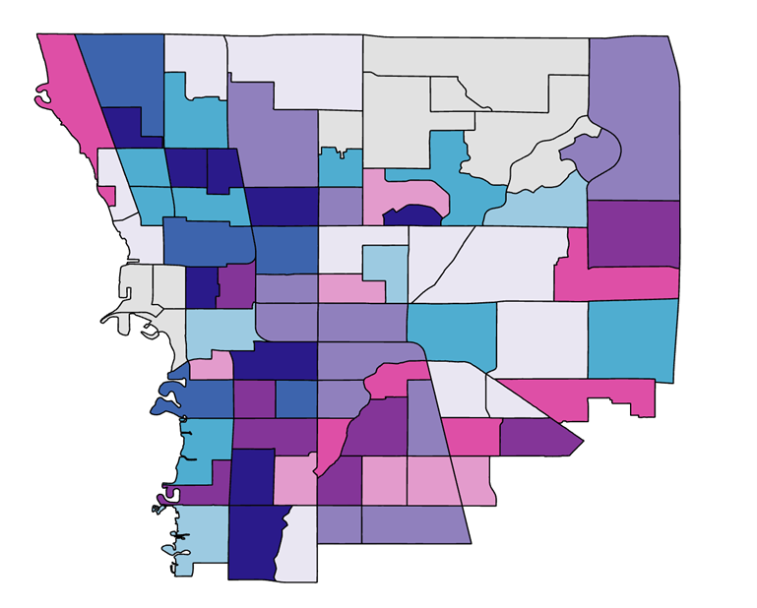
Heat Mitigation Priority (1/3)
North Sarasota
Heat Mitigation Priority
High
% Unemployed
Medium
% Below Poverty Line
Low
No Data
High
Low
Low
High
N
Average Daytime LST (°F)
Above 100
95-100
0
1
2
4
6
8
90-95
Miles
Map Credits: Catherine Gallagher and Theresia Phoa
Notes:
North Sarasota is, by far, the area with the highest overall vulnerability to heat hazards and therefore that which also requires primary mitigation priority. It contains multiple census tracts that both have high rates of unemployment and poverty while also having average DLST temperatures of over 100 degrees Fahrenheit, making them particularly vulnerable to heat hazards.

Slide 17
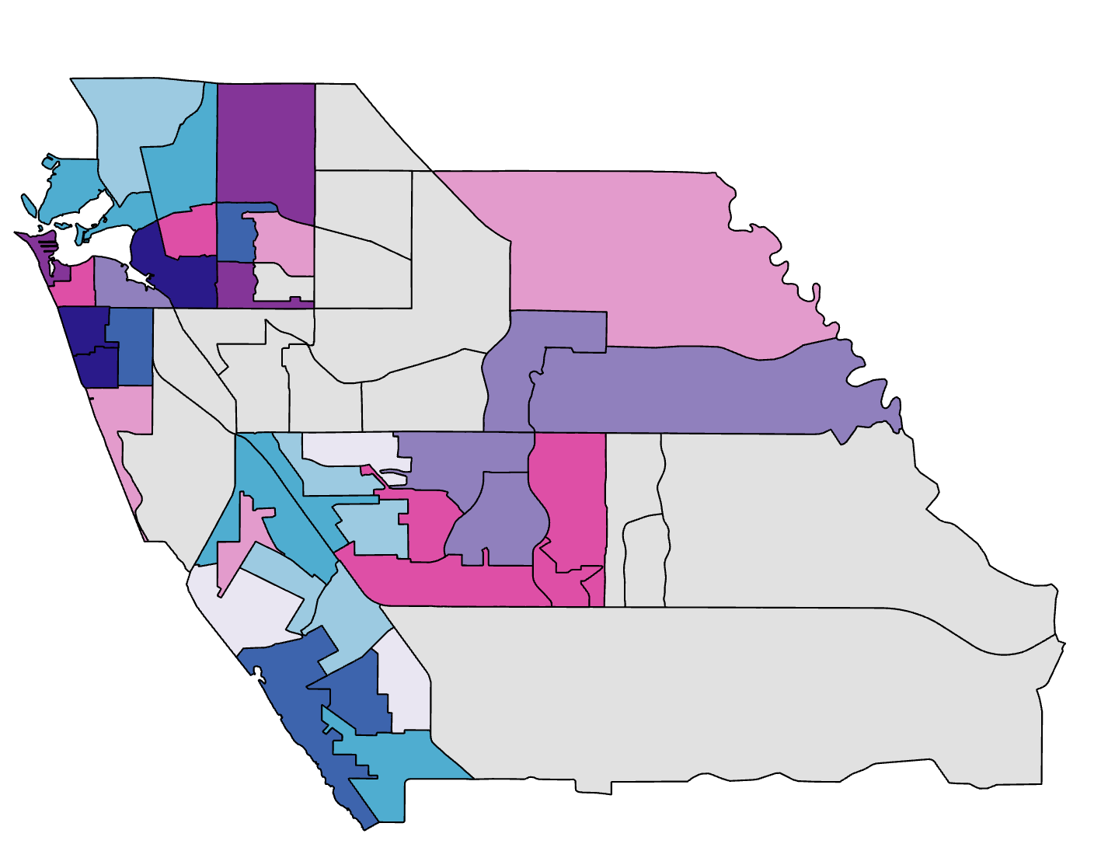
Heat Mitigation Priority (2/3)
Venice
N
% Age 65 and over
% Below Poverty Line
No Data
0
1
2
4
6
8
High
Miles
Low
Low
High
Heat Mitigation Priority
Average Daytime LST (°F)
High
Medium
Above 100
Low
95-100
90-95
85-90
Notes:
Venice in particular has a high amount of people living there that are 65 years old if not older, with a few of these communities also existing below the poverty line, making Venice a notable intersection between physical demographic risks (age) and socioeconomic ones. While not as hot during the day overall as in North Sarasota, DLST in the summer in Venice is still dangerously high given the demographic risks present.

Slide 18
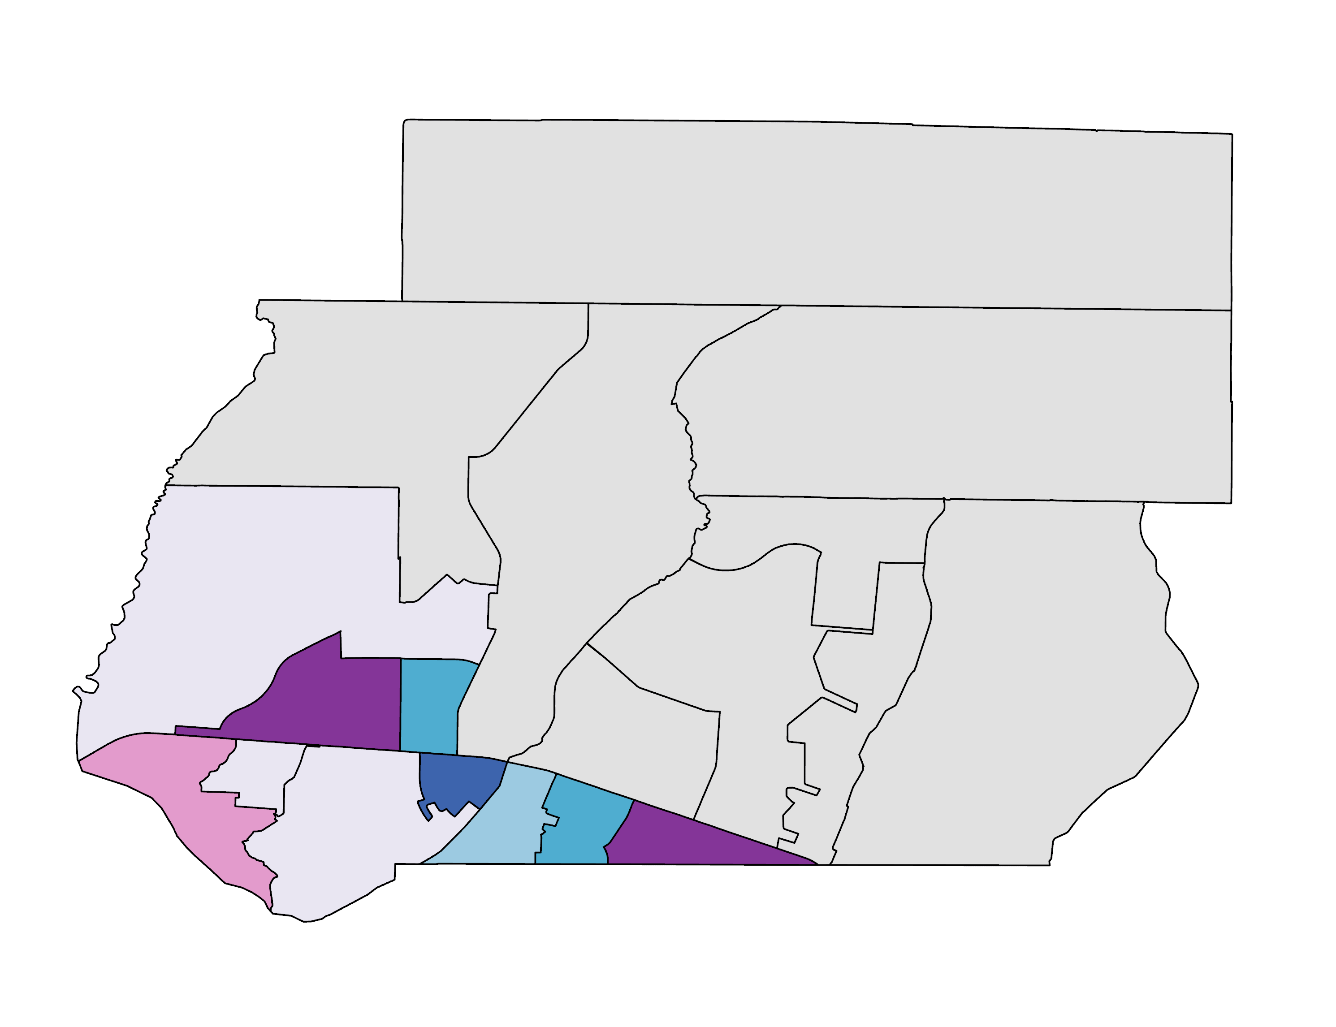
Heat Mitigation Priority (3/3)
North Port
% Unemployed
% Below Poverty Line
No Data
High
N
Low
Low
High
0
1
2
4
6
8
Miles
Average Daytime LST (°F)
95-100
Heat Mitigation Priority
90-95
85-90
High
80-85
Medium
Low
Notes:
With a combination of similar demographic risks to North Sarasota (unemployment rates, poverty, etc.), though there are also physical risks present as well (the census tract with the highest elderly population by percent is in North Port) North Port is the final area towards which heat mitigation ought to be directed with priority. While DLST is lower in much of North Port than in Northern Sarasota City or Venice, it is still higher than many other parts of the county (in combination with demographic risks and land cover factors).

Slide 19
Conclusions
Heat intensity varies significantly across Sarasota County, with the highest temperatures in the developed western portion of the county.
Many socio-economically vulnerable populations live in high-heat areas, particularly in North Sarasota, Venice, and North Port.
Tree canopy cover has a generally negative correlation with heat intensity, which could provide a strategy for mitigation in vulnerable areas.
Notes:
We found significant variation in heat intensity across the county, with hotspots in the developed eastern portion of the county; we also found overlap between extreme heat and vulnerable populations, and it is advised that mitigation strategies undertaken by the partners in response to this research focus on the outlined cities, with Northern Sarasota City being given the highest priority overall. Finally, we determined that tree canopy cover is negatively correlated with heat intensity, which could allow for future mitigation strategies.

Slide 20
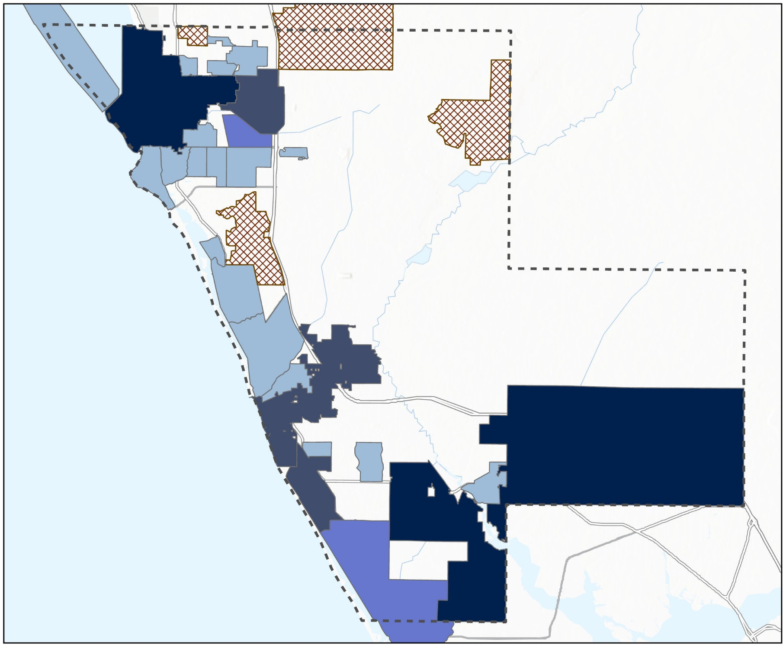
Limitations – Health Data
2020 BRFSS Data (CDC Telephone Surveys)
Data only available by Census Designated Places (equivalent to City, Townships, Village)
Age-adjusted percentage (Adults ≥ 18 yr old)
Aggregated using Cumulative Index method (Reid et al. 2009) by number of cases of Chronic Illnesses:
- Asthma
- Chronic obstructive pulmonary
disease (COPD)
- Coronary heart disease (CHD)
- High Blood Pressure (HBP)
- Stroke
- Obesity
- Diabetes
Chronic Illness Variables:
Asthma
COPD
CHD
HBP
Stroke
Obesity
Diabetes
N
0
1
2
4
6
8
Miles
Chronic Illness Prevalence
Vulnerability (Age ≥ 18 yr old)
Very High
High
Moderate
Low
No Data
Basemap credits: Esri, NASA, TomTom, Garmin, FAO, NOAA, USGS, © OpenStreetMap contributors, and the GIS User Community
Notes:
One notable limitation of our project is the exclusion of health data integration.
This decision stems from the fact that the available health data is only available at coarser geographic levels, that is, census-designated places (CDPs).
CDPs are equivalent to cities, townships, or villages. Moreover, not all census tracts belong to these CDPs shown by the amount of data gaps.
Despite these constraints, we opted to aggregate chronic illness prevalence data, to quantify vulnerability solely based on available health information using the same cumulative index method.

Slide 21
Future Recommendations
Future work should investigate potential mitigation methods to address extreme heat, such as:
Create an interactive web map of heat island data that will be available to the public
Monitor priority areas using low-cost temperature sensors
Increasing tree canopy cover in urban heat islands
Placing cooling centers in vulnerable communities
Increasing albedo by installing light-colored roofs
Partner
Further studies should include smaller scale regions using high-resolution microclimate models (Envi-MET, SOLWEIG, etc.)
DEVELOP
Notes:
At partner preference, heat mitigation strategies should focus primarily on community engagement and information dissemination therein; additionally, within DEVELOP, project methodology could be used to advise similar future endeavors involving risk mitigation.

Slide 22
Partners: Alia Garrett, Gary Schells, Anna Leavitt (Sarasota County Government - UF/IFAS Extension)
Advisors: Dr. Marguerite Madden (University of Georgia), Joseph Spruce (Analytical Mechanics Associates)
Center Lead: Megan Rich (NASA DEVELOP at Georgia – Athens)
Modeling/Coding Guidance: Dr. Kenton Ross (NASA DEVELOP Program Manager)
Notes:
We would like to thank our partners, science advisors, and our center lead for helping us with inputs and constructive feedbacks throughout the entire program period from January 22nd through March 29th 2024. <<Open the floor to questions.>>

Slide 23
PC Analysis
Variable Loadings
Correlation Coef.
% Impervious Surfaces
Daytime LST
Albedo
Nighttime LST
% Canopy Cover
% Living Alone
Total Population
% Disabled
% Age 65 years old and over
% Not in Labor Workforce
% Non Caucasian
% Below Poverty Line
% Without Car
% Not a Citizen
% Limited English Proficiency
% Without Health Insurance
1.0 (Positively Correlated)
0.5
0
-0.5 (Negatively Correlated)
PC1
PC2
PC3
PC4
Notes:
We determined number of PCs required from: Eigenvalues, Kaiser Criterion, and Scree plot. Positive loadings indicate an increase in one, which results in an increase in the other (positive correlation). Negative loadings indicate a negative correlation. Large (positive or negative) loadings indicate that a variable strongly affects that principal component.

