Slide 1
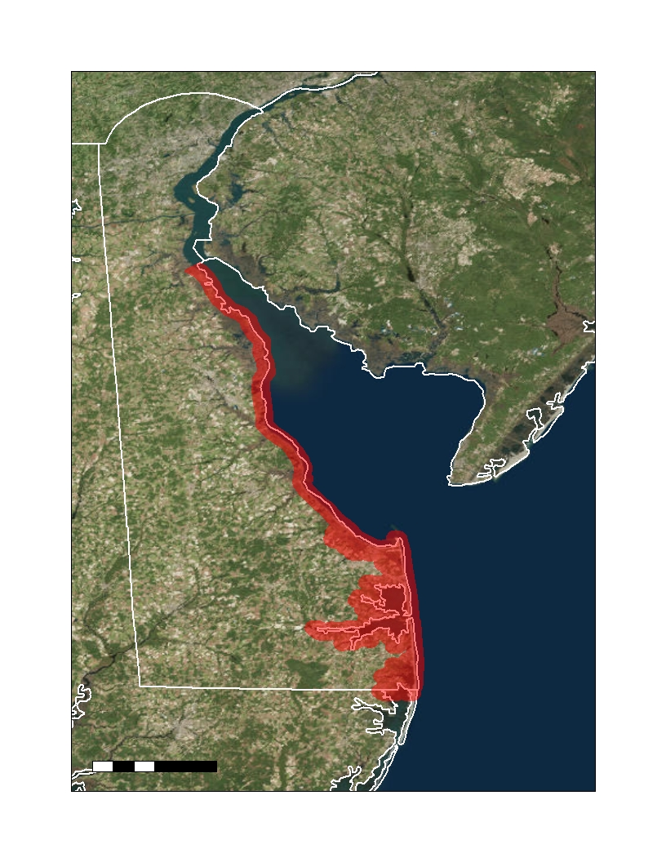
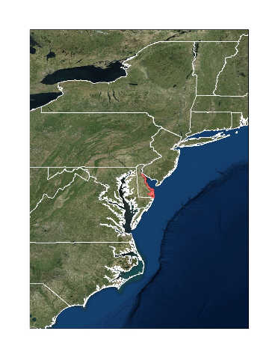
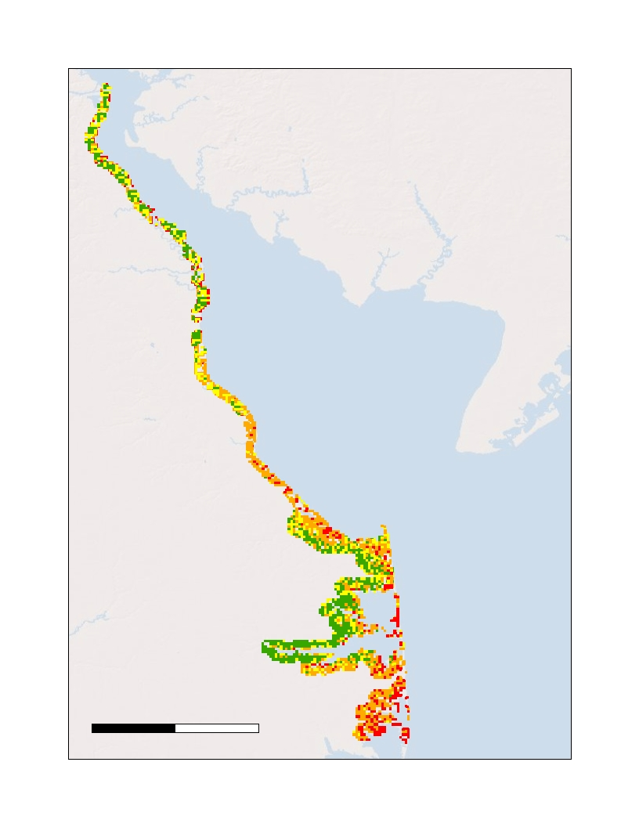
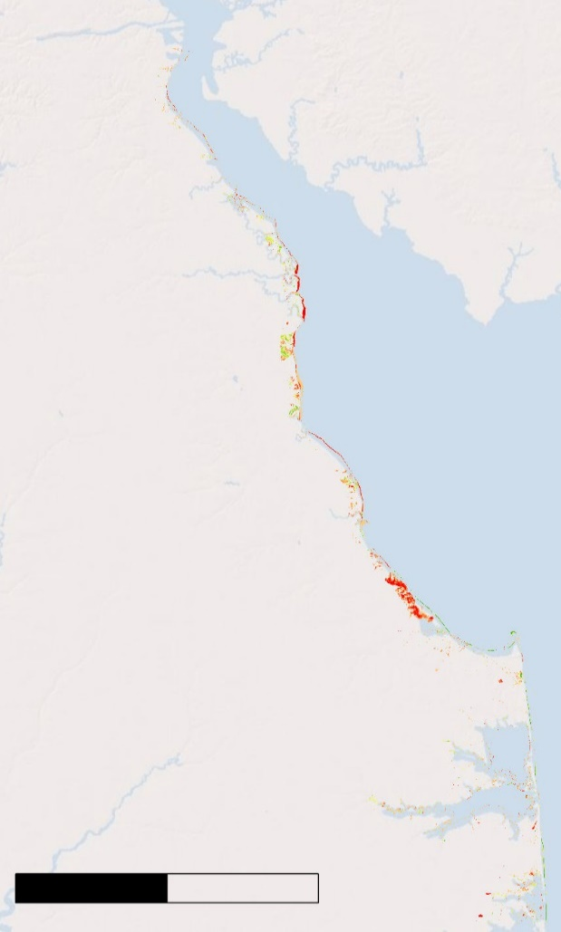
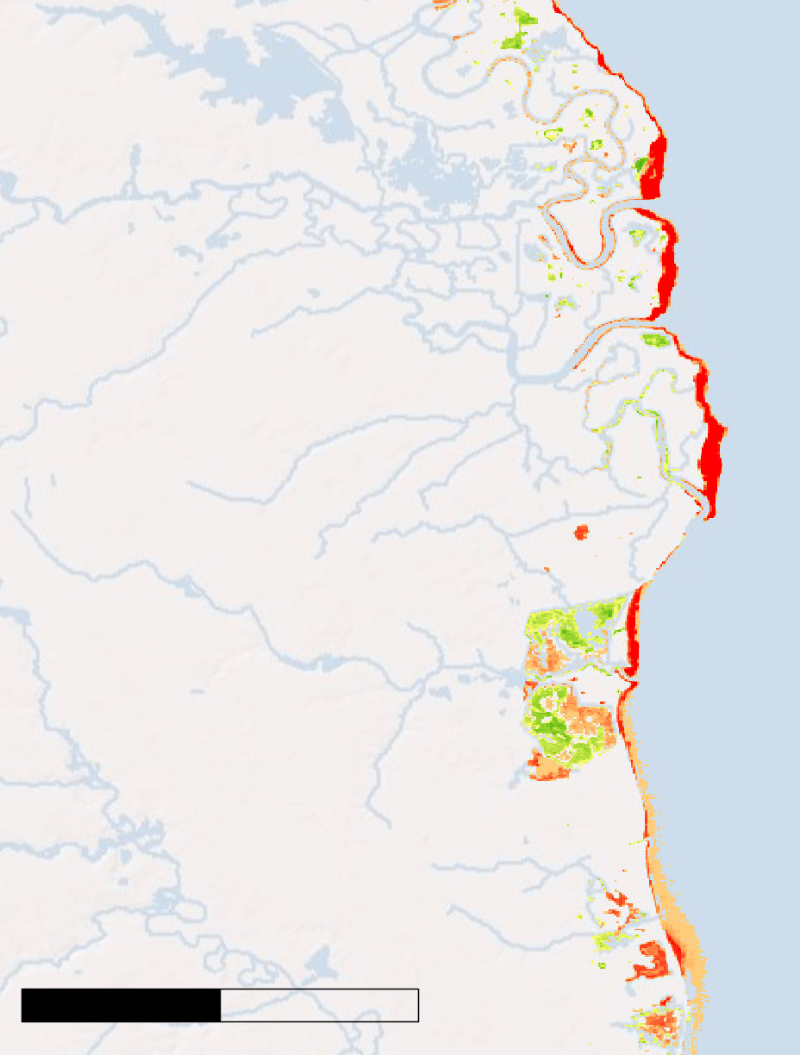
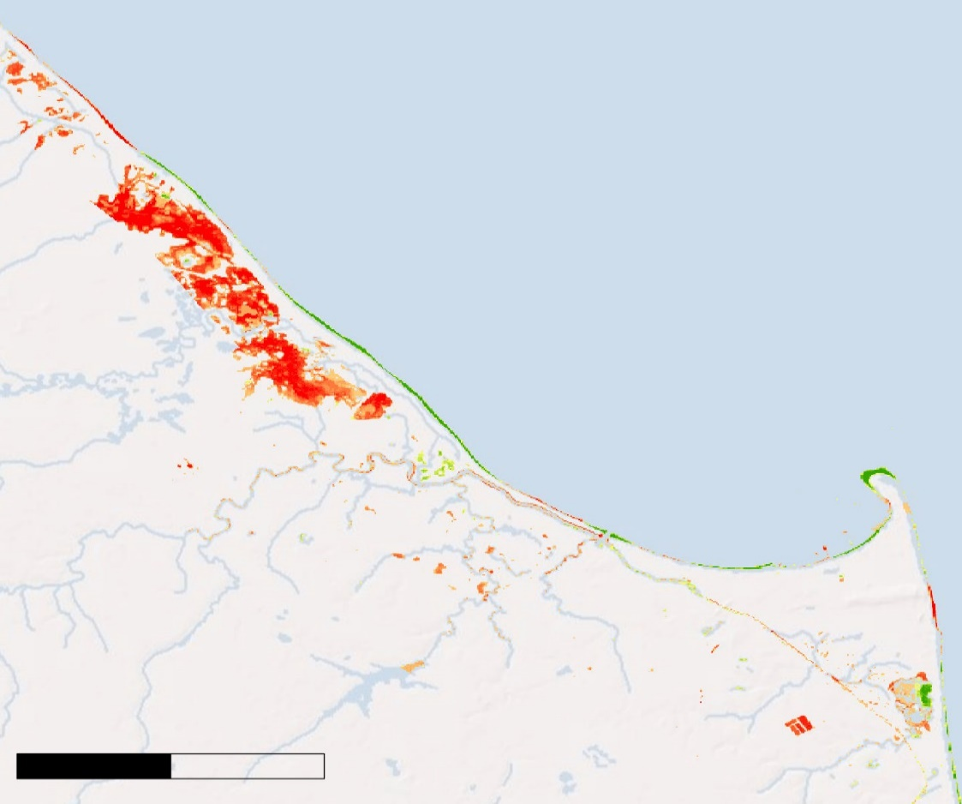
Utilizing NASA Earth Observations to Assess Coastline Replenishment Initiatives and Shoreline Risk Along Delaware’s Coasts
Abstract
Study Area
Objectives
Delaware’s coastline is a vibrant tourist destination and unique habitat for many vulnerable species. Yet, with the lowest mean elevation of any state, this indispensable stretch of land is threatened by numerous geological and climatic forces, including coastal erosion, sea level rise, storm surge, and subsidence. The state’s Department of Natural Resources and Environmental Control (DNREC) has, therefore, served as a diligent combatant of coastal land loss since the 1950s. In partnership with the DNREC, this team utilized Landsat 8 Operational Land Imager (OLI), Landsat 7 Enhanced Thematic Mapper Plus (ETM+), Landsat 5 Thematic Mapper (TM), and the Terra Advanced Spaceborne Thermal Emission and Reflection Radiometer (ASTER) in combination with ancillary datasets to create a suite of time-series maps that identified shoreline extent changes in response to management projects and to generate a coastal land loss susceptibility map. Analyses of coastline change across time were performed using quantifiable measures derived from the time-series maps. The team found that there was a statistically significant, dampening shift of land to water between 1988 and 2018. Bombay Hook Wildlife Refuge, Prime Hook Wildlife Refuge, Rehoboth Beach, Slaughter Beach, and Assawoman Bay are the most susceptible areas to land loss along Delaware’s coast. Areas that experienced the greatest land loss within the thirty-one-year range were the Prime Hook and Bombay Hook Wildlife Refuges. Conversely, Cape Henlopen exhibited a notable accretion of land. These maps and analyses can be used by the DNREC to support the development of future coastal protection and replenishment strategies through the evaluation of restoration technique effectiveness and identification of at-risk areas. Finally, these products were implemented into a story map that demonstrated the unique geological circumstances that put Delaware at risk and showcased the impacts of the state’s efforts to protect it.
N
Illustrate coastline changes in response to the state’s management projects over the past thirty-one years with a time-series map
Generate a susceptibility map to identify areas that are vulnerable to land loss that incorporates soil hydrology, land cover, slope, elevation, wind speed, wave height, sea level rise, and subsidence
Evaluate the performance of Delaware’s management strategies by comparing the timing and location of management projects with coastal land change
Demonstrate the environmental issues that put Delaware’s unique geographical area at risk and display the impacts of measures taken to protect the coastline through an ArcGIS Story Map
Delaware Urban Development
NJ
Delaware Bay
DE
Atlantic
Ocean
0
20
Miles
Methodology
Susceptibility
Maps
Time-series
Maps
& Analyses
Data Acquisition
Data Analysis
End Products
Landsat 5 TM
Terra ASTER
Ancillary Datasets
Reclassify Rasters
Weighted Sums
Data Processing
Time-series maps of entire study area + areas of interest
Analyses of Land Loss Trends and Rates of Loss
End Products
Coastal Annual Land Cover Change (CALCC) Calculator
Data Processing
1. Coastal Land Loss
2. Susceptibility Maps
Data Acquisition
Data Analysis
Calculate Slope
Classify Land Cover
Classify Soil Hydrology
Calculate Erodibility
Landsat 5 TM
Landsat 7 ETM+
Landsat 8 OLI
Ancillary Data
Raster Calculator
Reclassify Rasters
Regress Raster Values
Earth Observations
Results
Terra ASTER
Landsat 8 OLI
Landsat 5 TM
Landsat 7 ETM+
N
Rate of Coastal Change: 1988 - 2018
N
N
Augustine
Wildlife Area
High
Rate of Change
Zero Line (no change)
Quadratic Regression: R² = 0.0061
Bombay Hook National Wildlife Refuge
Cedar Swamp
Wildlife Area
Risk
Level
Little Creek Wildlife Area
Low
Rate of Change
Bombay Hook National Wildlife Refuge
Kitts Hummock
Delaware Bay
0 30
0 5
Prime Hook National
Wildlife Refuge
Time Segments (Years)
Miles
N
Miles
Slaughter
Beach
Rehoboth
Beach
Coastal Land Loss Trends: 1988 - 2018
Prime Hook National
Wildlife Refuge
Rehoboth Bay
Percent Water
Quadratic Regression: R² = 0.7611
Cape Henlopen
Gain
Indian River
Bay
Atlantic
Ocean
Percent Water
Wolfe Neck Wastewater Treatment Facility
Built: 1995
Land
Change
Assawoman
Bay
Rehoboth Beach
Loss
0 20
0 5
Miles
Time(Years)
Miles
Team Members
Conclusions
Project Partners
According to NASA’s Earth Observations, Delaware’s coast has experienced land loss since 1988. We have shown both qualitatively and quantifiably that Delaware’s coast has experienced land loss since 1988, but there was no detected trend in the rate of land change.
Wildlife Areas and Refuges, Rehoboth and Slaughter Beaches, and Assawoman Bay are the most susceptible areas to land loss along Delaware’s coast.
Prime and Bombay Hook National Wildlife Refuges have experienced the greatest amount of land loss from 1988-2018.
Delaware Department of Natural Resources and Environmental Control (DNREC)
Acknowledgements
Dr. Jeffrey Luvall, NASA Marshall Space Flight Center
Dr. Robert Griffin, University of Alabama in Huntsville
Danielle Ruffe, University of Texas at Austin
Madison Murphy, NASA DEVELOP
Christine Evans, University of Alabama in Huntsville
Maggi Klug, University of Alabama in Huntsville
Helen Baldwin, NASA SERVIR
Rachel Tessier
Project Lead
Ani Matevosian
Greta Paris
Nick Gagliano
Alabama – Marshall | Fall 2019

