Slide 1
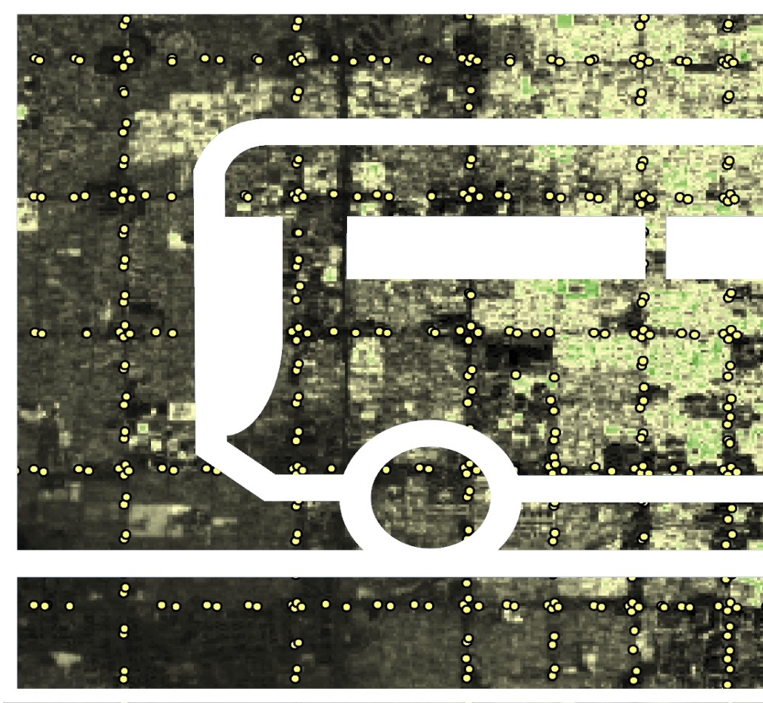

PHOENIX HEALTH & AIR QUALITY
Tamara Dunbarr
(Project Lead)
Utilizing NASA EOs to Assess the Impact of Extreme Heat on Transit Riders in Phoenix, Arizona
McKenzie Murphree
Lance Watkins
Maricopa County Department of Public Health and Arizona State University
2017 Spring

Slide 2
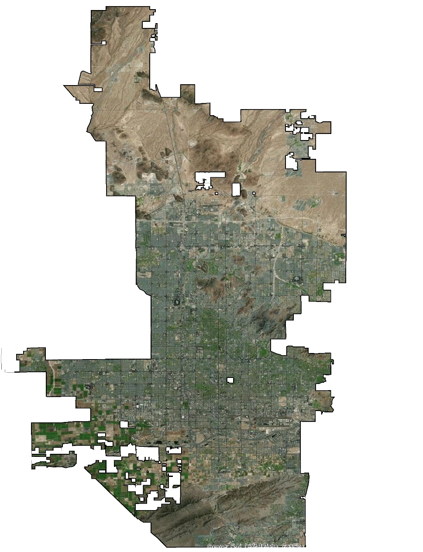
Study Area
Phoenix, Arizona
Semi-arid climate
Summer Temperatures
  Average High: 106 °F
  Average Low: 80 °F
  Record High: 122 °F
Population: 1.5 million (Census)
Yearly Bus Ridership: > 49 million
Study Period: May – October 2006-2016
Notes:
The study area was the city of phoenix. Phoenix experiences a semi-arid climate with hot and dry summers and a monsoon season in late summer. Average summer highs are around 106. Record high is 122.
Phoenix is a large city with an area of 517 square miles. Every year the bus transit system services over 49 million Phoenicians. Study period is May - October 2006 - 2016.
Base Layer Source: Esri Digital Globe GeoEye

Slide 3
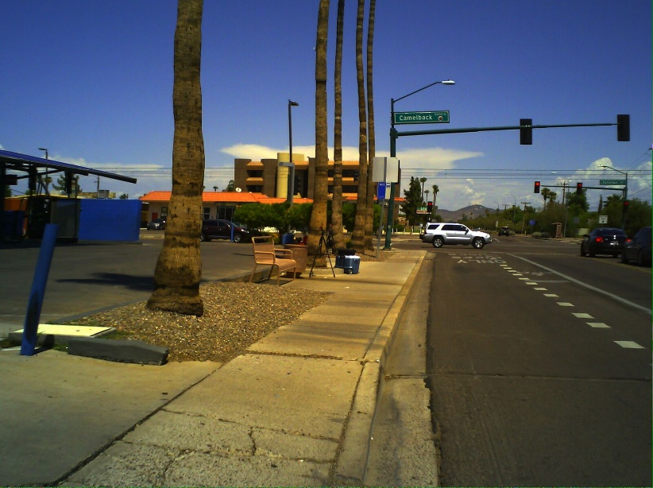
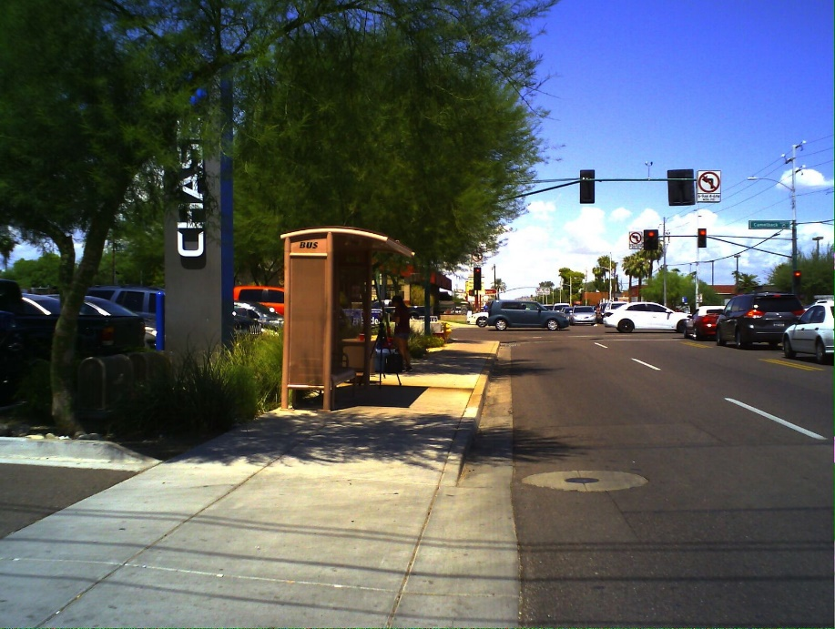
Project Partners
City of Phoenix, Public Transit Department
Vitalyst Health Foundation
ASU Urban Climate Research Center
ASU Center for Policy Informatics
Maricopa County Department of Public Health
Image Credit: ASU Urban Climate Research Center
Notes:
Our partners for this project include the City of Phoenix Transit Department, Vitalyst Health Foundation, Arizona State University (ASU) Climate Research Center, ASU Center for Policy Informatics, and the Maricopa County Department of Public Health.

Slide 4
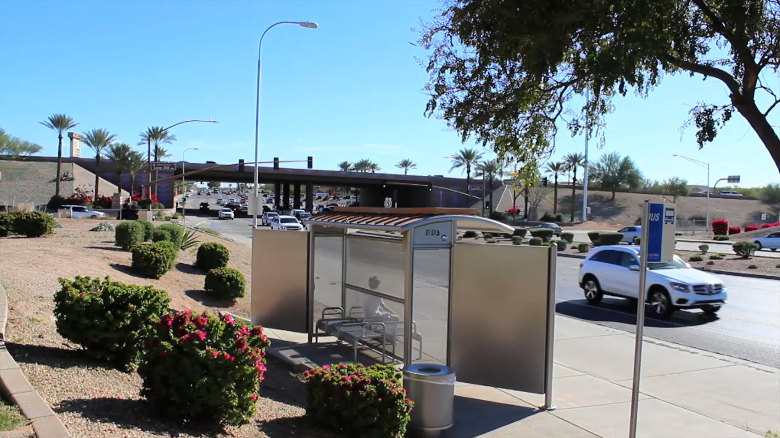
Community Concerns
Exposure to extreme heat can lead to hospitalization and death
Extreme heat disproportionally impacts low income, elderly, and ethnic minorities
Over 600 bus stops do not have any modifications in place to shield riders from heat
Image Credit: McKenzie Murphree
Notes:
Exposure to extreme heat can lead to heat related illness like heat cramps, sun burns, heat exhaustion and heat stroke. Extreme heat can also exacerbate preexisting respiratory and cardiovascular diseases. Additionally, extreme heat has been known to impact low income, elderly, ethnic minorities more. Over 600 bus stops in Phoenix that provide little to no shelter from extreme heat.

Slide 5



NASA Earth Observations
Terra – Advanced Spaceborne Thermal Emission and Reflection Radiometer (ASTER)
Landsat 8 – Operational Land Imager
Landsat 5 – Thematic Mapper
Notes:
Land surface temperature at our bus stops were assessed using the Terra Advanced Spaceborne Thermal Emission and Reflection Radiometer, Landsat 8 Operational Land Imager, and Landsat 5 Thematic Mapper. Landsat 8 Operational Land Imager was also used to calculate normalized vegetation difference index, which provides an estimate of vegetation prevalence. Ridership and bus stop data was attained from our partners at the Phoenix Transit Department

Slide 6
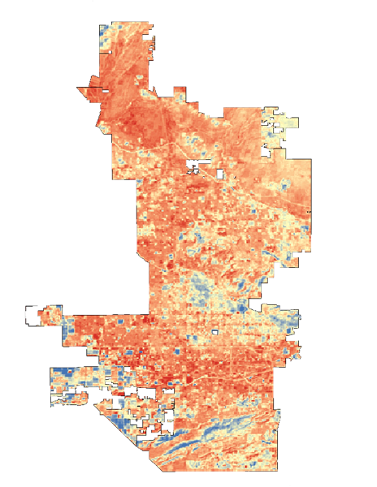
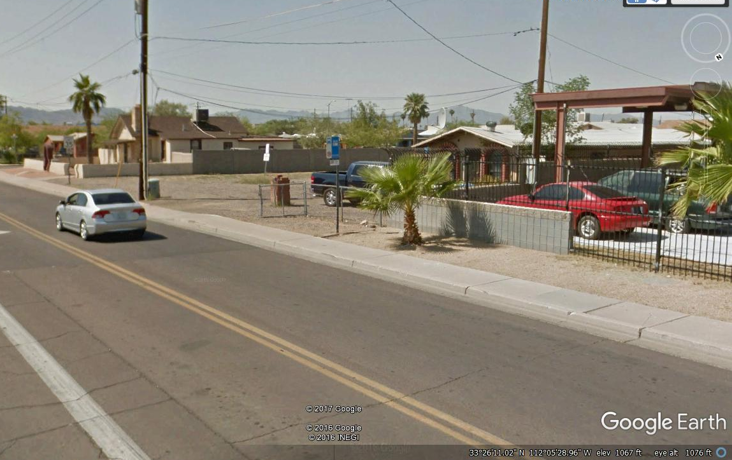
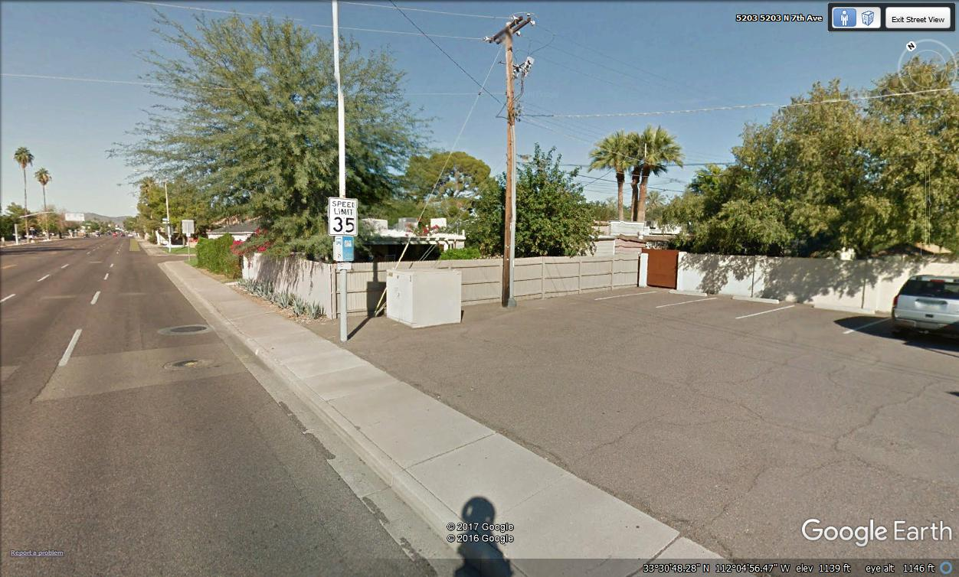


Land Surface Temperature
High LST: 136°F
15th Ave and Buckeye Rd
Low LST: 119°F
7th Ave and Colter St
Low LST
High LST
Notes:
Land Surface Temperature was complied for the city of Phoenix and values were extracted at bus stops to determine the land surface temperature associated with each bus stop. Land surface temperature calculated from ASTER and Landsat represents the surface temperature between 11am and 12pm MST. Here we have two examples of average LST values at two different bus stops in the city. The higher LST average of 136 degree Fahrenheit can be found at 15th Ave and Buckeye Rd. While the 7th Ave and Colter St stop is located in a cooler area, with an average LST of 119 degree Fahrenheit.

Slide 7
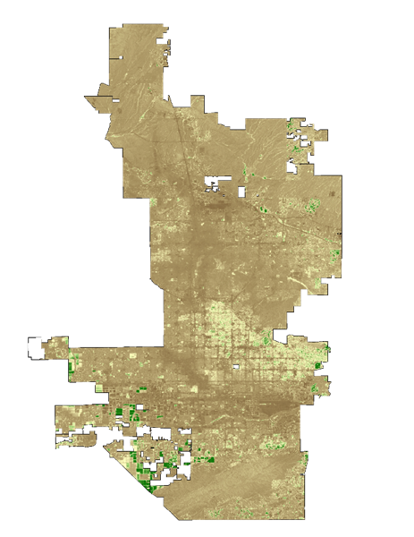
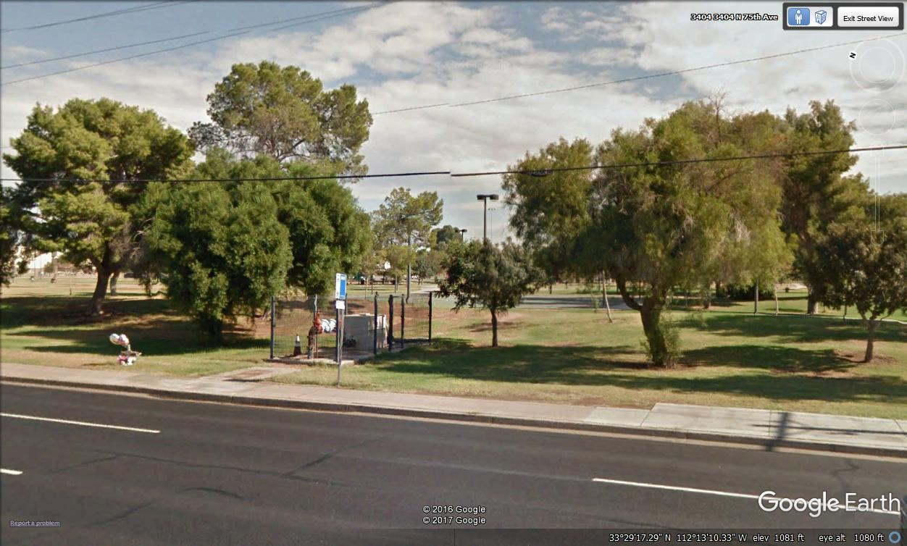
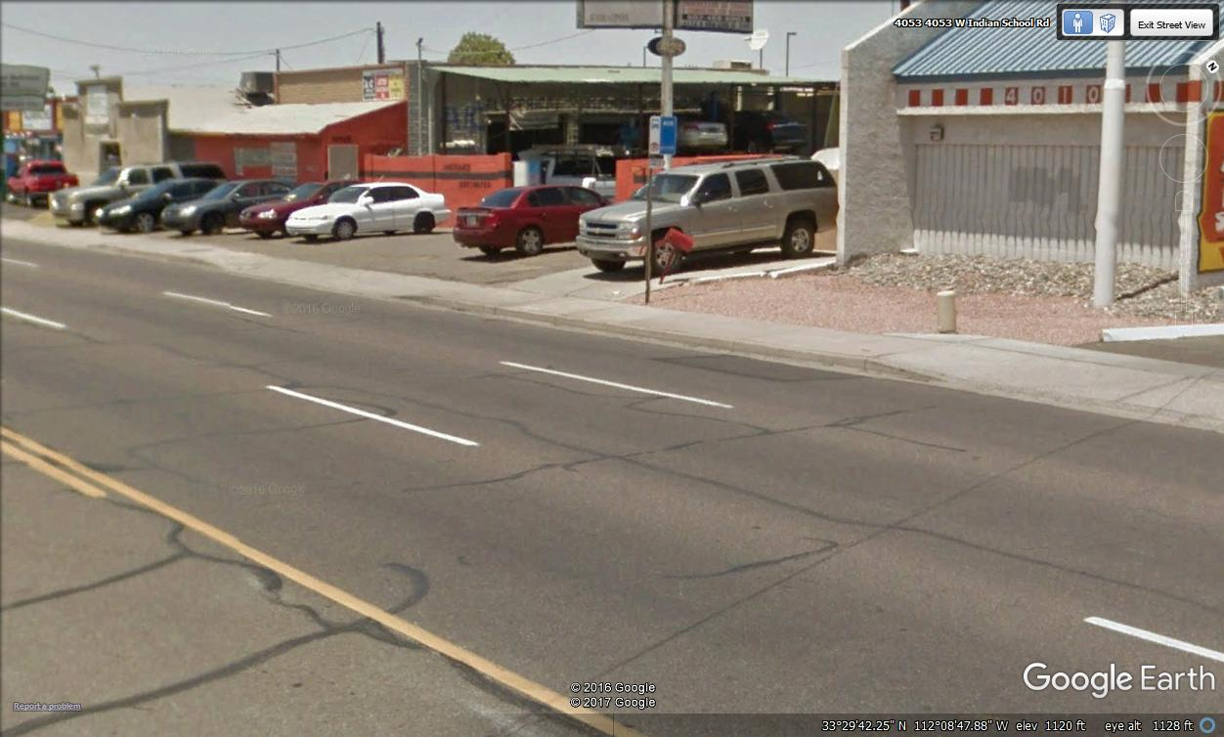


Normalized Vegetation Difference Index
High NDVI: 0.36
75th Ave and Osborn Rd
Low NDVI: 0.03
Indian School Rd and 40th St
Low NDVI
High NDVI
Notes:
Normalized Vegetation Difference Index gives us an understanding of the prevalence of green vegetation around each bus stop. We can see very stark differences in the amount of vegetation around each bus stop. A higher NDVI value of 0.36 is related with abundant green vegetation in the city. While a value of 0.03 is representative of little to no vegetation.

Slide 8

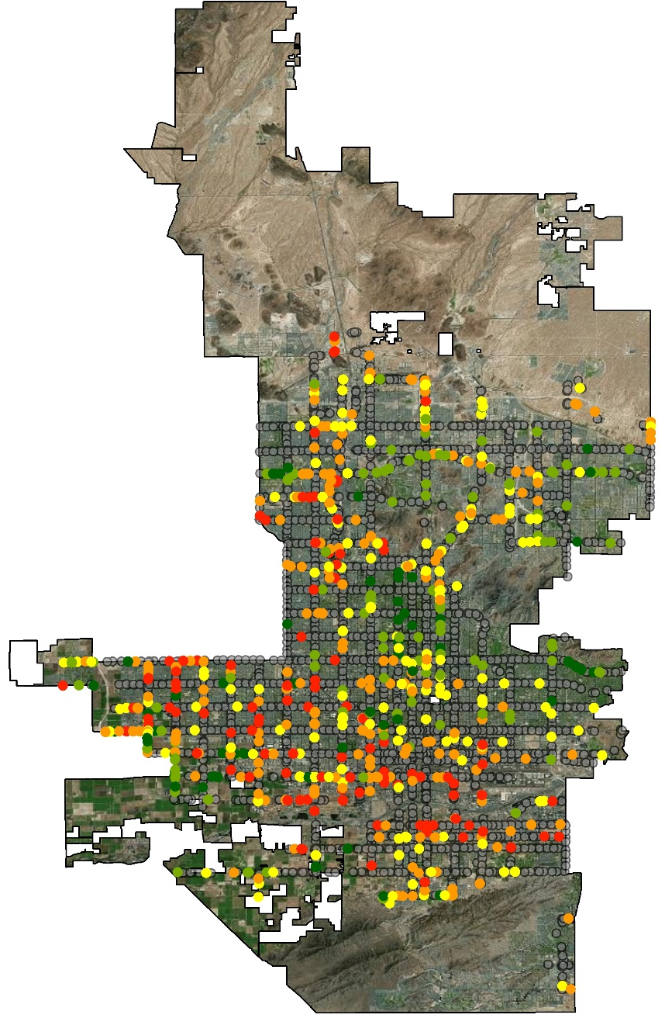
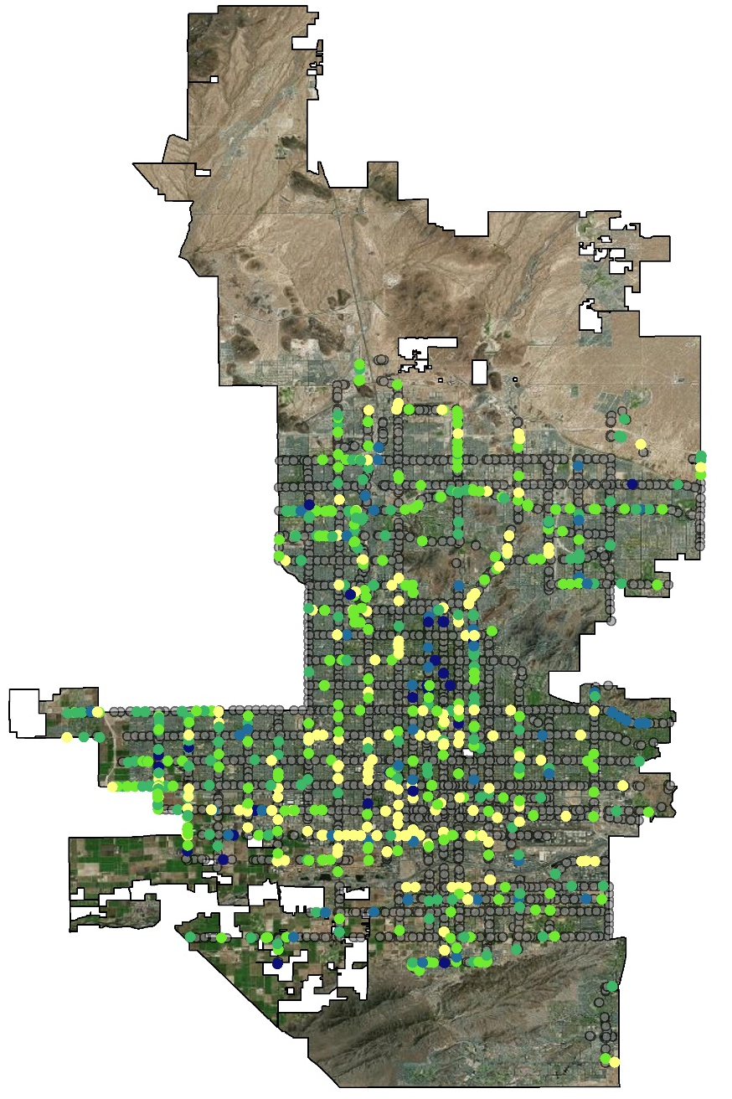
Results
Average LST | Average NDVI
127 °F | 0.12
Notes:
The individual NDVI and LST values at bus stops were compiled into averages for all the unshaded bus stops. The average LST is 127 degrees Fahrenheit and NDVI had an average value of 0.12, which is reflective of Phoenix’s semi arid environment. Downtown Phoenix is represented by the blue start in each image. Generally speaking, bus stops located in hotter less vegetated areas tend to occur just west and south of downtown Phoenix. While, cooler more vegetated stops can be found northeast of central Phoenix.
Base Layer Source: Esri Digital Globe GeoEye

Slide 9
Results
Stop ID | Address | Boards per Day | Average Temperature (°F) | Percent in the Top 33 Hottest Stops
130 | EB BROADWAY RD FS 20TH ST | 14 | 133.6 | 78.4
4907 | SB 35TH AVE FS ELWOOD ST | 1 | 133.4 | 78.4
4846 | SB 15TH AVE FS SHERMAN ST | 2 | 133.0 | 73.0
221 | EB BUCKEYE RD FS 14TH ST | 1 | 132.9 | 64.9
4995 | SB 7TH ST FS WIER AVE | 12 | 132.6 | 66.2
2366 | NB 43RD AVE FS INDIANOLA AVE | 10 | 132.5 | 52.7
2689 | NB 83RD AVE FS PALM LA | 3 | 132.3 | 59.5
2329 | NB 43RD AVE FS EARLL DR | 6 | 132.3 | 55.4
4845 | SB 15TH AVE FS BUCKEYE RD | 5 | 132.2 | 66.2
2230 | NB 35TH AVE FS CLARENDON AVE | 8 | 132.1 | 48.6
3249 | NB 59TH AVE FS SHERMAN ST | 1 | 132.1 | 43.2
1825 | NB 83RD AVE FS GLENROSA AVE | 2 | 132.0 | 47.3
8142 | NB 29TH AVE FS PINNACLE PEAK RD | 2 | 131.9 | 58.1
2988 | NB METRO PKY E NS CHERYL DR | 9 | 131.9 | 56.8
4895 | SB 24TH ST FS WIER AVE | 13 | 131.9 | 51.4
Show distribution of histograms of LST images color coded to depict early and late summer LST
Show Top 10 percent hottest
Some shit
Notes:
This figure helps us understand which stops are consistently hotter than others. The column on the far right indicates the percentage of land surface temperature images in which a particular stop was in the top 5% or top 33 hottest stops. Looking this rank along side average temperature a boards per day it becomes clear that some stops which or similarly hot experience very different levels of ridership. This indicates that careful consideration must be made it determining which stops to spend resources for shade enhancements. This also might indicate that looking at the consistently hottest stop may not be the best way to prioritize temperature in determining shade enhancements. The last stop has close to the same level of daily boards as the first stop but is slightly cooler and is only in the top 33 hottest stops 51% of the time.

Slide 10
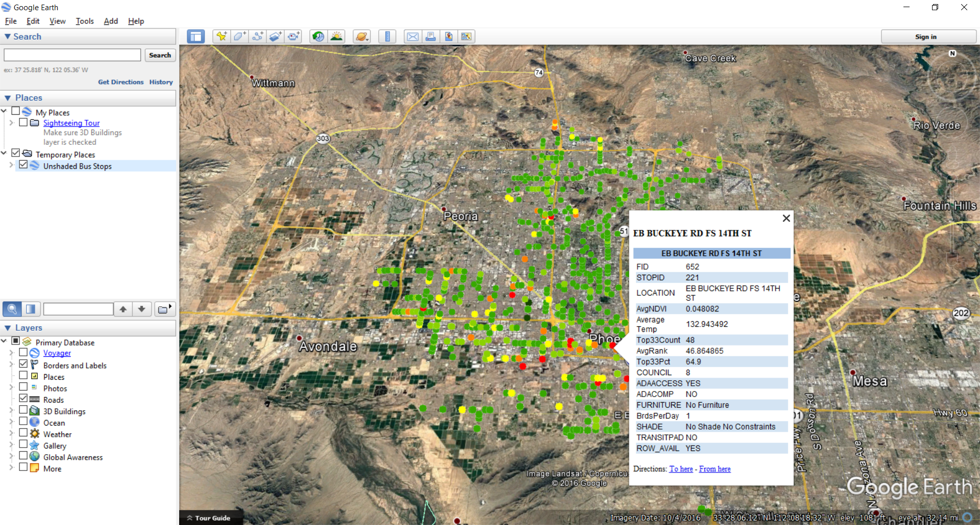
Results
Notes:
The resulting NDVI and LST layers, top 33 percent, bus stop rank, and bus stop infrastructure information was compiled into a KML layer which allows our end users to explore the data themselves
Base Layer: 2016 Google Landsat / Copernicus

Slide 11
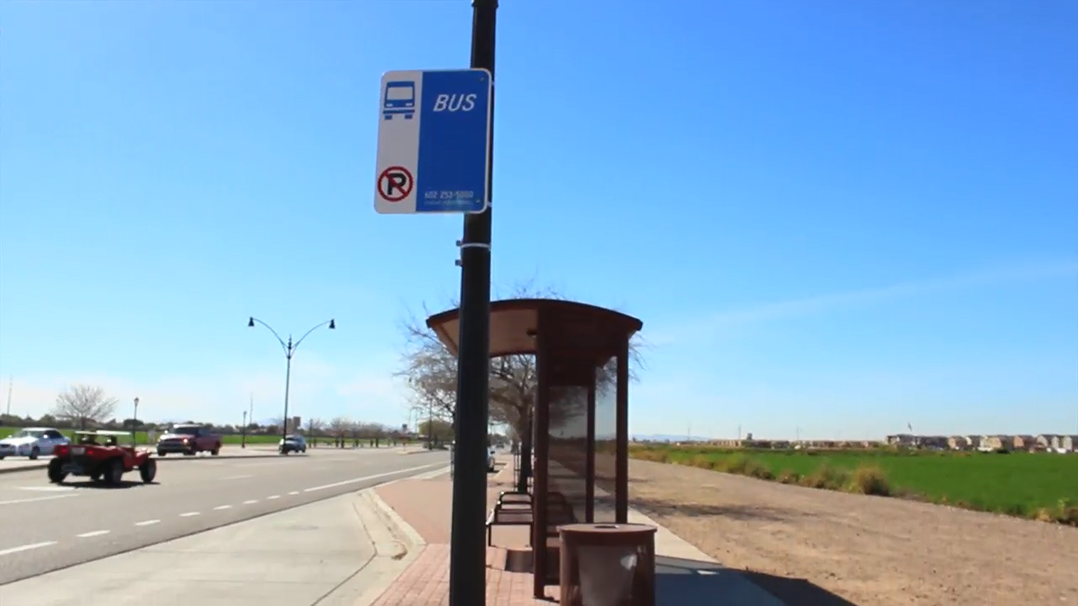
Conclusions
Landsat and Aster provide useful ways to estimate the thermal conditions of bus stops throughout Phoenix
Of the unshaded stops the hottest stops are not necessarily the most frequented stops
Future Work:
  Examine socioeconomic and demographic variation of residents near stops
  Assess thermal conditions of specific routes
  Incorporate data and end user perspective into a quantitative suitability analysis.
Image Credit: McKenzie Murphree
Notes:
Landsat and ASTER LST estimates provide a useful way to understand thermal conditions of bus stops throughout Phoenix. The rank analysis indicated that the stops which were most frequently the hottest stops were not always the most frequented stops by riders. Future work will examine the socioeconomic and demographic variation of the neighborhoods these stops serve. The analysis will be expanded to examine the thermal conditions of specific bus routes. Finally, we will incorporate the data and end user input into a quantitative suitability analysis to better identify stops to improve shade structures.

Slide 12
Joseph Bower, City of Phoenix, Public Transit Department
Dr. David Hondula, Arizona State University
Dr. Kenton Ross, NASA DEVELOP National Program
Notes:
We would like to thank our end users with the Phoenix Transit Department for the enthusiasm and engagement with the project. Thanks to Drs. Hondula and Ross for their scientific advising and support too.

