Slide 1
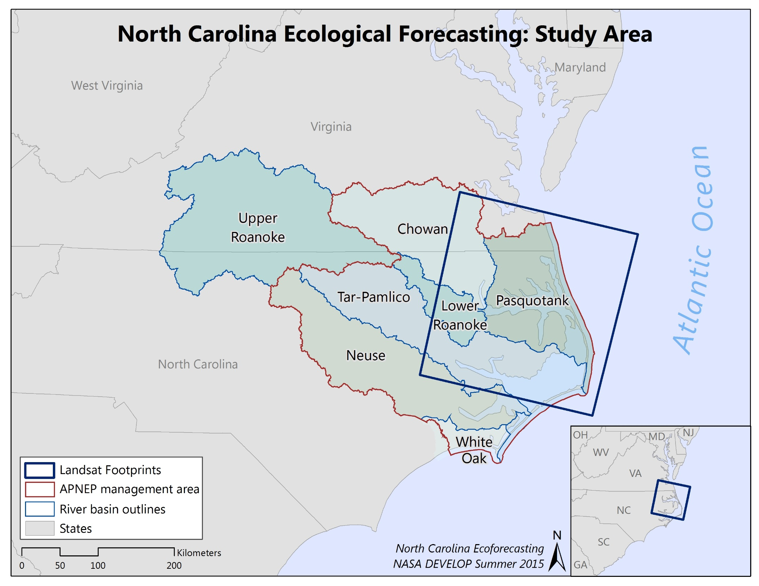

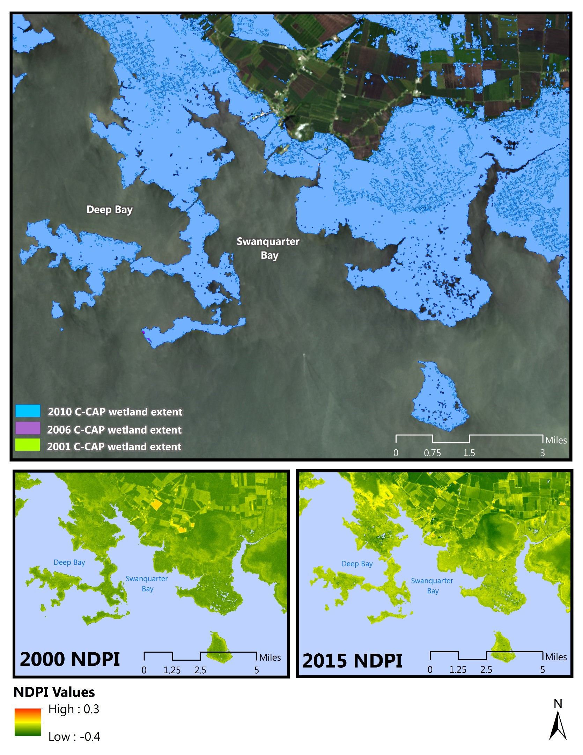
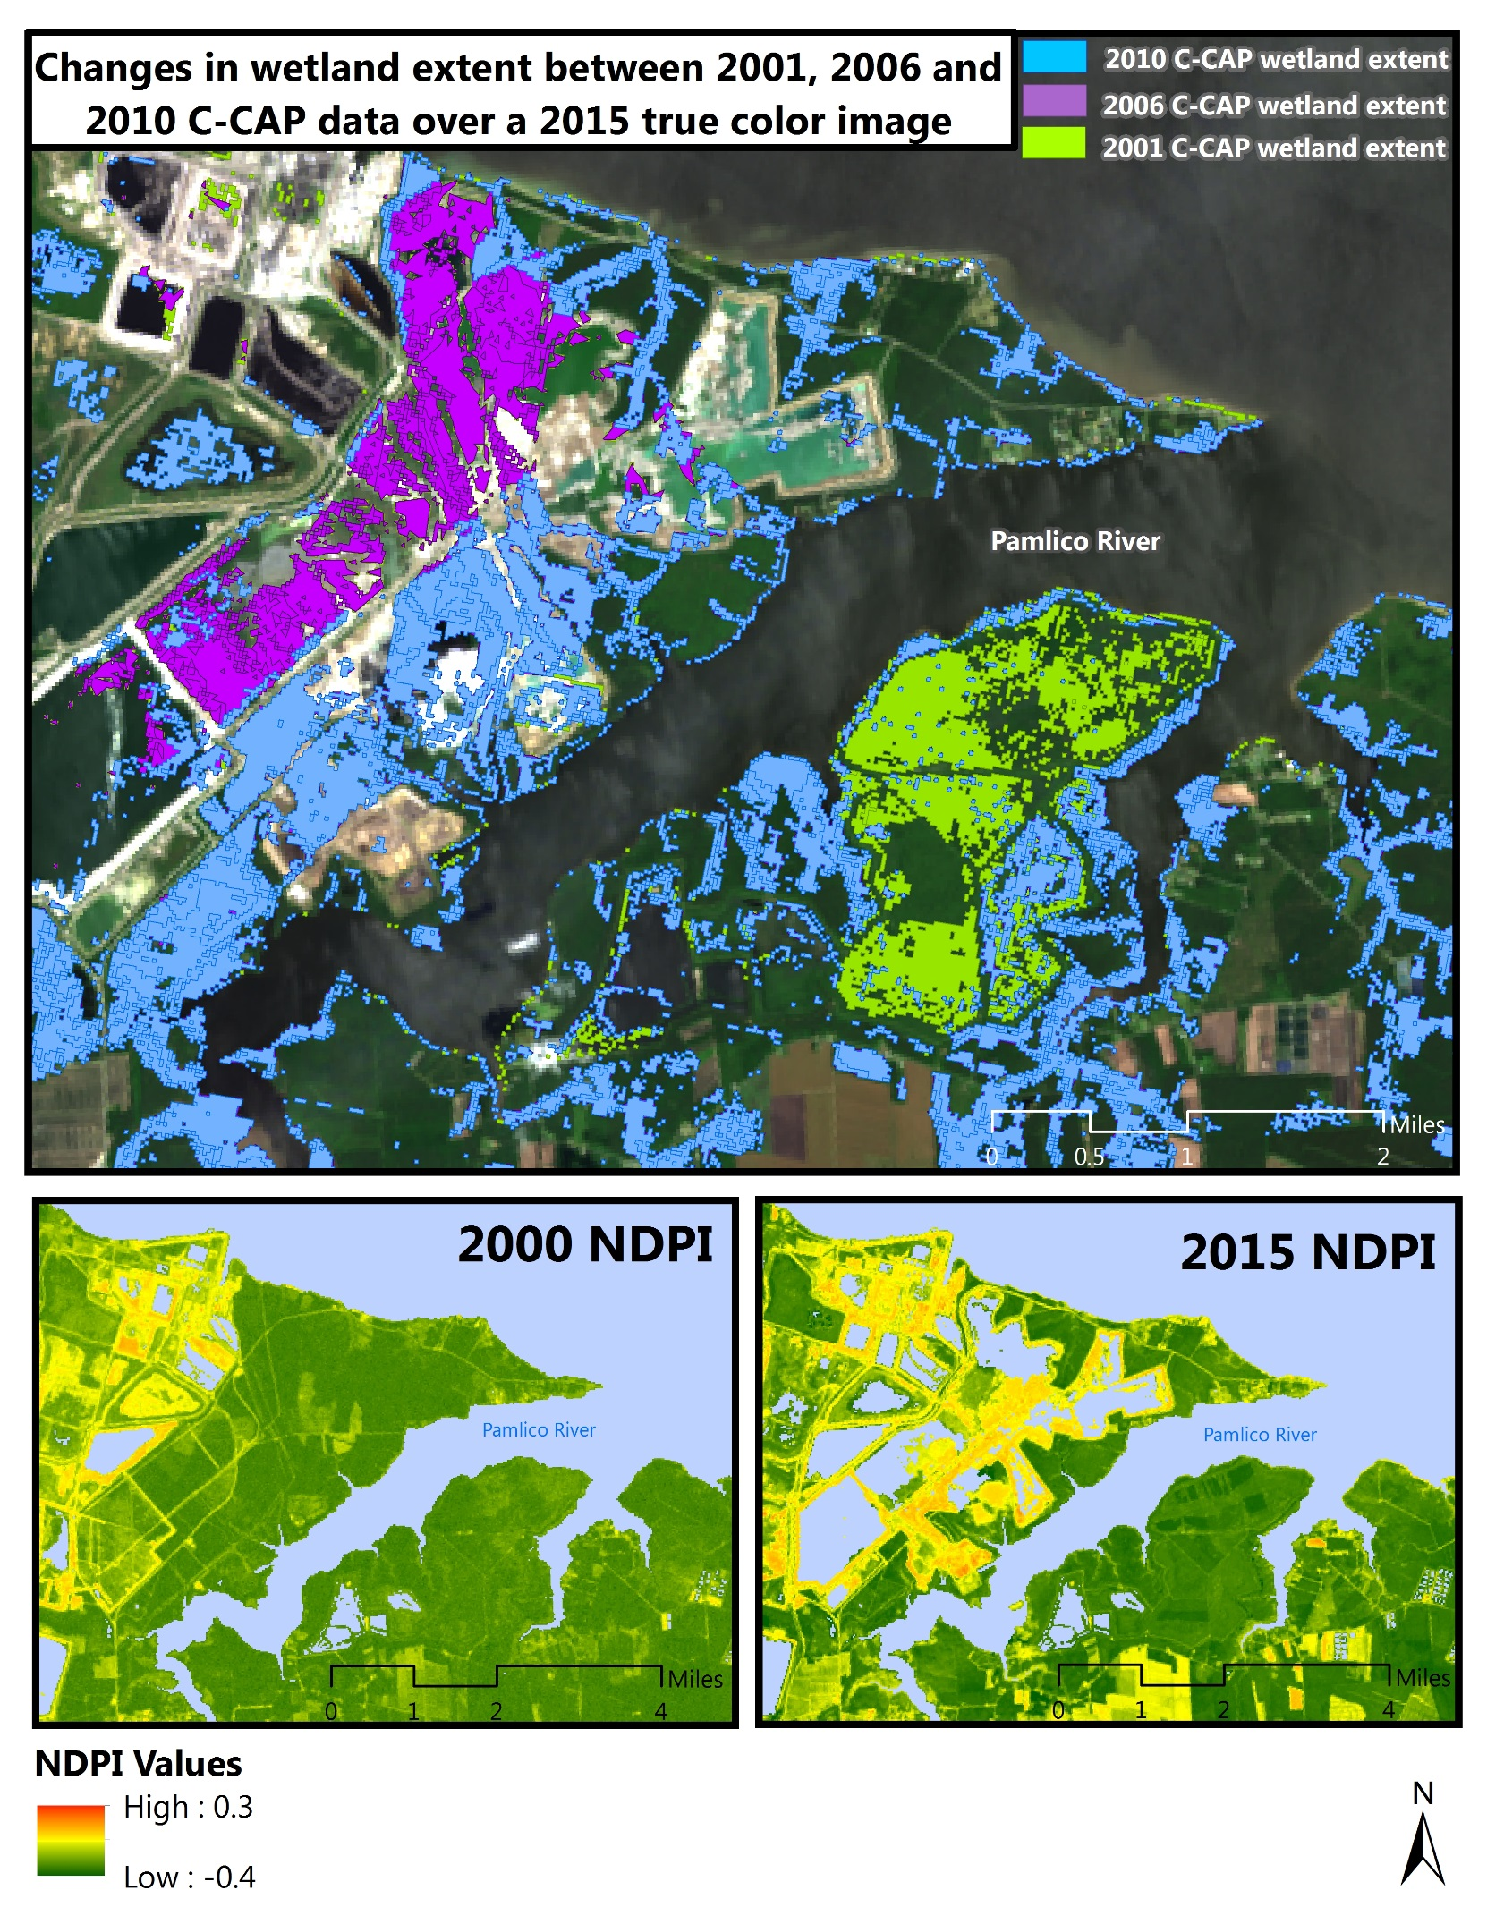
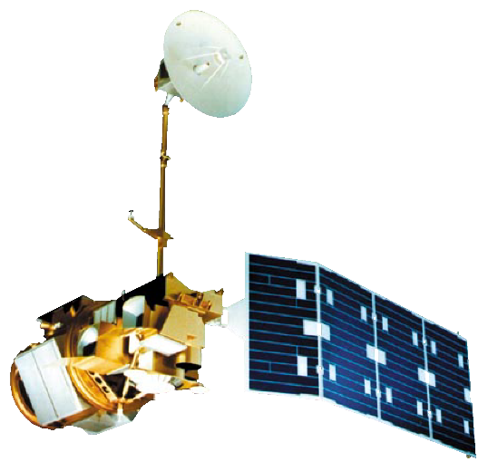

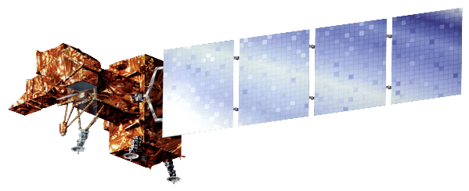


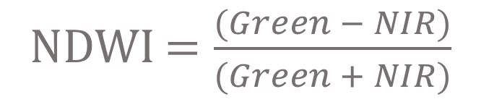
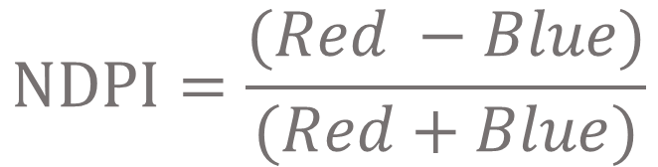
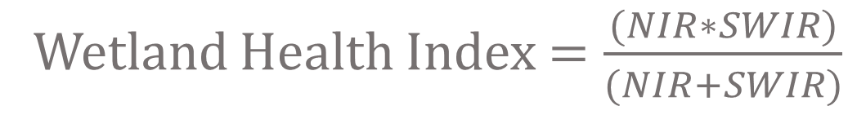
NORTH CAROLINA ECOLOGICAL FORECASTING
Evaluating the Application of NASA Earth Observations to Rapidly Detect
Change in Wetland Types at a Regional Scale
Zand Bakhtiari (Project Lead), Stephen Zimmerman, Kayla Patel, Brad Gregory
NASA DEVELOP National Program at NASA Langley Research Center
Abstract
Objectives
As a result of their sensitivity to sea level rise, wetlands are one of the most vulnerable ecosystems to climate change. In addition, wetland extents have diminished over time due to population increases and associated land change patterns. This project, partnered with the Albemarle-Pamlico National Estuary Partnership (APNEP), sought to delineate wetland extent within the Albemarle-Pamlico watershed from 2000 to 2015 using NASA’s Landsat 5 Thematic mapper(TM), Landsat 7 Enhanced Thematic Mapper Plus (ETM+), and Landsat 8 Operational Land Imager (OLI). Four images (representing spring, summer, fall, and winter) were collected for each year from 2000 to 2015. Multiple images were used for each year to account for tidal changes and to minimize the noise produced by clouds. After pre-processing the images, indices that measure water extent and wetland health were calculated for each image. A Normalized Difference Water Index was used to delineate shoreline. A wetland health index that ratios the near infrared and short wave infrared bands, and a Normalized Difference Pigment Index were used to assess wetland health. From these indices, wetland extent and relative health were measured more rapidly than contemporary classification methods. A tutorial was provided to APNEP to support the organization in implementing policies toward wetland monitoring, protection, and restoration.
Determine shoreline extent in the Albemarle-Pamlico watershed for 2000-2015
Assess relative wetland health by measuring carotenoid/chlorophyll-a ratios
Reference NOAA C-CAP data to determine specific areas of wetland loss/gain
Study Area
Methodology
NDWI $=\frac{(Green − NIR)}{(Green + NIR)}$
$$NDPI=\frac{(Red −Blue)}{(Red+Blue)}$$
Wetland Health Index $=\frac{(NIR∗SWIR)}{(NIR+SWIR)}$
56 Landsat (5 TM, 7 ETM+, 8 OLI) scenes were collected form 2000 - 2015
Four scenes per year were acquired in order to account for seasonal variations in vegetation phenology and also in tidal patterns to determine shoreline extent
Python was used to automate image pre-processing, for image analysis, and compiling results into graphics
Results
Earth Observations
Landsat 7 ETM+
Landsat 5 TM
Landsat 8 OLI
Conclusions
From 2000 – 2010 there was minimal change in wetland extent (approximately 30 mi² )
Noticeable decrease in the overall wetland health detected from health index (NDPI)
According to C-CAP for 2000-2010 wetland area will remain relatively consistent in future years, our assessment predicts wetland health will continue to decrease
Top Image: C-CAP data shows no change in wetland extent.
Bottom Images: Wetland health index (NDPI), low values represent healthy vegetation while high values are unhealthy. Wetland heath is decreasing the reason for the decrease is beyond the scope of this project.
Top Image: C-CAP data shows changes in land use that were previously wetlands.
Bottom Images: Wetland health index (NDPI), low values represent healthy vegetation while high values are unhealthy. This is a clear example of direct human drainage and urbanization of wetlands.
Team Members
Project Partners
Acknowledgements
Dr. Kenton Ross
NASA DEVELOP National Program Science Advisor
Jeff Ely
NASA DEVELOP National Program
Team members left to right: Zand Bakhtiari, Kayla Patel, Stephen Zimmerman
Albemarle-Pamlico National Estuary Partnership (APNEP)
NASA Langley Research Center

