Slide 1
Sierra Nevada Water Resources
Quantifying the Effects of Wildfire Severity on Snow Water Equivalent in the Sierra Nevada
Sean Cunningham (Project Lead) Nolan Cate
Justin Anzelc Vishal Arya Clayton Sodergren

Slide 2
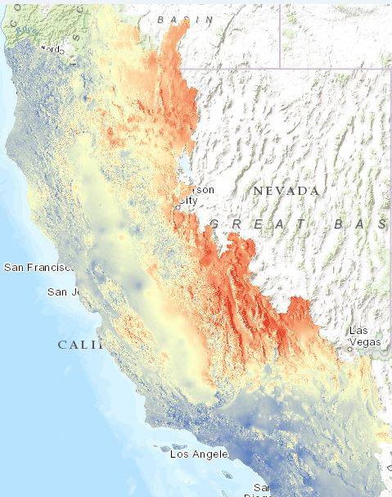

Background
CA Water Resources
Snowpack is a crucial component of the California water supply
Management, fire suppression policies and climate change are increasing wildfire frequency and severity
Little research exists quantifying effects of wildfire severity on snowpack
Projected change in winter minimum temperature, 2070
Notes:
The Sierra Nevada provides California with a variety of valuable ecosystem services, including carbon sequestration and wildlife habitat. Snowpack is of special importance, providing water storage, filtration and purification.
Precipitation in the form of snowpack accumulates in the Sierra Nevada and melts during the summer months, recharging watersheds relied upon by major metropolitan areas such as SF and LA.
However, snowpack in the Sierra has dropped drastically. These changes are caused in part by climate change and management practices. The image on the right shows projected increases in temp for California, with more severe increases in red. Changes like these are causing concern for long term water security. Currently, there is little quantitative data relating wildfire severity effects on snowpack.

Slide 3
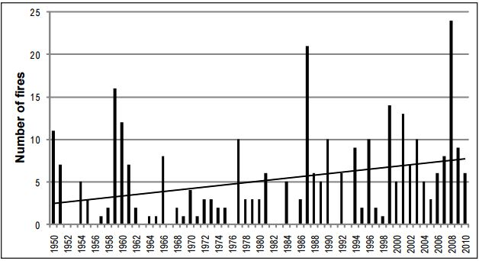
Background
A Qualitative Understanding
Sierra Nevada (SN) forest ecosystems adapted to, and require, low to moderate severity wildfire to remain healthy
Fire suppression has led to more fuels, denser forests and higher severity fires
High severity wildfire negatively impacts soil quality/structure, aquatic ecosystems, stand structure, albedo, etc
Trend in >1000-acre fires in SN, 1950 to 2010
Source: Miller and Safford 2012
Notes:
It’s important to understand that forests of the Sierra Nevada adapted to low and moderate severity fire as a present and integral part of the ecosystem, and rely on the inclusion of this process to remain healthy.
However, federal fire policy was enacted in 1905 that aimed to put out every fire in American forests. The policy allowed fuels to build up and forests to become more dense, which has led to an increase in wildfire frequency and severity in forests in the american west. High severity fires, which were historically very rare, have been becoming more and more common. The graph on the right shows how wildfire frequency has been increasing since the 1950’s.
These high-severity wildfires are extremely problematic as they negatively impact the quality and structure of soil, aquatic ecosystems, and stand structure. In addition, high-severity fires have the potential to affect snowpack by changing canopy cover and surface albedo, among other factors.

Slide 4
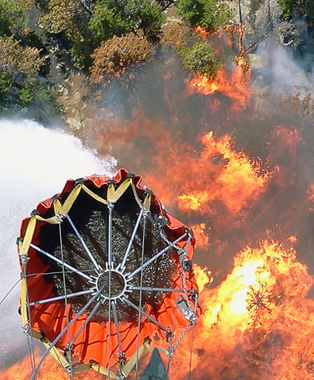
Community Concerns
Snowpack in the SN is a major source of drinking water
Wildfire severity and frequency are increasing in the SN
Current forest management practices and policies cause deviations from natural fire regimes
Source: National Guard
Notes:
The need for this research was brought on by several community concerns.
Sierra Nevada provides drinking water to a large part of California, including the Bay Area and the Los Angeles area.
There’s an ongoing increase in wildfire severity and frequency in the american west, including the SN.
Management policies are beginning to take natural fire regimes more into consideration, but still work to suppress most fires.
Now Sean’s going to describe our study area and the fires we selected.

Slide 5
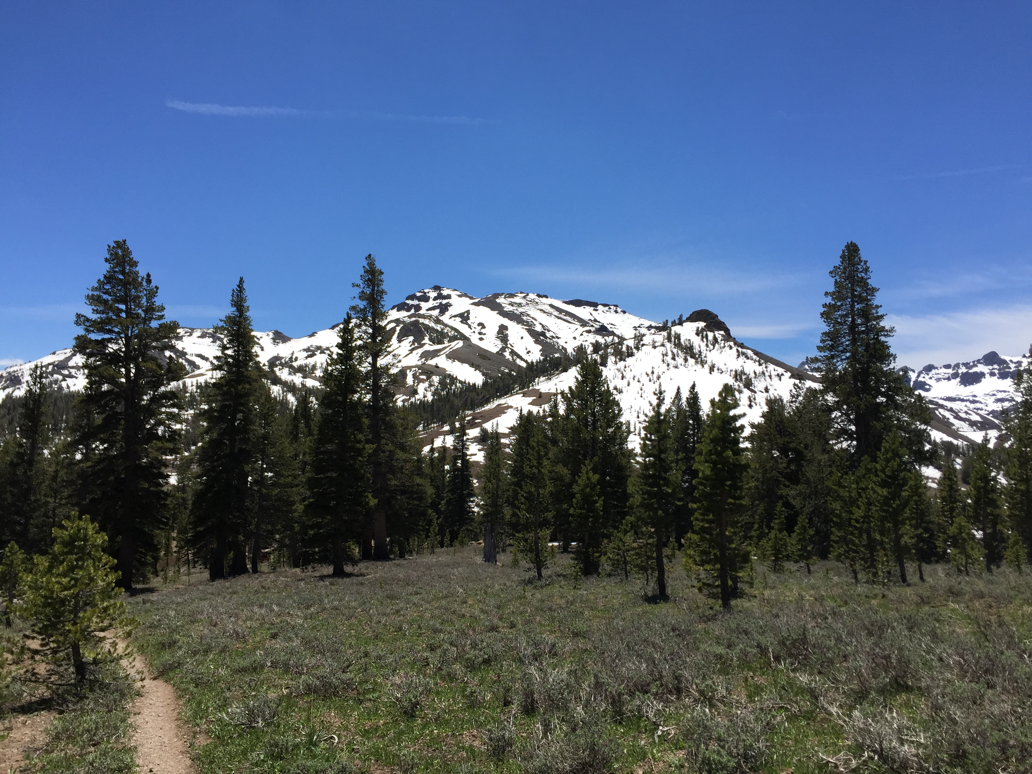
Study Area

Slide 6
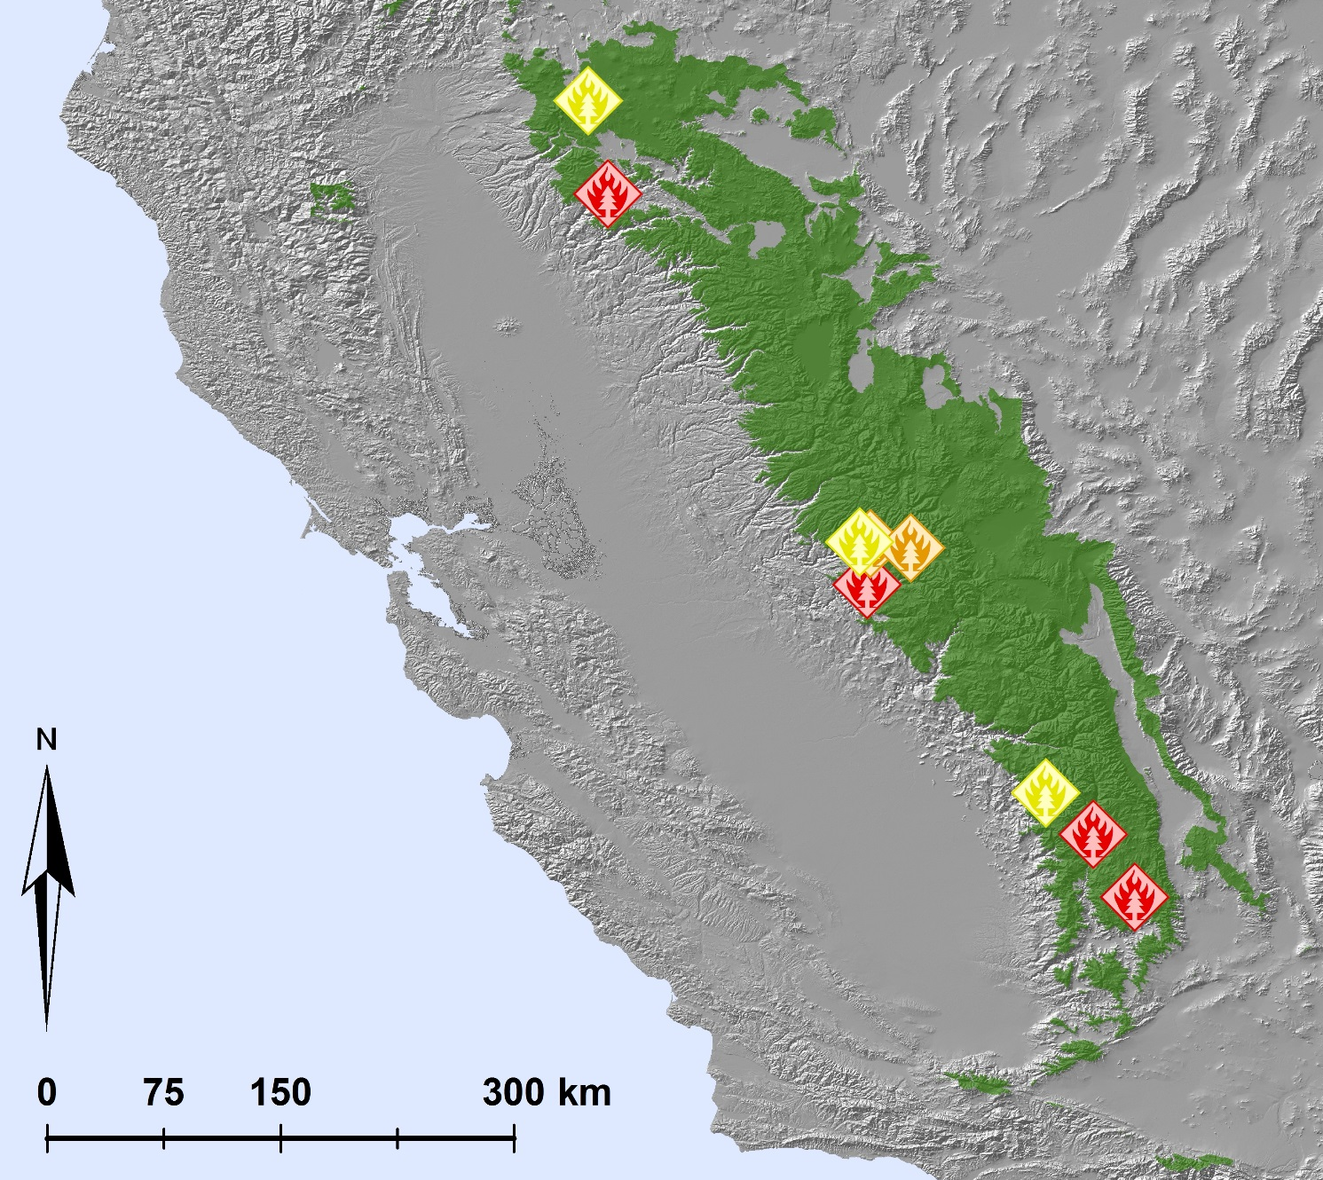
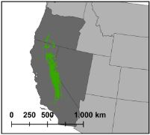
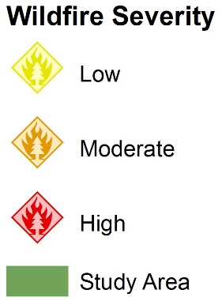
Study Area
Notes:
As you can see in the green area of the map, the study area for our
project was the Sierra Nevada mountain range within California
■ We refined our study area to nine wildfires of low, moderate and high
vegetation burn severity
● And 3 low severity wildfires the Castle in 1995, the Wapama in
● 2 moderate severity wildfires; the 2004 Hetchy and the 2009
● 4 high severity wildfires. The Arch Rock in 1990, the Manter and
2005, and the 2009 Fairfield.
Wildcat
Storrie in 2000, and the Grouse in 2007.

Slide 7
Objectives
For nine wildfires in the Sierra Nevada:
Map snow cover for each fire from 1984-2015
Quantify relationship between Snow Water Equivalent (SWE) and Normalized Difference Snow Index (NDSI)
Analyze trends in SWE pre- and post-fire
Notes:
With our study area selected, we focused our research objectives to the
following.
(1) Map snow-cover for each fire from 1984 – 2015 using the Normalized
Snow Difference Index or NDSI
(2) Correlate model estimates of Snow Water Equivalent to our NDSI
(3) Compare trends in snow-cover and snow water equilvalent using
NDSI and fractional snow cover pre and post fire

Slide 8

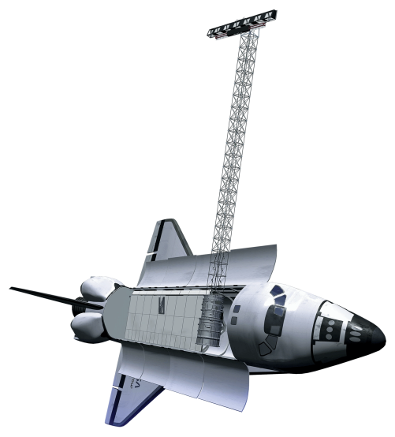

Earth Observations
Landsat 4-5 Thematic Mapper (TM)
Landsat 8
Operational Land Imager (OLI)
Shuttle Radar Topography Mission
(SRTM)
Notes:
Data used for our study was collected via NASA Earth Observing
Systems Landsat 4, 5 and 8; along with NASA’s Shuttle Radar
Topography Mission for elevation data.

Slide 9
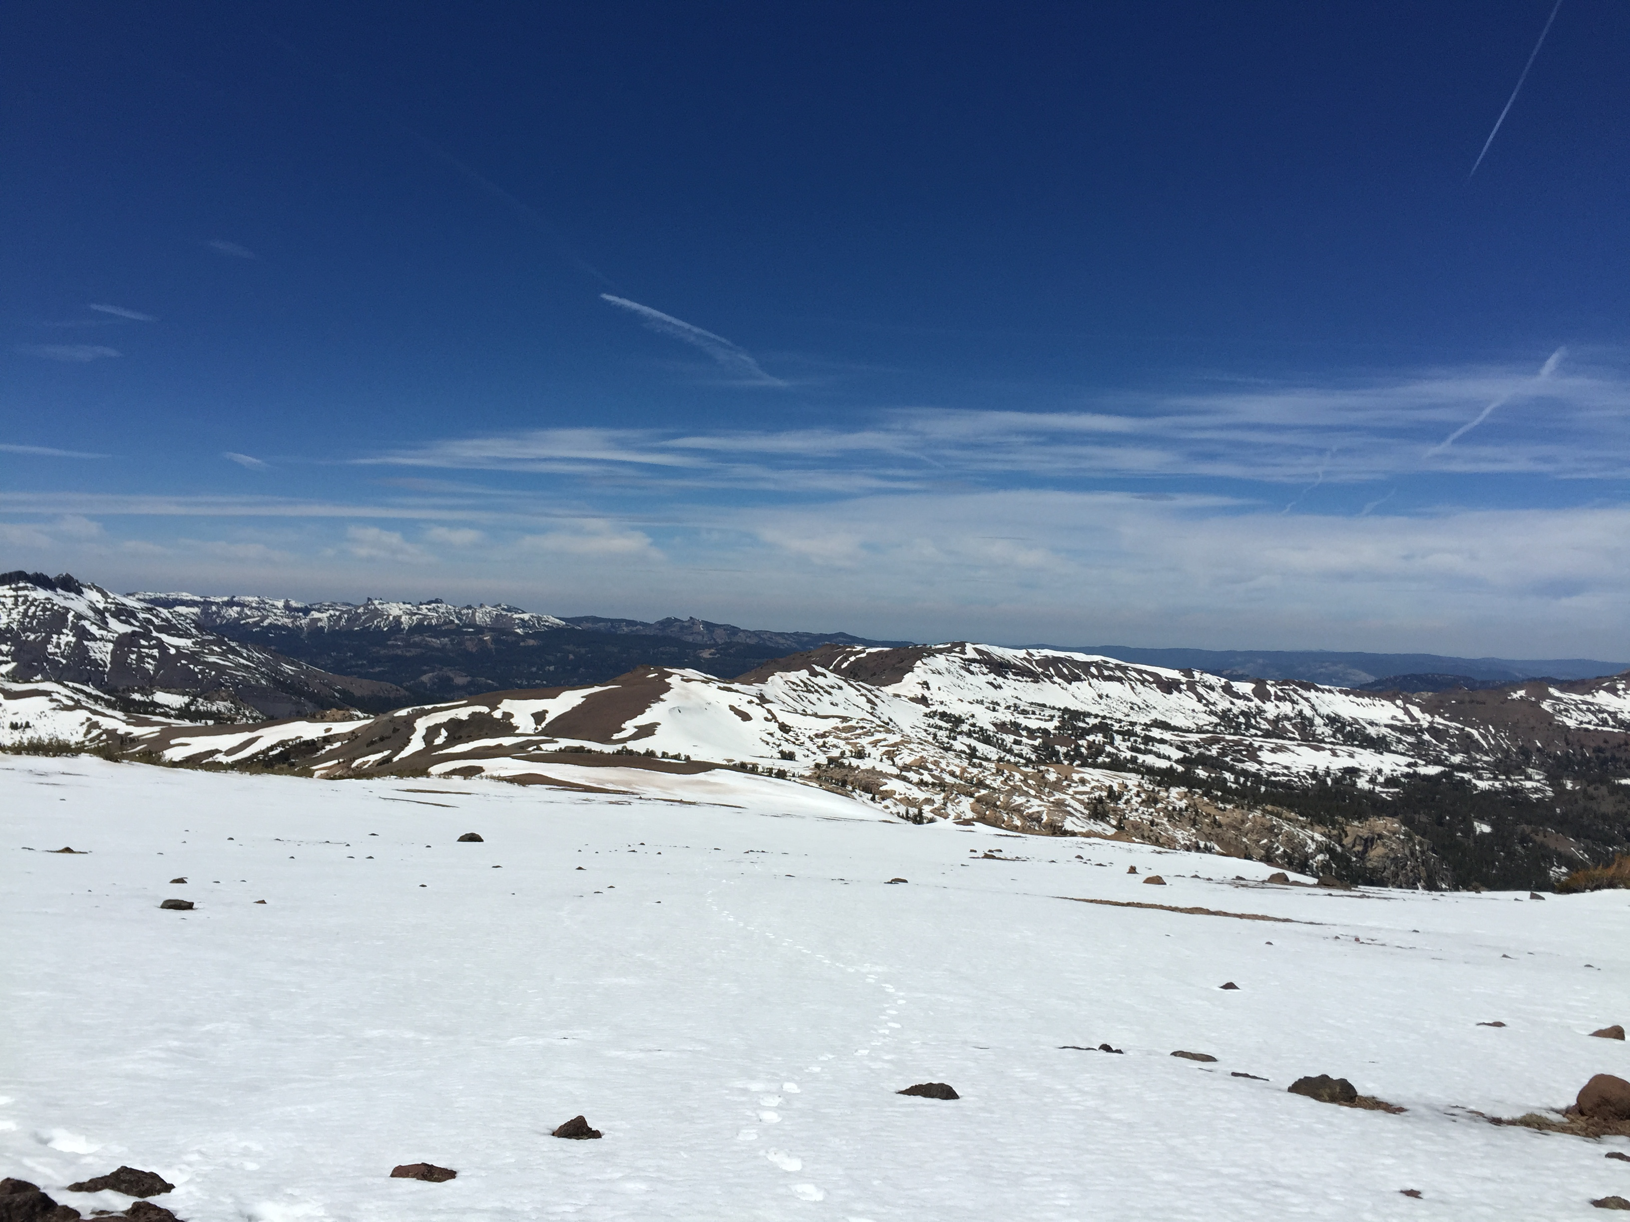
Methodology

Slide 10
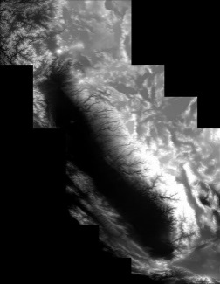
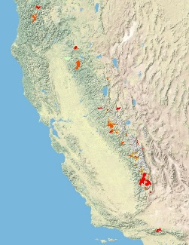
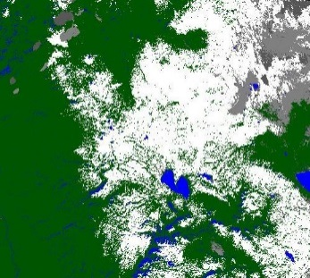
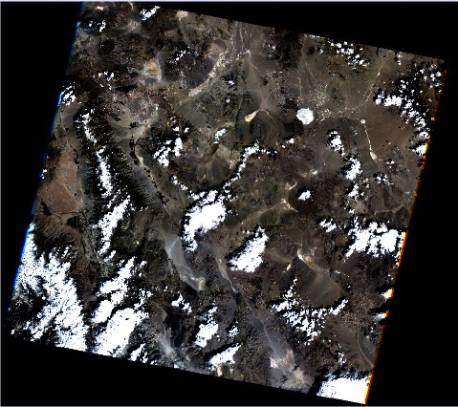
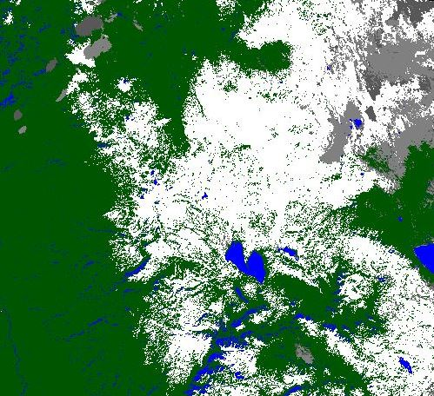
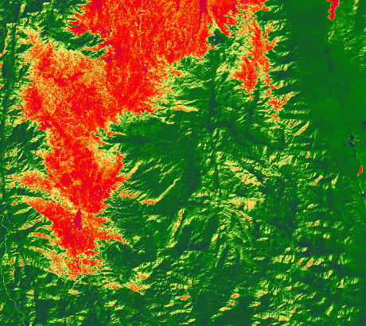
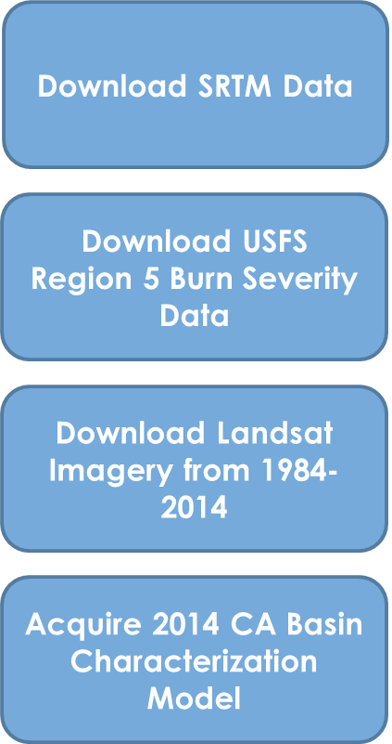
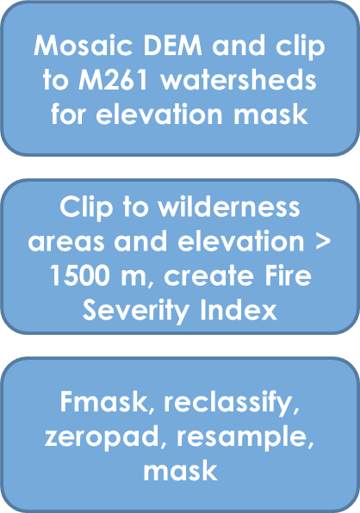
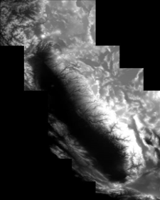

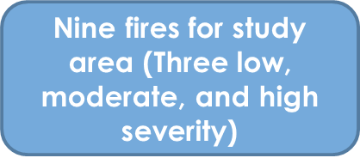
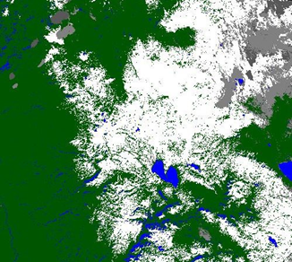


Methodology
Initial Data
Preprocessing
Final Analysis
Download SRTM Data
Mosaic DEM and clip to M261 watersheds for elevation mask
Nine fires for study area (Three low, two moderate, and four high severity)
+
Download USFS Region 5 Burn Severity Data
Clip to wilderness areas and elevation > 1500 m, create Fire Severity Index
Time series trend analysis, NDVI, NDSI
Download Landsat Imagery from 1984-2014
Fmask, reclassify, zeropad, resample, mask
Correlations between fire severity, snowpack and climate variables
Acquire 2014 CA Basin Characterization Model
Define projection, convert to geotiff, clip to study area, extract zonal statistics
+
FINAL IMAGE HERE

Slide 11

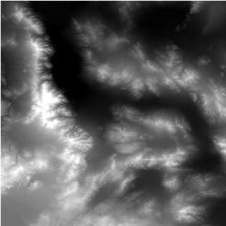
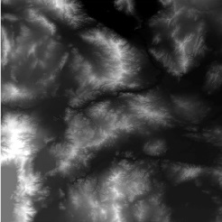
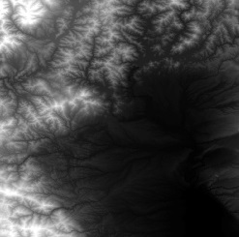
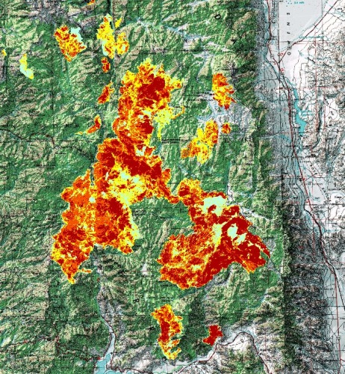

Methodology
SRTM
Region 5 Burn Severity Data
+
+
Notes:
We decided that to qualify as one of our study fires, the fire must have burned at an elevation greater than 1500 m. To mask out the lower fires we used a DEM which was constructed using elevation data from the Shuttle Radar Topography Mission.
Once we had narrowed down our list of potential fires we acquired Forest Service Region 5 burn severity data. This data came with information about burn severity patches within the fire itself. The decision was made to assign a single label of low, moderate, or high severity for each fire based on patch size. From this new list, our nine fires were chosen.

Slide 12
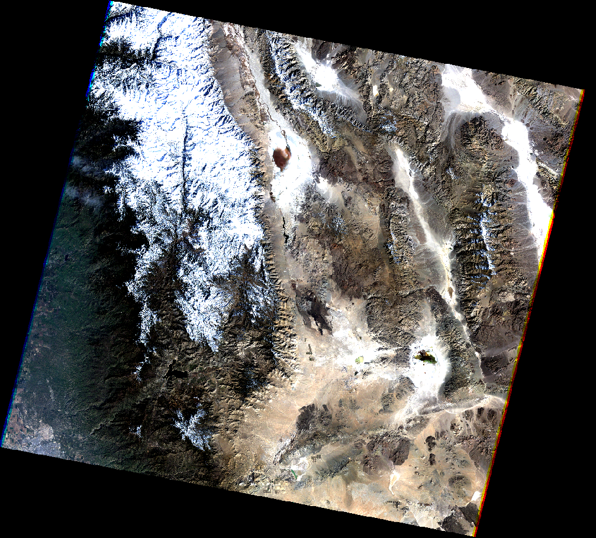
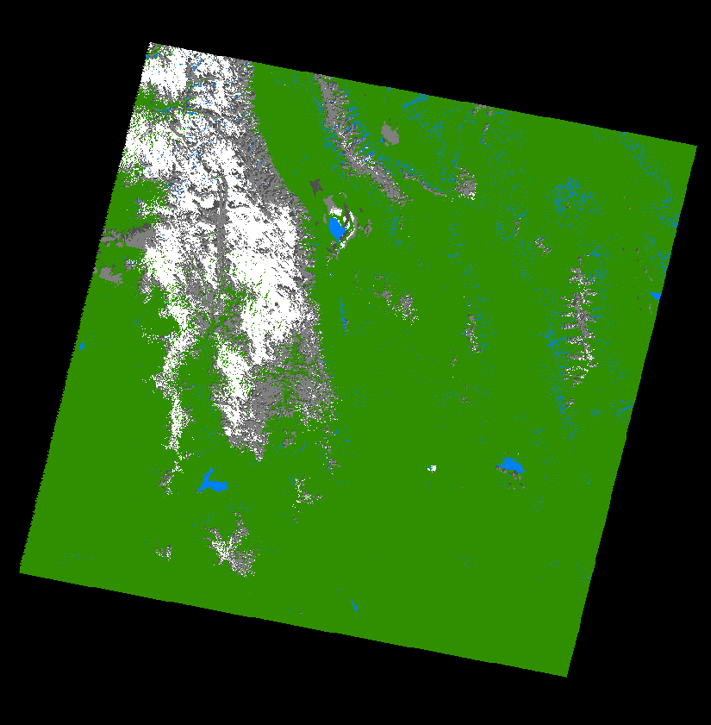
Methodology
Landsat Image
Fmask Image
Notes:
We began processing our imagery by using Fmask, a software for classifying landcover in landsat scenes. Shown here is an Fmask image over a Landsat 5 scene from February 25, 1985. These Fmask images were used to mask out things like clouds in our image that would throw off our results later and to create a time series of proportional snowcover within the burned areas. You can see in the image that the white is classified as snow, while the grey is cloud or cloud shadow.

Slide 13
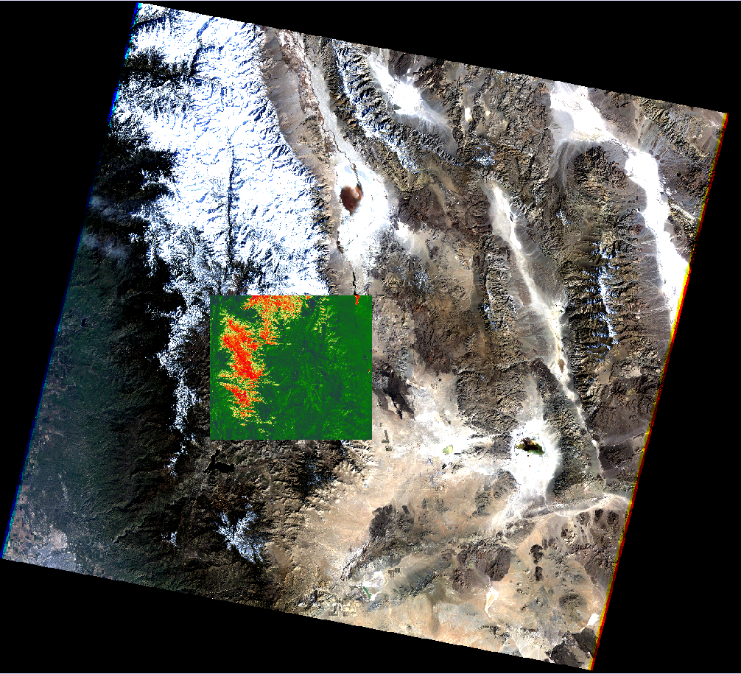

Methodology
Landsat True Color
Landsat NDSI
Green - SWIR
Green + SWIR
NDSI =
Notes:
We used our imagery to calculate Normalized Difference Snow Index. NDSI utilizes the green and Shortwave Infrared bands
Shown here is an NDSI image over the site of the Manter fire, before it burned. The red is showing areas with a greater NDSI value. This was done to every image, from every sensor, from 1984 to 2015, more than 3600 images.

Slide 14
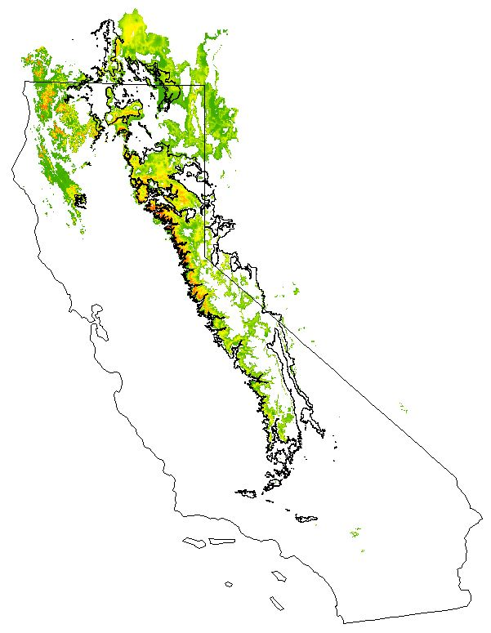
Methodology
Basin Characterization Model (BCM)
Snow Water Equivalent
(mm/month)
Notes:
This is an example from the Basin Characterization Model. From the BCM we used Snow Water Equivalent data. All the SWE came in mm/month over our entire study period.

Slide 15
Methodology
Snow Water Equivalent
NDSI
Established a relationship between NDSI and snow water equivalent data pre fire
Predicted snowmelt using NDSI post fire
Notes:
To analyze how snow water equivalent changes after a fire we established a relationship between NDSI and the BCM snow water equivalent data for all of our images prefire. Once we had established that those two were closely related we used our NDSI values to predict how SWE changes post fire.

Slide 16



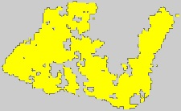
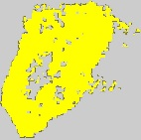
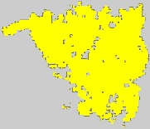
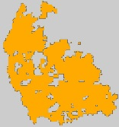
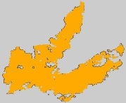

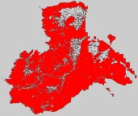
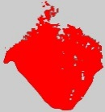
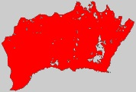
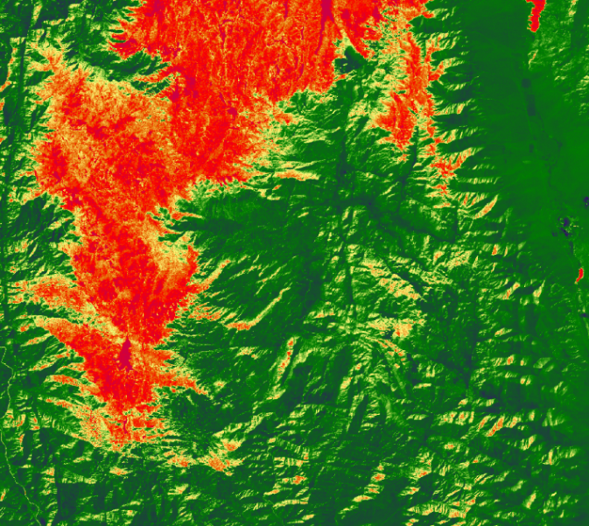
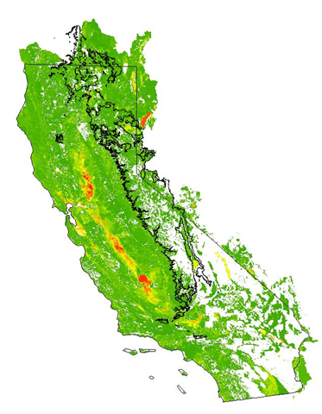
Summary
Methodology
Wildcat
Fairfield
Castle
DEM created
Study fires chosen
Fmask processed
NDSI calculated
BCM variables analyzed
Wapama
Hetchy
Grouse
Manter
ArchRock
Storrie
Notes:
To summarize, we created the DEM for our elevation mask, chose the fires shown here on the left, processed the fmasks to derive proportional snowcover, calculated the NDSI and analyzed BCM variables. Once all of this data was acquired and processed we began to conduct trend analyses on the data at the nine different fire sites, pre and post burn.

Slide 17
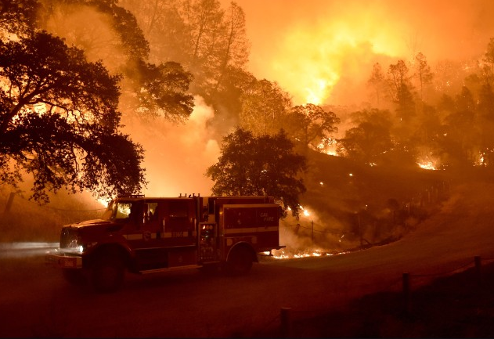
Results
Source: CNN.com

Slide 18
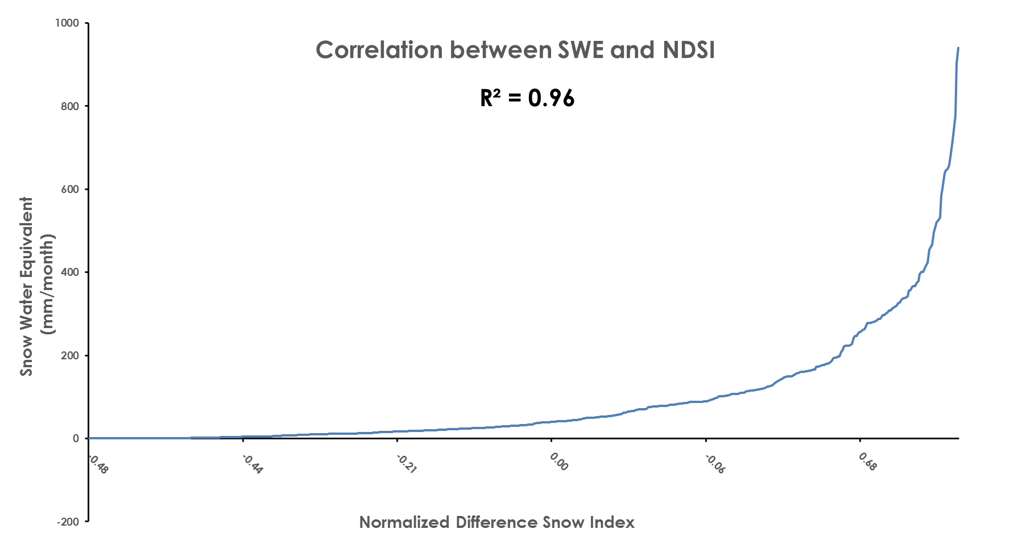
Results
Notes:
The results for our project became very interesting once we established the connection between pre-fire NDSI and BCM modeled snow water equivalent Nolan previously mentioned,
Point and explain graph
This graph depicts that relationship which allows us to measure snow water equivalent in absence of reliable post fire modeled BCM SWE data.

Slide 19
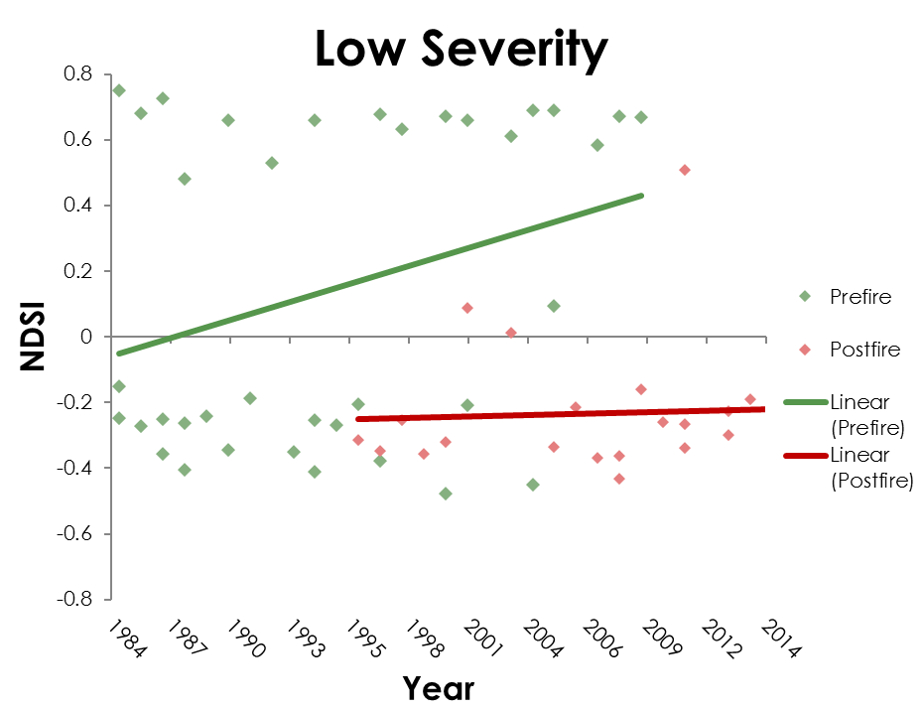
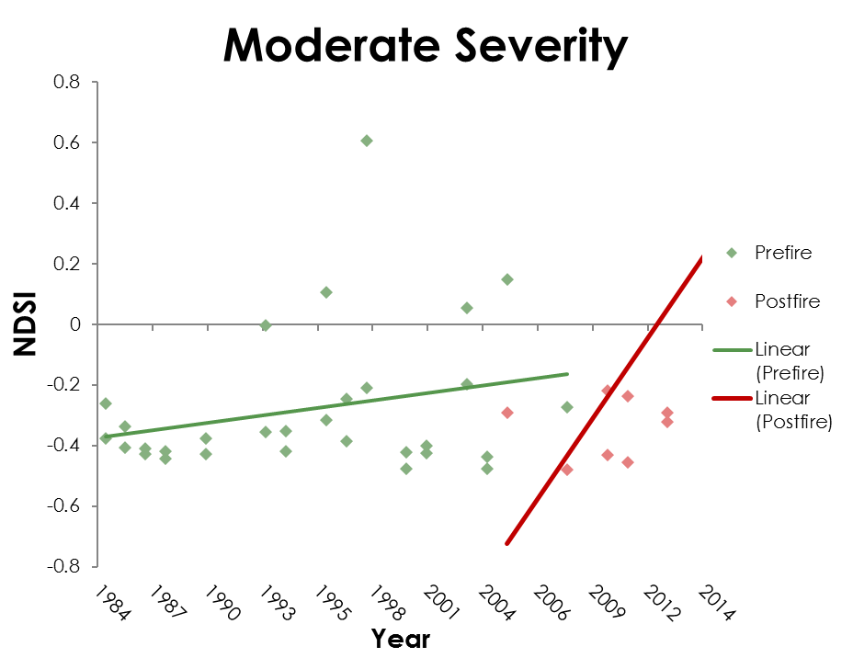
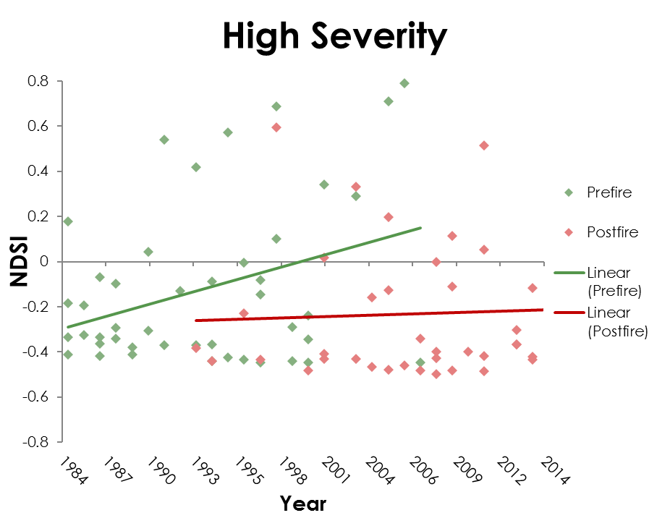
Results
NDSI
Notes:
When we examined the fires individually using T-tests to compare April monthly average NDSI values pre and post fire, no significant change was present,
it was only when data from all fires within each severity class were combined that a significant change was observed.
EXPLAIN GRAPHS
As you can see in these graphs, low severity fires were the only class that showed a significant decrease of NDSI.
Moderate and High severity fires surprisingly showed little to no change post fire and in most cases presented insignificant increasing trends,
likely due to higher NDSI values in the absence of canopy cover

Slide 20
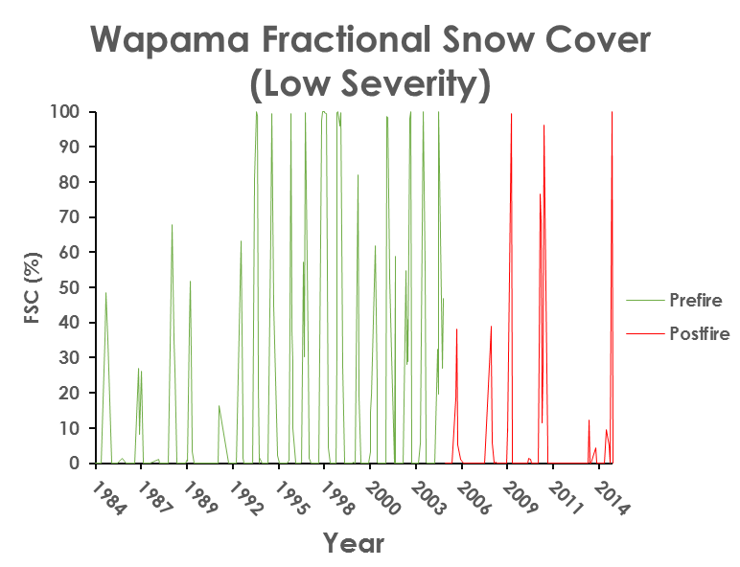
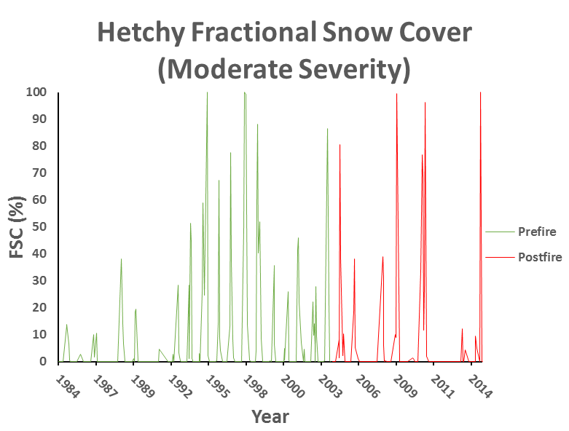
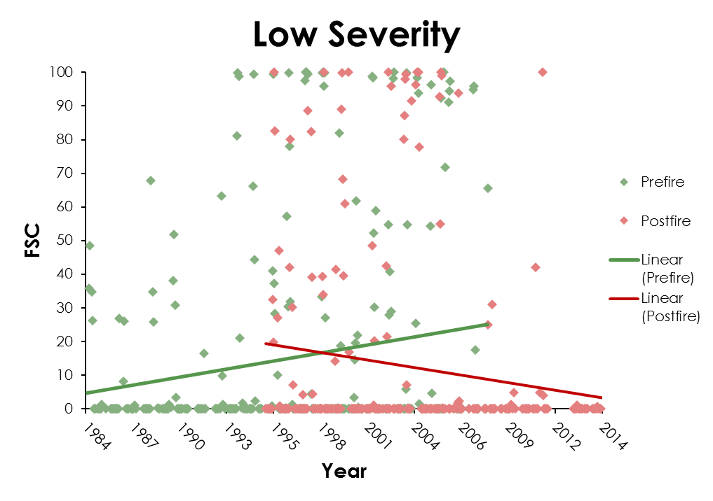
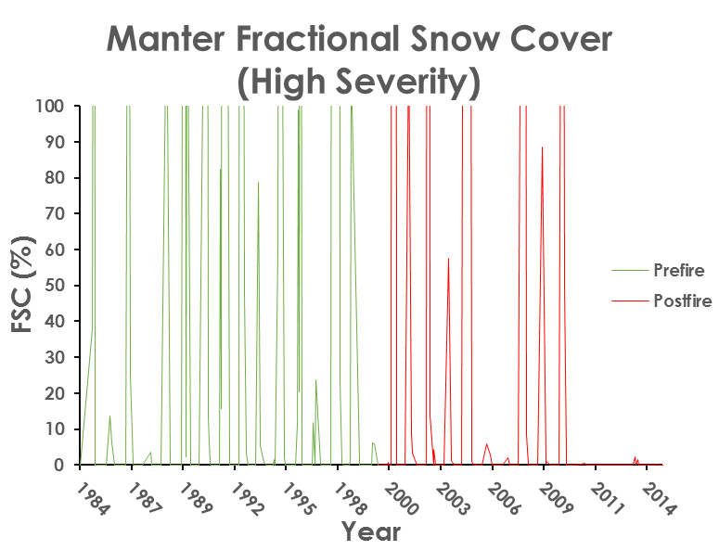
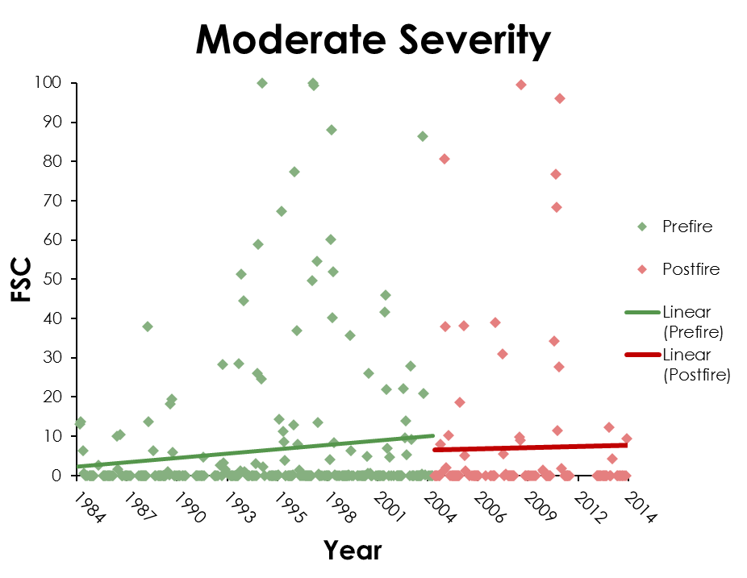
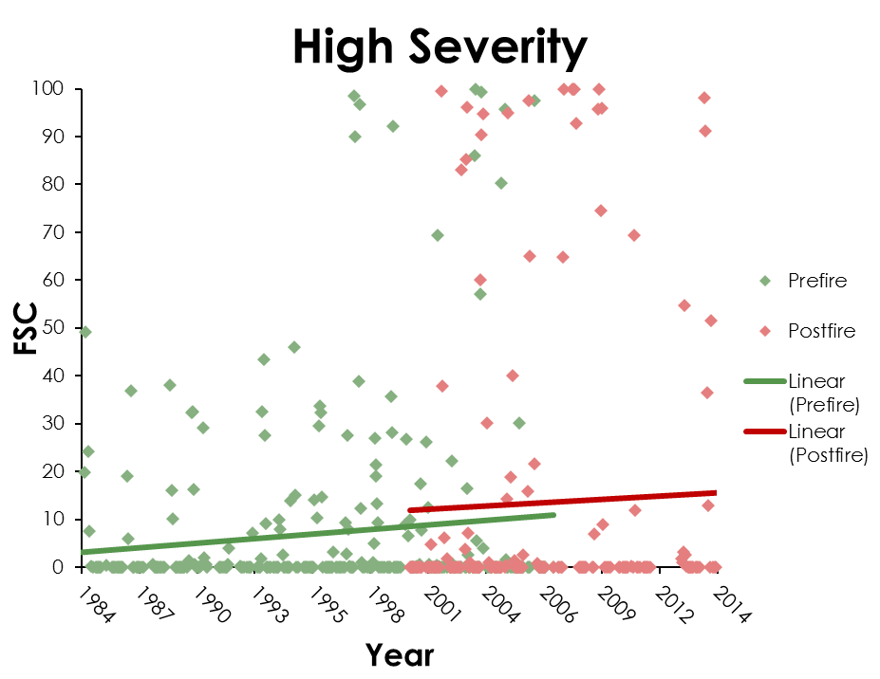
Results
Fractional Snow Cover
FSC (%)
Year
FSC (%)
FSC (%)
Year
Year
Notes:
Upon examination of pre and post fire Fractional snow cover, trends of decreasing values post fire were evident among several individual fires (list fires), however, when all fires amongst severity classes were combined results were similar to the analysis of NDSI.
An interesting note: All fires possessed low fractional snow cover values in the winters of 2006 and 2007, indicative of recorded low measurements for those extreme drought years
POINT AND EXPLAIN GRAPHS
Overall analysis shows that snowpack is not significantly affected by wildfire and changes little through severity type
Our results suggest that only low severity wildfire significantly affects future snow-water equivalent.
Other factors such as canopy cover, climate, vegetation and soil types, could influence the detected change

Slide 21
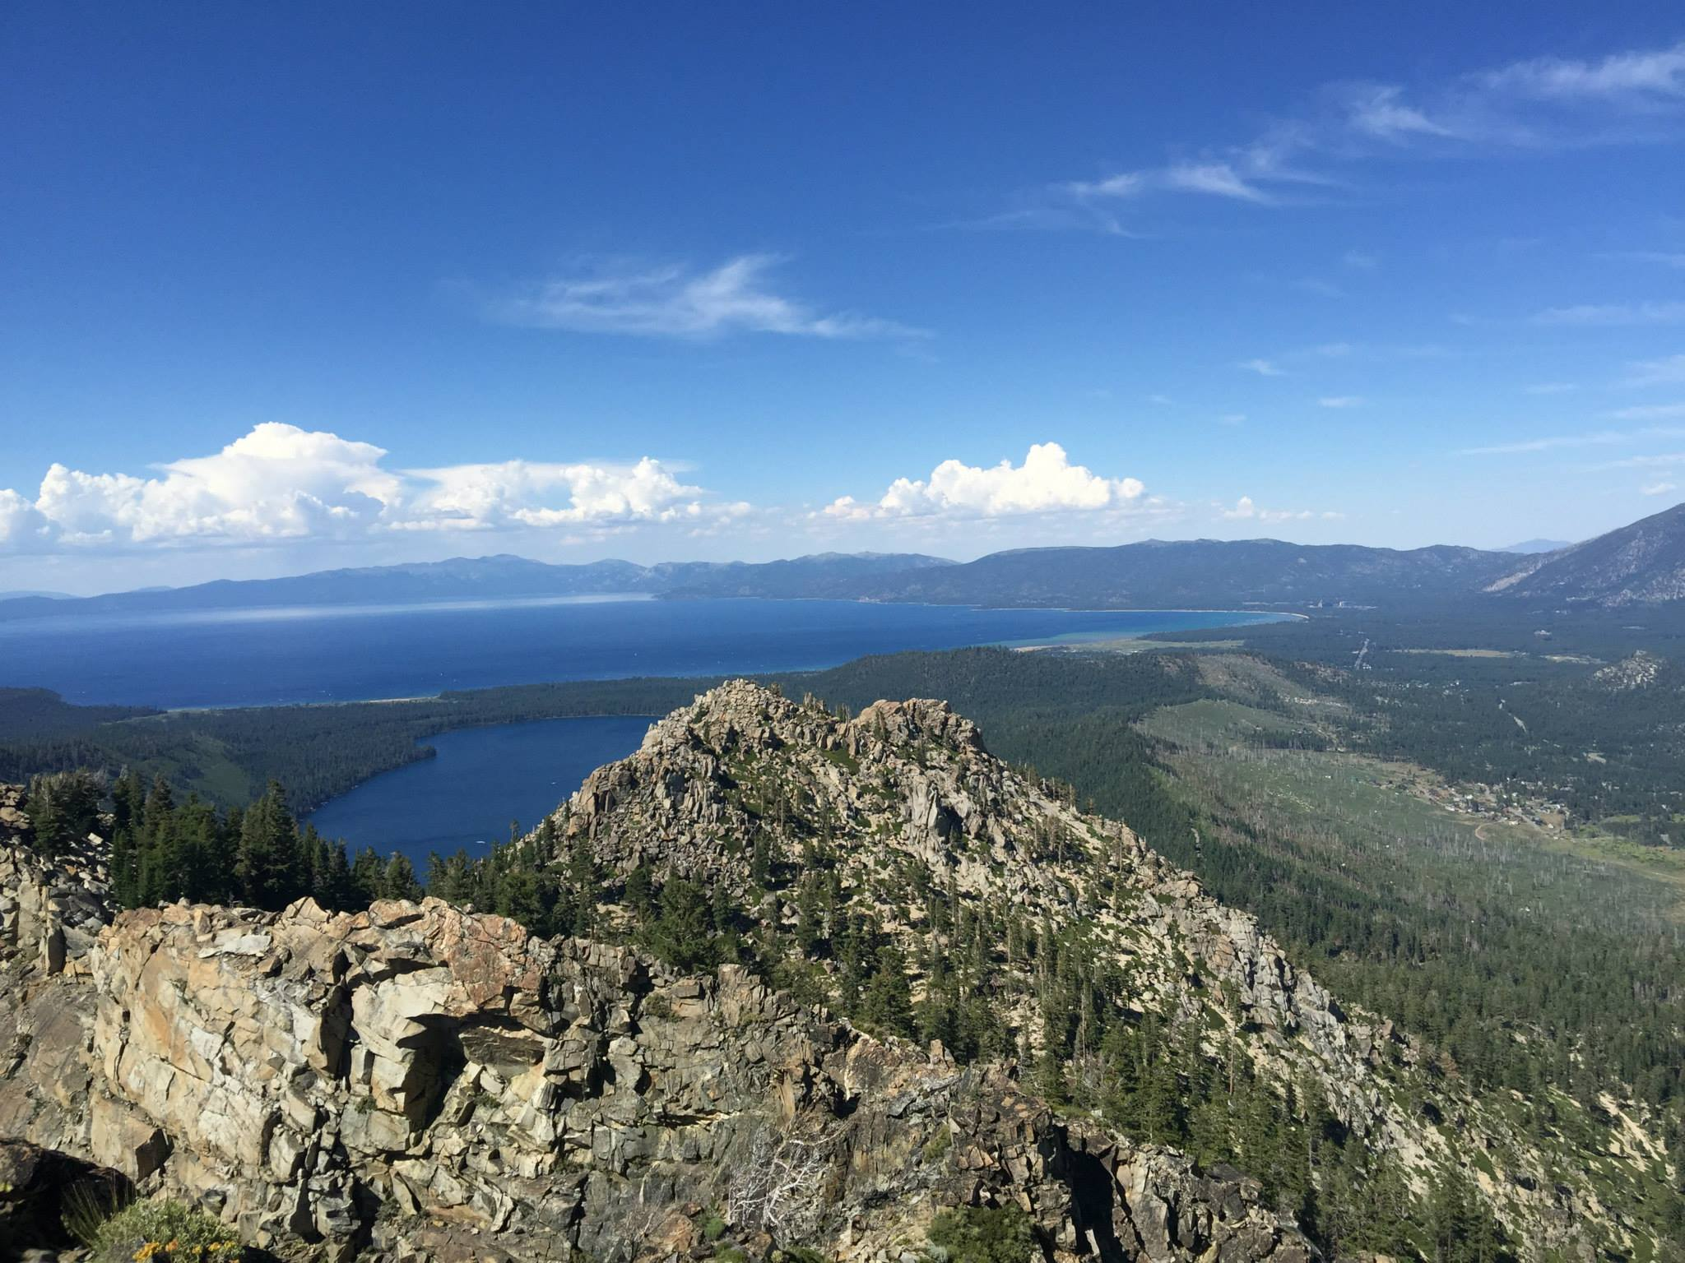
Conclusions

Slide 22

Conclusions
Remote sensing and GIS can further our understanding on the interaction between wildfire and snowpack
BCM data may not be a reliable source for SWE estimates post-fire.
Effects of wildfire severity on water resources are still unclear
Source: NASA
Notes:
Remote sensing techniques alongside applications in GIS are tools that can help aid forest managers in understanding the effects of wildfire severity on snowpack and snow water equivalent within the SN
finding accurate SWE data is necessary in order to assess the impact of wildfire severity
BCM may not provide the best data when trying to assess the impacts of disturbance events, such as wildfire, on modeled variables, such as snowmelt
It is also important to keep in mind that spectral indices are prone to confounding. as a result, efforts should be made to reduce this error.
All in all, more research needs to be done before a threshold wildfire severity can be determined as detrimental to water resources

Slide 23
Conclusions
Remote sensing and GIS can further our understanding on the interaction between wildfire and snowpack
BCM data may not be a reliable source for SWE estimates post-fire.
Effects of wildfire severity on water resources are still unclear
Notes:
Remote sensing techniques alongside applications in GIS are tools that can help aid forest managers in understanding the effects of wildfire severity on snowpack and snow water equivalent within the SN
finding accurate SWE data is necessary in order to assess the impact of wildfire severity
BCM may not provide the best data when trying to assess the impacts of disturbance events, such as wildfire, on modeled variables, such as snowmelt
It is also important to keep in mind that spectral indices are prone to confounding. as a result, efforts should be made to reduce this error.
All in all, more research needs to be done before a threshold wildfire severity can be determined as detrimental to water resources

Slide 24

Future Work
Parse out climatic events
Quantify the observed rate of decrease in snowpack
Incorporate burn patch size alongside burn severity
Gather in situ data on SWE
Notes:
In the future, further work should be done to parse out the effects of the climate such as extremely wet or dry years.
alongside this
Our first objective to map snow cover between 1984-2015 in the Sierra Nevada was achieved. However, further work needs to be done in order to quantify this rate of observed decrease
Also, a wildfire burn severity classification based on individual burn patch size within each severity class should be used, not just burn severity data.
lastly, in situ snow water equivalent data should be collected for better results and validation of modeled datasets.

Slide 25


Acknowledgements
Advisors
Dr. Marc Meyer, USDA Forest Service
Dr. Juan Torres-Perez (Bay Area Environmental Research Institute,
DEVELOP National Program)
Andrew Nguyen, DEVELOP National Program, NASA Ames Research Center
Partners
Dr. Marc Meyer, USDA Forest Service
Jim Roche, National Park Service
Others
Chippie Kislik, DEVELOP National Program, NASA Ames Research Center
This material is based upon work supported by NASA through contract NNL11AA00B and cooperative agreement NNX14AB60A.
Notes:
We would like to acknowledge our science advisors, Dr. Marc Meyer of the USFS, and Dr. Juan Torres-Perez of the Bay Area Environmental Research Institute as well as the general Ames DEVELOP management.
We would now like to welcome the Navajo Nation Climate Team

Slide 26

Thank You

Slide 27
References
Bales, R.C., J.J Battles, Y. Chen, M.H. Conklin, E. Holst, K.L. O’Hara, P. Saksa, and W. Stewart. 2011. Forests and Water in the Sierra Nevada: Sierra Nevada Watershed Ecosystem Enhancement Project. Sierra Nevada Research Institute Report 11(1).
Cayan, D.R., E.P. Maurer, M.D. Dettinger, M. Tyree, and K. Hayhoe. 2007. Climate change scenarios for the California region. Climatic Change, 87, 7-20.
California Department of Water Resources. 2008. Managing an Uncertain Future: Climate Change Adaptation Strategies for California's Water. Sacramento, CA. October, 34.
Collins, B.M., and S.L. Stephens. 2007. Managing Natural Fires in Sierra Nevada Wilderness Areas. Frontiers in Ecology and the Environment, 5(10), 523-527.
Notes:
Will be edited with additional text and different imagery

Slide 28
References (cont…)
Flint, L.E., and A.L. Flint. 2012. Simulation of climate change in San Francisco Bay basins, California: case studies in the Russian river valley and Santa Cruz mountains. US Geol Surv Sci Invest Rep 51, 32-55.
Flint, L.E., A.L. Flint, J. Thorne, and R. Boynton. 2013. Fine-scale hydrologic modeling for regional landscape applications: The California Basin Characterization Model development and performance. Ecological Processes, 2(25), 21-21.
Fry, D.L., S.L. Stephens, B.M. Collins, M.P. North, E. Franco-Vizcaino, and S.J. Gill. 2014. Contrasting Spatial Patterns in Active-Fire and Fire-Suppressed Mediterranean Climate Old-Growth Mixed Conifer Forests. PLOS ONE, 9(2).
Godsey, S. E., J.W. Kirchner, and C.L. Tague. 2014. Effects of changes in winter snowpacks on summer low flows: case studies in the Sierra Nevada, California, USA. Hydrological Processes, 28(19), 5048–5064
Notes:
Will be edited with additional text and different imagery

Slide 29
References (cont…)
Kapnick, S., and A. Hall. 2010. Observed climate–snowpack relationships in California and their implications for the future. Journal of Climate, 23, 3446-3456.
McKelvey, K.S., C.N. Skinner, C. Chang, D.C. Erman, S.J. Husari, D.J. Parsons, J.W. van Wagtendonk, C.P. Weatherspoon. 1996. An overview of Fire in the Sierra Nevada, Sierra Nevada Ecosystem Project: Final report to Congress, Volume II.
Meyer, M. 2015. Forest Fire Severity Patterns of Resource Objective Wildfires in the Southern Sierra Nevada. Journal of Forestry, 113(1), 49-56.
Miller, J. D., H. D. Safford, M. Crimmins, and A. E. Thode. 2008. Quantitative Evidence for Increasing Forest Fire Severity in the Sierra Nevada and Southern Cascade Mountains, California and Nevada, USA. Ecosystems, 12(1), 16-32.
Notes:
Will be edited with additional text and different imagery

Slide 30
References (cont…)
Mote, P., A. Hamlet, M. Clark, and D. Lettenmaier. 2005. Declining Mountain Snowpack In Western North America. Bulletin of the American Meteorological Society, 86, 39-49.
Poth. M, B. McGurk, and D. Payne . 2004. Prescribed fire, soils, and stream water chemistry in a watershed in the Lake Tahoe Basin. International Journal of Wildland Fire, 13, 27-35.
Rice, Doyle. 2015. California Snowpack at Lowest Level on Record. USA Today. Available at:
http://www.usatoday.com/story/weather/2015/03/30/california-drought-snowpack-sierra/70682114/
Riggs, G.A., D.k. Hall, and V.V. Salomonson. 1994. A Snow Index for the Landsat Thematic Mapper and Moderate Resolution Imaging Spectroradiometer. Proceedings of IGARSS '94 - 1994 IEEE International Geoscience and Remote Sensing Symposium.
Notes:
Will be edited with additional text and different imagery

Slide 31
References (cont…)
Rollins, M., and C. Collins. 2006. An Overview of the LANDFIRE Prototype Project: In The LANDFIRE Prototype Project nationally consistent and locally relevant geospatial data for wildland fire management. U.S. Department of Agriculture Forest Service, Rocky Mountain Research Station, Fort Collins, CO.
Shreve, C.M., G.S. Okin, and T.H. Painter. 2009. Indices for Estimating Fractional Snow Cover in the Western Tibetan Plateau. Journal of Glaciology, 55(192), 737-745.
Sierra Nevada Conservancy. 2015. Drought and the Sierra Nevada. Sierra Nevada Conservancy.
Stephens, S.L. 2014. Increasing resiliency in frequent fire forests: Lessons from the Sierra Nevada and western Australia. USDA RMRS General Technical Report, 71, 123-132.
Notes:
Will be edited with additional text and different imagery

Slide 32
References (cont…)
Stephens, S.L., T. Meixner,Mote, P., A. Hamlet, M. Clark, and D. Lettenmaier. 2005. Declining Mountain Snowpack In Western North America. Bulletin of the American Meteorological Society, 86, 39-49.
Stine, S. 1996. Climate, 1650–1850. Sierra Nevada Ecosystem Project: Final report to Congress, University of California, Centers for Water and Wildland Resources, Davis, CA,
Swetnam, T. W. 1993. Fire history and climate change in giant sequoia groves. Science, 262(5135), 885–889.
Van Wagtendonk, J.W., and J.A. Fites-Kaufman. 2006. Sierra Nevada Bioregion. Book chapter in: Fire in California’s ecosystems. University of California Press, Berkeley, CA.
Notes:
Will be edited with additional text and different imagery

