Slide 1
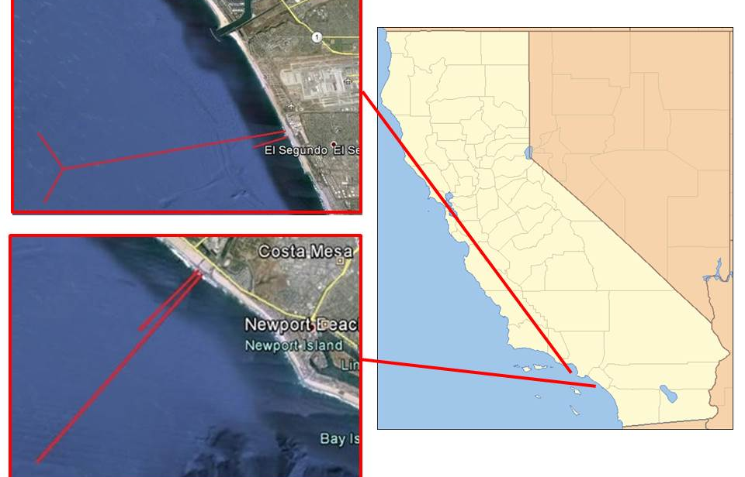
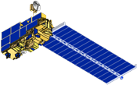
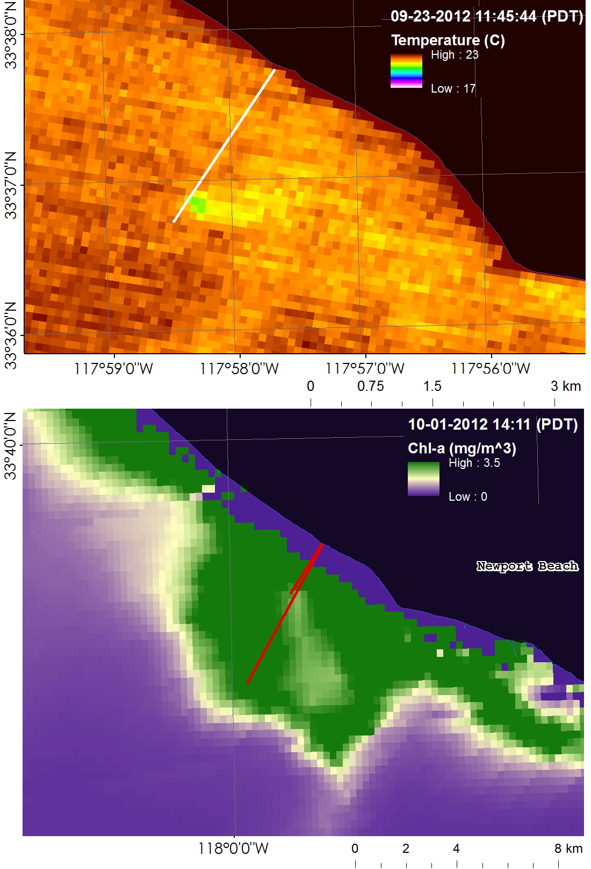
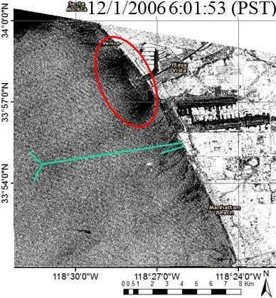
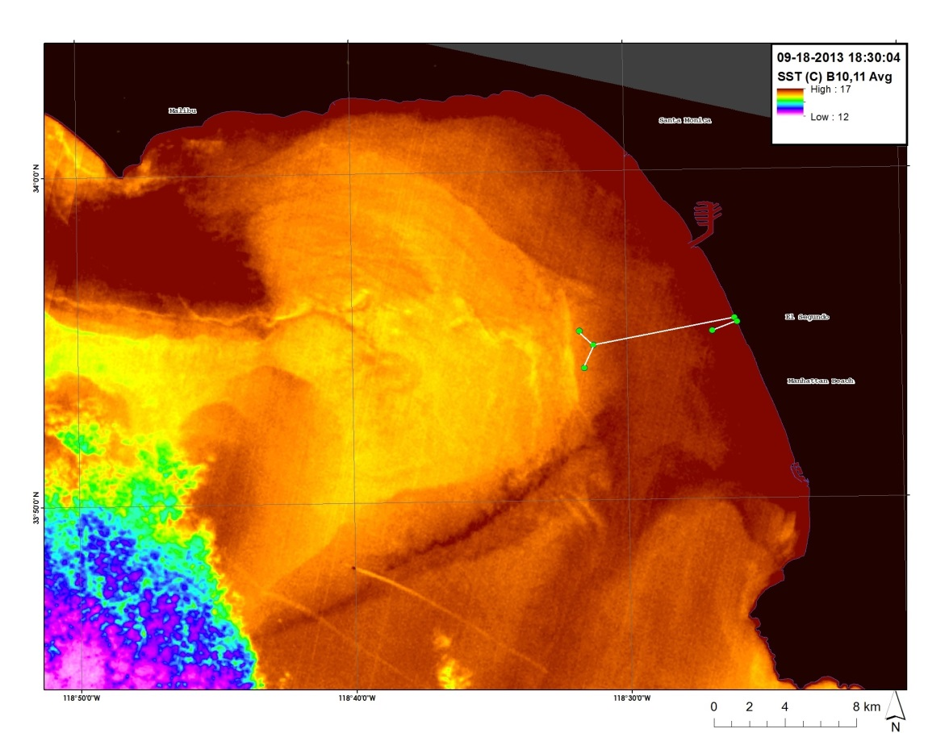
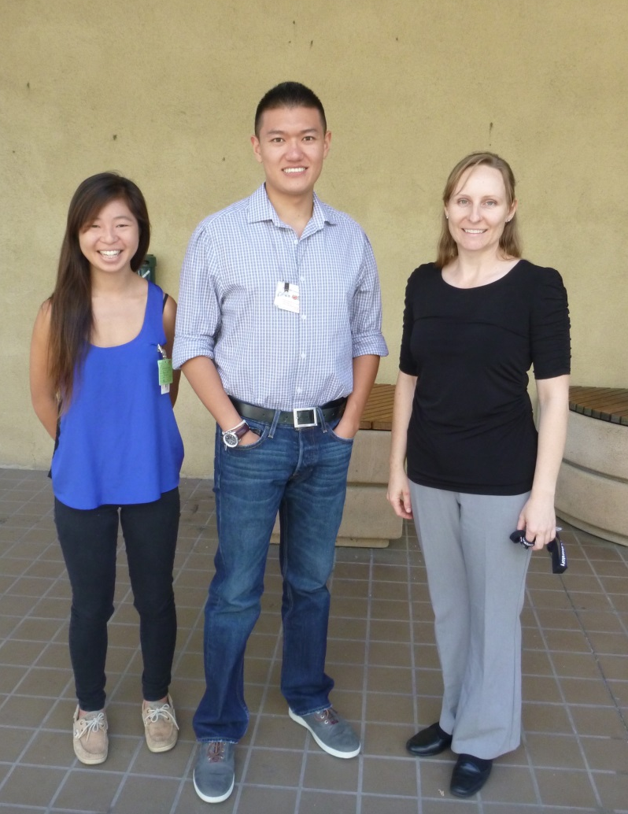
Southern California Oceans & Water Resources
Remote Sensing Detection of Wastewater Plumes to Assess Public Water Quality in Los Angeles and Orange Counties
Boyang “Jack” Pan (Scripps Institution of Oceanography, UCSD); Christine Rains (California State University, Northridge); Rebecca Trinh (University of California at Berkeley)
Jet Propulsion Laboratory
Treated sewage from the City of Los Angeles Hyperion Wastewater Treatment Plant (HWTP) and the Orange County Sanitation District (OCSD) are released through outfall pipes offshore. The two plants conduct regular repair and maintenance services on the main outfall pipes; during these service periods, treated sewage is temporally diverted to shorter pipes that extend into shallow coastal zones where buoyant, freshwater plumes may reach the surface. Two such events have taken place: one at the Hyperion Plant in November 2006; and the other in fall 2012 at OCSD. In both cases, the treated wastewater was diverted from nominal 5-mile long pipes terminating at approximately 60 m depth, to shorter 1-mile pipes that end at about 20 m depths. These diversion events can potentially impact coastal ecosystems and public health. This study focuses on these two cases and produces an assessment on the plumes’ thermal signature, impact on coastal biogeochemistry, and surface movement based on analysis of remote sensing data from multiple satellite sensors. The results are compared with in situ data for validation. These results not only allow a better understanding of the diverted outfall plume, but they also assist the development of a strategy for improved satellite detection during future diversion events.
Evaluate the capabilities of satellite data in detection of surface movement and roughness.
Detect potential ecosystem impacts of wastewater plumes discharged into shallow coastal zones, specifically the 2006 HTP and the 2012 OCSD diversion.
Develop an improved remote sensing strategy for monitoring future wastewater diversions, such as the proposed 2015 HTP diversion, by more accurately identifying (1) potential areas of altered water quality and (2) impacts on public health in nearshore environments.
Data Analysis
ASTER-Terra; MODIS-Aqua: Sea Surface Temperature (SST), water leaving radiance
MODIS-Aqua; MERIS-Envisat; HICO-ISS: Chlorophyll-a (Chl-a), water leaving radiance
SAR-Radarsat-1; ASAR-Envisat; PALSAR-ALSO: Surface roughness, slick detection
In-situ current speed/direction, wind speed/direction, river discharge, bacteria sample, CTD, drifter/gilder data
TIRS-Landsat 8: SST evaluation for future diversion events.
Applications and Benefits
Identifying potential areas of altered water quality
Identifying impacts on public health in nearshore environments
Improved satellite detection methods of future diversions
Improved understanding of plume dynamics in Southern California Bight
Coastal waters of Los Angeles and Orange County (Nearshore regions immediately outside of the Hyperion Plant and OCSD).
Terra: ASTER, MODIS
Aqua: MODIS
ISS: HICO
Envisat: ASAR, MERIS
Radarsat-1: SAR
ALOS: PALSAR
Landsat 8: TIRS
Terra
Aqua
Left: Landsat 8 SST from Sept. 18th, 2013.
Middle: (top) ASTER-Terra SST data showing OCSD on Sept. 23rd, 2012; and (bottom) MODIS-Aqua Chl-a data showing OCSD on Oct. 1st,2012.
Right: ASAR image from Dec. 1st 2006 overlooking HWTP.
Satellite remote sensing has the capability to detect surfaced treated wastewater plumes from HWTP and OCSD based on the plumes’ temperature signal, surface roughness, and stimulated phytoplankton blooms.
Though HWTP and OCSD take many cautionary measures to treat sewage; with the right conditions, the treated sewage can still surface and be transported towards the beach by wind/current.
Landsat 8 along with future satellite missions such as PACE can improve plume detection during a diversion event.
From left to right: Rebecca Trinh, B. Jack Pan (Team Lead), and Christine Rains
Curtis Cash, and Mas Dojiri (City of Los Angeles Hyperion Treatment Plant)
George Robertson (Orange County Sanitation District)
Meredith Howard (Southern California Coastal Water Research Project, SCCWRP)
The team would like to thank:
Science advisors—Ben Holt and Michelle Gierach for data retrieval and assisting us in data analysis
Project partners: Curtis Cash and Mas Dojiri at the Hyperion Treatment Plant, George Robertson at OCSD, and Meredith Howard at SCCWRP
NASA DEVELOP Program for making this project possible

