Slide 1
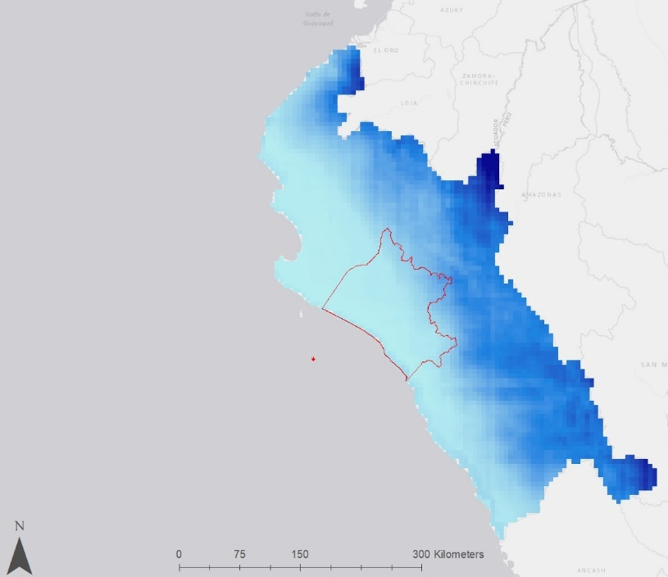
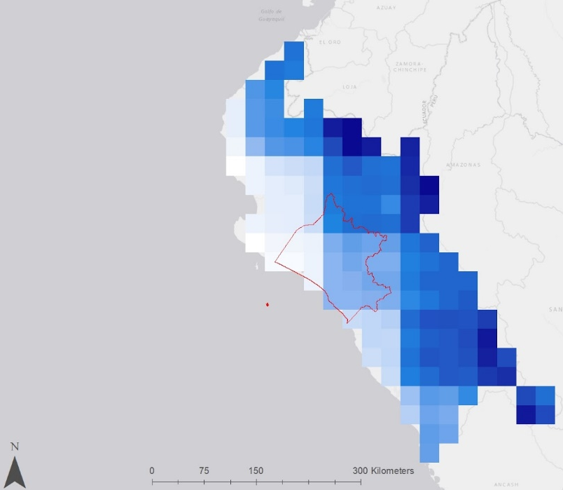
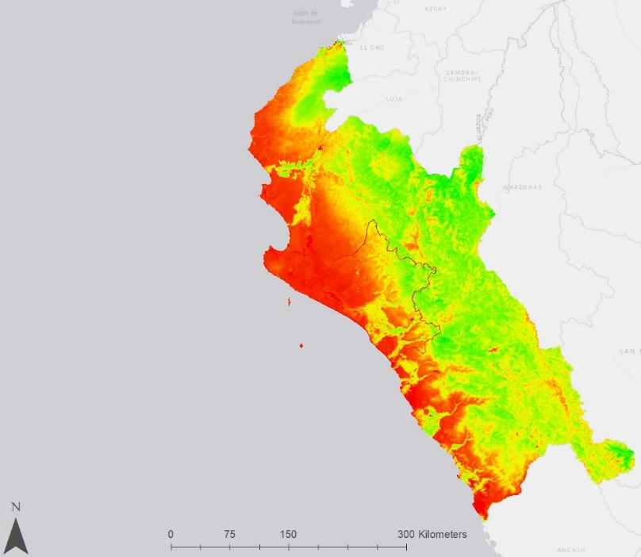
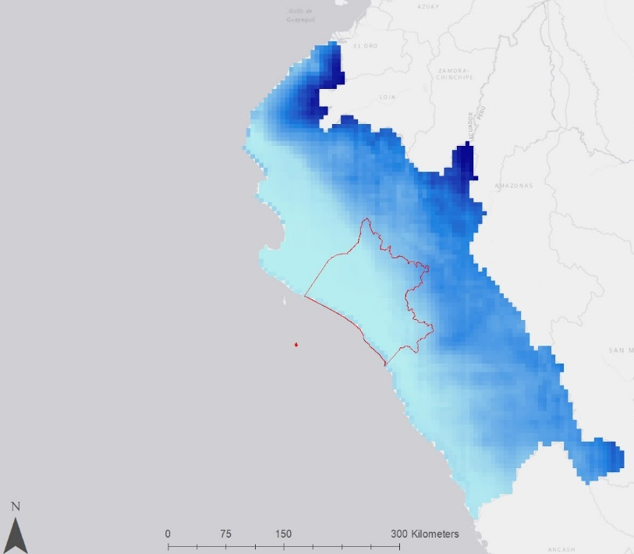
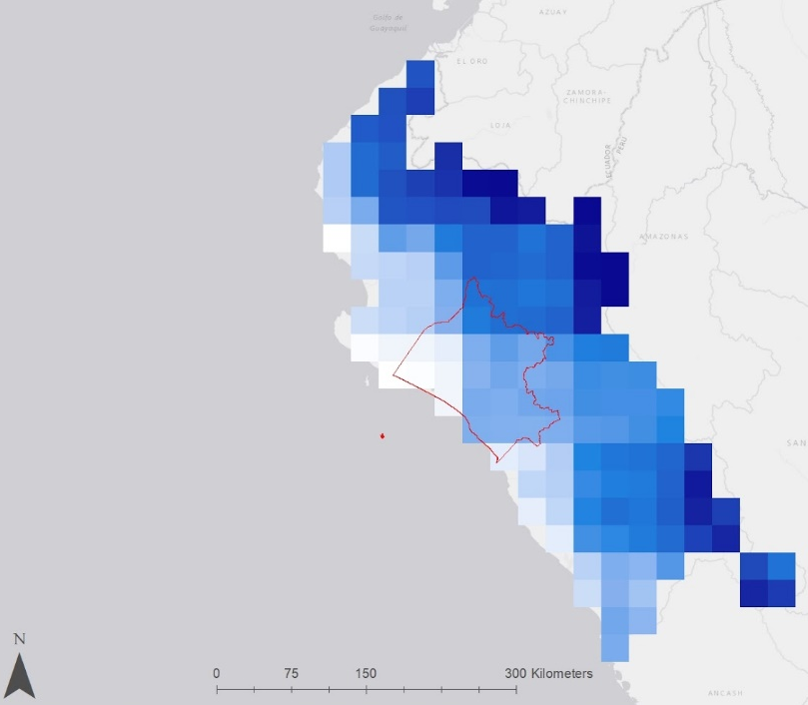
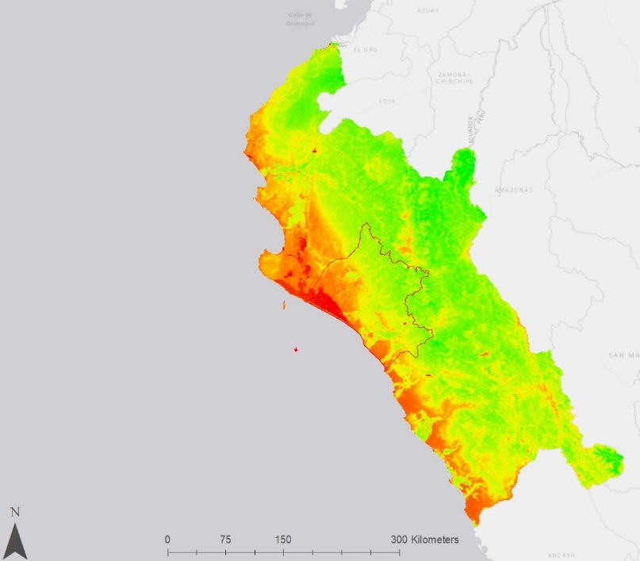
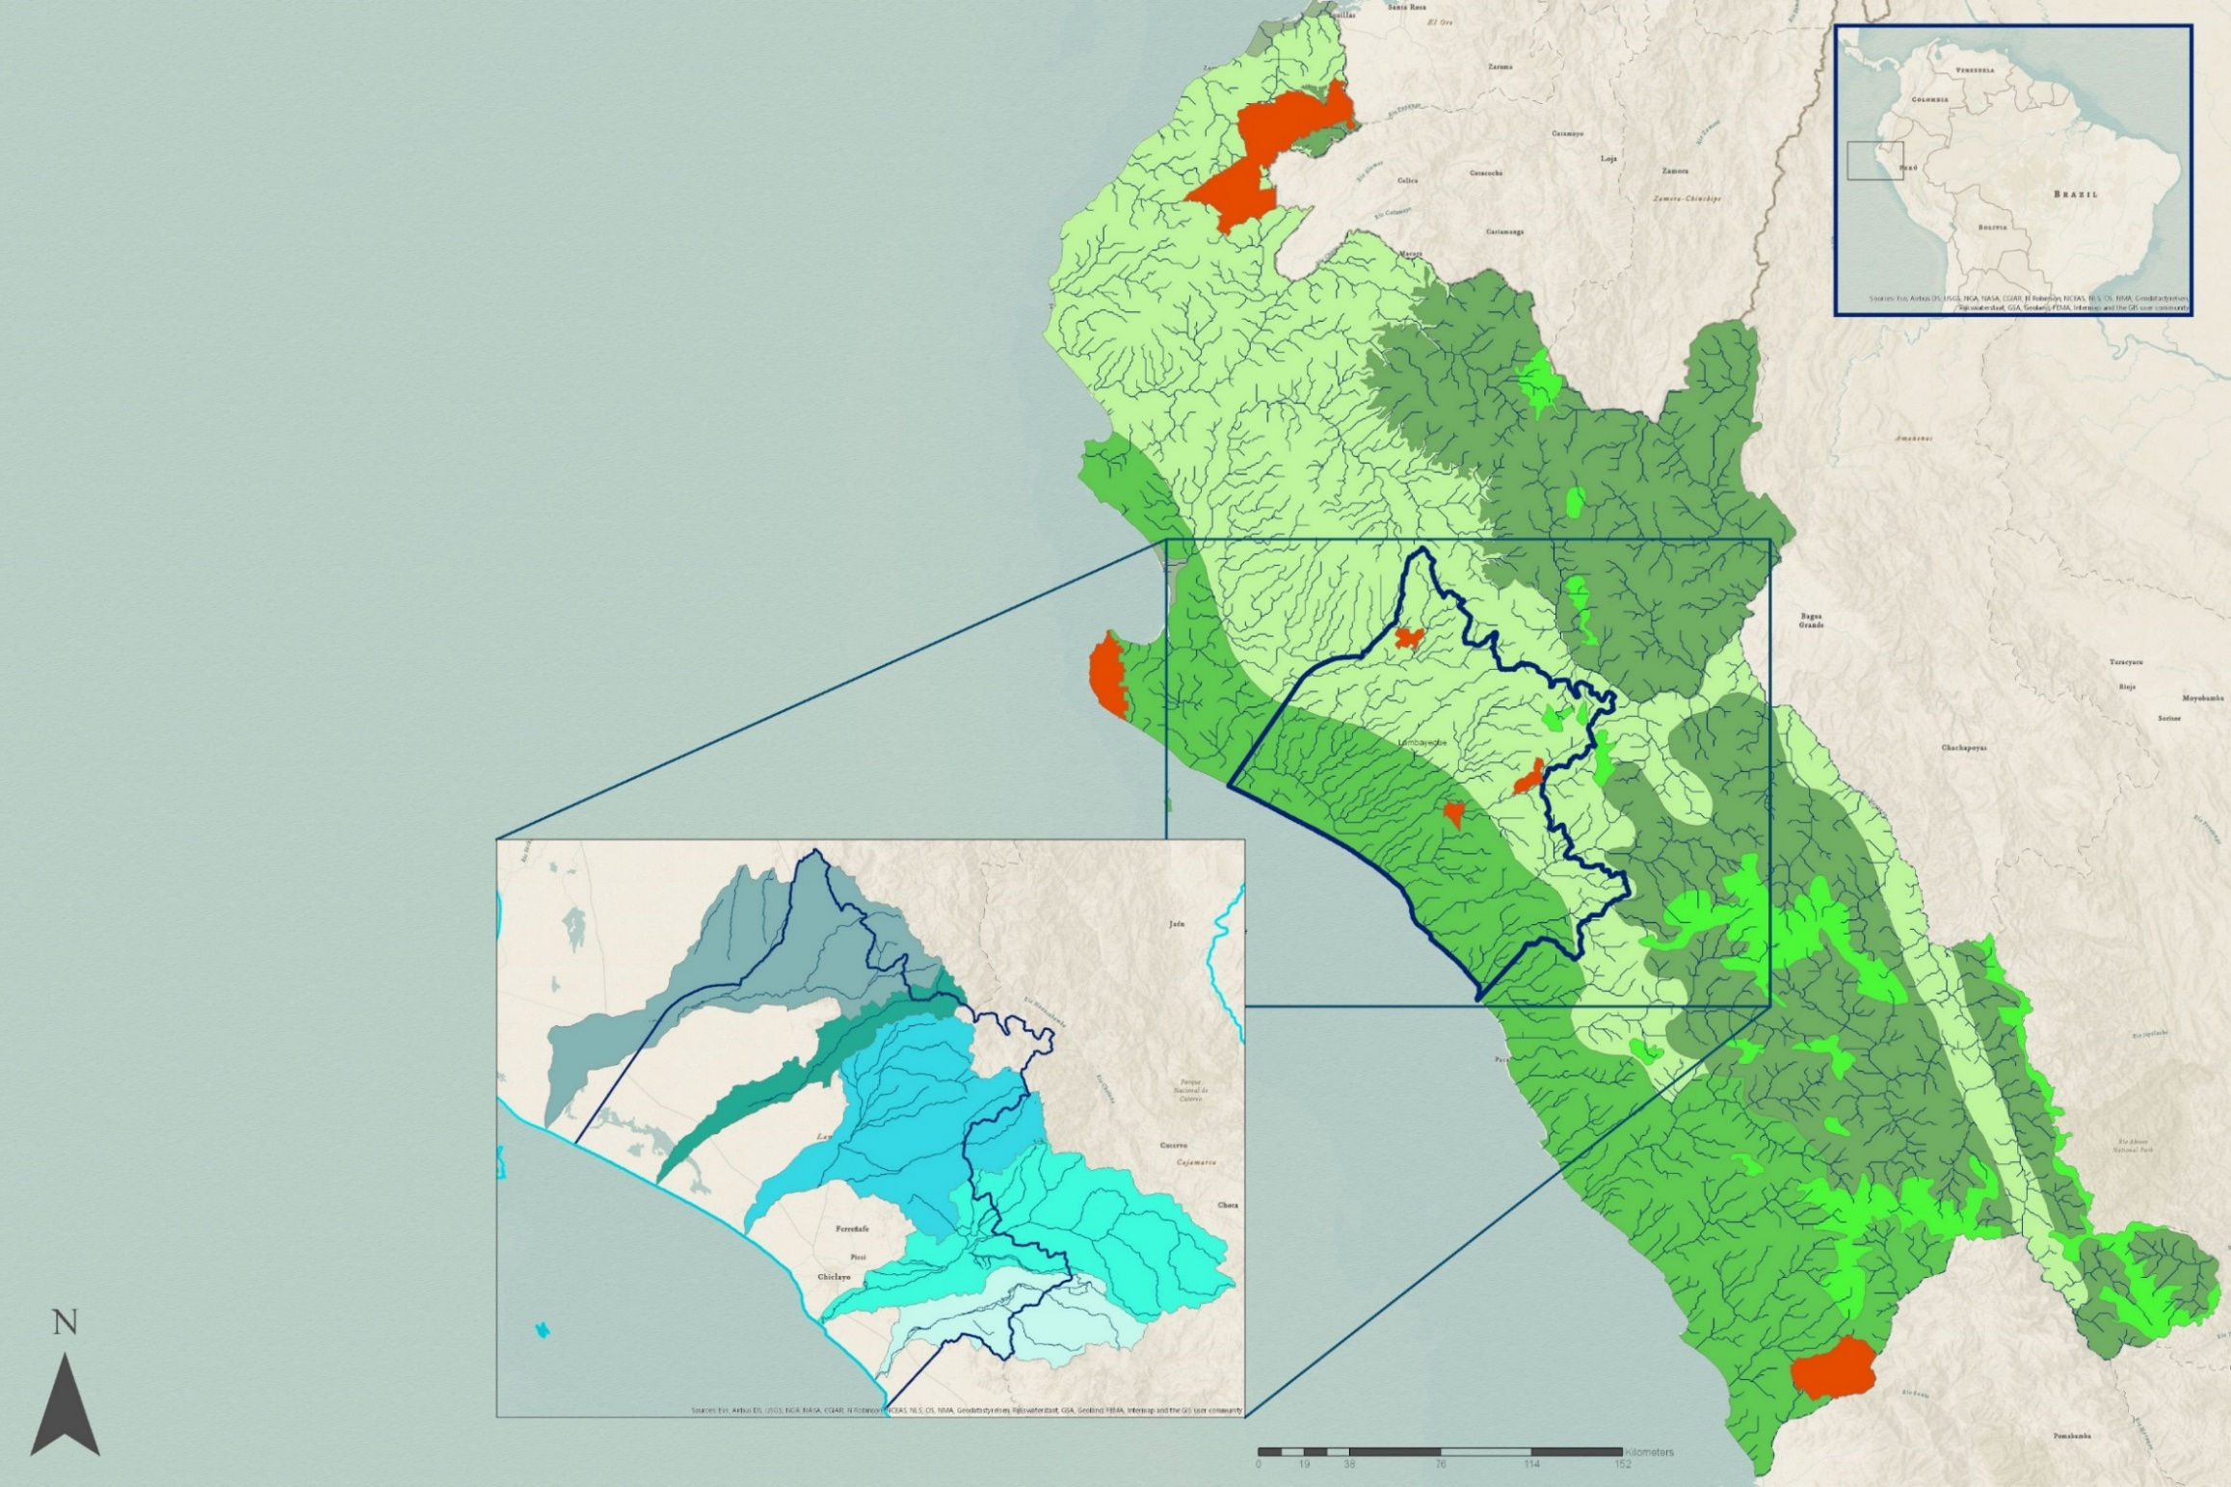
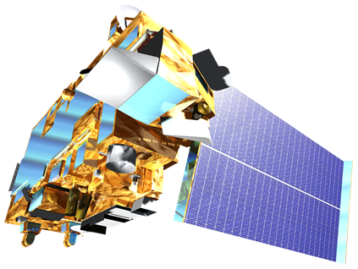
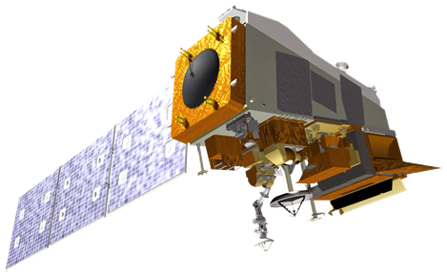
Assessing Hydrologic Patterns Using NASA Earth Observations to Address Tree Mortality in Peru’s Coastal Mesquite Forests
Abstract
Methodology
Lambayeque Water Resources
The mesquite (Prosopis sp.) forests in northwestern Peru have had a significant increase in tree mortality in the past fifty years. Within this time frame, 17% of the forest extent was lost and the forest saw an average annual declination rate of 0.33% (Ektvedt, Vetaas, & Lundberg, 2012). These habitats support the region's rich biodiversity and play an important role in local community economies. Several hydrologic causes for mesquite mortality have been hypothesized, but local researchers lack spatially comprehensive techniques to address the problem. While in situ research is currently being utilized in an attempt to explain this recent anomaly, landscape-level visualizations through remote sensing have not been produced to find connections between hydrologic trends and the health of Northwestern Peru’s mesquite forests. Climate Hazards Group InfraRed Precipitation with Station data and Global Land Data Assimilation System data were analyzed to assess hydrologic patterns pertaining to precipitation and soil moisture in the Lambayeque region of Peru. These data were then paired with vegetation indices derived from Terra Moderate Resolution Imaging Spectroradiometer (MODIS) and Suomi National Polar-orbiting Partnership (NPP) Visible Infrared Imaging Radiometer Suite (VIIRS) to display how changing hydrologic patterns relate to the health of mesquite trees. These data were then compiled on a monthly basis over the 30-year study period to create a time series product, which was later referenced with background research to find the likely causes of recent forest decline. The results will assist in the Lambayeque Regional Government’s understanding of recent biological declination and will help them design strategies to mitigate forest decline in Lambayeque, Peru and surrounding regions.
Precipitation
Obtain CHIRPS data (1989-2019)
Soil Moisture & ET
Obtain GLDAS data
(2000-2019)
Vegetation
Obtain Terra MODIS/VIIRS data
(2000-2019)
Process for time-series visualization
Analyze significance between hydrology and tree mortality
Results
Precipitation
2015
High
Evapotranspiration
NDVI
1892 mm
0.886
Objectives
0.75 mm
Low
-0.3
Classify the area of interest containing Prosopis sp. vegetation
Analyze patterns of the hydrologic cycle during the 30-year study period
Discover correlations between hydrologic parameters and tree mortality
Create products that the partners can utilize in evidence-based decision-making
N
0
75
300 km
2017
Precipitation
High
Evapotranspiration
NDVI
Study Area
2905 mm
0.904
The study area of this project was the region of Lambayeque, including the surrounding regions of Piura, Cajamarca, Tumbes, and La Libertad. These small departments in northwestern coastal Peru are characterized by the desert landscapes that support the abundant presence of Prosopis sp. in the region. Research has revealed that Lambayeque is a rich biodiversity hotspot, with much of the flora and fauna of the region experiencing high levels of endemism. Currently, Lambayeque is experiencing the highest level of Prosopis mortality in Peru.
0.76 mm
Low
-0.3
N
0
75
300 km
Ecoregions of Northwestern Peru
Protected Areas with Mesquite Forests
Rivers
Lambayeque
Terrestrial Ecoregions
Deserts and Xeric Shrublands
Mangroves
Montane Grasslands and Shrublands
Tropical and Subtropical Moist Broadleaf Forests
Tropical and Subtropical Dry Broadleaf Forests
Lambayeque Water Basins
Cuenca Chancay-Lambayeque
Cuenca Cascajal
Cuenca Motupe
Cuenca Olmos
Cuenca Zaña
0
38
76
114
152
Project Partners
km
Gobierno Regional de Lambayeque, Gerencia Regional de Recursos Naturales y Gestion Ambiental, Gerencia Regional de Agricultura
Universidad Nacional Pedro Ruiz Gallo
Clark University, George Perkins Marsh Institute
Conclusions
Earth Observations
Total precipitation has decreased over time.
El Niño events have decreased in strength.
Vegetation health increases during periods of high precipitation.
Evapotranspiration and soil moisture are dependent on the basin location.
There is a direct correlation between changing hydrologic parameters and vegetation health.
Research should be conducted on additional hydrologic and anthropogenic factors.
Temporal Resolution: Monthly
Spatial Resolution: 1 km
Temporal Resolution: 16 days
Spatial Resolution: 1 km
Terra MODIS
Suomi NPP VIIRS
Acknowledgements
Team Members
Dr. Kenton Ross, NASA Langley Research Center
Dr. Venkataraman Lakshi, University of Virginia
Professor Eleazar Rufasto, Universidad Nacional Pedro Ruiz Gallo
Juan Chapoñan Sanchez, Department of Lambayeque
Dr. Deborah Woodcock, George Perkins Marsh Institute (Clark University)
Sydney Neugebauer, NASA Langley Research Center
Jared Kelly
Project Lead
Jay Oliver
Fressia Bechard
Luke Quattrochi
Virginia - Langley

