Slide 1

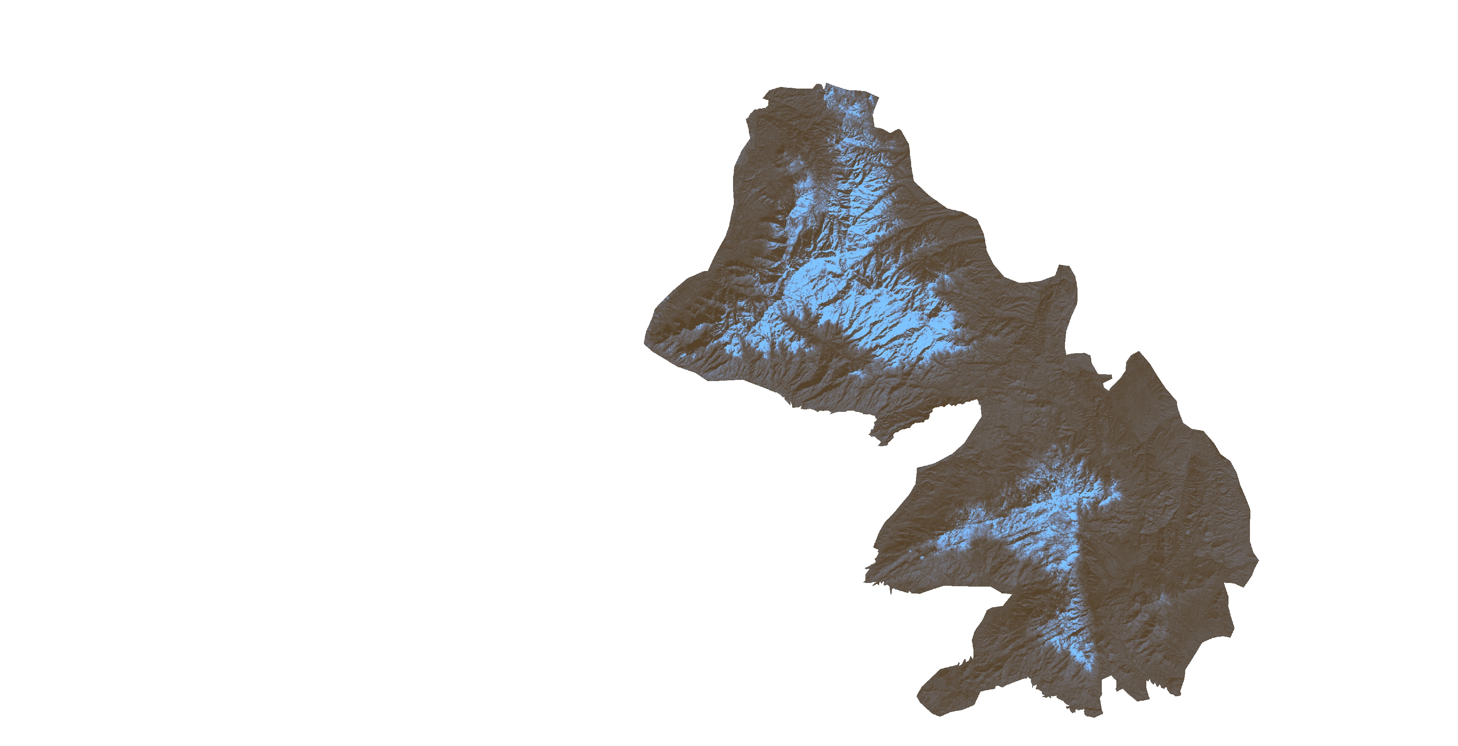
Charles Barrow
SOUTHEASTERN ARIZONA WATER RESOURCES
Saranee Dutta
Elaina Gonsoroski
Tyler Lynn (POC)
Using NASA Earth Observations to Assist the National Park Service in Assessing Snow Cover Distribution and Persistence Changes in the Sky Islands
Mobile County Health Department
2017 Spring

Slide 2
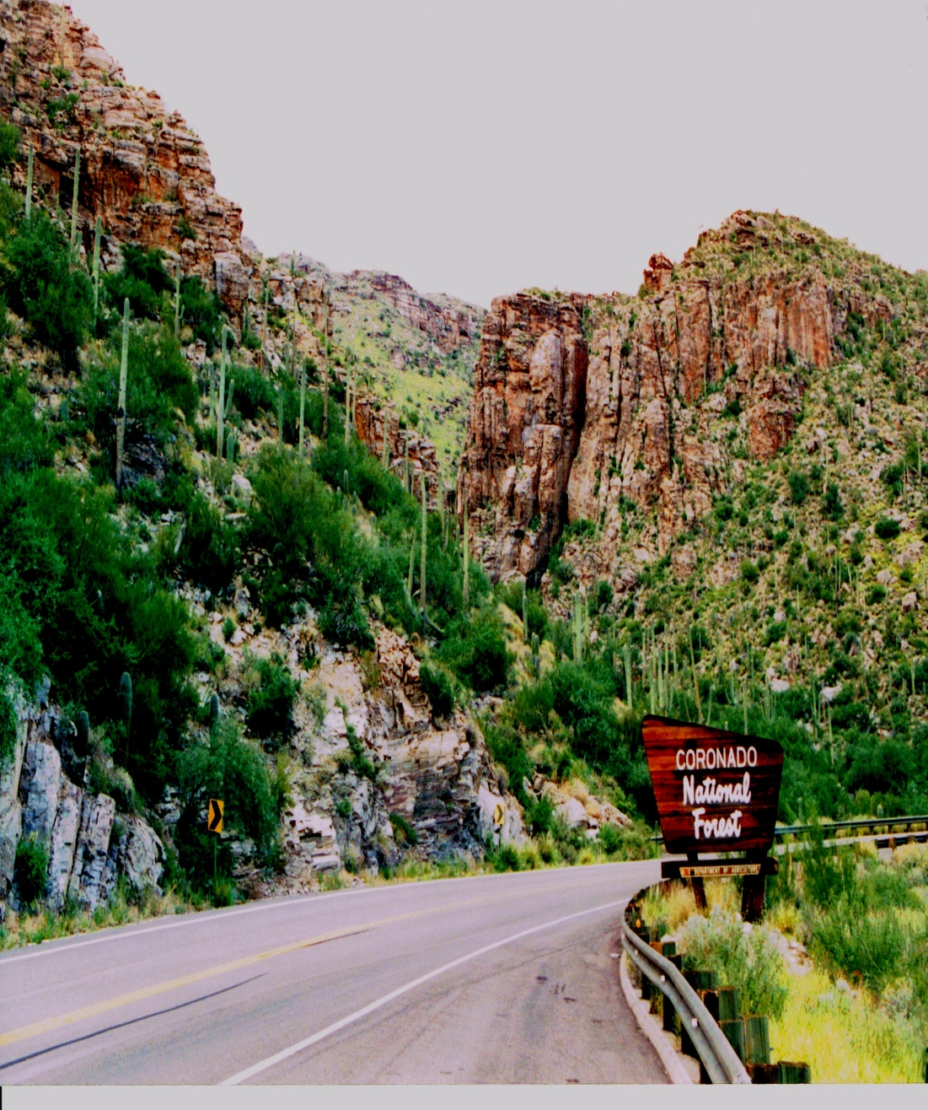
Area of Interest
Overall: Sky Islands (Madrean Archipelago)of Southeastern Arizona
Focus: Saguaro National Park East (East of Tucson, Arizona) and Santa Catalina Mountains
Study Period: 1984 - 2017
Image Credit : Joseph Spruce
Notes:
The study area for this project consisted of the Rincon Mountains, located in Eastern Saguaro National Park, and the Santa Catalina Mountains.
Image Credit – Joseph Spruce
Image Source – Joseph Spruce

Slide 3
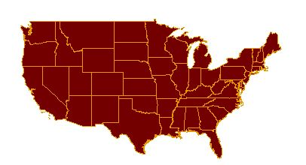
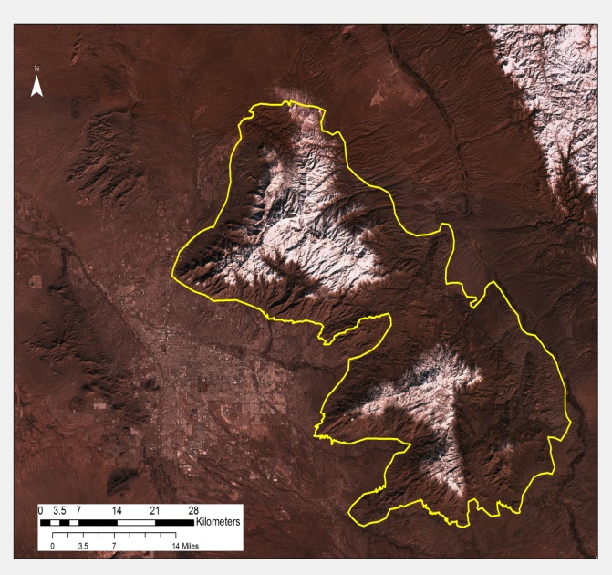
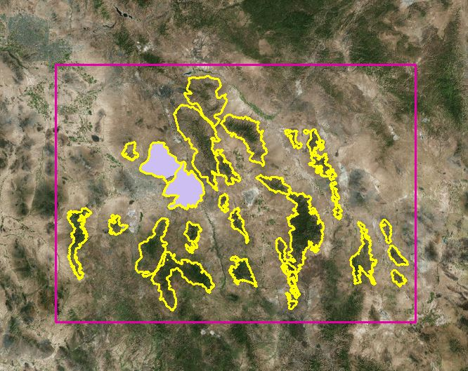
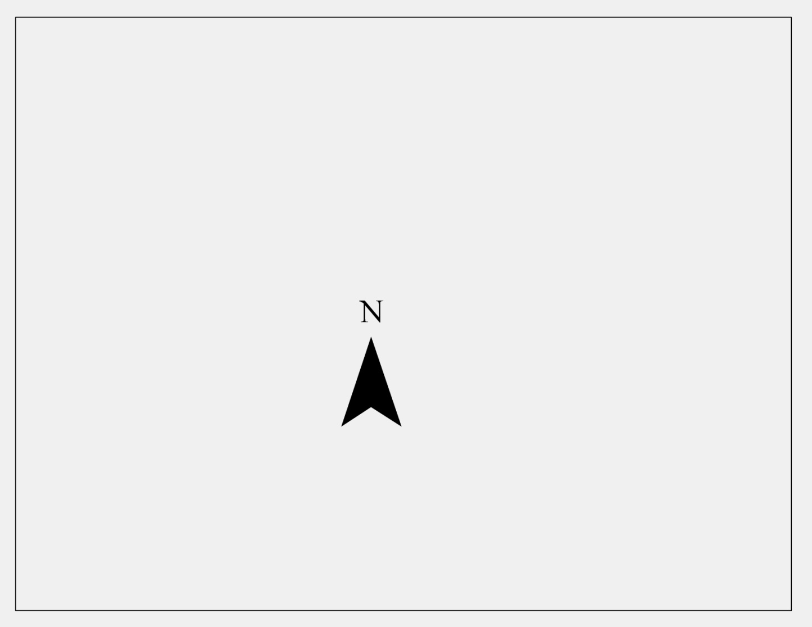

Area of Interest
Santa Catalina Mountain
Santa Catalina Mountain
Santa Catalina Mountain
Rincon Mountain
Rincon and Santa Catalina Mountains
Sky Islands of Southeastern Arizona
Rincon Mountain
Image Credit : Southeastern AZ Water Resource Team
Notes:
The slide shows the location of overall study area, i.e. Sky Island of Southeastern Arizona and a true color image of the focused study area, i.e. Rincon and Santa Catalina Mountains
Image Credit – Southeastern AZ Water Resource Team

Slide 4
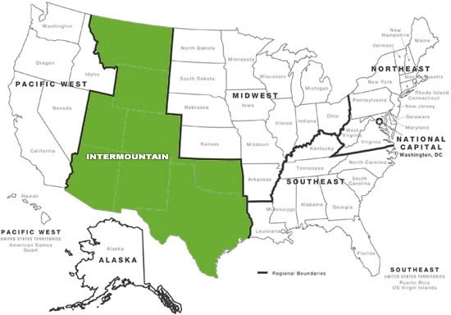

Project Partners
National Park Service,
Intermountain Region
National Park Service,
Saguaro National Park
Image Credit: National Park Service
Notes:
The Southeastern Arizona Water resource team collaborated with Partners from the National Park Service, Intermountain Region and the National Park Service at the Saguaro National Park to address the community concern of the potential impact of snow cover loss on water resources in the Sky Island region. With a more complete understanding of the impact of snow cover, the NPS will be able to analyze past snow cover changes to improve future land management decisions.
Image Source: https://www.nps.gov/nhl/contact/imro.htm

Slide 5
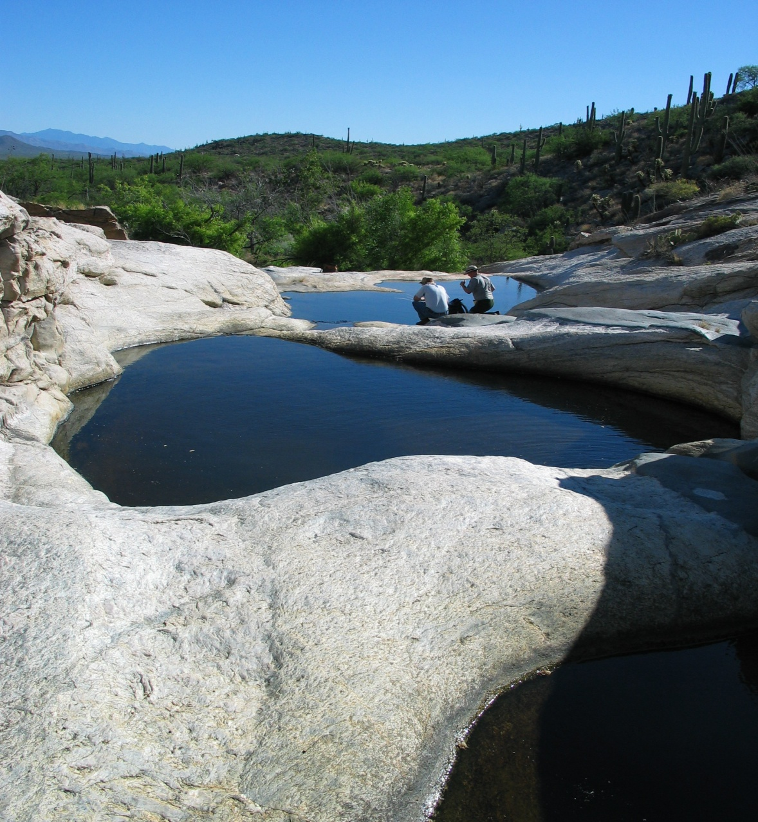
Community Concerns
Snowmelt runs into streams and water bodies, providing water resources to wildlife and vegetation even during the dry season
Reduced annual snowpack has potential to negatively impact flora and fauna that inhabit the Sky Islands
                Understanding impacts of reduced snow pack in the Sky Islands will assist the NPS in developing adaptive land management strategies for the future
Image Credit: National Park Service
Notes:
Noted climate change effects in the Southwestern United States include significant increases in temperature across the region (Colleen Filippone, Personal Communication, September 9,2016). Warmer temperature causes shifts in the winter precipitation pattern e.g. precipitation is falling as rain rather than snow, shifts in the hydrological cycle - such as a decrease in winter precipitation, and earlier yearly snowmelt. Without the contributions from snowmelt runoff, the many streams, springs, seeps would exhibit extremely low water levels and in some cases dry out completely. This could lead to loss of habitat and an increase in wildfires.
Image Source: National Park Service Archive

Slide 6
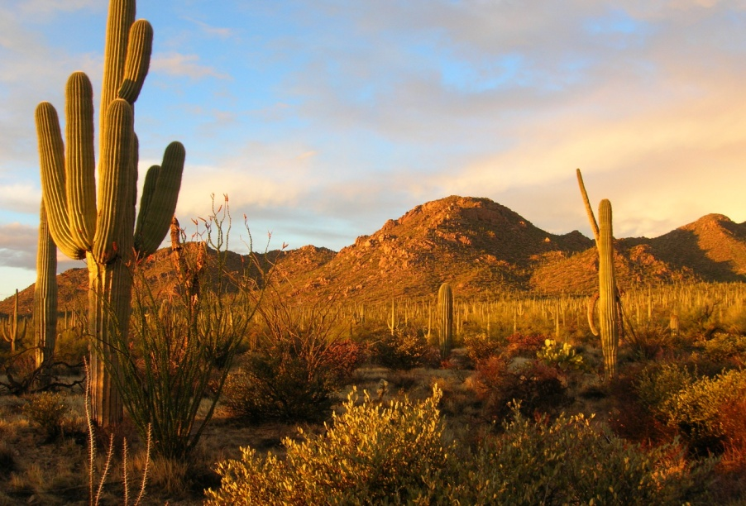
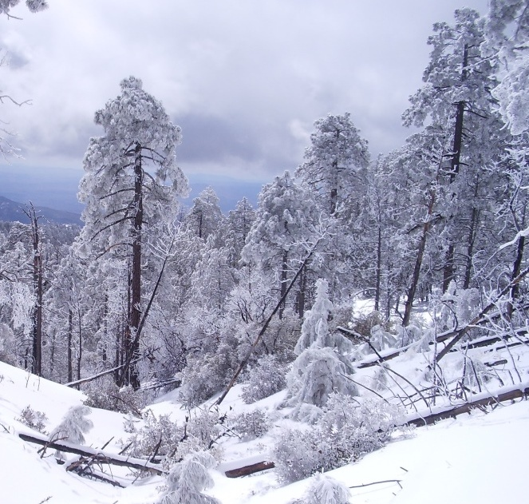
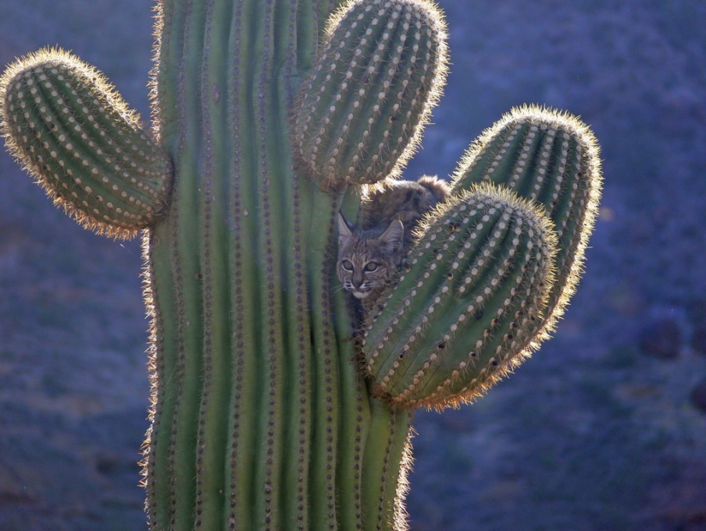
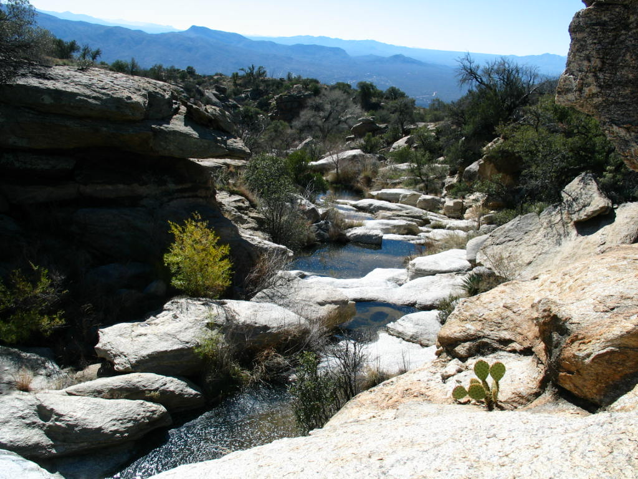
Community Concerns
Warming Temperatures =
More Rain and Less Snow
Snowpack decline results in less runoff during summer months.
  Potential Effects
  Water reduction
  Habitat change
  Wildfire outbreaks
Image Credit: National Park Service
Notes:
Understanding how the changing climate has historically affected the region will assist the NPS in developing adaptive land management strategies for the future. These strategies might include where and how to apply prescribed fire, which species (aquatic and terrestrial) and critical habitats may become stressed, threatened, or endangered and what might be done to supplement water bodies or establish refugia, as well as how backcountry visitors may be impacted by water availability changes.
Image Source: NPS Archive

Slide 7
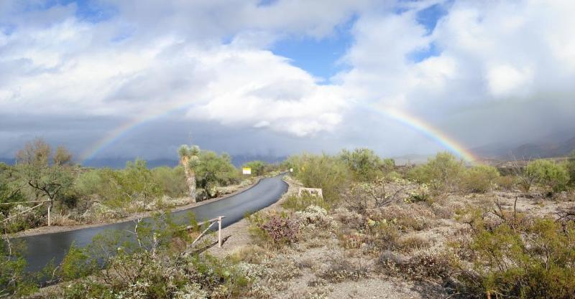
Image Credit: National Park Service
Objectives
Create an overall assessment of snow cover distribution in Rincon and Santa Catalina mountain ranges, using NASA Earth observations (Landsat) data
Assess and identify watersheds experiencing higher loss of snowpack with remote sensing products and supplement with USGS stream gauge and pool data provided by the NPS
Notes:
The objective of this project is to – Create an overall assessment of snow cover distribution in Rincon and Santa Catalina mountain ranges using NASA Earth observations (Landsat) data and Assess and identify watersheds experiencing higher loss of snowpack with remote sensing products and supplement with USGS stream gauge and pool data provided by the NPS.
NOTE: For every image on the slide include an image source in the speaker notes (ex. URL; Name, Affiliation, etc.)
Image Source: https://www.nps.gov/media/photo/gallery.htm?id=D063AD9E-155D-45 1F-67481BE5A6A49824

Slide 8

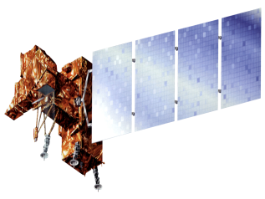
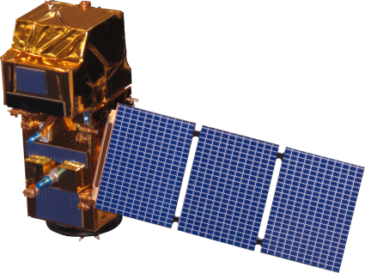

Earth Observations Used
NASA Earth Observations
Additional Earth Observations
Landsat 4 & 5 TM
  Landsat 7 ETM +
Sentinel -2
  Landsat 8 OLI
Image Credit: NASA
Notes:
NASA Earth observing system comprises a series of satellite designed for long term global observation of the land surface, atmosphere, biosphere and oceans to monitor environmental changes.
For this project we used data from Landsat 5 Thematic Mapper (TM ), Landsat 7 Enhanced Thematic Mapper Plus (ETM +) and Landsat 8 Operational Land Imager (OLI) with thermal infrared sensor (TIRS) were downloaded and processed in the Google Earth Engine (GEE).
Additionally, SENTINEL-2 data containing 13 UINT16 spectral bands representing TOA reflectance scaled by 10,000 were downloaded and processed in GEE.
Image Source:
Aqua: http://www.devpedia.developexchange.com/dp/index.php?title=List_of_Satellite_Pictures
Terra: http://www.devpedia.developexchange.com/dp/index.php?title=List_of_Satellite_Pictures
Landsat 5: http://www.devpedia.developexchange.com/dp/index.php?title=List_of_Satellite_Pictures
Landsat 7: http://www.devpedia.developexchange.com/dp/index.php?title=List_of_Satellite_Pictures
Landsat 8: http://www.devpedia.developexchange.com/dp/index.php?title=List_of_Satellite_Pictures
Sentinel 2: http://www.devpedia.developexchange.com/dp/images/d/dd/24_Sentinel2.png

Slide 9
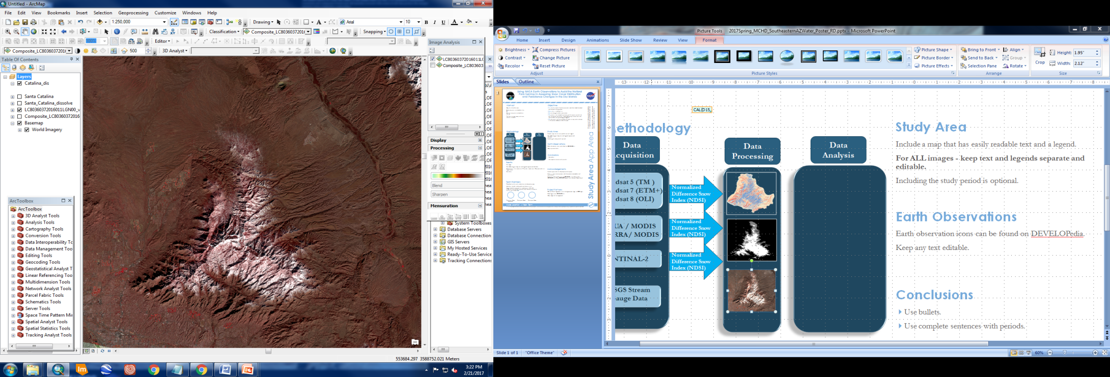
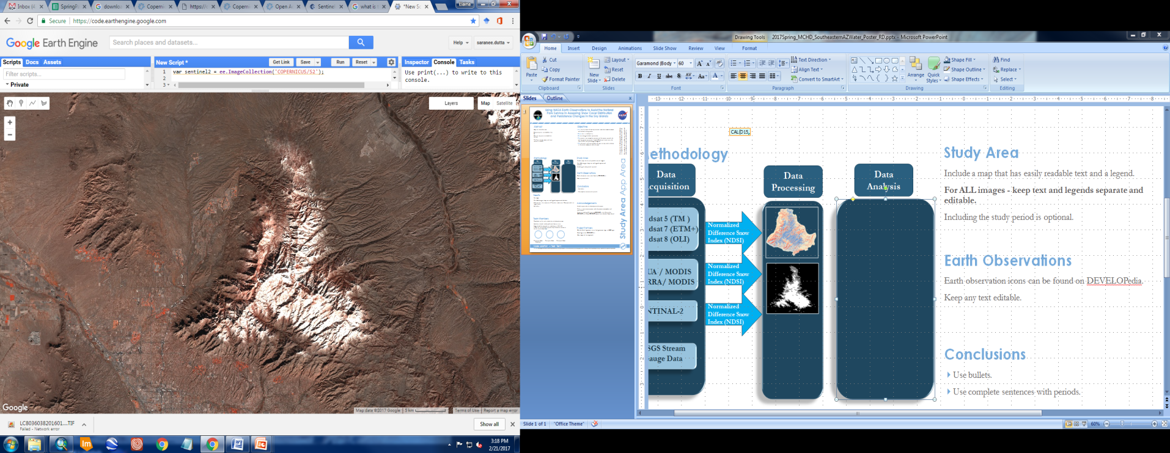
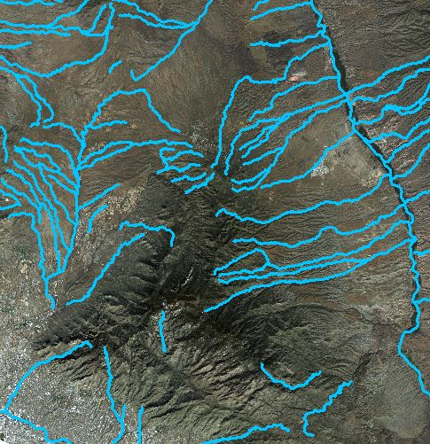
Methodology
Landsat 5 (TM )
Landsat 7 (ETM+)
Landsat 8 (OLI)
USGS Stream Gauge Data
Wet/Dry Data
Data Acquisition
SENTINEL - 2
Data Processing
Snow cover Distribution
Snow cover Distribution
Historical and current stream discharge and stream flow
Presence of surface water
Data Analysis
Image Credit : Southeastern AZ Water Resource Team
Notes:
All Landsat and Sentinel-2 data products were atmospherically corrected by using GEE. Our team developed a script in java script to detect topographic shadow and cloud cover. Snow cover is identified using Normalized Difference Snow Index (NDSI) and S3 index. NDSI was calculated using the reflectance value of band 2 and band 5. USGS stream gauge data dating back to 1985 was downloaded to compare the effect of snow melt in stream flow. Wetted length data was collected and provided by the NPS. The data provided information about the presence of surface water in the creek from 2005-2016.

Slide 10
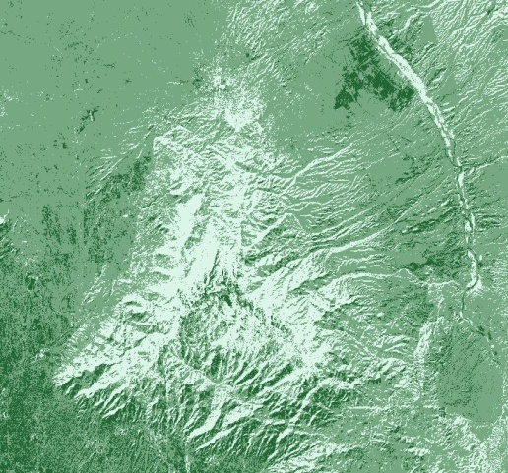
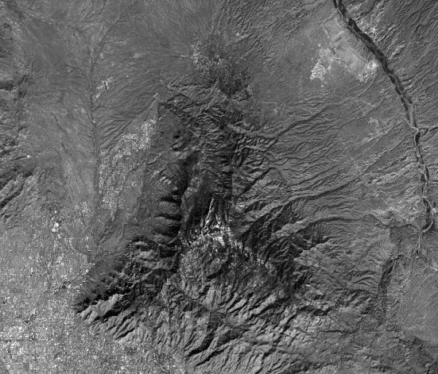
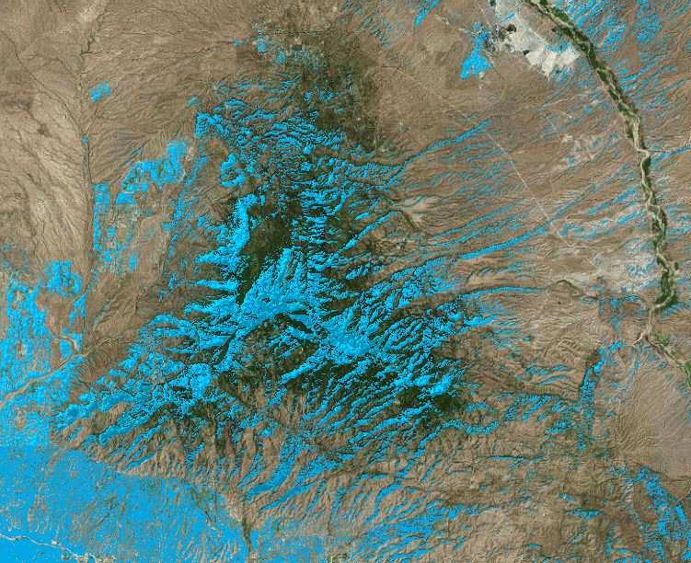
Methodology - Data Processing
Data processing for snow cover distribution
Normalized Difference Snow Index
Santa Catalina Mountain
Green - SWIR
=
Green + SWIR
Wavelengths of Landsat bands used to calculate NDSI
Landsat Bands | Landsat 5 TM | Landsat 7 ETM+ | Landsat 8 OLI
Green | 0.52 – 0.60 µm | 0.52 – 0.60 µm | 0.53 – 0.59 µm
SWIR | 1.55 – 1.75 µm | 1.55 – 1.75 µm | 1.57 – 1.65 µm
Landsat NDSI
Image Credit: : Southeastern AZ Water Resource Team
Notes:
Our team created a script in JavaScript to calculate the Normalized Difference Snow Index (NDSI) (Hall et al. 2001; Wang et al. 2015) . To do this, the green and short wave infrared (SWIR) bands were used in a band ratio. To avoid snow pixel confusion, an NDSI threshold was used where a pixel was mapped as snow if NDSI ≥ 0.4, reflectance in the Landsat band 5(0.85 – 0.88 µm) is > 0.11 and reflectance in Landsat band 3 (0.53 – 0.59 µm) >0.1 (Rosenthal and Dozier 1996; Hall et al. 2002).
To ensure the accuracy of the classification, the 10.4μm Thermal Infrared Sensor (TIRS) bands were used to measure the surface temperature of each pixel. A threshold of 277k was set and if the temperature of a pixel was >277k the pixel was not be mapped as snow (Hall et al. 2001; Hall et al. 2002).
Image Credit: Southeastern Arizona Water Resources II Team

Slide 11
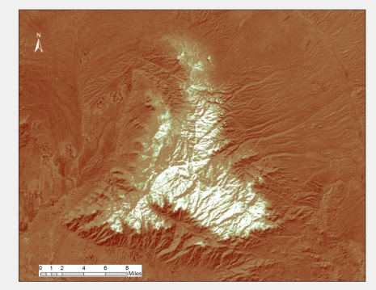
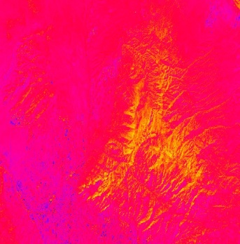
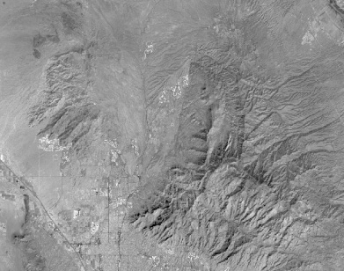
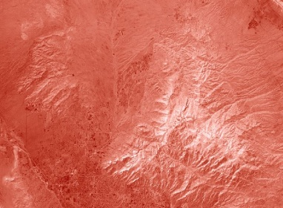
Methodology - Data Processing
Data processing for snow cover distribution
Santa Catalina Mountain
NIR * (Red – SWIR)
S3 Index
=
(NIR + Red)(Green + SWIR)
Landsat Bands | Landsat 5 TM | Landsat 7 ETM+ | Landsat 8 OLI
NIR | Band 4 (0.76 – 0.90 µm) | Band 4 (0.77 – 0.90 µm) | Band 5 (0.85 – 0.88 µm)
Red | Band 3 (0.63 – 0.69 µm) | Band 3 (0.63 – 0.69 µm) | Band 4 (0.64 – 0.67 µm)
SWIR | Band 5 (1.55 – 1.75 µm) | Band 5 (1.55 – 1.75 µm) | Band 6 (1.57 – 1.65 µm)
S3 Snow Index
Image Credit: : Southeastern AZ Water Resource Team
Notes:
Normalized snow index (S3) was proposed by Saito and Yamazaki (1999) to identify snow under vegetated area. Snow and ice cover is highly reflective in the visible part of the electromagnetic spectrum and highly absorptive in the near infra red (NIR) and short wave infra red (SWIR) part of the spectrum (Xiao et al. 2001). The combination of visible red, NIR and SWIR was used to calculate S3 index. S3 uses the reflectance characteristics of snow and vegetation to reduce the errors caused by snow covered areas mixed with vegetation (Negi et al. 2009). A pixel was mapped as snow, if S3 ≥ 0.01.
Image Credit: Southeastern Arizona Water Resources II Team

Slide 12
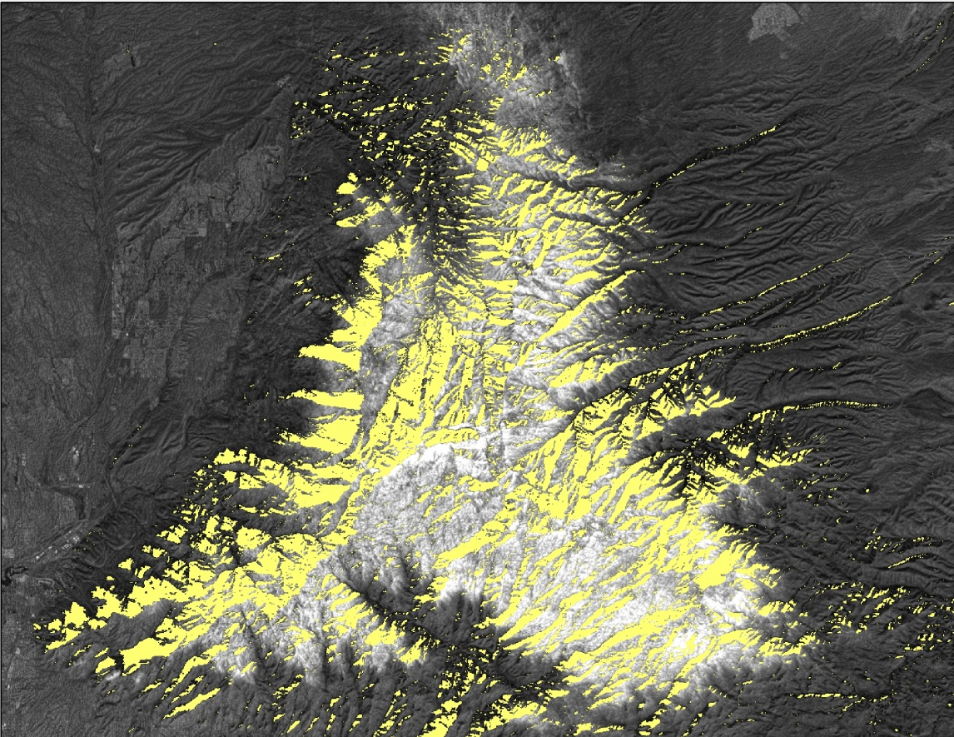
Methodology - Data Processing
Data processing to classify topographic shadow
Shadow areas are detected by using short wave infrared band (1.57 – 1.65 µm) (Jin et al. 2013; Ji et al. 2015; Candra et al. 2016).
Shadow threshold = (.0001 - .035)
A pixel was mapped as shadow if it falls between the shadow threshold.
Topographic shadow
Image Credit: : Southeastern AZ Water Resource Team
Notes:
In a Landsat image, there are two major types of shadow, mountain and cloud shadow (Ji et al. 2015). A shadow threshold was developed using short wave infra red band (1.57 – 1.65 µm) (Jin et al. 2013; Ji et al. 2015; Candra et al. 2016). Based on the idea that shadow has very low reflectance in the short wave infrared spectrum, we used a threshold of .0001 - .035 to detect topographic shadow, meaning a pixel was mapped as shadow if it falls between that ranges.
Image Credit: Southeastern Arizona Water Resources II Team

Slide 13
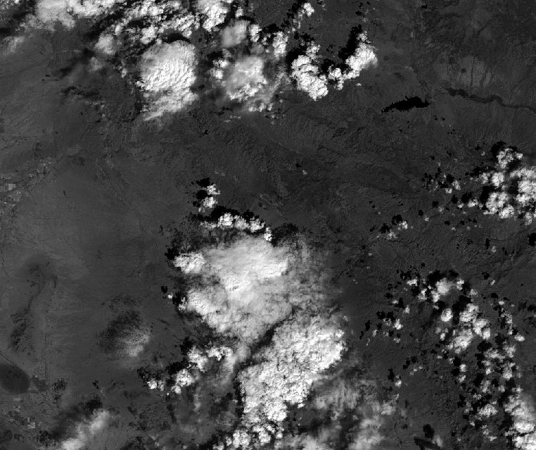
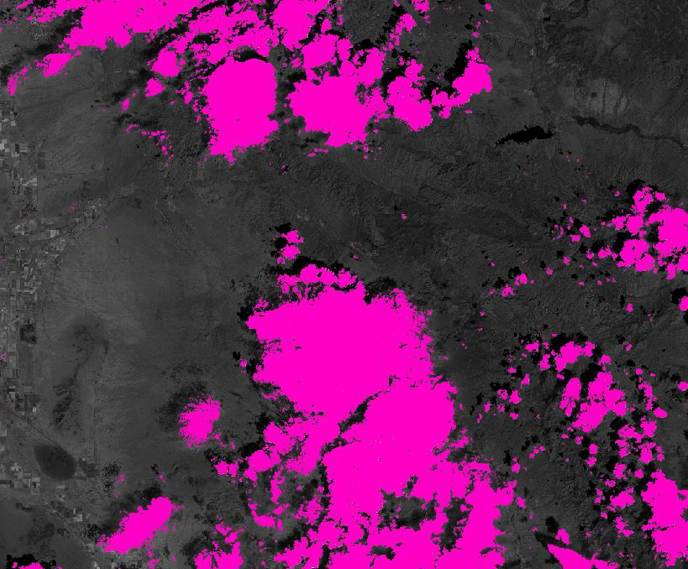
Methodology - Data Processing
Data processing to classify cloud cover
Clouds
Clouds
A pixel was mapped as a cloud if reflectance in the Landsat band5 (0.85 – 0.88 µm) is >=0.3 and reflectance in the Landsat band1 (0.43 – 0.45 µm) >= 0.26.
Image Credit: : Southeastern AZ Water Resource Team
Notes:
Cloud shadow is very similar to topographic shadow where the underlying spectral characteristics of the surface are not truly represented (Li et al. 2012; Mueller et al. 2016).
Accurate cloud identification is also affected by surface features (e.g. snow, white sand) that have reflectance signatures that are similar and in some cases identical to clouds in
the Landsat bands (Irish 2000). Since clouds are bright and cold and cloud shadows are darker than the surrounding landscape, a common approach is to apply a threshold to
the bands and band combinations to define a set of rules (Martinuzzi et al. 2007; Hughes and Hayes 2014). Our team determined a cloud threshold via trial and error methods
using Landsat data for the study area and study period. A pixel was mapped as a cloud if reflectance in the Landsat band5 (0.85 – 0.88 µm) is >=0.3 and reflectance in the
Landsat band1 (0.43 – 0.45 µm) >= 0.26.
Image Credit: Southeastern Arizona Water Resources II Team

Slide 14
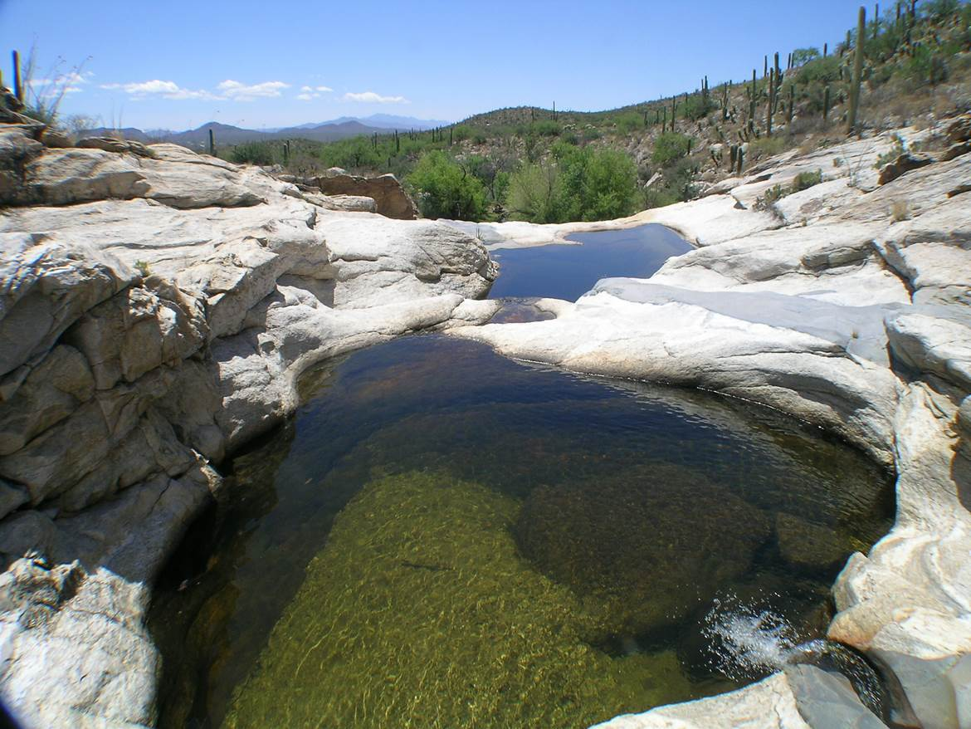
Methodology - In situ Data
USGS Stream Gauge Data
Wetted length data for the Rincon creek were collected and provided by the NPS.
Stream gauge data were download from the USGS website and compared with Landsat snow data
The data provided information about the presence of surface
water in the creek from 2005 – 2016.
Image Credit: National Park Service
Notes:
Stream gauge data were downloaded from the USGS website and compared to snow data from Landsat . Wetted length data for the Rincon creek were collected and provided by the NPS. The data provided information about the presence of surface water in the Rincon creek from 2005 – 2016.
Image Credit: NPS Archive

Slide 15
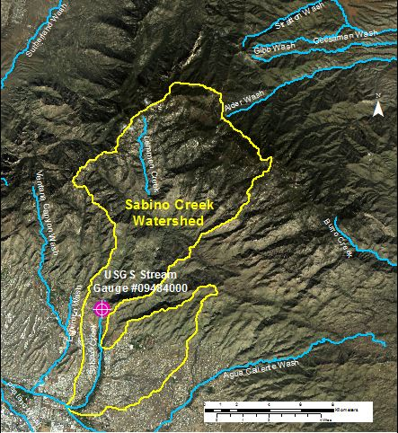
Analysis - Sabino Creek Watershed
Landsat 8 true color image of the Sabino Creek watershed and the location of the USGS stream gauge
Comparisons between Landsat snow cover data and USGS stream gauge data were performed for Sabino Creek Watershed
Image Credit: Southeastern AZ Water Resources Team
Notes:
Sabino Creek Watershed in the Santa Catalina Mountain was selected to perform snow cover analysis. Sabino creek is one of the major drainages in Santa Catalina Mountains and the watershed covers 35.5 square miles of area which extends from 822 meter at the gauging station to, 2,804 meter at the top of the Mount Lemmon (Gottfried and Ffllliottz 2011). The USGS gauge (USGS 09484000) is located at 32°18'53" latitude and 110°48'39.3" longitude .

Slide 16
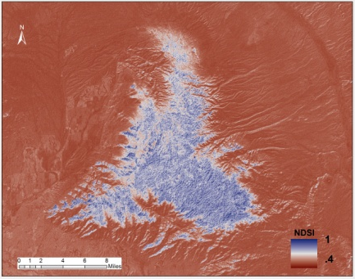
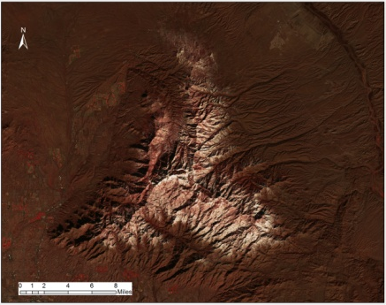
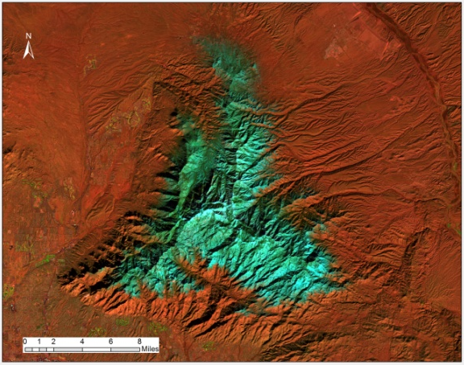
Analysis – Snow cover analysis
a
b
(a)Landsat 8 (OLI) NDSI imagery
(b) True color composites
(c) S3 index
(d) False color composites
c
d
Image Credit: Southeastern AZ Water Resources Team
Notes:
NDSI was prone to errors of commission (false positive) due to shadow and S3 snow index has snow commission error due to clouds. To overcome some of these limitations we used a hybrid approach (NDSI+S3) with a new set of decision rules for snow and cloud mapping. The new threshold value was set to NDSI ≥ 0.15 and S3 ≥0.01. A pixel was mapped as snow if it satisfies both criteria. The 4 images above showing side by side comparisons between NDSI, S3 with true color and false color composites.
Image Credit: Southeastern AZ Water Resources team

Slide 17
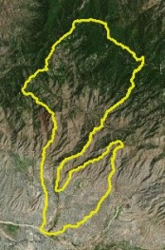
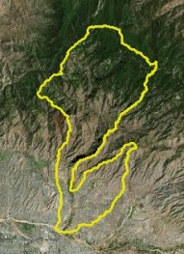
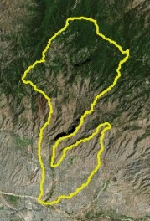
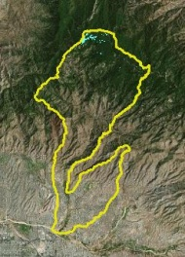
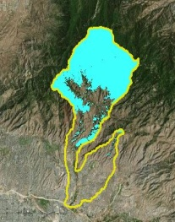
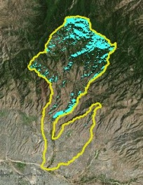
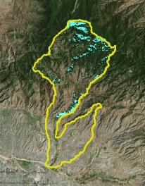
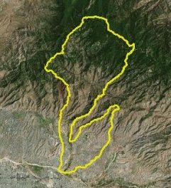
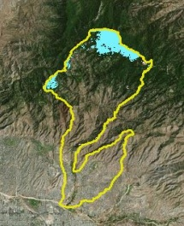
Analysis – Snow cover analysis
10/23/2015
11/08/2015
12/10/2015
12/26/2015
01/11/2016
01/27/2016
02/12/2015
02/28/2015
03/15/2016
03/31/2016
Snow Cover Distribution (%)
Image Credit :Southeastern AZ Water Resources Team
Notes:
Landsat 8 time series snow cover distribution (%) for Sabino Creek Watershed for 2015-2016 snow season. Percent snow cover distribution from October 2015 to march 2016 snow season shows fluctuations throughout the season with peak accumulation (50%)occurring in January 11, 2016. A second highest peak (11%) was observed in March 31st.
Image Source: Southeastern AZ Water Resources Team

Slide 18
Analysis
Comparison of snow covers distribution (%) and stream discharge (Ft³ / Sec) in Sabino Creek watershed for October 2015 to March 2016 snow season.
Image Credit: Southeastern AZ Water Resources Team
Notes:
Percent snow cover was compared with average monthly stream flow to understand the contribution of snowmelt in stream flow in order to gain a better understanding of how snow is impacting water resources in the Sky Island region. Percent snow cover distribution from October 2015 to march 2016 snow season shows fluctuations throughout the season with peak accumulation (50%)occurring in January 11, 2016. The greatest monthly recorded stream flow occurred in January 2016 when 21.23 Ft³/sec were measured.
Image Credit: Southeastern AZ Water Resources team

Slide 19
Analysis
Daily Min/Max stream discharge at the Sabino Creek Watershed from
October 2015 – April 2016 snow season
Months
Image Credit: Southeastern AZ Water Resources Team
Notes:
Daily min/max stream flow data for Sabino Creek watershed was obtained from USGS website. Maximum stream discharge for Sabino Creek were recorded on January 7th, 2016 (61.1 Ft³/sec) and minimum was recorded on April 7th, 2016 (0.48 Ft³/sec).
Image Credit: Southeastern AZ Water Resources team

Slide 20
Conclusions
Snow cover distribution (%) were compared with stream discharge data in Sabino Creek watershed for 2015-2016 snow season in order to assess the effect of snow on water resources.
Percent snow cover distribution shows fluctuations throughout the season with peak accumulation(50%)occurring in January 11, 2016 and the greatest average monthly stream flow was occurred in January 2016 when 21.23 Ft³/sec were recorded.
Monthly average stream discharge increased from December to January, indicating possible influence of snow melt on stream flow.
Landsat snow cover distribution maps provided useful information on snowpack phenology; however, some issues with satellite data (e.g., clouds and shadow) were encountered.
Image Credit: National Park Service
Notes:
Image Source: https://www.nps.gov/media/photo/gallery.htm?id=3289FA60-1DD8-B71B-0B13301754C65384

Slide 21
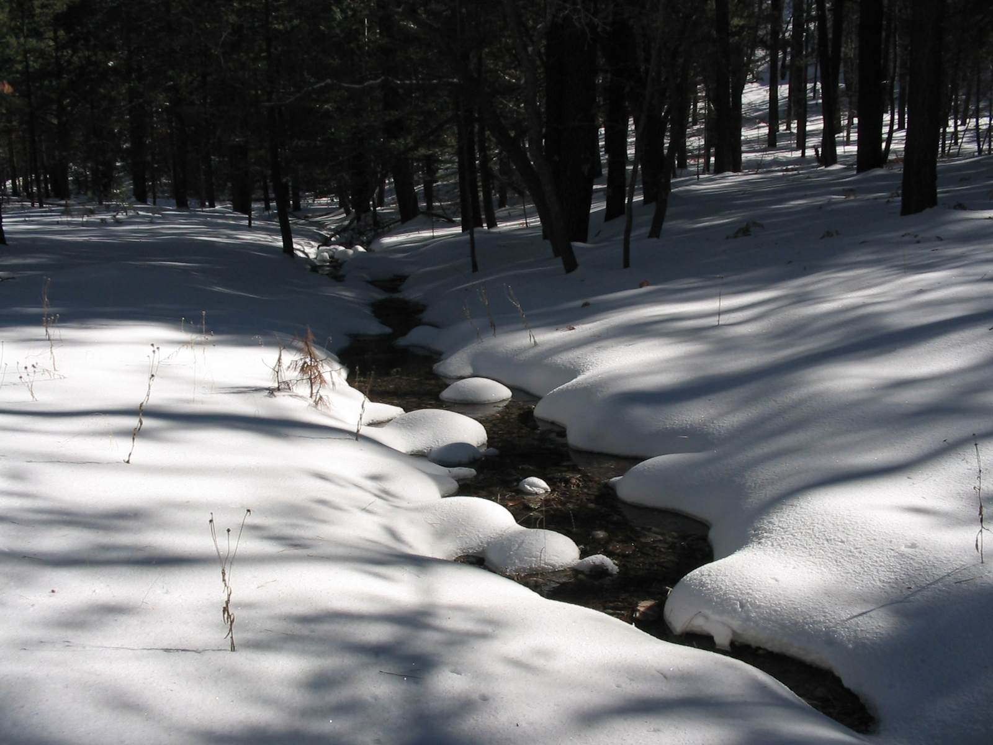
Errors and Uncertainties
NDSI and S3 snow index had snow classification errors (commission and omission errors).
Cloud shadow is very similar to topographic shadow where the underlying spectral characteristics of the surface are not truly represented
Both NDSI and S3 snow index were unable to identify snow covered area mixed with vegetation.
Image Credit: National Park Service
Notes:
Image Source: NPS Archive

Slide 22
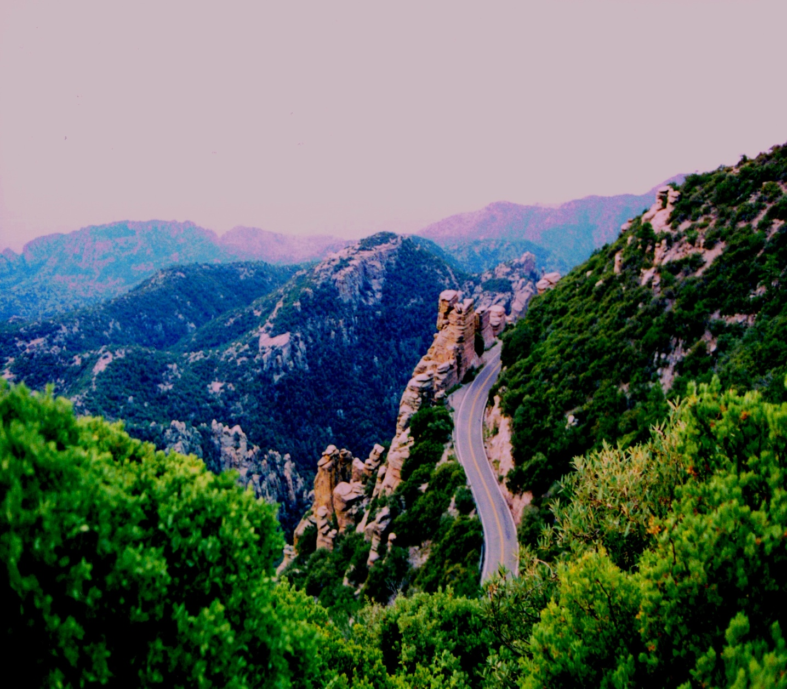
Future Work
Replicate the area of analysis to include all of the Sky Islands.
Include ground water and precipitation data in future analyses of snow pack and surface water flow
Incorporation of Sentinel-2b high resolution data
Incorporation of MODIS MODSCAG data to generate per pixel fractional snow covered area and snow grain size.
Image Credit: Joseph Spruce
Notes:
Future work involves : Replicate the area of analysis to include all of the Sky Islands, include ground water and precipitation data in future analyses of snow pack and surface water flow, Incorporation of Sentinel-2b high resolution data and using MODIS MODSCAG data to generate per pixel fractional snow covered area and snow grain size.
Image Source: Joseph Spruce

Slide 23
Partners:
Colleen Filippone, National Park Service (NPS), Intermountain Region
Don Swann, Saguaro National Park
Advisors and Mentors:
Bernard Eichold, M.D., Dr. PH (Mobile County Health Department)
Joseph Spruce (NASA Langley Research Center)
Kenton Ross, PhD (NASA Langley Research Center)
Previous Contributors:
Farnaz Bayat
Katie Harville

