Slide 1
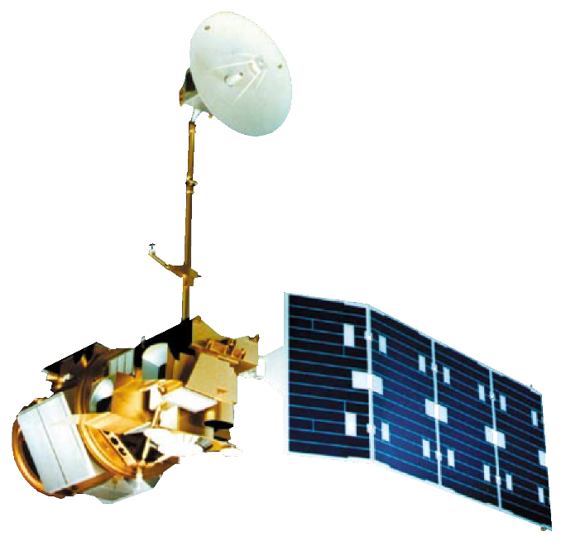
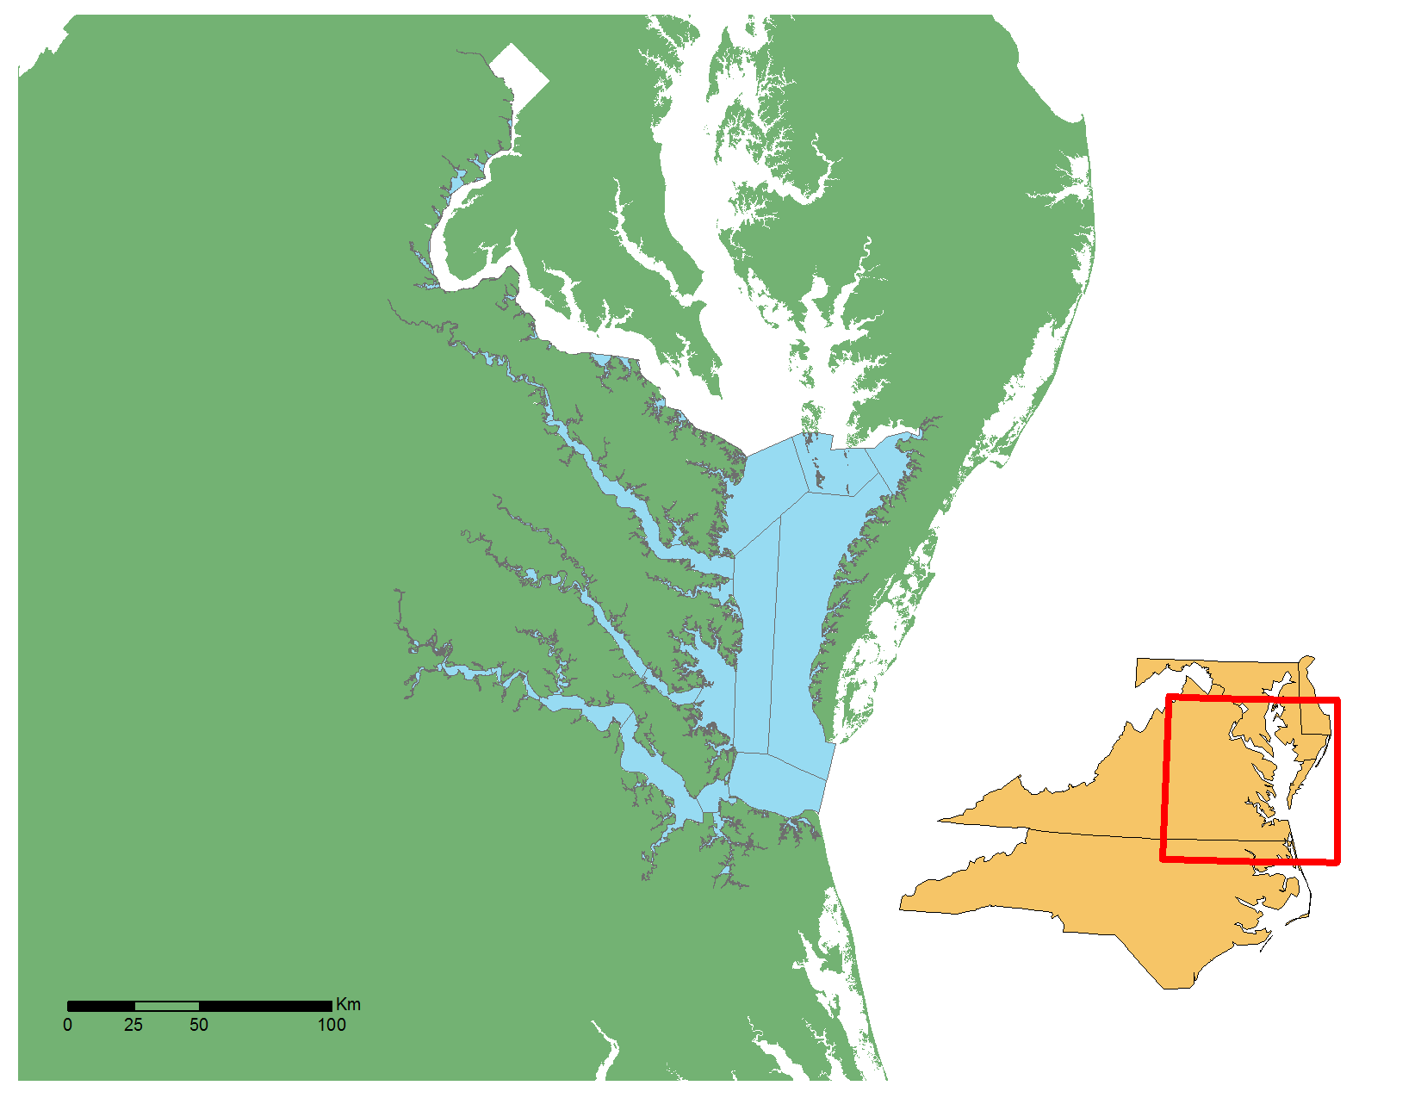
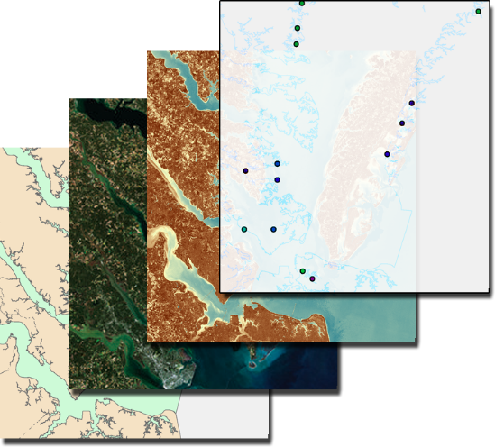
Assessing Water Clarity to Identify Potential Areas of Submerged Aquatic Vegetation (SAV) in the Chesapeake Bay
Abstract
Objectives
Submerged Aquatic Vegetation (SAV) is vitally important to the Chesapeake Bay, serving as one of the primary food sources for the organisms that inhabit the Bay. This project evaluated the efficacy of remote sensing applications as a tool to monitor water quality parameters, specifically turbidity, to indicate areas that can potentially support healthy seagrass populations in the Chesapeake Bay. The resources and methods included visual analysis of the Bay utilizing Landsat 5 Thematic Mapper (TM) and Landsat 8 Operational Land Imager (OLI). By correlating the Landsat-derived Normalized Difference Turbidity Index (NDTI) to the Virginia Institute of Marine Sciences’ (VIMS) in situ monitoring data, a model was created that can be used to provide an estimate of water clarity throughout the entire bay. This model focuses on providing an additional resource for the Virginia Department of Environmental Quality (DEQ) for use in monitoring changes in water turbidity in the Chesapeake Bay and aid in monitoring efforts of SAV growth locations and Total Maximum Daily Load (TMDL) calculations of the Bay.
Correlate and model Landsat derived water clarity metrics with continuous in situ monitoring data for the extent of the Chesapeake Bay and its tributaries in Virginia
Assess the use of NASA’s Earth observing satellites, Landsat 5 and Landsat 8, for monitoring water quality and submerged aquatic vegetation habitat
Earth Observations
Landsat 5 TM
Methodology
Landsat 8 OLI
Virginia Institute of Marine Science
Virginia Estuarine & Coastal Observing System
Landsat 5 TM & Landsat 8 OLI
Study Area
Legend
Land
Virginia Chesapeake Bay
State Area
In situ continuous monitoring data
Surface Reflectance
Turbidity (ntu)
Normalized Difference Turbidity Index
$\text{NDTI}\text{ = }\frac{\text{(}\text{Red}\text{ − }\text{Green}\text{)}}{\text{(}\text{Red}\text{ + }\text{Green}\text{) }}$
Google Earth Engine
Co-locate data for single date and overpass time
Correlate & Model
Chesapeake Bay Water Resources
Results
Landsat 5 TM
Landsat 8 OLI
Monitoring Station Data Points
R² = 0.1197
R² = 0.1692
Normalized Difference Turbidity Index
Landsat Surface Reflectance
Chesapeake Bay Study Area
Project Partners
R² = 0.2088
R² = 0.3481
Virginia Department of Environmental Quality
US Geological Survey, Water Science Center
Conclusions
Team Members
Annual aggregates of NDTI vs. turbidity had a stronger correlation than daily turbidity station data.
There is a margin of error caused by several underlying factors such as bottom effects caused by differences in substrate types and the SAV’s growing season.
Data from Landsat 8 may be capable of predicting turbidity values if these compounding factors are factored out of the analysis.
Acknowledgements
Danielle Quick
Team Lead
Amanda Clayton
Cole Cowher
Dr. Kenton Ross, NASA Langley Research Center
Tish Robertson, Virginia Department of Environmental Quality
Peter Tango, USGS, Water Science Center
David Wilcox & Bob Orth, Virginia Institute of Marine Science
Collin Henson
Gregory Hoobchaak
NASA Langley Research Center – 2017 Spring

