Slide 1
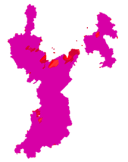
John C. Stennis Space Center
Texas Disasters II
Utilizing NASA Earth Observations to Assist the Texas Forest Service in Mapping and Analyzing Fuel Loads and Phenology in Texas Grasslands
Authors: James Michael Brooke (Project Lead), Meredith Williams, Teresa Fenn.
Possum Kingdom Complex
High Risk Vegetation of Study Area
Case Study
The risk of severe wildfires in Texas has been increasing due to weather phenomena such as climate change and recent urban expansion into wild land areas. Texas’ wild land areas are susceptible to sequences of wet and dry years that increase the wildfire risk. In order to prevent and contain wildfires, the Texas Forest Service (TFS) is tasked with eliminating and evaluating potential fire risk to manage and distribute resources. The task at hand is made more difficult due to the vast and varied landscape of Texas. The TFS assesses fire risk by understanding vegetative fuel types and fuel loads. To better assist the TFS, NASA Earth observations, including Landsat and MODIS data, were analyzed to produce maps of vegetation type and specific vegetation phenology as it related to potential wildfire fuel loads. Fuel maps from 2010-2011 and 2014-2015 fire seasons created by Texas Disasters I project were used and provided a more synergistic analysis of wildfire risk in Texas. The TFS will utilize the end products to evaluate and better understand wildfire risk across Texas.
DEVELOP Location
John C. Stennis Space Center
Earth Observations
Landsat 8 OLI, Terra & Aqua
Partners
Texas Forest Service POC: Tom Spencer
Texas Forest Service POC: Curt Stripling
USDA Forest Service POC: William Hargrove
Advisors
Joseph Spruce [John C. Stennis Space Center]
Advisor [Langley Research Center]

Slide 2
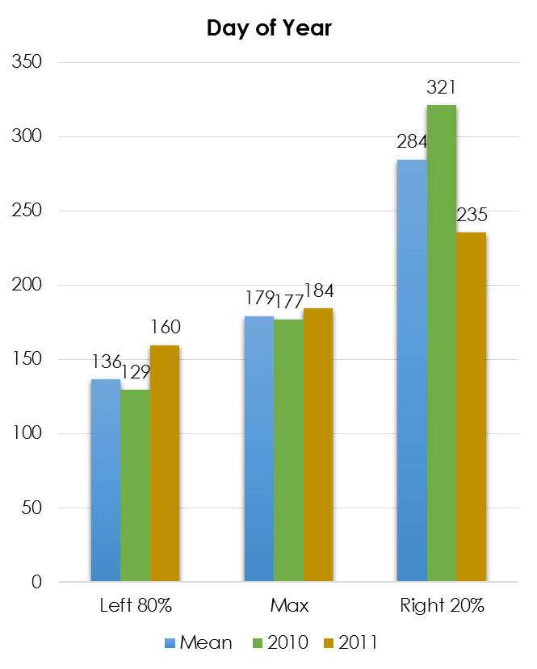
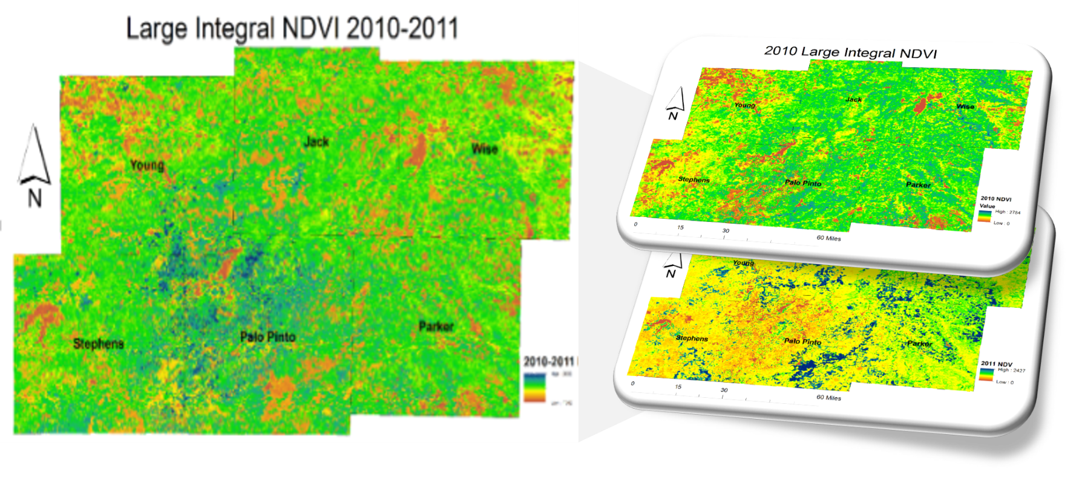
Objective
Utilize NASA Earth observations to assist the Texas Forest Service in mapping and analyzing fuel loads and phenology in Texas grasslands.
Methodology
The Normalized Difference Vegetation Index, NDVI, was used to compare the amount of reflected infrared and visible light to quantify the greenness of vegetation. The nation wide MODIS-derived phenology data set creates an NDVI curve that has 14 layers at 231m resolution. The MODIS 14 layer imagery was stacked with the most recent current cloud free Landsat 8 imagery. A classification was performed on this stack to produce land cover classes that had similar infrared Landsat and phonological characteristics.
Results
If by mid-May the NDVI value has not reached close to 0.6 within the majority of the High-Risk Area, there is a greater risk of wildfires. If the previous year had a growing season near 200 days long combined with a max NDVI of 0.7, the fuel load may contribute to more severe wildfires.
Conclusion
There is a high-risk area within the study area that has an enhanced phenological response to both wet and dry years relative to the surrounding area. This enhanced response is driven more by soil type than climate. In a typical el Nino cycle this area has a greater risk for large, damaging wildfires. As yearly climate swings grow more pronounced and growth continues in the area, this risk will escalate.
Study Area
NDVI Day of Year
Large Integral NDVI for 2010-2011

