Slide 1
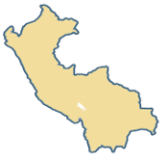
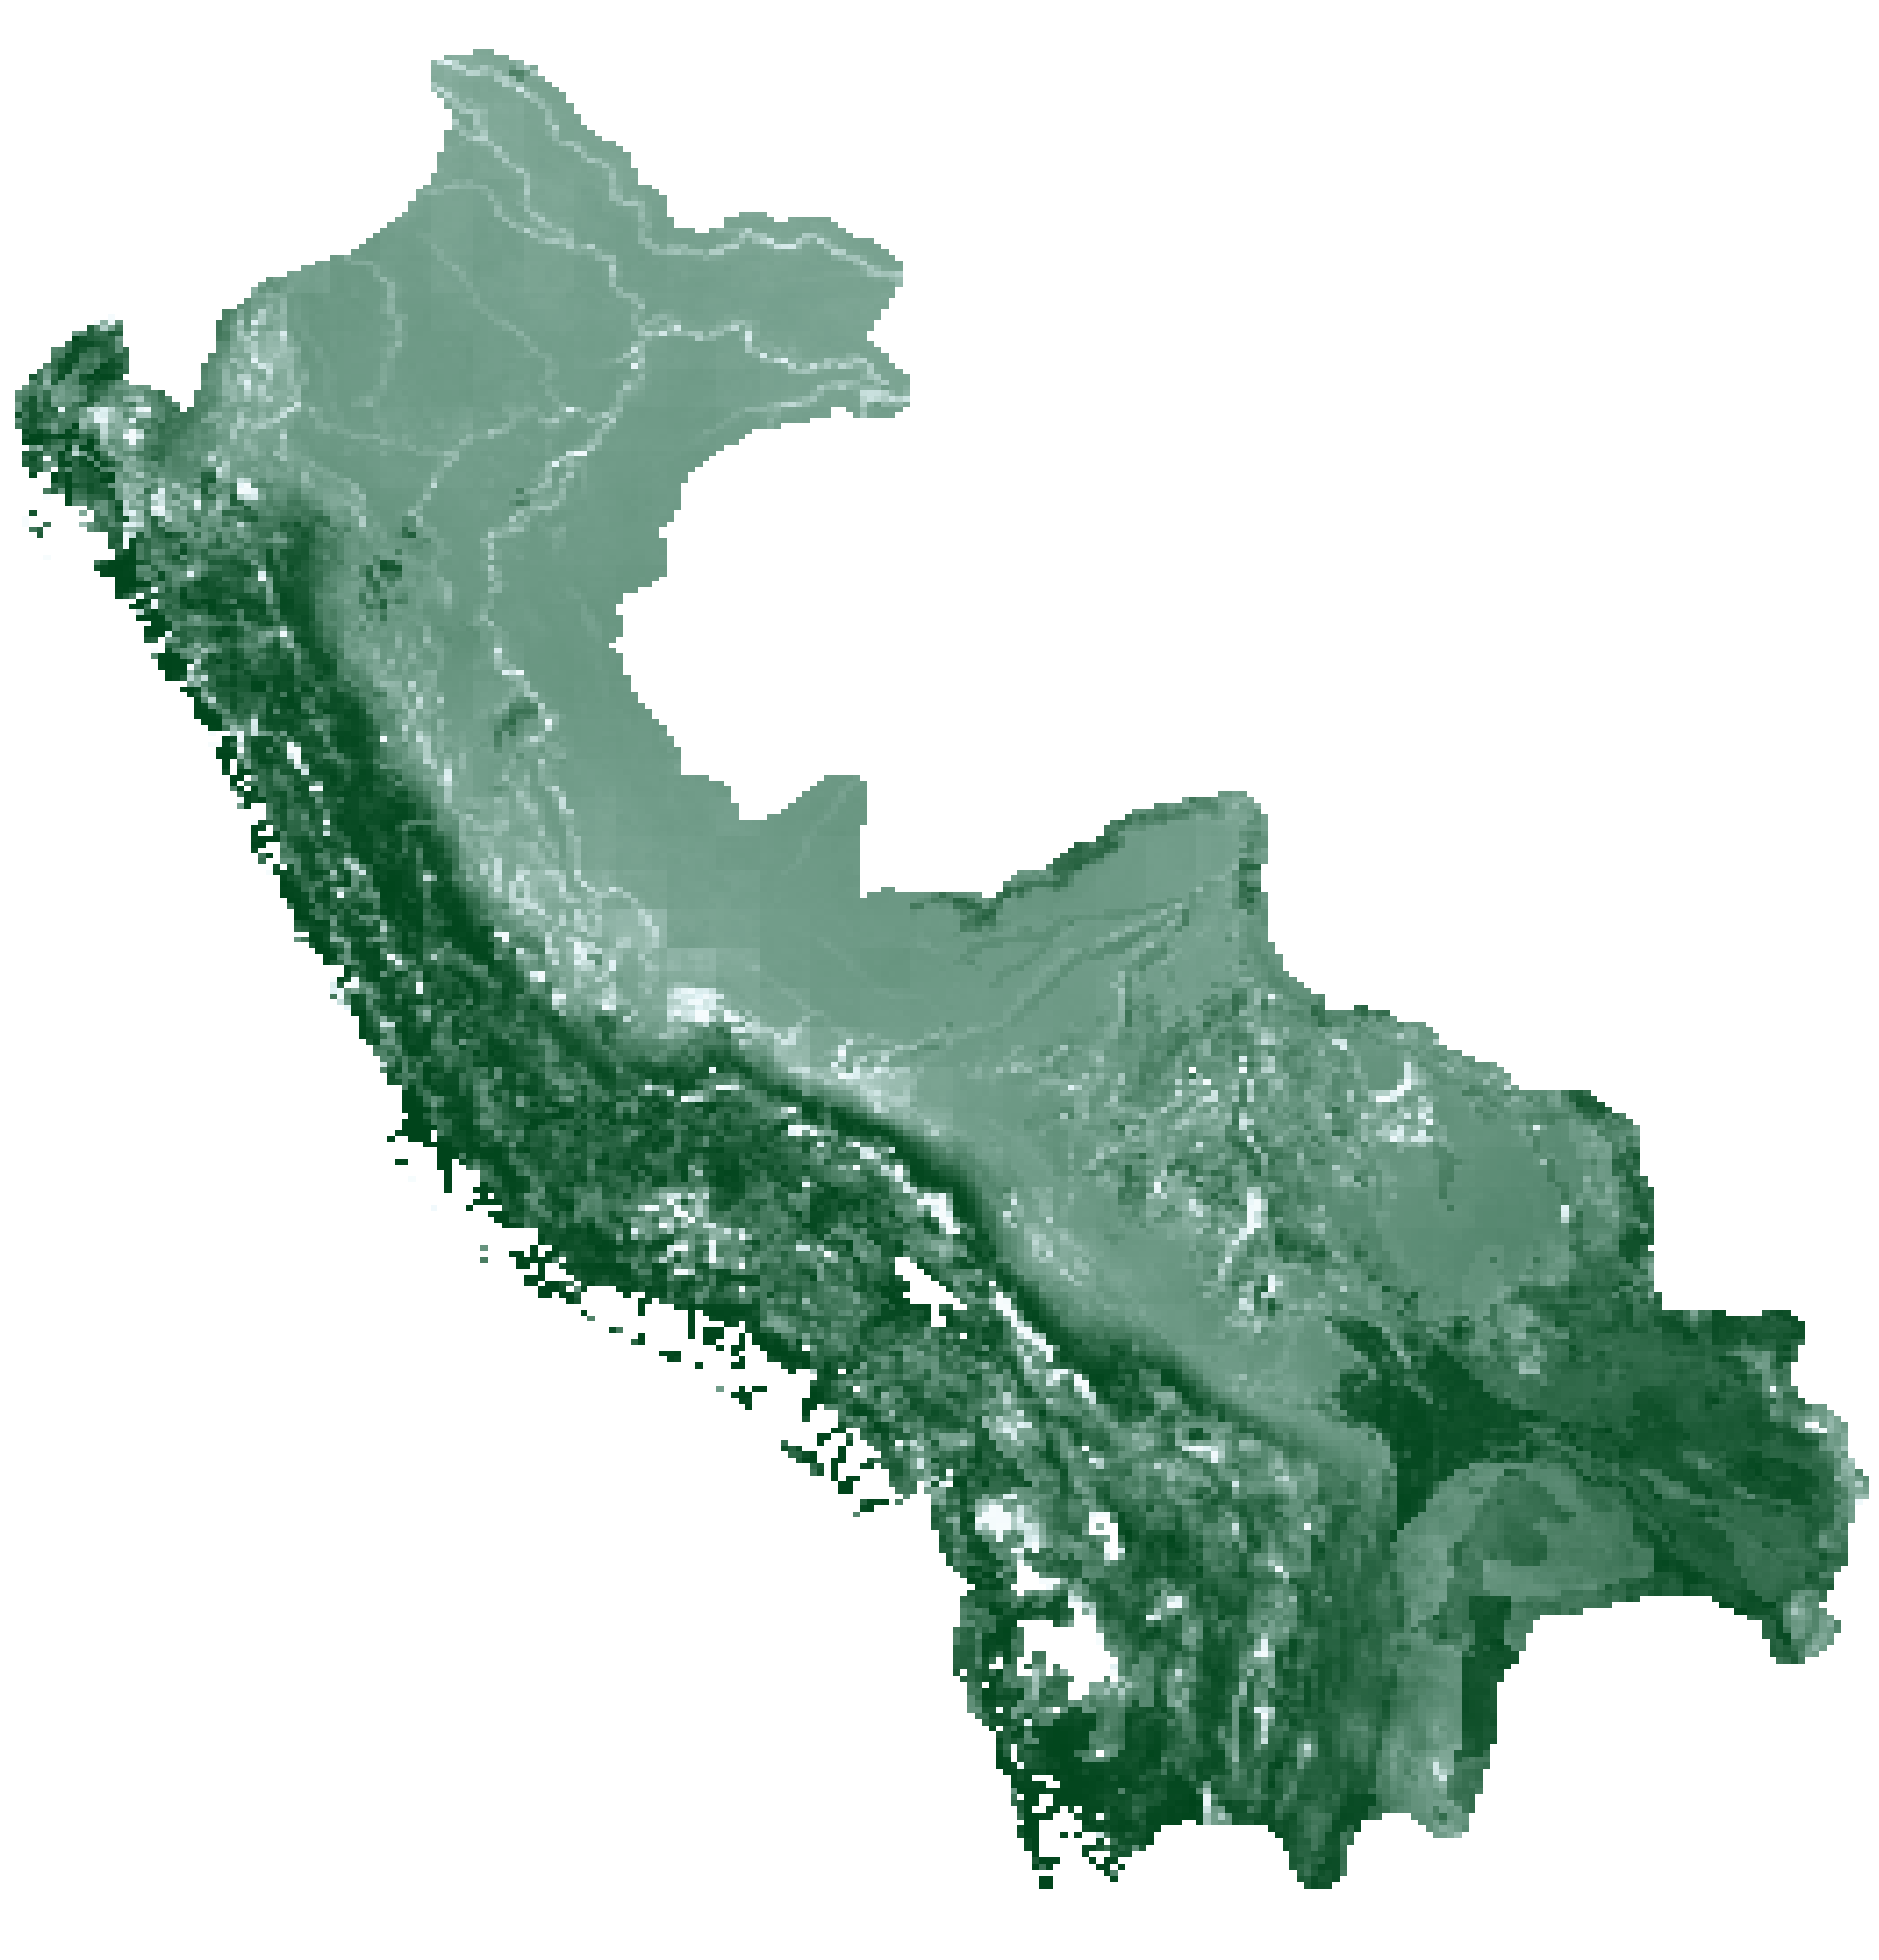
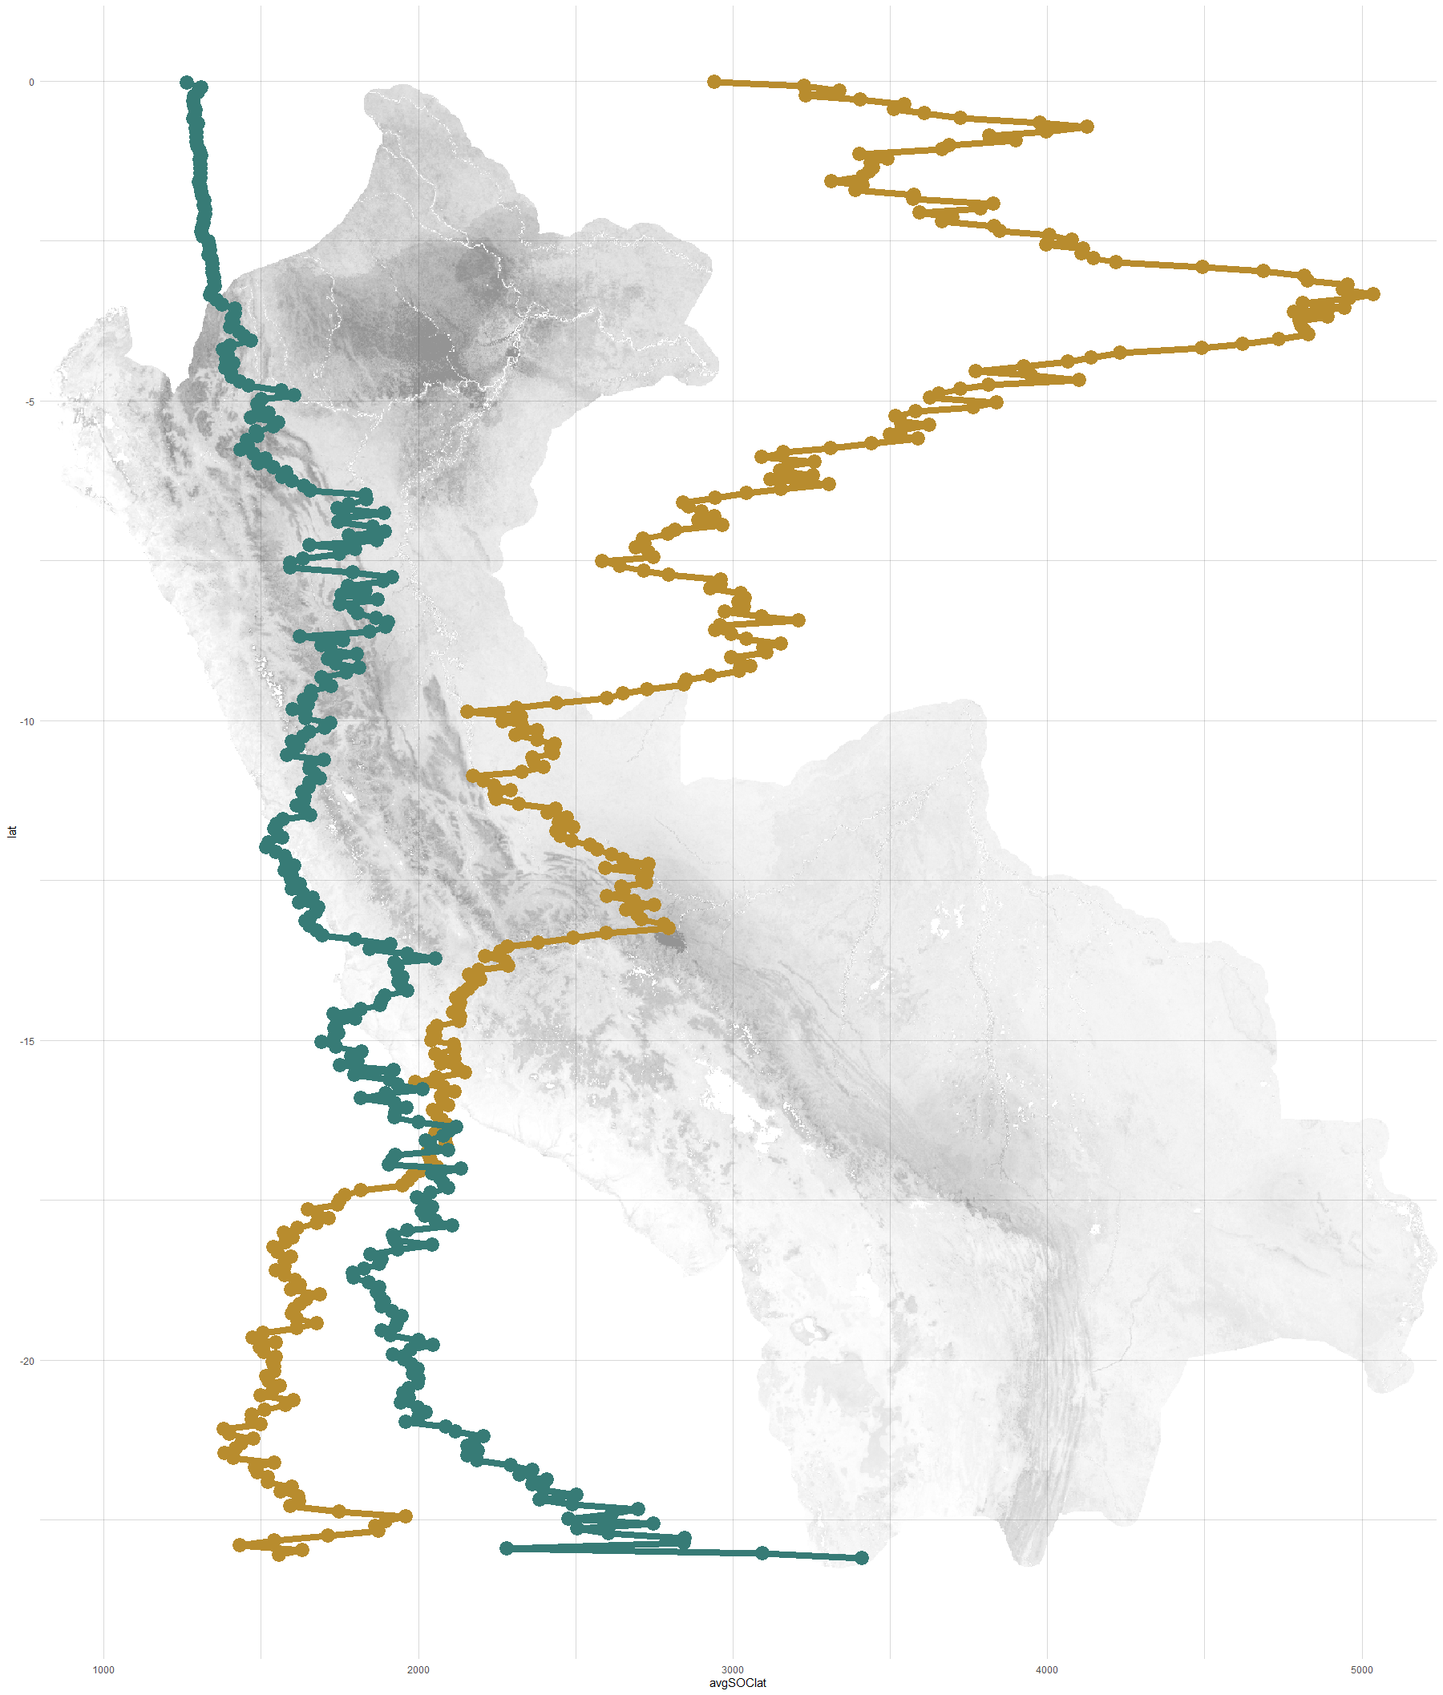
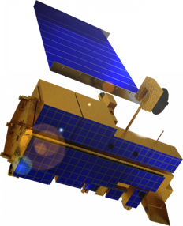
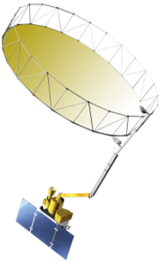
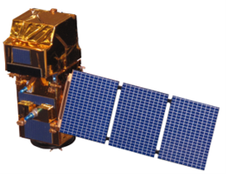
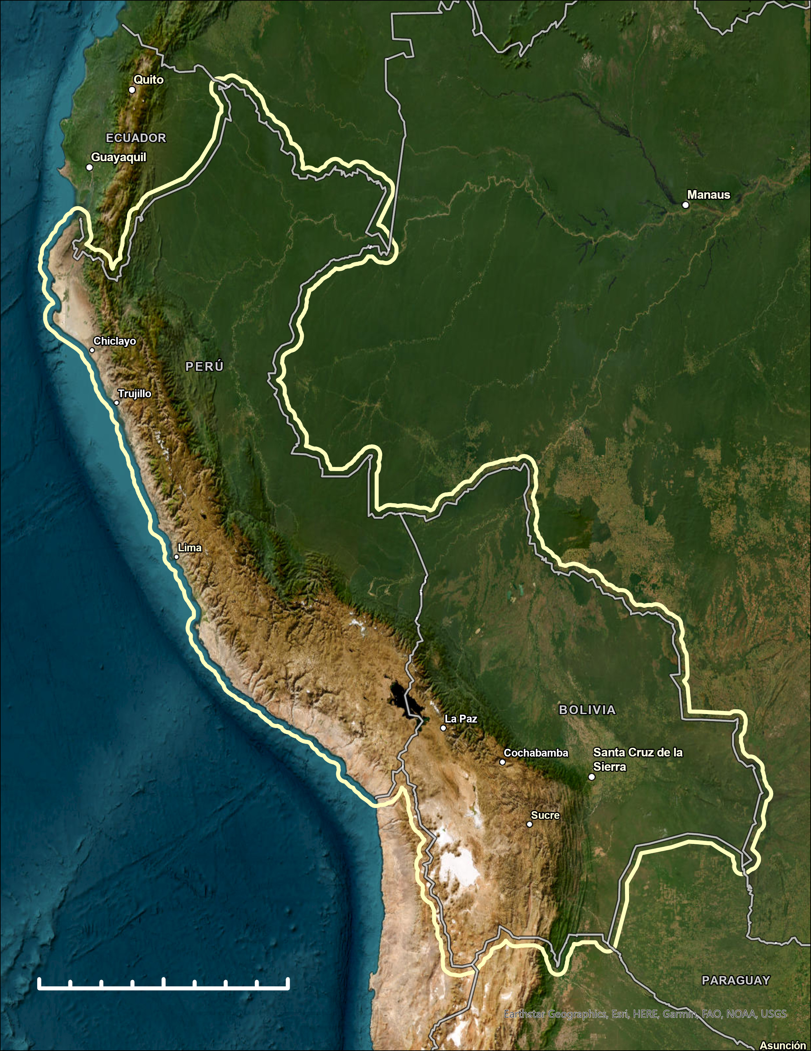
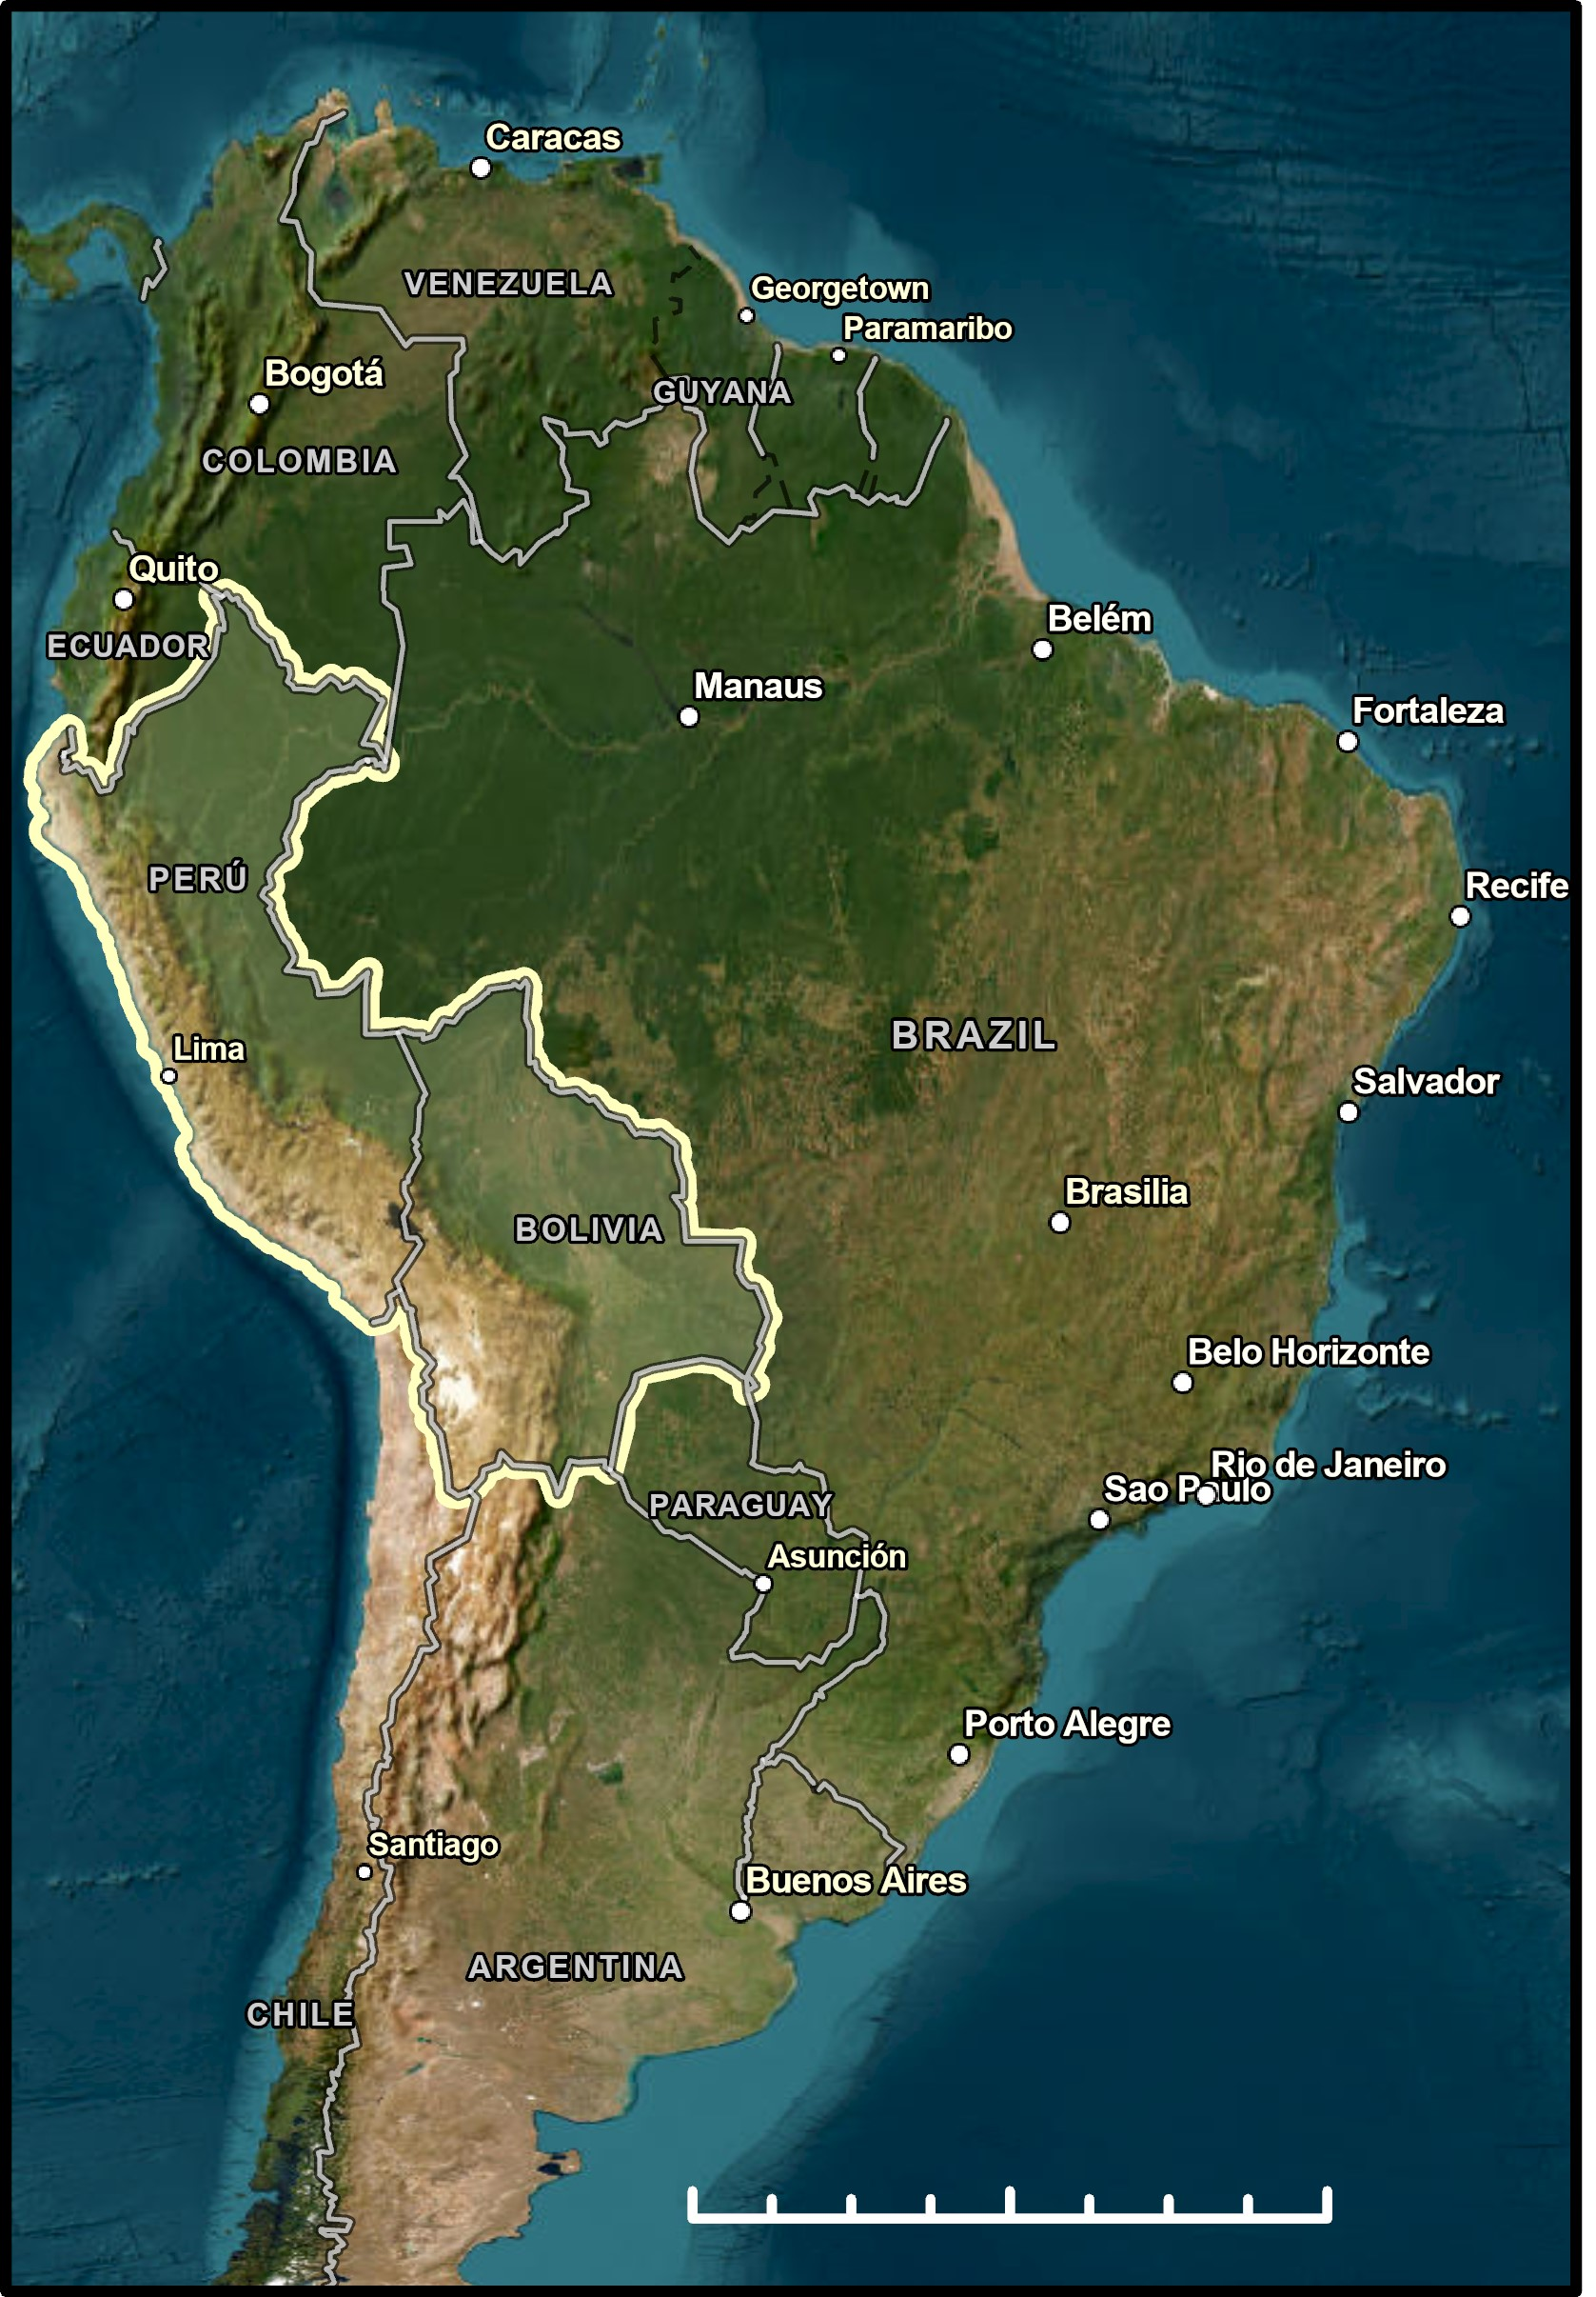
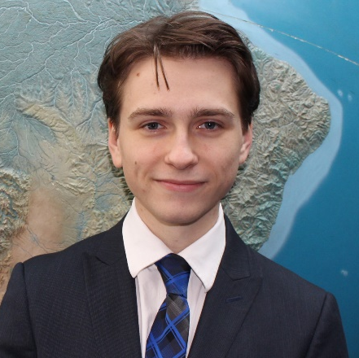
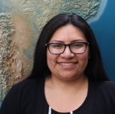
Peru & Bolivia Climate
25km
Estimating Soil Organic Carbon using Earth Observations to Inform Irrecoverable Carbon Reserve Management
Abstract
Methodology
Created shapefile and buffered to 25 km beyond country borders in Python. Utilized new shapefile to clip data from:
Irrecoverable carbon (IC) reserves contain large stores of the element, are at risk of being released due to human activity and consequentially contribute to global warming upon eviction. The Amazon, which covers about 0.5% of Earth's surface, contains the largest and highest-density reserves of IC. Conservation International (CI) works with local communities to establish and expand protected areas to prevent the loss of these reserves. This project's research strived to help CI better understand soil organic carbon (SOC) stocks and supplement their ability to monitor SOC changes in South America through a remote sensing lens.
Earth observations utilized included the Soil Moisture Active Passive Level 4 Carbon Net Ecosystem Exchange (SMAP L4C) product and Level-2A true color imagery from Sentinel-2 MultiSpectral Instrument (MSI). SOC distribution maps and trend analyses were generated for Peru and Bolivia between 2016 and 2022. SMAP L4C SOC estimates were then compared to SoilGrids, CI’s current SOC data source. Additionally, a methodology for monitoring SOC utilizing SMAP will allow CI to monitor future changes.
The project determined that trends of significantly decreasing SOC generally occurred within the extent of the Atacama Desert while most area outside had increased. Overall, SOC increased across the entire study period for each plant functional type and the overall mean. SMAP agrees with SoilGrids in the eastern portion of the study area and within the Bolivian Amazon, but disagrees along the Andes range and in northeastern Peru.
Sentinel-2 MSI
GEE Data Catalog
2019 – 2022
SMAP L4C
AppEEARS
2016 – 2022
SoilGrids
ISRIC WebDAV
Static
True color maps
Mapping SOC by year
Calculate SOC change between 2016 and 2021 with Mann-Kendall
Time series of SOC by plant functional type
Root mean square error SMAP vs SoilGrids for 2021, and 2016-2021
Results
Objectives
Peru and Bolivia SOC Distribution (2021)
Peru and Bolivia SOC Latitude Profile
Estimate soil organic carbon stocks for Peru and Bolivia annually between January 1, 2016 – November 8,2022 and analyze change over time.
Compare outputs data of soil organic carbon stocks between SMAP L4C and SoilGrids.
Visualize soil organic carbon abundance in Peru and Bolivia.
0
N
-5
SoilGrids (1km)
-10
SMAP L4C
(9km, 2016-2021)
Earth Observations
Latitude of Row Center (degrees)
Terra Moderate Resolution Imaging Spectroradiometer
Level-3
Soil Moisture Active Passive Radiometer
Level-4C
Sentinel-2 MultiSpectral Instrument
Level-2A Surface Reflectance
-15
Average SOC (g C $m^{−2}$)
-20
5,000
100
0
200
400
800
km
1000
2000
3000
4000
5000
Conclusions
Average SOC (g C $m^{−2} {row width}^{−1}$)
Study Area
SMAP L4C shows increases of SOC over the study period with desert regions being the exception However, SOC stocks are generally larger in arid and mountainous regions.
The SMAP L4C outputs do not agree with SoilGrids closer to the equator which may have to do with the models underlying the two datasets. Further analysis could increase the granularity of the SOC outputs and connect changes in land cover with SOC. Overall, this methodology will help CI monitor changes in SOC and connect what they find with their partners on the ground.
Project Partners
Peru
The NASA DEVELOP team partnered with Conservation International (CI).
Combining scientific research, fieldwork, and collaborations, CI aims to protect and restore nature for climate through collaboration and partnership with Indigenous peoples and local communities.
0
0
500
1000
2000
km
Acknowledgements
Partners: Monica Noon, Erika Munshi, and Patrick Roehrdanz (Conservation International)
Science Advisors: Dr. Arthur Endsley (University of Montana) and Sean McCartney (NASA GSFC, Science Systems & Applications, Inc.)
Fellow: Carli Merrick (NASA GSFC, Science Systems & Applications, Inc.)
Bolivia
N
Team Members
0
200
400
800
km
Aarti Arora
Project Lead
Aaron Carr
Arina Fuqua
Haydee Portillo
Maryland – Goddard Spa

