Slide 1
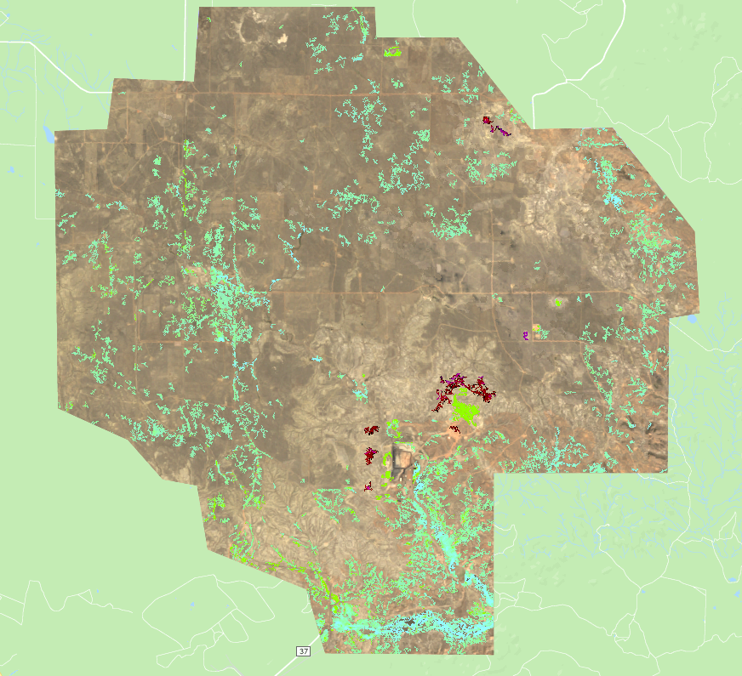
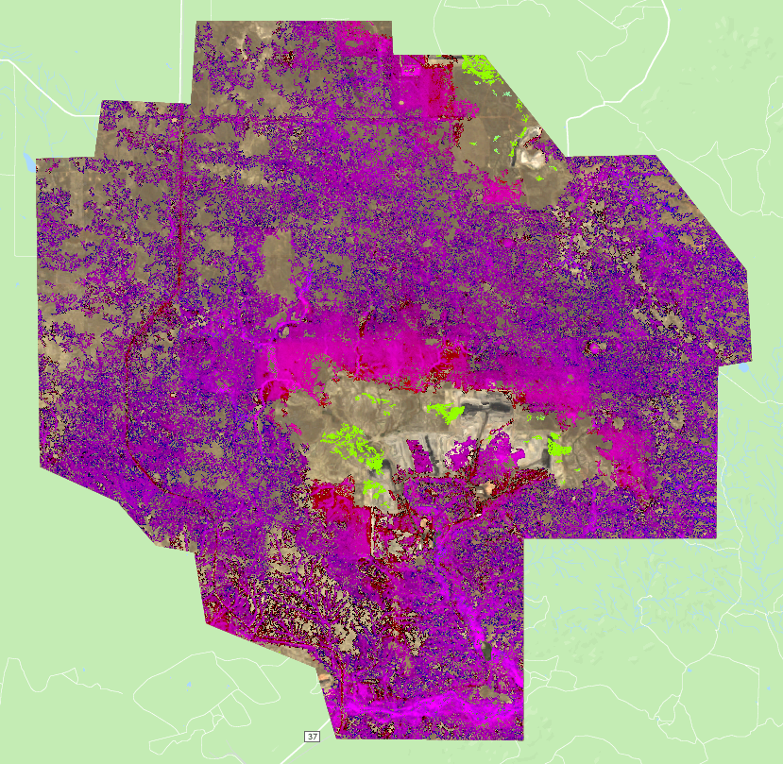
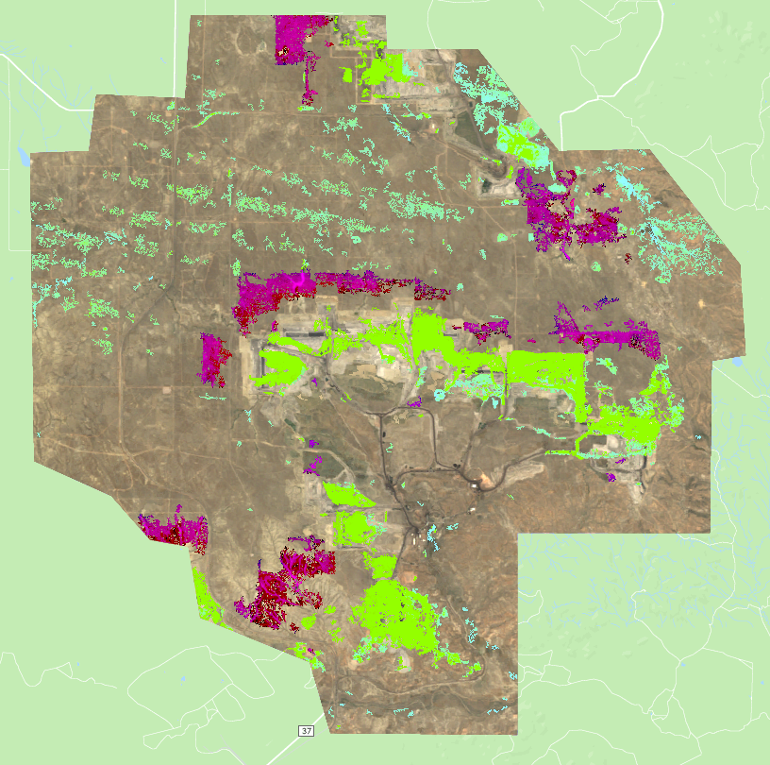
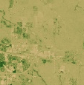
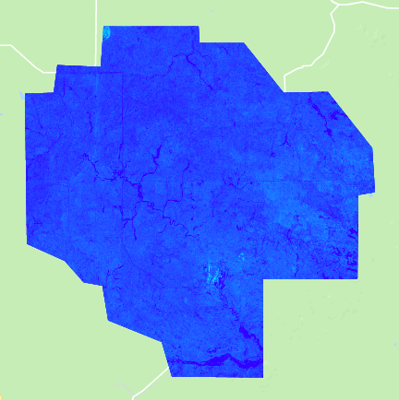
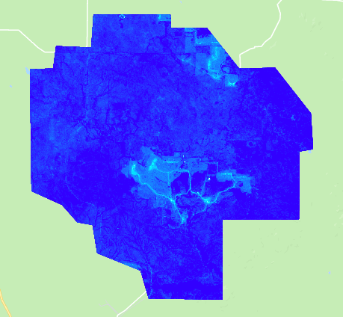
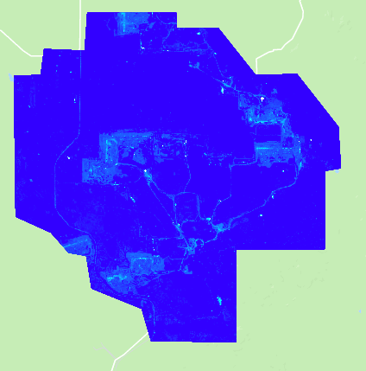
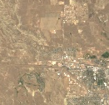
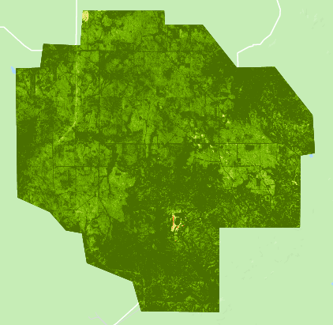
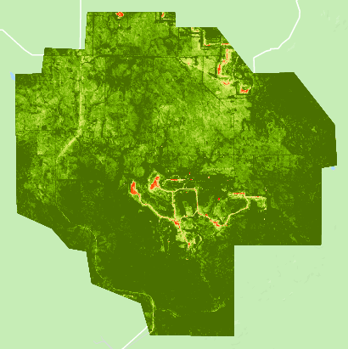
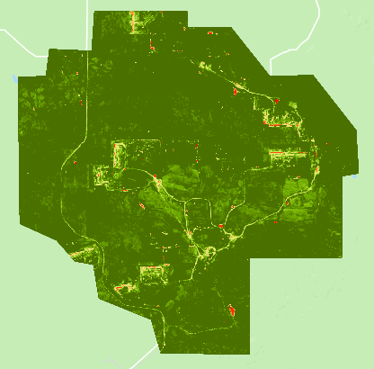
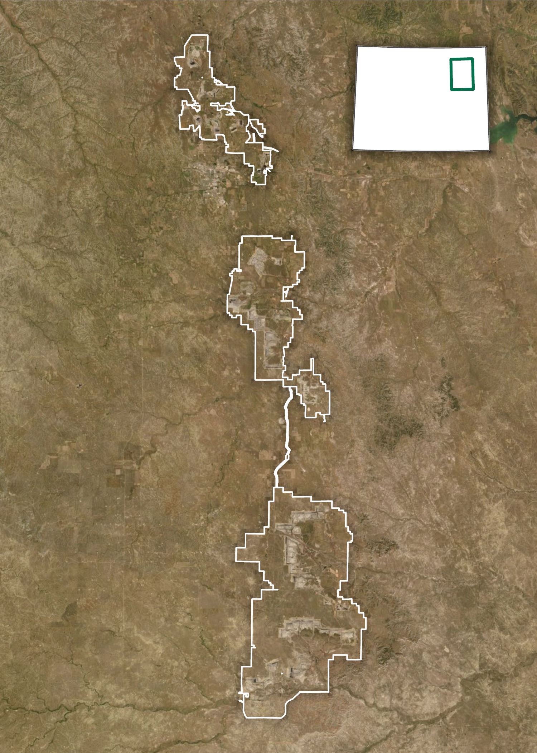
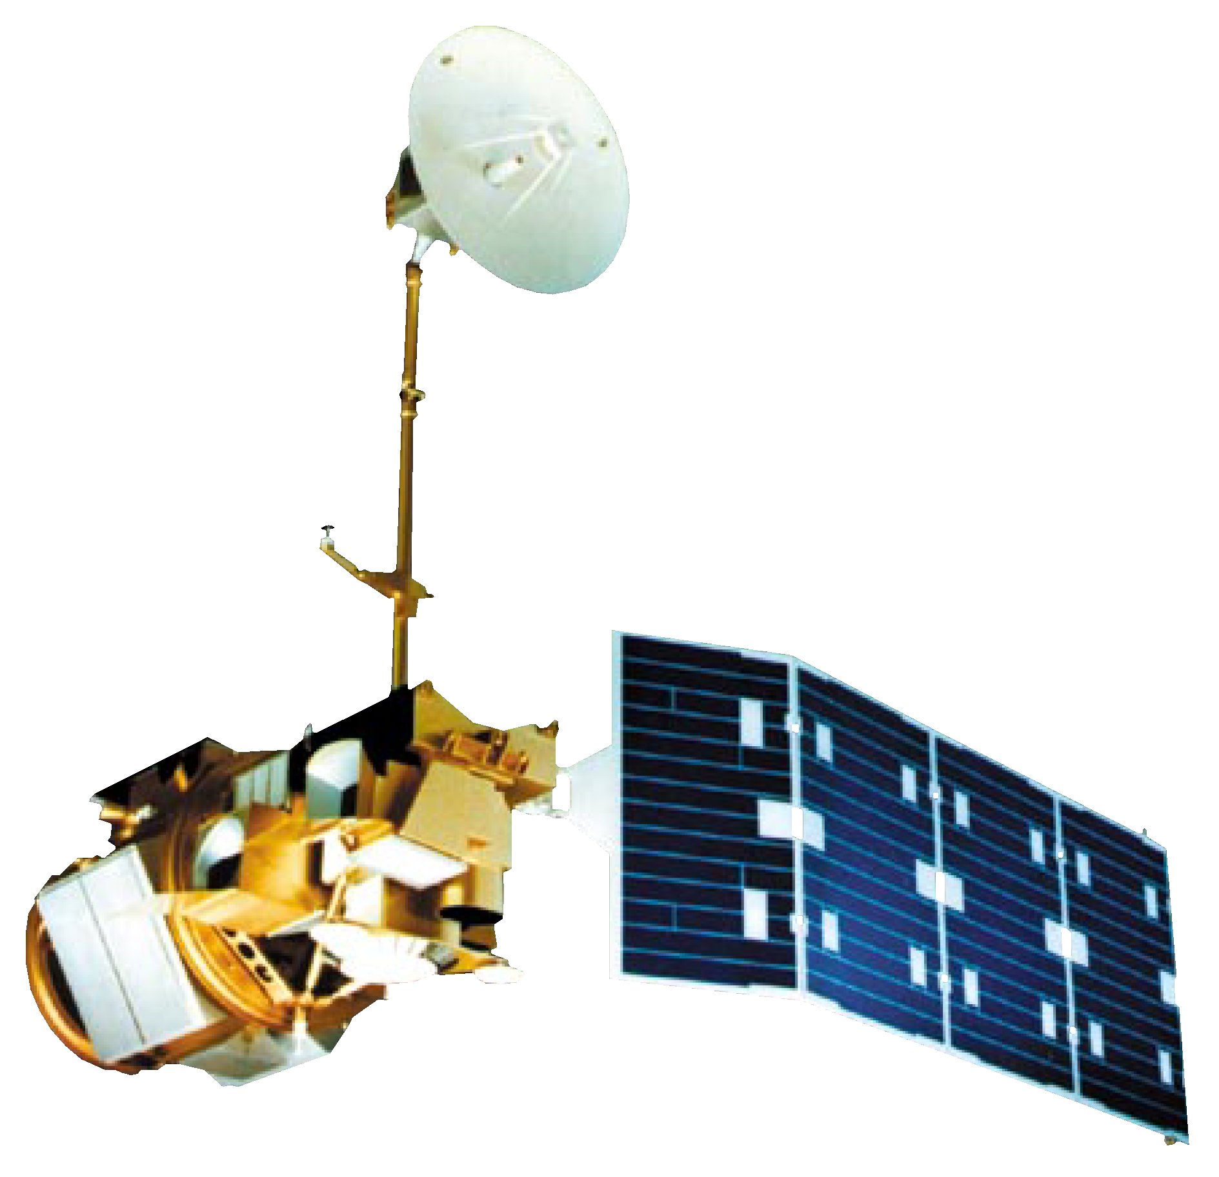
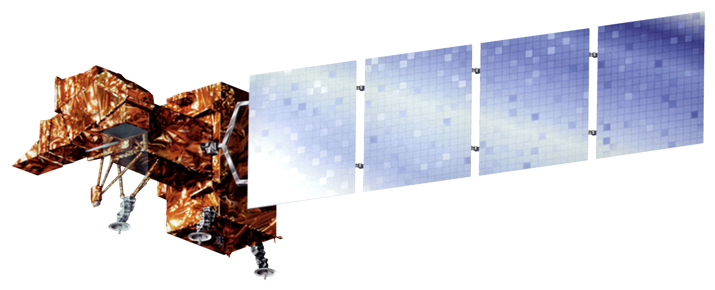
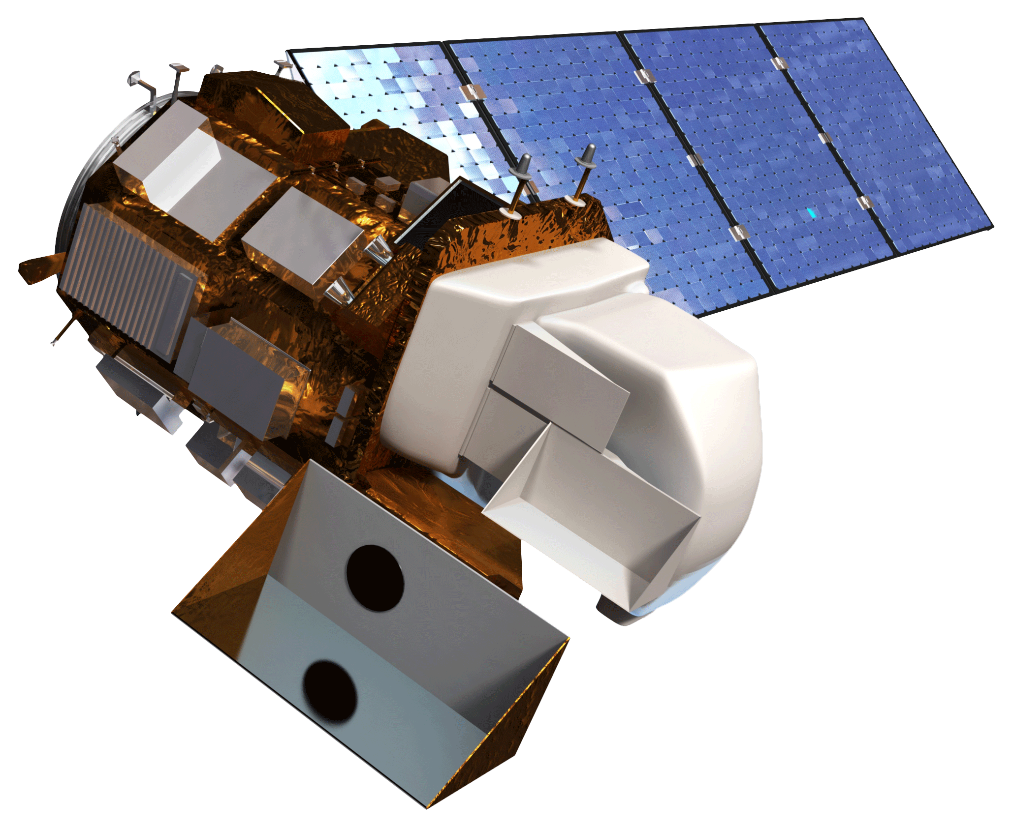
Monitoring Land Disturbances Caused by Coal Mining in the Powder River Basin Using Remote Sensing
Abstract
Objectives
Powder River Basin Transportation & Infrastructure
Coal mines in the Powder River Basin of Wyoming account for approximately 41 percent of coal production in the United States, causing significant land disturbances. Without proper reclamation practices, orphan mines create barren, unstable lands unlikely to recover. Where mines have been successfully reclaimed, human and natural communities have benefited from reconnected hydrology, functioning ecosystems, and economic opportunities, but the financial decline of the coal industry has raised concerns about the stability of long-term reclamation efforts. The Powder River Basin Transportation & Infrastructure team partnered with the Powder River Basin Resource Council and the Western Organization of Resource Councils to create a Coal Mining Assessment Tool (CMAT) in Google Earth Engine to monitor the impacts and reclamation efforts of coal mines in the basin. The tool incorporates Earth observations from Landsat 5 Thematic Mapper (TM), Landsat 7 Enhanced Thematic Mapper Plus (ETM+), and Landsat 8 Operational Land Imager (OLI), and utilizes the LandTrendr change detection algorithm to assess land disturbance. CMAT outputs include land disturbance maps and charts showing how land cover, Normalized Difference Vegetation Index (NDVI), Normalized Difference Water Index (NDWI), and tasseled cap transformations have changed from 1985 to 2018. In a case study of three neighboring mines, results showed that the mine nationally recognized for its reclamation practices recovered land up to 78 percent faster than its neighbors. The ability to visualize and assess how coal mining and reclamation has progressed over the study period will allow partners to better understand and advocate for regional reclamation practices.
Classify reclamation and land disturbance throughout the Powder River Basin
Analyze the extent and distribution of water and vegetation change around coal mines throughout the Powder River Basin over time
Provide the CMAT to project partners, allowing them to monitor land reclamation efforts into the future and review the success of previous efforts
Produce output data from CMAT that can be used as inputs for broader analyses on energy extraction
Results
1985 - 1995
2 mi
1996 - 2007
2 mi
2008 - 2018
2 mi
Methodology
Disturbance
Google Earth Engine – Coal Mining Assessment Tool (CMAT)
Outputs
lower higher
Reclamation
Figure 1. LandTrendr pixel time series analysis imagery indicating the extent of land disturbance and land revegetation (reclamation) over three ten-year periods for the North Antelope-Rochelle mine.
NDVI
Water and vegetation maps
Landsat 5
Landsat 7
Landsat 8
NDWI
LandTrendr change detection pixel time series analysis
Water and vegetation time series graphs
Tasseled Cap Greenness
Land disturbance time series graphs
1985
2 mi
2001
2 mi
2018
2 mi
Tasseled Cap
Angle
Land disturbance classification
Land disturbance maps
-91 907
Tasseled Cap Angle
Figure 2. Tasseled cap angle imagery for the North Antelope-Rochelle mine generated from Landsat data in Google Earth Engine. Lighter blue values show higher ratios of barren to vegetated land.
Study Area
Earth Observations
WY
Landsat 5 TM
(1985 - 2011)
1985
2 mi
2001
2 mi
2018
2 mi
Landsat 7 ETM+
(2012)
-75 805
Tasseled Cap Greenness
Figure 3. Tasseled cap greenness imagery for the North Antelope-Rochelle mine generated from Landsat data in Google Earth Engine.
Conclusions
The Coal Mining Assessment Tool (CMAT) determines the magnitude and persistence of land change over a 34 year time period, which partner organizations can use to effectively monitor mining land disturbance and reclamation efforts.
While NDVI and NDWI can be helpful indices for evaluating land disturbance, the spatial and temporal patterns of mining and reclamation call for more advanced methods.
Tasseled cap greenness and tasseled cap angle values indicate that mines that engage in thorough contemporaneous reclamation can restore vegetation closer to previous levels than other mines.
Coal mine boundaries
N
Landsat 8 OLI
(2013 - 2018)
Team Members
12 mi
Acknowledgements
Shannon Anderson, Powder River Basin Resource Council, Staff Attorney
Dan Cohn, Western Organization of Resource Councils, Regional Organizer
Jason Whiteman, Northern Cheyenne Tribe, Water and Natural Resources Administrator
Dr. Mik Carbajales-Dale, Clemson Energy-Economy-Environment (E3) Systems Analysis Group
Christian Thomas, SkyTruth, Geospatial Engineer
Dr. Juan Torres-Pérez, Bay Area Environmental Research Institute, NASA Ames Research Center, Science Adviser
Dr. Kenton Ross, NASA Langley Research Center, Science Adviser
John Dilger, Spatial Informatics Group, LLC, Science Adviser
Farnaz Bayat, DEVELOP National Program, California – Ames Node Center Lead
Jerrold Acdan, DEVELOP National Program, California – Ames Node Project Coordination Fellow
Gina Cova
Project Lead
Andrew Bake
Claudia Herbert
Hayley Pippin
Project Partners
Powder River Basin Resource Council (PRBRC), Western Organization of Resource Councils (WORC), Clemson University – Energy-Economy-Environment Systems Analysis Group, SkyTruth
California – Ames | Summer 2019

