Slide 1
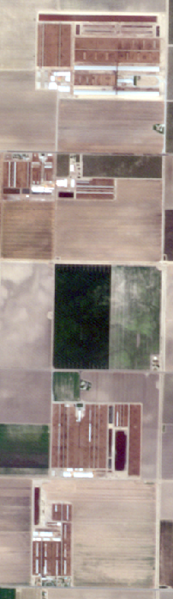
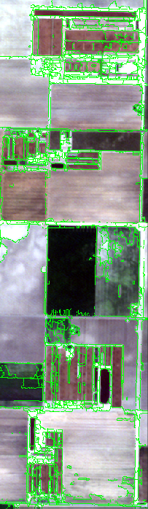



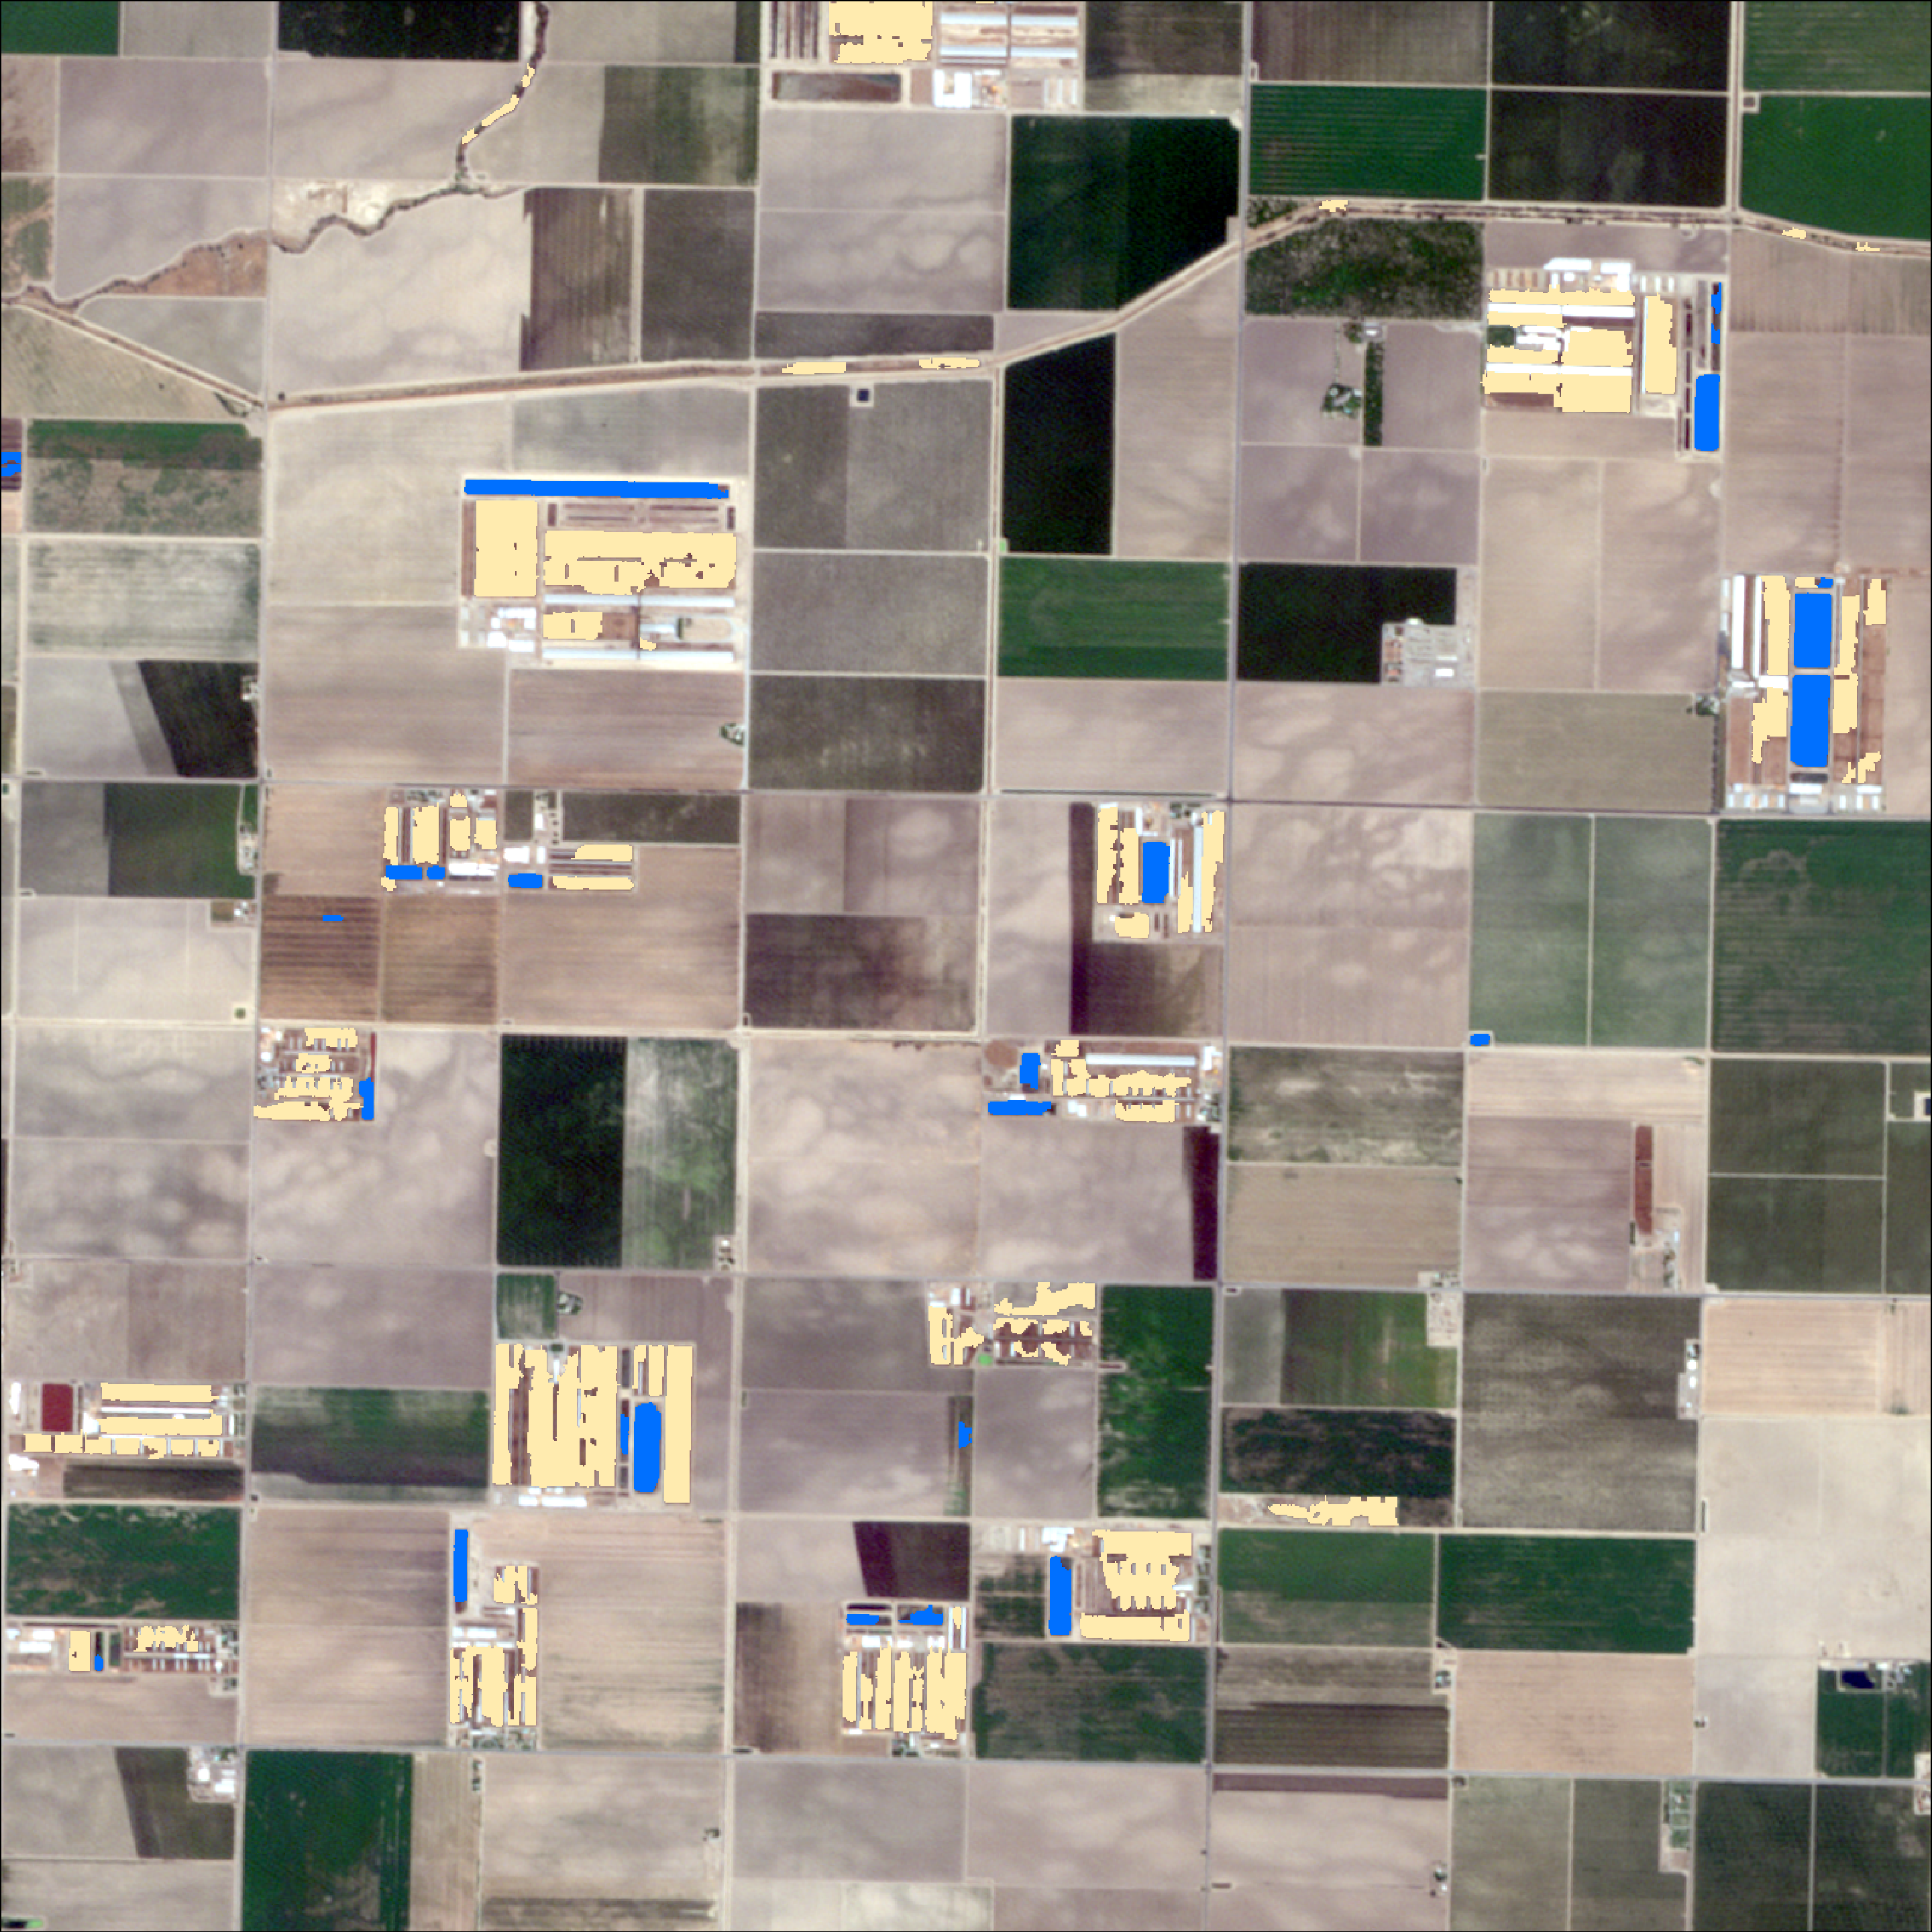
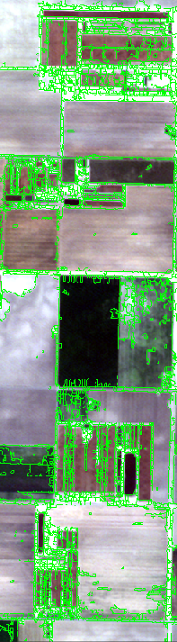



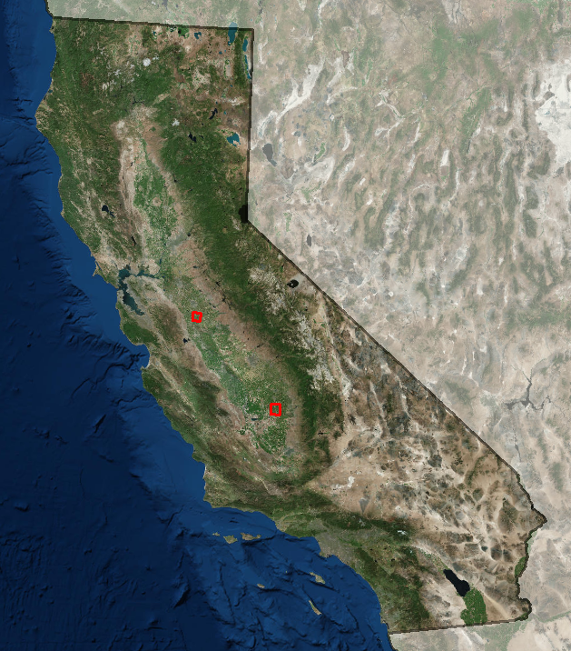
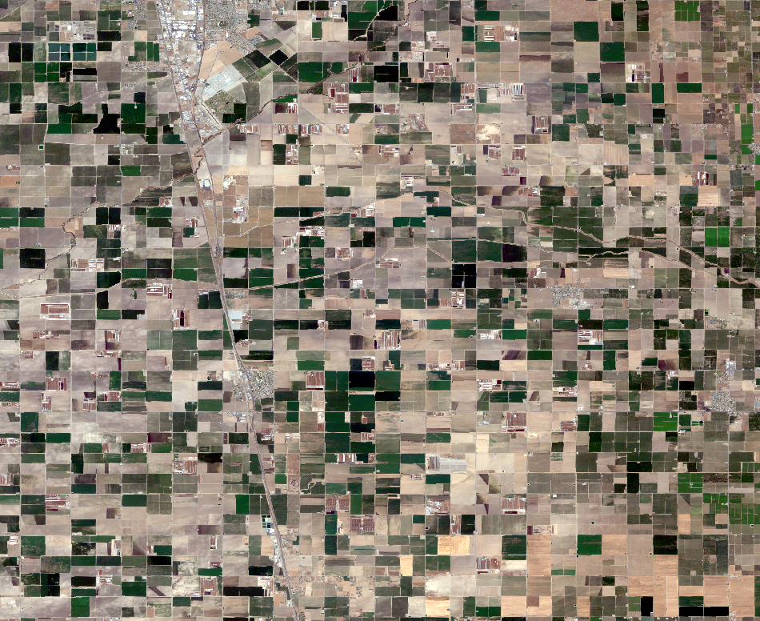
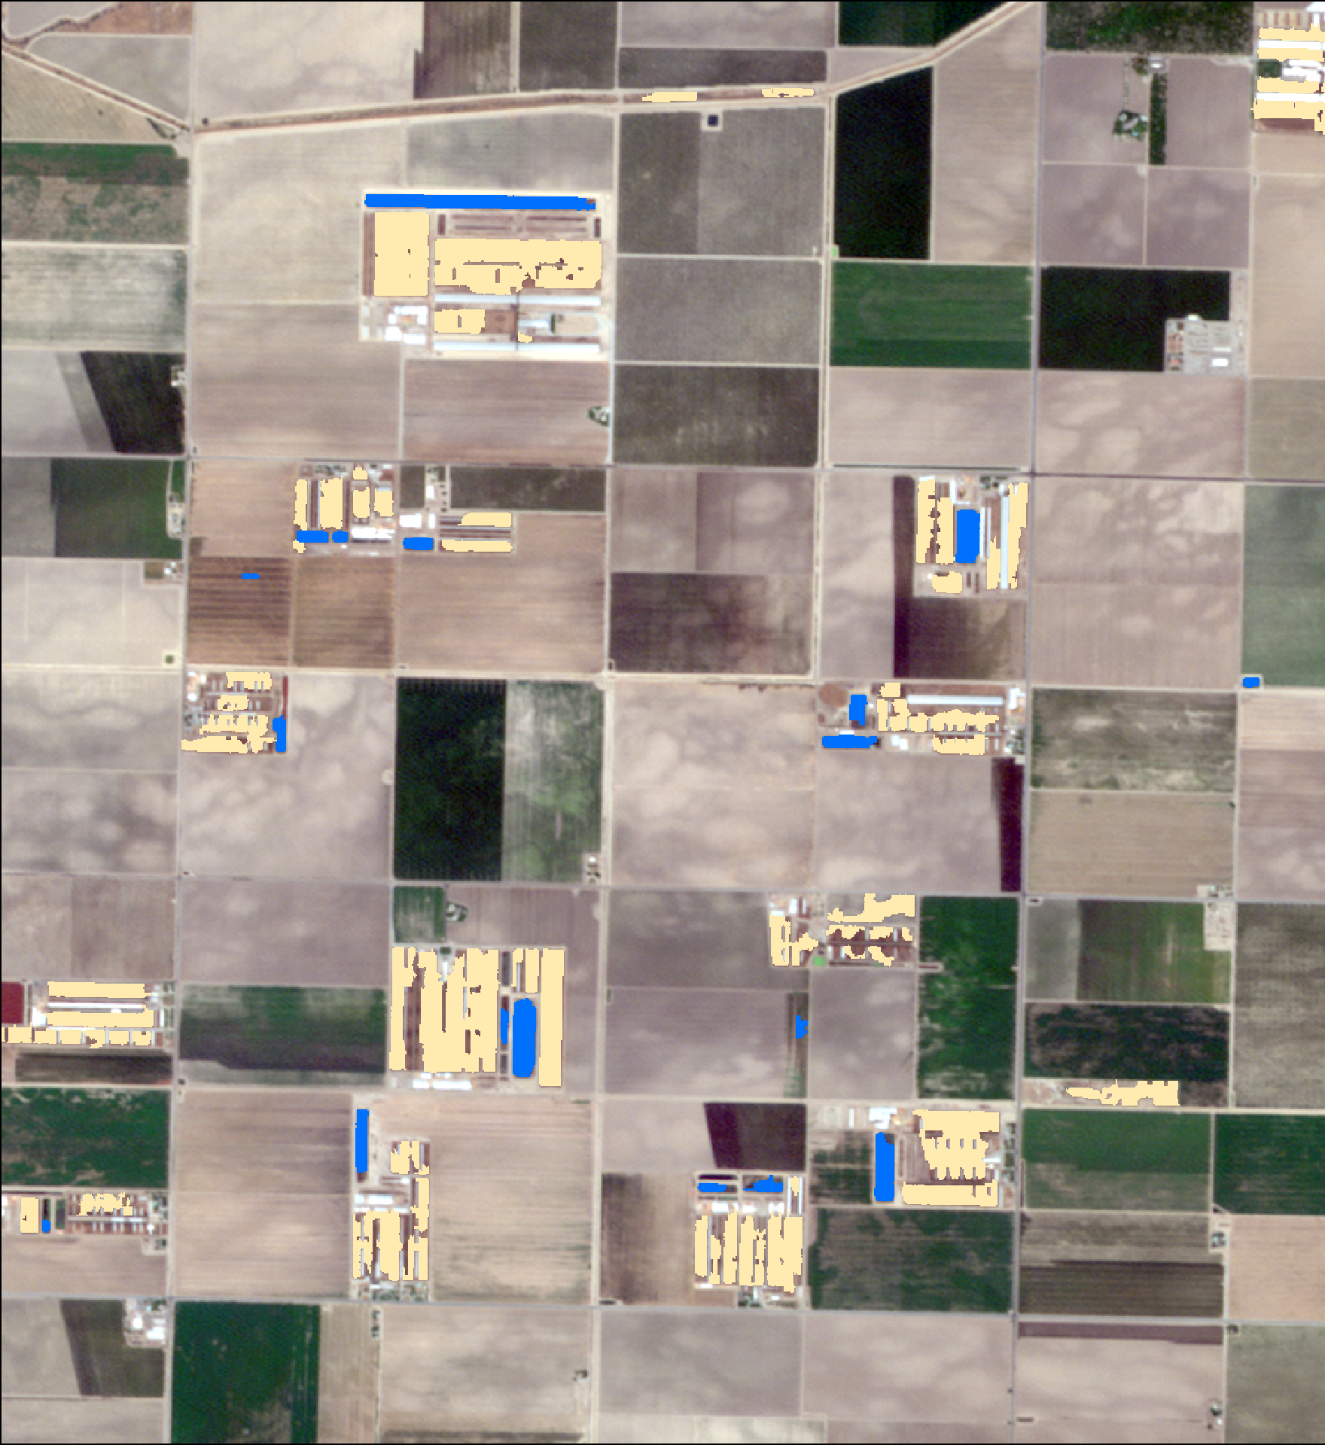
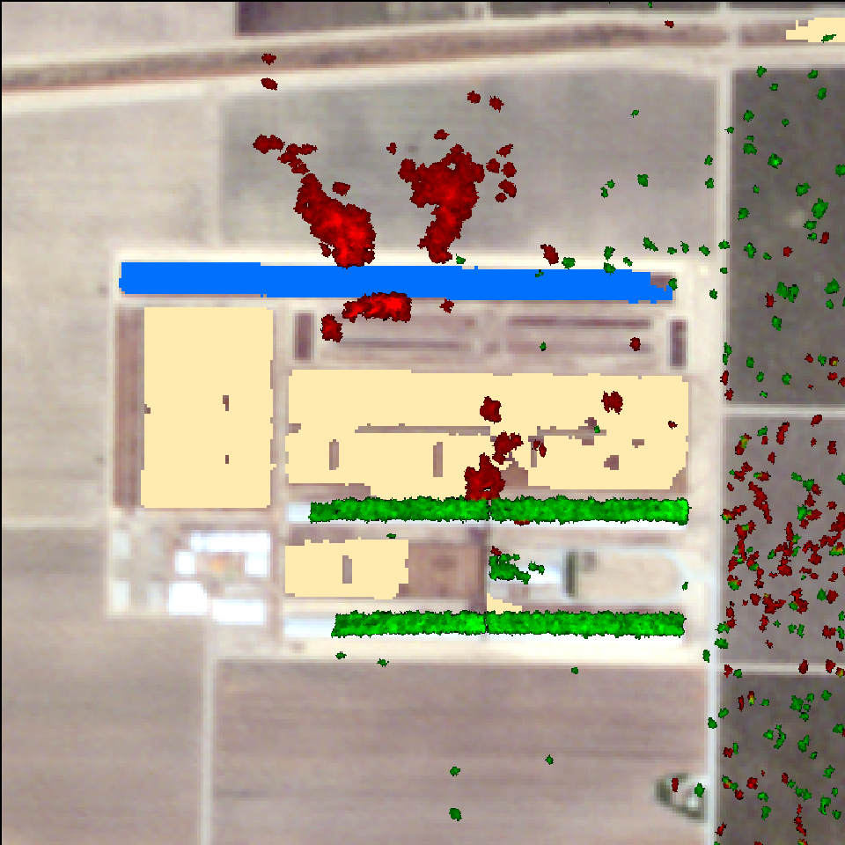
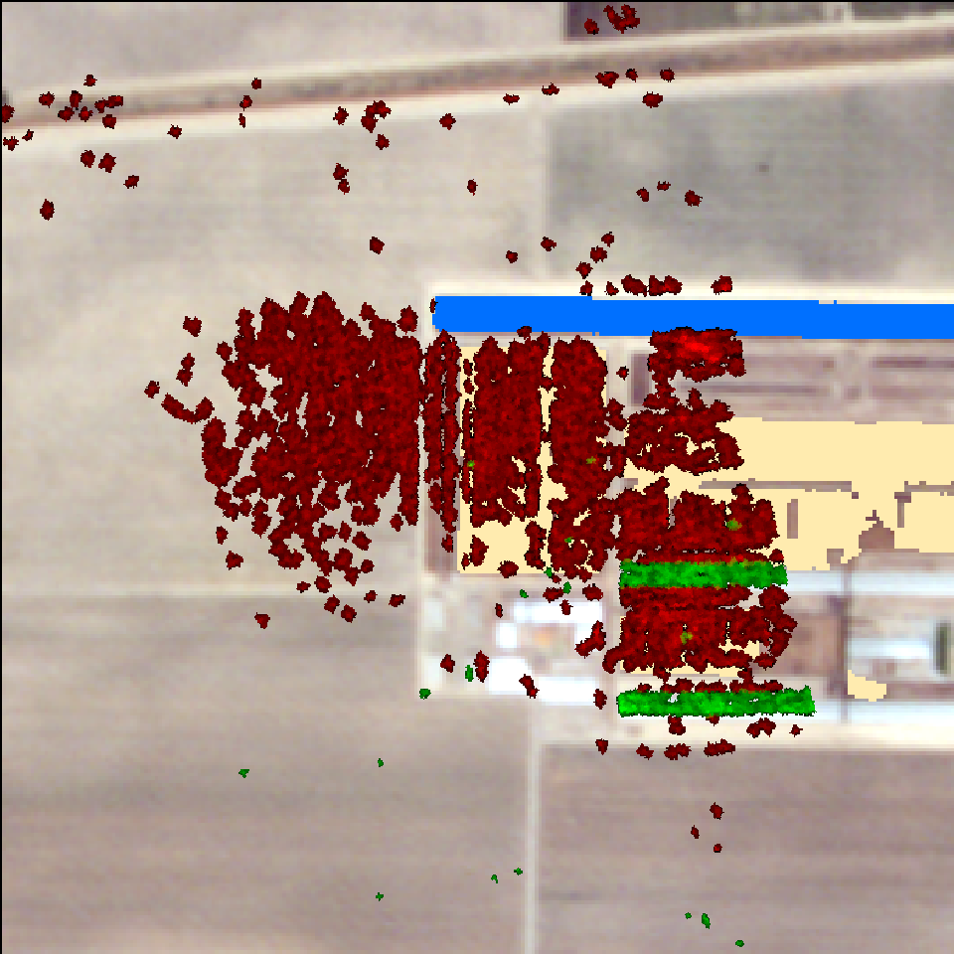
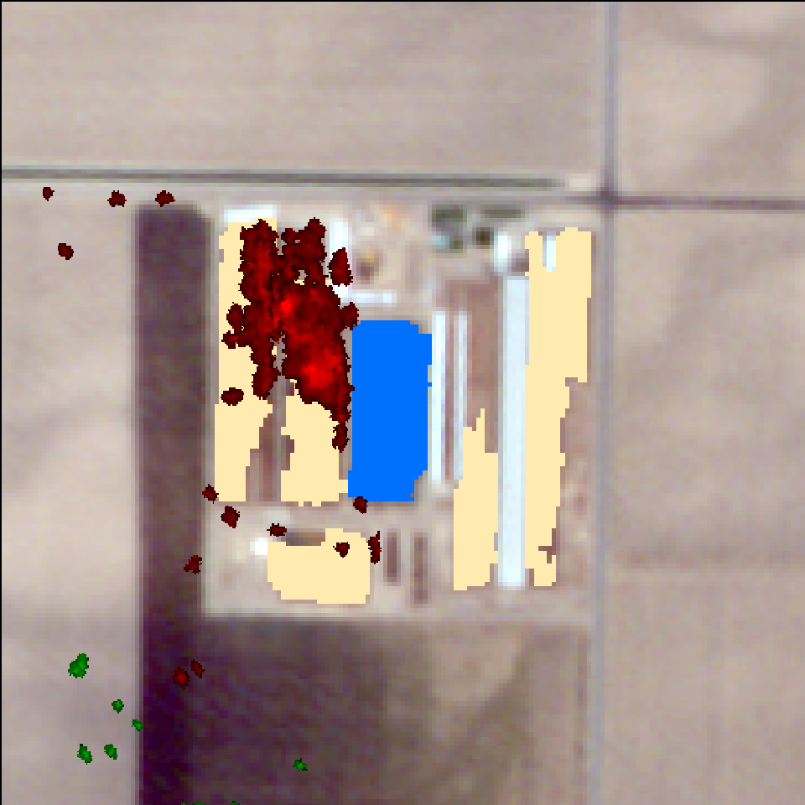
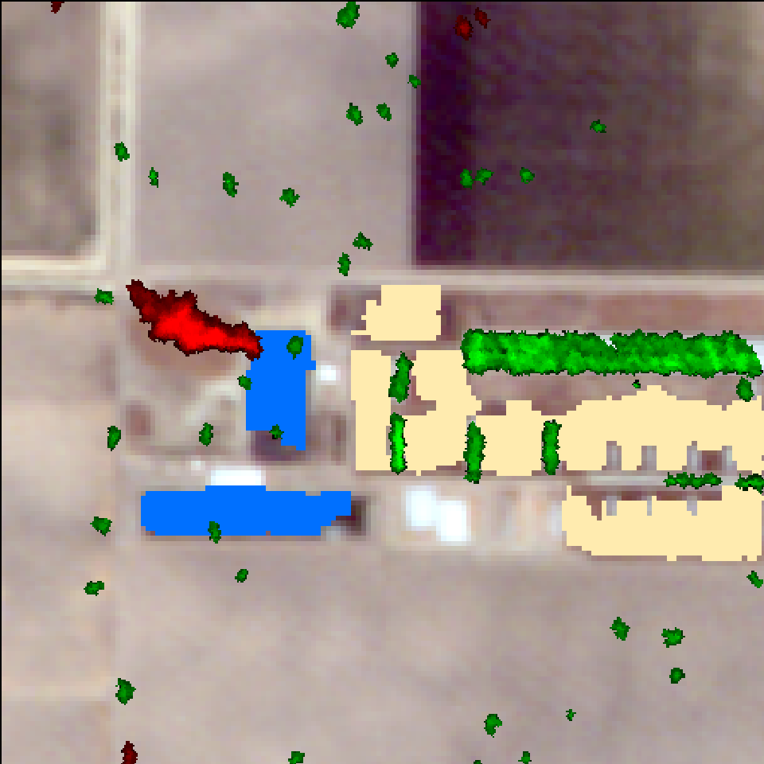
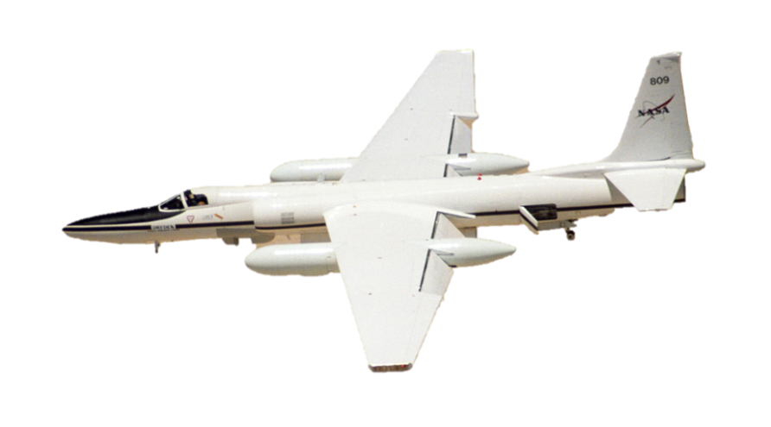

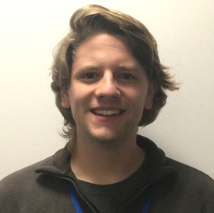


Identifying Methane Emissions Patterns from Dairy Farms Using Aircraft
Remote Sensing Observations
and Image Classification
Abstract
Methodology
Methane (CH₄) is a potent greenhouse gas (GHG) with a lifetime of less than 10 years and a global warming potential that is 25 times greater than carbon dioxide (CO₂) over a 100 year time period. Between the energy, industrial processes and product use, agriculture, and waste sectors, the majority of CH₄ emissions in the United States come from the agriculture sector. Within this sector, enteric fermentation by domestic livestock and manure management are the largest sources of emissions. California is the leading dairy producer in the United States, and thus enteric fermentation and manure management make substantial contributions to the state’s CH₄ budget. Furthermore, a number of studies suggest that EPA bottom-up methodologies are underestimating CH₄ emissions in many regions across California. Total number, location, size, and manure management infrastructure of dairy farms throughout the state is also uncertain. Given these uncertainties, in addition to dairy production’s large contribution to CH₄ emissions, its industrialization, and the need to more accurately account for and understand CH₄ emissions, we located and inventoried dairy farms across California’s Central Valley using RapidEye imagery and object-based image analysis. We used the resulting classifications to create a spatial dataset of dairy farms and used it to help interpret AVIRIS-NG and HyTES CH₄ plume data collected over the dairy farms. This will ultimately provide insight into an important source of CH₄ and help policy makers, dairy farmers, and management officials make more informed decisions on how best to mitigate CH₄ emissions within the state of California.
Synthesize HyTES & AVIRIS-NG airborne data
Acquire RapidEye imagery over
the areas of interest
Build flight line footprints
Segment the image,
classify objects, and extract features
Extract plumes and record
attribute information
Create a spatial dairy dataset from the classification
Interpret management practices based on the classification
Analyze plumes over dairies
Results
Project Partners
Feedlots
California Environmental Protection Agency, Air Resources Board
Objectives
Identify which satellite observations or data products work best to classify and study dairies
Develop a survey of emissions data over dairy regions
Create a GIS dataset of dairy farms to better understand facility-level activities that lead to methane emissions
Assist the California Environmental Protection Agency, Air Resources Board in improving their inventory of dairies and understanding their emissions
Lagoons
RapidEye classification results of dairy features and the resulting GIS dataset.
California Health & Air Quality
Study Area
A
B
Imagery © 2017 Planet Labs Inc.
May 1, 2015
May 2, 2015
May 1, 2015
Imagery © 2017 Planet Labs Inc.
Study Area: Tulare and Turlock regions in California
Study Period: January 2014 – August 2017
May 1, 2015
Conclusions
Earth Observations
High resolution imagery is required for classifying features on dairies. We found that feature extraction is a suitable method for identifying dairy features.
Current satellites lack the ability to accurately measure near-surface facility level GHG emissions. However, they can help us pinpoint regional hotspots which we can then further analyze with aircraft data.
More HyTES and AVIRIS-NG flights are necessary in order to fully understand emissions from dairies, as well as how those emissions vary over time.
Future satellites with greater sensitivity and higher resolution will help us better understand surface level emissions at higher temporal frequency and spatial extent than aircraft data.
Satellites
RapidEye
Airborne Sensors
AVIRIS-NG
HyTES
Team Members
Acknowledgements
Dr. Kristal Verhulst, NASA JPL
Dr. Charles Miller, NASA JPL
Dr. Francesca Hopkins, University of California Riverside
Talha Rafiq, UCLA Joint Institute for Regional Earth System Science and Engineering, NASA JPL
Nick Rousseau, NASA DEVELOP National Program, JPL Center Lead
Ben Holt, Jet Propulsion Laboratory, California Technical Institute
Jacob Arndt
Team Lead
Kelsey Foster
Erika Higa
NASA Jet Propulsion Laboratory – Summer 2017

