Slide 1
Alabama Ecological Forecasting
Assessing Southern Pine Beetle Epidemics in Alabama’s Bankhead National Forest Using NASA Earth Observations
Ryan Schick (Project Lead)
Leigh Sinclair
Kelsey Herndon
Maggi Klug

Slide 2
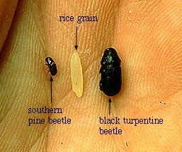
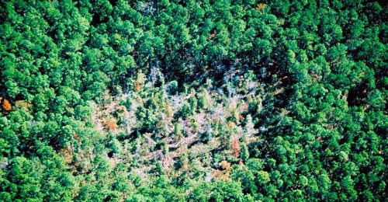
Background
The Southern Pine Beetle (SPB), or Dendroctonus frontalis, is an opportunistic species that attacks stressed trees
Stress can be caused by drought, fire, or damage from storms or machinery
Most active during summer months
2-4 mm in length
Image Credit: USDA Forest Service
Image Credit: USDA Forest Service
Notes:
The Southern Pine Beetle (SPB), or Dendroctonus frontalis, is an opportunistic species that attacks stressed trees that have been weakened by drought, fire, storm damage, or machinery damage, such as that caused during routine thinnings
They cause the most damage in the summer when they are most active. They are typically dormant during the cold, winter months
These beetles are only 2-4mm in length, yet are considered one of the most destructive pests in the southern United States
Image Source: http://blogs.usda.gov/2011/11/15/southern-pine-beetle-one-million-acres-protected-one-acre-at-a-time/
Image Source: http://www.srs.fs.usda.gov/compass/2014/01/09/guidelines-for-regenerating-southern-pine-beetle-spots-2/

Slide 3
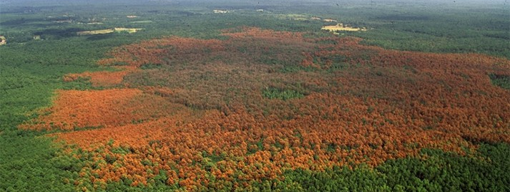
Community Concerns
SPB causes hundreds of thousands of dollars in damage to pines trees annually
Trees killed by SPB can increase severity of forest fires
Damages caused by SPB may result in limited diversity
Image Credit: Texas Forest Service
Notes:
SPB cause hundreds of thousands of dollars in damage to pine trees each year
Trees killed by SPB can increase the risk or severity of forest fires by increasing the fuel load available to burn
Damages caused by the beetles may result in limited diversity in surrounding plants as well as harm other animals’ habitats, such as that of the near-threatened Red-cockaded Woodpecker.
Image Source: Ronald F. Billings, Texas Forest Service, forestryimages.org Damage to a forest from the Southern pine beetle (http://www.barkbeetles.org/browse/subject.cfm?SUB=24)

Slide 4
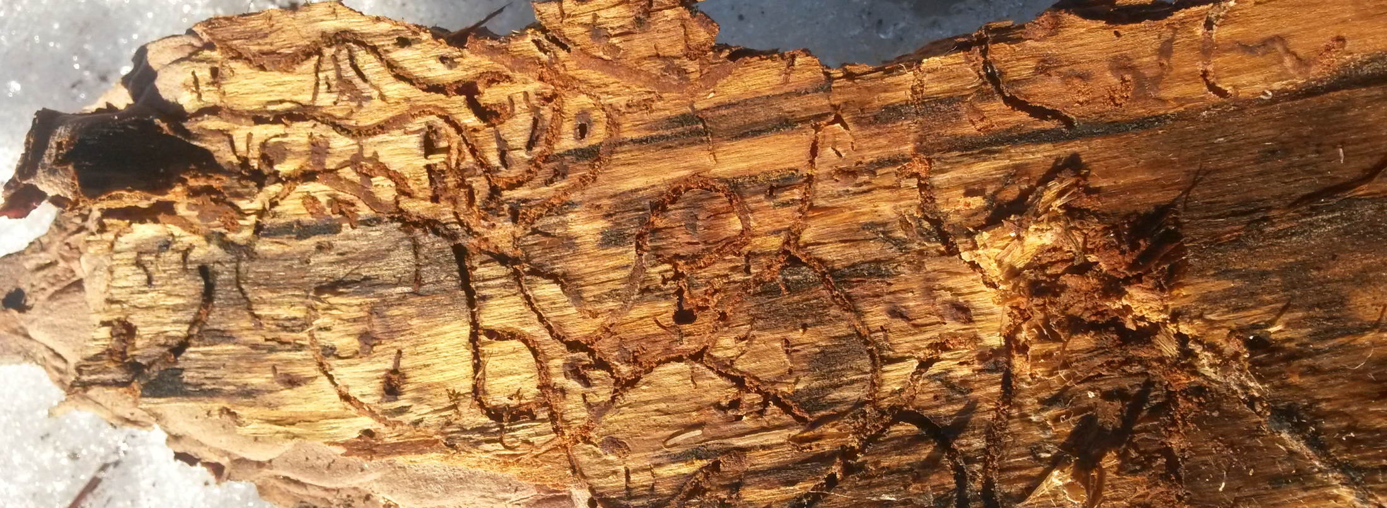
Image Credit: State of Connecticut
Objectives
Map previous SPB infestations to determine areas affected by the SPB
Assess current and future susceptibility of SPB outbreaks to help determine where suppression efforts should be focused
Create a near real-time susceptibility model to continually assess the ongoing risk of SPB outbreaks
Notes:
There were 3 objectives for this project:
First, determine the locations of previous pine beetle infestations to determine what environmental thresholds favor beetle activity.
Second, assess the current and future risk of outbreaks to aid in suppression efforts
Finally, generate a Near Real-Time Susceptibility Model for project partners to assess the continuous risk of Southern Pine Beetle infestations on a weekly basis
Image Source: http://www.ct.gov/deep/cwp/view.asp?a=2697&q=563452

Slide 5
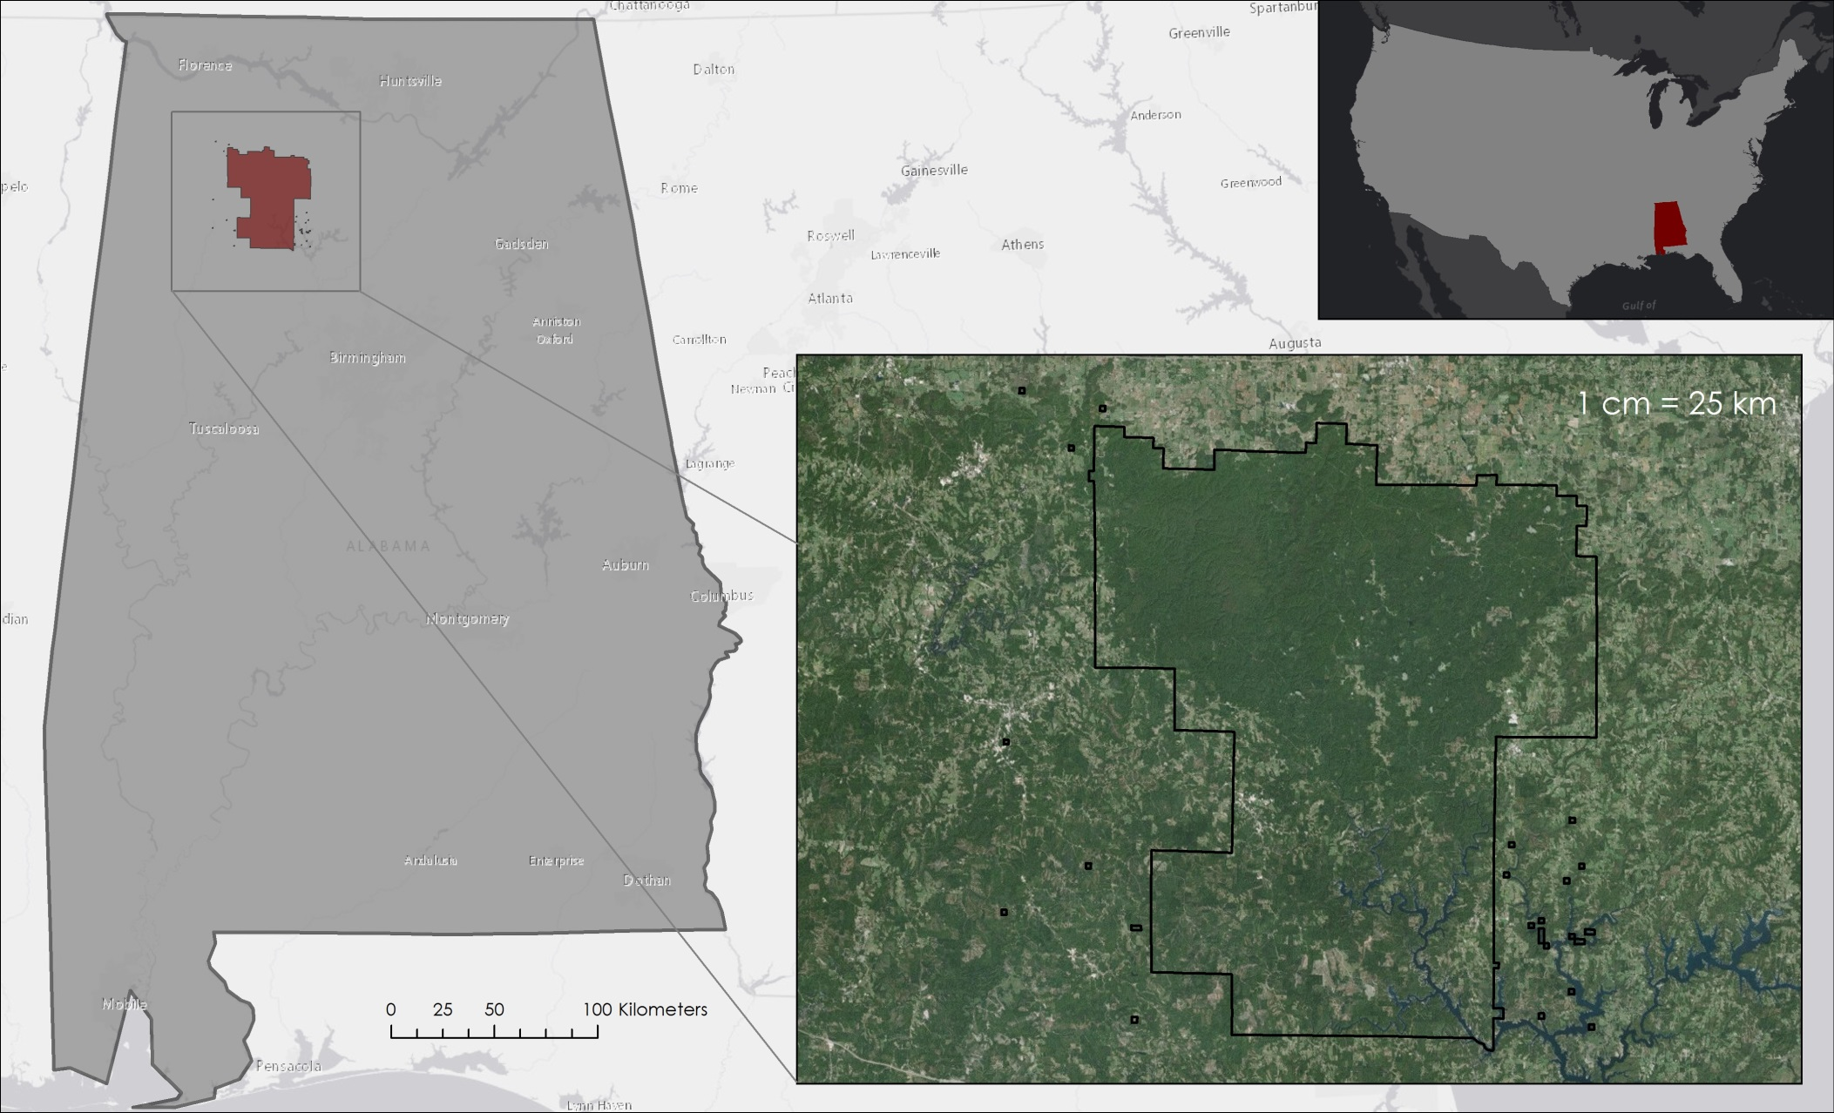
Study Area
Alabama, with a focus on Bankhead National Forest
Notes:
The study area for this project was the state of Alabama with a particular focus on Bankhead National Forest.
An estimated 69% of Alabama is forested, which consists mainly of hardwoods and pine trees.
Loblolly and longleaf account for a majority of these pines and are the preferred host of the Southern Pine Beetle.

Slide 6
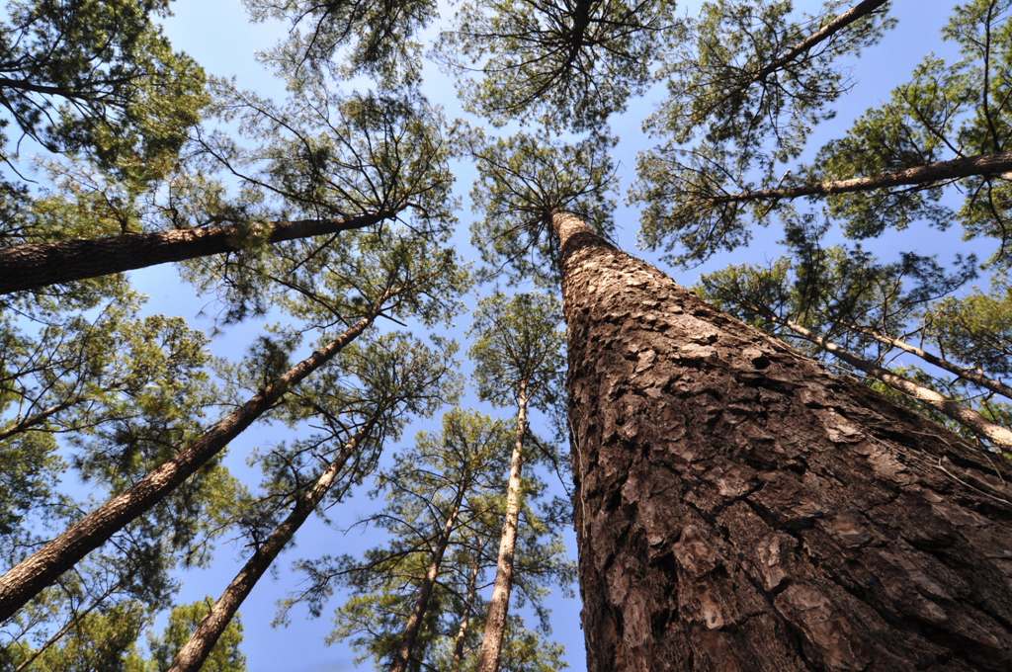
Study Period
Image Credit: Texas A&M Forest Service
Past
Future
January 2010
December
2015
2050
Notes:
The study period for historical data was from January 2010 to December 2015 and a risk projection was created for 2050.
Image Source: Ron Billings/Texas A and M Forest Service; http://cdn.phys.org/newman/gfx/news/hires/2014/loblollypine.jpg

Slide 7

Project Partners
USDA Forest Service
Notes:
Kelsey: This project partnered with the USDA Forest Service. The forest service currently relies on expensive manned aerial surveys and ground surveys, MODIS ForWarn data at 232 meter resolution, and Forest Disturbance Monitor data at 250 meter resolution. One of our goals for this project was to provide monitoring tools at higher resolution than those already being utilized by our partners.

Slide 8
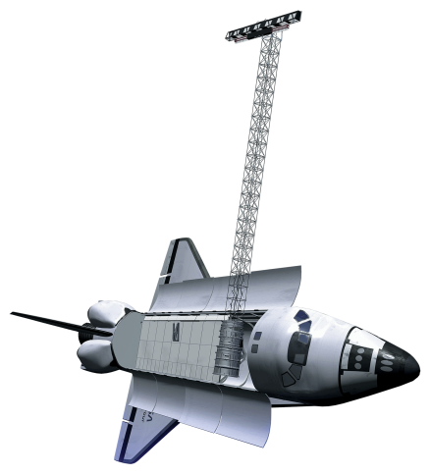


NASA Earth Observations
Landsat 8 OLI
SRTM-v2 C-band
Landsat 5 TM
Notes:
Kelsey: The NASA Satellites and Sensors used for this project include 30 meter data from the Landsat 5 Thematic Mapper, 30 meter data from the Landsat 8 Operational Land Imager, and 30 meter data from the Shuttle Radar Topography Mission version 2 C-band. In addition to NASA Earth Observations, we used LANDFIRE land cover data at 30 meter resolution and WorldClim future climate data (at 1 kilometer resolution). In situ locations of southern pine beetle outbreaks were provided by the Alabama Forestry Commission.

Slide 9
Methodology
Historic Southern Pine Beetle Maps
Historic Southern Pine Beetle Maps
In Situ
Point Data
Point Density
Tool
Notes:
Kelsey: The historic southern Pine Beetle Maps were created at an annual temporal scale for 2010-2015. Density maps were then created for each year using the point density tool in ARCMap. These maps allowed us to visualize spatial and temporal patterns of southern pine beetle outbreaks across the state of Alabama.

Slide 10
Methodology
Southern Pine Beetle Prediction Map
Southern Pine Beetle Prediction Map
Calculate from Landsat 8:
NDVI
GRVI
SRTM-v2:
Slope
Elevation
Princeton Maximum Entropy Model
LANDFIRE:
Tree Species
WorldClim:
Climate Data
Notes:
Kelsey: The Southern Pine Beetle Prediction Map was created for 2050 using the Princeton Maximum Entropy Model. Landsat data were downloaded and used to calculate the Normalized Difference Vegetation Index and the Green Red Vegetation Index. Slope and elevation were derived from SRTM version 2 data. Tree species data were based on 2013 LANDFIRE land cover data, and future climatic variable—including maximum temperature, minimum temperature, mean temperature, and 19 bioclimatic variables—were downloaded from WorldClim. The prediction map was designed to indicate areas that will be especially susceptible to future southern pine beetle outbreaks as environmental factors change.

Slide 11
Methodology
Near Real-Time Southern Pine Beetle Susceptibility Model
LANDFIRE: Land Cover Data
Calculate:
NDVI
GRVI
Fuzzy Memberships
Landsat 8
Near Real-Time Southern Pine Beetle Susceptibility Map
Notes:
Kelsey: The Near Real-Time Southern Pine Beetle Susceptibility Model consists of a semi-automated Python computer script. The code downloads the most recent Landsat 8 tiles and calculates NDVI and GRVI. The most recent LANDFIRE data was reclassified into southern pine beetle preferred and not preferred species and pulled into the model. The code then uses predetermined fuzzy memberships for each variable to apply the Fuzzy Logic Model. 80 percent of in situ data was used to train the Fuzzy Logic Model and the remaining 20 percent of the data was used for verification. The resulting product gives the most up-to-date susceptibility distribution of southern pine beetle outbreaks within the study area.

Slide 12
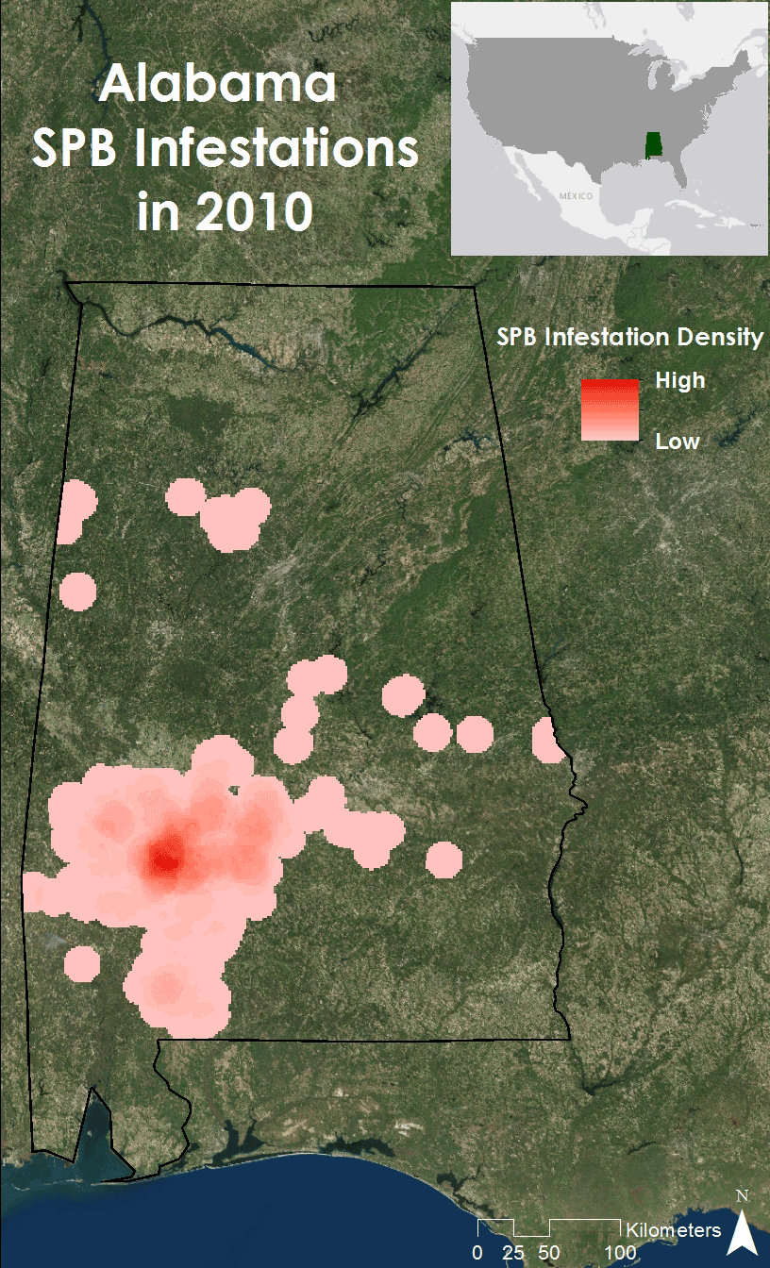
Historic Southern Pine Beetle Map
Image Credit: Ryan Schick
Notes:
These Historical Maps show infestation spots across the state of Alabama from 2010 to 2015. This animation illustrates the prevalence of Southern Pine Beetle outbreaks as well as their cyclical nature. Southwestern Alabama was determined to have the highest concentration and severity of infestations over the study period.

Slide 13
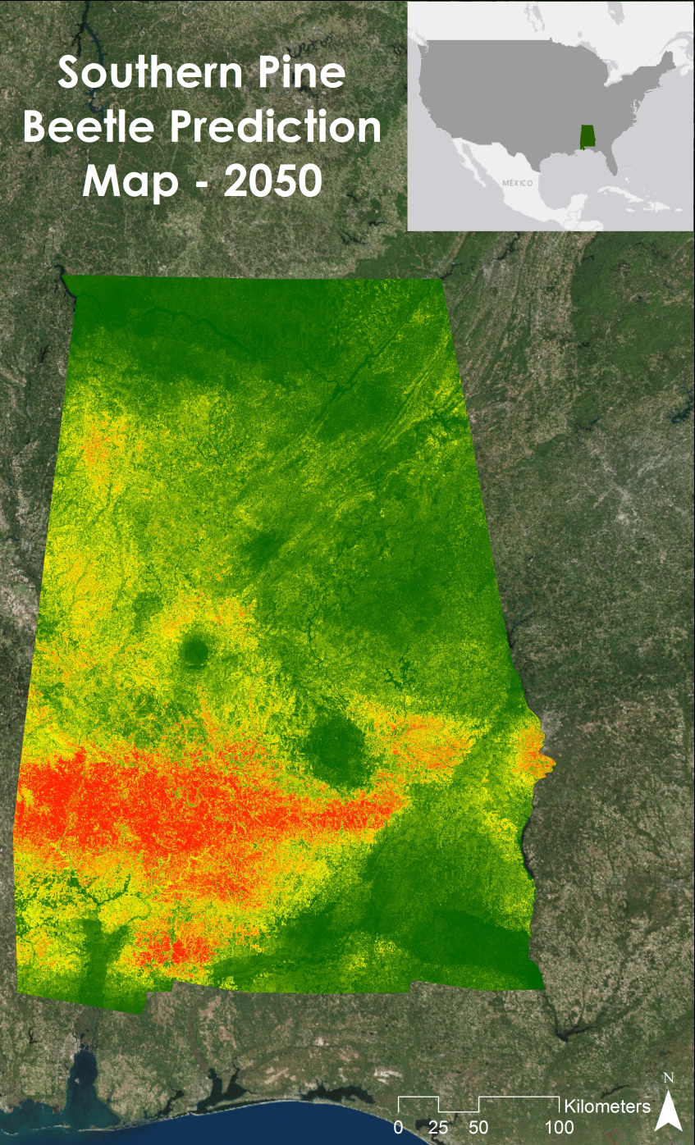
Southern Pine Beetle Prediction Map
Accuracy: 86%
Image Credit: Ryan Schick
Notes:
This map shows the probability of a Southern Pine Beetle outbreak in 2050 created using the Maximum Entropy model. The results of this map fall in line with the historical maps, showing that the same areas of the state that had infestations over the past 5 years are still at risk in the future. Bankhead National Forest is projected to have a slight risk of Southern Pine Beetle outbreaks, but it is not as severe as the rest of the state. This model was found to have an 86% accuracy.

Slide 14
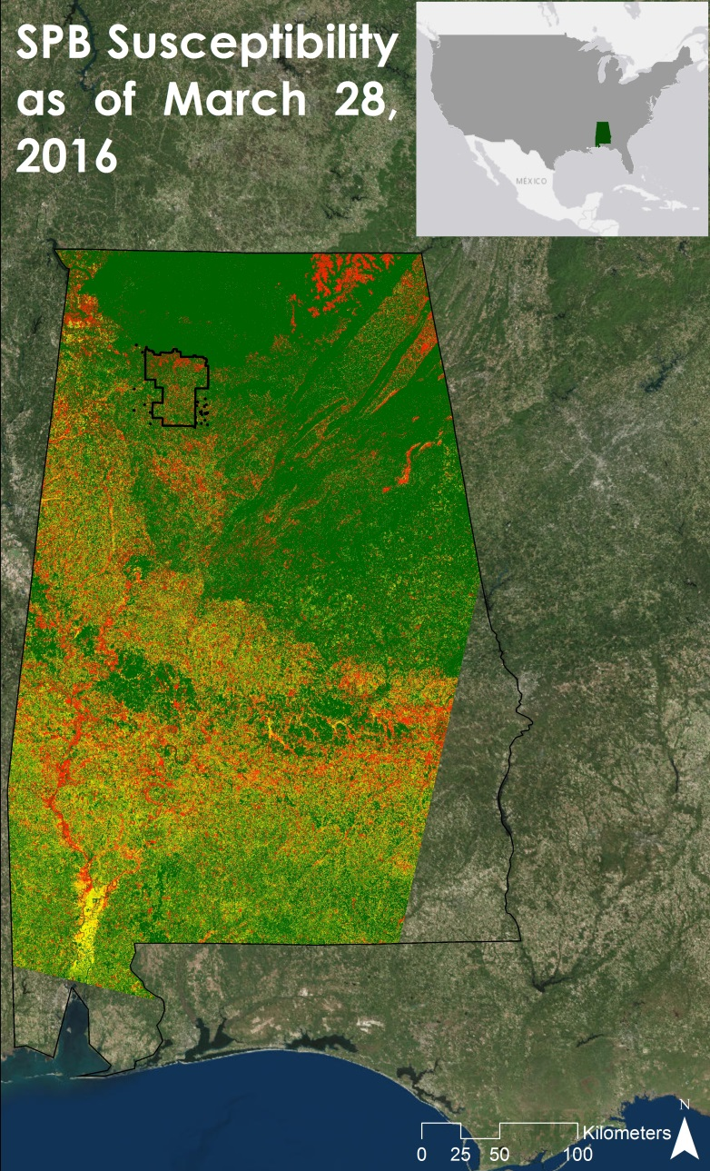
Near Real-Time Southern Pine Beetle Susceptibility Model
Accuracy: 88%
Notes:
This is an example output from our near real-time model as of March 28th. This model found that Northeastern and Southwestern Alabama are presently at the highest risk.

Slide 15
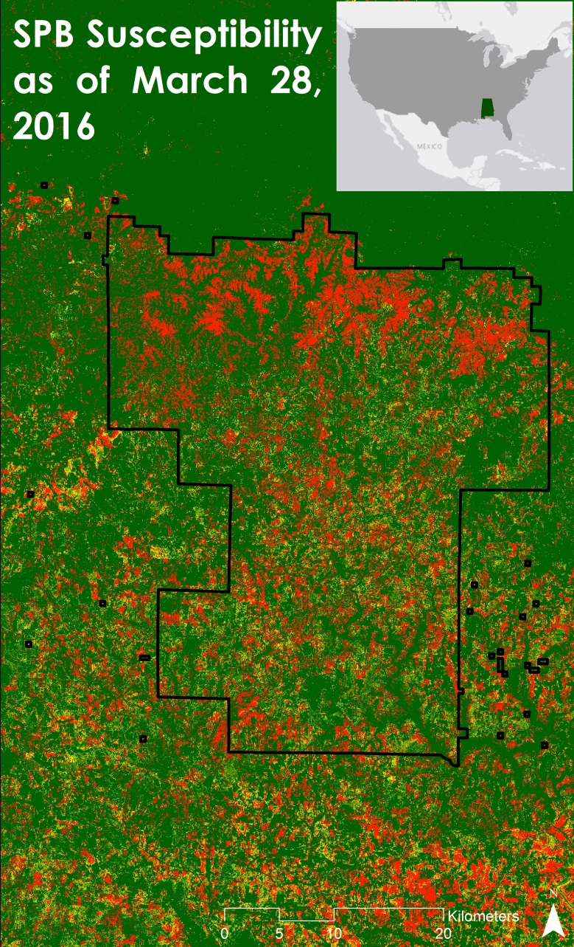
Near Real-Time Southern Pine Beetle Susceptibility Model
Accuracy: 88%
Notes:
This is from the same image on the previous slide only zoomed into Bankhead national Forest. As you can see Bankhead currently has favorable conditions for an infestation, especially in the northern portion.

Slide 16
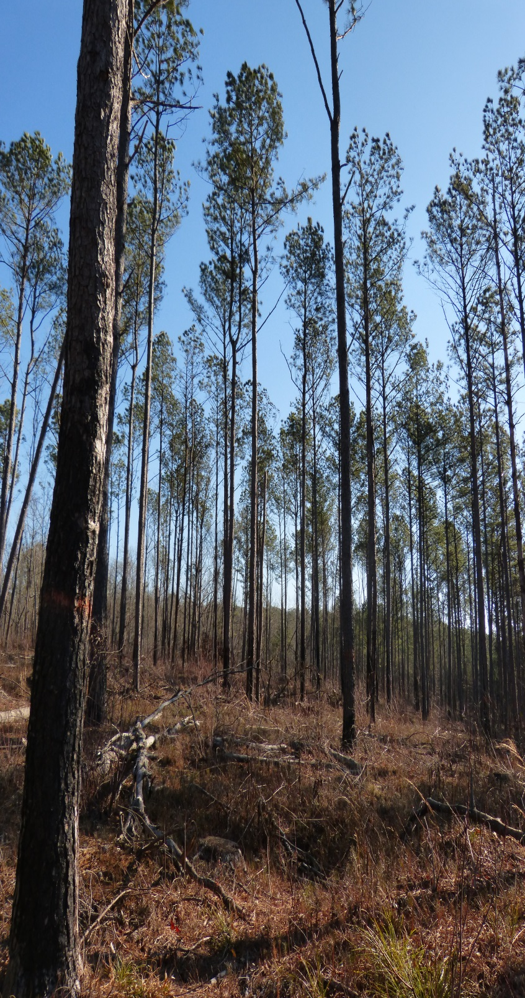
Results
Majority of SPB attacks in southwestern Alabama from 2010-2015
Few outbreaks occurred in or near Bankhead National Forest
SPB Prediction Map showed southwest Alabama was at greatest risk in 2050
The Near-Real Time Model verified to be 88% accurate
Image Credit: Ryan Schick
Notes:
The Historical Pine Beetle Maps created by this project showed that a majority of the Southern Pine Beetle outbreaks between 2010 and 2015 occurred in southwestern Alabama. Furthermore, most of the outbreaks that were more concentrated in nature occurred in that same area. There were only a few infestations that occurred in or around Bankhead National Forest relative to the rest of the state. This projects Southern Pine Beetle Prediction map showed that southwest Alabama will be at major risk in 2050. And finally the Near Real-Time model was verified to have an 88% accuracy.

Slide 17
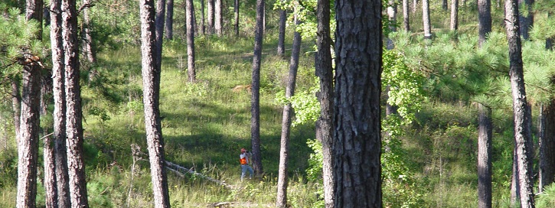
Image Credit: USDA Forest Service
Conclusions
Southwestern Alabama is at greatest risk
This area see infestations more frequently and density of outbreaks is higher
Bankhead National Forest is still at risk
The last SPB spot recorded was in 2014
Notes:
All of this has led us to conclude that while other parts of Alabama are at greater risk and see Southern Pine Beetle outbreaks both more frequently and with higher density, Bankhead National Forest is still considered at risk. The products from this project will help the USDA Forest Service decide where to focus mitigation efforts to attempt to reduce or even prevent future Southern Pine Beetle outbreaks.
Image Source: http://www.srs.fs.usda.gov/compass/2015/07/21/thinning-and-burning-the-best-defense-against-southern-pine-beetle/

Slide 18
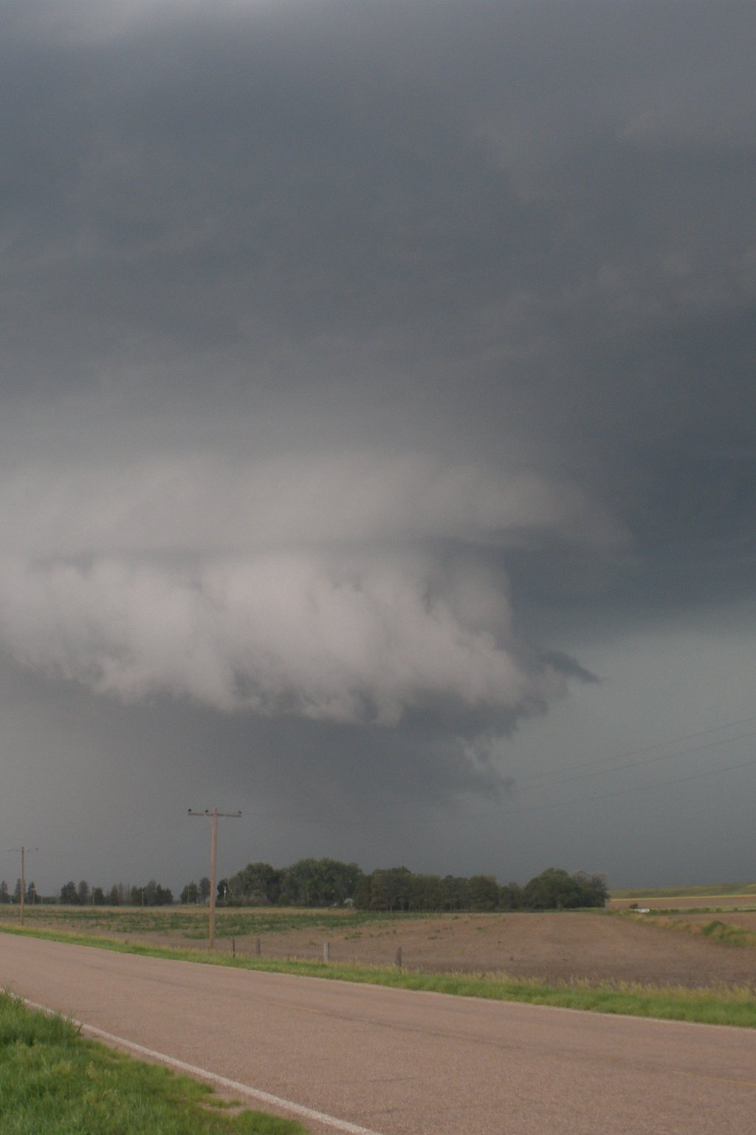
Errors and Uncertainties
Cloud cover
Erroneous dashes (Landsat 5)
In situ data – Engraver beetle
Image Credit: Leigh Sinclair
Notes:
Cloud cover in the data limited the ability of the Near Real-Time model to assess susceptibility of SPB outbreaks. Also, dashes of erroneous data in the Landsat 5 imagery could have caused problems when determining the thresholds. Lastly, the data provided by the Alabama Forestry Commission included infestations of beetle species other than the Southern Pine Beetle, such as the Engraver Beetle.

Slide 19
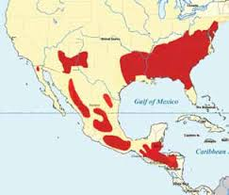
Future Work
Improvements to Near Real-Time Southern Pine Beetle Susceptibility Model
  Amount of variables
Improvements to Southern Pine Beetle Prediction Map
  Include planned mitigation
Map SPB outbreaks back to 2000 or earlier
Relationship between current outbreaks and historical conditions
SPB distribution:
Image Credit: USDA Forest Service
Notes:
Future work includes improving the Near-Real Time Southern Pine Beetle Susceptibility Model by increasing the number of variables, such as temperature, a thermal band drought index, proximity to previous and current outbreaks, proximity to storm damage, and tree density. Also, future work would be in improve the Southern Pine Beetle Prediction Map by including where there are plans to mitigate. We would also like to map Southern Pine Beetle outbreaks from 200 and earlier. Lastly, we would like to examine the relationship between current outbreaks and historical conditions.
Image from USFS: http://www.fs.usda.gov/Internet/FSE_DOCUMENTS/fsbdev2_042840.pdf

Slide 20
Acknowledgements
Advisors:
Dr. Jeffrey Luvall, NASA at NSSTC
Dr. Robert Griffin, University of Alabama in Huntsville
Partners:
Dave Casey, USDA Forest Service
Dr. John Nowak, USDA Forest Service
Dr. Chris Asaro, USDA Forest Service
Other:
Daryl Ann Winstead, NASA DEVELOP
Tim Klug, University of Alabama in Huntsville Graduate Research Assistant
Kel Markert, SERVIR Graduate Research Assistant
Alabama Forestry Commission

Slide 21
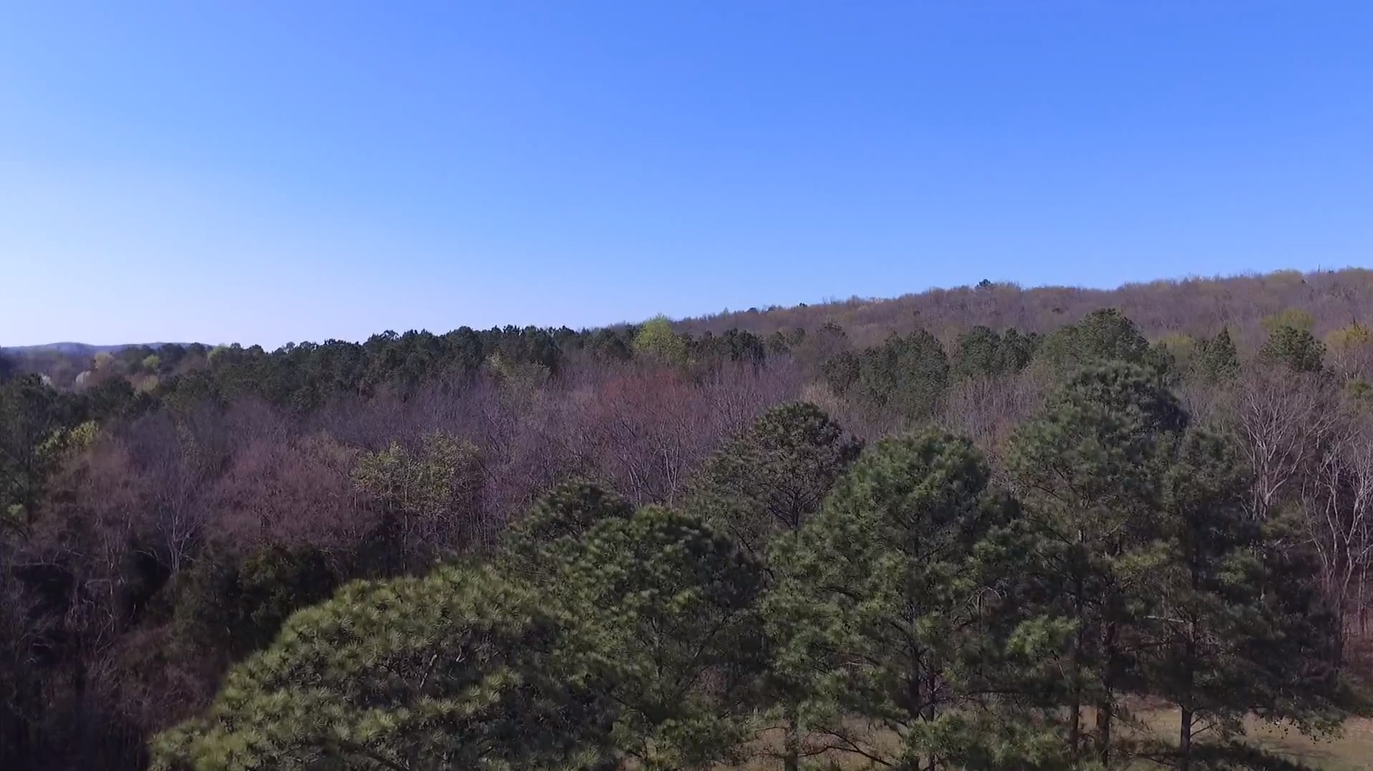
Questions?
Image Credit: Ryan Schick

Slide 22
Near Real-Time Model Accuracy Assessment
20% of in situ data | In SPB Susceptible Area | Not in SPB Susceptible Area | Overall Accuracy
75 | 66 | 9 | 88.0%

Slide 23
Fuzzy Memberships
Assign Fuzzy Membership Type
NDVI | Near
GRVI | Near
Variables
NDVI
GRVI
Desired Tree Species
Fuzzy
Overlay
Near Real-Time
Southern Pine Beetle
Susceptibility Model
Notes:
Back-up slide
The Fuzzy Logic Model is more of a heuristic approach to make the Near Real-Time Southern Pine Beetle Susceptibility Model. This means that a list a variables and Southern Pine Beetle preferred thresholds were determined based on a combination of expert opinion from scientific journal articles, in situ data, and educated guesses on behalf of the team. This approach is appropriate for Southern Pine Beetle susceptibility studies because the details of what causes any individual Southern Pine Beetle outbreaks can be difficult to pinpoint. The Fuzzy Membership tool was used to rescale NDVI and GRVI on a scale from 0 to 1, with values closer to 0 representing lower Southern Pine Beetle susceptibility and 1 representing higher Southern Pine Beetle susceptibility. These Fuzzy Memberships were then combined with the Fuzzy Overlay tool using the “AND” operator. This takes the lowest value of all the variables and assign that value on a pixel per pixel basis, resulting in a single layer with values from 0 to 1 with values closer to 0 representing lower Southern Pine Beetle susceptibility and 1 representing higher Southern Pine Beetle susceptibility.

Slide 24
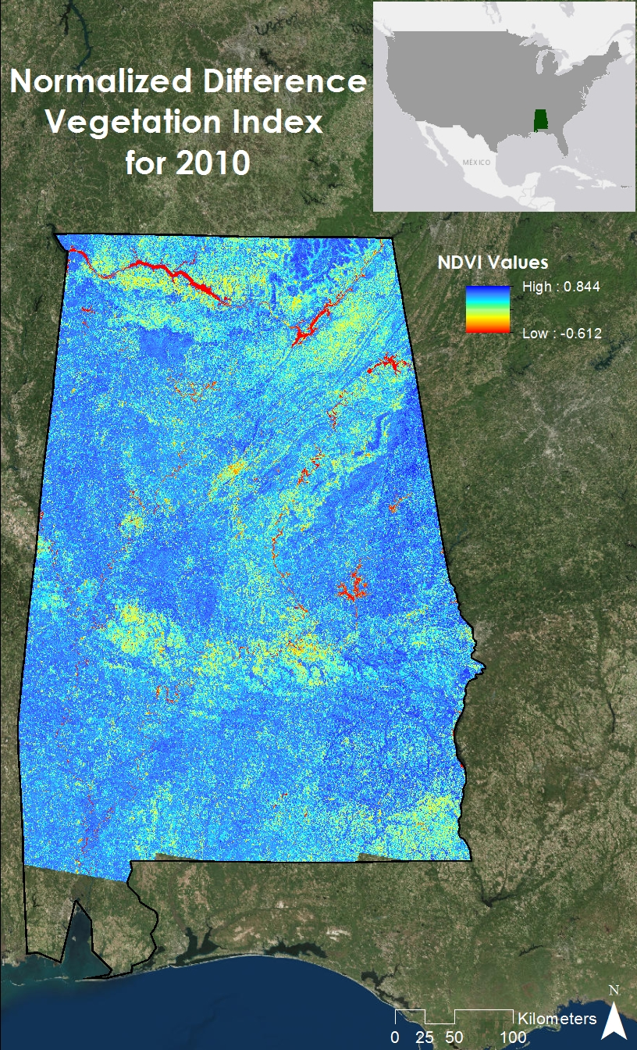
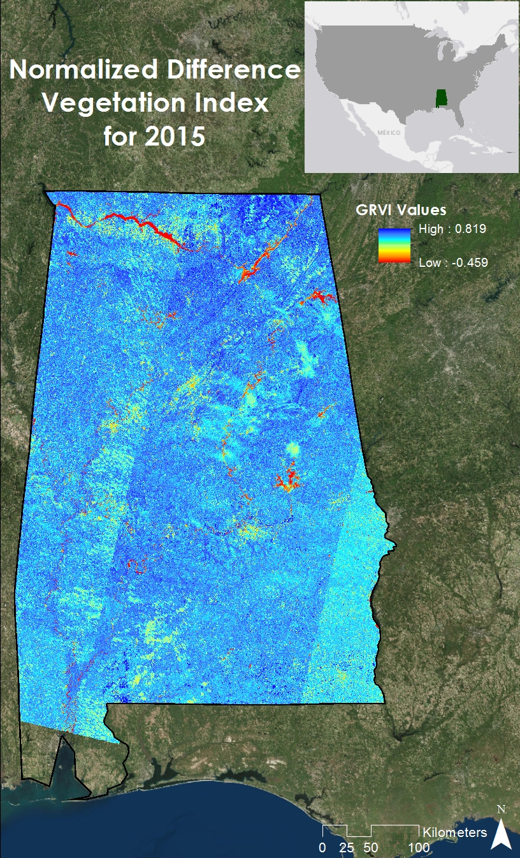
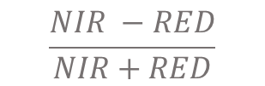
NDVI
$$\frac{NIR −RED}{NIR+RED}$$
Notes:
Back-up slide

Slide 25
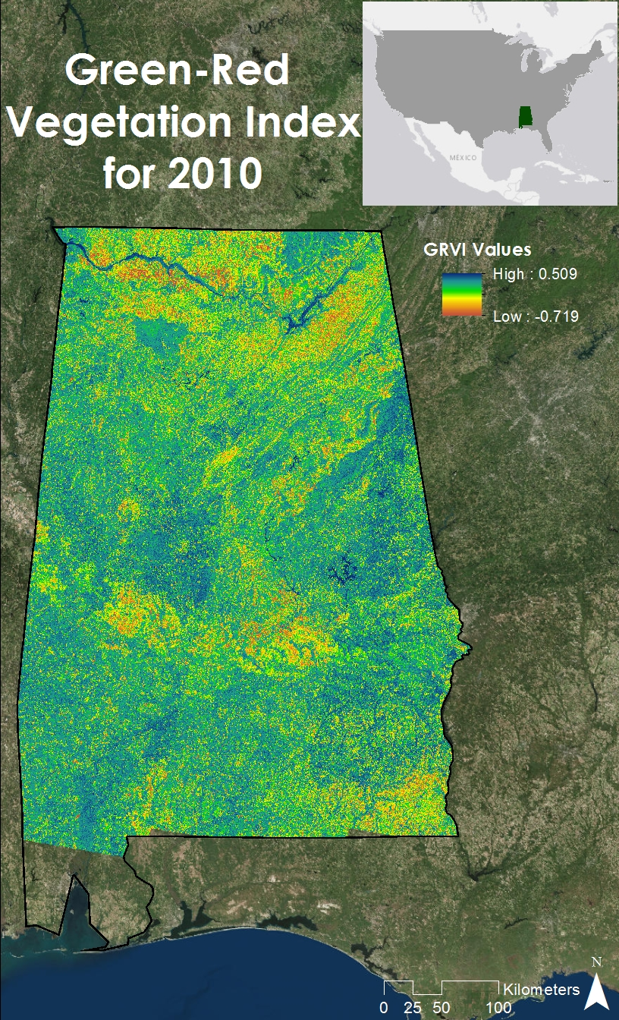
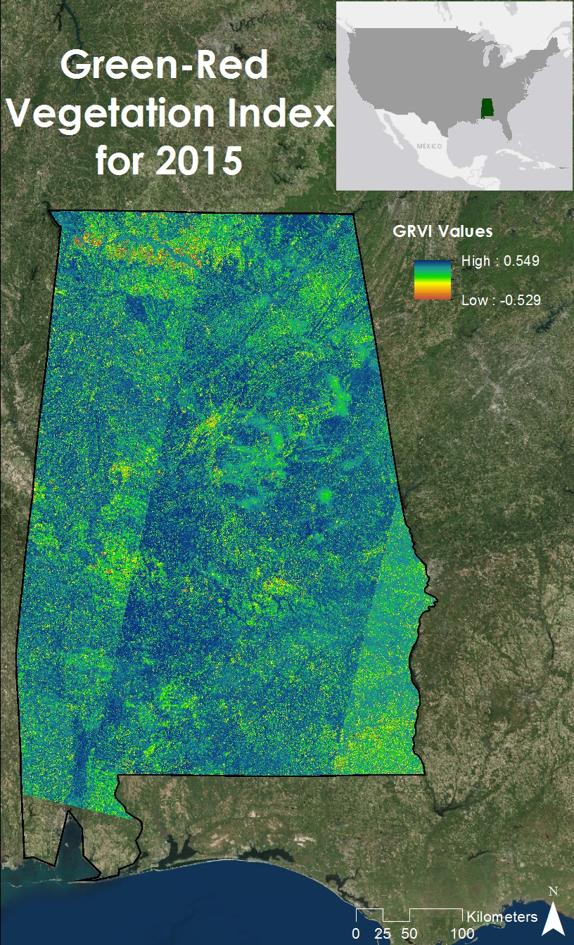
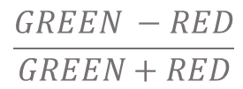
GRVI
$$\frac{GREEN −RED}{GREEN+RED}$$
Notes:
Back-up slide

Slide 26
19 Bioclimatic Variables:
Variable Title | Variable
Bio 1 | Annual Mean Temperature
Bio 2 | Mean Diurnal Range [ Mean of monthly (max temp - min temp) ]
Bio 3 | Isothermality [ (Bio 2 / Bio 7) * 100 ]
Bio 4 | Temperature Seasonality [ Standard Deviation of Weekly Mean Temperature * 100 ]
Bio 5 | Max Temperature of Warmest Month
Bio 6 | Min Temperature of Coldest Month
Bio 7 | Temperature Annual Range [ Bio - Bio 6 ]
Bio 8 | Mean of Temperature of Wettest Quarter
Bio 9 | Mean Temperature of Driest Quarter
Bio 10 | Mean Temperature of Warmest Quarter
Bio 11 | Mean Temperature of Coldest Quarter
Bio 12 | Annual Precipitation
Bio 13 | Precipitation of Wettest Month
Bio 14 | Precipitation of Driest Month
Bio 15 | Precipitation of Seasonality [ Coefficient of Variation ]
Bio 16 | Precipitation of Wettest Quarter
Bio 17 | Precipitation of Driest Quarter
Bio 18 | Precipitation of Warmest Quarter
Bio 19 | Precipitation of Coldest Quarter
Notes:
Back-up slide

Slide 27
MaxEnt Variable Contributions:
Variable | Average Percent Contribution (%) | Average Permutation Importance (%)
Bio 4 | 20.98 | 8.27
Bio 5 | 20.08 | 0.89
Bio 11 | 9.53 | 0.38
Tree Species | 7.29 | 8.64
GRVI 10 | 7.26 | 8.31
Bio 13 | 5.91 | 10.50
NDVI 10 | 4.33 | 4.37
Bio 9 | 3.81 | 0.97
Bio 1 | 3.12 | 0.48
NDVI 15 | 2.80 | 4.26
Bio 18 | 2.50 | 4.11
Bio 7 | 1.88 | 12.45
Elevation | 1.57 | 0.65
Bio 10 | 1.44 | 9.86
Bio 3 | 1.44 | 1.94
Bio 8 | 1.38 | 4.00
Bio 17 | 0.87 | 2.27
Bio 2 | 0.85 | 4.58
Bio 15 | 0.70 | 1.18
Bio 14 | 0.69 | 3.61
Bio 6 | 0.65 | 1.18
Bio 19 | 0.43 | 4.80
Bio 12 | 0.28 | 1.76
Slope | 0.10 | 0.13
GRVI 15 | 0.09 | 0.25
Bio16 | 0.06 | 0.58
Notes:
Back-up slide

