Slide 1
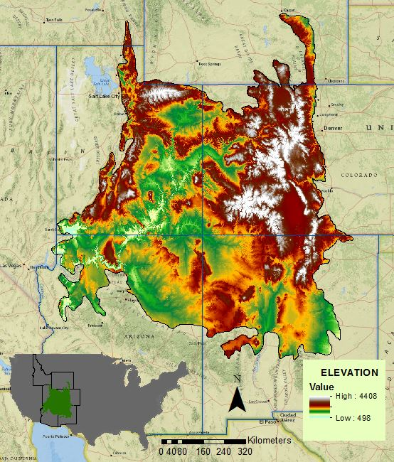
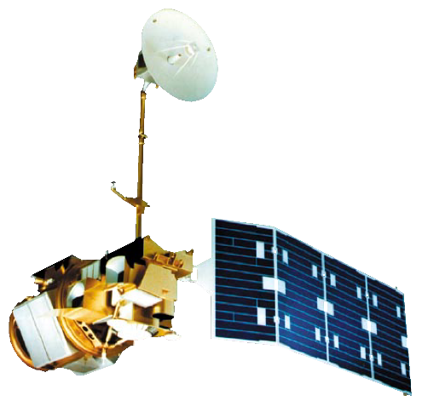
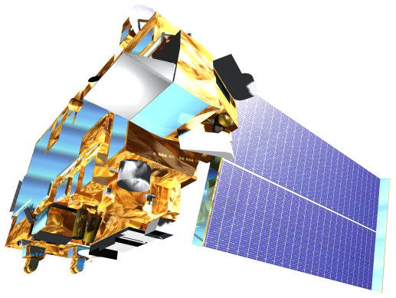
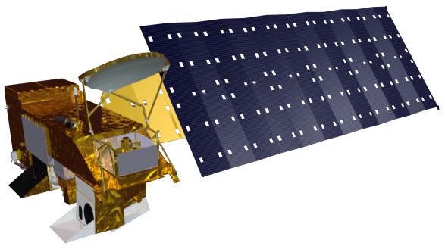
Southern Rockies Ecological Forecasting II
Tracking Mule Deer for Wildlife Corridors between Seasonal Habitats in the Southern Rockies
Tyler Rhodes (Project Lead), Mike Sclater , Amanda Flake, Allison Chappell, Maggie Jenkins, Cody Walker
DEVELOP National Program at NASA Langley Research Center
Abstract
Objectives
Keep this blank for now.
Body text point size should be at least 24.
Caption text point size should be at least 16.
Feel free to rename, move, and resize sections as needed.
Improve understanding of mule deer migration
Determine how anthropogenic features affect migration
Identify ideal conservation areas
Develop migratory corridors to maintain the current population
Study Area
Methodology
Acquisition
Processing
Analysis
NLCD
Landsat
Aster
Prism
Earth Observations
Used ERDAS Imagine with Landsat images to create vegetation phenology
Created DEM/slope using ArcGIS
Added NLCD, Vegetation phenology, climate data, DEM/slope, MODIS snow data and clipped to study area for the final mule deer corridor map.
Landsat 5 TM
Landsat 8 OLI
Terra
Aqua
Results
Conclusions
Use images.
Make sure that it has some sort of flow, that it makes sense. Show your results in a logical order.
No bullets.
Use bullets.
Use complete sentences with periods.
Team Members
Project Partners
Acknowledgements
Southern Rockies Landscape Conservation Cooperative
John Rice
Mule Deer Western Association of Fish and Wildlife Agencies (WAFWA) Working Group
Jim Heffelfinger
Dr. Kenton Ross
NASA DEVELOP National Program Science Advisor
Emily Adams
NASA DEVELOP Langley Center Lead
Rebekke Muench
NASA DEVELOP Langley Assistant Center Lead
Past Contributors from Fall 2015
Ross Reahard
Teresa Fenn
Jeri Wisman
Tyler Rhodes
Michael Sclater
Amanda Flake
Allison Chappell
Maggie Jenkins
Cody Walker
NASA Langley Research Center

