Slide 1
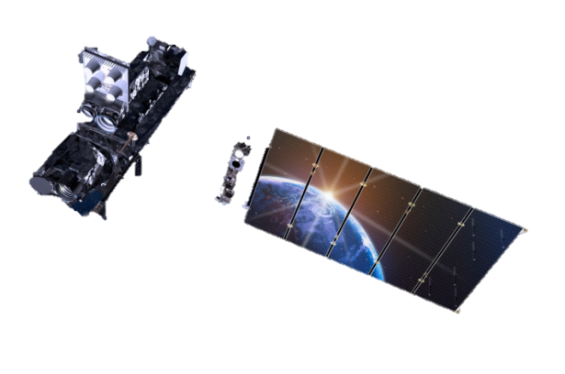
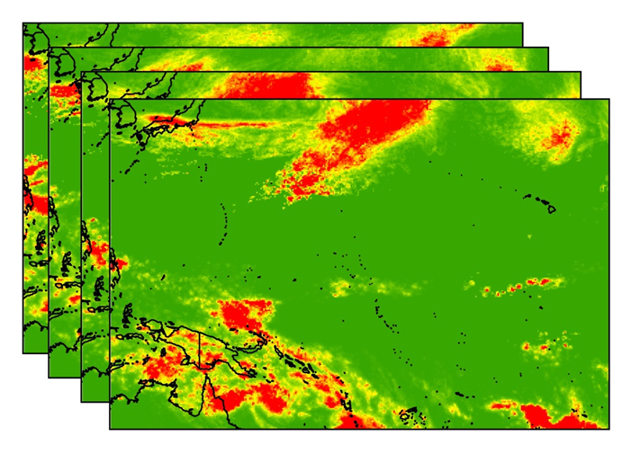
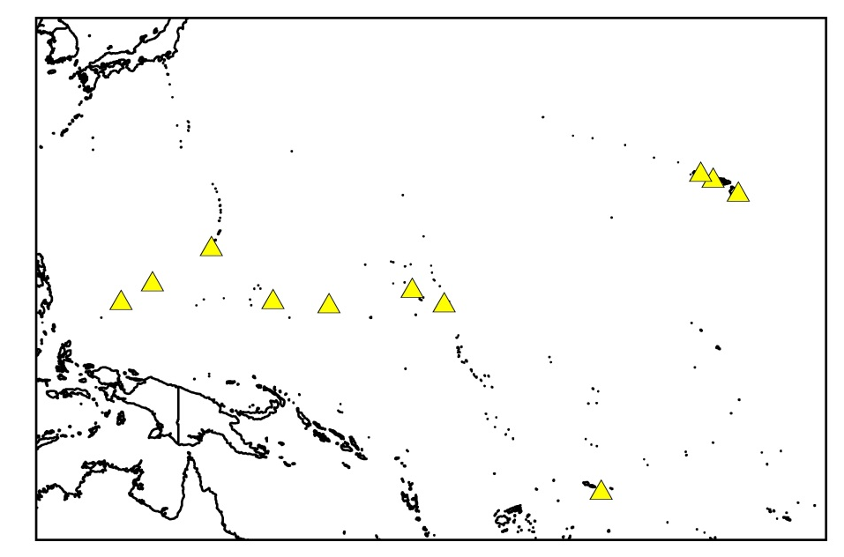
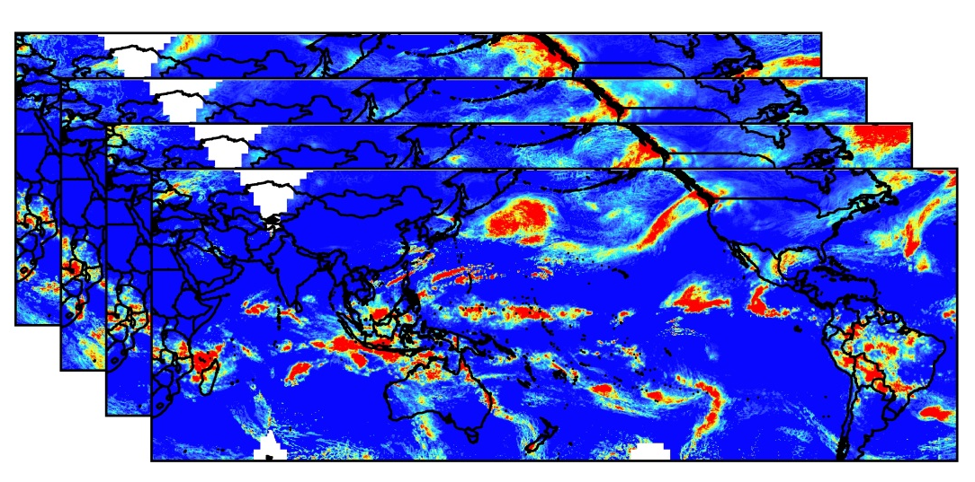
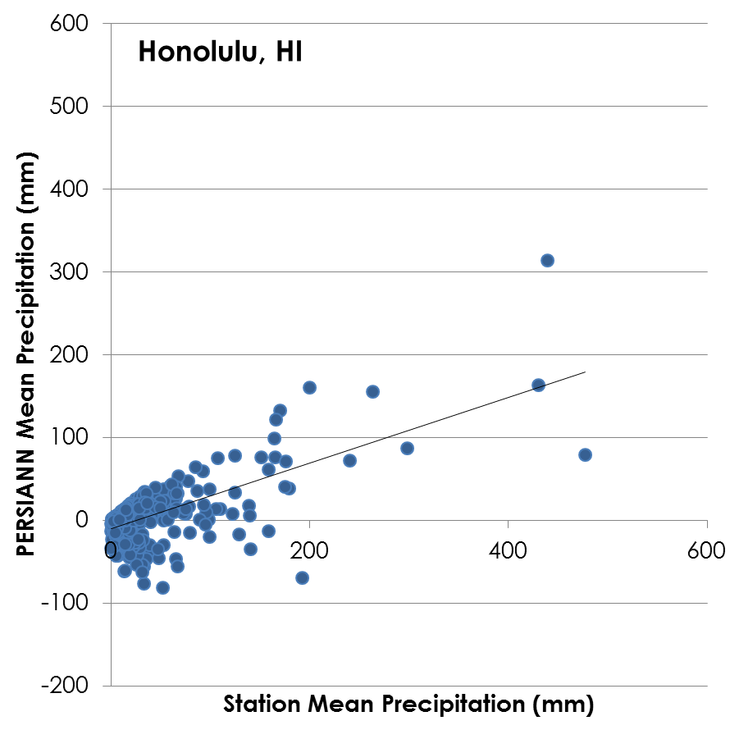
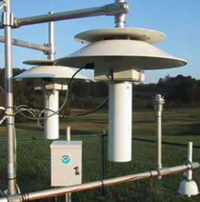
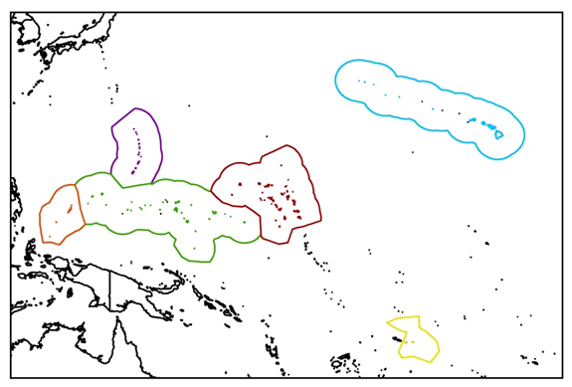
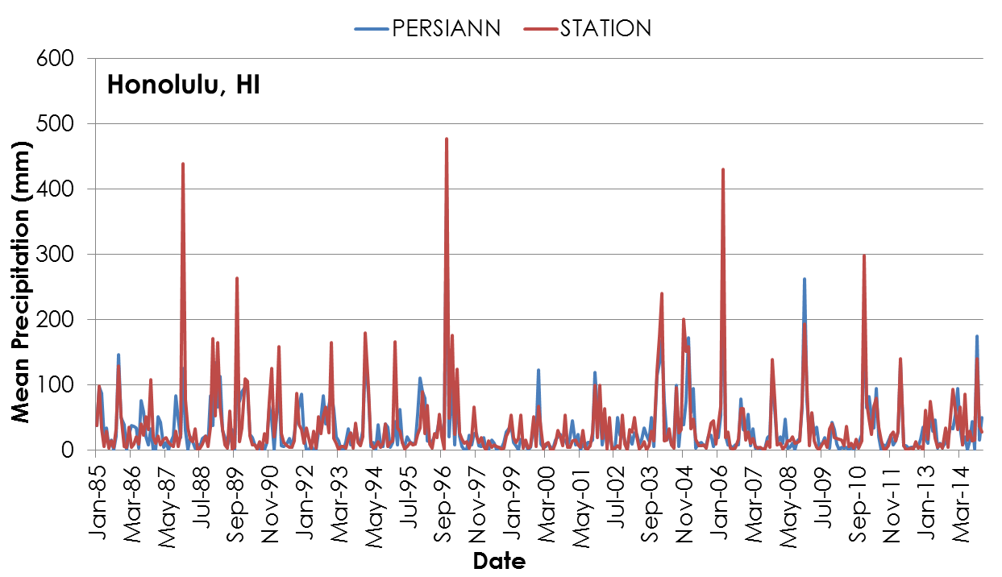
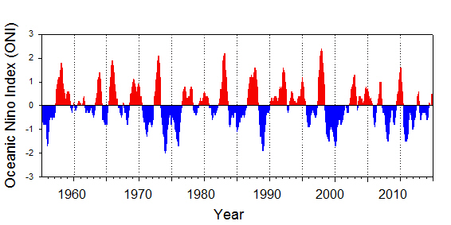
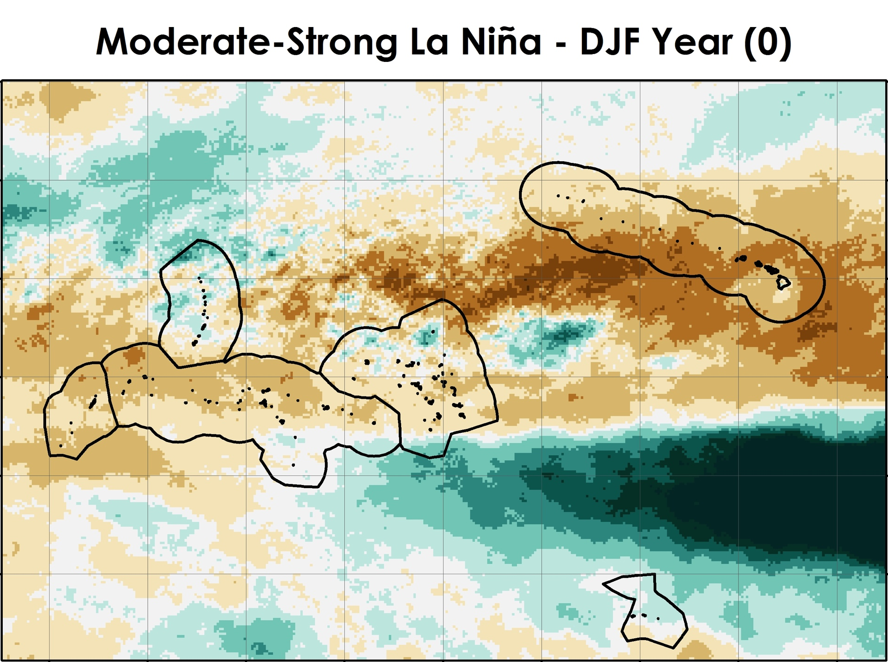
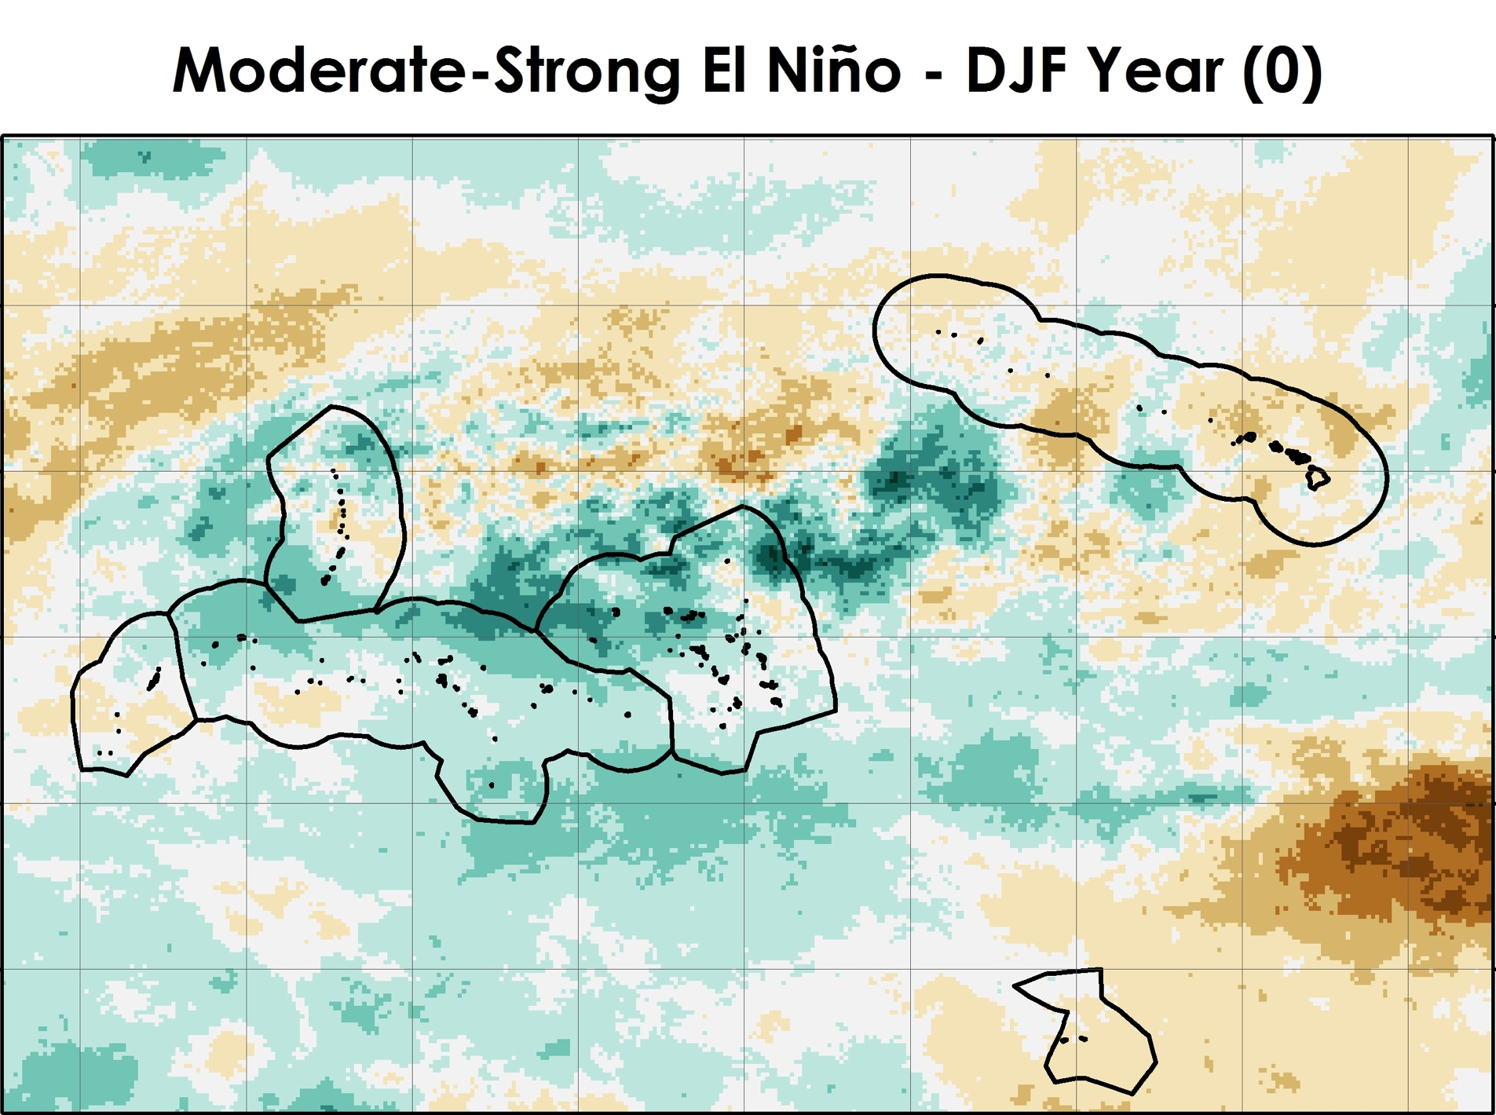
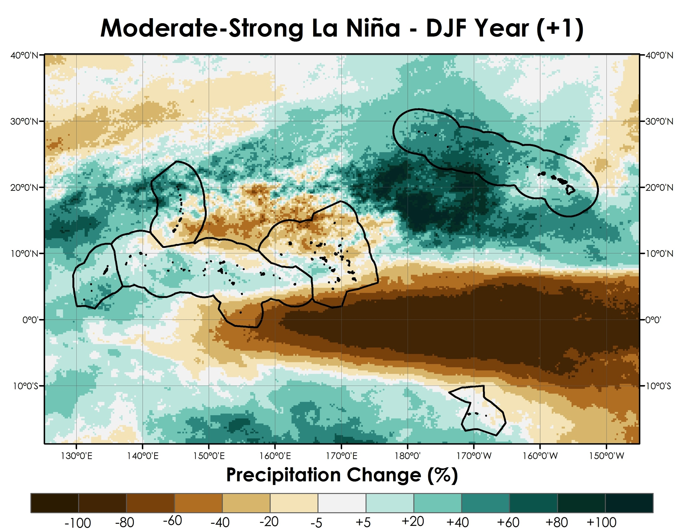
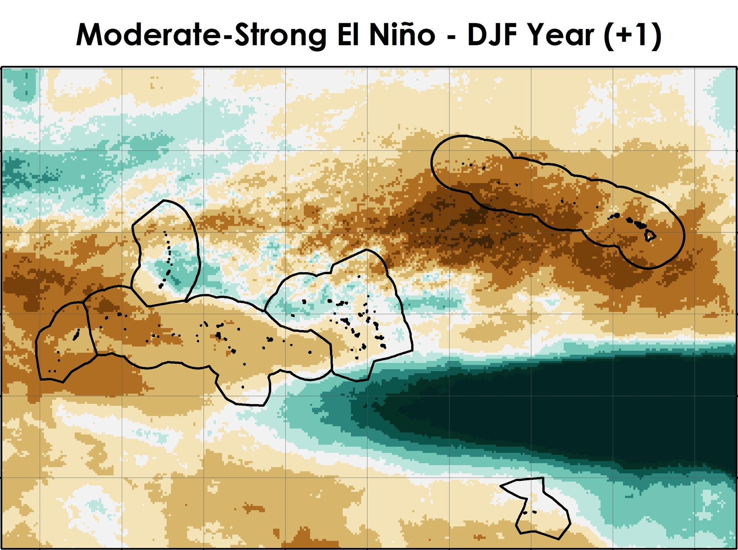
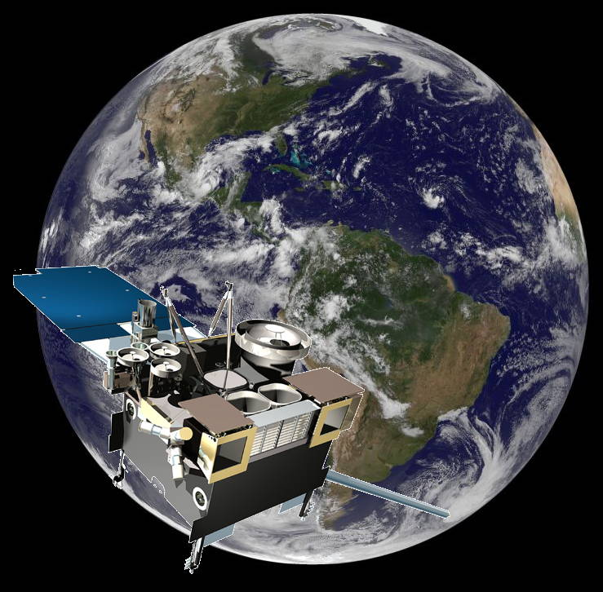
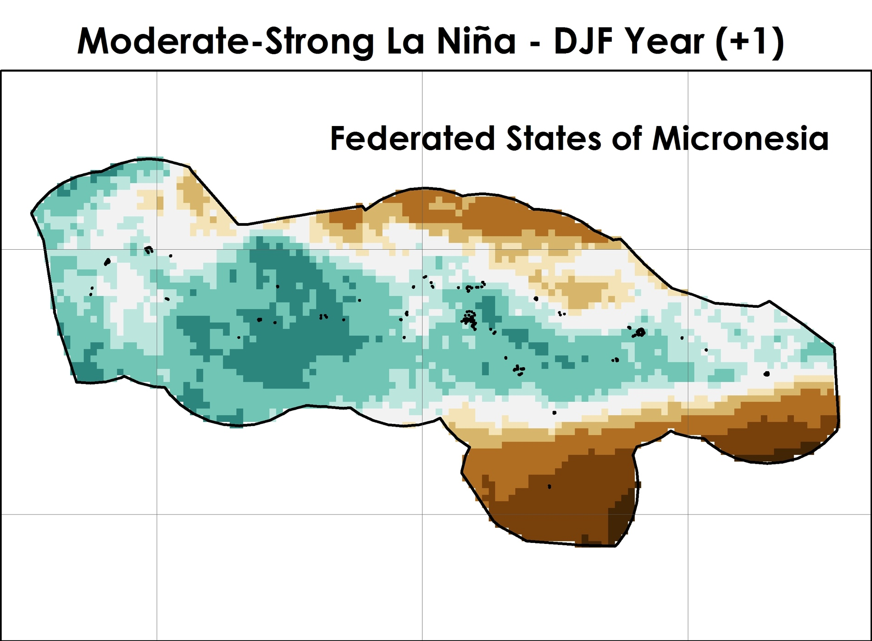
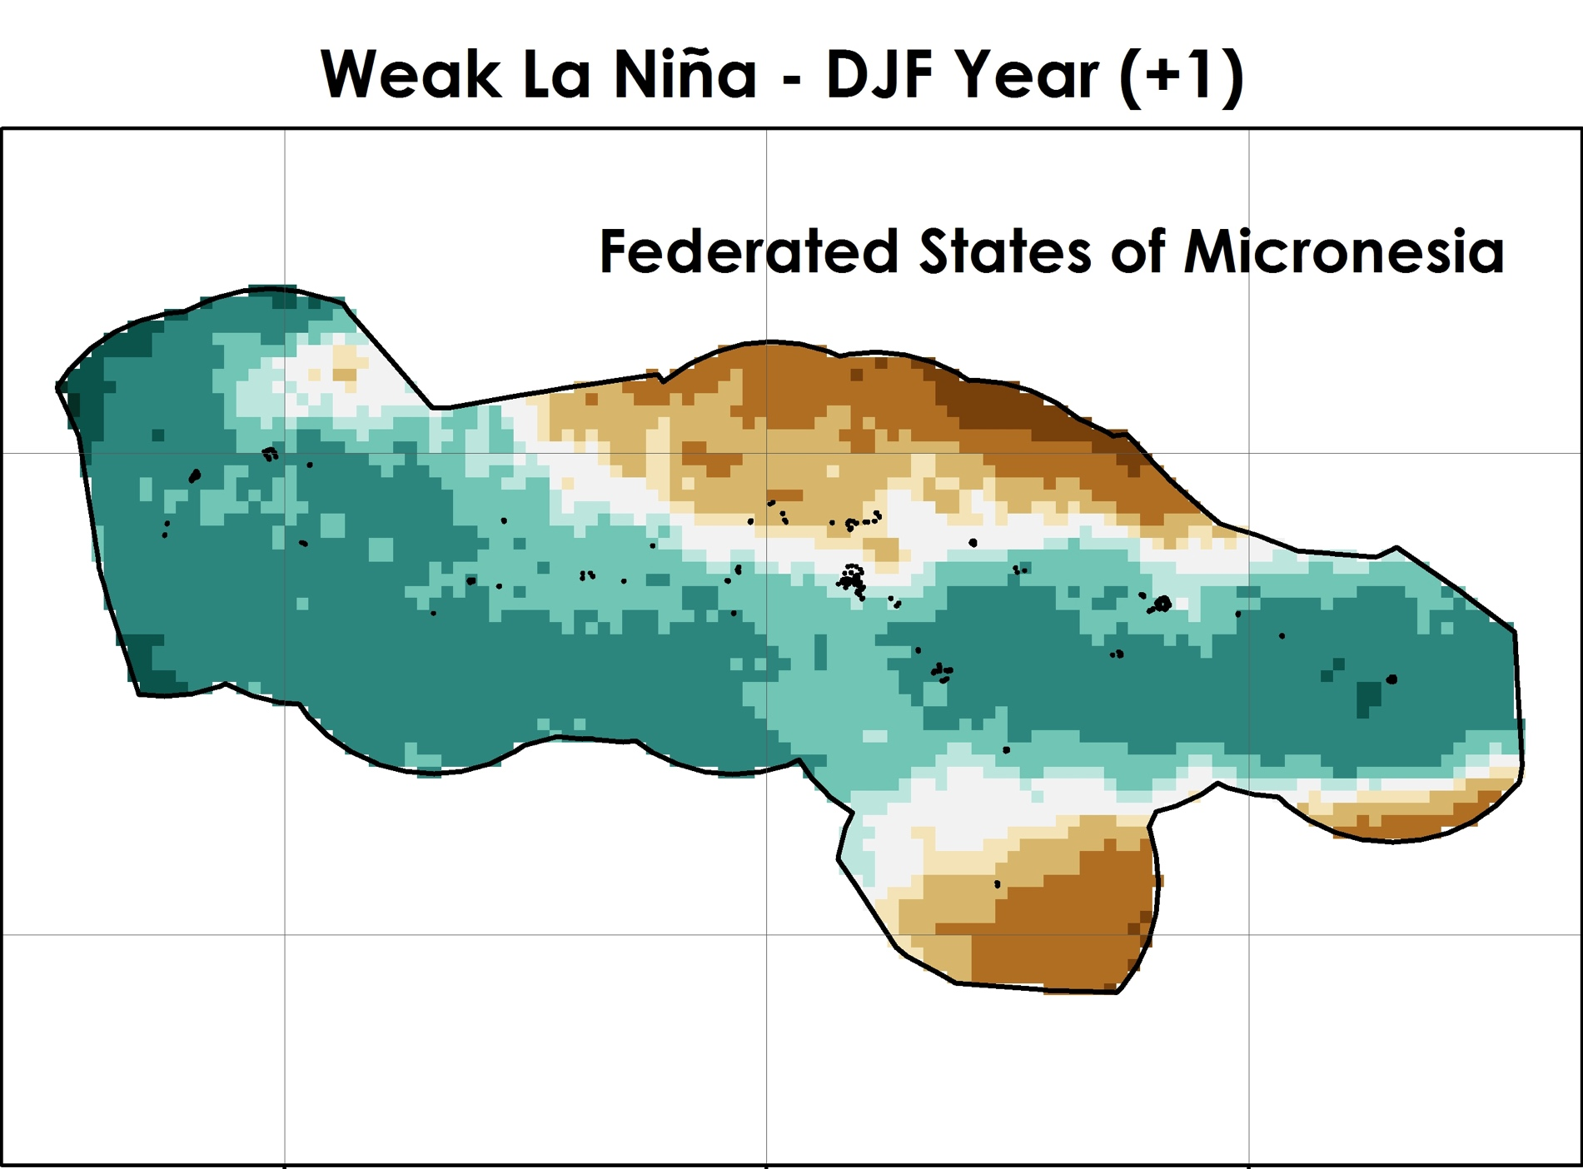
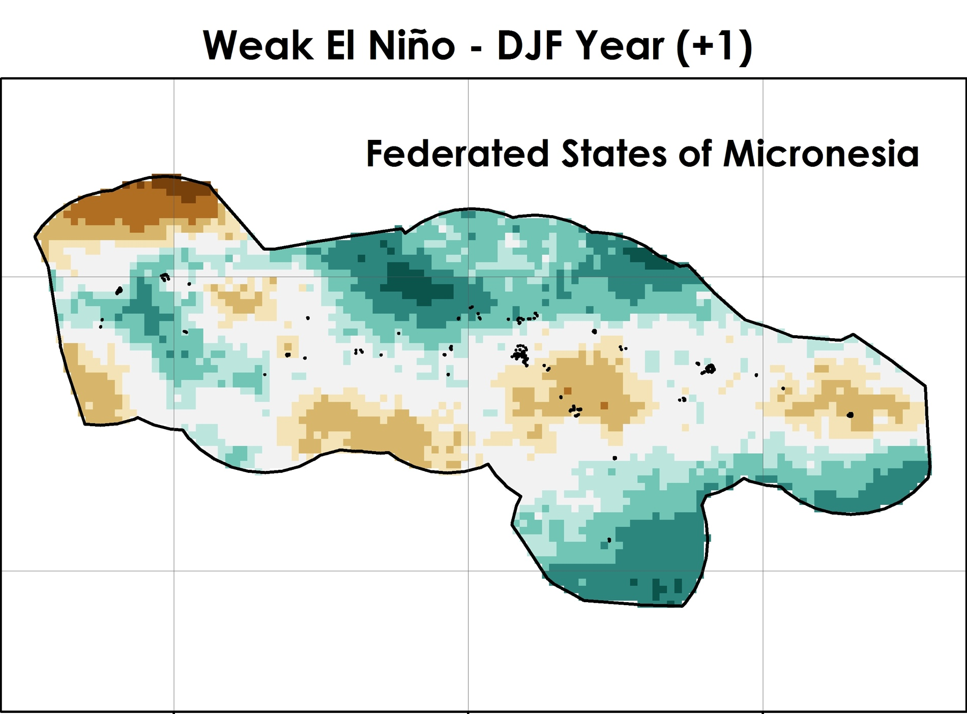
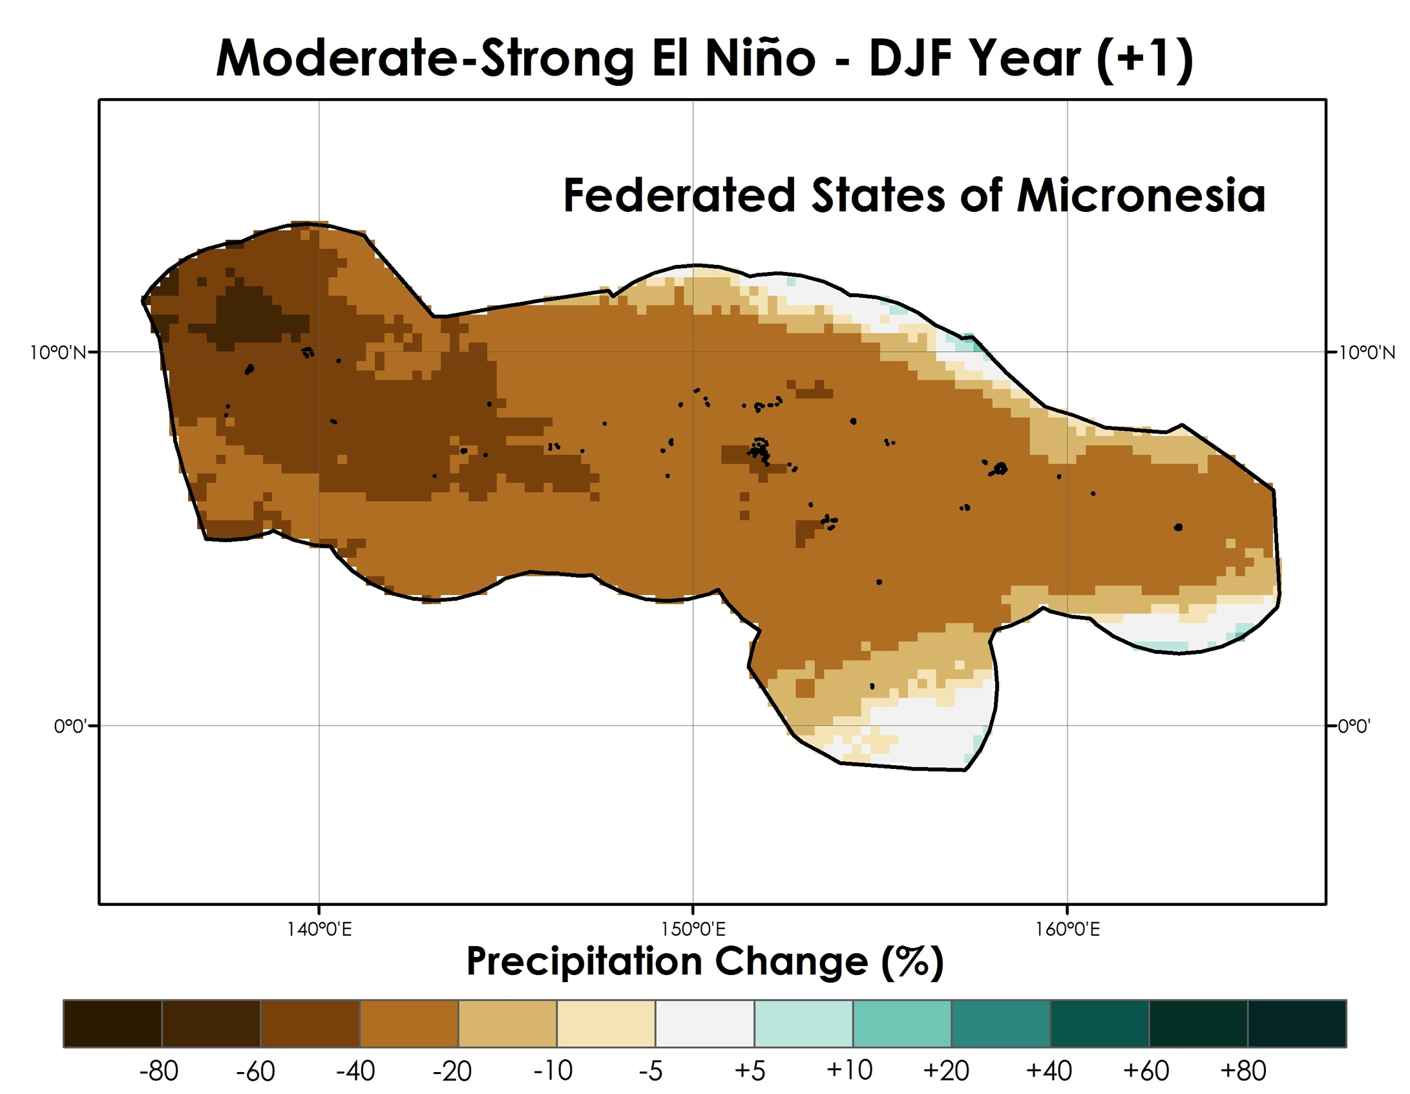
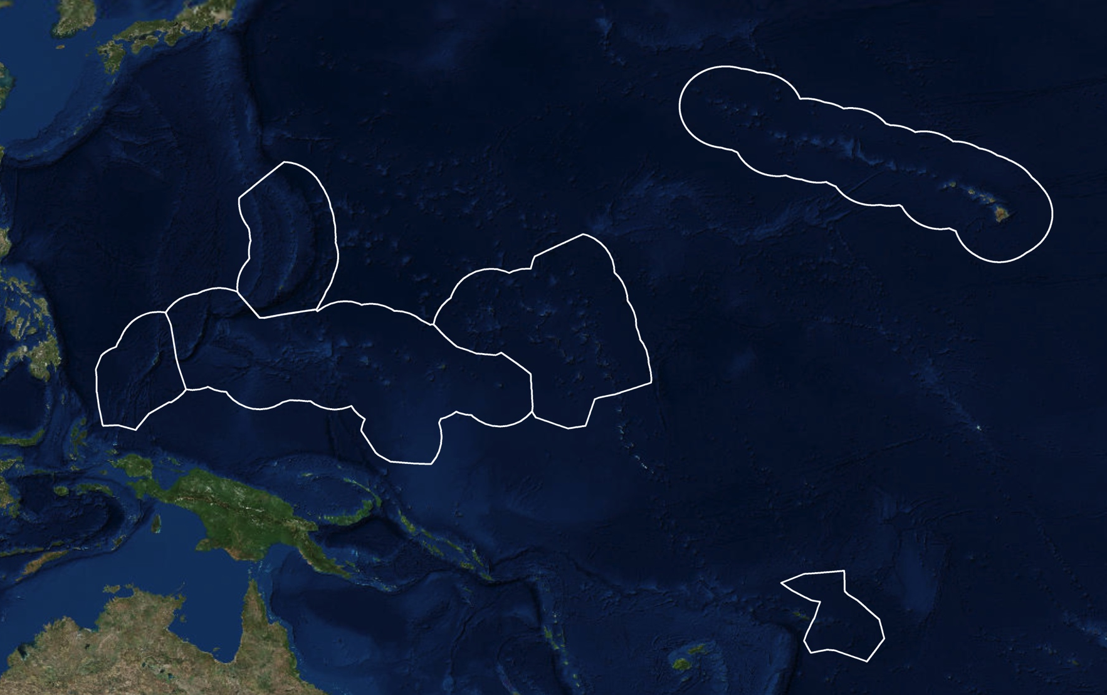

Pacific Water Resources
Using NOAA CDRs and satellite data to connect phases of the El Niño Southern Oscillation (ENSO) with precipitation across Hawaii and the U.S. Affiliated Pacific Islands (USAPI)
Jessica Sutton (Project Lead) ¹, Nicholas Luchetti¹, Ethan Wright¹, Michael Kruk², and John Marra³
¹NASA DEVELOP National Program at NCEI, ²Pacific Water Resources Product Development, and ³NOAA Region Climate Services
Abstract
Methodology
The United States Affiliated Pacific Islands (USAPI) are highly susceptible to extreme precipitation events such as drought and flooding, which directly affect their freshwater availability. Precipitation distribution differs by sub-region, and is predominantly influenced by phases of the El Niño Southern Oscillation (ENSO). Forecasters currently rely on ENSO climatologies from sparse in situ station data to inform their precipitation outlooks. This project provided an updated ENSO-based climatology of long-term precipitation patterns for each USAPI Exclusive Economic Zone (EEZ) using the NOAA PERSIANN Climate Data Record (CDR). This data provided a 30-year record (1984-2015) of daily precipitation at 0.25° resolution, which was used to calculate monthly, seasonal, and yearly precipitation. Results indicated that while the PERSIANN CDR precipitation accurately described the monthly, seasonal, and annual trends, it under-predicted the precipitation on the islands. Additionally, maps showing percent departure from normal (30 year average) were made for each three month season based on the Oceanic Niño Index (ONI) for five ENSO phases (moderate-strong El Niño and La Niña, weak El Niño and La Niña, and neutral). Local weather service offices plan on using these results and maps to better understand how the different ENSO phases influence precipitation patterns.
DATA PREPARATION & ANALYSIS
IN SITU VS. PERSIANN CDR VERIFICATION
GLOBAL PERSIANN CDR PRECIPITATION
MONTHLY
SEASONAL
YEARLY
NOAA STATIONS
LOCATIONS
sum
Daily 0.25° resolution
EXCLUSIVE ECONOMIC ZONES (EEZ)
Oceanic Niño Index (ONI)
Results
Objectives
Provide an updated ENSO-based climatology (1985-2014) of long-term precipitation patterns for each USAPI using the NOAA PERSIANN Climate Data Record (CDR)
Conduct verification analyses with in situ precipitation
Determine the relationship between PERSIANN CDR precipitation measurements and the five ENSO phases
Determine precipitation anomalies for each USAPI Exclusive Economic Zone (EEZ) during the five ENSO phases
Lihue, HI
Earth Observations
GOES
Figure 2. Mean three month season of DJF PERSIANN CDR precipitation for five moderate to strong pre and post La Niña years (88/89, 98/99, 99/00, 07/08, 10/11) , and for six moderate to strong pre and post El Niño years (86/87, 87/89, 91/92, 97/98, 02/03, 09/10). The Exclusive Economic Zones are shown outlined in black and the Lihue NOAA station is highlighted using a colored circle which corresponds to the time series figure (bottom). The time series plot showing mean PERSIANN CDR precipitation in Lihue for each three month season for the five ENSO phases.
Project Partners
Earth Resources Technology (ERT), Collaborator, POC: Michael Kruk
Regional Climate Services Director (RCSD), Collaborator, POC: John Marra
Pacific ENSO Applications Climate (PEAC) Center, Boundary Organization, POC: Carl Noblitt
Chuuk, FSM
Study Area
Hawaii
Figure 3. Percent change of PERSIANN CDR precipitation for mean DJF for the Federated States of Micronesia (FSM) during four phases of ENSO (top). Percent change of PERSIANN precipitation for mean DJR for Chuuk, FSM (bottom).
Commonwealth of the Northern Mariana Islands
Conclusions & Future Work
Team Members
Republic of Palau
Republic of the Marshall Islands
PERSIANN-CDR precipitation was always lower than in situ precipitation and varied with station
There were distinct differences and spatial variation of precipitation during the five ENSO phases within each EEZ
Results were shared using the ArcGIS online Mapping Application with local weather service offices to help understand precipitation patterns within the USAPI
Future work will utilize other satellite products to provide higher resolution precipitation maps
Pictured from left to right,
Jessica Sutton (team lead), Nicholas Luchetti, and Ethan Wright at the NOAA National Centers for Environmental Information in Asheville, North Carolina.
Federated States of Micronesia
American Samoa
Acknowledgements
Figure 1. Map of the study area with the Exclusive Economic Zones (EEZs) outlined for each U.S. Affiliated Pacific Island (USAPI) chain. This made map was made using the imagery base map from ArcGIS.
We would like to acknowledge Lance Watkins, Carl Noblitt, Carl Schreck, Olivier Pratt, Mark Lander, Luke He, Kevin Kodama, Charles Guard, Thomas Schroeder, Maria Ngemaes, and the NASA DEVELOP National Program Office for their support, edits, and commentary that has strengthened this research.
NOAA National Centers for Environmental Information

