Slide 1
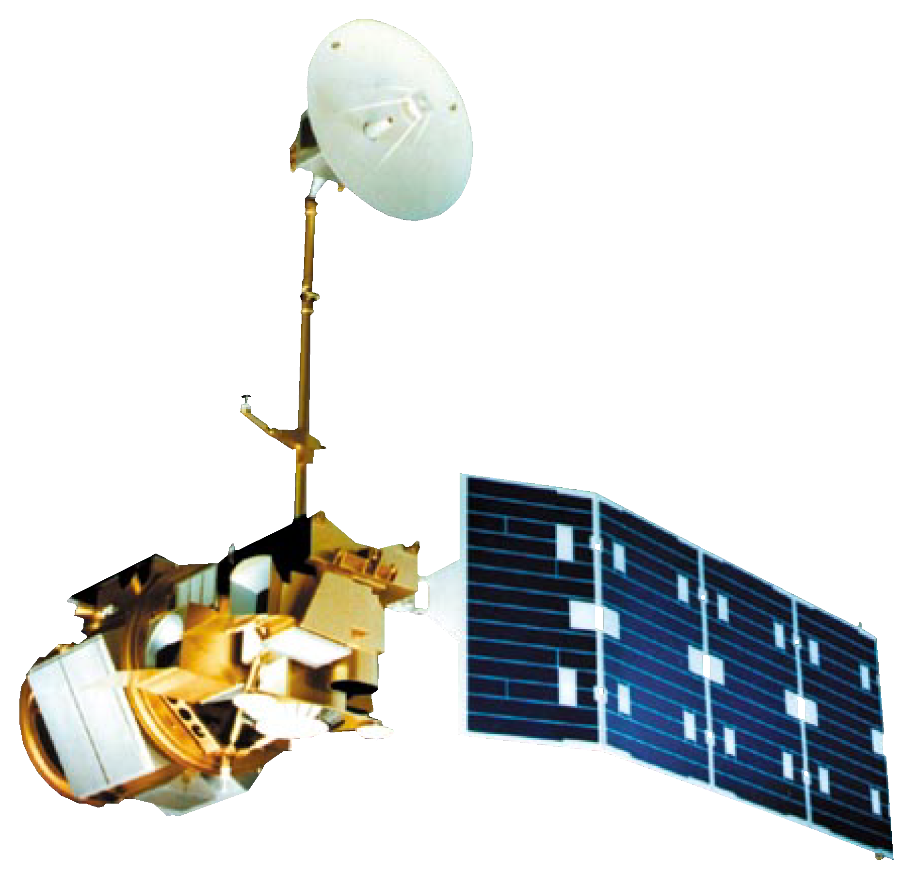

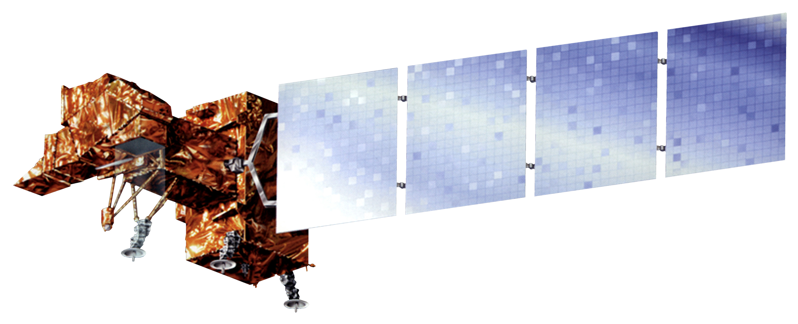
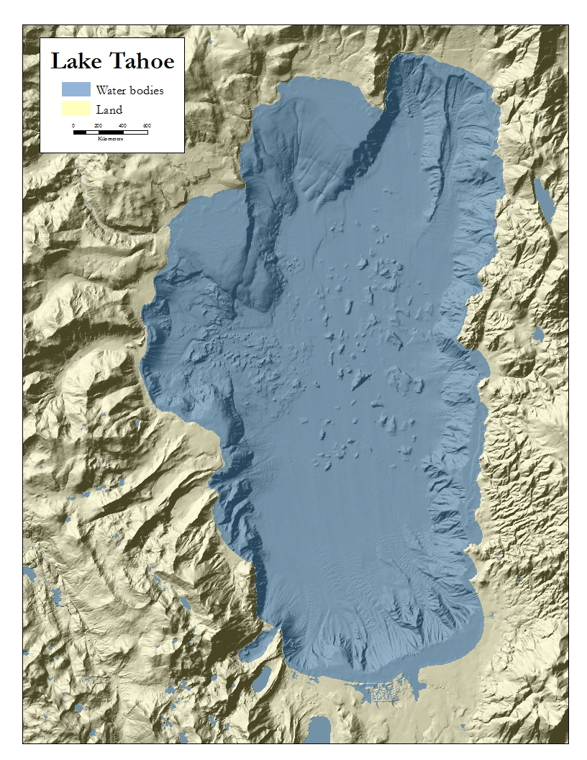
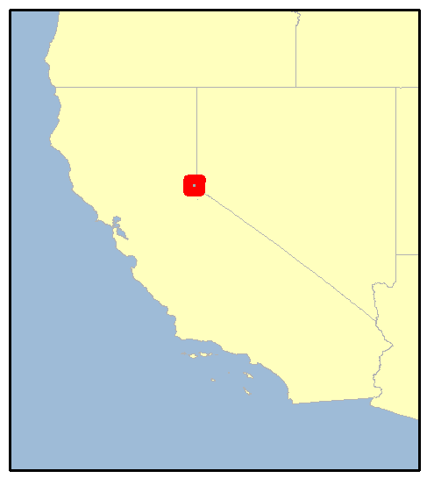

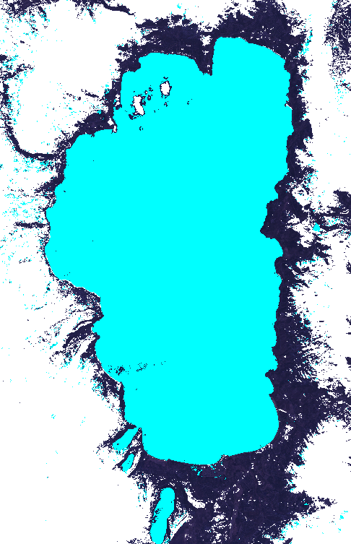
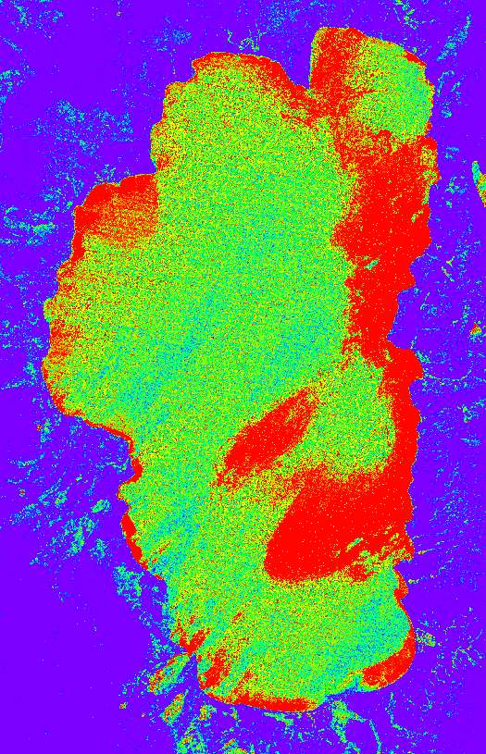
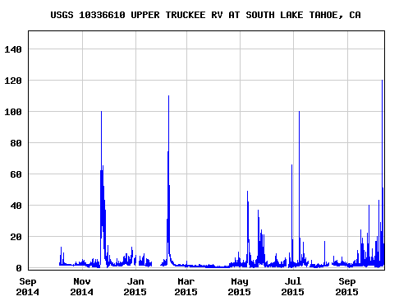
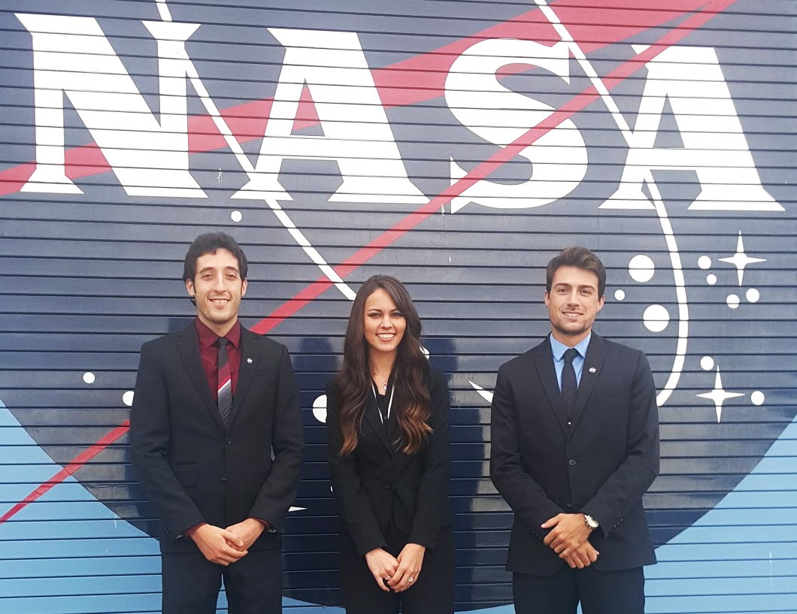

Lake Tahoe Water Resources
Creating an Algorithm for Global Continuous Lake Level Monitoring
using Landsat Imagery
Nolan Cate (Project Lead), Anton Surunis, Chelsea Ackroyd
NASA DEVELOP National Program
Earth Observations
Objectives
Abstract
As global climate change continues to escalate and droughts become more frequent and more severe, it becomes increasingly necessary to monitor available water resources. Lake Tahoe (CA/NV) is an important reservoir particularly in the tourism industry. With nearly 5 million visitors each year, Lake Tahoe is one of northern California’s most popular attractions. Its tourists contribute at least $300 million to the local economy annually. The lowering water levels, therefore, are a concern for both residents and the economy. Current methods for monitoring lake levels, however, are often based on gauges that require time intensive field work to record data. This project provides a continuous detection lake level monitoring algorithm based on Landsat imagery and an Modified Normalized Difference Water Index, coupled with radar altimetry. The algorithm allows managers in the Lake Tahoe Basin Management Unit to monitor the lake level in near real-time. The final objective is to produce a lake level monitoring algorithm that measures Lake Tahoe, as well as lakes and reservoirs throughout the world.
Create a tool to allow LTBMU to continually monitor the level of Lake Tahoe and the surrounding lakes
Provide a method to consistently measure lake turbidity
Generalize the tool to make it accessible to water managers worldwide for localized resource monitoring
Landsat 4-5 (TM) Landsat 8 (OLI)
Study Area
Landsat 7 (ETM+)
Methodology
Locate water body
Four step water detection process
Calculate turbidity and algal information
Output statistics
Results
Conclusions
Use images.
Make sure that it has some sort of flow, that it makes sense. Show your results in a logical order.
No bullets.
Use bullets.
Use complete sentences with periods.
Team Members
Project Partners
Lake Tahoe Basin
Management Unit,
USDA Forest Service
Acknowledgements
Dr. Brian Coltin (NASA Ames Research Center)
Dr. Juan Torres-Perez
(Bay Area Environmental Research Institute)
Dr. Joey Keely
(Lake Tahoe Basin Management Unit, USDA Forest Service)
(From left to right)
Anton Surunis, Chelsea Ackroyd, Nolan Cate
NASA Ames Research Center

