Slide 1
California
Agriculture
Using Earth Observations to Estimate the Age and Carbon Stock of Perennial Agriculture
Rachael Ross
Stefanie Dimayuga Mendoza
Alex Posen
Shreya Suri
California – Ames
Notes:
We are the California Agriculture Team from Ames Research Center and we are excited to share with you all our hard work from our ten week journey exploring the feasibility of using Earth Observations to estimate ages and monitor carbon stocks of perennial agriculture.
I am the team lead, Rachael Ross. These are my team mates Stefanie Mendoza, Alex Posen and Shreya Suri.

Slide 2
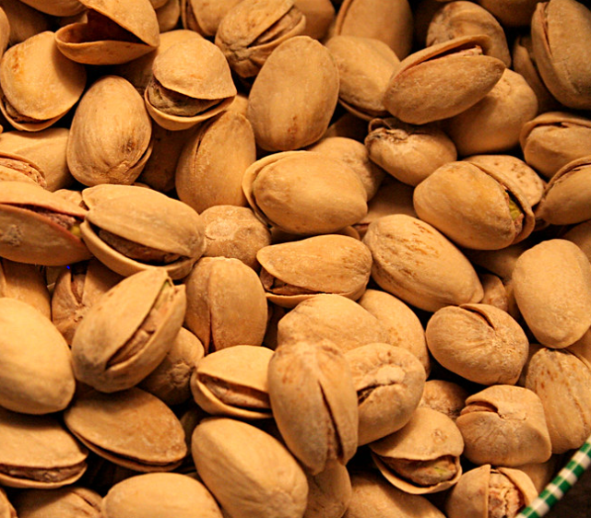
PRESENTATION OUTLINE
Image credits: Moonjazz, Pierre Vignau, Narayan, Rosana Prada, Alberto Gonzales
Study Area & Period
Objectives
Partners
Community Concerns
NASA Satellites/Sensors
Methodology
Results
Errors & Uncertainties
Conclusions
Future Work
Notes:
Hello everyone, here is the road map to our presentation. To begin we will first introduce to you our study area as well as our wonderful partners and their concerns. Then we will dive into discussing the spatial methods we employed to address these concerns, followed by our findings.
Orange Image credit: moonjazz, public domain
https://www.flickr.com/photos/8398907@N02/4365688086
Walnut image credit: Pierre Vignau, CC BY 2.0
https://www.flickr.com/photos/13997606@N03/4855557192
Almond image credit: narayan.nikita, CC BY 2.0
https://www.flickr.com/photos/128218207@N02/15650191325
Pistachios image credit: Rosana Prada, CC BY 2.0
https://www.flickr.com/photos/49503201503@N01/416862855
Grapes image credit: Alberto Gonzales CC BY-NC 2.0
https://wordpress.org/openverse/image/127bf186-e3fa-4732-b798-29da0972f077

Slide 3
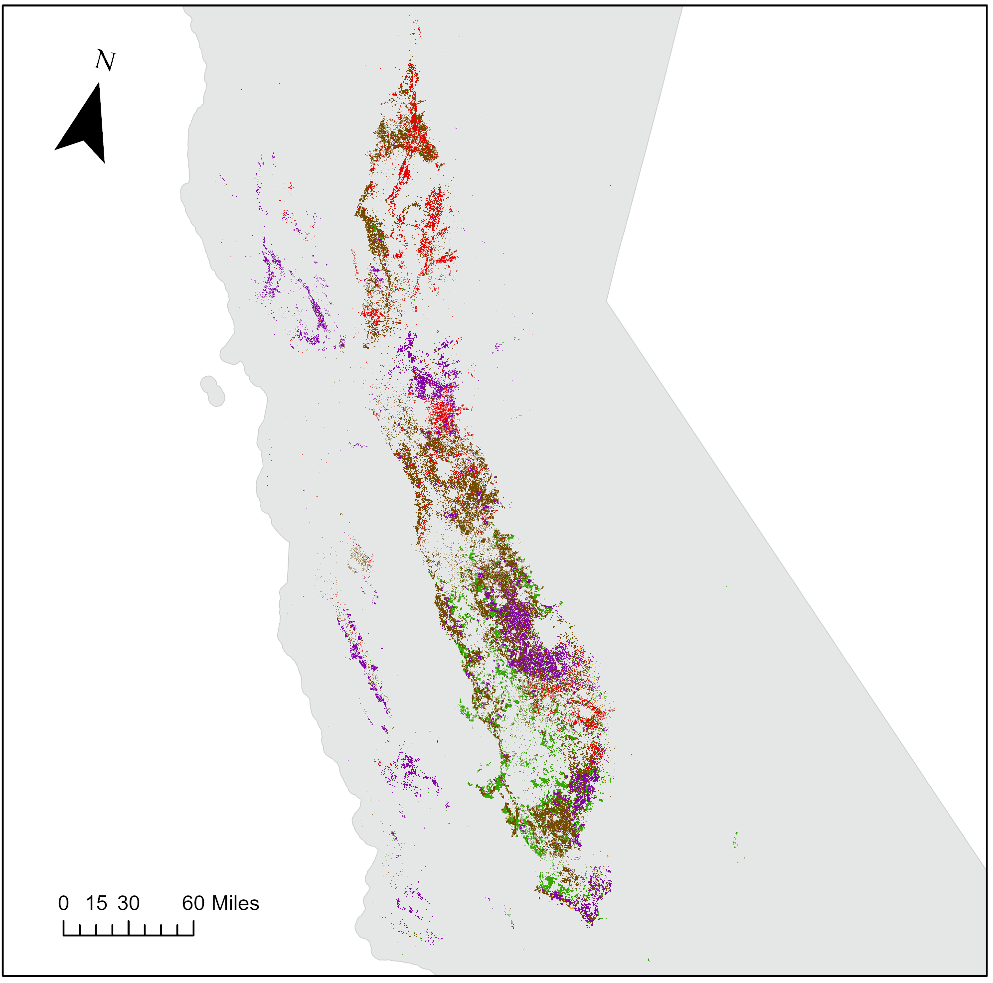
STUDY AREA AND PERIOD
USDA-NASS 2 Cropland Data Layer (CDL), 2021
Study Area: Crop-specific agricultural regions of California
Study Period: March 1984 – December 2021
Crop Type
Grapes
Almonds
Walnuts
Pistachios
Oranges
0 15 30 60 Miles
Sources: Esri, DeLorme, HERE, MapmyIndia
Notes:
All analyses conducted for this project focused on the Agricultural regions of California which included almond, orange, pistachio and walnut orchards as well as vineyards from the years 1984 through 2021. These areas are part of California's natural working lands which provide a range of environmental, human health, social and economic benefits. It is apparent that California’s natural and working lands have been deteriorating over time as a result of extreme events exacerbated by climate change. Due to the loss of carbon from events such as wildfires and drought, these lands are currently a net source of greenhouse gas emissions. Cropland represents an important land category of interest for greater carbon storage. More specifically, perennial biomass in orchards and vineyards have the greatest carbon sequestration potential in the agricultural sector.
Esri Light Gray Canvas Map: Sources: Esri, DeLorme, HERE, MapmyIndia
Map data credit: USDA-NASS 2 Cropland Data Layer, 2021

Slide 4
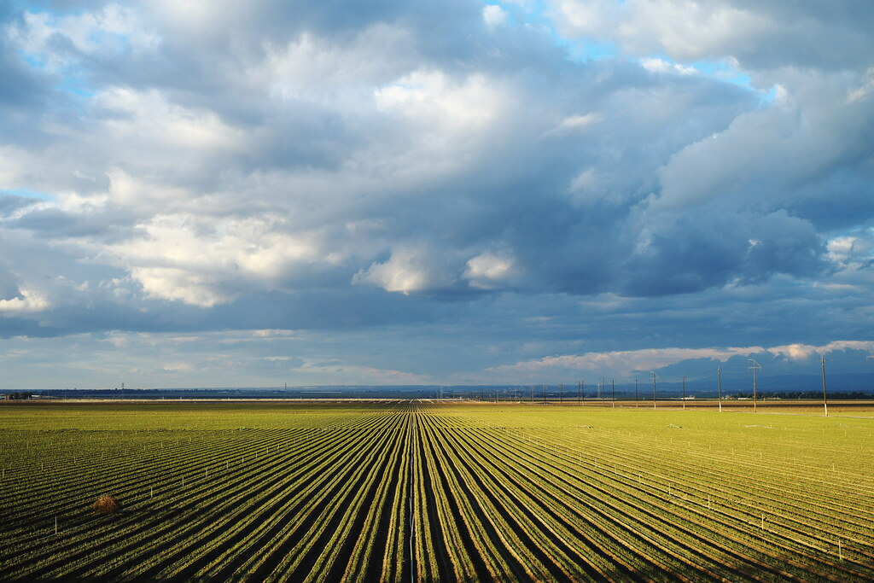
OBJECTIVES
Develop a GEE tool to map crop age and biomass
1
Estimate total carbon stock
2
Compare carbon stocks across different ages and crop types
3
Image Credit: Gina Collecchia
Notes:
Our project's aim was to increase the capabilities of detecting annual changes in the age and biomass of California’s orchards and vineyards from 1984 to 2021 by designing a user-friendly GEE tool for CARB to assist with carbon stock inventory. The mapping tool will track annual changes in the age, biomass, and carbon stock of California’s orchards and vineyards. The methods developed during the term will serve as the basis for future efforts with evaluation of carbon stocks in other land cover varieties within California as well as other states. In addition, CARB will also use this tool to increase accuracy, lower costs, and improve the temporal frequency for their timeseries analyses and monitoring of agricultural land cover types and biomass.
Image Credit: Gina Collecchia (CC BY-NC-ND 2.0)
https://www.flickr.com/photos/27351743@N08/8505697502

Slide 5
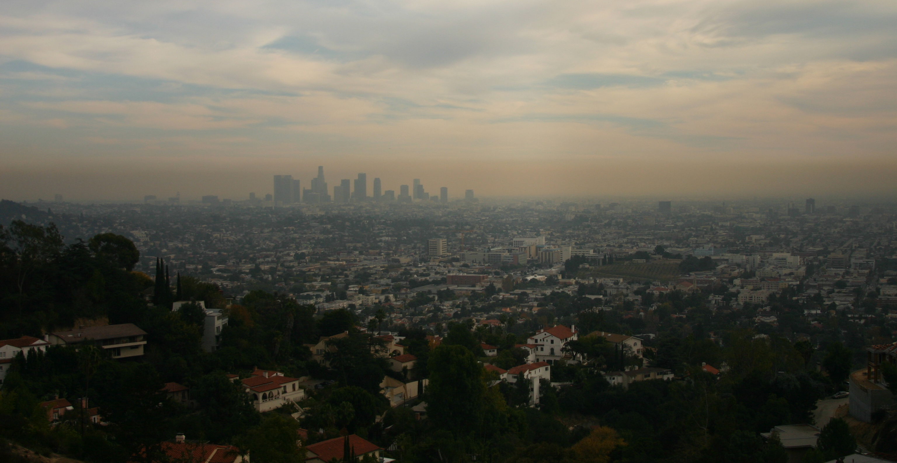
PARTNERS
Partner Objectives
California carbon neutral by 2045
Understand carbon services of agricultural ecosystems
Improve methods for orchard carbon stocks
Image Credit: Steven Buss
California Air Resource Board (CARB)
Notes:
For this project, our DEVELOP team partnered with the California Air and Resources Board (CARB). Carb is tasked with making sure California becomes carbon neutral by 2045. As California’s climate change planning agency, CARB is responsible for setting emissions standards, ecosystem carbon targets, and desired sequestration rates to meet climate goals. In order to track progress towards California's 2045 carbon neutrality goal, CARB developed the Natural and Working Lands (NWL) Inventory, which quantitatively estimates the amount of carbon contained within the state’s land base.
Image Credit: Steven Buss, CC BY-SA 2.0
Image URL: https://www.flickr.com/photos/steven-buss/349912280/in/photolist-wVoJm-bk6BD-RzLk6T-2aKSsQm-2axApqi-3eoE5B-abxHo6-abxH8K-Vr2SDo-abxHAz-jaguU-5FATZA-4zQ6N2-4YjC1Q-4Yfn2V-5ueSDn-6BmGW-5XqhXW-M1FEuS-5kmLRh-59YaFe-DWMLwb-H7YZXR-auMMF9-abxGTr-abxGCP-jn4jKU-2mJdNVs-jdQdKv-p8nQV-WHeA16-zGoBv-fRPmwf-YnGpaD-5GwsJo-gnpru-mWvu-6BmGr-718ngr-wS3Z2-qd8Gt-BrPwp-2jDtAJT-5tyjpj-6E5YEo-sfqW9H-GFQCrz-2ef5ggg-2jHNQSa-2hC5x4t

Slide 6
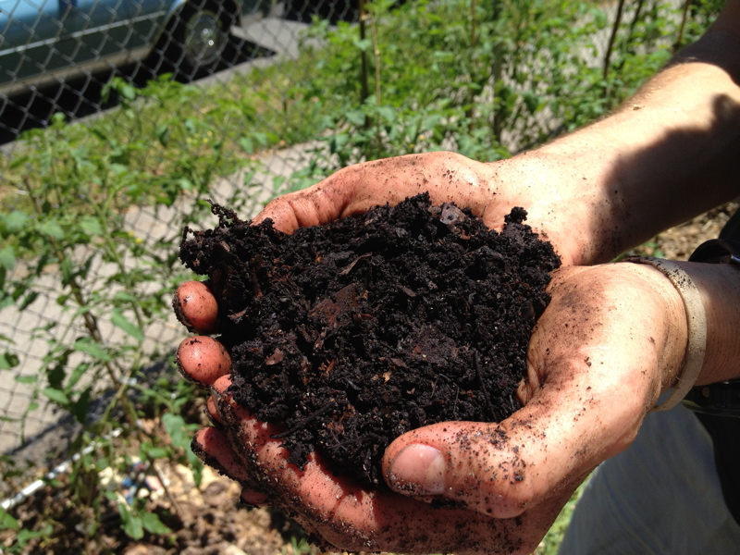
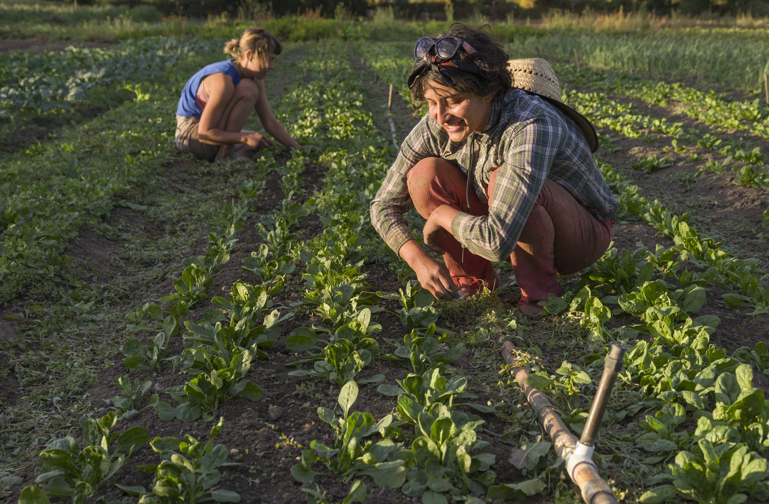
COMMUNITY CONCERNS
It is difficult to track progress towards California's carbon neutrality goal because of the large uncertainties using available carbon stock methods
Current inventory estimation methods contain significant uncertainties, allowing for improvement in estimating cropland carbon stock methodology.
The most recent estimates of cropland carbon stock were last estimated for 2016, becoming out of date.
Image Credit: Elsa Capuntas, Bob Dass
Notes:
Some community concerns are that CARB must accurately quantify carbon stocks for natural and working lands in order to track progress towards California's Carbon Neutrality goal, but current inventory estimation methods are inconsistent and contain significant uncertainties, resulting in inaccurate carbon stock estimates.
Image credit:
Top: Elsa Capuntas, CC BY-SA 2.0
https://www.flickr.com/photos/elsacapuntas/8390398292/in/photolist-dMqZ6w-dMkqqZ-dMqYRL-zraLSo-dMqZ8Q-dMqZ5N-dMqZ2q-dMkqtT-dMkqjt-dMkqAi-dMkqqz-dMkqxa-dMkqFM-dMqZi1-dMkquv-dMqZ7o-dMqYZs-dMkqk6-dMkqjc-dMkqzg-dMkqvp-dMkquV-dMkqBH-dMqZ31-dMqYYS-dMkqA4-dMqZcY-dMqYTN-dMqZbS-dMqZhy-dMkqta-dMkqgZ-dMqZ9W-dMqYXs-dMqZ55-dMkqEx-dMkqB8-dMqZ1L-dMkqFn-dMqZ4q-dMqZmA-dMqZdQ-dMqYVy-dMkqsK-dMkqF4-dMkqhD-dMqZno-dMkqoe-2mTjvmN-2j3njUE
Bottom: Bob Dass, CC BY-SA 2.0
https://www.flickr.com/photos/54144402@N03/21944592690/in/photolist-zraLSo-dMqZ8Q-dMqZ5N-dMqZ2q-dMkqtT-dMkqjt-dMkqAi-dMkqqz-dMkqxa-dMkqFM-dMqZi1-dMkquv-dMqZ7o-dMqYZs-dMkqk6-dMkqjc-dMkqzg-dMkqvp-dMkquV-dMkqBH-dMqZ31-dMqYYS-dMkqA4-dMqZcY-dMqYTN-dMqZbS-dMqZhy-dMkqta-dMkqgZ-dMqZ9W-dMqYXs-dMqZ55-dMkqEx-dMkqB8-dMqZ1L-dMkqFn-dMqZ4q-dMqZmA-dMqZdQ-dMqYVy-dMkqsK-dMkqF4-dMkqhD-dMqZno-dMkqoe-dMqZ4L-dMqZiS-FijrN-4bMizC-2mTjvmN

Slide 7
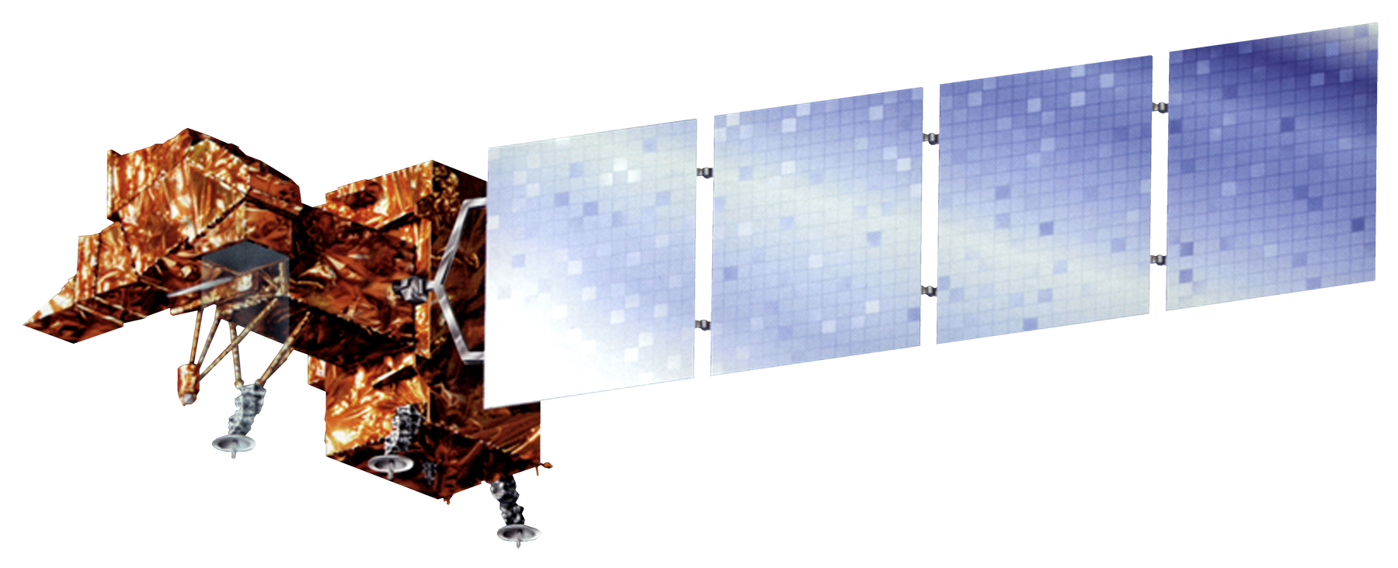
NASA SATELLITES/ SENSORS USED
Landsat missions – 38 years of continuous earth observations
Landsat 8 OLI
2013 – Present
Landsat 7 ETM+
1999 – Present
Landsat 5 TM
1984 - 2012
Image Credit: NASA
Notes:
Our analysis utilized the full range of Landsat data dating back to 1984. Between Landsat 8, 7, and 5, we were able to use 38 years of continuous earth observations at a 30 square meter resolution.
Image Credit: NASA
Landsat 8 OLI image URL: https://www.devpedia.developexchange.com/dp/images/c/c2/03_Landsat8.png
Landsat 7 ETM+ image URL: https://www.devpedia.developexchange.com/dp/images/3/39/02_Landsat7.png
Landsat 5 TM: https://www.devpedia.developexchange.com/dp/images/6/69/01_Landsat5.png

Slide 8
METHODOLOGY
Perennial Agriculture Age and Carbon Estimation Tool (PAACET)
Access Landsat 5,7,8 images
Calculate greenness (NDVI)
Calculate max NDVI per year
Access crop data
(USDA CDL)
Annual max NDVI for California Orchards
Identify orchards
Notes:
In order to address our project objectives, our team developed a software tool using google earth engine, an open source, cloud computing platform. We developed a program called: Perennial Agriculture Age and Carbon Estimation Tool or (PAACET). This tool is designed to access up to date data, perform analysis, and estimate the age and carbon stock for orchards.
First, the tool access the most up to date and historical satellite imagery from Landsat. Cloud masking is applied to remove cloudy images and low quality pixels
Then, NDVI is calculated for all images in order to assess plant health and greenness
The maximum NDVI is reported for each year.
Next, the script accessed CDL from USDA CropScape and California orchards are identified.
Finally, the annual max NDVI is calculated for all California orchards.
Image information:
Satellite, Plant, Watering Plant, Farm, Apple, and Field icon: Office 365 (2022)

Slide 9
METHODOLOGY
Perennial Agriculture Age and Carbon Estimation Tool (PAACET)
Time series stack
Landsat 5,7 & 8
Mean $μ$
(of max NDVI values over 37 years of study period)
1985
Z score
$$z_{i}=\frac{x_{i}− μ}{σ}$$
Planting Year
Z score < -2
Orchard Age
(Current year – planting year)
2021
STD $σ$
(of max NDVI values over 37 years of study period)
Max NDVI $x_{i}$
(by orchard type)
Notes:
PAACET estimates the planting year and orchard age using a z score change detection approach based on the temporal analysis of the annual maximum NDVI composites. It detects low NDVI values as large deviations from yearly mean NDVI values, corresponding to the occurrence of a planting event. PAACET subtracts the planting year from the current year to estimate cropland age. The tool incorporates the age estimates with CARB’s species-specific allometric equations to estimate spatially explicit cropland carbon storage.

Slide 10
RESULTS
Orchard Age
Orchard Age (years)
38
1
Sources: Esri, DigitalGlobe, GeoEye, i-cubed, USDA FSA, USGS, AEX, Getmapping, Aerogrid, IGN, IGP, swisstopo, and the GIS User Community
Notes:
Alex
Here you can see our tool's output of orchard ages near Modesto California. The darker shades of blue represent older orchards. Our tool is able to estimate orchard ages up to 38 years old, due to the limited time span of the Landsat missions.
Esri World Imagery basemap:
Sources: Esri, DigitalGlobe, GeoEye, i-cubed, USDA FSA, USGS, AEX, Getmapping, Aerogrid, IGN, IGP, swisstopo, and the GIS User Community

Slide 11
RESULTS
Distribution of Orchard Age
5,000,000
Pixels
0
5
10
15
20
25
30
35
Age (years)
Notes:
This plot shows the distribution of orchard ages. There is a wide range of ages across California's orchards. There are more orchards that were planted more recently and are younger in age than older orchards.

Slide 12
RESULTS
Mean Age by Crop Type
18.5
Age (Years)
17.0
15.0
Almond
Walnut
Pistachio
Orange
Grape
Notes:
This plot shows the mean age by crop type across a large region of the Central Valley in California in 2021. Walnut orchards and vineyards are older on average, while almond and pistachio orchards are younger.

Slide 13
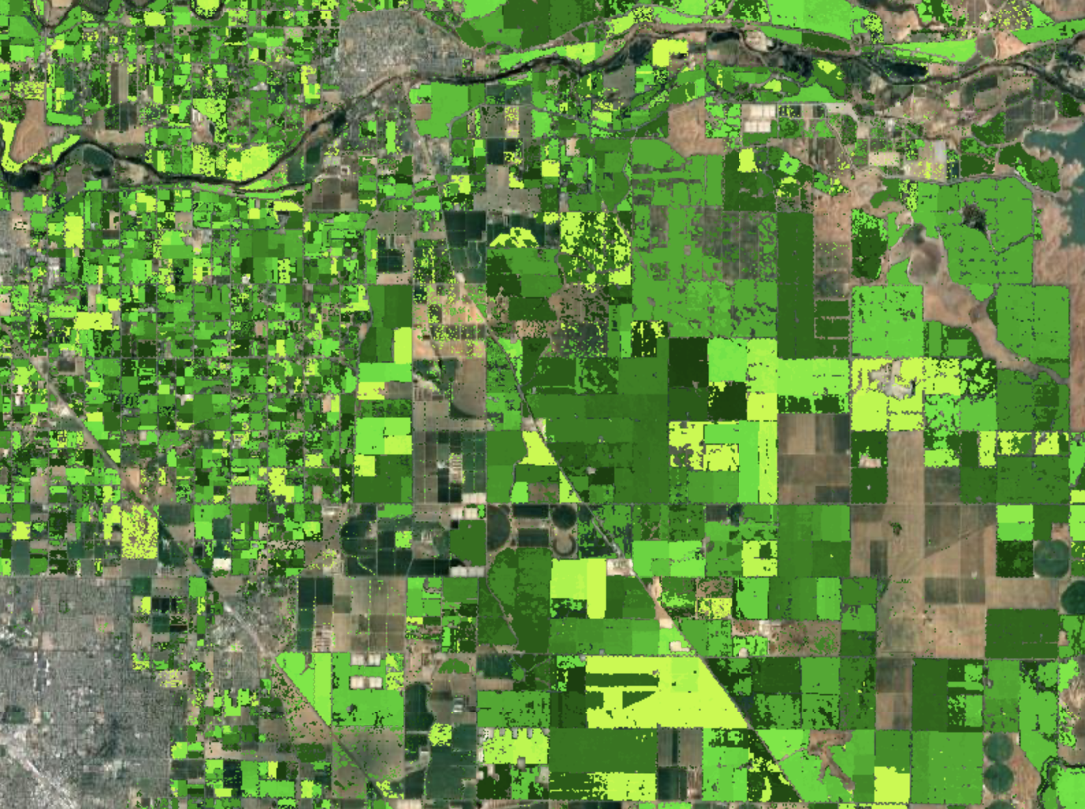
RESULTS
Carbon Stock
Carbon Stock (Kg/m²)
High
Low
Sources: Esri, DigitalGlobe, GeoEye, i-cubed, USDA FSA, USGS, AEX, Getmapping, Aerogrid, IGN, IGP, swisstopo, and the GIS User Community
Notes:
This map shows carbon stock across all orchards types near Modesto, California. The darker green represents orchards with higher carbon stock.
Esri World Imagery basemap:
Sources: Esri, DigitalGlobe, GeoEye, i-cubed, USDA FSA, USGS, AEX, Getmapping, Aerogrid, IGN, IGP, swisstopo, and the GIS User Community

Slide 14
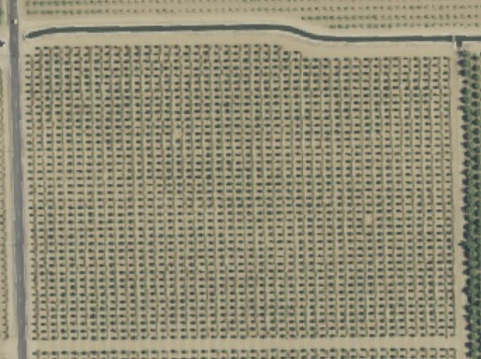
ASSESSING AGE ACCURACY
2003 2013 2016 = planting year
Map data credit: USDA, NAIP
Notes:
To test for accuracy, we performed ocular sampling of the CDL data in order to get better visual interpretation of when the true planting year of each orchard was. For each crop type, we randomly selected individual farm plots and browsed through NAIP imagery until the planting year was identified
Image information:
Map data credit: USDA NAIP

Slide 15
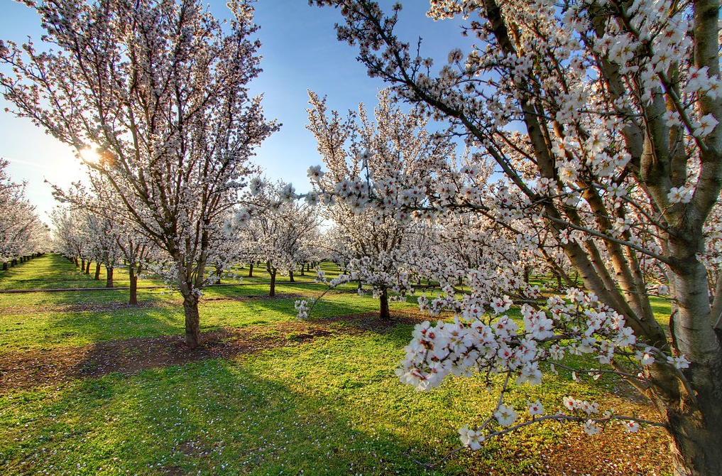
ERRORS AND UNCERTAINTIES
Accuracy is largely dependent on CDL data
GEE Tool can't estimate tree ages older than 38 years
Barren soil may be present before orchards were planted
Image Credit: Nicholas D.
Notes:
The accuracy of PAACET is largely dependent on the crop classification accuracy of the USDA-NASS CDL data layer.
There were many orchard pixels that PAACET was not able to estimate the age and carbon stock for. This could be due to the limitation of Landsat data availability, which starts in 1984. As a result, the tool can not estimate the age of orchards and vineyards older than 38 years.
Additionally, barren soil may be present before orchards were planted, resulting in false age estimation.
Image Credit: Nicholas D. CC BY-NC 2.0
https://www.flickr.com/photos/22391804@N06/6953566289

Slide 16
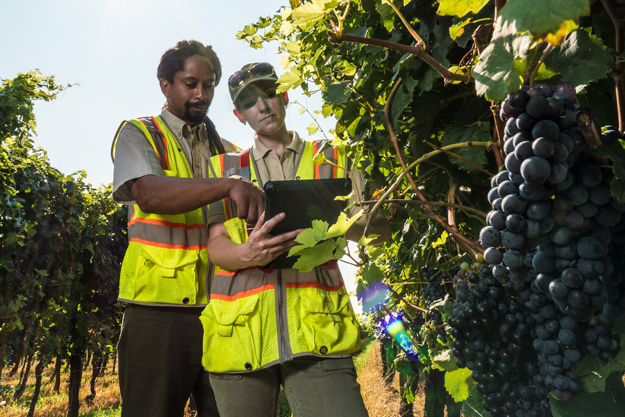
CONCLUSIONS
PAACET estimates and maps the differences in carbon stock across ages and crop types.
PAACET can detect the planting years for most orchards and vineyards. However, there are still many pixels with undetected planting years.
This tool will enhance the accuracy of CARB’s natural and working lands carbon inventory estimates by using annually updated data.
Image Credit: USDA
Notes:
To conclude, our Google Earth Engine tool estimates and maps age and biomass of perennial agriculture in California on an annual basis, allowing our partners to utilize an improved workflow that reduces user inputs and increases temporal resolution when estimating agricultural carbon stock.
Our tool maps the differences in carbon stock across ages and orchard types.
This tool can detect the planting years for most orchards and vineyards. However, there are still many pixels with undetected planting years.
By incorporating annually updated data, this tool will enhance the accuracy of CARB’s natural and working lands carbon inventory estimates and improve CARB’s ability to monitor progress towards California’s 2045 carbon neutrality goal.
Image credit: USDA, Public domain
https://www.flickr.com/photos/41284017@N08/42708587330

Slide 17
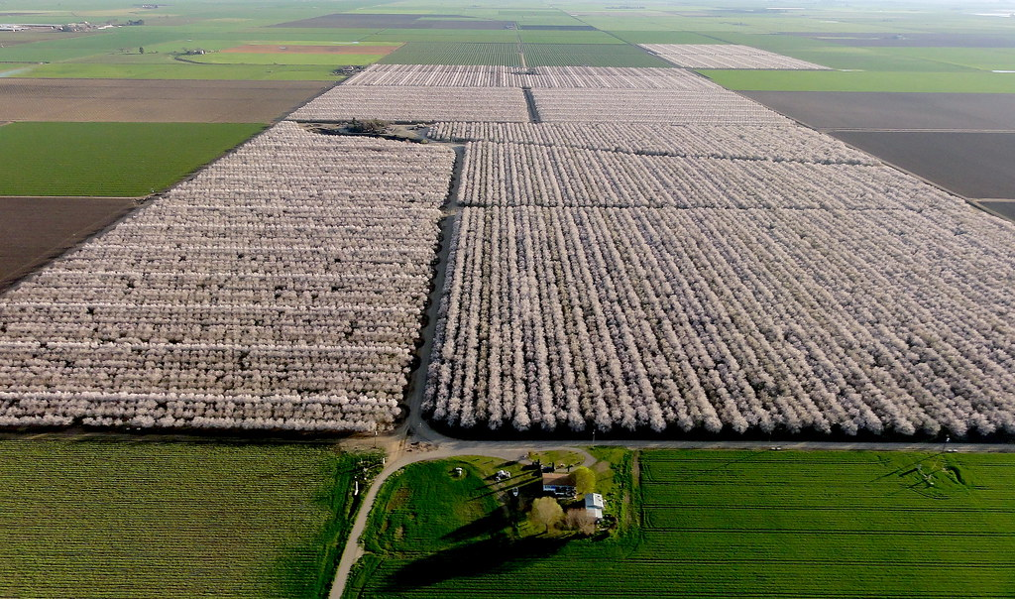
FUTURE WORK
Methods may be applied to other land cover varieties within California and to other states
Tool can also be applied to CARB's soil organic carbon and fertilizer inventories
Lidar data may improve carbon estimates
Updated orchard block data may be incorporated when available
Image credit: Bruce Barnett
Notes:
The methods developed during the term will serve as the basis for future efforts evaluating carbon stocks in other land cover varieties within California and may be applied to other states or regions.
Although the primary focus of this project was to improve CARB’s natural and working lands carbon inventory estimates, future collaborations between DEVELOP and CARB may focus on improving soil organic carbon and fertilizer inventories using our annually updated GEE orchard mapping tool.
Future work may also incorporate light detection and ranging (Lidar) data and updated parcel data for improved accuracy in carbon stock estimation.
Image credit: Bruce Barnett/Flickr, CC BY-NC 2.0
https://www.flickr.com/photos/143925215@N04/44536055045

Slide 18
Project Partners
California Air Resources Board
Science Advisors
Dr. Juan Torres-Pérez (DEVELOP Science Advisor, NASA ARC)
Dr. Kenton Ross (DEVELOP Lead Science Advisor, NASA LaRC)
Additional thanks to:
Britnay Beaudry (DEVELOP ARC Fellow)
Hayley Pippin (DEVELOP ARC Senior Fellow)
Dr. Lee Johnson (Senior Research Scientist, NASA ARC)
Dr. Forrest Melton (Senior Research Scientist, NASA ARC)
Notes:
The California Agriculture team would like to thank all of our partners, advisors, and mentors who made this project possible.
Maps throughout this work were created using ArcGIS® software by Esri. ArcGIS® and ArcMap™ are the intellectual property of Esri and are used herein under license.

