Slide 1
NASA DEVELOP National Program
DEVELOP Resources
What’s Available?

Slide 2
DEVELOPedia
DEVELOPedia is an internal wiki intended to serve three purposes:
Enhance project workflow
Capture lessons learned and make them available to future project teams
Record data required for operational metrics
DEVELOPedia is a collaborative effort whose utility is directly related to the efforts of previous DEVELOP participants.
DEVELOPedia is a living document, constantly adapting to meet the needs of the NASA DEVELOP National Program and the people that make the program great. (That’s you!)
http://www.devpedia.developexchange.com
POC – Jordan Vaa

Slide 3
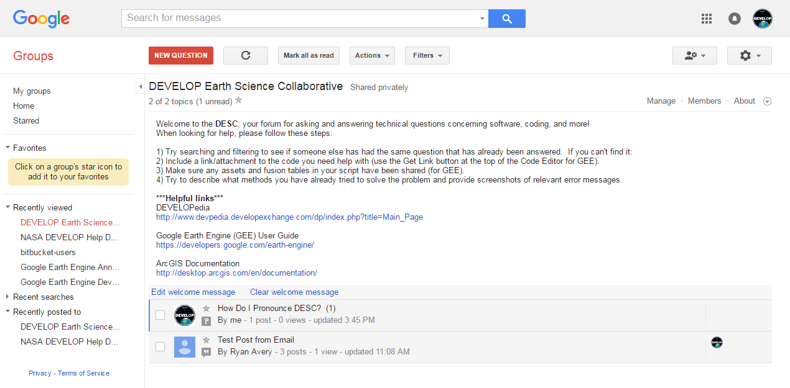
The DEVELOP Earth Science Collaborative
A forum for software, geospatial, and coding questions
Can email forum directly like a regular email address
Moderated by the Geoinformatics Team
Copy link, go join, and bookmark the DESC on your favorite browser!
https://groups.google.com/d/forum/developesc

Slide 4
Resources
DEVELOP Handbook: Given to each participant at start of term, also on DEVELOPedia
DEVELOPedia: http://www.devpedia.developexchange.com/
You should have received information about your account just before the beginning of the term.
DEVELOP Website: http://develop.larc.nasa.gov/
Need Help?
Geoinformatics Team: DEVELOP.Geoinformatics@gmail.com
Project Coordination Team: DEVELOP.ProjectCoordination@gmail.com
Communications Team: DEVELOP.Communications@gmail.com
Graphic Design Team: DEVELOP.GraphicDesign@gmail.com
Impact Analysis Team: DEVELOP.ImpactAnalysis@gmail.com
NPO-level questions - refer to the questions page in the About DEVELOP section and email the appropriate contact, unsure who? Ask your Center Lead.

Slide 5
National POCs
DEVELOP
NPO
Mike Ruiz
Karen Allsbrook
Lauren Childs-Gleason
Dr. Kenton Ross
Jennifer Tindell
Senior Fellows
Georgina Crepps
Tiffani Miller
Carrie Kelley
Jordan Vaa
DEVELOP
Fellows
Ryan Avery (LaRC)
Sean Cameron (UGA)
Sarah Carroll (FC)
Amanda Clayton (LaRC)
Dash Cruz (MSFC)
Elaina Gonsoroski (MCHD)
Erika Higa (JPL)
Sol Kim (JPL)
Kelly Meehan (NCEI)
Christie Stevens (WC)
Alison Thieme (GSFC)
Caitlin Toner (ID)
Jenna Williams (ARC)
DEVELOP Node Leadership
Langley
Emily Gotschalk (CL)
Amanda Clayton (ACL)
Ryan Avery (ACL)
Marshall
Maggi Klug (CL)
Dash Cruz (ACL)
Mobile
Tyler Lynn (CL)
Elaina Gonsoroski (ACL)
NOAA NCEI
Alec Courtright (CL)
Kelly Meehan (ACL)
UGA
Caren Remillard (CL)
Sean Cameron (ACL)
Wise County
Michael Brooke (CL)
Christine Stevens (ACL)
Goddard
Sean McCartney (CL)
Alison Thieme (ACL)
Idaho
Courtney Ohr (CL)
Caitlin Toner (ACL)
JPL
Nick Rousseau (CL)
Erika Higa (ACL)
Ames
Jenna Williams (CL)
Arizona
Lance Watkins (CL)
Fort Collins
Brian Woodward (CL)
Sarah Carroll (ACL)

Slide 6
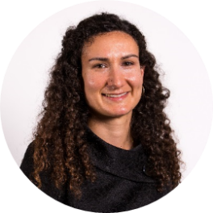
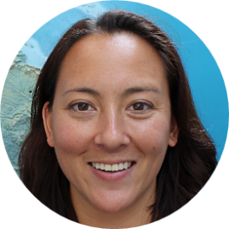
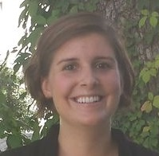
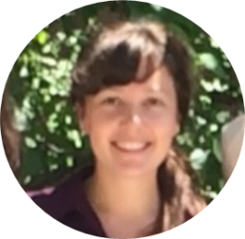
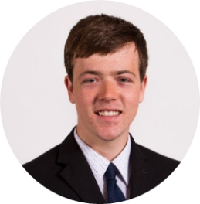
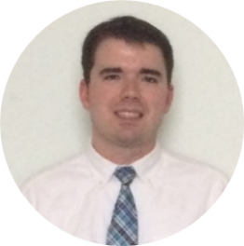
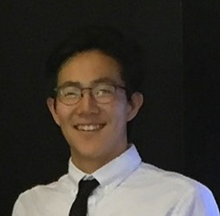
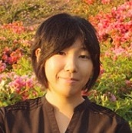
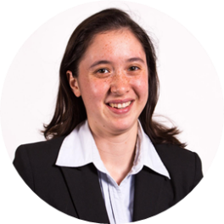
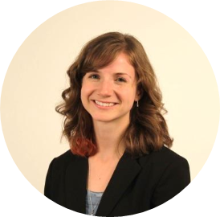
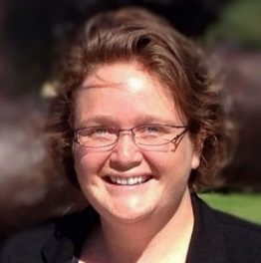
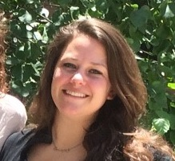
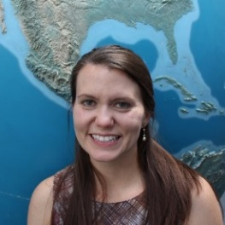
FY17 Fellows Class
What is a DEVELOP Fellow?
A recent college graduate who spends one year with DEVELOP growing both personally and professionally, and contributing to the program as a whole. Each Fellow serves in a dual-role, splitting their time between their node and NPO-related tasks.
Kelly Meehan
Geo (NCEI)
Allison Thieme
Geo (GSFC)
Elaina Gonsoroski
IA (MCHD)
Dash Cruz
IA (MSFC)
Sarah Carroll
IA (FC)
Ryan Avery
PC/Geo (LaRC)
Sean Cameron
PC (UGA)
Sol Kim
Geo/Mission Apps (JPL)
Erika Higa
Geo (JPL)
Caitlin Tonner Comm (ID)
Christie Stevens
Comm (WC)
Jenna Williams
Comm (ARC)
Aubrey Hilte
PC (WC)
Amanda Clayton PC (LaRC)

Slide 7
Question? Contact…
Karen: contracts, payroll, status reports/invoices, schedule adjustments, online app system, travel, SSAI
Lauren: projects, deadlines, conferences, telecons, Fellow class, CL position competition, publications, international activities, state/local government activities, partner engagement, project hand-offs, media interactions, Wise County
Georgina: Impact Analysis Team-related items, tracking metrics, indicators, socioeconomic impact analysis, PSI, participant surveys, alumni survey
Carrie: Communications Team-related items, graphic design support, social media, newsletter, VPS, video help, recruiting, military engagement, recruiting, outreach activities, Ambassador Corps, print materials
Tiffani: Project Coordination Team-related items, publications, deliverables, using the national telecon line
Jordan: IT Team-related items, DEVELOPedia, DEVELOP website, DEVELOP Exchange, software, hardware, software release authority
Topics Not Listed Here: ANYONE! We love answering questions and will direct you to the right person if we can’t answer ☺

Slide 8
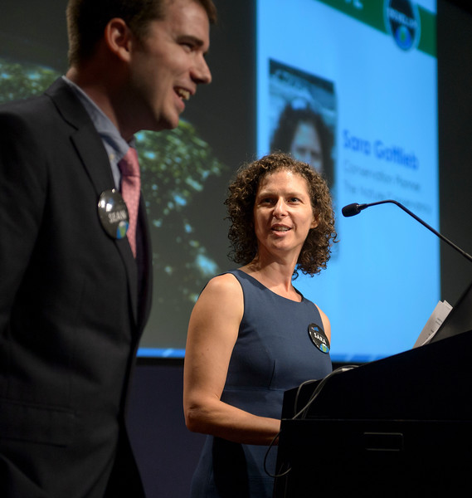
Thank You!
Ask lots of Questions!

