Slide 1
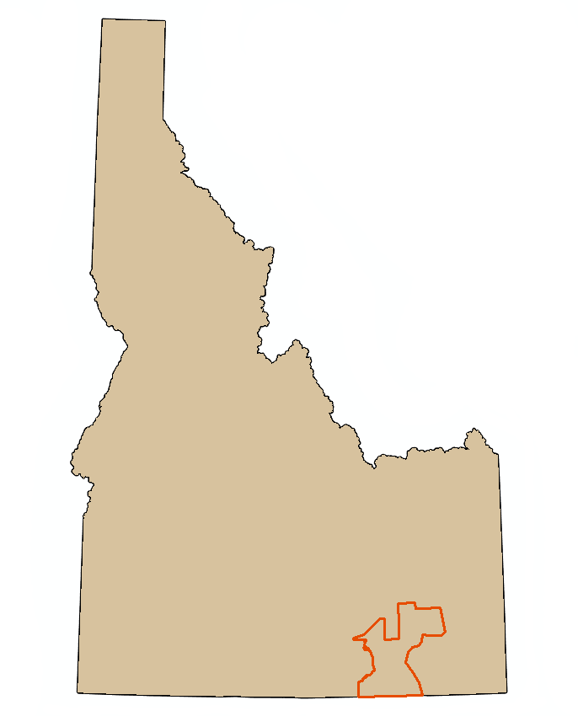
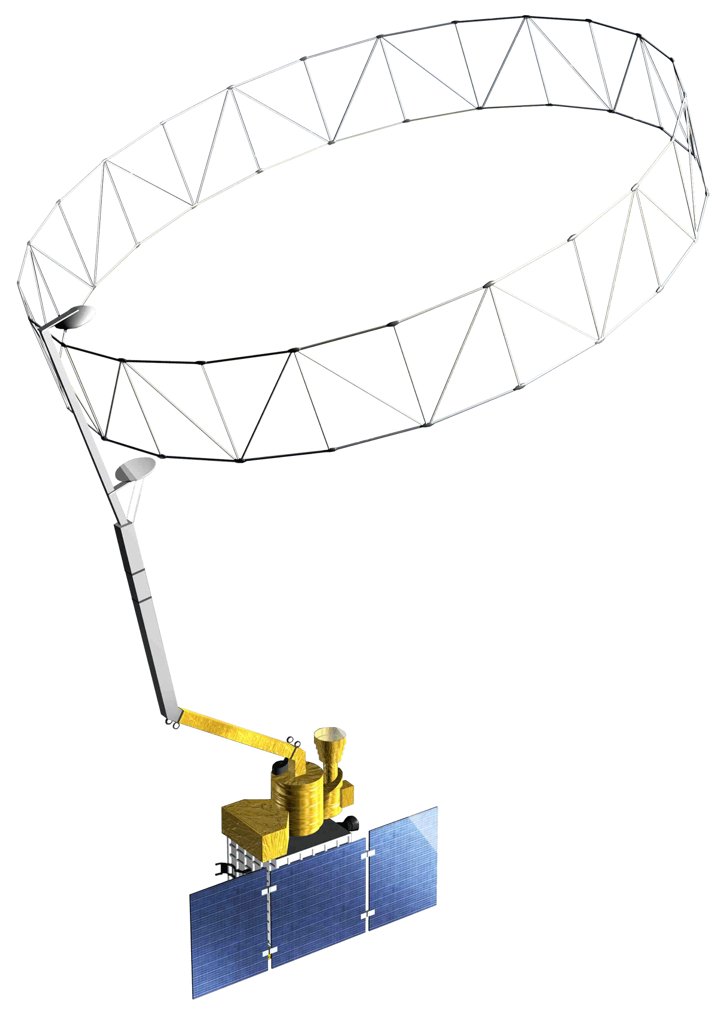
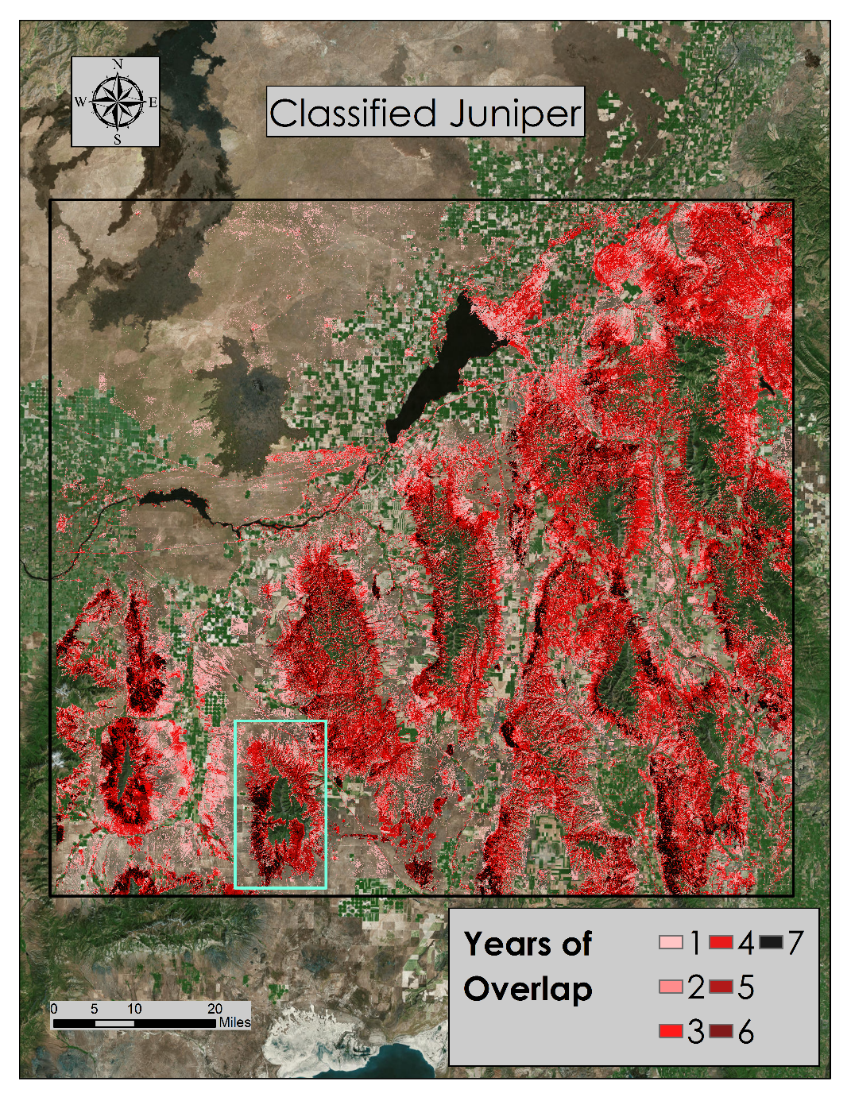
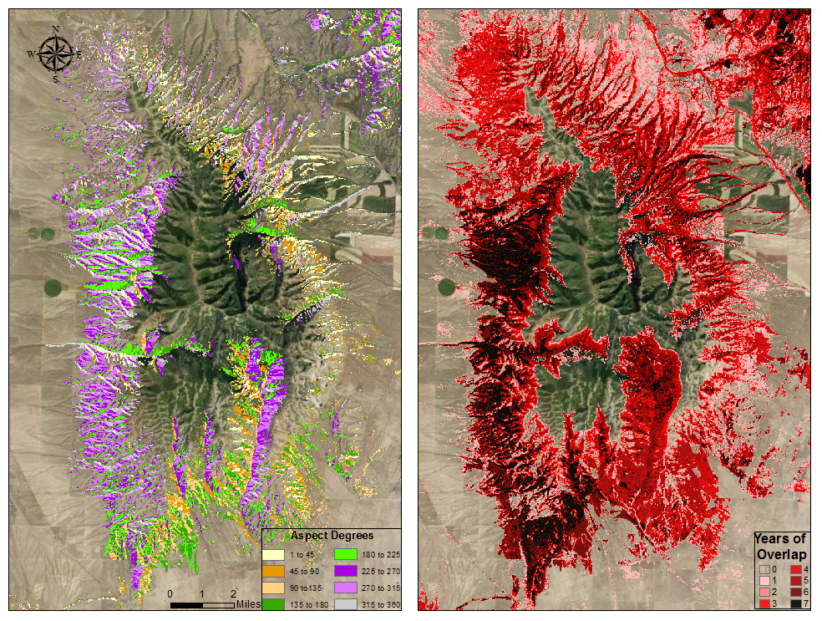
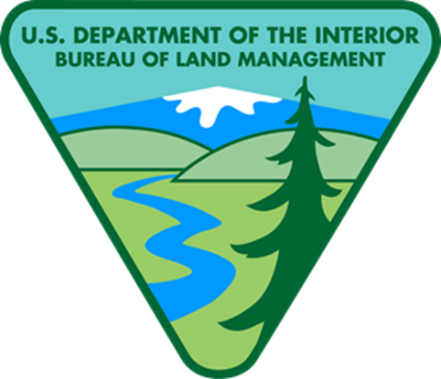
Southeast Idaho Disasters ll
Using NASA Earth observations to characterize juniper invasion and assess changes in soil moisture within cheatgrass dominated sites relative to wildfire susceptibility in southeast Idaho.
Jenna Williams(Project Lead), Cody O’Dale, Kshitiz Shrestha, Ryan Howerton
DEVELOP National Program at BLM at Idaho State University GIS TReC
Abstract
Objectives
The expansion of juniper from their original rocky terrain into herbaceous communities alter fire regimes and increase fire severity not only in Idaho but throughout the Great Basin and Intermountain West. As the range of juniper expands, they begin to co-dominate communities resulting in the die-off of shrubs, grasses, and forbs. Wildfires, coupled with the presence of invasive plant species like cheatgrass, are primary drivers of change in semi-arid savanna ecosystems. By comparing soil moisture changes in cheatgrass dominated sites with sagebrush dominated sites, this project will provide maps and graphs that will aid project partners in understanding why vegetation is departing from its native habitat and help with vegetation conservation efforts. This project looked at the historical changes in juniper distribution from 1985 to 2015. Imagery from Landsat 5 and 8 was gathered in 5 year increments in August or September was combined with different topographic and climatic data to characterize juniper expansion. The maps produced provide land managers with the most current information on juniper encroachment and support decision making regarding the management of junipers.
Characterize juniper encroachment by analyzing 30 meter Landsat imagery from 1985 to 2015.
Assess temporal changes in soil moisture in cheat grass dominated sites and compare that to sagebrush dominated sites over the 2015 growing season; April 1st through September 30th.
Study Area
Methodology
Southeast Idaho
Landsat WRS-2 Path 39 Row 30
Landsat WRS-2 Path 39 Row 31
Vegetation Based soil moisture
Daily Air Temperature &
Precipitation
SMAP: Passive Radiometer Data
Vegetation Based Soil Map
Earth Observations
GAP NW Land Cover Dataset
Zonal Statistics % cover per pixel
Seasonal Soil Moisture Comparison
Landsat 8
Juniper Encroachment Map
Juniper Encroachment 1985 to 2015
NAIP 2009, 2011, 2013, 2015
Historic Fire Data
Classification Points
CTA Classification
Classified Juniper Extraction
Landsat 5 Thematic Mapper (TM)
Soil Moisture Active Passive (SMAP)
Landsat 8 Operational Land Imager (OLI)
Results
Landsat 5
Conclusions
This project demonstrates the usefulness of Landsat missions to analyze changes on the environment over a long period of time. These data helped to characterize historical juniper movement and provides insight into where juniper may be moving to in the future.
These results will be advantageous for land managers in fire prevention planning and allocation of resources used for juniper reduction that will help to reduce wildfire severity and intensity by reducing heavy fuel loads.
Determining dominant land cover type in correlation with soil moisture data is advantageous in further understanding why wildfires occur where they do.
These results relate directly to improving understanding of wildfire susceptibility.
As wildfires continue to grow understanding of how remote sensing can be used to provide different types of information on a larger special scale is beneficial for our land managers in many different aspects of planning, fuels management, and land restoration.
The spike in June in the agricultural pixels may be a result of farmers starting to use irrigation on their crops.
The sharp drop in soil moisture from May to June in the semi-desert shrub and grassland pixels led to concerns within the fire community about heavy fuel loading especially in the finer fuels.
Although July brought lightning storms, these storms were accompanied by rain and as a result there were few fires in this study region in 2015.
Team Members
Although juniper can and does grow on all aspects, this species seems to prefer south western slopes.
This could be because there is less competition from larger species such as Douglas Firs that typically grow on northern facing slopes.
As a result juniper is a powerful player on the landscape because it is competing against smaller plants like sagebrush.
Jenna Williams, Ryan Howerton,
Cody O’Dale, Kshitiz Shretha
Project Partners
Acknowledgements
Bureau of Land Management
Idaho Fish and Game
Caribou-Targhee National Forest
NASA RECOVER
Keith Weber (ISU), Sara Ramos (DEVELOP), Zachary Simpson (DEVELOP), Mike Kuyper (BLM), Brian Holmes (BLM), Shelli Mavors (BLM), Karen Kraus (BLM), Scott Bergen (IDFG), Airk Jorgensen (FS), Chris Colt (FS), Jeff May (ISU), Kindra Serr (ISU)
Pocatello, Idaho

