Slide 1
African Great Lakes Weather
Utilizing NASA Earth observations to identify indicators
to help predict deadly storms over the African Great Lakes
William Wilson (Project Lead)
Annabel White
Grant Bloomer
Juan Antonio Chacón Castro

Slide 2
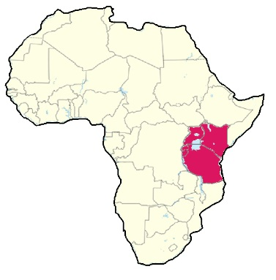
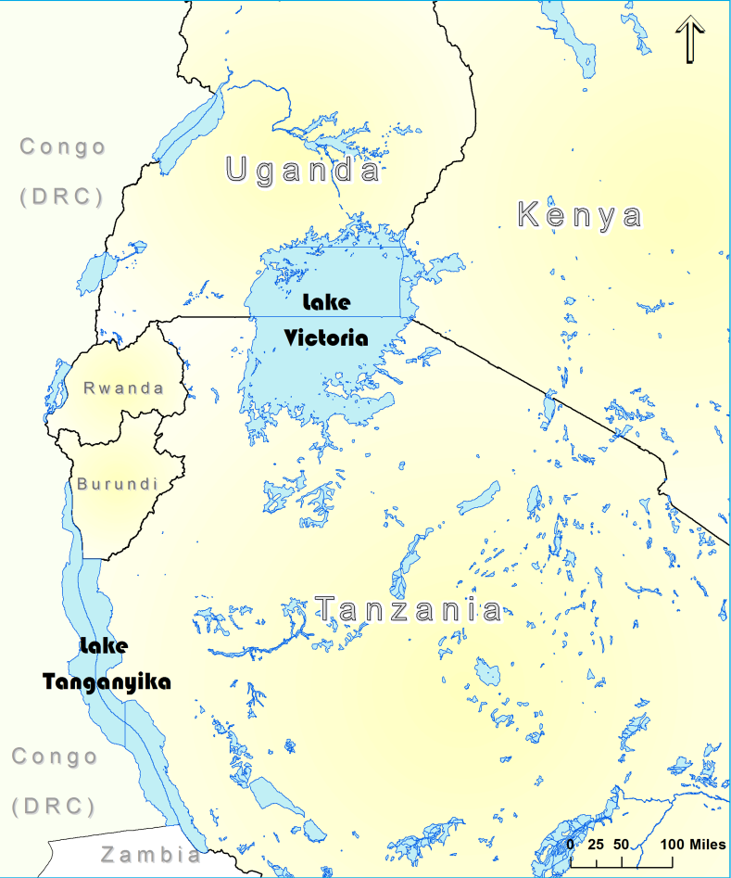
Lake Victoria & the East African Great Lakes (EAGL)
27% of the world’s freshwater
The 3 largest lakes in Africa – Lake Malawi, Lake Tanganyika, Lake Victoria
Geologic context of the area defined by East African Rift Valley.
Environmental issues - pollution, invasive species
Notes:
Lake Victoria – second largest freshwater lake in world in terms of surface area & Lake Tanganyika second largest in terms of water volume.
Lake Victoria jurisdiction split between Uganda, Tanzania, and Kenya. The larger Lake Victoria Basin includes areas of these three nations and Burundi and Rwanda covering an area of 194,000km2.
East African rift a result of divergent tectonics in which a new Somali Plate is separating from the African Plate.
Most lakes sit within the ‘troughs’ or ‘grabens’ of the rift system however Lake Victoria actually sits in a depression between the two arms of the rift system.
Little consideration for ecosystem of lake. Most cities dumping raw sewage into tributaries into Lake, although some groups such as Lake Victoria Basin Commission advocate for lake.

Slide 3
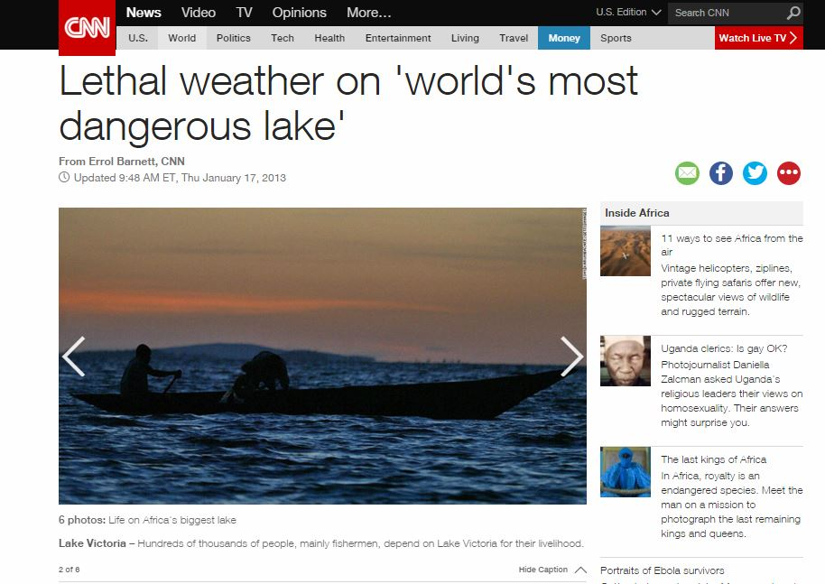
Community Livelihood & Concern
Over 30 million people live in Lake Victoria watershed alone
One of the highest population densities in the world
Close economic ties to the lake as a source of food and livelihood
2 million fishermen hauling in around 1 million tons of fish annually
Notes:
Construction of fishing boats poor and warning systems not comprehensive.
Weather is intense, storms arise suddenly… Are often not part of larger storm systems that can be forecasted.

Slide 4
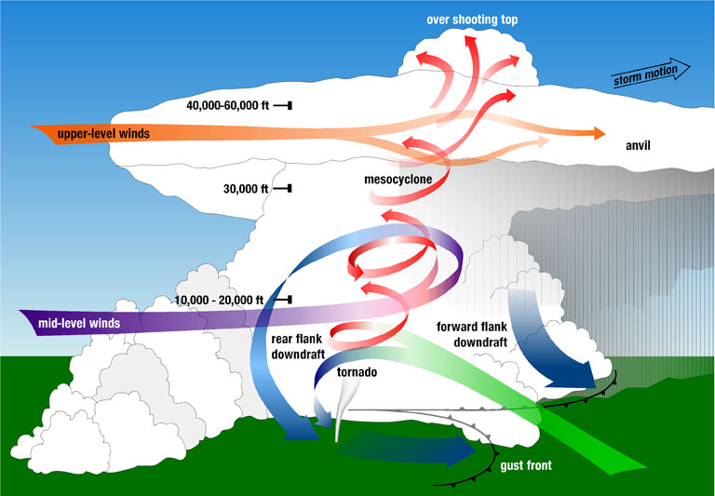
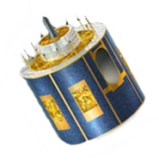
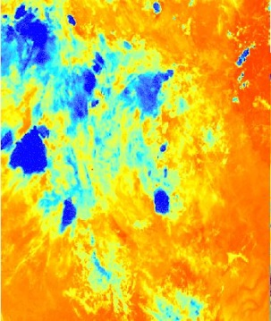
Background Info: Overshooting Tops & the HSED
Image Credit: Wikipedia Commons
EUMETSAT – SEVIRI
Infrared Images
OT’s
Hazardous Storm Event Database
Notes:
https://upload.wikimedia.org/wikipedia/commons/6/67/Tornadic_supercell.jpg
https://upload.wikimedia.org/wikipedia/commons/thumb/9/93/Cumulonimbus13_-_NOAA.jpg/1280px-Cumulonimbus13_-_NOAA.jpg

Slide 5
Image Credit: Wikipedia
Determining the study dates
Study Dates
50th
Hazardous Storm Event Database
Summarize
OT detections / day
Intensity
Percentiles
Study
Dates
99th
Notes:
These notes should be thorough enough for someone not familiar with the project to clearly present the material.
Image Source: http://commons.wikimedia.org/wiki/File:Claude_Monet_-_The_Magpie_-_Google_Art_Project.jpg

Slide 6
MERRA
Modern Era Retrospective-Analysis for Research and Applications
MERRA
MAT1NXSLV
Average Surface Pressure
Eastward Wind
Northward Wind
Temperature
Humidity
Vertical Pressure Velocity
Surface Skin Temperature
Notes:
MERRA Data Variable Names
PS - Time average surface pressure
U500 – Eastward wind at 500 mb
V500 – Northward wind at 500 mb
T500 – Tempurature at 500 mb
Q500 – Specific humidity at 500 mb
OMEGA500 - Vertical pressure velocity at 500 mb
TS – Surface skin tempurature

Slide 7
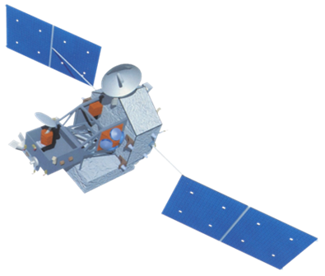
TRMM - LIS
Tropical Radar Measuring Mission – Lightning
Infrared Sensor
Collections of adjacent observed pulse events in the same 2ms timeframe (lightning strikes)
TRMM
Areas
Flashes
Groups
Events
L.
I.
S.

Slide 8
Statistical Analysis
TRMM

Slide 9
Statistical Analysis

Slide 10
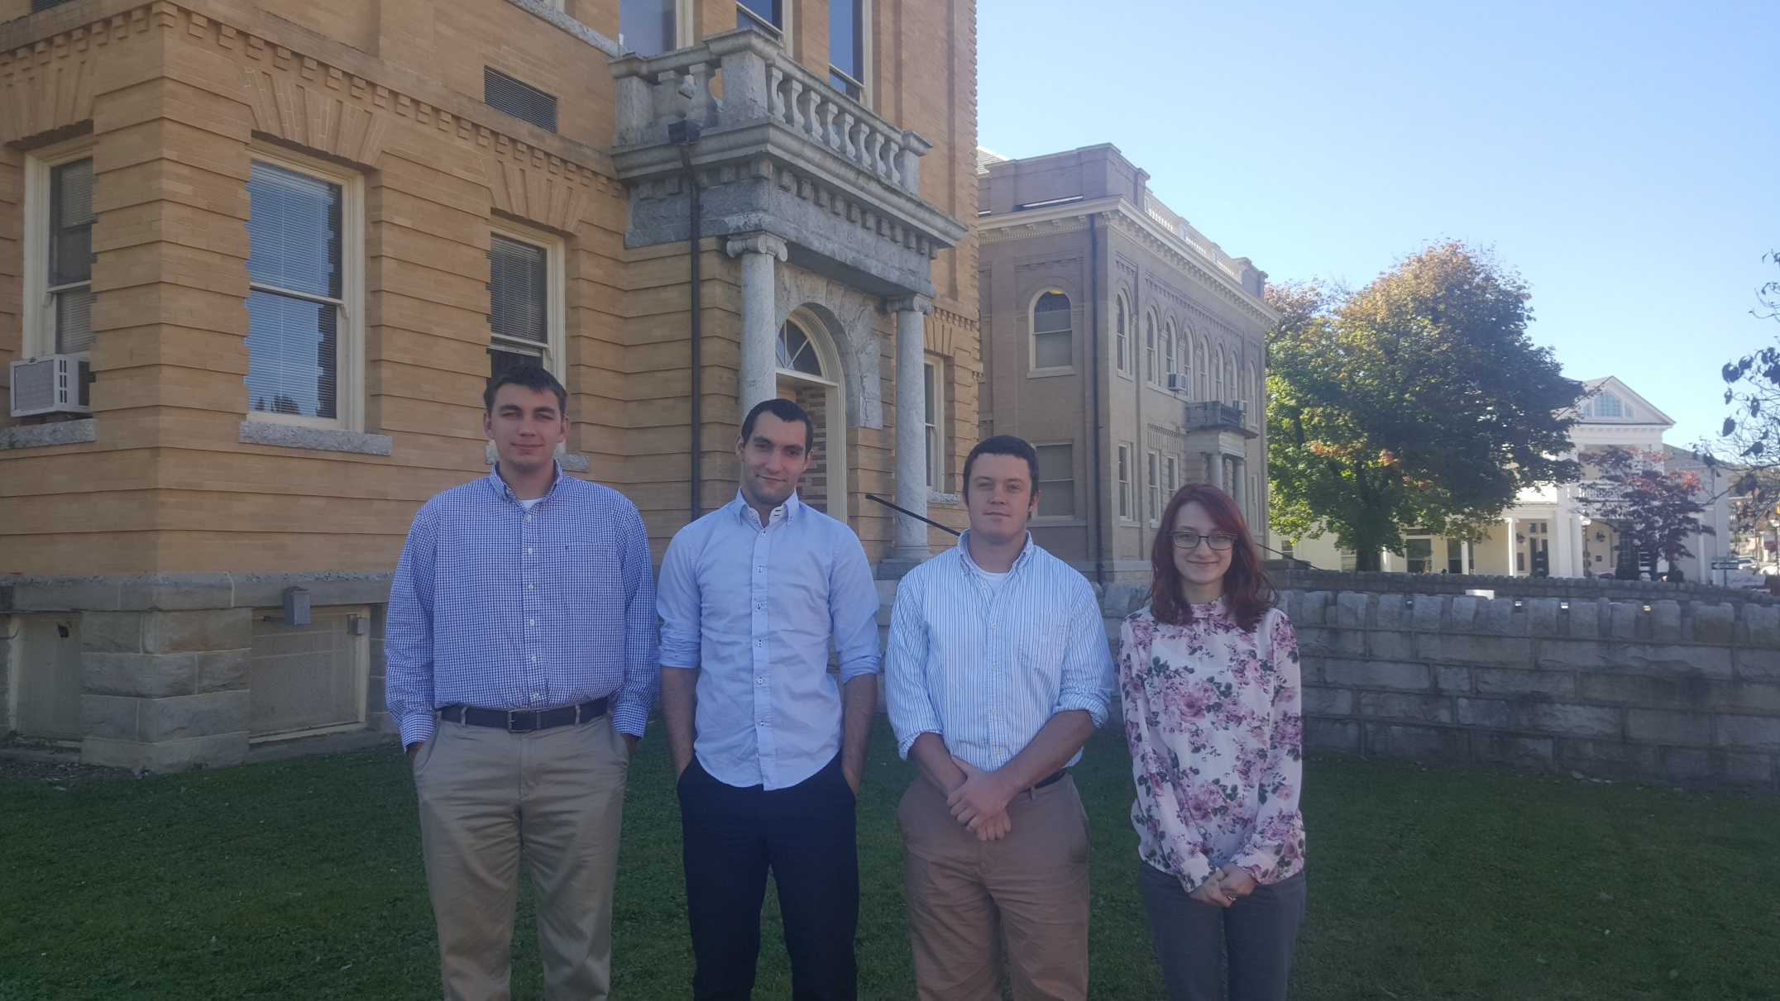
Project Team
From left to right: Grant Bloomer (Big Stone Gap, VA), Juan Antonio Chacón
Castro (Marbella, Spain), Will Wilson (Norton, VA), Annabel White (Clintwood, VA)

Slide 11
Advisors
Dr. Kenton Ross – NASA DEVELOP
Kristopher Bedka – NASA Climate Science Branch
Dr. DeWayne Cecil – Global Science and Technology, Inc.
Professor Robert Vangundy – University of Virginia’s College at Wise
Partners
Kenya Meteorological Department
Others
Ms. Melanie Salyer - Mentor
Notes:
Do we need a bibliography page for facts from the introduction…similar to bibliography cited in techpaper

