Slide 1
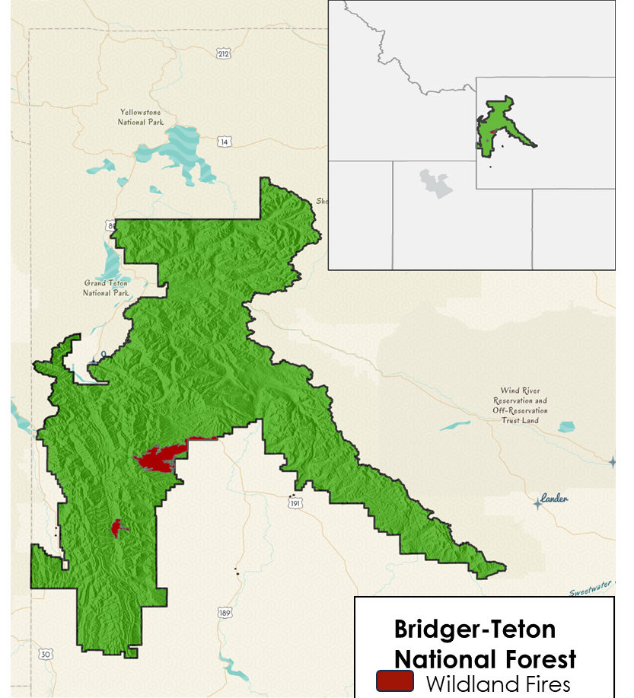
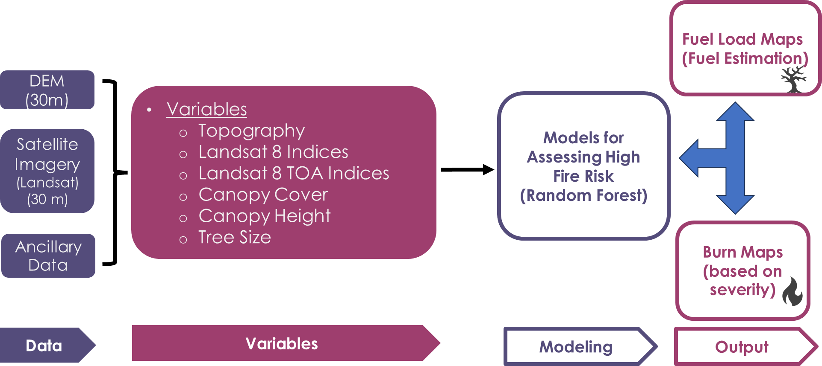
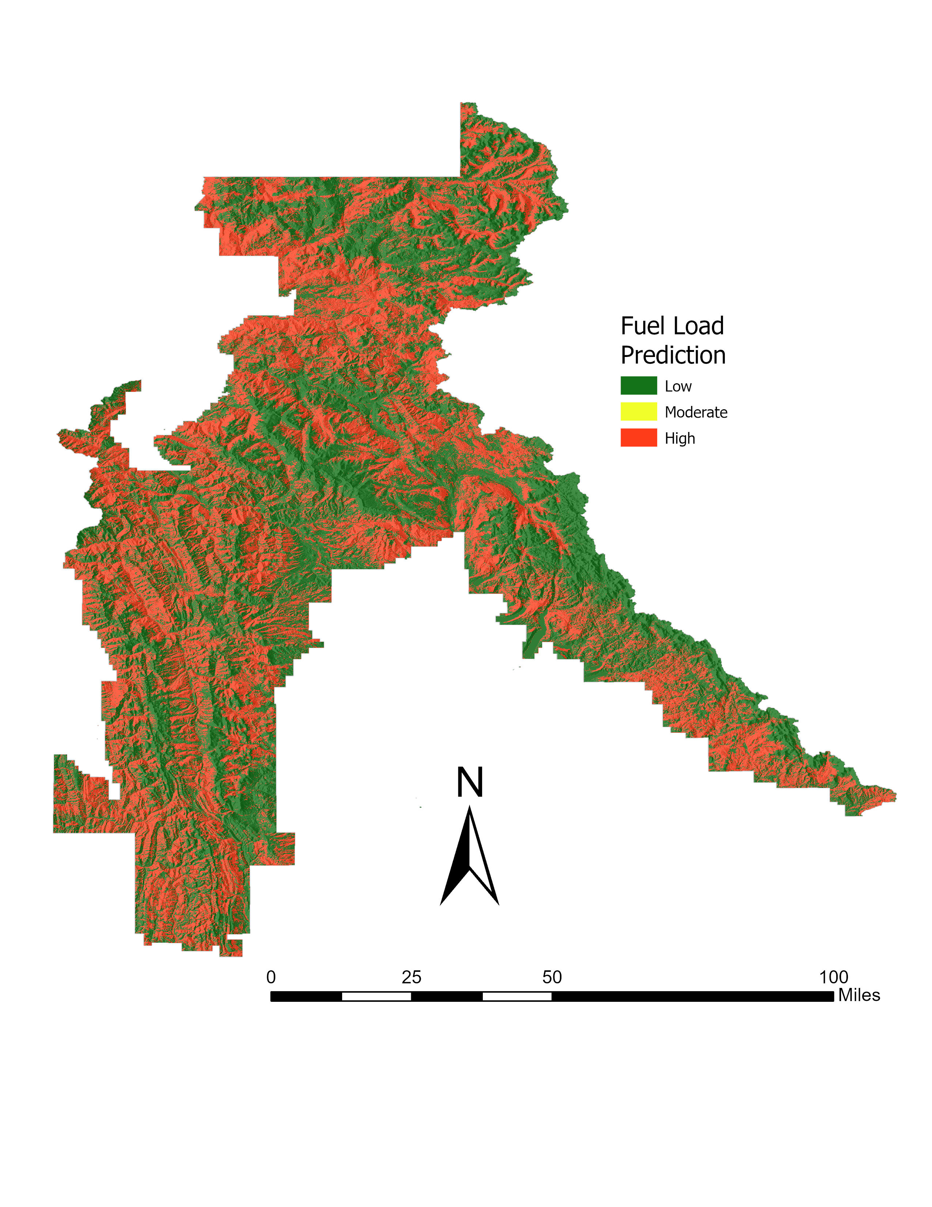
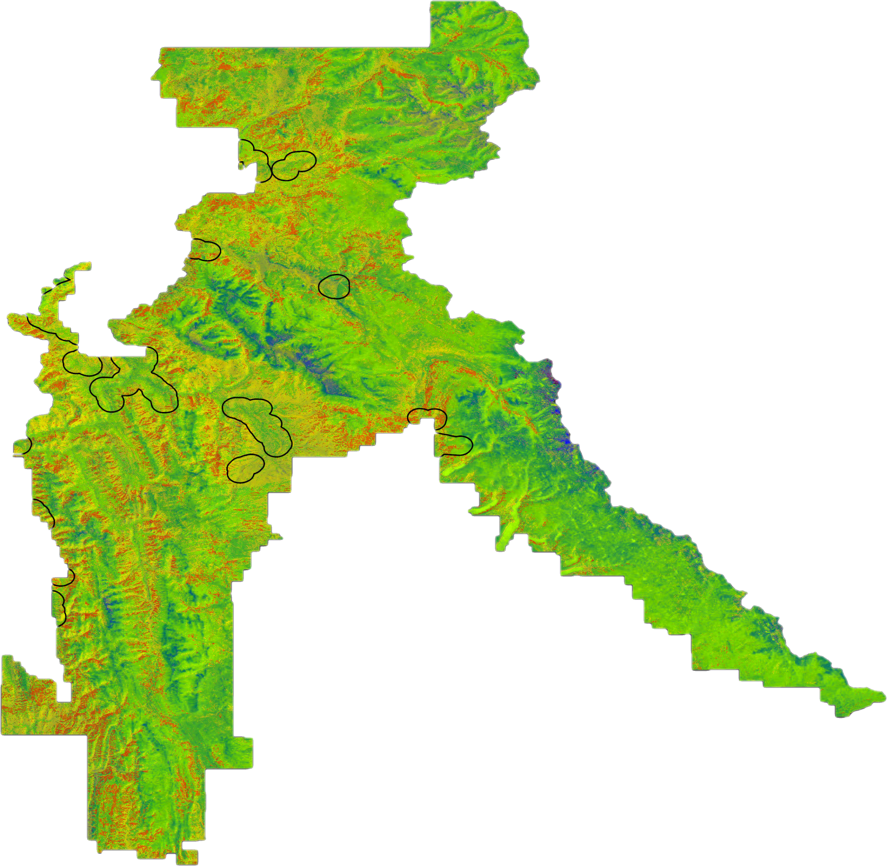
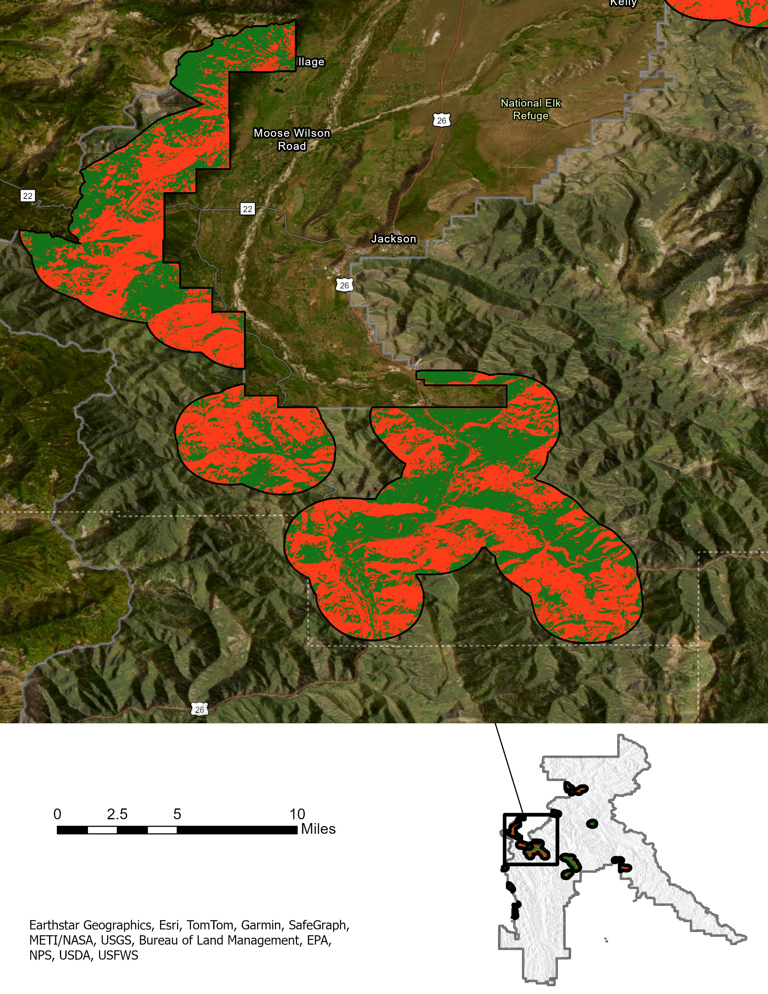
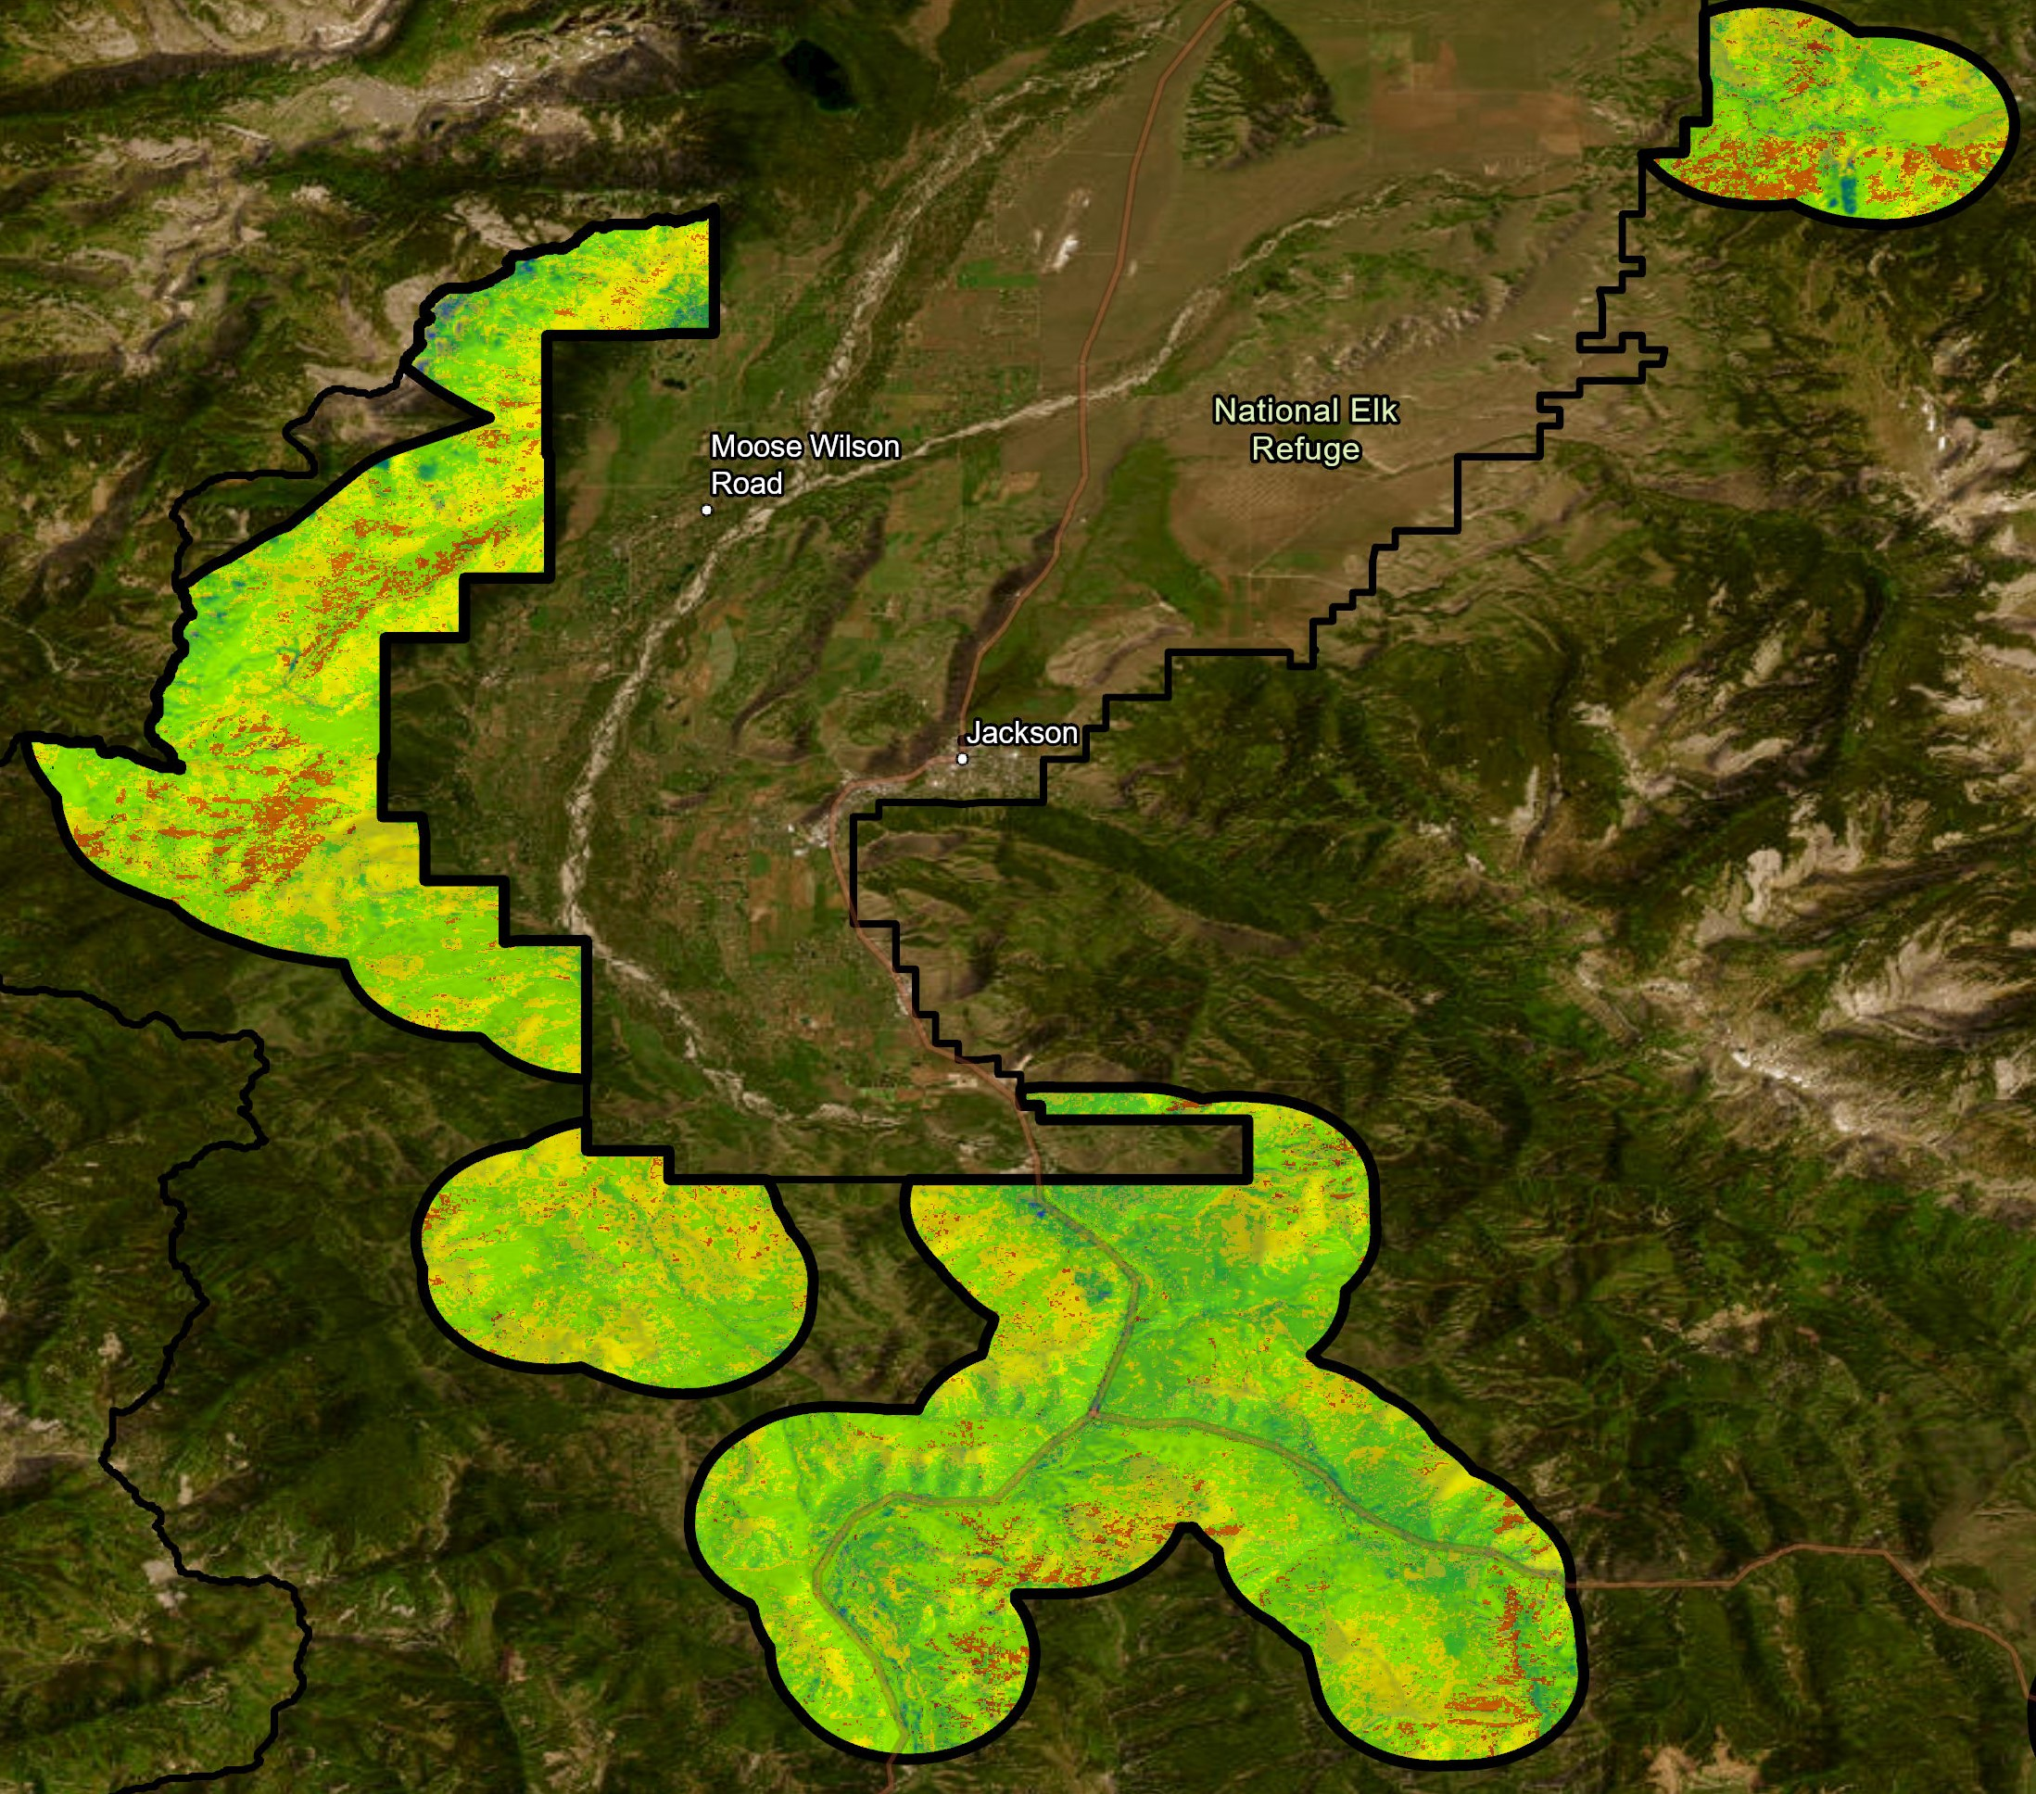
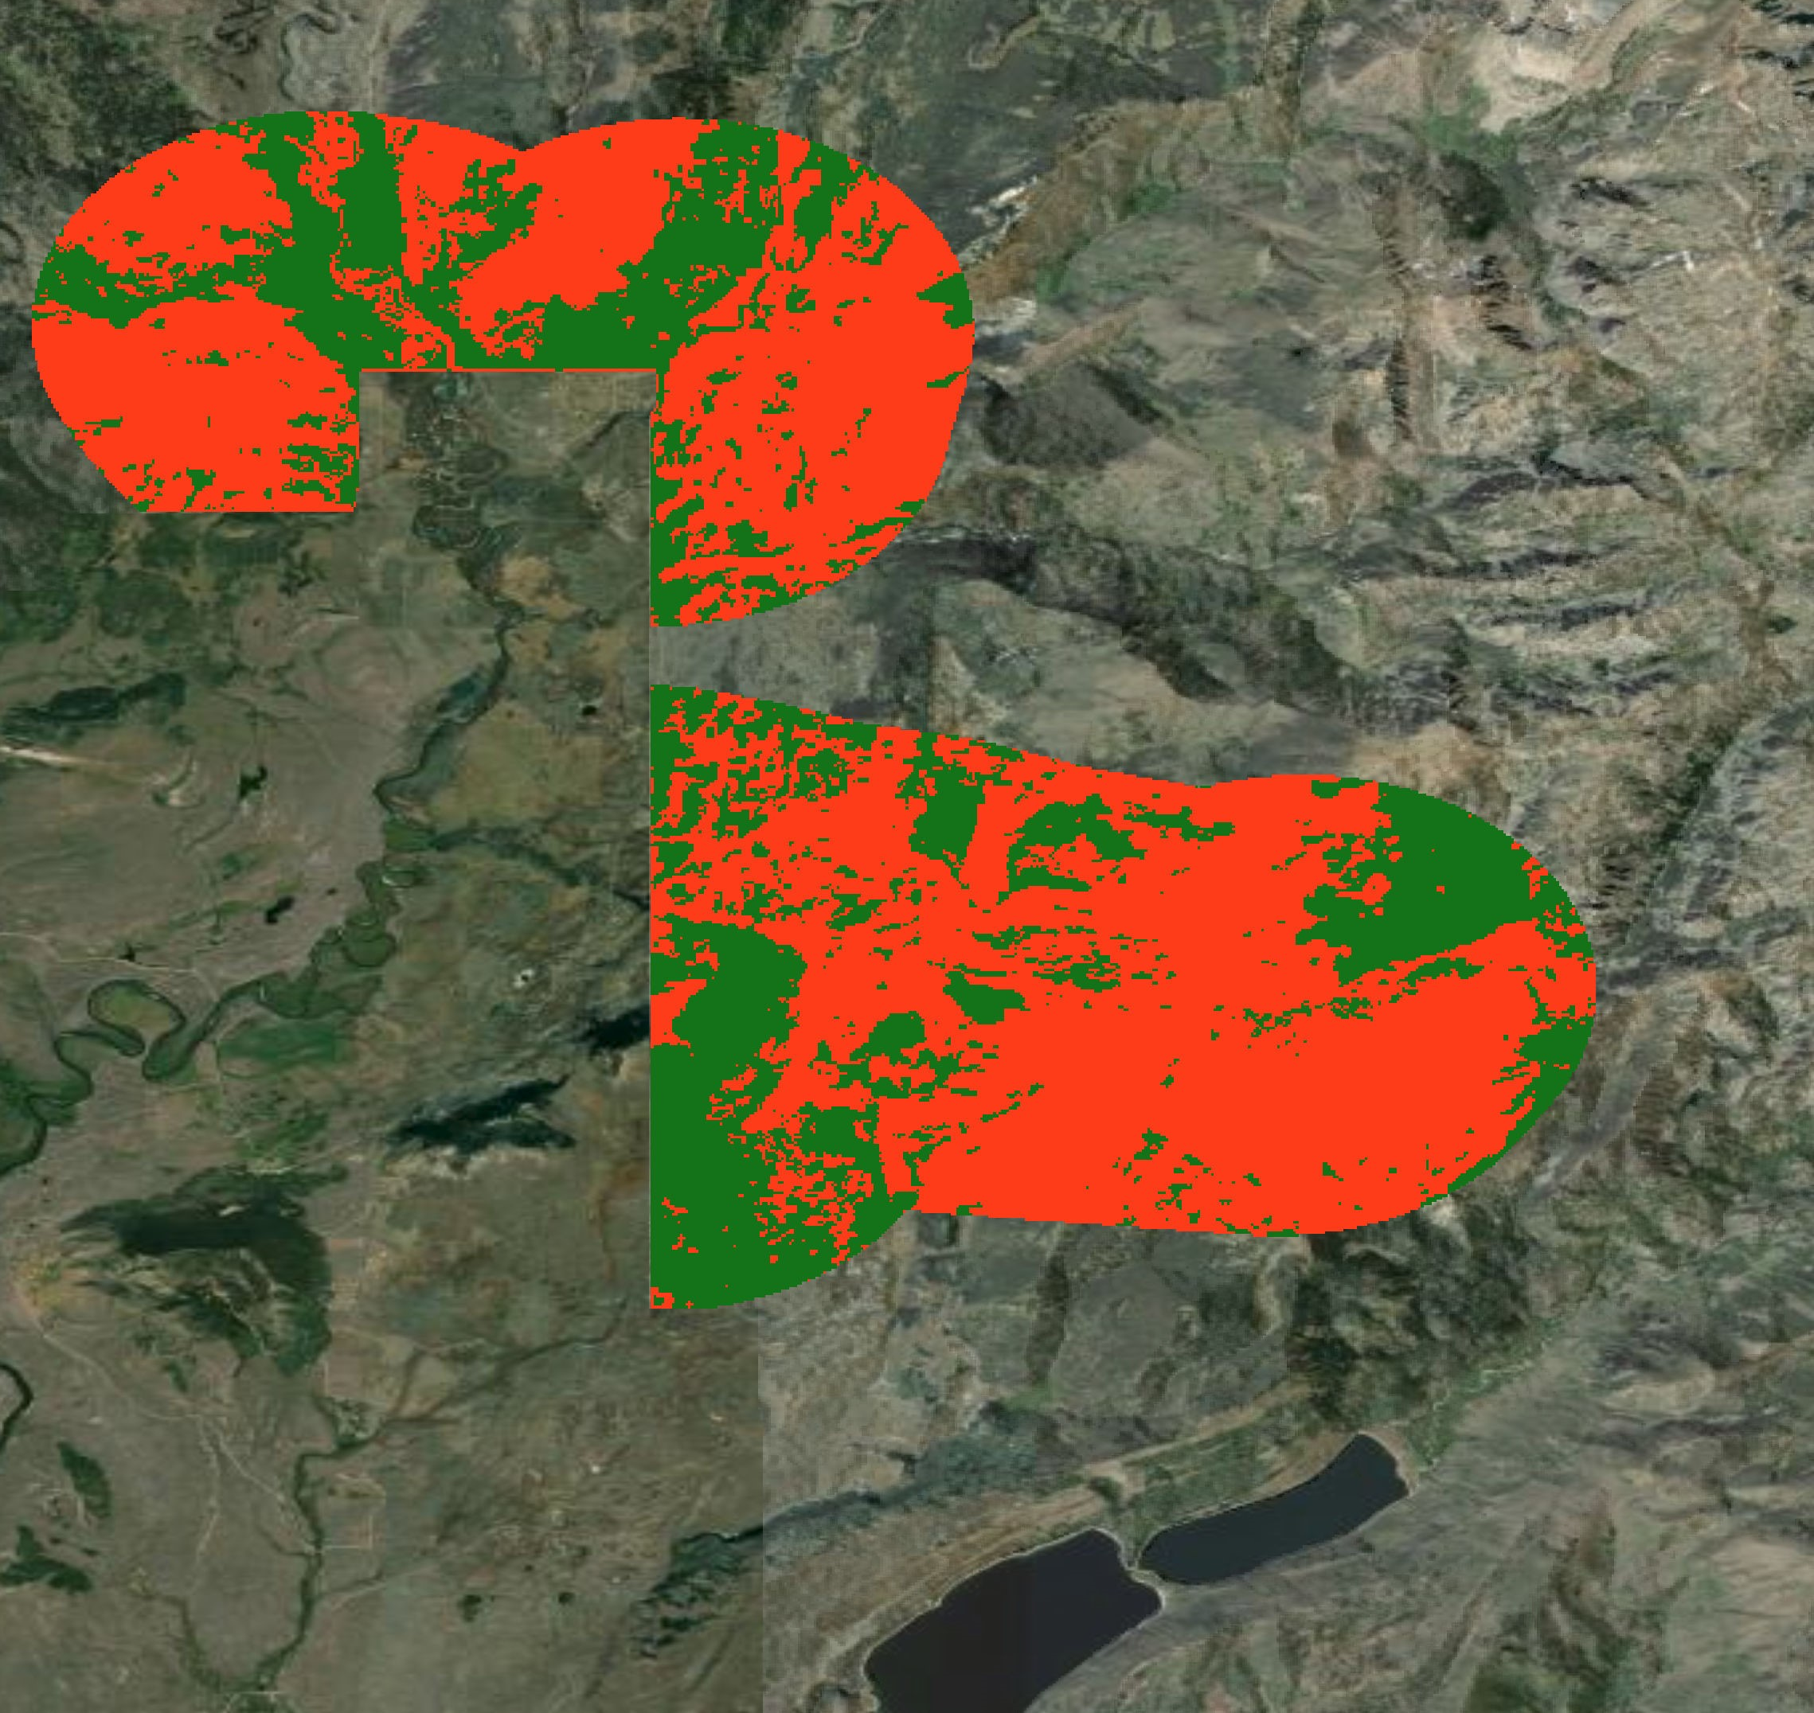
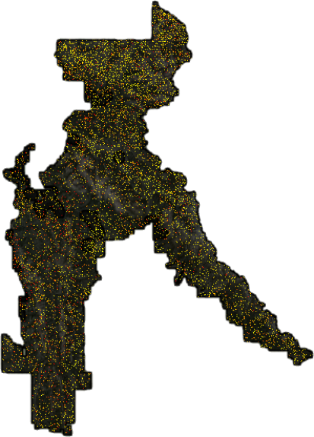
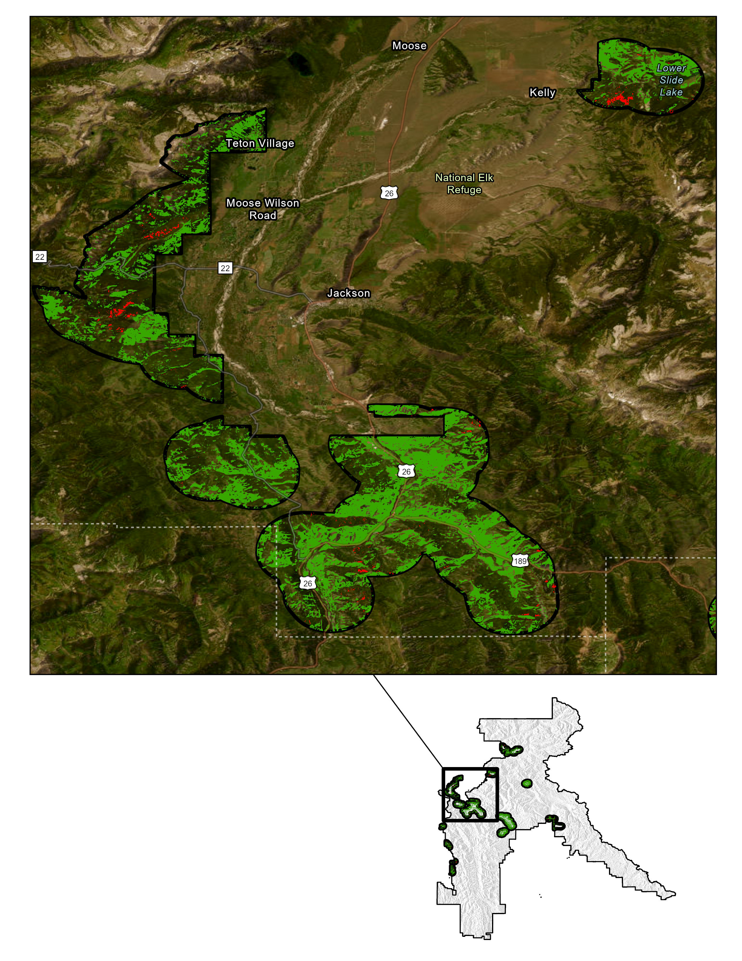
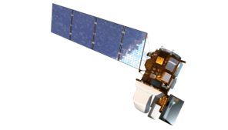
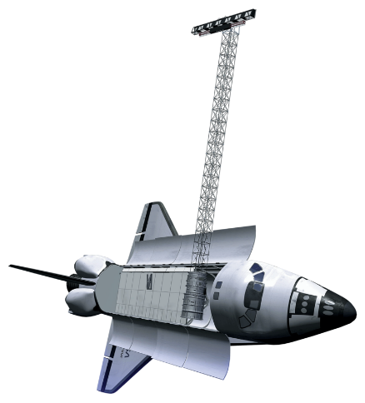
Intermountain West Wildland Fires
Mapping Tree Mortality and Burn Patches using NASA Earth Observations to Determine Fire Risk and Inform Fire Management Practices
Project Synopsis
Study Area
Monitoring fuel loads is a major concern for wildland fire management efforts within the intermountain west. To address this concern, we partnered with the U.S. Forest Service (USFS) to inform the agency which forested areas should be prioritized for prescribed burning and fuel reduction near human communities in the Bridger-Teton National Forest, Wyoming. We made burn maps, fuel load maps, and a tutorial document to identify forest impact trends and provide the partner with the tools to replicate project methods for expansion to other wildfire crisis strategy sites.
Map 1. The study area was the Bridger-Teton National Forest, which is in northwestern Wyoming. Because the largest area burned in 2018, we focused our analysis to the 2018 fires. Our temporal period focused on the months of June to October, coinciding with the active fire season.
Objectives
Map forested areas with high fuel loading and high fire severity
Delineate priority areas for fuel reduction within Wildland Urban Interface
Develop a methodology to replicate project methods to other wildfire crisis strategy sites
Bridger-Teton National Forest
Methodology
0 25 50 75 100 miles
N
Wildland Fires (2018)
Esri, TomTom, Garmin, FAO, NOAA, USGS, EPA, USFWS, Earthstar Geographics
U.S. Forest Service Lands
Pre-Fire: 2017(June-October) and 2018 (June-July)
Post-Fire: 2018 (August-October) and 2019 (June-October)
Current: 2023(June-October)
Results
Predicted Fuel Load
Predicted Burn Severity
Low Fuel Load
Moderate Fuel Load
High Fuel Load
Enhanced Regrowth
Unburned
Low Severity
Moderate Severity
High Severity
Ridgetop Feature
WUI
Moose Wilson
Rd
Moose Wilson
Rd
Kelly
Jackson
Jackson
National Elk Refuge
0 2.5 5.0 7.5 10miles
0 2.5 5.0 7.5 10miles
N
0 25 50 miles
0 25 50 miles
Map 2 and 3. Predicted raster datasets based on random forest models for fuel (left map) and burn severity (right map). Insets highlight fuel loads and burn severity for Jackson in relation to the Wildland Urban Interface.
New Fork Lakes
New Fork Lakes
0 1.25 2.5 2.75 3miles
0 1.25 2.5 2.75 3miles
Figure 1. Workflow shows which datasets and variables were used to build random forest models. One model predicted fuel load while the other predicted burn severity.3
N
Modeling
GEDI:
Predicted Above Ground Biomass Density (mg/ha)
Kelly
Fuel & Burn Severity In WUI
Fuel Load Random Forest Modeling
Burn Severity Random Forest Modeling
0
Moose Wilson
Rd
National Elk Refuge
Low
Moderate
High
WUI
Dependent Variable
Dependent Variable
814
Jackson
Fuel & Burn Severity Category | Acres & % of WUI
Low Fuel & Low Burn | 74,376 (39%)
Medium Fuel & Medium Burn | <1 (<1%)
High Fuel & High Burn | 998 (1%)
Fuel Load Categories | Tree Canopy Cover | Shrub Canopy Cover | Canopy Height | Tree Size (Diameter at Breast Height)
Low | Non-forest 10-20% | 0-10% | Non-Forested | Non-forest
Medium | 20-50% | 10-24% | 25-50m | 20-30+" DBH
High | 50-100% | 25-100% | 0-25m | 0-19.9" DBH
Severity Level | DNBR Range
Enhanced Growth | < - 0.1
Unburned | -0.1 to +0.1
Low Severity | +0.1 to +0.27
Moderate Severity | +0.27 to +0.66
High Severity | >0.66
N
Map 4. Areas with both high fuel load and high burn severity (red) are recommended for fuel reduction, as observed in the inset of Jackson.
Independent Variables:
Elevation, Slope, Aspect
NDVI, NDMI, dNBR
Brightness, Greenness, Wetness
Independent Variables:
Elevation, Slope, Aspect
NDVI, NDMI
Brightness, Greenness, Wetness
0 25 50 miles
0 2.5 5.0 7.5 10miles
N
Tables 1 and 2. Categorizations of dependent variables for random forest models, with fuel in the left table and burn severity in the right table.
Conclusions
Earth Observations
Fuel maps and burn maps identified 998 areas with high fuel loading and high severity fires.
Areas in Wildland Urban Interfaces near Jackson, Kelly, Moran, New Forks Lake, and Turnerville (Star Valley Ranch) could benefit from fuel reduction.
Areas outside the WUI are recommended for less pressing management (e.g. timber harvest).
GEDI provides fine resolution and would be a great tool for future fuel load management considerations. Future studies can use both GEDI and vegetation indices together to create high power models.
Landsat 8 OLI
Shuttle Radar Topography Mission
Team Members
Acknowledgements
Project Partner
Science Advisors:
Dr. Di Yang (University of Wyoming)
Dr. Austin Madson (University of Wyoming)
NASA DEVELOP:
Truman Anarella (Colorado Lead)
Marisa Smedsrud (Project Coordination Fellow)
Dr. Kenton Ross (Lead Science Advisor)
Dr. Xia Cai (Lead Science Advisor)
USDA, US Forest Service
Region 4
Teo Rautu
Mark Cervantes
Britt Hays
Alec Wallen
Pop-Up Project| Spring 2024

