Slide 1
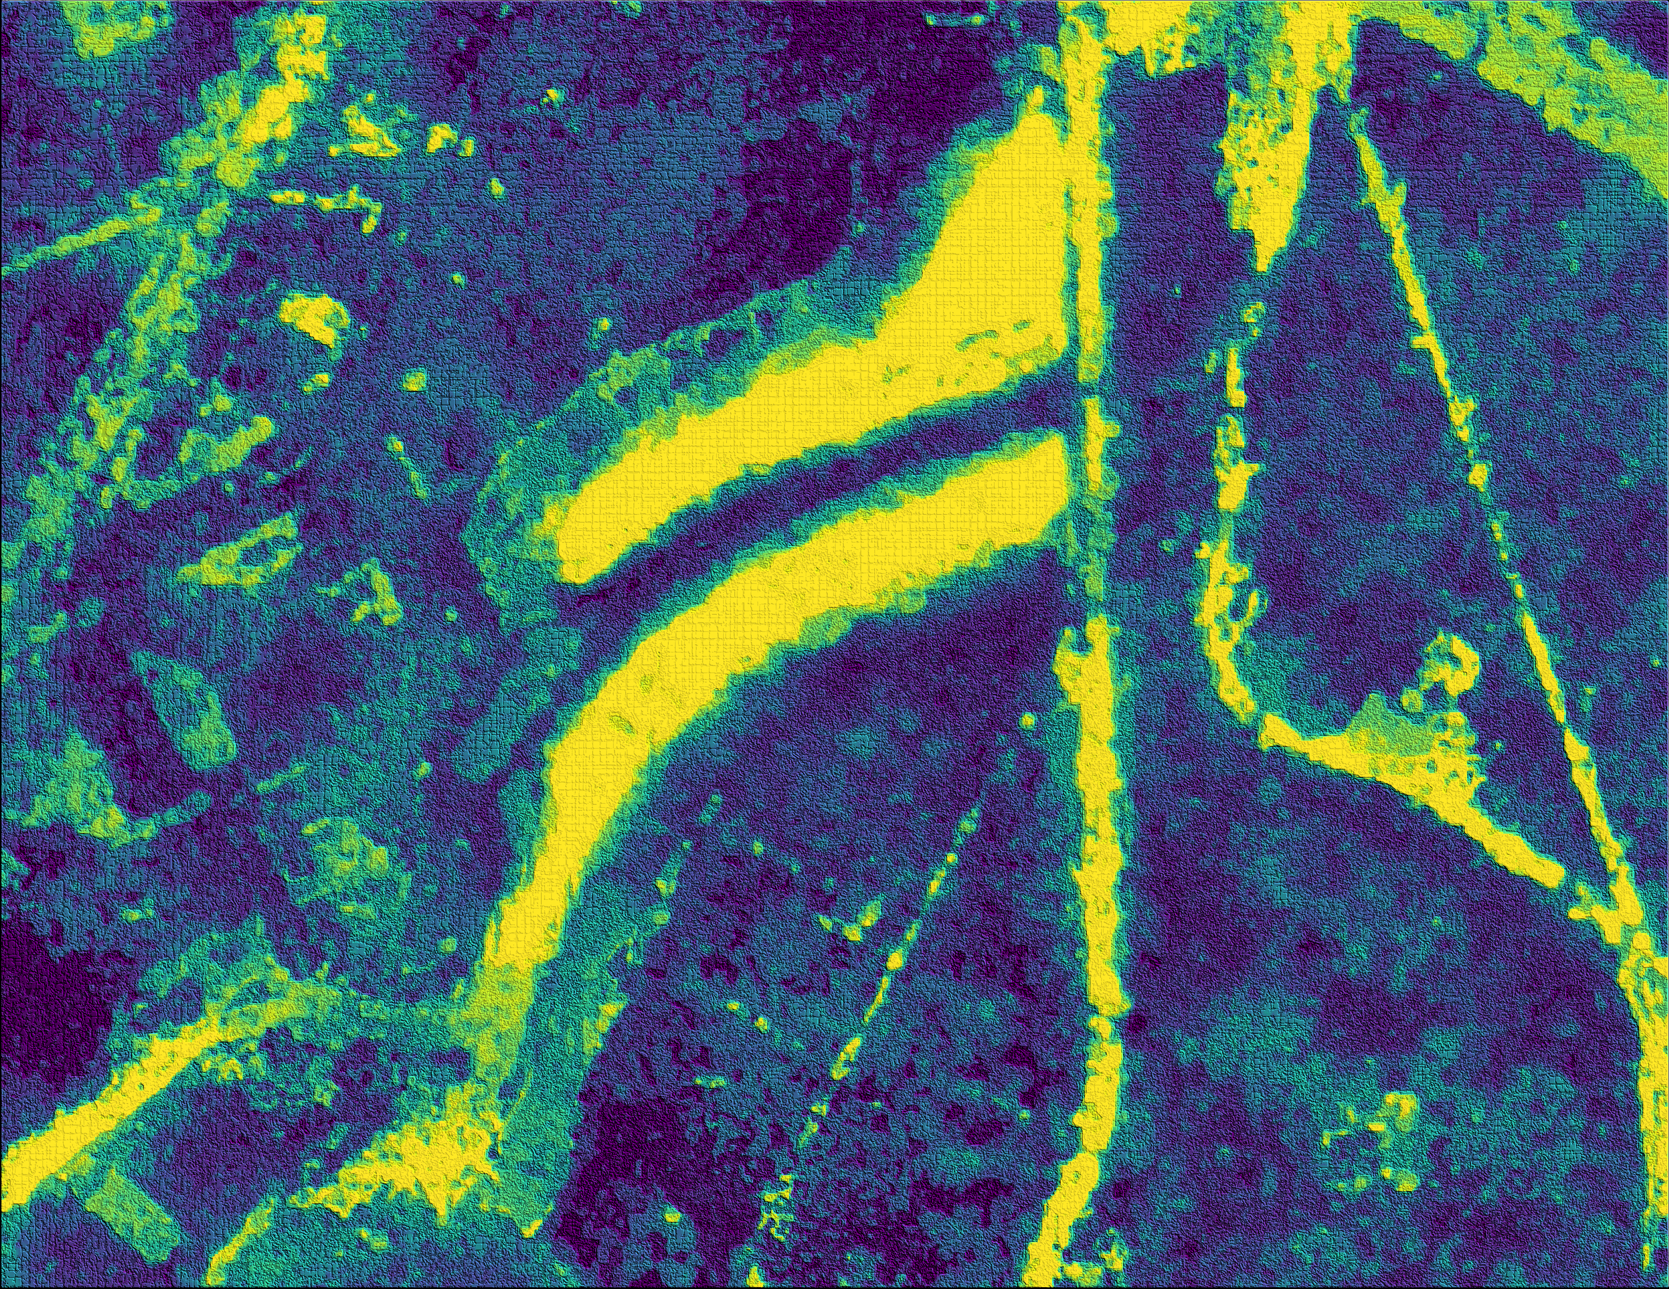
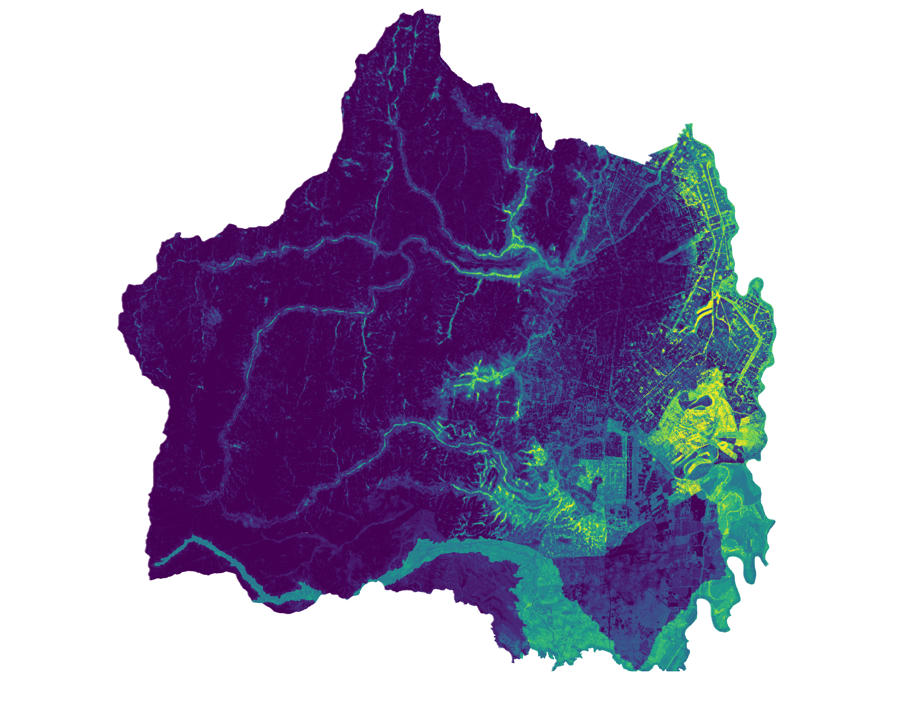
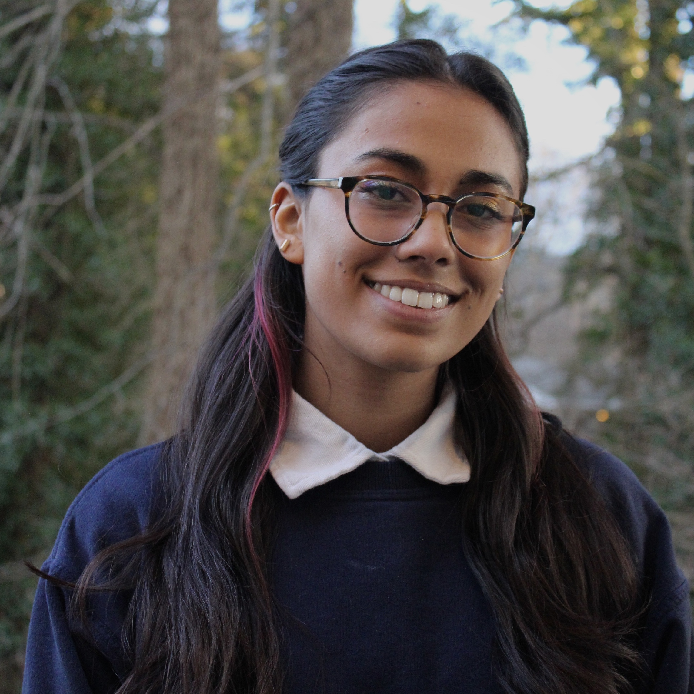
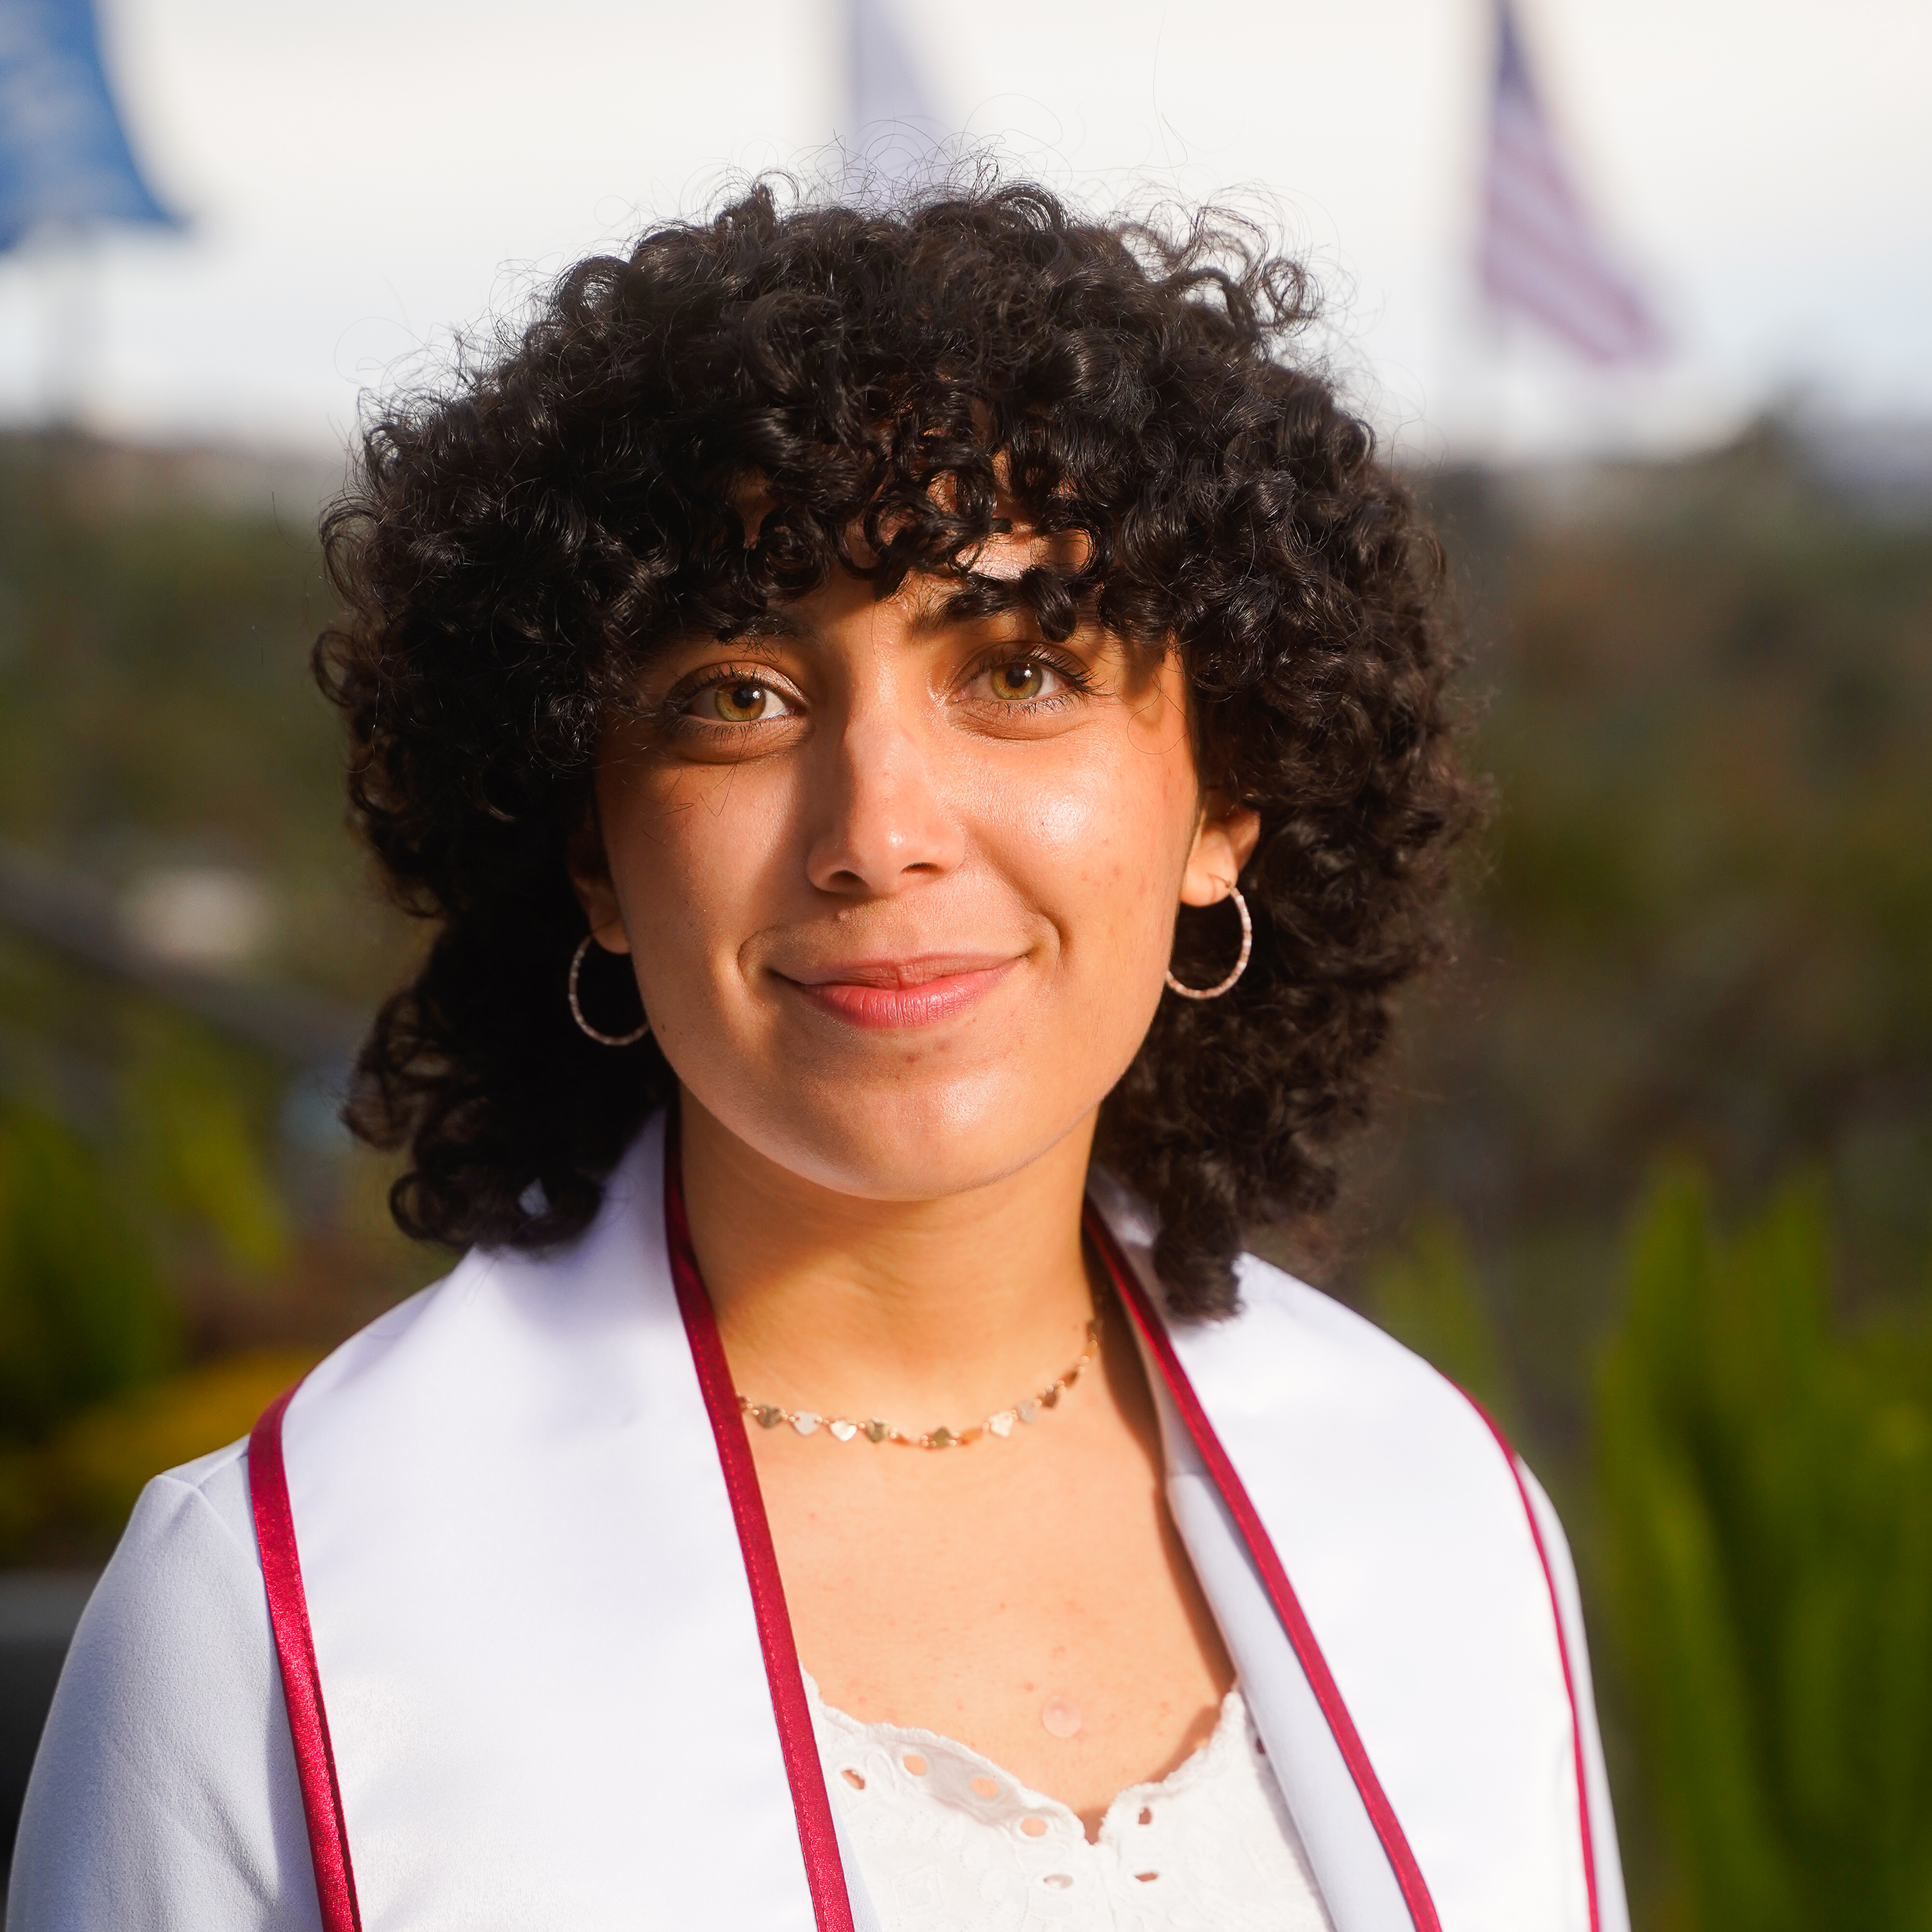
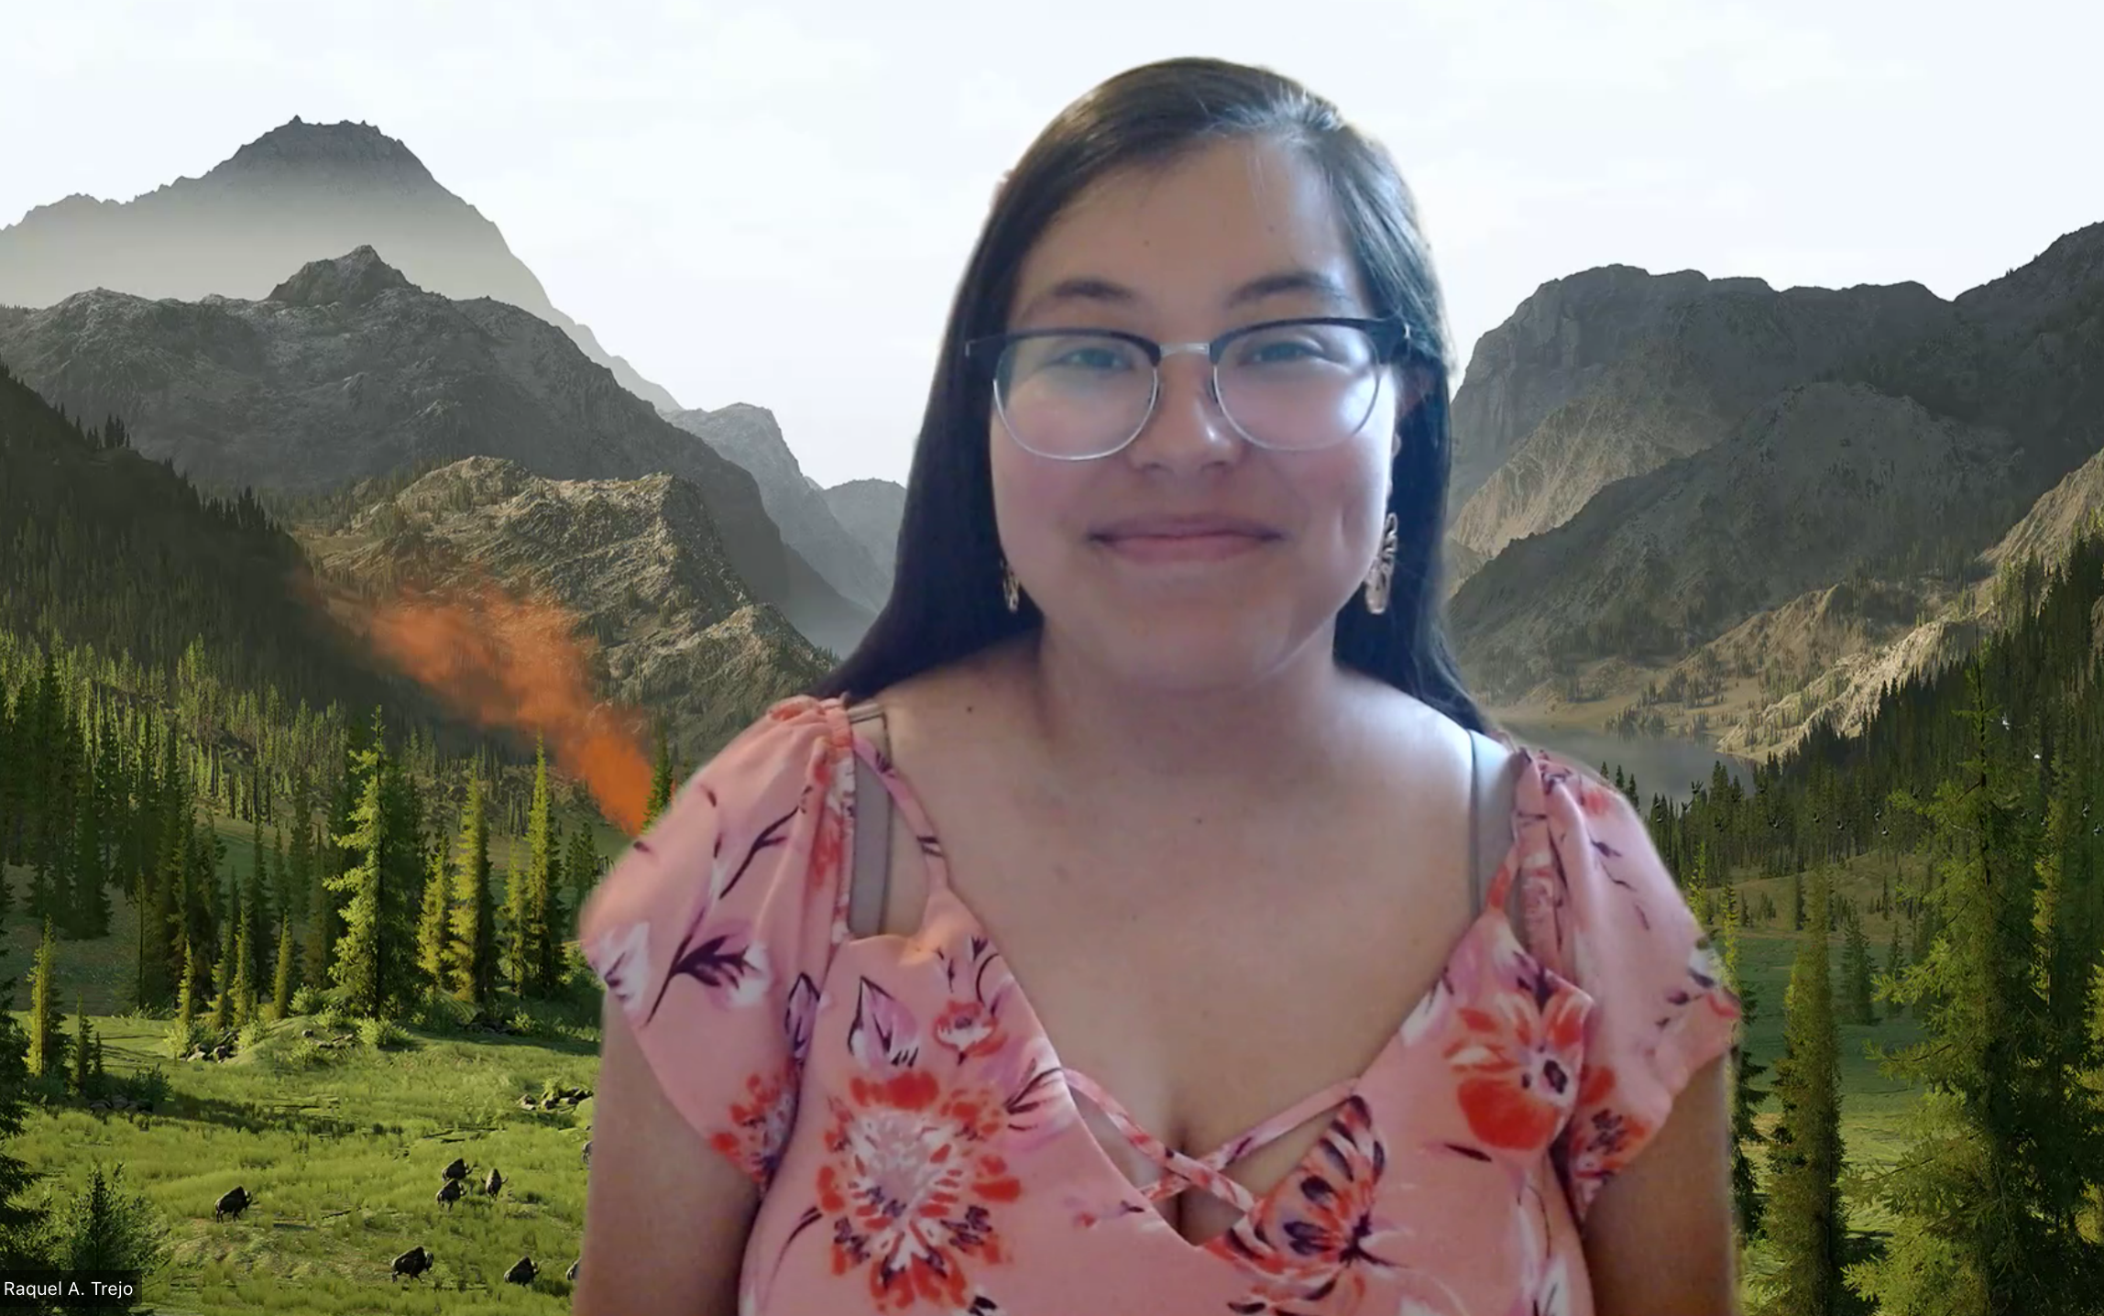
Cali Urban Development
Using NASA Earth Observations to Assess Wetlands and Land Reclamation in Cali, Colombia
In Cali, Colombia…
Wetlands provide…
Increasingly severe flooding events
Wetlands in urban neighborhoods are polluted
Development of community-led conservation initiatives
Flood control
Cultural value
Habitat for diverse species
Carbon storage
Water quality improvement
NASA DEVELOP is using satellite data to help Fundación Dinamizadores Ambientales and DAGMA understand wetland distribution and declination in Cali, Colombia.
Where in Cali is there the most potential for wetlands?
Wetland Probability
Output from Wetland Intrinsic Potential (WIP) Tool for 2022.
Low
High
Charco Azul and El Pondaje, the largest urban wetlands in Cali
Cali can effectively allocate current efforts for wetland conservation based on the identified wetland potential derived from the WIP tool.
Project Partners
Departamento Administrativo de Gestión del Medio Ambiente (DAGMA)
Sebastián Oyola, Fundación Dinamizadores Ambientales
0km
4km
Team Members
Acknowledgements
Dr. Juan Torres-Pérez (NASA Ames Research Center)
Dr. Morgan Gilmour (NASA Ames Research Center)
Dr. Alexandra Christensen (NASA Jet Propulsion Laboratory)
Lisa Tanh (Environmental Systems Research Institute, Inc.)
Lauren Webster (DEVELOP Lead, California – Ames)
Connor Racette (Washington Department of Ecology)
Tallis Monteiro
Project Lead
Gabi Davidson-Gomez
Nathan Tesfayi
Raquel Trejo
California – Ames| Spring 2024

