Slide 1
Gulf Of Maine
Water Resources
Assessing the Use of NASA Earth Observations for Identifying Harmful Algal Blooms of Pseudo-nitzschia in the Gulf of Maine
Suhani Dalal
Lily Gray
Phyllis Yixuan Li
Jane Zugarek
Massachusetts-Boston | Fall 2022
Notes:
[Suhani]:
Hello everyone! My name is Suhani Dalal, and this is the Gulf of Maine Water Resources team! I am joined by Lily, Phyllis, and Jane and we are excited to talk a little bit about our project today. We will be covering our project objectives, methods, and most notable results in our assessment of the use of NASA Earth observations to identify harmful algal blooms of Pseudo-nitzschia in the Gulf of Maine. Thanks for joining us!

Slide 2
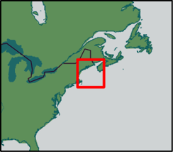
STUDY AREA & PERIOD
Study Area:
Gulf of Maine, Buzzard's Bay, Nantucket Sound
Study Period:
August — December
2016, 2020
Basemap: Esri, HERE, Garmin, FAO, NOAA, USGS, OpenStreetMap contributors, and the GIS User Community
Notes:
[Phyllis]:
Our study area was the Gulf of Maine, Buzzard’s Bay, and Nantucket Sound, which was selected due to recent increases of harmful algal blooms, rapidly changing oceanic conditions, and the presence of accessible in-situ data in this region.
We acquired all cloud-free satellite imagery of the Gulf of Maine in fall of 2016 and 2020, as our partners confirmed the presence of large Pseudo-nitzchia blooms through their ground observations in that time period, that could be used to validate the satellite imagery. In this way, these bloom years served as strong case studies for the use of remote sensing imagery to monitor HAB events. We did not cover every single day during this timeframe due to limitations in available in-situ and satellite data, as could only use remotely sensed imagery of the Gulf of Maine on days with clear skies and when the satellite image encompassed our entire study area.
----------------------------------------------------------------------------Image Information Below----------------------------------------------------------------------------
Icon Source: Microsoft Suite/powerpoint
Esri Map: https://www.arcgis.com/home/item.html?id=f33a34de3a294590ab48f246e99958c9
Basemap: Esri, HERE, Garmin, FAO, NOAA, USGS, OpenStreetMap contributors, and the GIS User Community

Slide 3
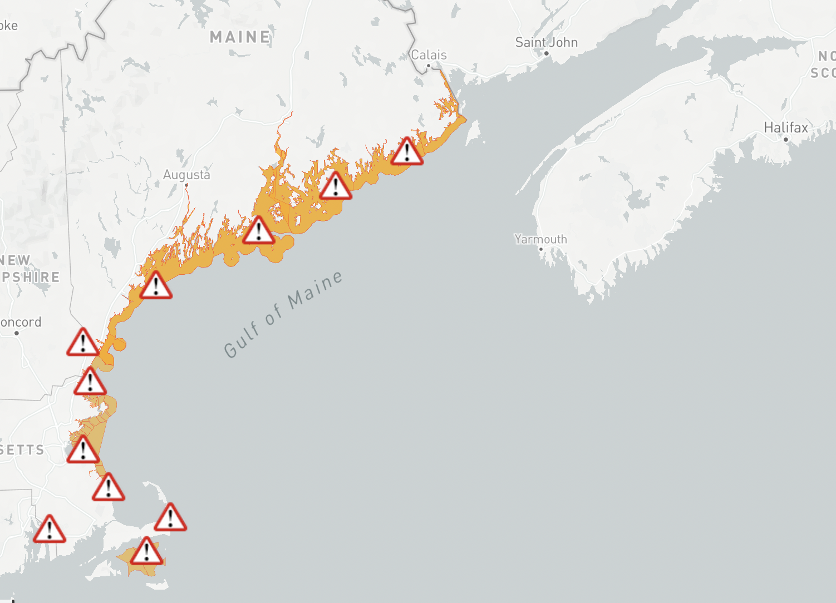
COMMUNITY CONCERNS
Shellfish bed closures due to Pseudo-nitzchia
Aug. 2016 - Dec. 2020
Public
Health
Amnesic Shellfish Poisoning (ASP)
Economic
Shellfish bed closure & fishery closure
shellfish bed closure
Marine Health
Poisoning of marine habitats
Image Credit: WHOI HABhub
Notes:
[Lily]:
For this project, we were interested in the Pseudo-nitzschia algae genus, which is a marine planktonic diatom. Pseudo-nitzchia can produce the neurotoxin domoic acid, which causes domoic acid poisoning in shellfish and can be transmitted to humans through consumption. Because of its high toxicity to humans, detection of domoic acid in shellfish beds and fisheries often leads to their closure. Coastal New England economies rely on shellfishing and fishing
and closure can be extremely detrimental to the local communities. Particular industries, such as oyster farming, can be impacted by one HAB event for many years after due to the cyclical nature of shellfish production.
Finally, this form of poisoning affects the marine ecosystem as well, as it can be transported throughout the food chain and disrupt the natural ecosystem.
This image depicts shellfish bed closures along the Gulf of Maine from August 2016 to December 2020, our two time periods of interest, illustrating the prolific closures caused by Pseudo-nitzchia.
----------------------------------------------------------------------------Image Information Below----------------------------------------------------------------------------
Waiting on written permission from our partners for this image
WHOI HABhub: https://habhub.whoi.edu/

Slide 4
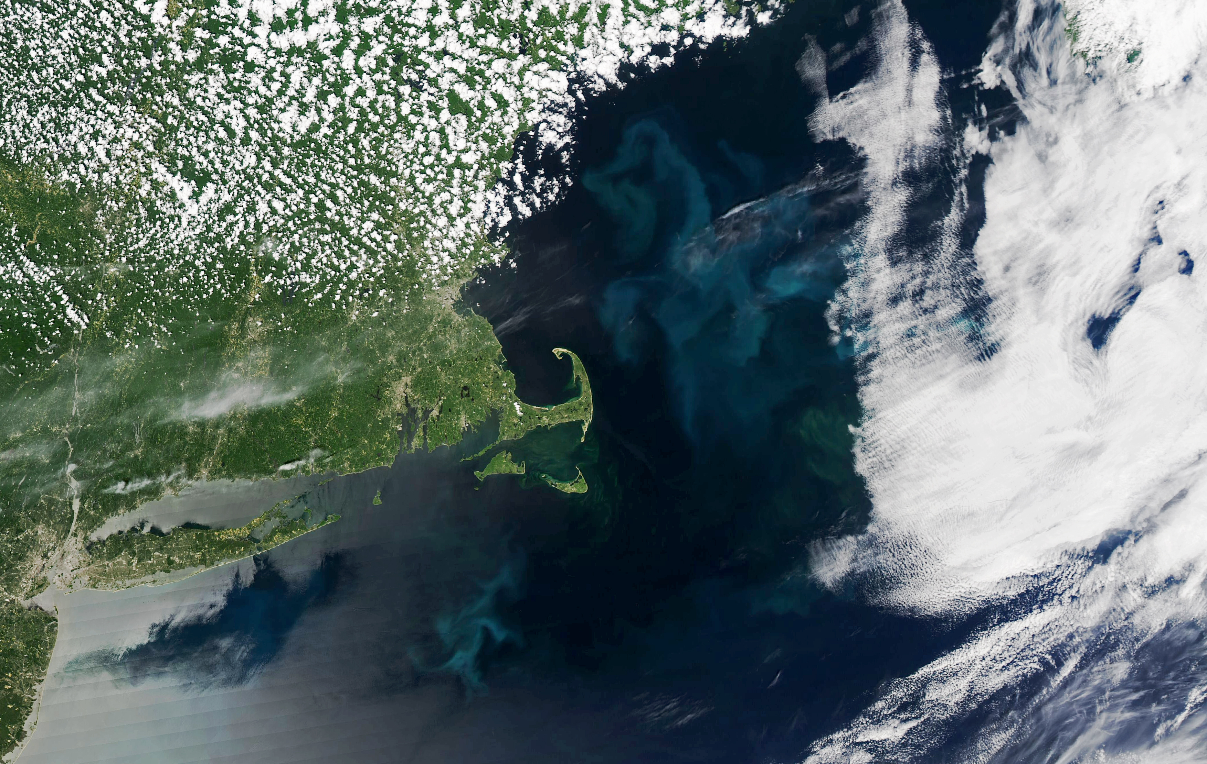
PARTNERS
End Users
Southern Gulf of Maine in natural color
— June 5, 2022 —
Woods Hole Oceanographic Institution (WHOI)
Battelle's Environmental Division
NOAA's Stellwagen Bank Marine Sanctuary
Image credit: NASA’s Aqua MODIS
Notes:
[Jane]
For this project we collaborated with three different partners: the Woods Hole Oceanographic Institution, the Environmental Division of Battelle and NOAA's Stellwagen Bank Marine Sanctuary.
----------------------------------------------------------------------------Image Information Below----------------------------------------------------------------------------
NASA’s Aqua satellite observed the Gulf of Maine in natural color on June 5, 2022, public domain.
Retrieved from: https://www.nasa.gov/feature/esnt/2022/nasa-funded-study-gulf-of-maine-phytoplankton-productivity-down

Slide 5
OBJECTIVES
Identify and track two known Pseudo-nitzschia blooms
Validate remotely-sensed bloom data with in-situ data
Determine if reflectance in a given pixel is caused by a diatom
Notes:
[Suhani]
Our primary goal was to assess the feasibility of using Earth observations to identify and map HAB events, using the 2016 and 2020 HAB events as case studies. In order to do this we processed remote sensing imagery and validated the trends we observed with the in-situ data to confirm that remote sensing in the Gulf of Maine could be a reliable metric of observing harmful algal blooms. Additionally, because remotely sensed images are currently unable to provide hyper-spectral distinguishments between species of algae, we used a script to calculate if observed reflectance was caused by a diatom.
----------------------------------------------------------------------------Image Information Below----------------------------------------------------------------------------
Icon Source: Microsoft Suite/powerpoint

Slide 6
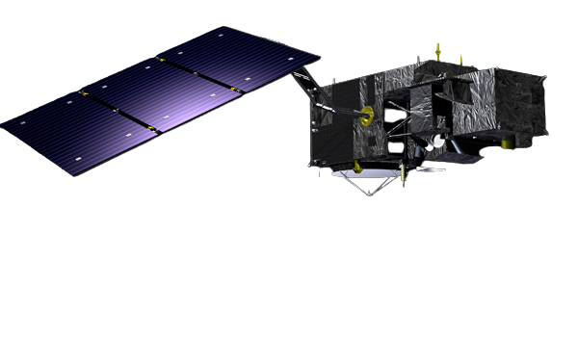
SATELLITES
Aqua Moderate Resolution Imaging Spectroradiometer (MODIS)
Image Credit: NASA
Sentinel-3 Ocean and Land Color Instrument (OLCI)
Image Credit: European Space Agency
Notes:
[Phyllis]
Our team used satellite data from Sentinel-3 OLCI and NASA's Aqua MODIS, though primarily used images from the Sentinel-3 because the OLCI sensor offered higher image resolution.
----------------------------------------------------------------------------Image Information Below----------------------------------------------------------------------------
The European Space Agency
https://sentinels.copernicus.eu/web/sentinel/missions/sentinel-3/overview/mission-summary
DEVELOPedia
https://www.devpedia.developexchange.com/dp/images/b/bf/06_Aqua.png

Slide 7
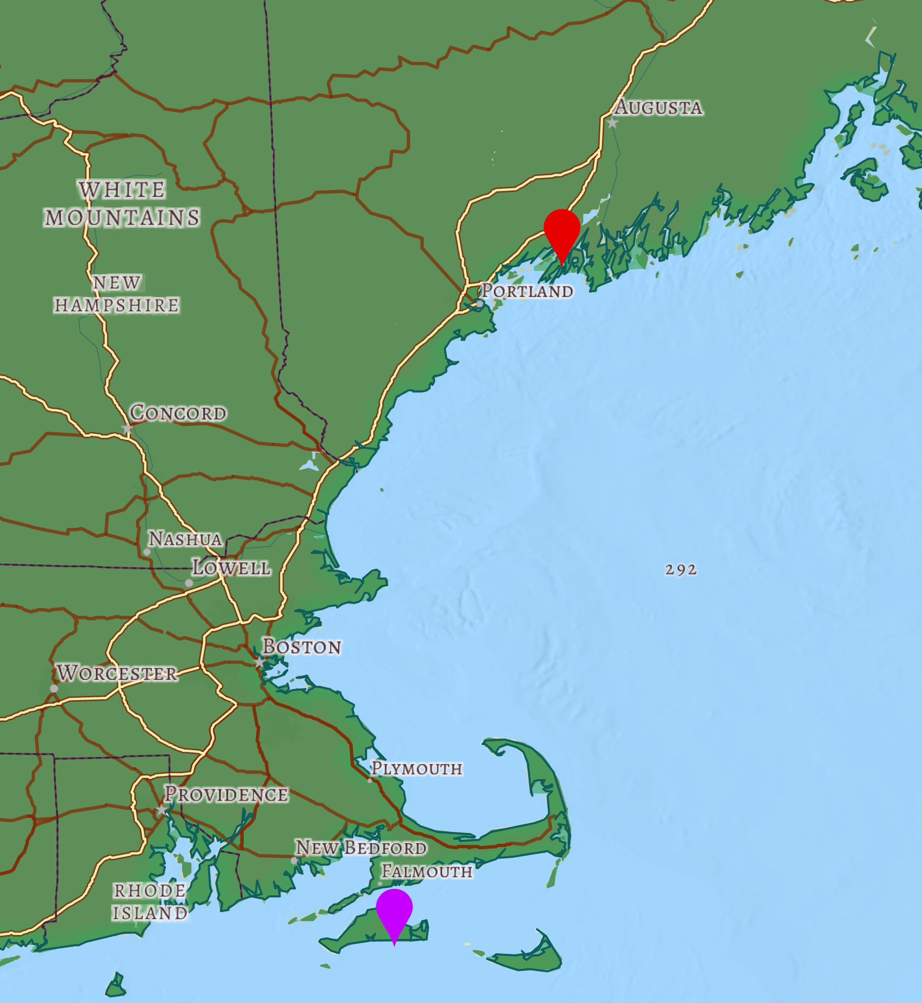
IN-SITU DATA
Harpswell
Woods Hole Oceanographic ——— Institution (WHOI) ———
Imaging FlowCytobot (IFCB) Dashboard
Pseudo-nitzschia concentrations (images / mL analyzed) & locations (latitude, longitude)
Martha's Vineyard
Basemap: Esri, HERE, Garmin, FAO, NOAA, USGS, OpenStreetMap contributors, and the GIS User Community
Notes:
[Lily]
To validate satellite imagery, we used in-situ data from one of our partners, the Woods Hole Oceanographic Institution or WHOI. The WHOI operates an open source dashboard that can be used to download data from various monitoring sites. The dashboard uses imagery collected by imaging flowcytobots, which are automated underwater microscopes that take pictures of water constituents, like phytoplankton. This high resolution image collection system is great for monitoring constituents in the ocean over larger time scales.
We specifically looked at in-situ data collected at two stations, Harpswell and Martha's Vineyard, from the 2016 and 2020 Pseudo-nitzschia blooms . For images when Pseudo-nitzschia was the dominant species, we generated the concentration and placed markers at the respective locations of the sensor.
----------------------------------------------------------------------------Image Information Below----------------------------------------------------------------------------
Esri Map: https://www.arcgis.com/home/item.html?id=f33a34de3a294590ab48f246e99958c9
Basemap: Esri, HERE, Garmin, FAO, NOAA, USGS, OpenStreetMap contributors, and the GIS User Community

Slide 8
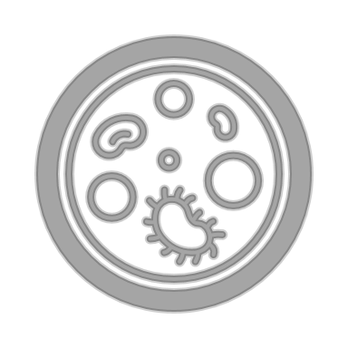
METHODOLOGY
Data Analysis
Data Acquisition
Data Processing
NASA's Ocean Color Web
L2 OC & IOP images
Sentinel-3
L2 OC images
MODIS
WHOI's IFCB Dashboard
Concentration & Coordinates
NESLTER, harpswell, MVCO
[from IFCB Dashboard]
Notes:
[Phyllis]
To best explain our team's methodology we split it into 3 parts: data acquisition, data processing, and data analysis.
First we'll discuss how we got our data. We acquired all our data from NASA's open source ocean color web and WHOI's IFCB Dashboard. In NASA Ocean Color, we downloaded Level 2 imagery of Sentinel-3 and MODIS data that we pulled into NASA's SeaDAS software. We used SeaDAS to process, display and analyze the ocean color data. We saved both Ocean Color and Inherent Optical Properties data to have a range of data across the Electromagnetic spectrum of reflected light.
For our in-situ data, we downloaded everything using available datasets from the IFCB Dashboard.
Next slide please.
----------------------------------------------------------------------------Image Information Below----------------------------------------------------------------------------
Icon Source: Microsoft Suite/powerpoint

Slide 9
METHODOLOGY
Data Analysis
Data Acquisition
Data Processing
Pseudo-nitzschia Data
Image Credit: ESA
Sentinel-3
Python & R
Coordinates (Latitude, Longitude)
Concentration (images/mL)
SeaDAS
Normalized Fluorescence Line Height (nFLH)
Absorption by phytoplankton — aph(433)
Notes:
[Suhani]
Though we pulled both Sentinel-3 and MODIS data, we only processed Sentinel-3 because of its higher resolution and number of bands.
To process the in-situ data from the IFCB dashboard we wrote a Python script to calculate the concentration of images per volume analyzed of Pseudo-nitzschia for bloom periods.
In SeaDAS we calculated the normalized fluorescence line height which is a measure of certain reflectance bands, looking primarily at the red spectrum of an absorption curve. It can be more accurate when trying to identify algal blooms than raw remote sensing bands, as it limits possible false positives from other inorganic materials causing reflectance, like sediments, detritus, and non-phytoplankton organic materials . We also looked at the absorption by phytoplankton, or aph433, which is a product calculated by Sentinel-3 and another method of excluding other interference from our imagery.
----------------------------------------------------------------------------Image Information Below----------------------------------------------------------------------------
The European Space Agency
https://sentinels.copernicus.eu/web/sentinel/missions/sentinel-3/overview/mission-summary

Slide 10
METHODOLOGY
Data Acquisition
Data Analysis
Data Processing
In-situ Data
Diatom Distinction
Statistically analyze concentration of Pseudo-nitzschia with time-series plots
Compare aph443 and nFLH from satellite data with concentration
Analyzing pixels of satellite imagery to determine if it is diatom dominant
Cross-validating satellite imagery with diatom distinction and in-situ data
Notes:
[Lily]
In order to further validate the satellite imagery, we cross-referenced our remotely-sensed products of aph443 and nFLH with the calculated concentrations from the in-situ data to track any patterns and follow the development of the bloom.
Another method we used to confirm that our perceived blooms were caused by algae, specifically diatoms, was a diatom distinction code. This script, when applied to our satellite imagery, produced an image that distinguished which pixels were diatom dominant in reflectance of select wavelengths. We used the diatom distinction product to cross-validate satellite imagery and in-situ data to determine on which bloom days diatoms were dominant.
----------------------------------------------------------------------------Image Information Below----------------------------------------------------------------------------
Icon Source: Microsoft Suite/powerpoint

Slide 11
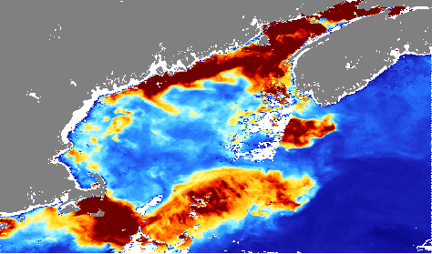
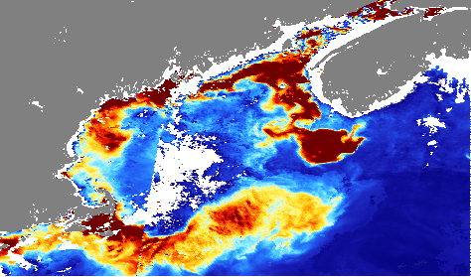
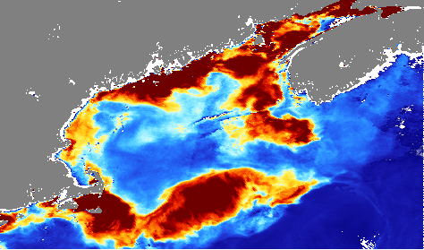
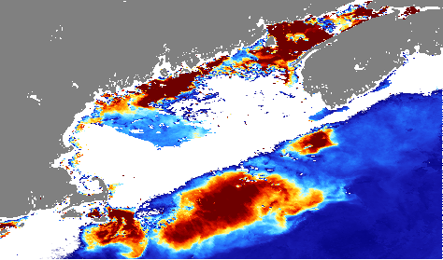
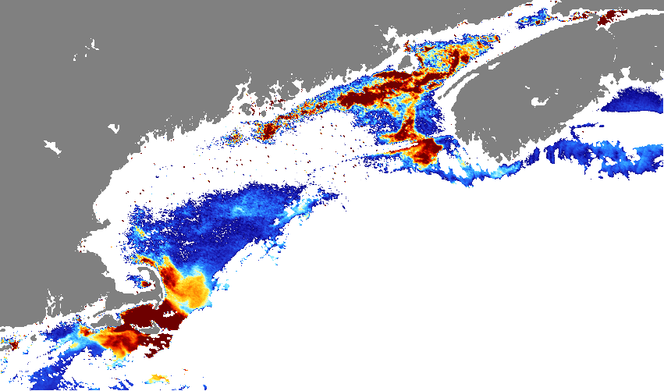
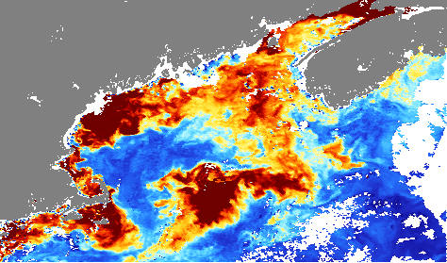
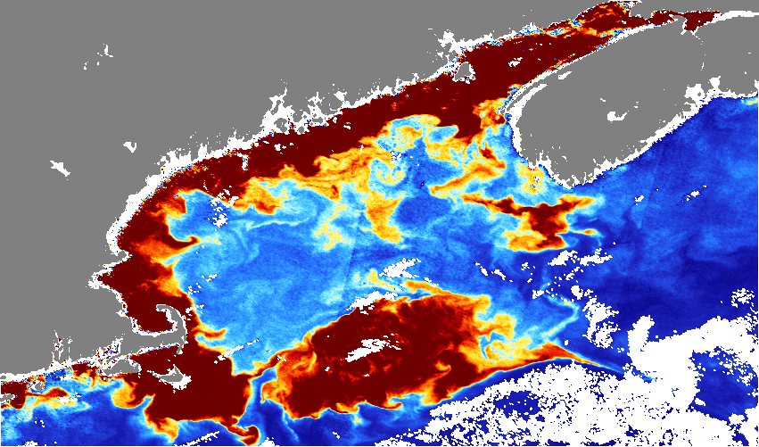
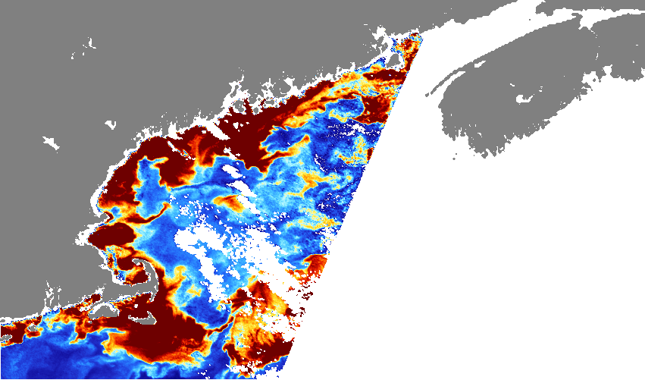
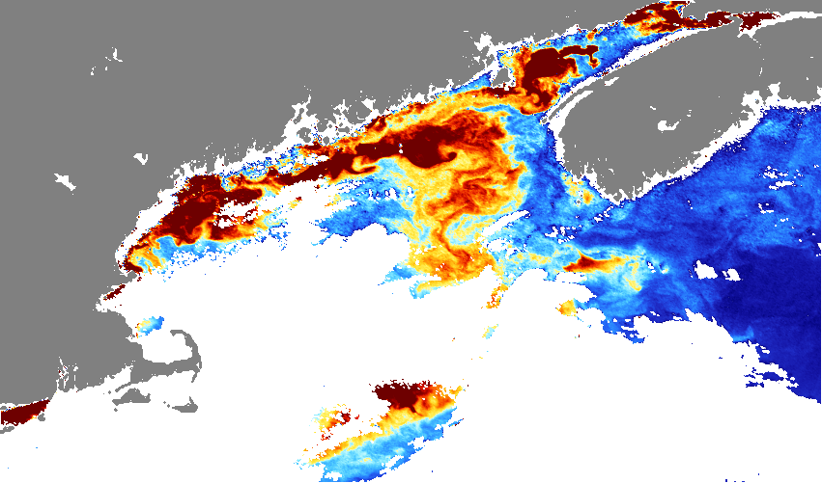
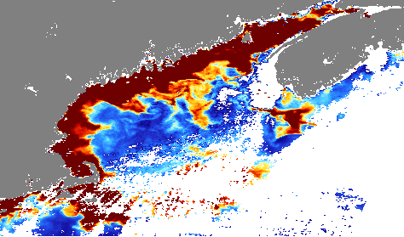
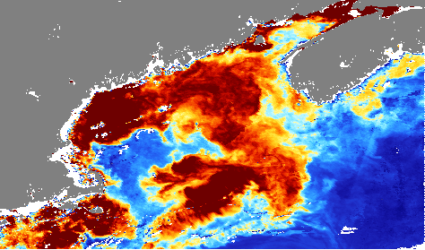
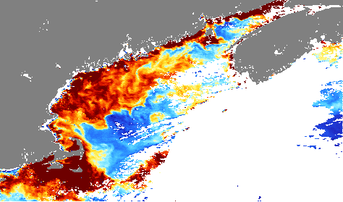
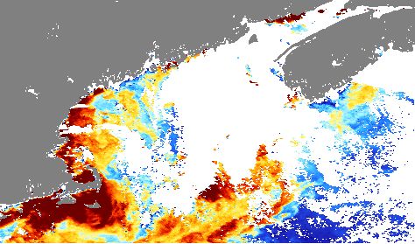
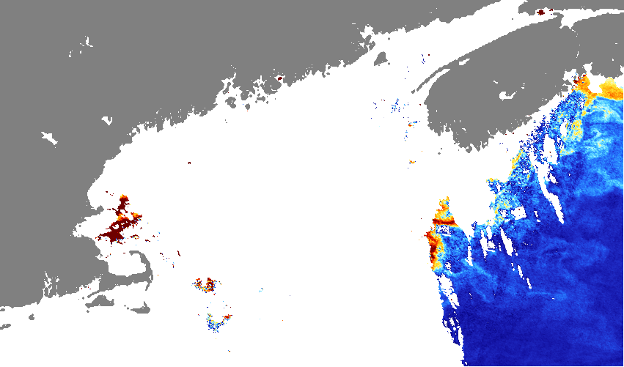
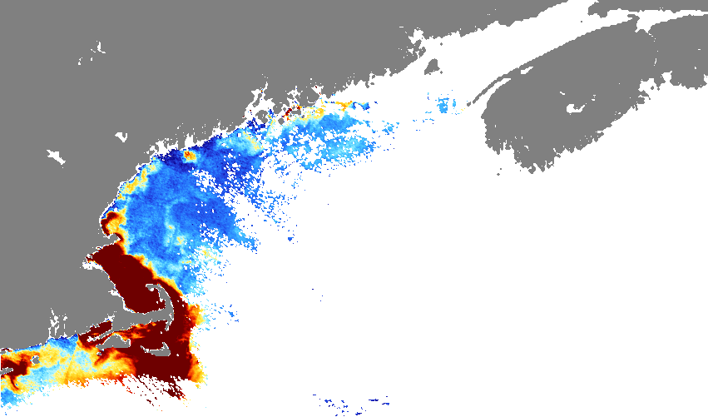
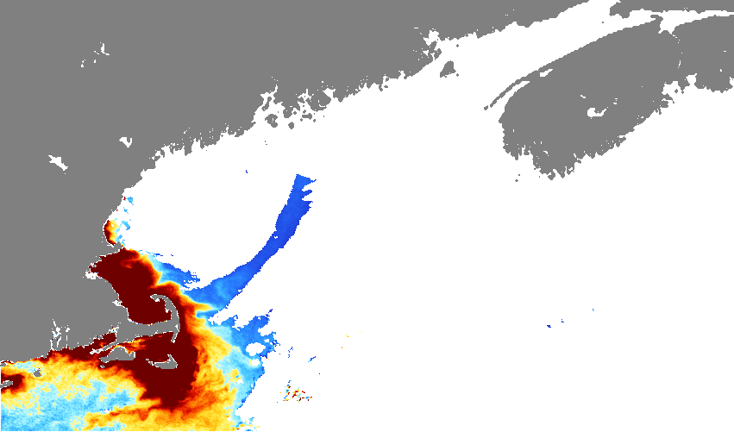
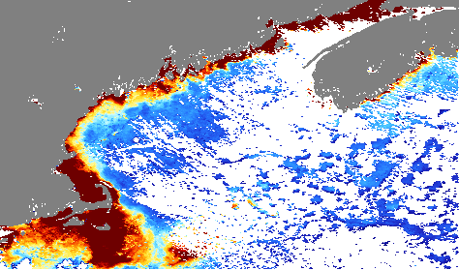
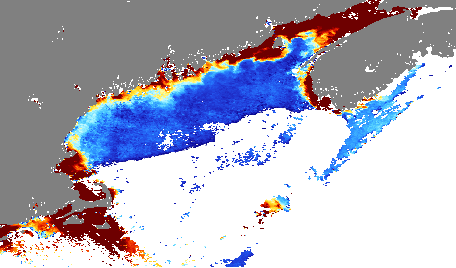
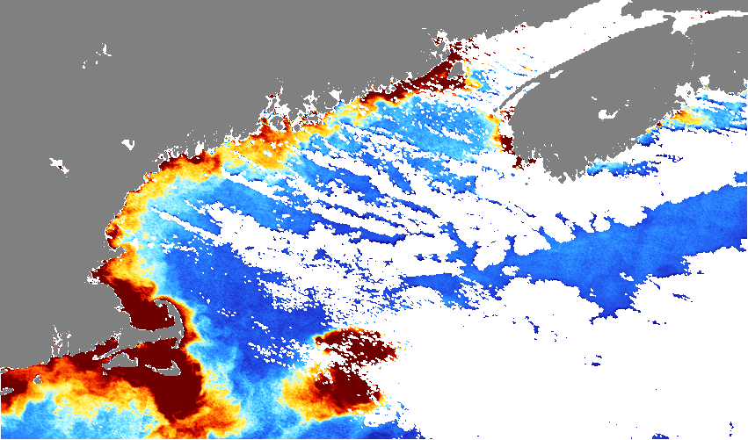
Weekly Composite Absorption Due to Phytoplankton (aph443) (August – December 2016)
RESULTS
Week 1
Week 2
Week 3
Week 4
August
aph443
0 (Low)
September
October
November
N/A
0.1 (High)
Cloud Coverage or No Data
December
Notes:
[Jane]
Now getting to some of our results. So one of our initial steps in our processes was visualizing or remote sensing products of interest, aph443 and nflh. Here we have time-series aph imagery for 2016. While one of our limitations is satellite imagery coverage, it was important for us to look at weekly composite imagery because algal blooms have the propensity to change and migrate rapidly. Low values of aph, depicted by dark blues indicate there is no phytoplankton present and high aph values (red and orange) indicate higher concentrations of phytoplankton in a given area. White area indicates where there was cloud coverage or no data in weekly imagery. From these images we can get a sense that there was a large algal bloom from August – early October and the bloom had very intense concentrations around Martha's Vineyard.
----------------------------------------------------------------------------Image Information Below----------------------------------------------------------------------------

Slide 12
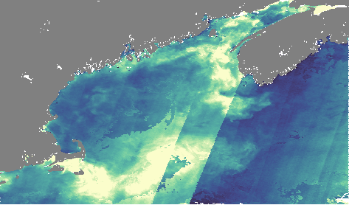
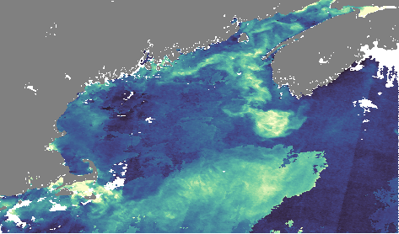
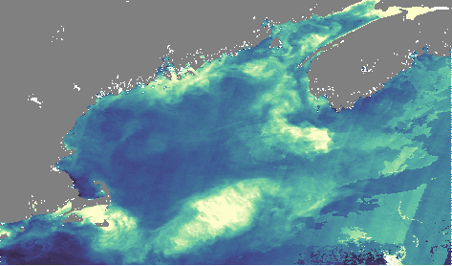
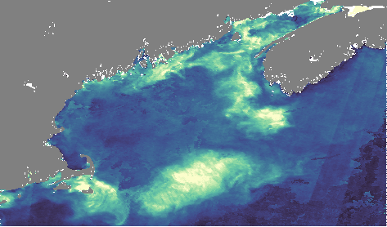
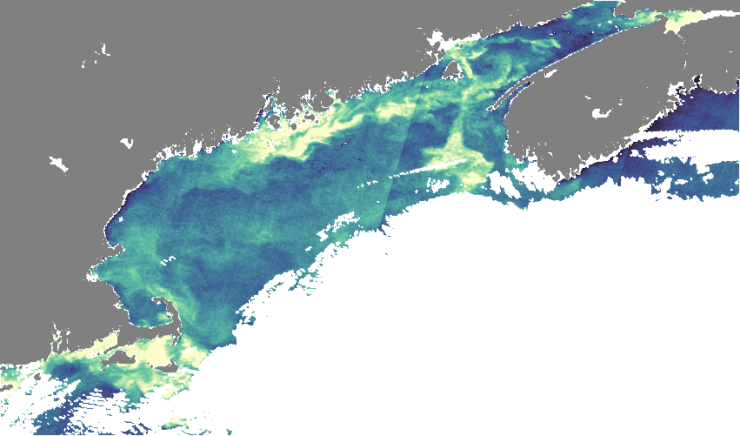
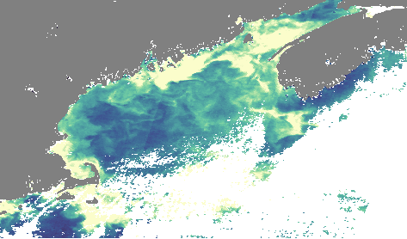
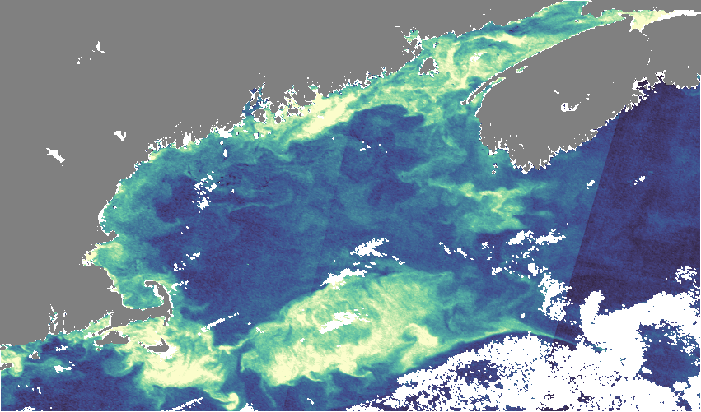
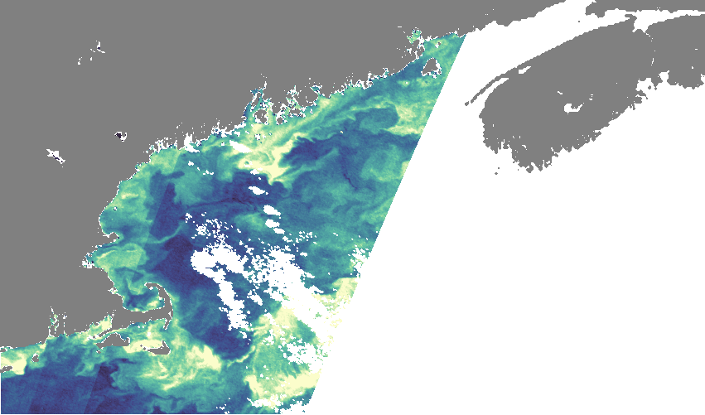
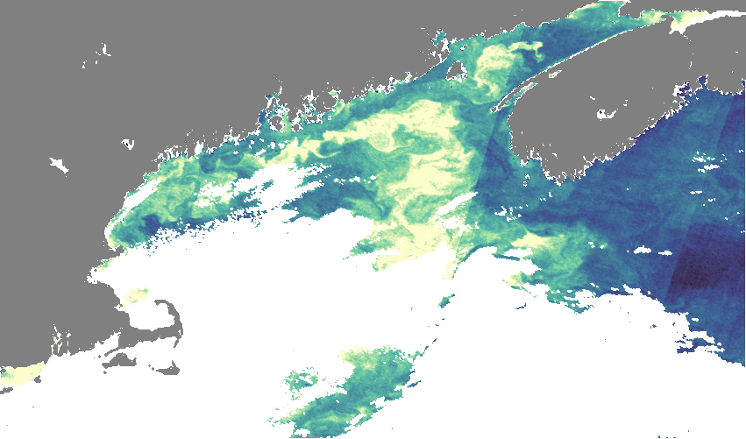
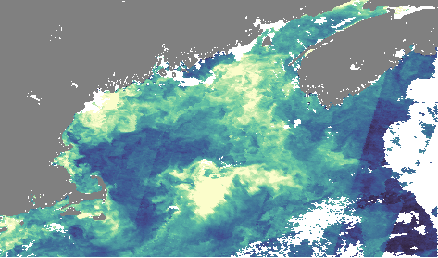
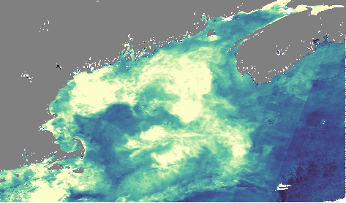
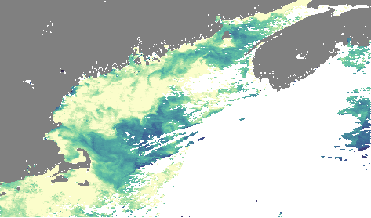
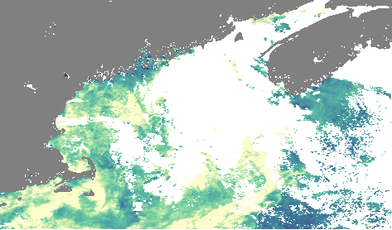
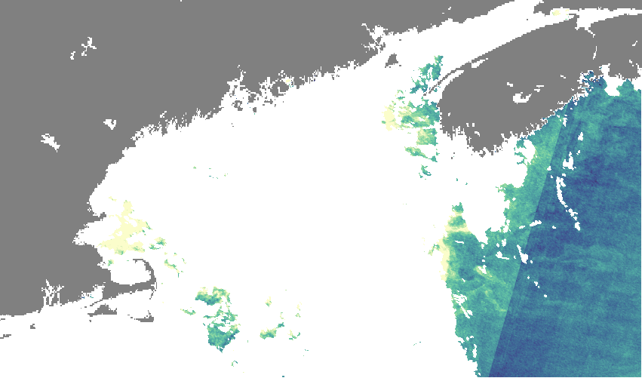
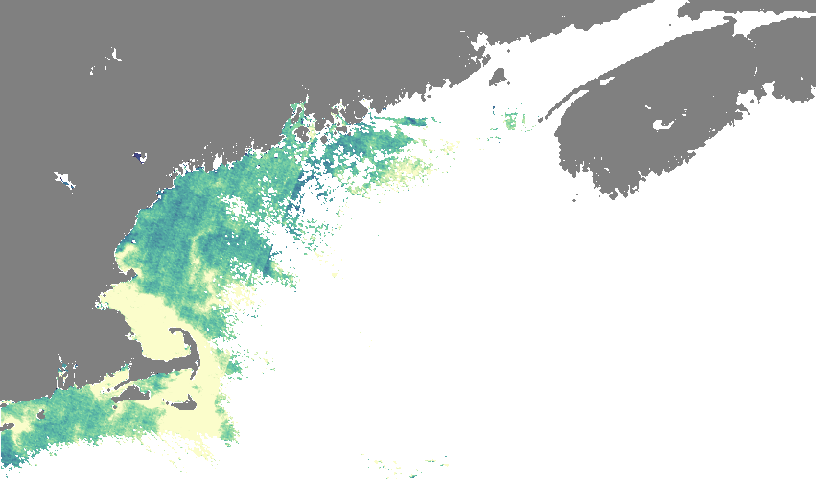
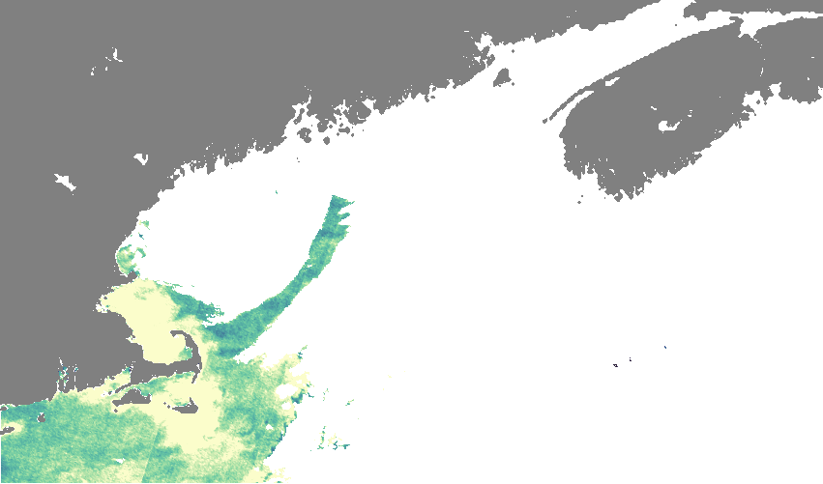
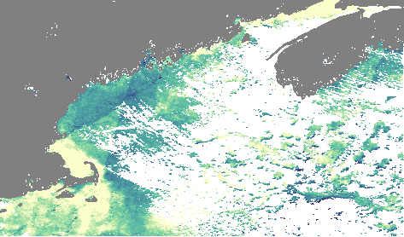
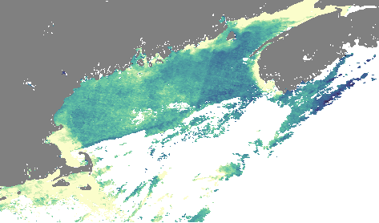
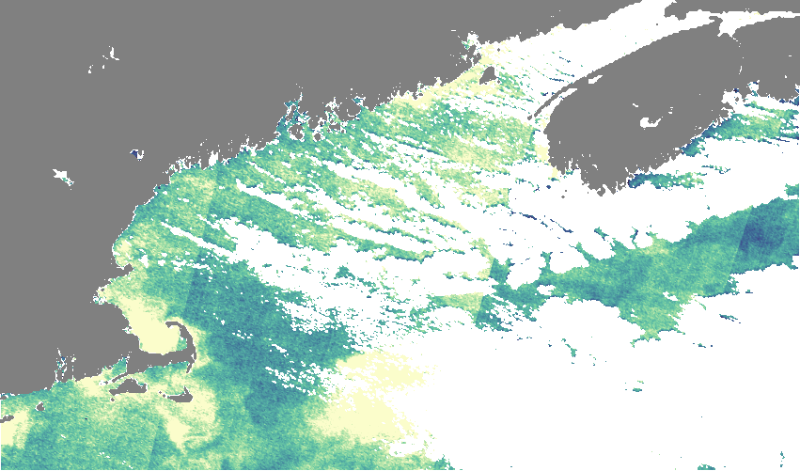
Weekly Composite Normalized Fluorescent Line Height (nFLH) (August – December 2016)
RESULTS
Week 1
Week 2
Week 3
Week 4
August
nFLH
0 (Low)
September
October
November
N/A
0.06 (High)
Cloud Coverage or No Data
December
Notes:
[Jane]
And here we have similar time-series plots for 2016, but for nFLF for the same time period.
NFLH is calculated by an interpolation of bands and is essentially and estimation because the sensor we used does not directly sense the bands used to calculate nFLH. Nevertheless we could visually see some patterns in our images.
Low values of nFLH, depicted by dark blues indicate there is no phytoplankton present and high nFLH values (pale yellow) indicates higher concentrations of phytoplankton in a given area. White area again indicates where there was cloud coverage or no data in weekly imagery. We can visualize again how the algal bloom expanded in October and became more concentrated around Martha's Vineyard as the year progressed.
----------------------------------------------------------------------------Image Information Below----------------------------------------------------------------------------

Slide 13
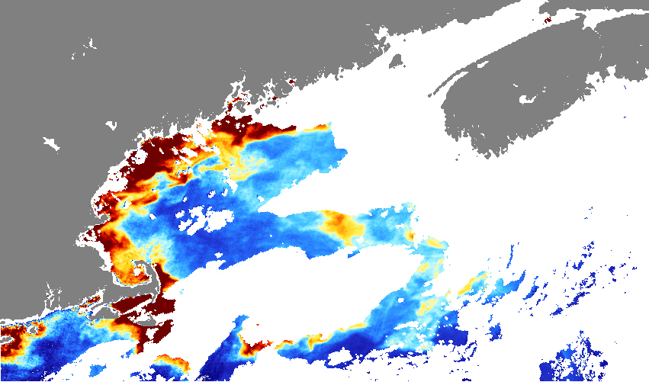
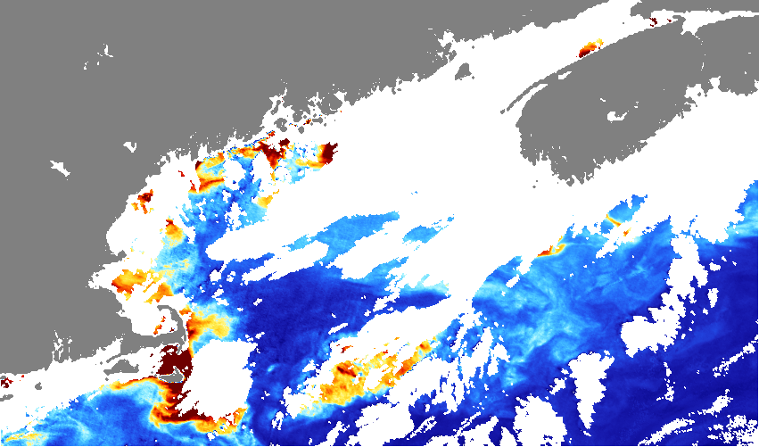
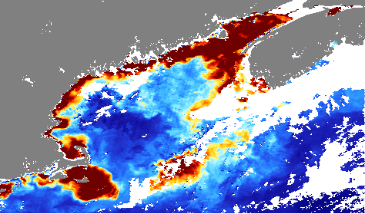
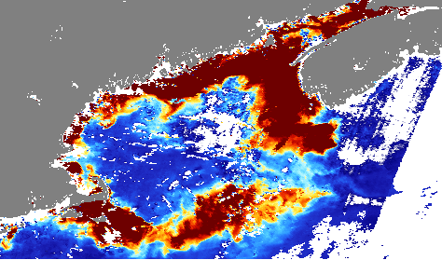
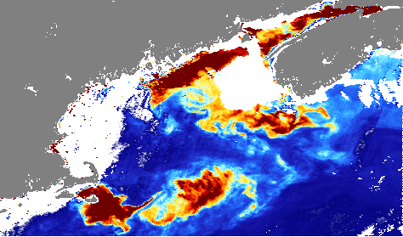
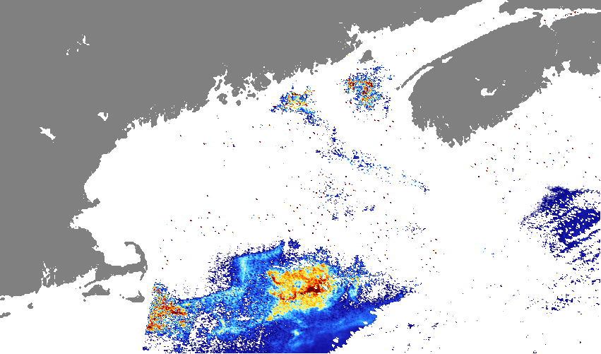
Weekly Composite Absorption Due to Phytoplankton (aph443) (August – December 2020)
RESULTS
Week 1
Week 2
Week 3
Week 4
August
aph443
0 (Low)
September
N/A
October
November
0.1 (High)
Cloud Coverage or No Data
December
N/A
N/A
Notes:
[Jane]
Now for 2020, our partners expressed that the temporal presence of the 2020 Pseudo-nitzschia bloom differed from 2016. In 2020, the bloom occurred later in the year, around October and November where as the 2016 bloom occurred earlier in the year. In the second week of October the bloom expanded from its presence in September.
----------------------------------------------------------------------------Image Information Below----------------------------------------------------------------------------

Slide 14
Weekly Composite Normalized Fluorescent Line Height (nFLH) (August – December 2020)
RESULTS
Week 1
Week 2
Week 3
Week 4
August
nFLH
0 (Low)
September
N/A
October
November
0.06 (High)
Cloud Coverage or No Data
December
N/A
N/A
Notes:
[Jane]
The 2020 nFLH gave us much more complete imagery due to it being calculated via interpolation, and we can see much clearer how the bloom was expanding throughout October and November.
----------------------------------------------------------------------------Image Information Below----------------------------------------------------------------------------

Slide 15
Sentinel-3 vs. In-situ data: Statistical Analysis
RESULTS
2016 Pseudo-nitzschia Concentration Martha's Vineyard, MA
2020 Pseudo-nitzschia Concentration Harpswell, ME
120
70
100
60
80
50
Concentration (images/mL)
Concentration (images/mL)
40
60
30
40
20
20
10
0
0
Sept
Oct
Nov
Dec
Oct
Nov
Dec
Notes:
[Phyllis]
In order to validate our satellite imagery, we used statistical models and visualizations to compare measurements from the imagery with concentration calculated from ground observations. These two graphs depict the concentration of Pseudo-nitzschia at Martha's Vineyard and Harpswell in 2016 and 2020 respectively. The visualizations depict the peak concentration days at these locations. In 2016, you see a spike in concentration in November and in 2020 the concentration peaked in late October and early November. The Harpswell sensor did not collect data during the month of September, which is why we have fewer data points in the figure.
Next slide please.

Slide 16
Sentinel-3 vs. In-situ data: Statistical Analysis
RESULTS
Harpswell, ME Concentration vs nFLH and aph443
70
0.14
60
concentration
0.12
50
aph443
0.1
nFLH
40
0.08
30
0.06
20
0.04
10
0.02
0
0
September
October
Notes:
[Phyllis]
In this graph we plotted nFLH and aph from the satellite imagery and concentration from the in-situ data set in 2020 at Harpswell for the days we had available imagery and ground observations. As you can see, aph and concentration follow similar increases in early November, corroborating the visual bloom in the Sentinel-3 image.

Slide 17
Diatom Analysis 2020
RESULTS
Diatoms
aph443
nFLH
Aug 19th
Sept 19th
Oct 31st
Cloud Coverage or No Data
0 (No diatoms)
(Diatoms) 1
0 (Low)
(High) 0.1
0 (Low)
(High) 0.06
Notes:
[Lily]
To further validate our satellite imagery and determine what is causing the reflectance we see in the aph and nflh images, we used a diatom distinguishing algorithm developed by our science advisor's colleague, Emmanuel Devred. This algorithm was applied to Sentinel satellite imagery to determine what pixels are diatom dominant. Pixels dominated by diatoms appear green, while pixels not dominated by diatoms appear white. We ran this algorithm in MATLAB on our processed Sentinel imagery. The outputted diatom images had varied success as on some days a clear correlation between aph and nflh products, and where in-situ data placed the bloom and diatomic confirmation existed. On other days, however, like [] the code generated an image contrary to aph and nflh patterns. [] The images shown here are a selection of days in 2020 that correlate highly with the aph and nflh images.

Slide 18
CONCLUSIONS
Question I
Can we use NASA EOs to detect
Pseudo-nitzschia blooms in the Gulf of Maine?
Question II
Can we distinguish diatom specific blooms with Sentinel-3 data?
Question III
What do our findings mean for partners and communities impacted by HABs?
Notes:
[Phyllis]
Thanks Lily. In wrapping up our results we wanted to take a step back and see how our initial project questions were answered based on our term's work. Our three questions were: Can we use Nasa EOs to detect Pseudo-nitzschia blooms in the Gulf of Maine? Can we distinguish diatom specific blooms with Sentinel-3 data? And finally, : What do our findings mean for partners and communities impacted by harmful algal blooms?

Slide 19
CONCLUSIONS
Question I
The satellite imagery visually aligned with the in-situ data.
Question II
The diatom distinction correctly distinguished areas of algal blooms with diatom presence in off-shore regions.
Question III
EOs can help monitor and track HABs in near real-time for partners and the community.
Notes:
[Jane]
In regards to validating our satellite imagery, we found that the remotely-sensed data aligned with the in-situ data, indicating that Earth Observations could be used to track Pseudo-nitzschia events in the Gulf of Maine. As the diatom distinguishing code correctly corroborated areas of algal blooms with diatom presence in off-shore regions, we found it successful in specifying diatoms, like Pseudo-nitzschia, from other types of algal species present in a bloom. With our findings, our validated satellite products can help partners monitor and track Pseudo-nitzschia blooms in near real-time which can help communities who rely on Gulf of Maine water resources.

Slide 20
LIMITATIONS
MODIS
Sentinel-3 images of the Gulf of Maine:
Lower resolution
Sentinel-3 OLCA
Relatively clear day
Interpolation of specific Rrs bands
Limited data availability
In-situ Data
Limited available data
Units of concentration is not exact
Location of sensors
Missing swath & cloud cover
Notes:
[Lily]
Thank you [previous speaker]. While our study presented an important investigation into the use of remote sensing to track algal blooms in the Gulf of Maine, we encountered some limitations in the process.
We initially began our analyses by looking at MODIS data and quickly realized that the spatial resolution was much coarser than we hoped. Because of this, we extrapolated the clearer remote sensing days that we gathered through MODIS to download specific Sentinel-3 data which turned out to be very worthwhile because Sentinel 3 files were much larger with high spatial and temporal resolution.
While using Sentinel-3 imagery, the Ocean and Land Color Instrument sensor did not sense the specific bands we needed to compute nFLH, thus we had to do some mathematical interpolation to calculate nFLH for each Sentinel image. By calculating nFLH in this way we are using an estimate of the bands, which can affect the value. And another limitation related to Sentinel-3, which is a common DEVELOP trope, is that using satellite imagery limited the number of viable days within our timeframe for data analysis, as neither of the satellites we used imaged the entire Gulf of Maine daily. This frequently resulted in partial images or days when the Gulf of Maine was not imaged at all. Additionally, satellites were not able to measure reflectance through cloud cover, which meant that days with heavy cloud cover were also not able to be analyzed.
In regard to the in-situ data, the sensors were unable to count the number of cells in a given cell chain of Pseudo-nitzschia, which are highly variable, and instead counted each cell chain as one cell, or image. This meant that our calculations for the concentration of Pseudo-nitchzia were likely underestimations. Finally, because increased monitoring of algae in the Gulf of Maine started in response to the toxic 2016 Psuedo-nitzschia bloom, we were limited by the available in-situ data for the 2016 and 2020 blooms that we had to match to our satellite data – and were limited to the sites of Harpswell and Martha's Vineyard.

Slide 21
FUTURE WORK
Expanding time range, algal genus/species, and region of interest
PACE Spacecraft
Integration into WHOI's HABhub
Near-real time satellite tracking of HABs
Image Credit: NASA GSFC
Notes:
[Suhani]
If our team had more time to work on this project there are many ways in which we could further our results. [the rest written as if we get positive results, edit if bad results!]
While our project focused on two distinct time periods and the Pseudo-nitzschia genus, our results [are promising?] for future use of satellite imagery in tracking HABs in the Gulf of Maine.
Expanding the time range and genus or species of focus is a worthwhile expansion of our work. Because we were largely testing the feasibility of using satellite imagery to confirm known Pseudo-nitzschia blooms, our processes could be replicated to retrospectively confirm bloom development and migration in other years in the Gulf of Maine.
It would be worthwhile to investigate a more expansive region of interest currents from the Scotian Shelf have the capacity to transport algal species into the Gulf of Maine, which is particularly important within the context of warming waters as algal composition and sea temperatures potentially change.
A future goal of our work is to be directly integrated into WHOI’s HABhub, such that remotely sensed imagery depicting blooms can be automated into a layer
And to have such automation track HABs in near-real time so that oceanographers can track bloom migration and proliferation, and so that New England Coastal economies and communities have a product to predict how they may be affected by a HAB.
NASA's Pace mission is scheduled to launch in 2024, which will also greatly advance satellite observations of global ocean biology, aerosols and clouds, providing us much more elaborate ocean color products that can be used for better tracking of harmful algal blooms in the future.
----------------------------------------------------------------------------Image Information Below----------------------------------------------------------------------------
Image from NASA : https://pace.oceansciences.org/gallery_more.htm?id=1766

Slide 22
A special thank you to our Science Advisors, Fellow, and Partners for their direction and support:
Dr. Cédric Fichot, Science Advisor (Boston University Earth & Environment Department)
Tyler Pantle, NASA DEVELOP Fellow
Dr. Michael Brosnahan, Science Advisor & Partner (WHOI)
Dr. Dave Ralston, Science Advisor & Partner (WHOI)
Dr. Scott Libby, Partner (Battelle's Environmental Division)
Ben Haskell, Partner (NOAA Stellwagen Bank National Marine Sanctuary)
Liam Waters, Partner (NOAA Stellwagen Bank National Marine Sanctuary)
This material contains modified Copernicus Sentinel-3 data (2016, 2020), processed by ESA.
Notes:
[Suhani]
We would like thank our science advisors Cedric Fichot of Boston University and Mike and Dave of WHOI, and DEVELOP fellow Tyler Pantle for their consistent guidance and support through our project.
And we would also like to thank our project partners Scott of Battelle's Environmental Division and Ben and Liam of NOAA's Stellwagen Bank National Marine Sanctuary.
Thank you so much for your time today.

