Slide 1
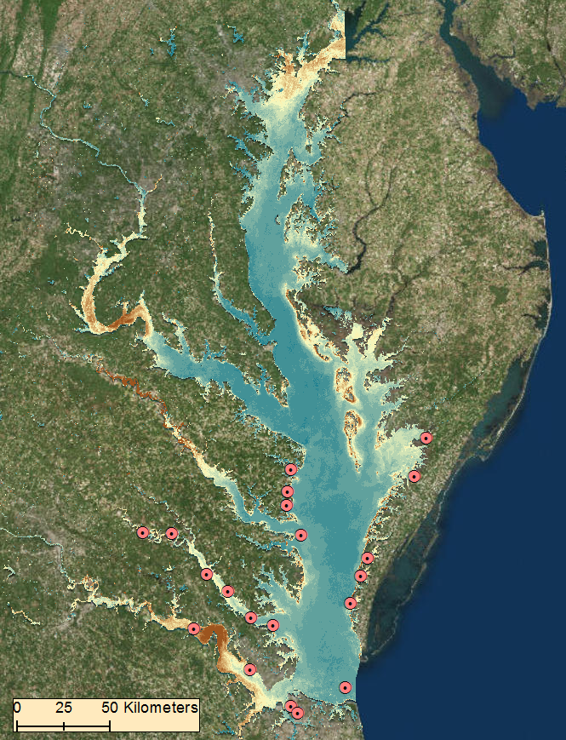
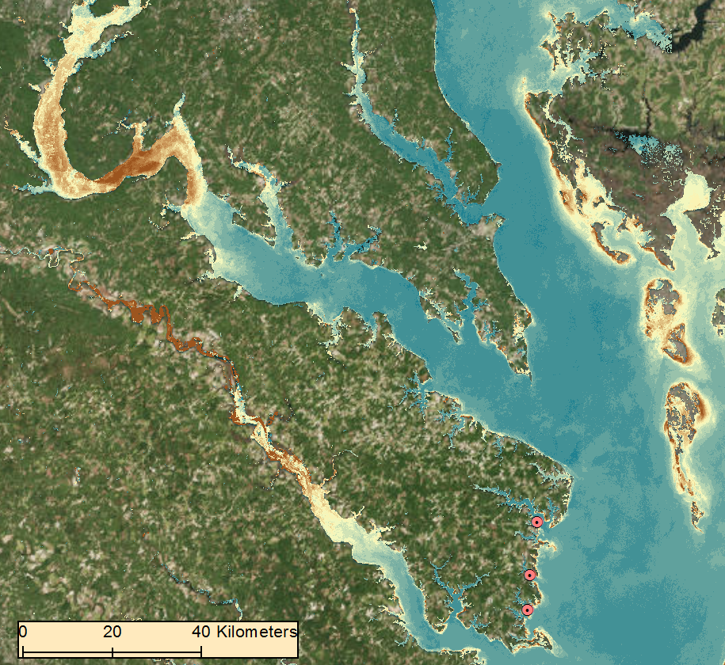
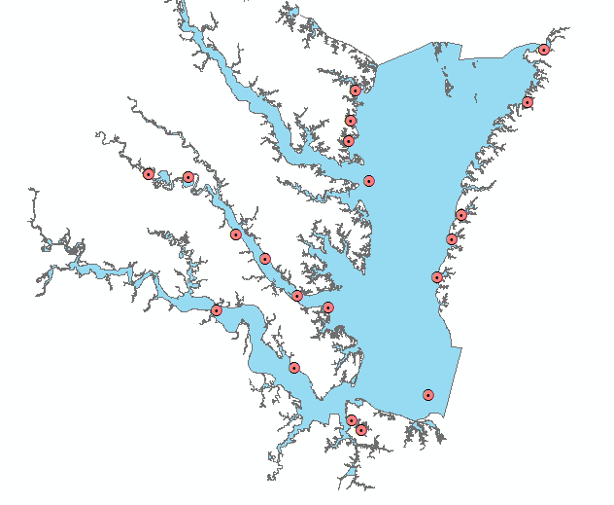
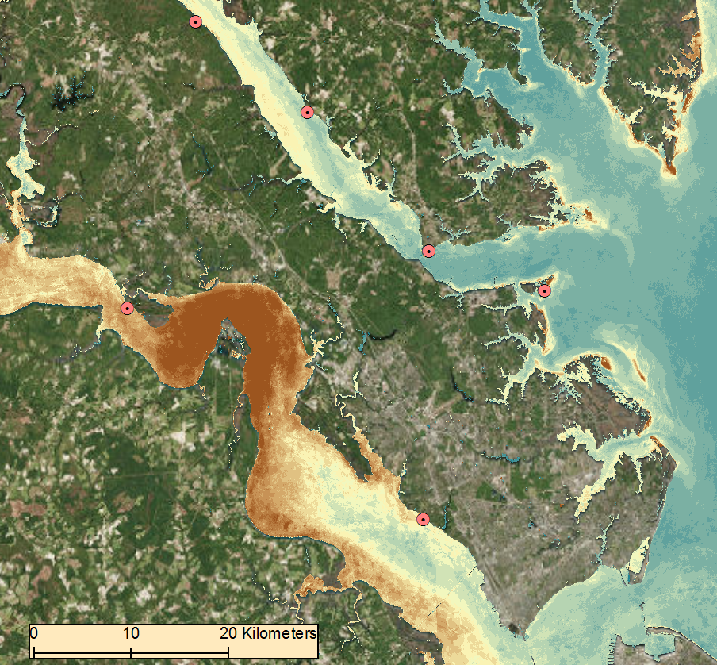
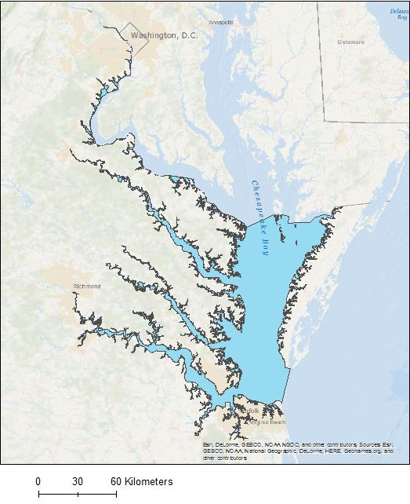
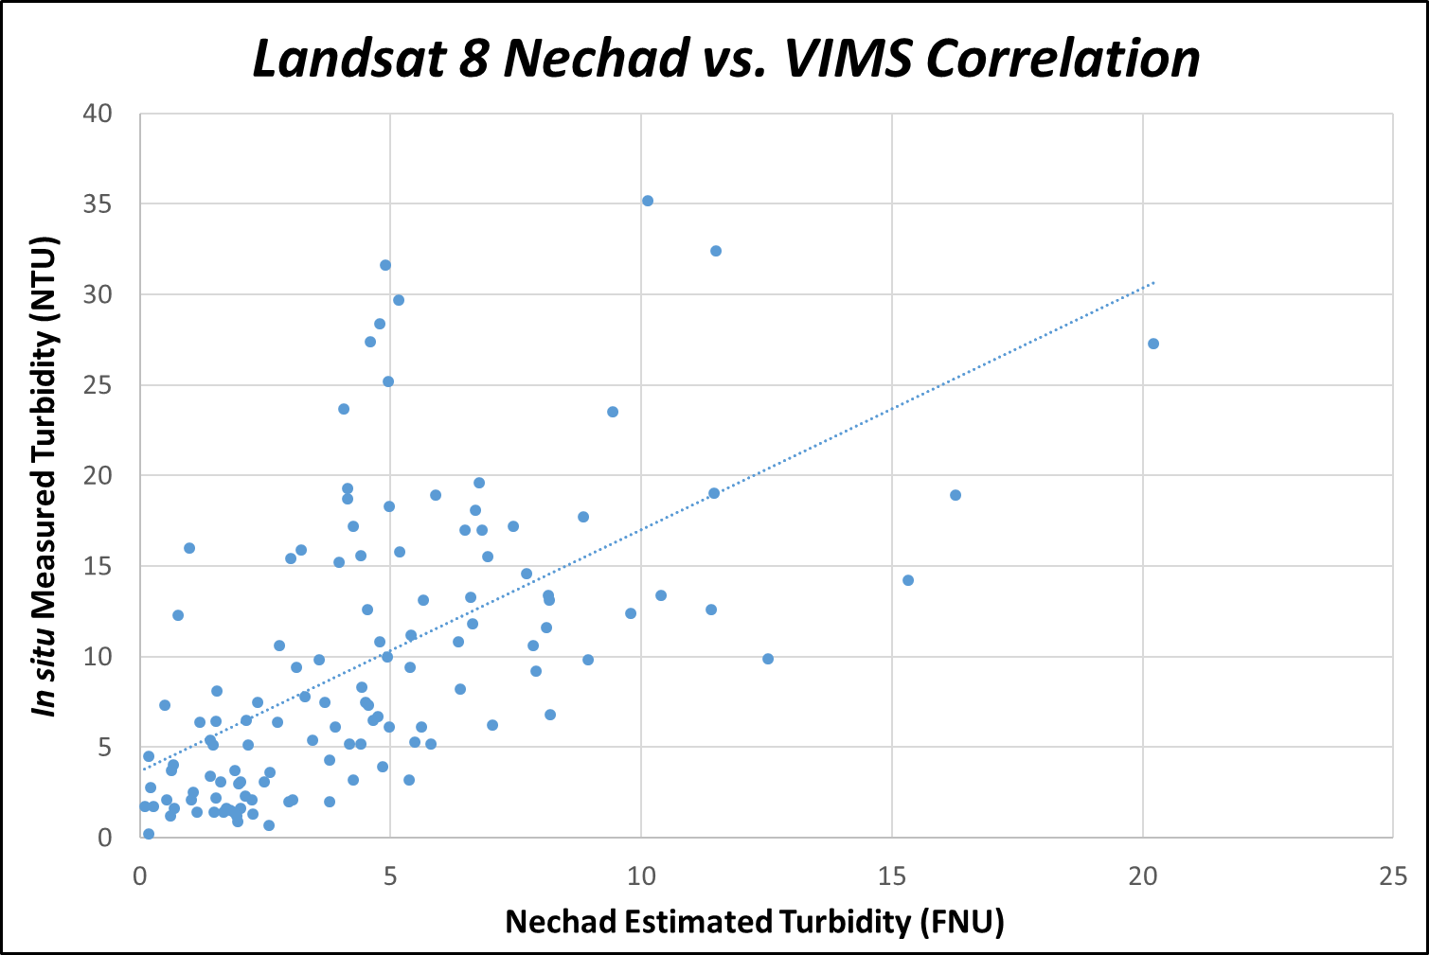
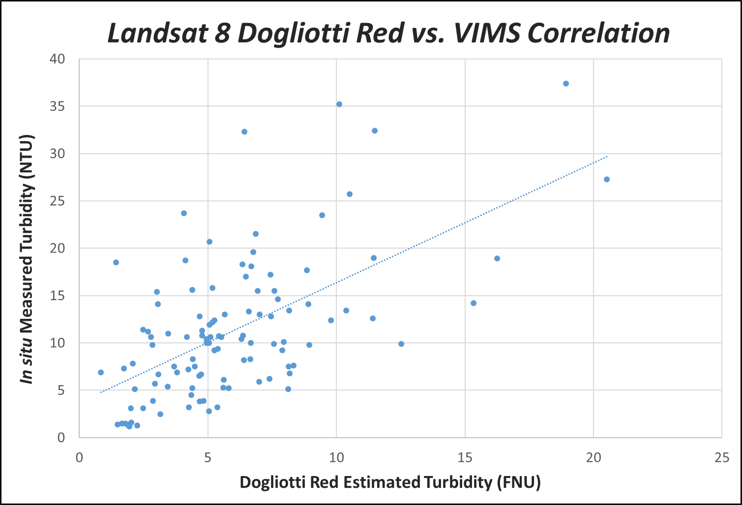
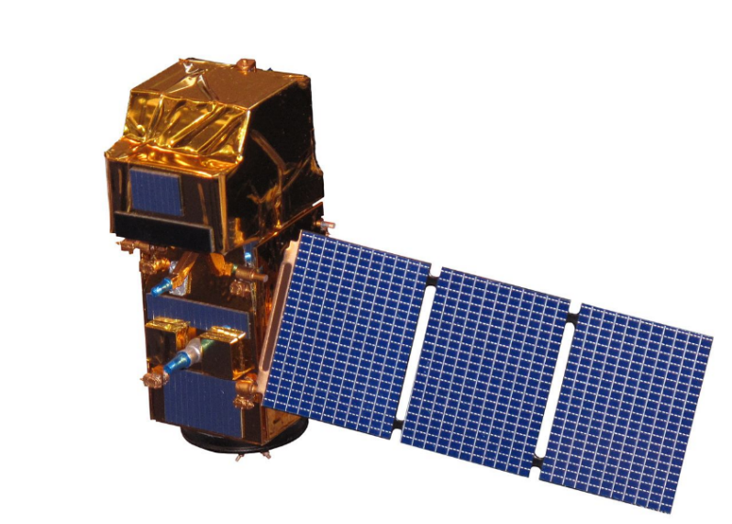
Assessing and Assisting Monitoring Efforts
of Water Clarity to Identify Potential Areas of Submerged Aquatic Vegetation
within Chesapeake Bay
Abstract
Methodology
Submerged Aquatic Vegetation (SAV) is vitally important to the Chesapeake Bay, serving as one of the primary food sources for the organisms that inhabit its ecosystems. This project evaluated the efficacy of remote sensing applications to monitor water quality parameters, specifically turbidity, to indicate areas that can potentially support healthy populations of SAV in the Chesapeake Bay. The resources and methods included visual analysis by utilizing Landsat 8 Operational Land Imager (OLI) and Sentinel-2 MultiSpectral Instrument (MSI). The algorithms incorporated in the ACOLITE software allow for atmospheric correction of spatial and temporal surface reflectance satellite imagery. By correlating Landsat and Sentinel derived output turbidity products to the Virginia Institute of Marine Sciences’ in situ monitoring data, different models were created that provided an estimate of water clarity throughout the entire bay and its associated tributaries. Dogliotti turbidity products provided the best correlations between satellite remote sensing and in situ turbidity data throughout the open waters of the Chesapeake Bay, while Nechad turbidity products provided stronger correlations throughout the bay’s tributaries. The models can be used as an additional resource for the Virginia Department of Environmental Quality to aid the monitoring of turbidity variations within the Chesapeake Bay. These monitoring techniques will also assist in determining Total Maximum Daily Load calculations and the resulting effects on the growth of SAV.
Earth Observations Acquisition
Virginia Institute of Marine Science
Landsat 8 OLI
Sentinel-2 MSI
In Situ Continuous Monitoring Stations
ACOLITE Imagery Processing
VIMS vs. EO Date Matching
Resulting End Products:
Statistical correlations of L8 and S2
Chesapeake Bay Water Clarity Maps
Results
Landsat 8 Chesapeake Bay-wide 2013 Mosaic:
Turbidity Scale (NTU)
High: 15+ NTU
Low: 0 NTU
Study Area
Monitoring Stations
Study Period:
2013 - 2017
March - October
Turbidity Scale (NTU)
High: 15+ NTU
Low: 0 NTU
Chesapeake Bay Water Resources II
Landsat 8 Statistical Correlations and Models:
Monitoring Stations
NIR Corrected by Station Statistical Analysis |  | ACOLITE Turbidity Products (R Values)
 |  | RRS Red | Dogliotti Red | Dogliotti Blended | Garaba | Nechad
Continuous Monitoring Stations | Cherrystone | 0.275 | 0.257 | 0.257 | 0.398 | 0.385
 | Ashland Circle | N/A | N/A | N/A | 0.949 | 0.949
 | Claybank | 0.151 | 0.174 | 0.174 | 0.052 | 0.119
 | Dividing Creek | 0.104 | 0.100 | 0.100 | 0.484 | 0.570
 | First Landing | 0.861 | 0.867 | 0.867 | 0.861 | 0.867
 | Gloucester | 0.302 | 0.305 | 0.305 | 0.290 | 0.332
 | Goodwin Island | 0.036 | 0.054 | 0.050 | 0.145 | 0.030
 | Hungars Creek | 0.903 | 0.747 | 0.747 | 0.723 | 0.741
 | Hunting Creek | 0.960 | 0.263 | 0.263 | 0.323 | 0.375
 | Indian Creek | 0.448 | 0.466 | 0.466 | 0.492 | 0.503
 | Ingram Bay | 0.491 | 0.507 | 0.507 | 0.264 | 0.097
 | Jamestown Buoy | 0.670 | 0.725 | 0.732 | 0.677 | 0.731
 | James River | 0.241 | 0.393 | 0.393 | 0.414 | 0.562
 | Nassawadox Creek | N/A | 0.497 | 0.497 | 0.583 | 0.623
 | Norfolk Yacht | 0.102 | 0.126 | 0.126 | 0.080 | 0.466
 | Stingray Point | 0.984 | 0.984 | 0.984 | 0.961 | 0.950
 | Tallpines | N/A | N/A | N/A | 0.999 | 0.999
 | White House Landing | N/A | N/A | N/A | 0.193 | 0.198
 | Sweet Hall Marsh | 1.000 | 0.999 | 0.999 | 0.378 | 0.419
Continuous Monitoring Stations
VA Chesapeake Bay Study Area
Earth Observations
Landsat 8 OLI
Sentinel-2 MSI
Active: 2013 - Present
Active: 2015 - Present
NO STATION AVAILABLE
NEGATIVE CORRELATIONS
POSITIVE CORRELATIONS
BEST POSITIVE CORRELATION
Remote Sensing vs. In Situ Correlation Strength
Objectives
Nechad: R = 0.5929
Dogliotti Red: R = 0.5997
Combined: R = 0.6727
Conclusions
Determine feasibility of using remote sensing techniques to help aid the measurement of water clarity within the Chesapeake Bay
Correlate and model satellite derived water clarity metrics with continuous in situ monitoring data to validate methodology
Develop an automated Python tool utilizing NASA and ESA Earth observations that ease the use of ACOLITE software processing
Produce annual Chesapeake Bay-wide and tributary Water Clarity Maps identifying variations in turbidity and its effect on SAV growth
ACOLITE provides effective atmospheric corrections for water monitoring applications but is currently only optimal for satellite imagery ranging 2013-present.
Remote sensing over shallow waters is influenced by proximity to land, sediment upwelling due to tidal movements, and sandy bottom effects.
Dogliotti Red and Nechad turbidity products provide the most accurate assessment for monitoring water clarity within the Chesapeake Bay.
Sentinel-2 captures imagery with a finer spatial resolution but has difficulties producing confident correlations since its recent launch date results in a limited data archive.
Team Members
Project Partners
Acknowledgements
Dr. Kenton Ross: NASA Langley Research Center
Previous Contributors:
Danielle Quick
Gregory Hoobchaak
Collin Henson
Cole Cowher
Amanda Clayton
Tish Robertson:
Virginia Department of Environmental Quality,
Office of Ecology
Peter Tango:
United States Geological Survey, Water Science Center
Eli Simonson
Team Lead
Antonio Alvarado
Will Crowley
NASA Langley Research Center – Summer 2017

