Slide 1
Himalayan Disasters II
Utilizing near real-time landslide identification and precipitation monitoring products for enhanced landslide detection
Justin Roberts – Pierel (Project Lead)
Aakash Ahamed
Jessica Fayne
Binu Maharjan
Kanti Sen Ojha
Amanda Schochet
Ang Dawa Sherpa

Slide 2
Study Area: Nepal
Location: Nepal and the Himalaya Region
Area: 147,181 km²
Climates: Tropical, Suptropical Temperate, Subalpine, Alpine, Permanent Snow, Cold Desert
Precipitation: 160 mm – 5000 mm
Notes:
Image Source: Aakash Ahamed
Image Data sources: ICIMOD
Content source: Wikipedia
Speaker Notes:
Location: Nepal is a landlocked, mountainous East Asian country that is slightly larger than the state of Arkansas.
Area: The country is 147,181 square kilometers in size.
Climate: 8 Climatic zones across the country due to large gradients in altitude and precipitation.

Slide 3
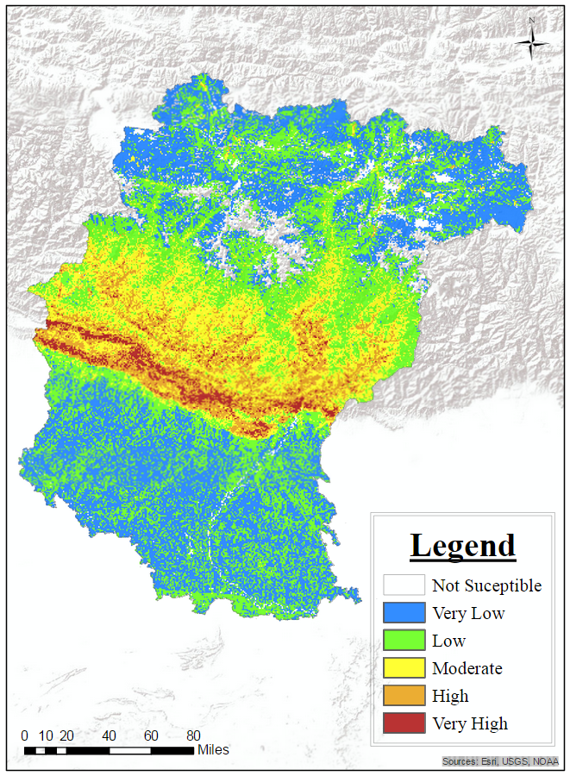
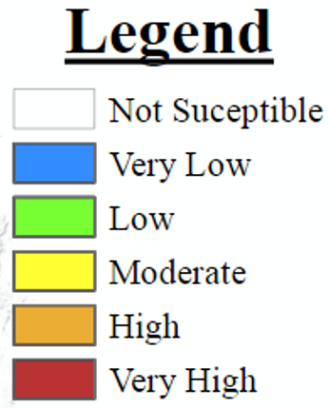
Study Objectives
Develop a near real time automatic landslide detection product for Nepal and the Himalaya region (SLIP).
Add landslide events to the Global Landslide Catalog (GLC) Database.
Develop a near real time precipitation monitoring product for Nepal and the Himalaya region (DRIP).
Notes:
Image Source:
Amanda Rumsey
Speaker Notes: Goal in general is an automatic landslide detection and near realtime warning product. Image shows a landslide susceptibility map from last term based on frequency ratios of landslides in relation to 12 conditioning variables.

Slide 4
Community Concerns
Landslides cause hundreds of fatalities and millions of dollars in losses in the Nepal and Himalaya region annually.
Significant induced hazard arising from M7.8 Gorkha earthquake.
Increase in frequency and severity during summer monsoon.
Landslides currently underestimated globally.
Placeholder for ICIMOD Landslide/Earthquake Photograph(s)
Notes:
Speaker Notes:
Nepal is an underdeveloped country- poor infrastructure results in significant economic damage and loss of life from landslide events.
In August 2014, over 150 people were killed in a single landslide in the Koshi region [other deadly landslides?]. The landslide also blocked the intersection of two rivers, causing extended concern for flooding.

Slide 5

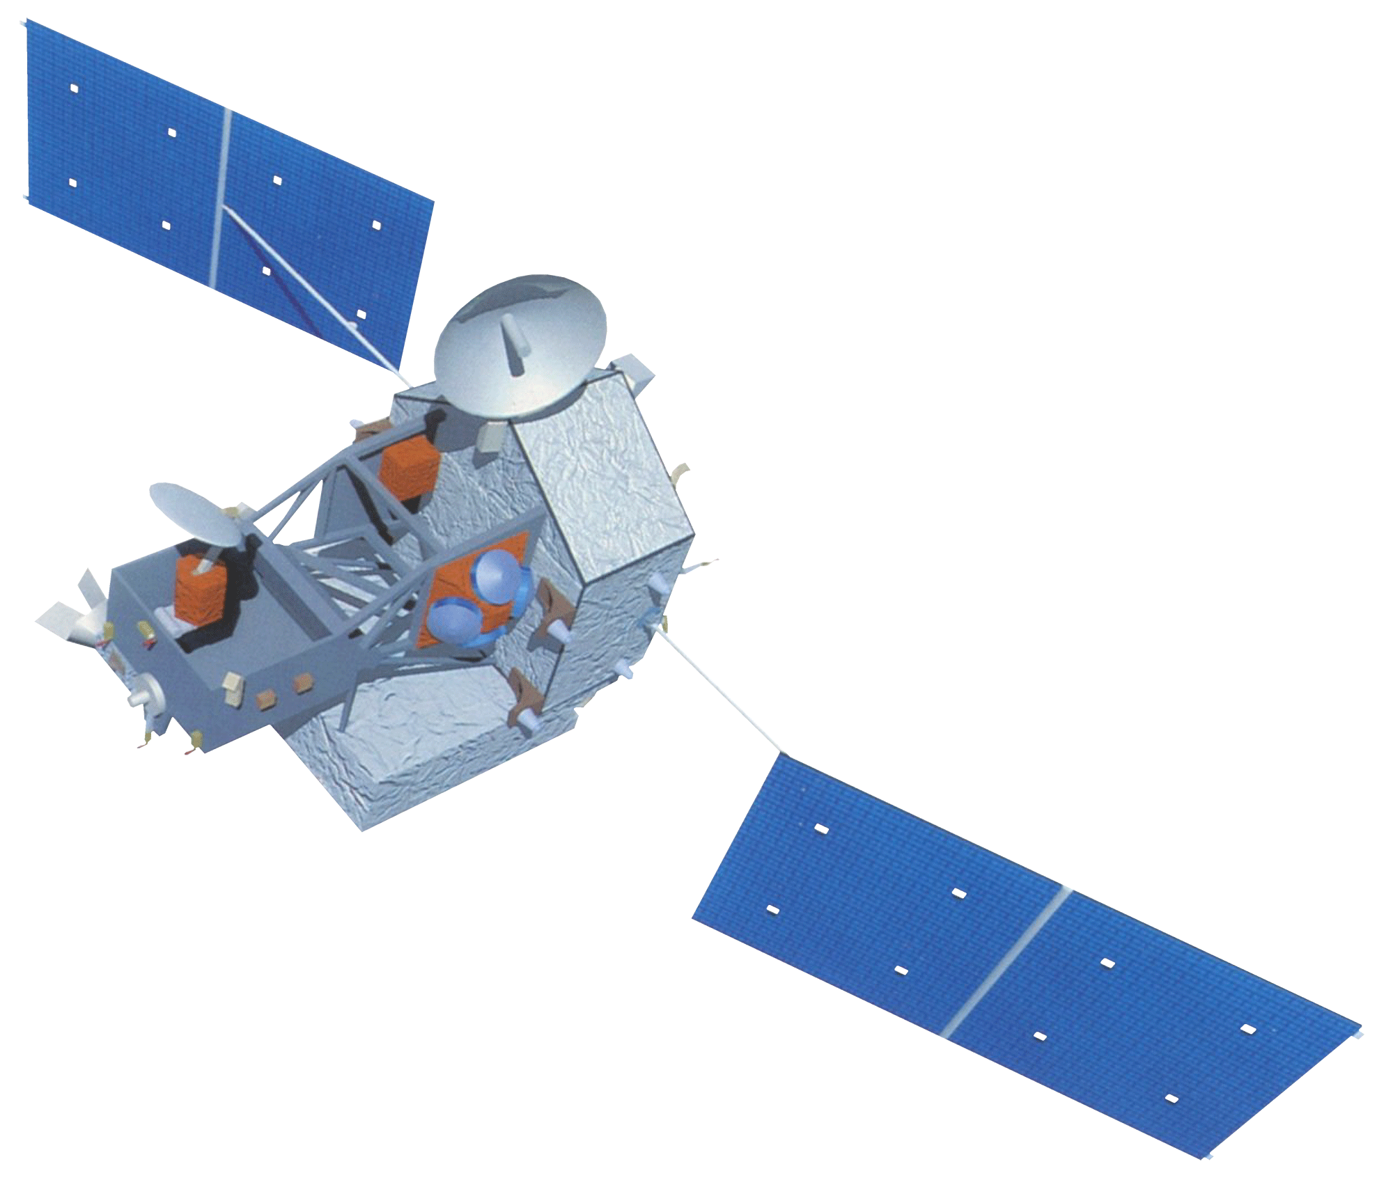
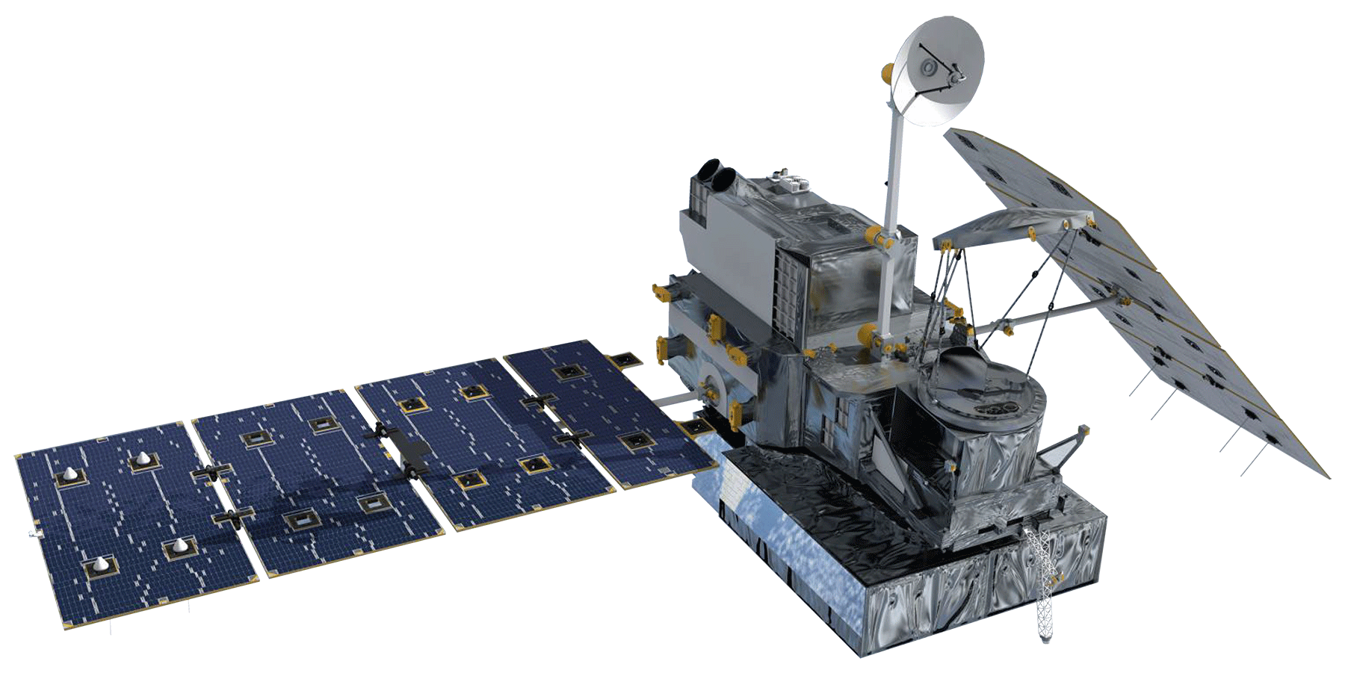

NASA Satellites / Sensors Used
TRMM
Landsat 8
GPM
Terra
Notes:
Image Source: Developedia (http://www.devpedia.developexchange.com/dv/index.php?title=List_of_Satellite_Pictures)
Speaker notes: TRMM and GPM are used to monitor precipitation, which is the main cause of landslides.
Landsat used for aerial imagery (30m resolution)
Terra used for ASTER DEMs.

Slide 6
Methodology: SLIP
Sudden Landslide Identification Product
Landsat 8
Terra
Notes:
Image Source: Developedia (http://www.devpedia.developexchange.com/dv/index.php?title=List_of_Satellite_Pictures)
Speaker Notes: Landsat used for imagery, Terra used to create ASTER DEMs.

Slide 7
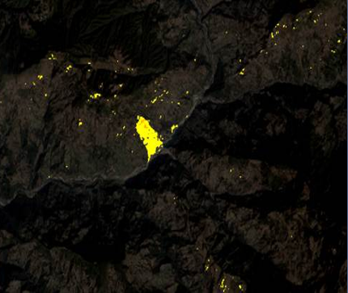
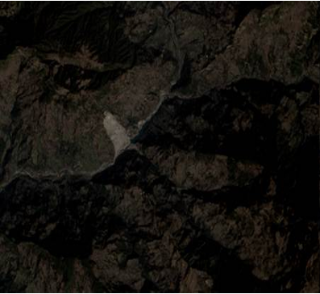
Methodology: SLIP
Data Collection
  Collect Landsat scenes and extract R, IR,SWIR and QA bands
Cloud Mask
  Use the QA Band to Remove Clouds from the R, IR, and SWIR images
Red Increase
  Calculate percent change between two Red images
Post SLIP Image
Moisture Index
  Calculate moist areas using the IR and SWIR bands, comparing two images
Remove Flat Terrain
  Remove pixels with slopes lower than 15%
Pre SLIP Image
Notes:
Image Source:
Jessica Fayne
Speaker notes: Originally written in R, transcribed in to python this term. Original calibration based on one large landslide event. Calibration and validation have since been expanded to multiple areas (i.e. CA, Rio, Nepal), and algorithm improved.

Slide 8
Methodology: SLIP
Placeholder for SLIP method video (too large to attach)
Notes:
Image Source:
Jessica Fayne
Speaker notes TBD (Jessica Fayne)

Slide 9
Methodology: DRIP
Detecting Real-time Increased Precipitation
TRMM
GPM
Notes:
Image Source: Developedia (http://www.devpedia.developexchange.com/dv/index.php?title=List_of_Satellite_Pictures)
Speaker Notes: TRMM data used in order to determine seasonal, annual, monthly rainfall statistics.
GPM data monitored in real time and compared against historic TRMM data.

Slide 10
Methodology: DRIP
GPM
GPM data is downloaded in near real-time
TRMM
IMERG 30-Minute
TMPA-RT 3B42
Data Collection
Thresholds
Comparison
Alert
Monthly mean thresholds calculated from historical TRMM data
Monitors 30 min GPM IMERG data; looks for anomalies compared with thresholds
If current rainfall levels are significantly higher than thresholds, alert is issued for the affected area
Notes:
Image Source:
Aakash Ahamed, Justin Roberts-Pierel
Speaker Notes: Schematic of workflow for DRIP model. DRIP used to monitor precipitation in Nepal.

Slide 11
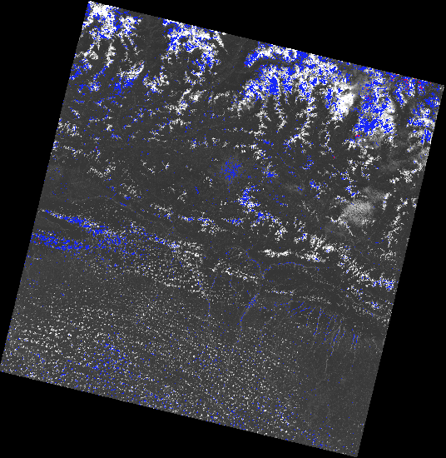
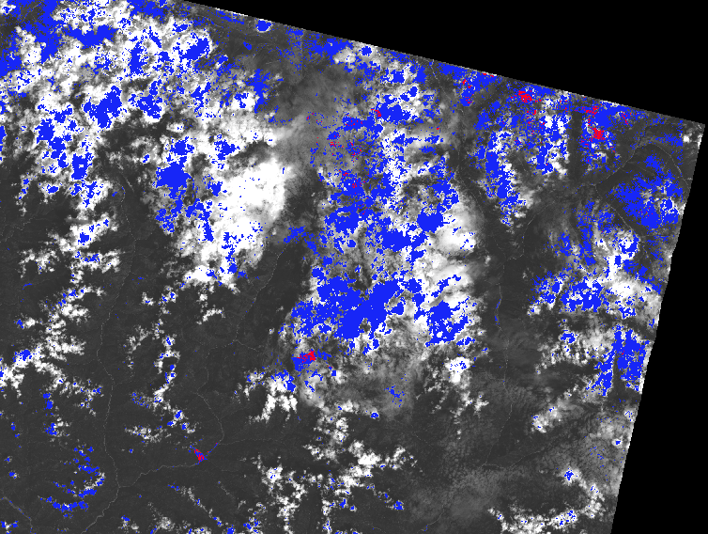
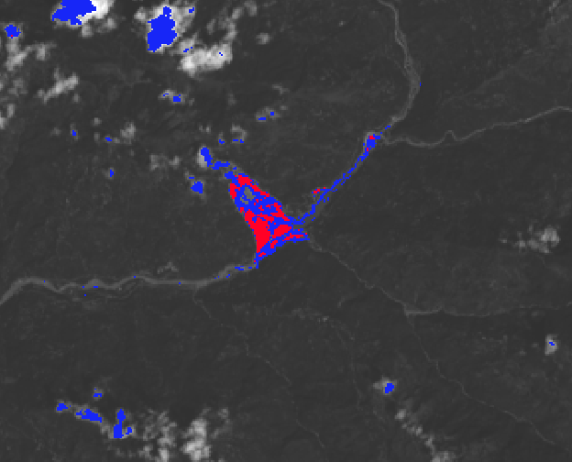
Results: SLIP
Notes:
Image Source:
Jessica Fayne
Speaker Notes:
Blue areas match either the moisture or the red increase criteria, the red areas match both.
Next step: incorporate slope
This example is from an non-cloud masked image.

Slide 12
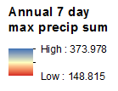
Results: DRIP
Notes:
Image Source:
Aakash Ahamed
Speaker Note:
Blue areas represent higher average for 7 day max precipitation for length of record, red areas represent lower average 7 day max precipitation for length of record

Slide 13
Results: Other
TBD
Notes:
Speaker Notes: TBD

Slide 14
Conclusions
TBD
Notes:
Speaker Notes: TBD

Slide 15
Conclusions
TBD
Notes:
Speaker Notes: TBD

Slide 16
Errors and Uncertainties
TBD
Notes:
Speaker Notes: TBD

Slide 17
Future Work
TBD
Notes:
Speaker Notes: TBD

Slide 18
Advisors
Dr. Dalia B. Kirschbaum, NASA Goddard Space Flight Center (Science Advisor )
Dr. John D. Bolten, NASA Goddard Space Flight Center (Science Advisor)
Thomas A. Stanley, NASA Goddard Space Flight Center (Science Advisor)
Sebastian Wesselman, ICIMOD (Science Advisor)
Partners
International Centre for Integrated Mountain Development (ICIMOD)
Former Teammates
Amanda Rumsey
Jamie Shiplet

