Slide 1

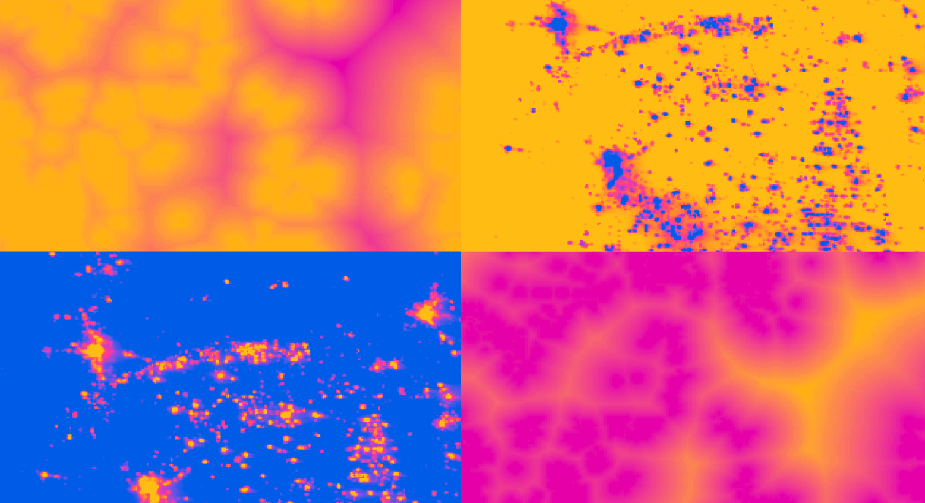

2018 Summer | Alabama - Marshall
NEW MEXICO ENERGY
Identifying Optimal Site Location for Wind Energy Farms Considering Ecological and Social Impacts
Kara Cassano
Joy Marich
Franny Senkowsky
Notes:
-Hi everyone! We are the New Mexico Energy Team. The goal of our project is to identify optimal site locations for Wind Energy Farms Considering ecological and social impacts while also assessing areas of high wind power potential.
-(everyone introduces themselves)
-and we are excited to talk to you about our project today!

Slide 2
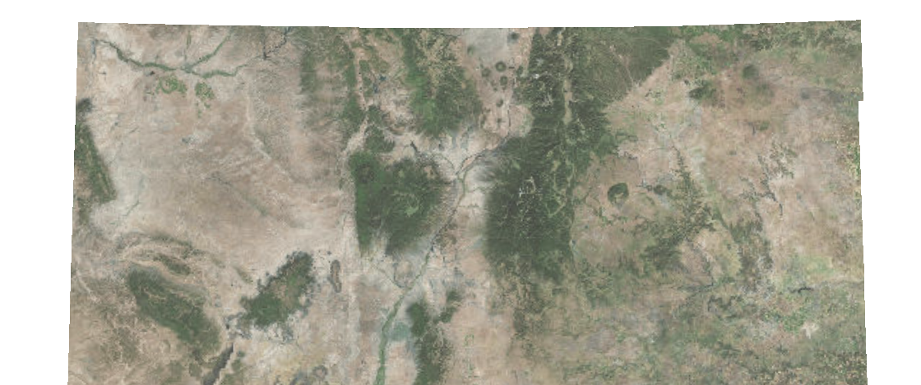
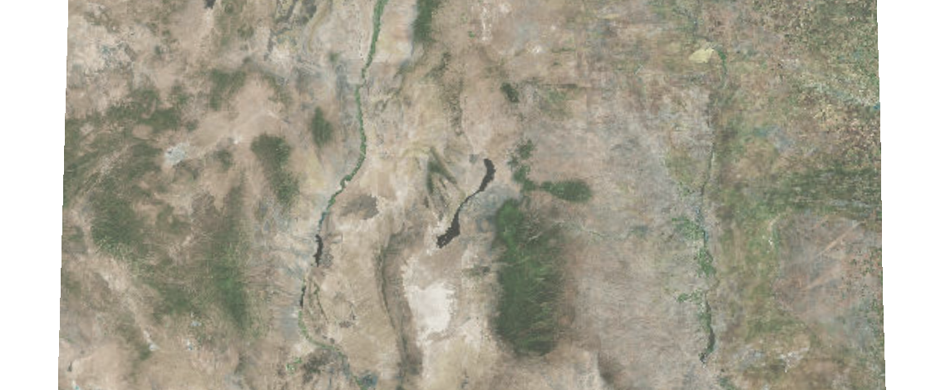
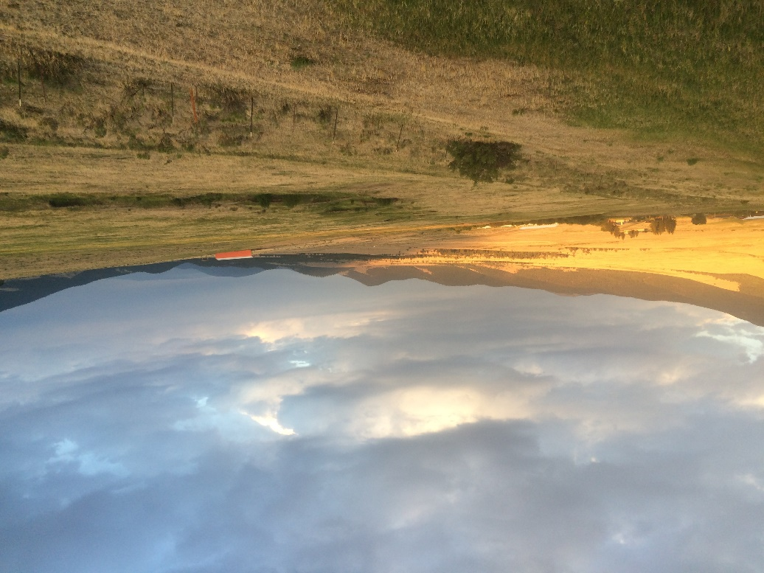
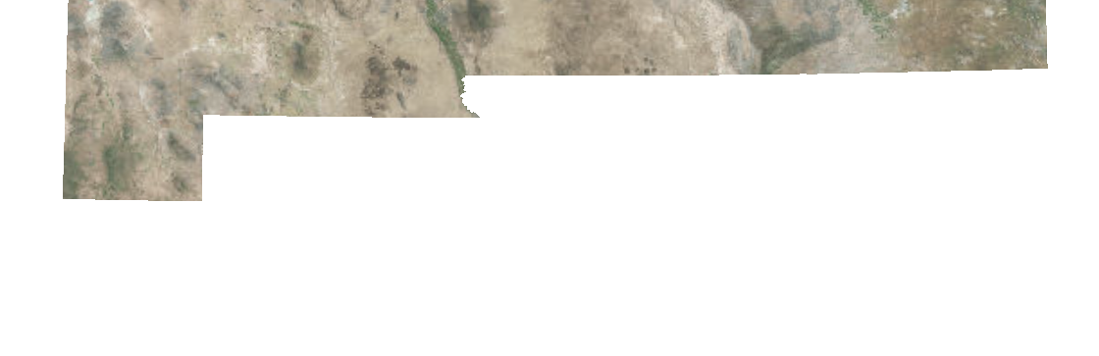
Study Area
Location: New Mexico
Time Period: February 2013 – May 2018
Santa Fe
!
Albuquerque
!
±
!
Major City
Interstate Highway
Image: Susie Firra
0
50
100
Miles
Notes:
The area of focus for our project is the entire state of New Mexico. We utilized data from Feb 2013 – May 2018 to create a snapshot of future development potential of wind farms within the state.

Slide 3
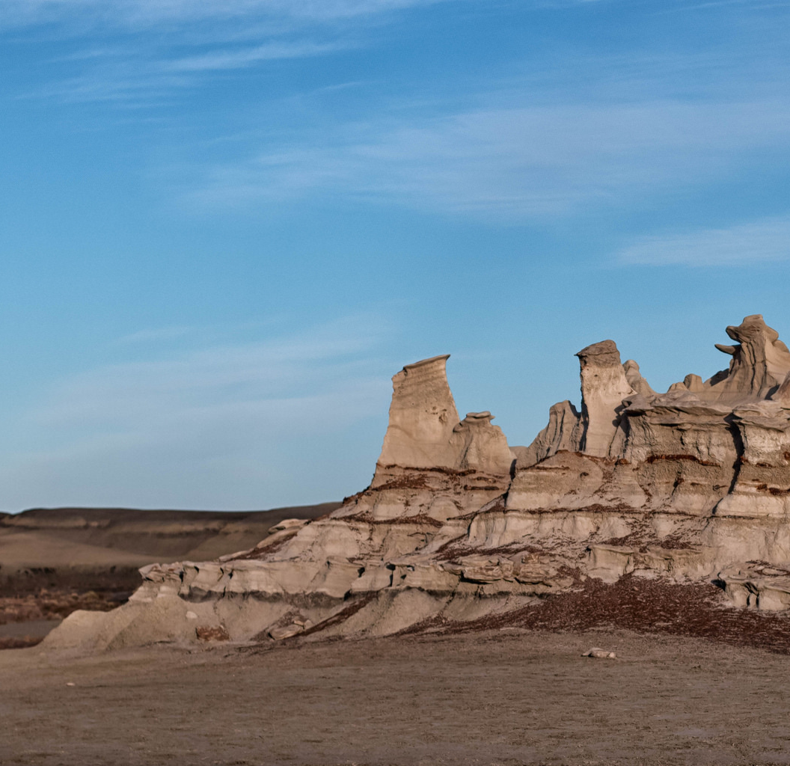
Objectives
Showcase SRTM v4 and Suomi NPP VIIRS Day Night Band data
Determine areas of low social and ecological impact
Assess wind power potential through the state
Identify regions of optimal suitability for wind farms
Image Credit: Matt Domonkos
Notes:
Our main objectives for this project were
to Showcase the Shuttle Radar Topography Mission Version 4 and Suomi National Polar-Orbiting Partnership VIIRS Day Night Band data through site suitability analysis of possible locations for wind farm development
to Determine site suitability based on ecological factors, such as vulnerable species and protected lands, and social factors, such as population density and Air Force Bases
to Assess wind power potential through the state by calculating wind power density and taking into account other land characteristics such as elevation and land cover types
and to Identify areas with the greatest wind power potential
Link: https://www.flickr.com/photos/mtdomonkos/29257260188/in/pool-newmexico/

Slide 4
Project Partners
Organization | POC (Name, Position/Title)
New Mexico Energy, Minerals & Natural Resources Department, Energy Conservation & Management Division | Jeremy Lewis, Bureau Chief
New Mexico Department of Game and Fish | Ronald Kellermueller, Mining & Energy Habitat Specialist
Department of Energy, National Renewable Energy Laboratory | Robi Robichaud, Researcher IV
Notes:
We partnered with three organizations:
The New Mexico Energy Conservation and Management division which is under their minerals and natural resources department, which we worked with their bureau chief Jeremy Lewis
The New Mexico Department of Game & Fish and Ronald Kellermueller, a mining and energy habitat specialist
And lastly, Robi Robichaud, a researcher at the department of energy’s national renewable energy lab
Link: https://www.flickr.com/photos/larry1732/5644896280/in/photolist-povgY-smPPsb-TspLTD-5T5v4B-9zaiXV-Sq1kEa-TAdgVh-SneCVW-E62TS3-9APyZW-eUGtAQ-TpZhm9-eUvcYM-eUv2ja-eUGqPY-eUv9xP-eUva5k-eUvbJt-eUvasx-eUGvEJ-eUv94V-eUv9Rx-eUGw4y-eUGom1-eUvdoX-eUv2w6-eUvbtB-eUv9gZ-oWsfZw-eUGtU7-9APzc7-eUGu8Q-TpWhZQ-eUvbzM-eUGtsN-E63g6L-eUvb48-eUGvrC-TAccE5-eUvbaX-eUv5P4-9ALDXk-sDf3LW-smR8Vo-rGBSwe-DGZkoi-eUGu1A-eUvaUn-eUv75k-9APzny/

Slide 5
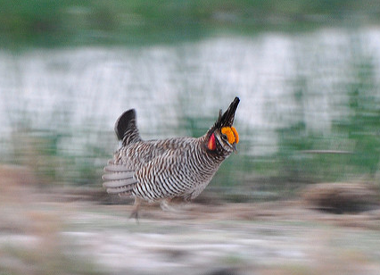
Community Concerns
More growth in wind energy in 2017 than any other state
Renewables Portfolio Standard set goals increase renewable energy production
Impacts and potential conflicting land uses that must be assessed to meet goals:
  Air Force Bases
  Vulnerable Species
  Protected lands
  Wind power potential
Image Credit: Larry Lamsa
Notes:
In 2017, New Mexico was the state with the largest growth in wind energy production. The state’s government established the Renewables Portfolio Standard in 2004, which set goals to increase the wind energy sector. According to the National Renewable Energy Lab, this will require increasing New Mexico’s wind power capacity by 520% by 2030.
However, while pursuing this growth, impacts and potential land use conflict must be considered, including
Social impacts, particularly presence of Air Force Bases and special use air spaces throughout the state.
Ecological impacts, such as the effects on golden eagle, bald eagle, and lesser-prairie chicken populations as well as protected lands throughout the state
And lastly, wind power potential based on factors such as wind speed and elevation
Link: https://www.flickr.com/photos/larry1732/5644896280/in/photolist-povgY-smPPsb-TspLTD-5T5v4B-9zaiXV-Sq1kEa-TAdgVh-SneCVW-E62TS3-9APyZW-eUGtAQ-TpZhm9-eUvcYM-eUv2ja-eUGqPY-eUv9xP-eUva5k-eUvbJt-eUvasx-eUGvEJ-eUv94V-eUv9Rx-eUGw4y-eUGom1-eUvdoX-eUv2w6-eUvbtB-eUv9gZ-oWsfZw-eUGtU7-9APzc7-eUGu8Q-TpWhZQ-eUvbzM-eUGtsN-E63g6L-eUvb48-eUGvrC-TAccE5-eUvbaX-eUv5P4-9ALDXk-sDf3LW-smR8Vo-rGBSwe-DGZkoi-eUGu1A-eUvaUn-eUv75k-9APzny/

Slide 6
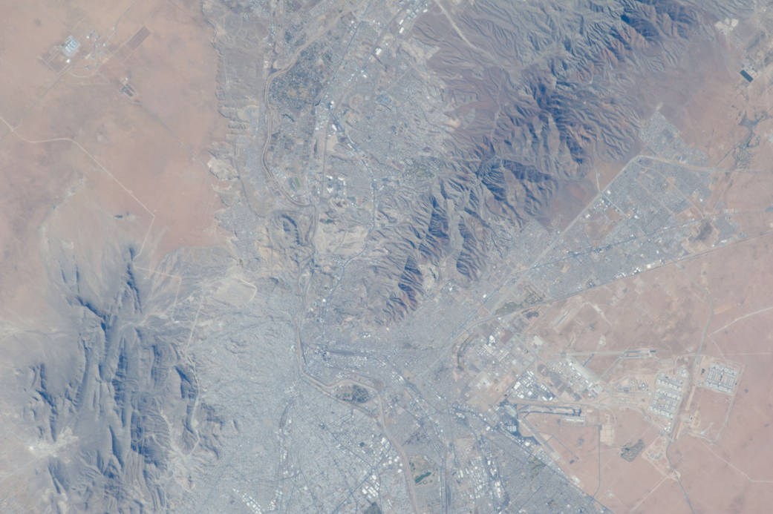
End Products
Suitability of Sites Considering Low Ecological Impact Map
Suitability of Sites Considering Low Social Impact Map
Suitability of Sites Considering Wind Power Potential Map
Optimal Wind Farm Suitability Map
Image Credit: NASA
Notes:
Our team created four end products for our partners in New Mexico
- The first is a suitability map considering a low ecological impact of wind farm development.
- The second is a suitability map considering a low social impact of wind farm development.
- The third is a suitability map considering wind power potential across the state of New Mexico.
- the final product is a combination of the preceding three maps creating an Optimal Wind Farm suitability map.

Slide 7
Methodologies
Data Analysis
Data Acquisition
End Products
SRTM v4
Fuzzy Logic
Suitability of Sites Considering Low Ecological Impact Map
Suomi NPP VIIRS
LUCIS Model
Suitability of Sites Considering Low Social Impact Map
Ancillary Datasets
Suitability of Sites Considering Wind Power Potential Map
Optimal Wind Farm Suitability Map
Notes:
Starting with Data Acquisition, we collected data from The Shuttle Radar Topography mission for elevation and Suomi NPP for population density, along with data from other ancillary datasets.
From this we conducted Analysis using the Fuzzy Logic and LUCIS Models to create our final four end products.

Slide 8
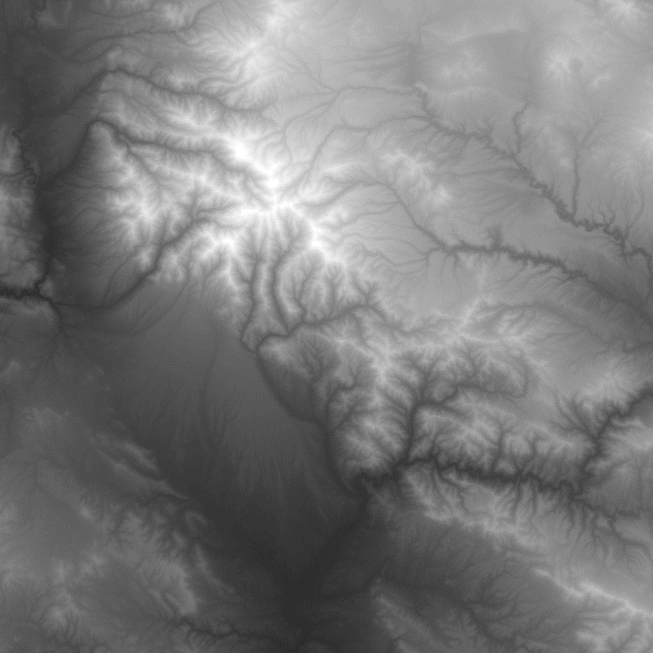
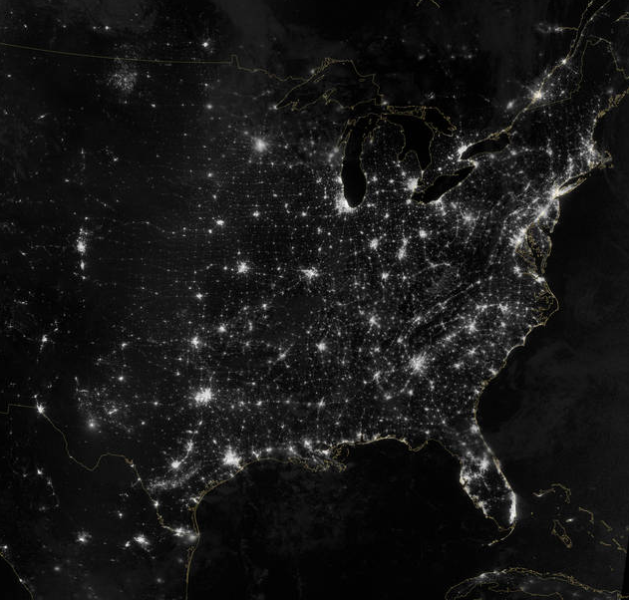
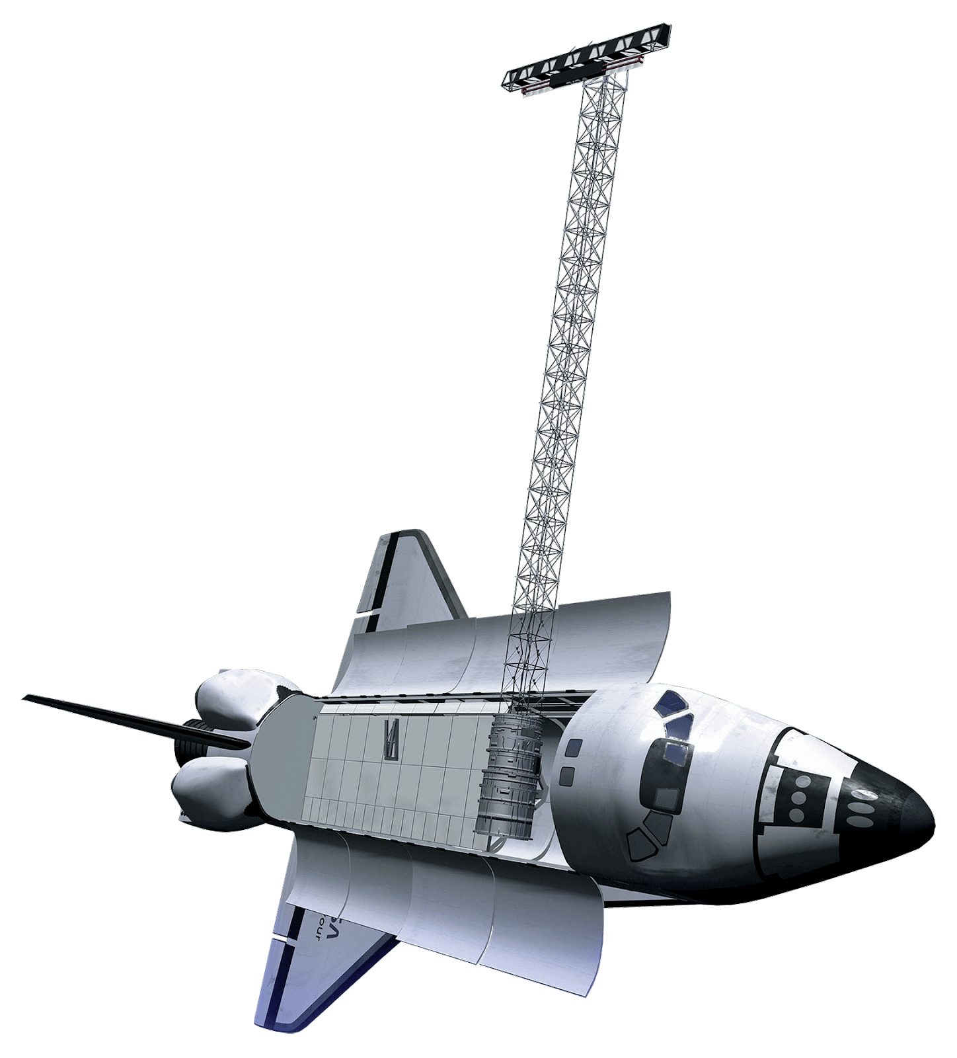
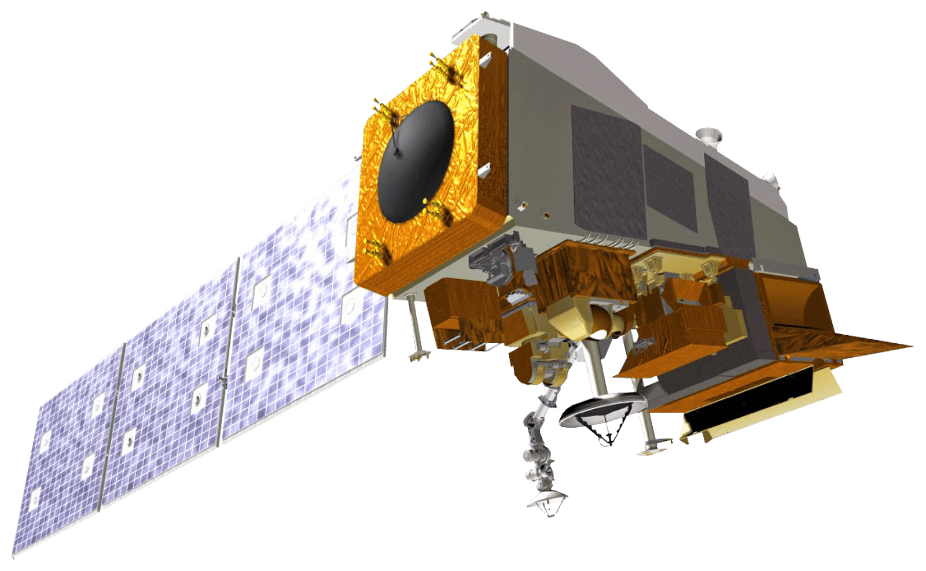
NASA Satellites/Sensors Used
Shuttle Radar Topography Mission (SRTM)
Suomi National Polar-orbiting Partnership (NPP)
Image Credits: NASA
Notes:
We used the Shuttle Radar Topography Mission (version 4) for elevation data to help determine wind power density across New Mexico, and Suomi National Polar-orbiting Partnership VIIRS Day Night Band for light intensity to estimate population density
http://www.devpedia.developexchange.com/dp/index.php?title=List_of_Satellite_Pictures

Slide 9
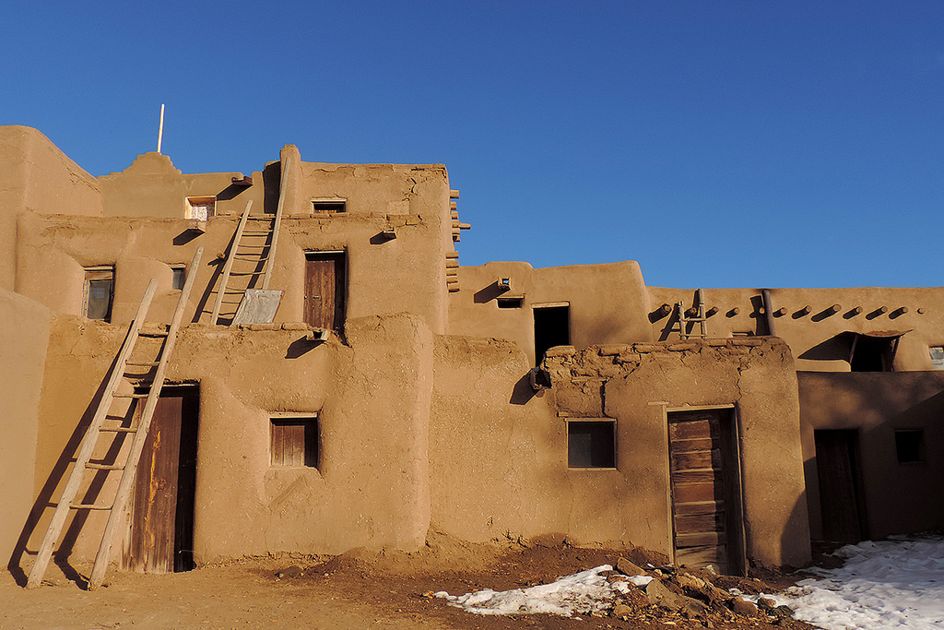
Ancillary Datasets
Natural Heritage New Mexico Golden Eagle and Lesser-Prairie Chicken Distribution Data
2011 National Land Cover Dataset (NLCD)
NASA Surface Meteorology & Solar Energy (SSE)
NASA Socioeconomic Data and Application Center (SEDAC)
Department of Defense Flight Information Publication (FLIP) Planning Books
Image Credit: Drriss & Marrionn
Notes:
- In addition to NASA Earth Observations, we used several other datasets such as
Golden eagle and lesser-prairie chicken population distribution data provided by Natural Heritage New Mexico
The 2011 version of the national land cover dataset, which we reclassified to use in our wind efficiency map
Wind data from the NASA Surface meteorology and solar energy
Population data from NASA’s socioeconomic data and application center to supplement Suomi NPP
And for locations of air force bases and special use airspace, we used data from the DoD’s flight information publication planning books
Link: https://www.flickr.com/photos/drriss/23030438543/in/photolist-B6821B-WV6Nw3-9H8Bq5-iS1fnL-ahTRe3-ayncV9-bE2J2v-VGna3h-br7NF3-bez88Z-WLSjAH-bez6GH-b87eav-e78ZmW-nDxRQL-axy2p8-rr4K6-VQ2n7j-qcTtu4-X3soG5-To4vch-X3sheL-4MssAh-RgET22-46uZse-fke2iv-mRSoy7-q3FkgR-dNZntR-CTQ2qz-TcQSQ9-S8pwWh-95ZwCH-ayniB3-WvptDA-bez9Kn-Y9xgkM-aAo4iY-j9bK3r-fz7mng-VKaNDV-kn9gSc-8EXEmJ-Wvpv2q-b87fwz-93egYe-WYDrQv-cBa5FE-54zvp5-bE2JoK

Slide 10
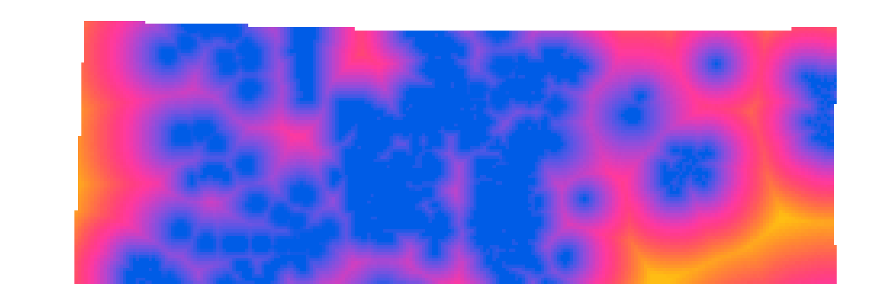
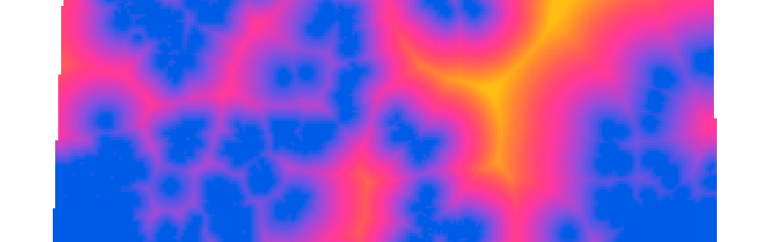
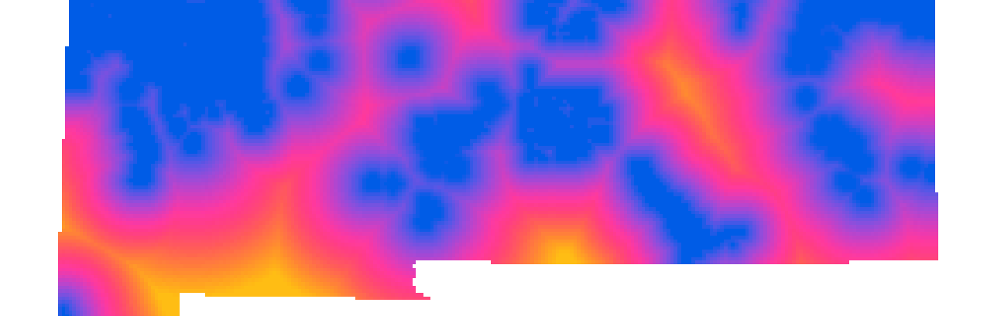
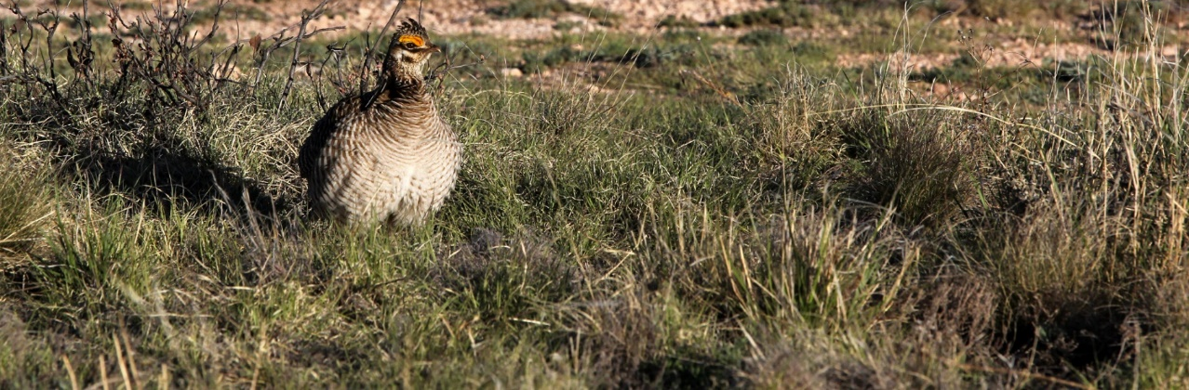

Results
Suitability of Sites Considering Low Ecological Impact
Factors:
  Population distribution of golden eagle and lesser prairie chicken
  National Parks, Forests, and Wildlife Refuges
Santa Fe
Albuquerque
Albuquerque
Low
Image Credit: Drriss & Marrionn
Major Cities
0
25
50
100
Miles
High
Notes:
We created three suitability maps which we then combined to create our fourth, final suitability map.
We created an Ecological Impact map, pictured here, taking into consideration population distribution of the golden eagle and lesser-prairie chicken on private and public land, as well as National Parks, Forests, and Wildlife Refuges. The yellow on the map represents more suitable areas for wind farm development based on these ecological factors.
For example, the yellow area to the east of Albuquerque would be highly suitable for wind farm development when considering these ecological factors.
Link: https://www.flickr.com/photos/sparverius/33733519301/in/photolist-ToV72K-27P2Xk5-78juSy-6gRPqc-VggvvT-6gVZn9-6gRPo8-FCdwUd-8aHefV-HjYGf-FhfY3-bi6MjB-TspLTD-9y5fEq-9zZrw2-H78WpK-9F1J4o-9F1J4d-DPmtYN-s8ydAp-WuSisR-a11G3u-5T5v4B-8639pm-4FosPz-ToV7qF-8aHe9T-rU1mSZ-Tkr6W1-4GbFWB-bzhGw3-eJfi7Z-6fZ1tV-smPPsb-6hmQ16-e9UPRW-rpb5ra-V4STKr-4Avdse-eDL913-4CPNk7-WibBVz-26eBPTe-8aLurs-4CPWRo-WrdLQm-b3XZMe-9EjPK4-9APzny-eUGtAQ

Slide 11
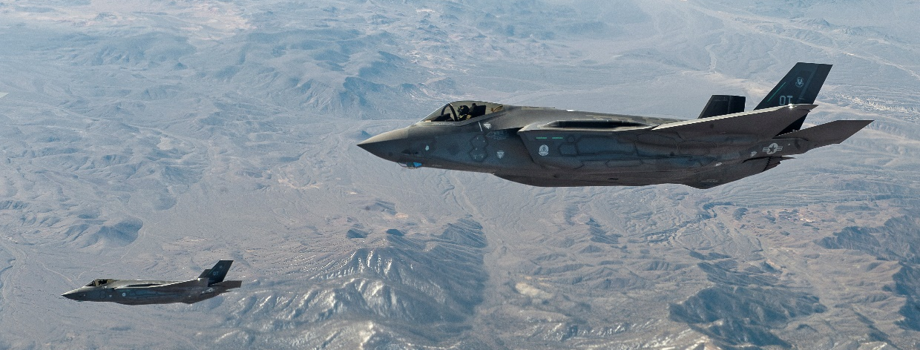
Results
Suitability of Sites Considering Low Social Impact
Factors:
  Population Density
  Air Force Bases
  Special Use Airspaces
  Major roads (Interstates and highways)
Santa Fe
Albuquerque
Low
Image: 99th Air Base Wing Public Affairs
Major Cities
0
25
50
100
Miles
High
Notes:
We assessed suitability based on social factors such as population density, air force bases, special use airspaces, and major roads.
Using ArcMap tools such as Fuzzy Membership and Fuzzy Overlay, created the map shown here, and yellow represents more suitable areas from a social impact point of view
Areas in between roads and cities and away from AF bases and special use airspaces are more suitable
https://www.flickr.com/photos/47833351@N02/13990678439/in/photolist-njiTgM-dkhEeE-7ycAyp-7ooXyo-7okcTK-dRH4Hk-s1KRTG-apLmug-7QKAQh-qYiUap-aq7VcG-drfpLs-aqgxLu-aqgwCs-drfpFS-aqbsRe-aqxv7y-ckLLTL-oAgjwm-dazVDP-mwBaCR-6JUtmG-aqjo1o-aq7USu-aMPLS2-aqjo2L-aqh5H6-21uzynu-qGTodV-7We1oj-6ZP1jt-aqdS5a-8T1QLR-apPwXC-aqkSDg-aivTjk-e5iCrC-ckQRUS-drY4m8-ehk5VM-n9n4qp-aqbsSM-aqdS48-nU9mG5-o85Prc-o9RQLi-Bgs9NT-aMPFTM-5uXiyr-ckMiWA

Slide 12
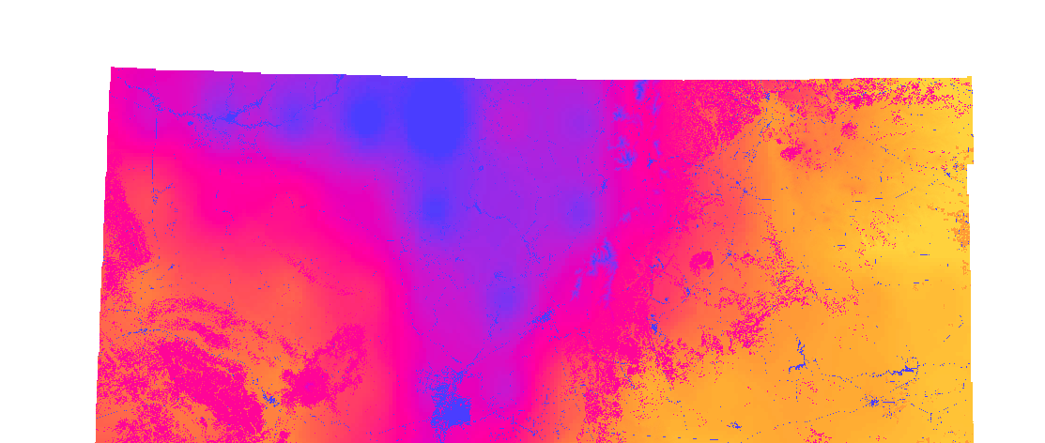
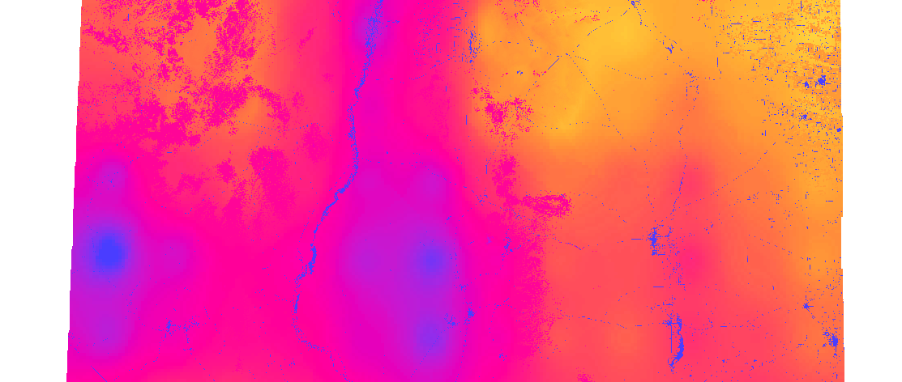
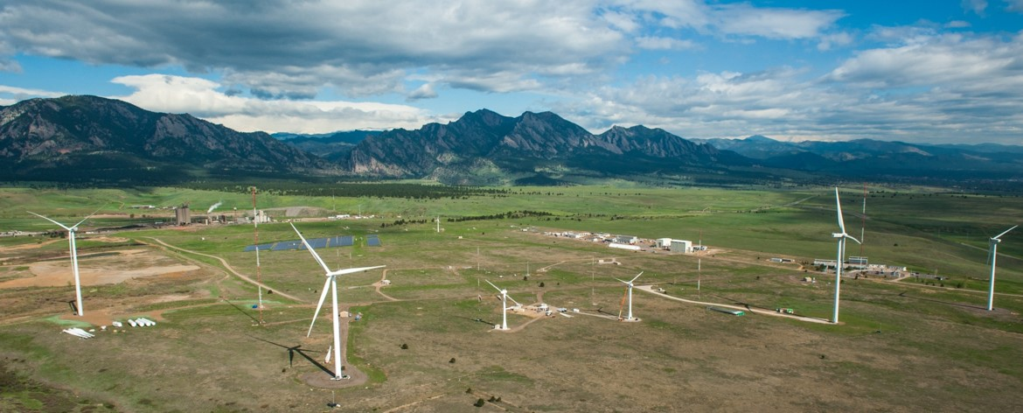
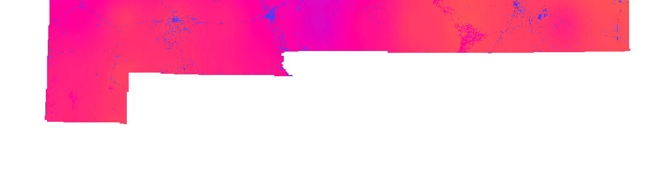
Results
Suitability of Sites Considering Wind Power Potential
Factors
  Wind power density
  Land cover type
  Elevation
Santa Fe
Albuquerque
Image Credit: NREL
Low
Major Cities
0
25
50
100
Miles
High
Notes:
Wind power potential is a very important factor when considering suitability for wind farm development. This map was created using three factors imperative to assessing the wind power potential for the state
of New Mexico. First we considered land cover land use data from the NLCD, reclassified to our own specifications. We rated different land types as more or less suitable depending on the feasibility of wind farm development.
Areas such as forests or urban centers were rated less suitable, whereas areas such as barren land were considered more suitable for development. Next we used SRTM for elevation considerations. Areas with extremely high or extremely variable elevation over a small period were rated less suitable, likewise flatter land was considered more suitable. Finally, we calculated Wind Power Density at 100m across the state of New Mexico using NASA SSE data with excel and python programming. Using Fuzzy Logic, we ranked these variables and produced this final suitability map. The yellow areas are the most suitable areas considering the three factors.

Slide 13
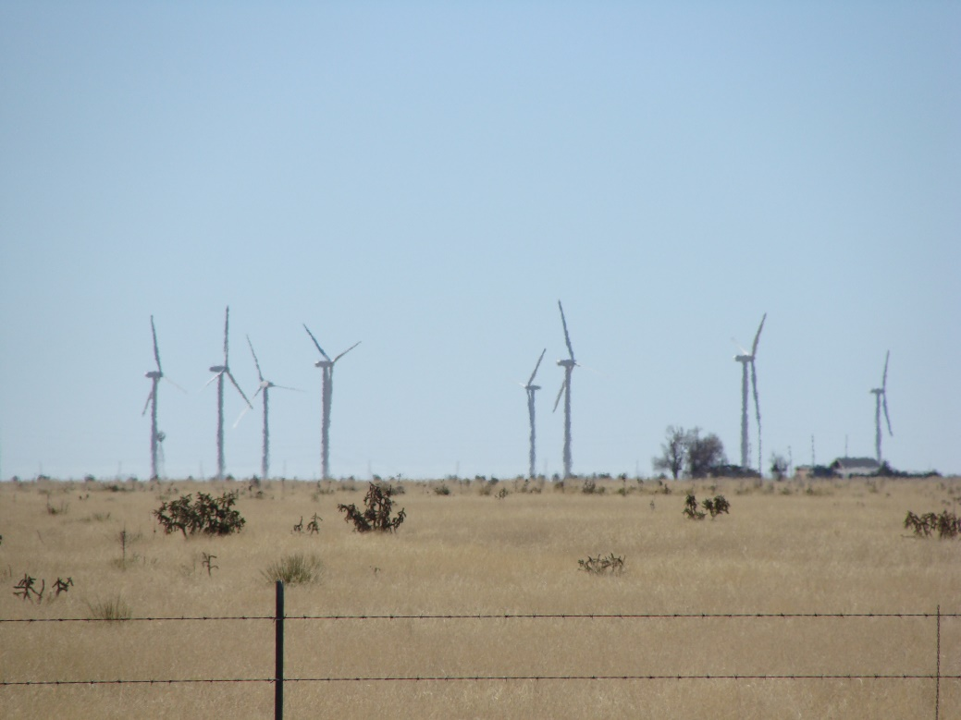
Results
Optimal Wind Farm Suitability
Land Use Conflict Identification Strategy (LUCIS)
Santa Fe
Albuquerque
Low
Image Credit: Jeremy Lewis
Major Cities
0
25
50
100
Miles
High
Notes:
Using the LUCIS model, the 3 maps previously shown were combined to create an optimal suitability map that displays areas of conflict between several factors.
Blue represents areas of low suitability/high conflict and vice versa
After showing our results to our project partners, the areas of high conflict match where they expected them to be with a few exceptions such as the Boothill area (bottom left area), which could be a subject for future work

Slide 14
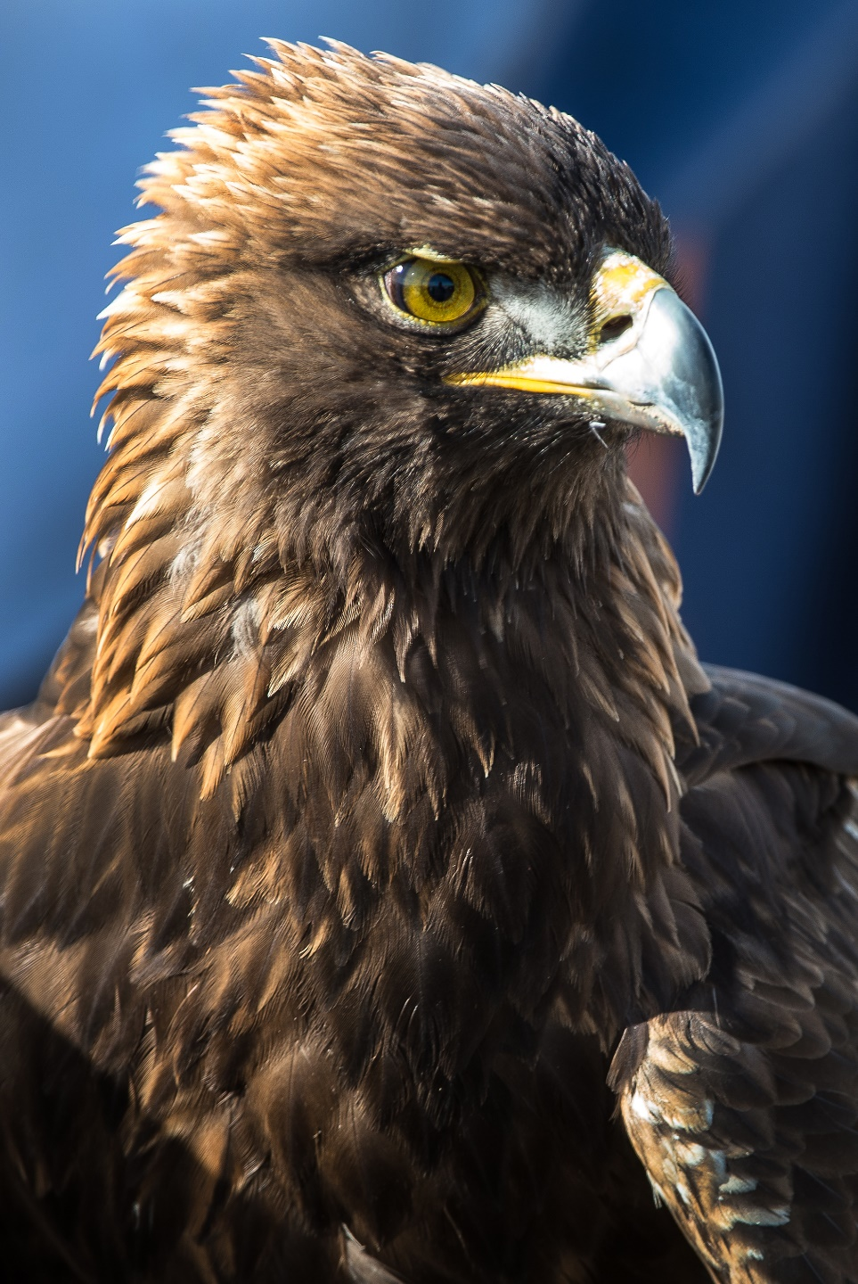
Conclusions
NASA Earth observations can address potential land use conflicts when conducting wind farm site suitability.
Suitability for wind farm development greatly varies across New Mexico, and the Fuzzy Logic and LUCIS Models were integral in identifying these suitable locations.
Chosen factors such as Air Force Base locations, wind power density, and lesser-prairie chicken and golden eagle distribution greatly impact an area’s suitability for potential development.
Our maps shared with the public by the project partners can facilitate conversation between various stakeholders regarding policy making and development.
Image Credit: NREL
Notes:
The final take-away from this project can be summarized in these four points:
- NASA Earth Observations are extremely useful in identifying and addressing potential land use conflicts when conducting wind farm site suitability.
- Not unexpectedly, site suitability greatly varies across the state of New Mexico, and tools such as Fuzzy Logic and LUCIS can help to easily rate the most suitable sites.
- There are many factors to take into consideration when conducting suitability analysis. Deciding which factors to rank higher or lower was a challenge that our team faced and was decided with much help from our partners and advisors.
- Finally, Having access to maps like these can help to facilitate conversation between people and organizations with different concerns in mind when it comes to wind farm development.

Slide 15
Future Work
Assess impact of wind farms on other species such as bats or the sand dune lizard.
Continue validation of in-situ wind data to calculate wind power density.
Incorporate transmission line accessibility in suitability analysis.
Including wind shear and diurnal wind variation in assessing wind power potential.
Running a more detailed suitability analysis on a smaller area of the state
Notes:
With only a ten week DEVELOP term, time itself can pose a limitation. We have several opportunities for future work that we would propose:
- Assessing the impact of wind farms of other species, such as bats or the sand dune lizard.
- Continued validation of in-situ wind data to calculate wind power density.
- Incorporating transmission line accessibility in suitability analysis.
- Including other wind-related factors, such as wind shear and diurnal wind variation, when assessing wind power potential.
- And finally, running a more detailed suitability analysis on a smaller area of the state, such as the boot heel area, that surprised our project partners, in order to pinpoint why these particular areas are highly suitable for wind farm development.

Slide 16
Acknowledgements
Dr. Jeffrey Luvall, NASA Marshall Space Flight Center (Science Advisor)
Dr. Robert Griffin, University of Alabama in Huntsville (Science Advisor)
Leigh Sinclair, University of Alabama in Huntsville/Information Technology and Systems Center (Mentor)
Maggi Klug, University of Alabama in Huntsville (Mentor)
Helen Baldwin, NASA DEVELOP
Mercedes Bartkovich, NASA DEVELOP
Notes:
And finally, we would like to thank all of our mentors and advisors who made this project possible!

