Slide 1
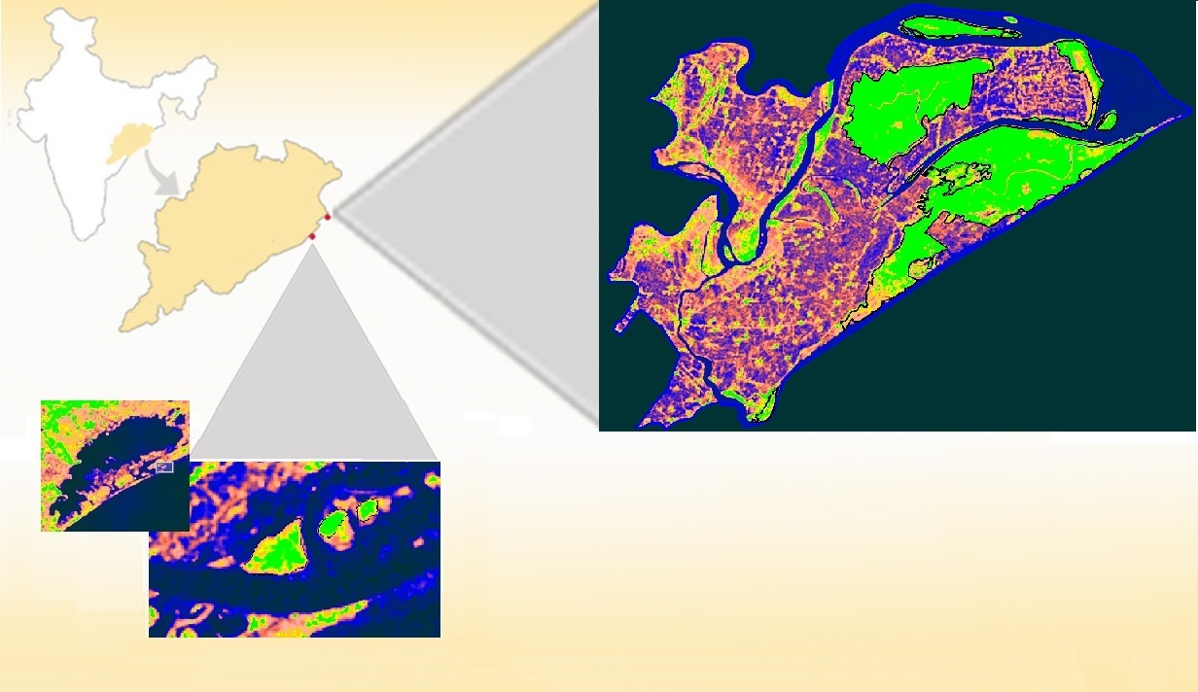
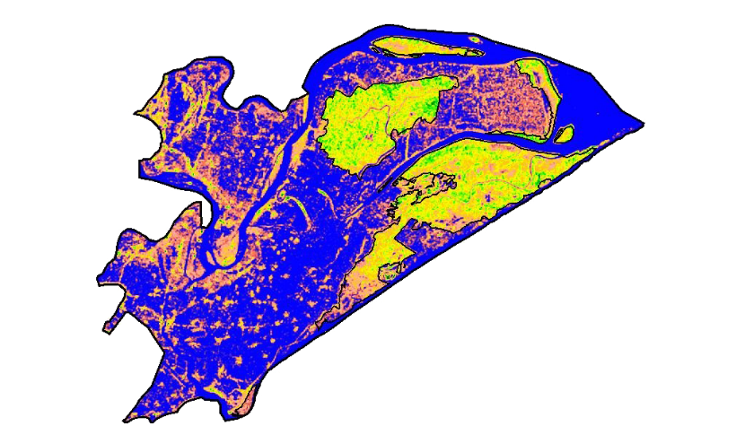
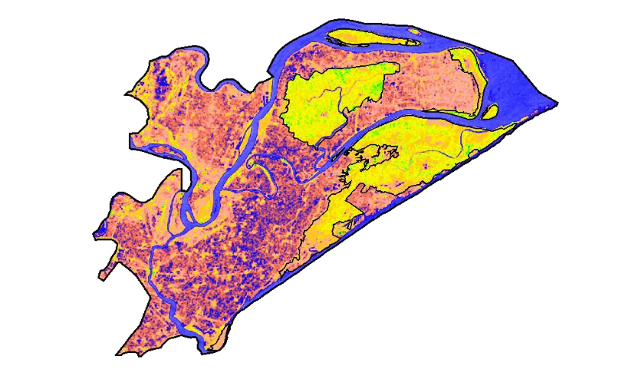
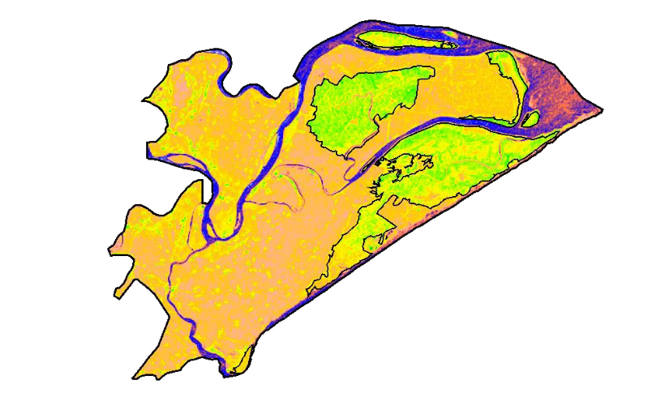
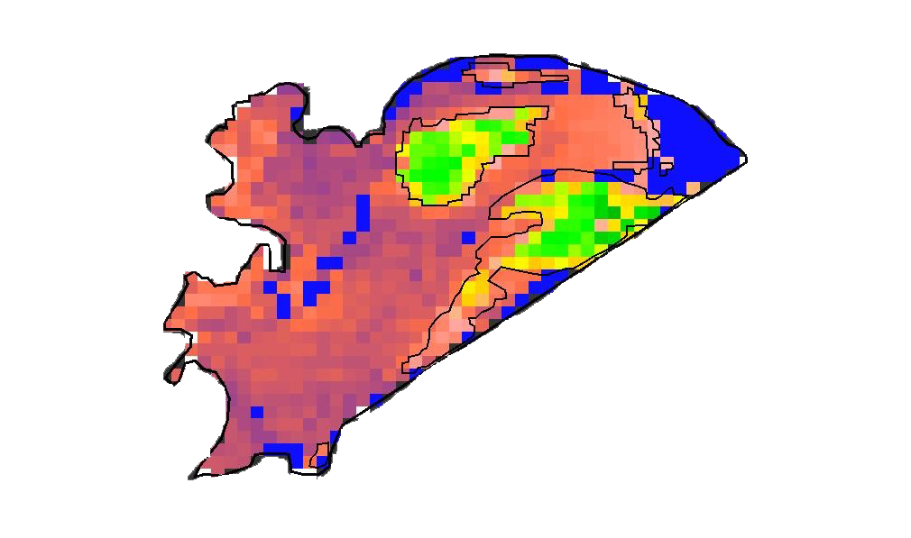
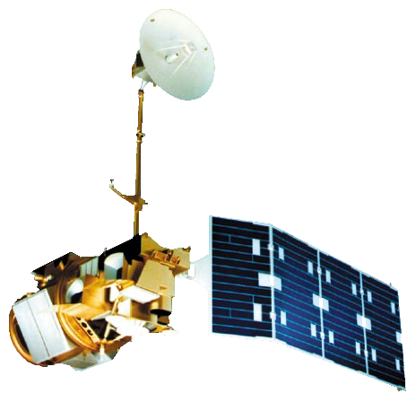
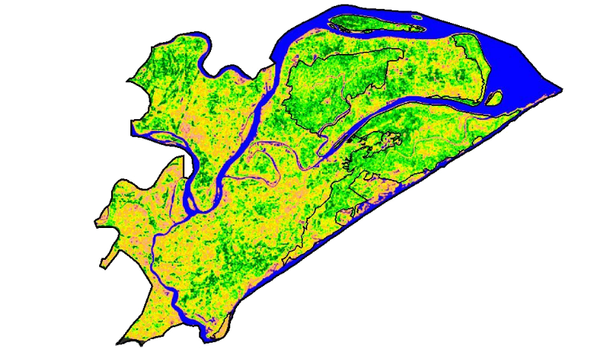
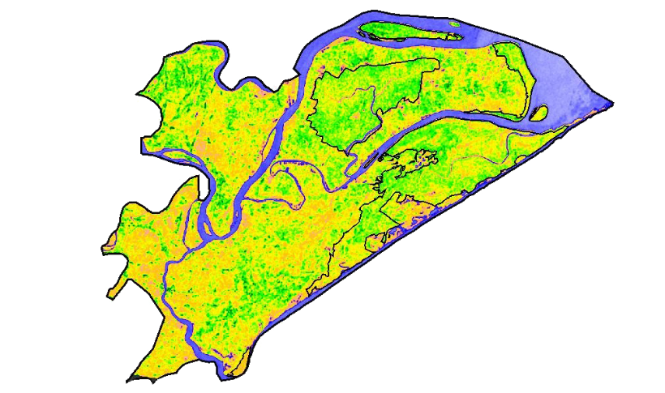
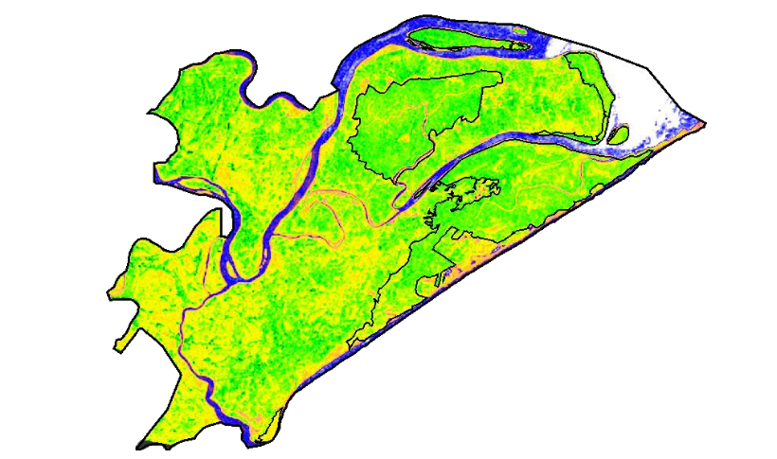
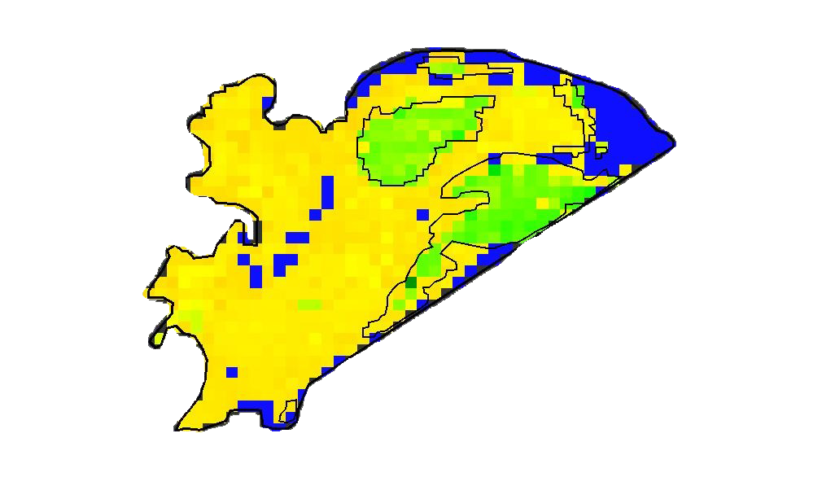
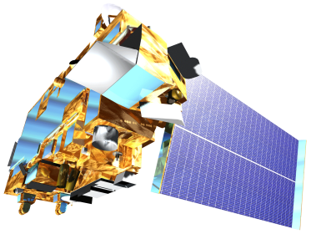
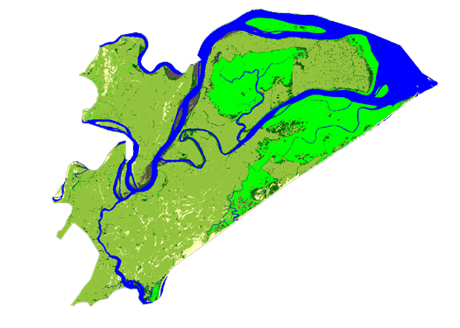
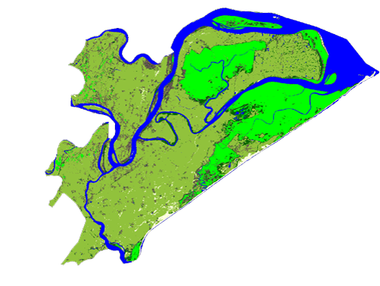
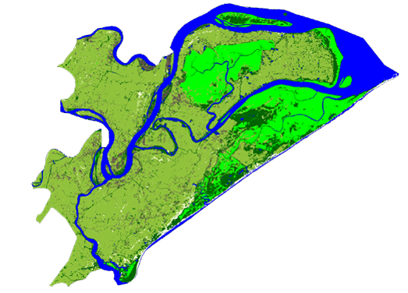
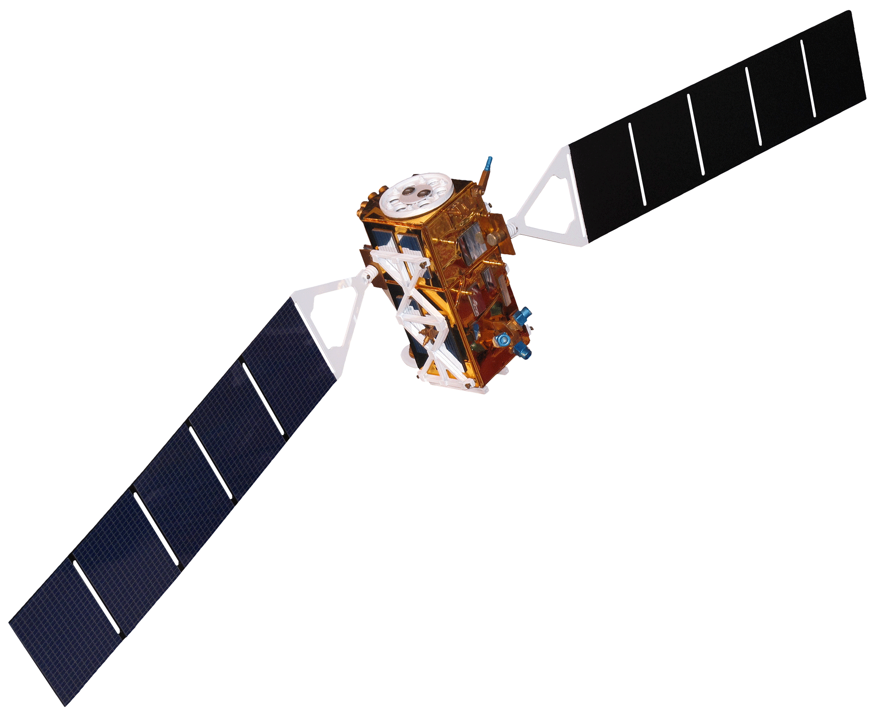
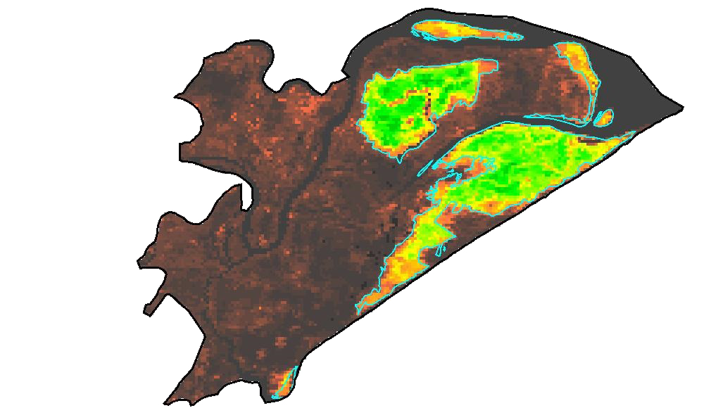
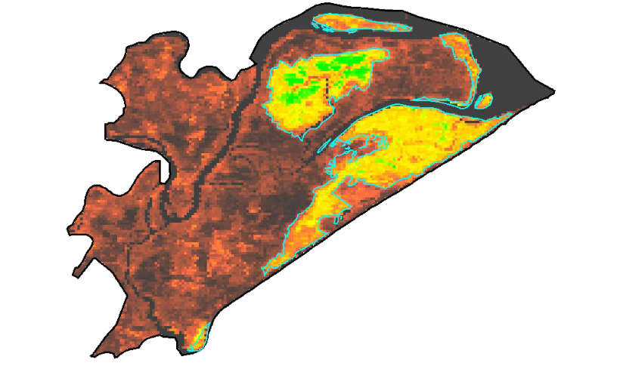
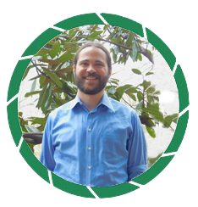
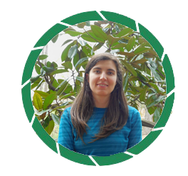
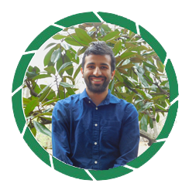
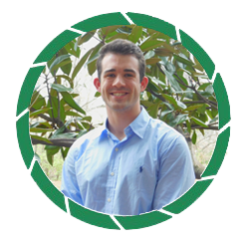
A Multi-Sensor Approach to Enhance the Prediction of Mangrove Biophysical Characteristics in Chilika Lagoon and Bhitarkanika Wildlife Sanctuary, Odisha, India
Abstract
Objectives
Mangroves, one of the most productive ecosystems on Earth, play a major role in coastal ecosystem processes from mitigating erosion to acting as a barrier against tidal and storm surges associated with tropical cyclones. India has about 5 % of the world’s mangrove vegetation, and over half of which is found along the east coast of the country. Chilika Lagoon and Bhitarkanika Wildlife Sanctuary are Ramsar sites of international wetland importance, situated in the state of Odisha along the east coast of India. Chilika Lagoon holds three small, but distinct mangrove patches, while Bhitarkanika Wildlife Sanctuary has several large, dense patches of mangroves. There is growing concern for the effective management and conservation of these mangrove forests. This study demonstrated the use of a suite of satellite data (Terra, Landsat, and Sentinel-1) for meeting the following objectives: 1. Derive a long-term spatio-temporal phenological maps of the biophysical parameters (chlorophyll, leaf area index, gross primary productivity, and evapotranspiration); 2. Analyze long-term spatio-temporal variability of physical and meteorological parameters; 3. Document decadal changes in mangroves area estimates starting from 1995 to 2017 using Landsat and radar data. The time series developed in this study revealed a phenological pattern for mangrove biophysical characteristics. Historical analysis of land cover maps indicated decrease in dense mangrove area and increase in open mangrove area and fragmentation. The results of this study will be used as an efficient biophysical mapping and monitoring protocol for mangrove forests in restoration decision-making.
Derive a long term phenology of biophysical parameters in order to enhance management and restoration efforts
Produce land use/land cover time series maps to observe changes in mangrove cover over the past 20 years
Integrate high resolution radar data to enhance future seasonal analyses of mangrove characteristics
Methodology
Satellite Data
NASA
Giovanni
Landsat 5 & 8
Surface Reflectance
MODIS/Terra
Surface Reflectance
Sentinel 1A GRD/IW C-SAR
MODIS Biophysical Products
ET, PTC, LAI, GPP
Precipitation
NDVI, EVI, R_{rs}
Correlation
Backscattering coefficient
Biophysical Data Extraction
Study Area
Surface Temperature
Classification
(Supervised)
Biophysical Models
LAI, GPP, CHL
Monthly & Annual Composites
Surface Runoff
India
Change Detection
Spatio-Temporal
Maps
Seasonal Variability
Odisha
Correlation
Bhitarkanika Wildlife Sanctuary
Long-Term
Time Series
Correlation
Results
Kilometers
Sen 1A - CHL | Sen 1A - LAI | Sen 1A - GPP | Terra - ET
Chilika
0 7.5 15
Summer
Fall
LU-LC
PTC
Bright green polygon indicates mangrove area
Eastern India Ecological Forecasting II
Earth Observations
Satellite | Instrument
Landsat 5 | Thematic Mapper (TM)
Landsat 8 | Operational Land Imager (OLI)
Terra | Moderate Resolution Imaging Spectroradiometer (MODIS)
Sentinel-1 | C-Band Synthetic Aperture Radar (C-SAR)
0
CHL (µg/cm²)
60
0
LAI
6
0
GPP (gC/m²)
0.07
0
ET (kg/m²)
150
Landsat 5
Landsat 5
Landsat 8
April-1995
April-2005
April-2014
Acknowledgements
TERRA Annual Product
Land use/land cover change
(1995, 2005, 2014)
Science Advisor: Dr. Deepak Mishra, University of Georgia, Department of Geography
Partner: Dr. Gurdeep Rastogi, Senior Scientist, Chilika Development Authority
Other Contributor: Patricia Stupp
Year 2000
Year 2010
Dense Mangrove
Open Mangrove
Agriculture
Mudflat
Water
Sand
0
100
Project Partners
Conclusions
Government of Odisha, Department of Forest and Environment, Chilika Development Authority
Multi-sensor remote sensing tools can be effectively utilized to capture seasonal and inter-annual variability of mangrove biophysical characteristics in Eastern India.
Integrating radar and optical sensor data showed promising results and can be applied to monitor the future health of mangroves (even during cloudy conditions).
The accuracy of biophysical models can be further improved by incorporating field data.
Team Members
Abhishek Kumar
Team Lead
Roger Bledsoe
María José Rivera Araya
Christopher Cameron
Subash Dahal
Caren Remillard
Austin Stone
University of Georgia – 2017 Spring

