Slide 1
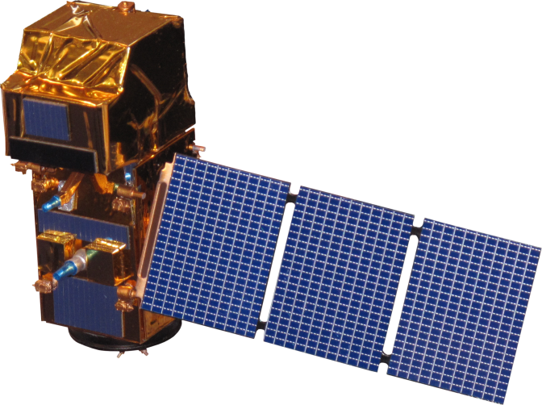
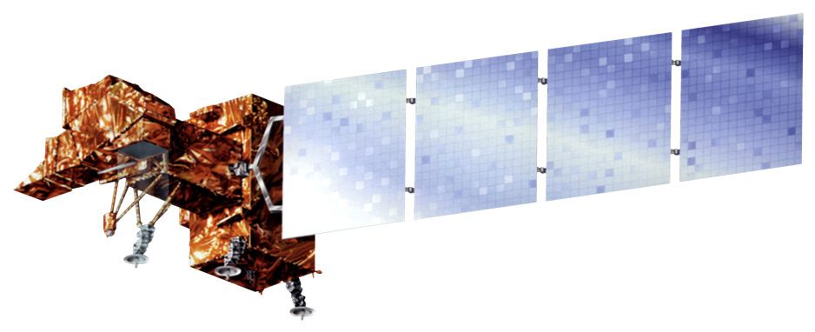
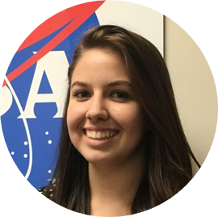
Utilizing NASA Earth Observations to Identify Water Hyacinth Dynamics and Other Water Quality Parameters in Lake Victoria
Abstract
Objectives
With a surface area of 68,800 km², Lake Victoria is the largest lake in Africa. More than 30 million people living around the lake in Kenya, Tanzania, and Uganda rely on the lake for everyday use. With populations increasing around the lake, run-off from various sources is negatively impacting the water quality in the lake resulting in the introduction of the invasive water hyacinth (Eichhornia crassipes). The NASA SERVIR Coordination Office at Marshall Space Flight Center, the SERVIR-Eastern and Southern Africa Hub, the Regional Centre for Mapping of Resources for Development (RCMRD), and the Makerere University Department of Geomatics and Land Management have been assessing and monitoring water quality parameters, such as chlorophyll concentration, temperature, and turbidity, for Lake Victoria using the Moderate Resolution Imaging Spectrometer (MODIS) sensor on the Aqua satellite. As a continuation of the Lake Victoria Water Resources II project from Spring 2016, this project focused on implementing an atmospheric correction and water extraction algorithm into the Surface Aquatic Vegetation Detection Toolbox (SAVDT) that was previously created. The SAVDT processes satellite imagery from Landsat 5, 7, and 8 or Sentinel-2 and results in an output shapefile that detects the location of aquatic vegetation on the surface of the Winam Gulf in Lake Victoria. This project also conducted an accuracy assessment on the SAVDT outputs using high-resolution data from World View 2 and 3. The completed SAVDT will be used to complement the partner organization's current efforts on researching and monitoring the water hyacinth.
Implement atmospheric correction into SAVDT
Assess the accuracy of the Surface Aquatic Vegetation Detection Toolbox (SAVDT) outputs
Study Area
Landsat 8 OLI
RGB
Winam Gulf, Lake Victoria, Africa
Methodology
Adjust Surface Aquatic Vegetation Toolbox (SAVDT)
Create and implement python script for atmospheric correction
Accuracy Assessment
Conduct an accuracy assessment on Landsat 7 ETM+, Landsat 8 OLI, and Sentinel-2 MSI model outputs using high resolution data from DigitalGlobe
Assessment Analysis
Analyze which method resulted in a higher accuracy and water hyacinth extent
Landsat 8 OLI
Model Output
Earth Observations
Lake Victoria Water Resources III
Sentinel-2 MSI
Landsat 7 ETM+
Landsat 8 OLI
Results
Conclusions
Accuracy Assessments | WorldView-1 Nov 29, 2013 | Geoeye-1 Aug 26, 2016
Landsat 7 ETM+ Aug 25, 2016 | N/A | 86.4%
Landsat 7 ETM+ Surface Reflectance Aug 25, 2016 | N/A | 85%
:Landsat 8 OLI Nov 26, 2013 | 94.4% | N/A
Landsat 8 OLI Surface Reflectance Nov 26, 2013 | 85.8% | N/A
Sentinel-2 MSI Aug 25, 2016 | N/A | 82%
Atmospheric correction for Sentinel-2 MSI imagery was unsuccessful
Further accuracy assessments using in situ measurements and high resolution images will need to be conducted in order to determine the SAVDT accuracy
Overall, accuracy assessments were above 80%
Accuracy assessment for Nov 26, 2013 Landsat 8 OLI model output was the highest
Accuracy assessments were not conducted over entire Winam Gulf due to limited high resolution data
Initial accuracy assessments used a total of 500 random points and having more
Team Members
Project Partners
Africa Flores, NASA SERVIR Coordination Office at MSFC
Dr. Robinson Mugo, SERVIR – Eastern and Southern Africa Hub
James Wanjohi Nyaga, Regional Centre for Mapping of Resources for Development (RCMRD)
Dr. Anthony Gidudu, Makerere University Department of Geomatics and Land Management
Daryl Ann Winstead
Team Lead
Ankur Shah
Acknowledgements
We would like to thank our science advisor, Dr. Jeffrey Luvall with NASA at NSSTC, our science mentor Dr. Robert Griffin with UAH, Leigh Sinclair with ITSC, and Africa Flores with SERVIR.
We would also like to thank the past contributors to the project: Jeanné le Roux, Christina Fischer, Sara Amirazodi, Dwight Tigner, and Austin Vacek.
This material is based upon work supported by NASA through contract NNL11AA00B and cooperative agreement NNX14AB60A. Any mention of a commercial product, service, or activity in this material does not constitute NASA endorsement. Any opinions, findings, and conclusions or recommendations expressed in this material are those of the author(s) and do not necessarily reflect the views of the National Aeronautics and Space Administration and partner organizations.
Maggi Klug
Tony Ngabo
Kristen Barnard
NASA Marshall Space Flight Center – 2016 Fall

