Slide 1
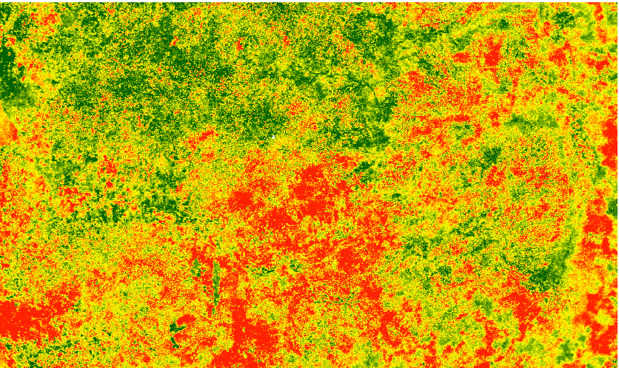
ETHIOPIA DISASTERS
Utilizing NASA Earth Observations to Assess Agricultural Drought Severity in Ethiopia and Provide a Tool for Monitoring Drought at the Regional Level
Amandeep Vashisht (Project Lead)
Sarah Carroll
Rebecca Girma
Bethlehem Astella
Cara Steger
Notes:
Our title is Ethiopia Disasters : Utilizing NASA Earth Observations to Assess Agricultural Drought Severity in Ethiopia and Provide a Tool for Monitoring Drought at the Regional Level

Slide 2
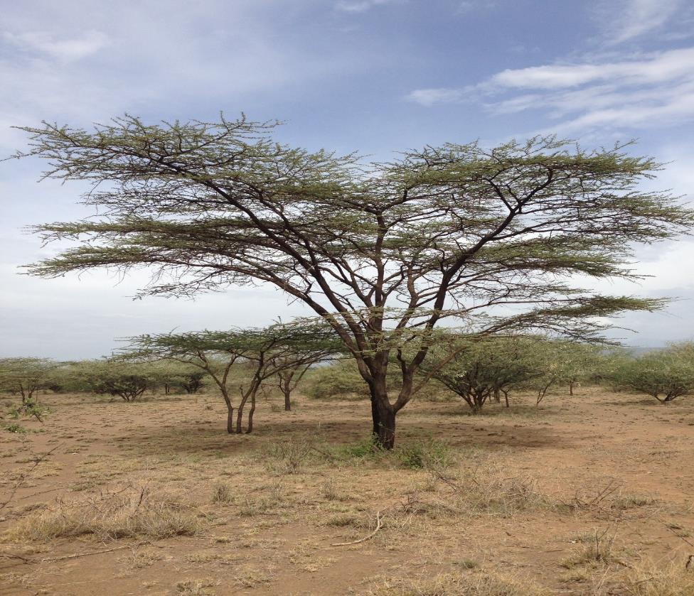
Overview
Background
Community Concerns
Partners
Objectives
Study Area and Period
Methodology
Data Acquisition
Data Processing
Data Analysis
Results
Conclusions
Errors & Uncertainties
Future Work
Acknowledgements
Image Credit: Matthew Luizza
Notes:
Image Source: Matthew Luizza, Natural Resources Ecology Laboratory, Colorado State University

Slide 3
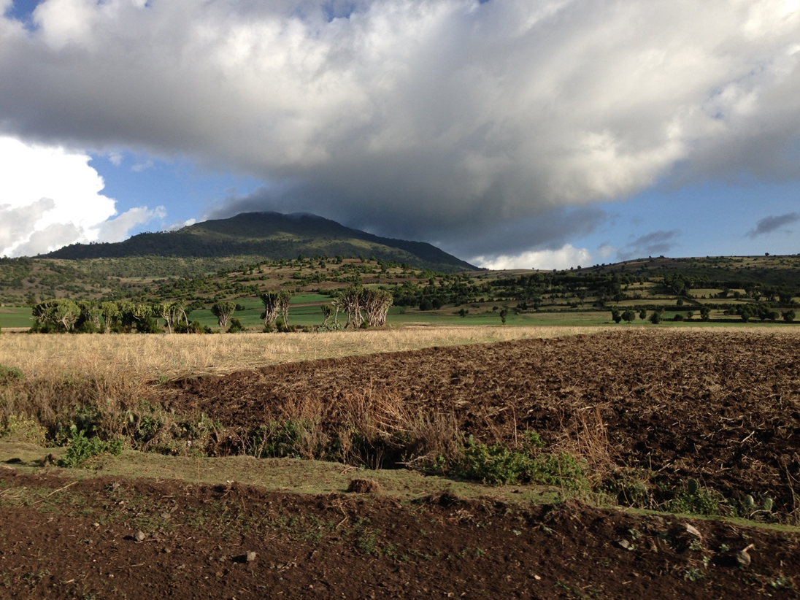
Background
Ethiopia’s economy predominantly relies on rain-fed agriculture
Drought is primarily defined as an extended period of below normal precipitation
El Niño climatic events often result in drought conditions
Climate diversity in Ethiopia makes it difficult to analyze drought
Remote-sensing methods can improve our ability to monitor drought on a landscape scale
Image Credit: Matthew Luizza
Notes:
Ethiopia’s population relies on rain fed agriculture as the main source of livelihood, implying the economy is considerably vulnerable to effects of climate change.
Drought is related to a reduction in the amount of precipitation received over an extended period of time such as a season or a year.
Climate variations attributed to El Niño Southern Oscillation (ENSO) has caused four out of nine historical droughts from 1986-2013.
Ethiopia’s climate is highly variable, including spatial and temporal variation in mean annual precipitation which makes it difficult to analyze drought trends.
Remote sensing, drought indices, numerical modelling, and geographic information systems are now considered to be improved methods of climate and drought monitoring
Image Source: Matthew Luizza, Natural Resources Ecology Laboratory, Colorado State University

Slide 4
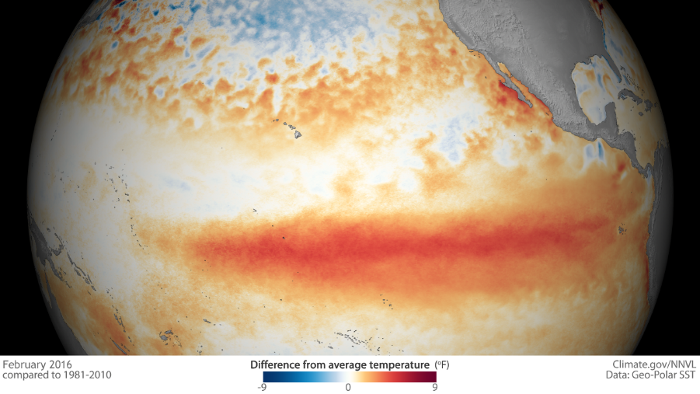
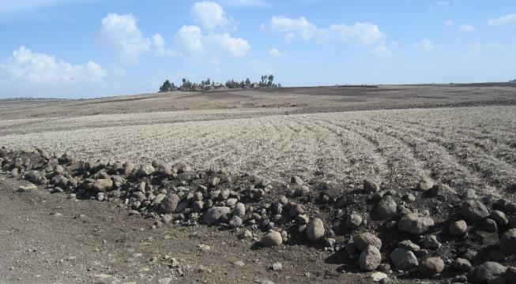
Community Concerns
Worst drought conditions in over 35 years due to extreme 2015-2016 El Niño
Crop failures have resulted in over 10 million people in need of food aid
Drought conditions may persist in the latter part of 2016 and early 2017
Need for information on duration, location, and severity of drought
Image Credit: Cara Steger
Image Credit: Muttley 05
Notes:
In 2015, El Niño conditions significantly modulated rainfall across eastern Africa, and in Ethiopia caused alteration of the onset and withdrawal of rainfall during the kiremt season.
Because the main growing season depends on kiremt rainfall, this led to the worst drought and crop failure in the last half-century.
In order to direct response efforts and humanitarian aid, reliable and timely information on duration, location, and severity of drought is needed.
Image Source: https://www.climate.gov/enso
Image Source: Ethiopia Disasters team

Slide 5
Partners
Department of State Office of Space and Advanced Technology (OES/SAT) and Humanitarian Information Unit (HIU)
Institute of Geo-Information and Earth Observation Sciences (I-GEOS) Mekelle University
USGS North Central Climate Science Center
Image Credit: Mekelle University
NPR 2200.2C D.6.4.1 Trade names and trademarks are used in this report for identification only. Their usage does not constitute an official endorsement, either expressed or implied, by the National Aeronautics and Space Administration.
Notes:
The Office of Space and Advanced Technology (OES/SAT) and Humanitarian Information Unit (HIU)frequently incorporate satellite imagery in their decision making, and have emphasized the need of an effective drought assessment tool to identify areas of severe drought impact and allocate humanitarian aid accordingly.
The Institute of Geo-information and Earth Observation Sciences (I-GEOS) recognize the need for incorporation of remote sensing technology to build the organization’s capacity to train their staff/students and to carry out future drought monitoring.
United States Geological Survey (USGS) North Central Climate Science Center(NCSC) revealed the need of a drought assessment tool at a regional scale. This collaboration will help in working towards the common goal of effectively utilizing NASA Earth Observations for drought assessment.
Image Source: http://www.mu.edu.et/index.php/endayesus-main

Slide 6
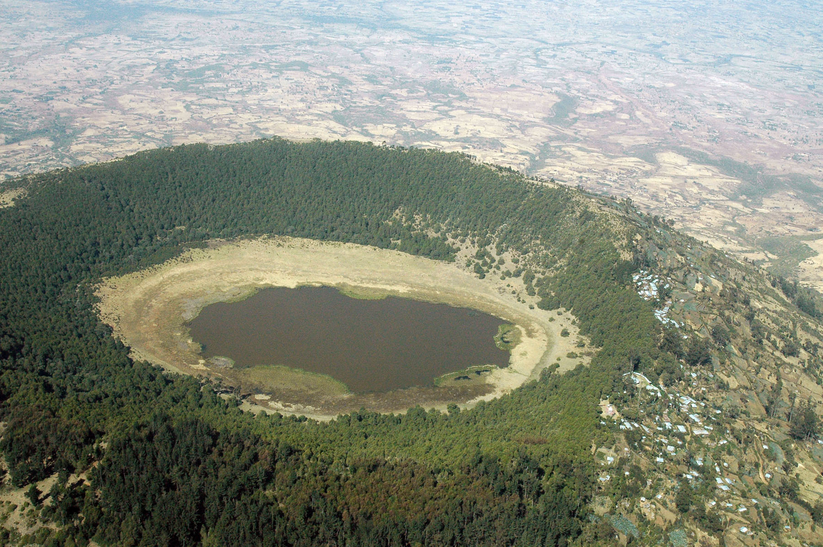
Image Credit: aheavens
Image Credit: Andrew Heavens
Objectives
Develop a scaled drought index to characterize drought conditions
Analyze drought severity and spatiotemporal variation across the study area
Create tutorials for partner organizations to build their capacity to monitor drought in the future
Notes:
A monthly scaled drought index was developed for central and eastern Ethiopia over a 10-year time period and analyzed drought severity and impact over agricultural areas in the study area.
Tutorials were created to help build technical capacity in I-GEOS to monitor drought in the future by utilizing the project’s methodology.
Image Source: https://www.flickr.com/photos/andrewheavens/100054923/sizes/l

Slide 7
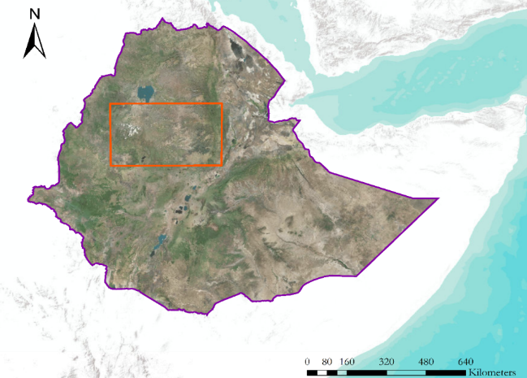
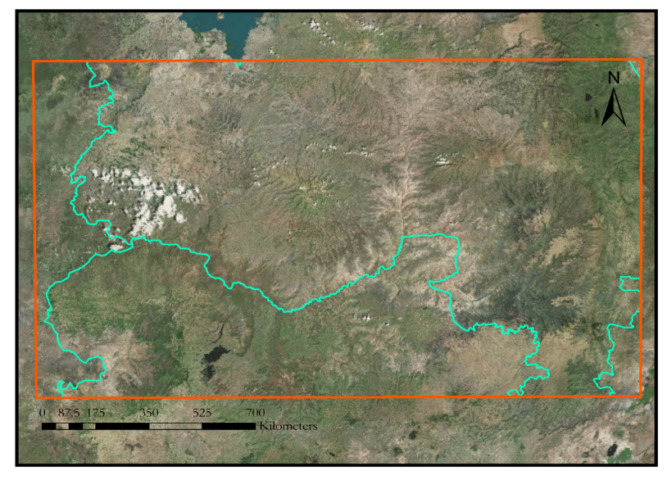
Study Area & Period
Yemen
Ethiopia Boundary
Study area: southern Amhara, northern Oromia and eastern parts of Beneshangul-Gumu regions
Study period: January 2006 to August 2016
Dominant crops are cereal crops such as barley, corn, millet, wheat, sorghum,teff, etc.
Study Area Boundary
Regional Boundary
ETHIOPIA
Somalia
Kenya
Benishangul -
Gumuz
Amhara
Oromia
Addis Ababa
Image Credit: Amanda West
Notes:
The study area is approximately 120,000 km².
Elevation ranges from 900m to 3,000m.
The regions in the study area predominantly support agrarian communities practicing a mixture of traditional farming and livestock keeping as well as shifting cultivation.

Slide 8
Methodology
End Products
Data Analysis
Data Processing
Data Acquisition
Image Credit: USAID
Image Credit: creative commons
Image Credit: mikeawful
Notes:
Our methodology consisted of data acquisition, data processing and analysis and making final maps and tutorials. These steps are explained in the subsequent slides.
Image Source:
https://www.flickr.com/photos/75563129@N04/6936387139/sizes/l
https://www.flickr.com/photos/internetarchivebookimages/20331215208/sizes/l
http://www.ayyaantuu.net/how-bad-is-the-drought-in-ethiopia/#lightbox/1/

Slide 9
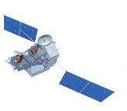
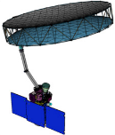
Data Acquisition
Satellites/Sensors
Source
Data Product
SRTM
USGS Earth Explorer
Digital Elevation Model (DEM)
Google Earth Engine
MODIS(Terra)
NDVI, Land Surface Temperature(LST)
MODIS(Aqua)
Google Earth Engine
Climate Hazards Group InfraRed Precipitation with Station data (CHIRPS)
TRMM
Precipitation Data
Land Surface Soil Moisture
SMAP
Reverb ECHO
Image Sources: NASA
Notes:
SRTM data was utilized to obtain digital elevation model (DEM).
Modis Terra and Aqua NDVI and LST products were downloaded.
TRMM data was downloaded in the form of CHIPRS dataset, that also includes additional ground weather observations
SMAP data was used to obtain land surface soil moisture values
Image Credits: NASA

Slide 10
Data Processing
1. Aggregate MODIS NDVI and LST 8-day composites and calculate a monthly average
July
July
mean
LST
mean
NDVI
2. Resample data to common spatial resolution of1km
1
3. Scale temperature, precipitation, and
vegetation index values from 0 -1
0
Notes:
Preliminary processing of the imagery acquired for the chosen study area involved projecting it to a common projection of WGS 84/ UTM Zone 37 N.
Both the NDVI and CHIRPS datasets were resampled to match 1-km resolution of the LST data.
The NDVI, LST, and CHIRPS data were aggregated and then averaged for each month of the main cropping season (meher) from 2006-2016.
The monthly averages of these three parameters were then scaled from zero to one, with zero representing the wettest value and one representing the driest value for each parameter over the 10 year period.
Image Source: Noun Project

Slide 11
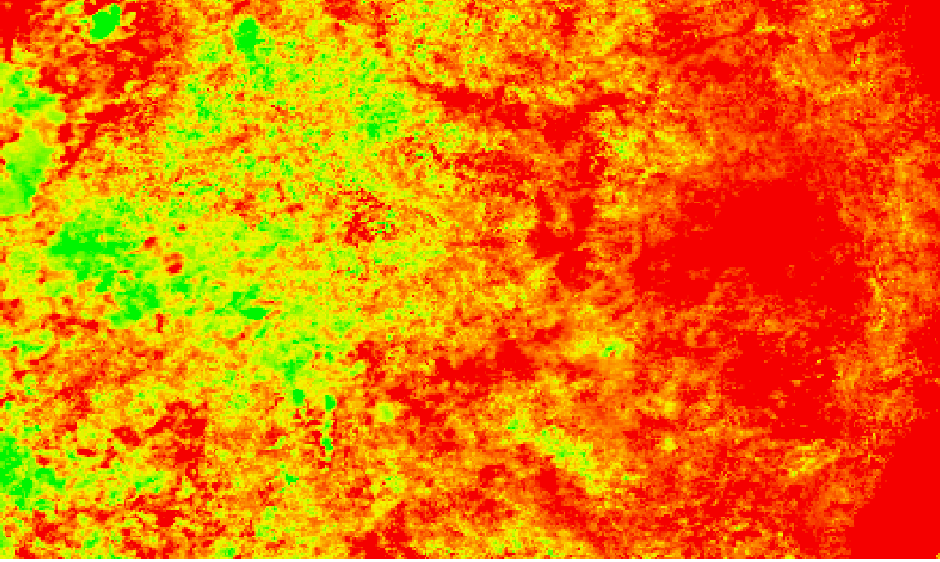
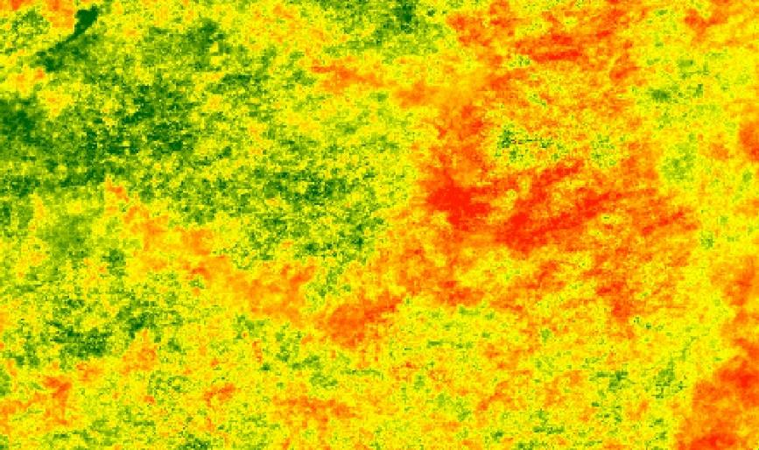
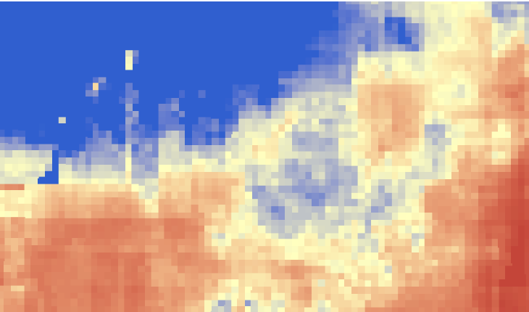
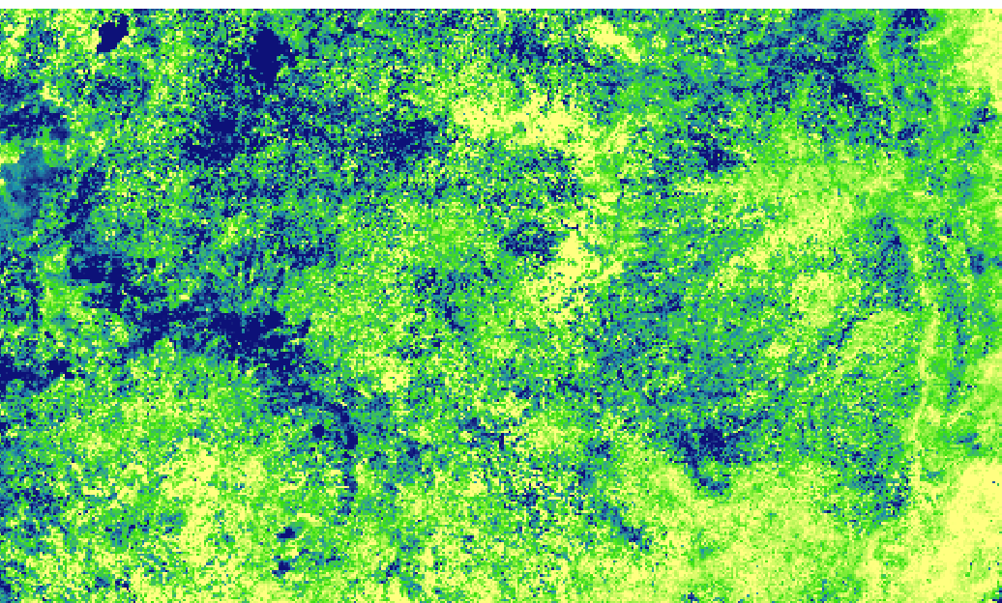
Data Processing
4. Combine and weight drought parameters to create an index of drought severity
Scaled Drought Index
(SDI) = ½ (RF) + ¼(LST) + ¼ (NDVI)
Scaled LST
Scaled Rainfall (RF)
Scaled NDVI
Notes:
Preliminary processing of the imagery acquired for the chosen study area involved projecting it to a common projection of WGS 84/ UTM Zone 37 N.
Both the NDVI and CHIRPS datasets were resampled to match 1-km resolution of the LST data.
The NDVI, LST, and CHIRPS data were aggregated and then averaged for each month from 2006-2016.
The monthly averages of these three parameters were then scaled from zero to one, with zero representing the wettest value and one representing the driest value for each parameter over the 10 year period.

Slide 12
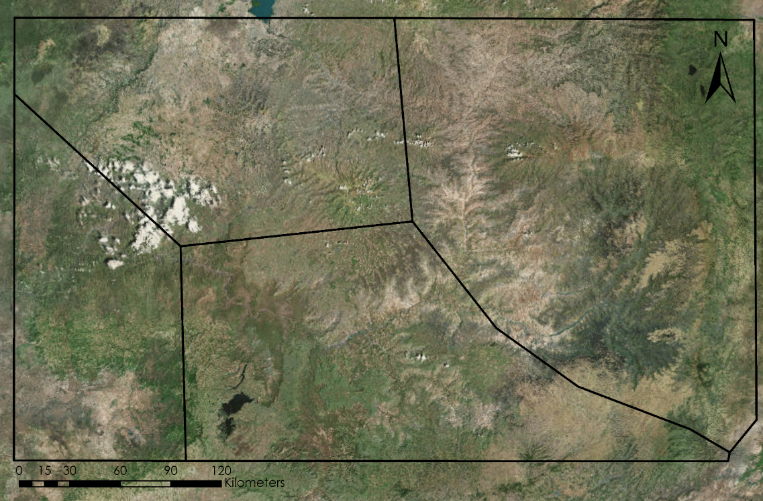
Data Analysis
Spatial Analysis
Divide study area into nearly homogenous climate zones delineated in a previous study
Zones are based on precipitation, elevation, and temperature
Climatic Zones:
I. North West Highlands
II. North East Highlands
III. South West Rainforest
IV. Central Highlands
I.
II
III
IV
Notes:
For consistent spatial analysis over time, the study area was divided into 4 nearly homogenous climatic zones (I-V.) to analyze drought severity.
These zones are based upon precipitation, elevation, and temperature data from Viste et. al http://link.springer.com/article/10.1007/s00704-012-0746-3

Slide 13
Data Analysis
Drought Index and Soil Moisture Comparison
North West Highlands
Central Highlands
North East Highlands
South West Rainforest
June
July
Aug
Sept
Oct
Nov
Notes:
We compared drought index values to soil moisture measurements from SMAP for April-December of 2015, where values approaching zero indicate extreme drought and low soil moisture.
Temporal trends in drought severity and soil moisture values were similar.

Slide 14
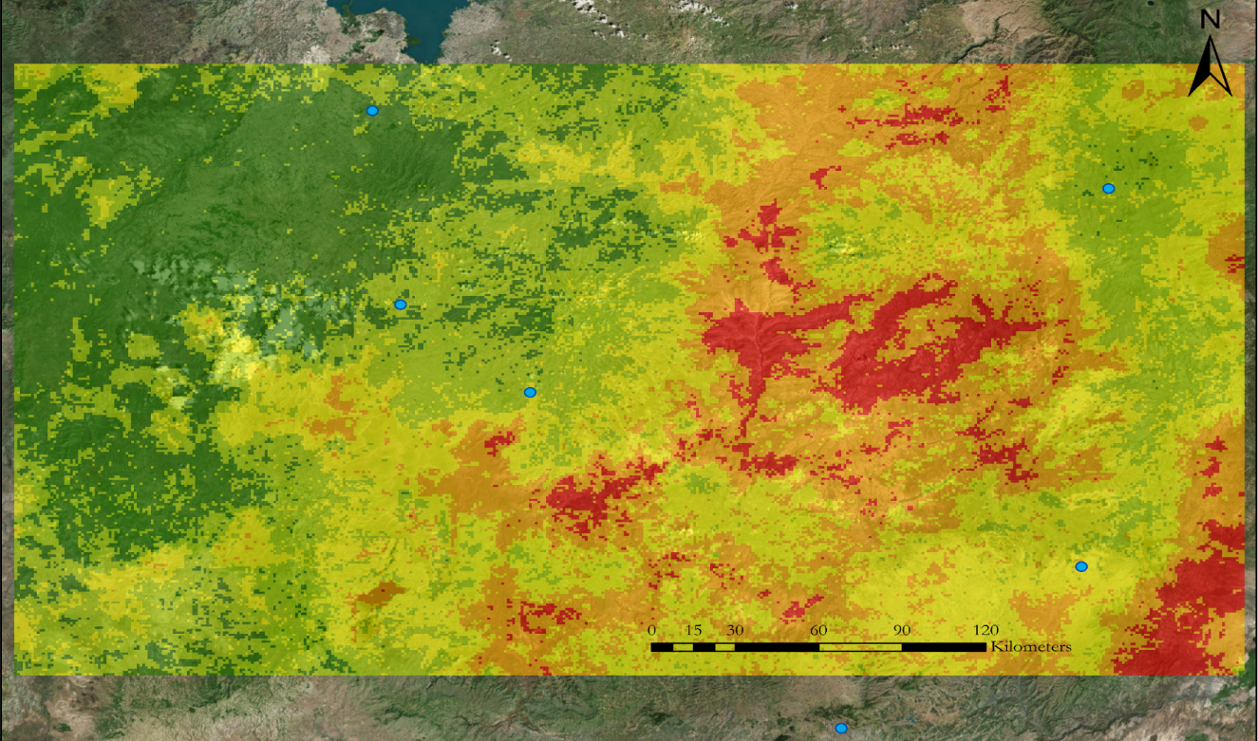
Results
2015 Drought Classification Map
Extreme drought
Bahir Dar
Dese
Severe drought
Finote Selam
Moderate drought
Debre Mark’os
Abnormally dry
Debre Birhan
No drought
Cities
Addis Ababa
Notes:
This map shows the average drought severity across the study area for the main growing season of 2015.

Slide 15
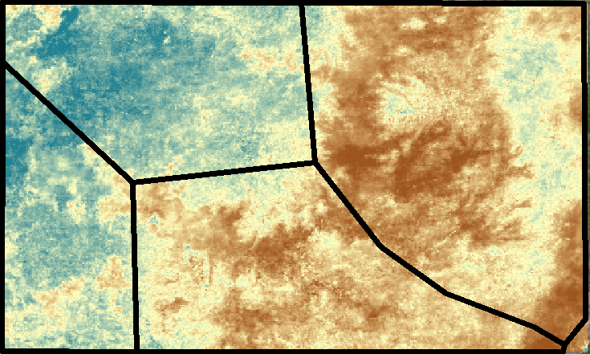
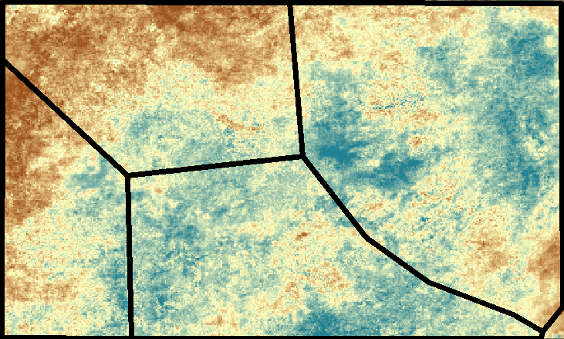
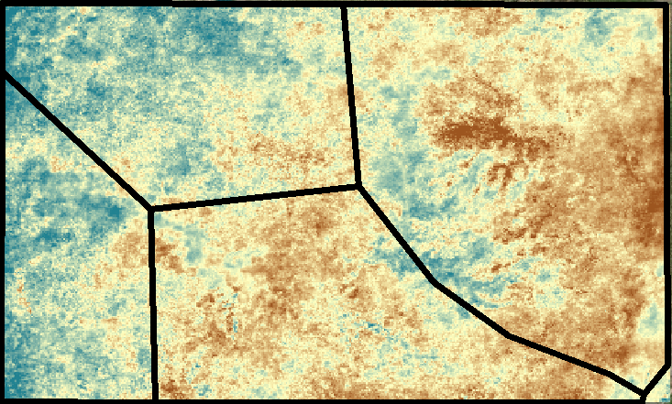
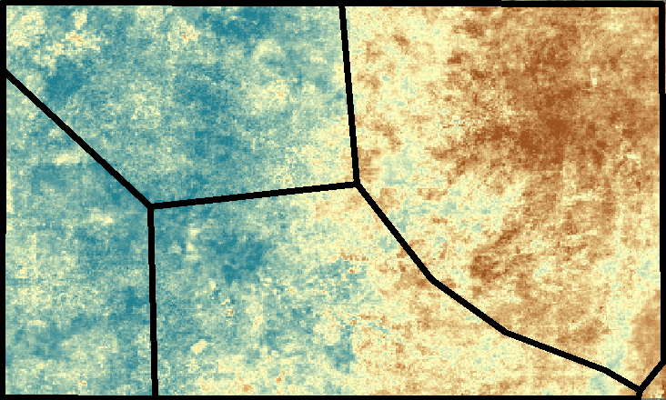
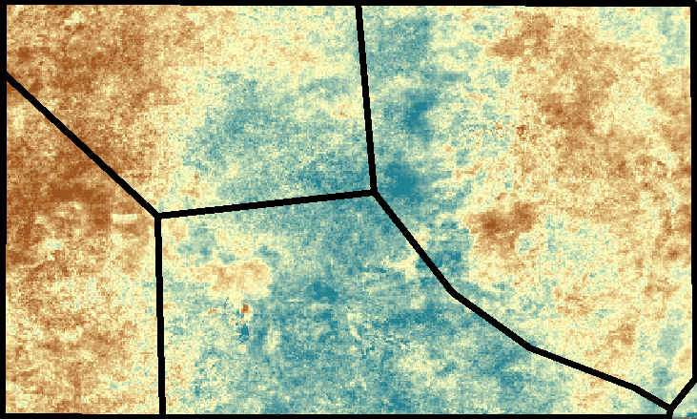
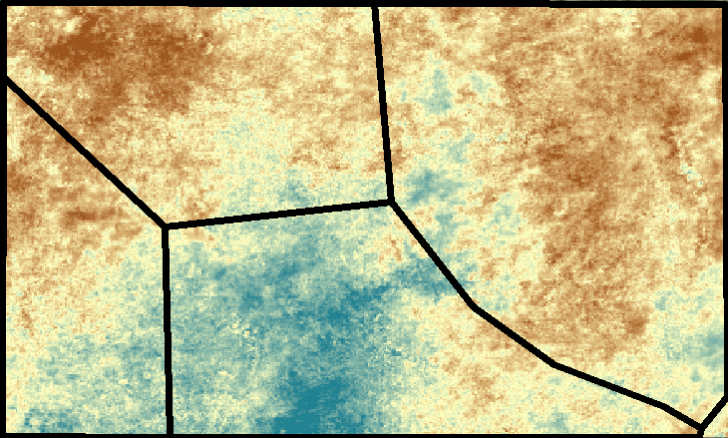
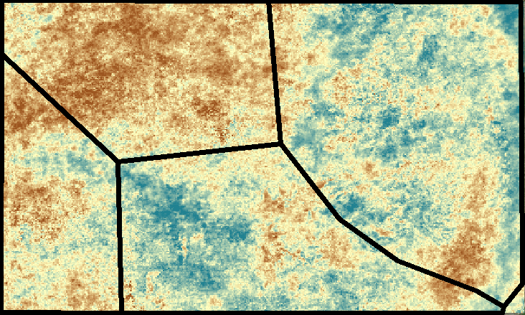
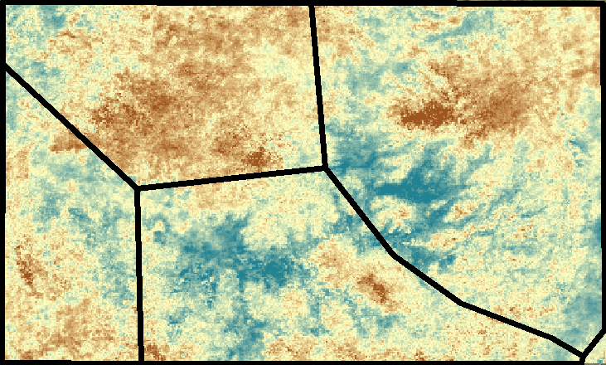
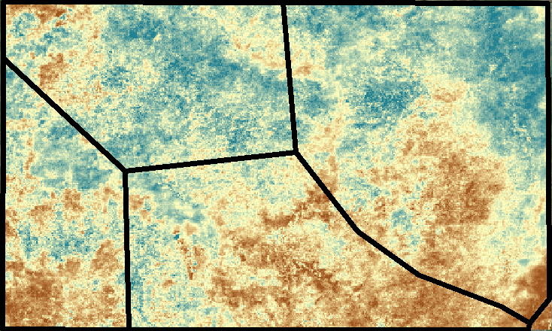
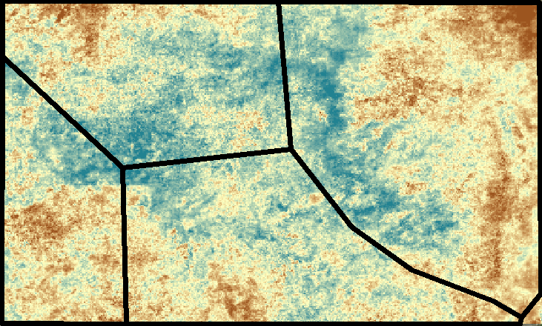
Results
Drought Index Time Series Across Climatic Zones
2009
2014
2012
2008
2013
2006
2007
2011
2010
2015
Climatic Zones
I. North West Highlands
II. North East Highlands
III. South West Rainforest
IV. Central Highlands
I
II
III
High: 1 (wettest)
IV
Low: 0 (driest)
Notes:
Drought severity varied spatially (across climate zones) over time from 2006 – 2015.

Slide 16
Results
Notes:
This chart shows the mean seasonal drought index by climate zones from 2006 to 2015.
Values approaching zero indicate severe drought and the most extreme drought conditions occurred in 2009 and 2015.
In 2009, drought conditions were more severe in the NW Highlands and SW Rainforest zones, and in 2015 the central Highlands and NE Highlands experienced the more extreme drought, and these points are highlighted on the graph.

Slide 17
Results
Notes:
These charts display the total area in square kilometers within the study area (total area is 120,000 km² ) under extreme drought conditions by climate zone from 2006-2015.
These charts provide an additional visualization of how drought severity varied spatially within the study area across climate zones.
A larger geographic area was affected by drought in 2009 and 2015, both years that were classified as extreme droughts.

Slide 18
Conclusions
The drought index captured the severity and extent of drought from 2006-2015 across the study area
In 2009 the NW Highlands and SW Rainforest experienced severe drought whereas in 2015 the NW Highlands and central Highlands experienced severe drought
The drought index and SMAP soil moisture values showed similar trends for the 2015 growing season
Image Credit: Sarah Carroll
Notes:
Image Source: Ethiopia Disasters team

Slide 19
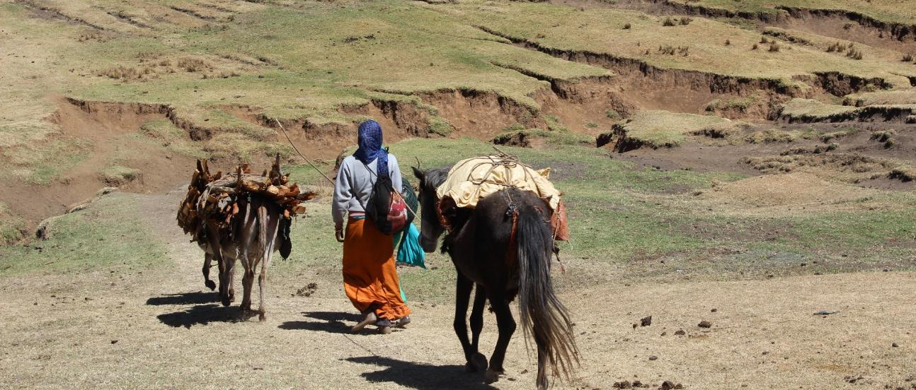
Image Credit: Cara Steger
Errors & Uncertainties
Pixels masked due to clouds may create minor biases in monthly aggregation of data
Weights of drought parameters are somewhat subjective and may vary spatially and temporally
A linear combination of parameters does not account for codependency of drought indicators
Notes:
Removing clouded pixels could create minor biases in the data that is included in analysis.
Within the different climatic zones, it is possible that for example, rainfall could be a more significant indicator of drought in the rainforest zone, whereas temperature may be a stronger indicator in the highland zones.
A linear combination of drought parameters ignores any codependency between drought parameters which could affect drought index values.
Image Source: Ethiopia Disasters team

Slide 20
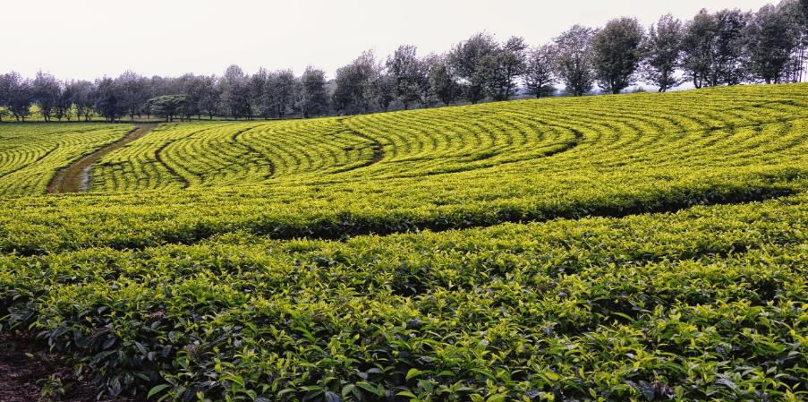
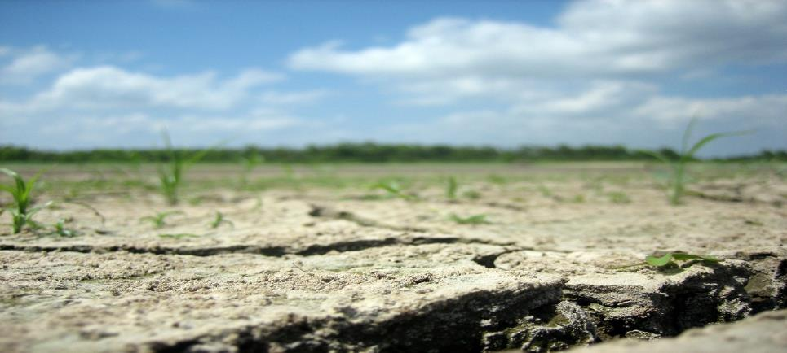
Future Work
Explore other methods such as principal components analyses or multivariate statistics
Expand the study area to the entire country of Ethiopia
Analyze effects of drought conditions on water, carbon and energy budgets of the regional ecosystems
Image Credit: Rod Waddington
Image Credit: dasroofless
Notes:
Image Source:
https://www.flickr.com/photos/roofless/5779444286/sizes/l
https://www.flickr.com/photos/rod_waddington/13306763123/sizes/l

Slide 21
Advisors
Dr. Paul Evangelista (Colorado State University, Natural Resource Ecology Laboratory)
Dr. Amanda West (Colorado State University, Natural Resource Ecology Laboratory)
Ryan Anderson (Colorado State University, Natural Resource Ecology Laboratory)
Other Contributors:
Brian Woodward (Center Lead)
Partners
Dr. Gabriel Senay (USGS North Central Climate Center)
Dr. Daniel Teka (Institute of Geo-Information and Earth Observation Sciences (I-GEOS))
Dr. Melinda Laituri (US Department of State Office of Space and Advanced Technology (OES/SAT) and Humanitarian Information Unit (HUI))

