Slide 1
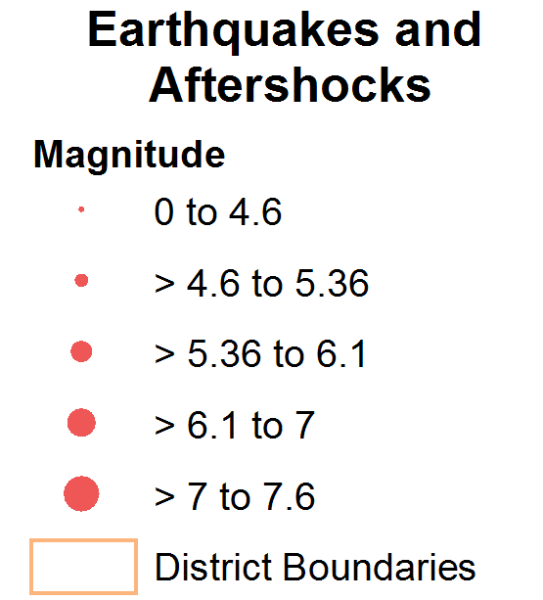
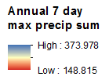
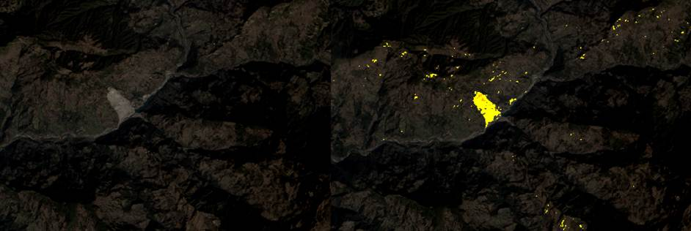
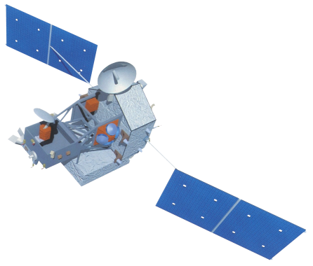
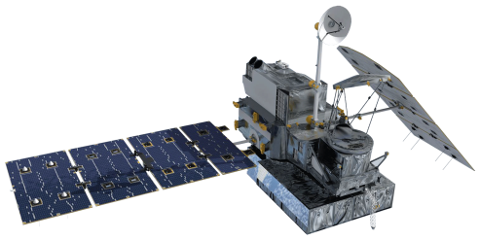
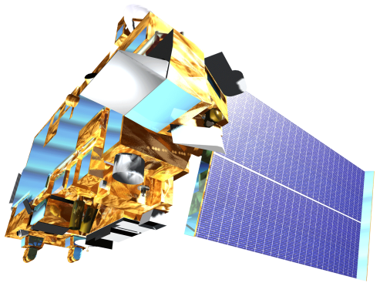
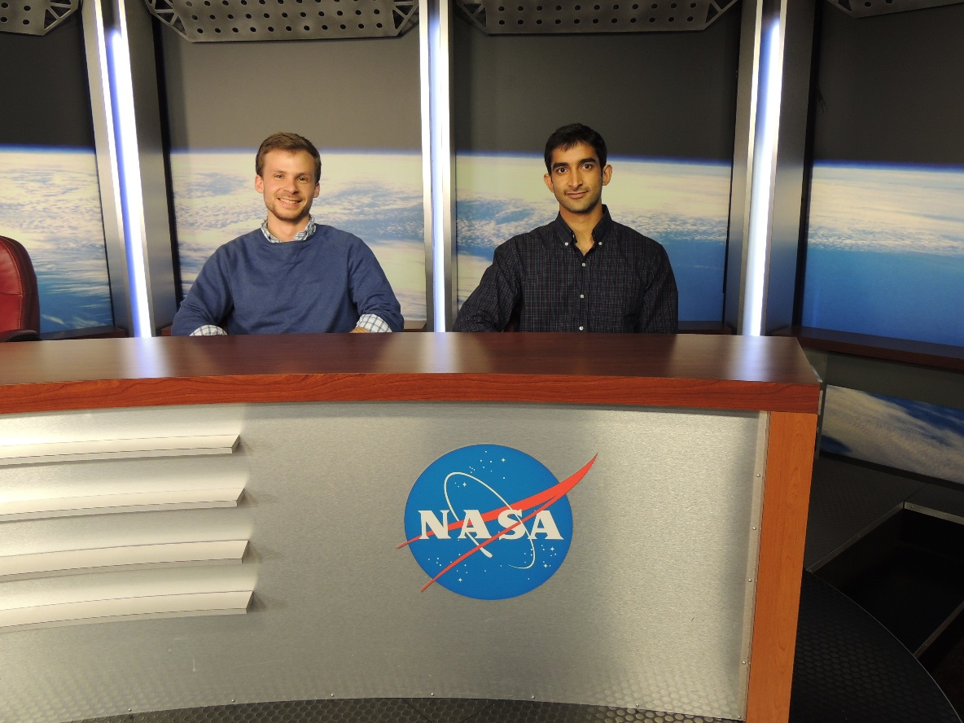
Himalayan Disasters II
Utilizing near real-time landslide identification and precipitation monitoring products for enhanced landslide detection
GSFC: Justin Roberts-Pierel (Project Lead), Aakash Ahamed, Jessica Fayne
ICIMOD: Kanti Sen Ojha, Ang Dawa Sherpa, Binu Maharjan, Amanda Schochet
NASA DEVELOP National Program
Abstract
Objectives
Keep this blank for now.
Body text point size should be at least 24.
Caption text point size should be at least 16.
Feel free to rename, move, and resize sections as needed.
Better characterize landslide hazards within Nepal and the Himalaya region
Utilize newly available high resolution remote sensing data and international landslide mapping efforts following the Gorkha earthquake to develop a landslide identification product
Analyze historical precipitation data and create a near real-time precipitation monitoring system
Develop a near real-time tool incorporating the identification product and precipitation monitoring system
Study Area
Methodology
GPM data is downloaded using Python 3 in near real-time
Monitors GPM IMERG data every 30 minutes looking for anomalies compared with calculated threshold values
If current rainfall levels are significantly higher than thresholds, an alert is created for the affected area
DRIP
GPM
Historical TRMM data was used to calculate monthly mean thresholds used to detect anomalies in near real-time with GPM
Alert
IMERG 30-Minute
Data Collection
Thresholds
Comparison
TRMM
TMPA-RT 3B42
Nepal
Landsat 8 data is downloaded using Python 3 in near real-time
Red Increase
Landsat 8
Example of precipitation monitoring by DRIP
Combined Model Output
IR
SWIR
Calculate percent change between two Red band images
Source: ICIMOD
SLIP
QA
Red
Cloud Mask
Moisture Index
SRTM
Data Collection
QA band from Landsat 8 is used to remove clouds from the other bands
Model Evaluation
Earth Observations
ASTER
Compare two images’ moisture using IR and SWIR bands
Example of a successful landslide detection by SLIP (Yellow region)
Remove Flat Terrain
TRMM
Landsat 8
Remove pixels with slopes lower than 15%
Results
Section will include SLIP validation results, and DRIP simulation results, rainfall analysis results, etc.
GPM
Terra
Conclusions
Use bullets.
Use complete sentences with periods.
Team Members
Justin Roberts-Pierel, Aakash Ahamed
(Will change to a picture including Jessica Fayne
and ICIMOD members)
Project Partners
Acknowledgements
International Centre for Integrated Mountain Development (ICIMOD), Kathmandu, Nepal
Advisors: GSFC- Dr. Dalia Kirschbaum, Thomas Stanley
ICIMOD- Sebastian Wesselman
Past contributors: Amanda Rumsey, Jamie Shiplet
NASA Goddard Space Flight Center

