Slide 1
Alto Orinoco Health & Air Quality
Utilizing NASA Earth Observations to Locate Remote Yanomami Villages in the Alto Orinoco Municipality for Targeted Eradication of River Blindness Disease
Amanda Rumsey
Rajkishan Rajappan
Kyle Sowder
Annabel White
Timothy Larson
Zachary Tate

Slide 2

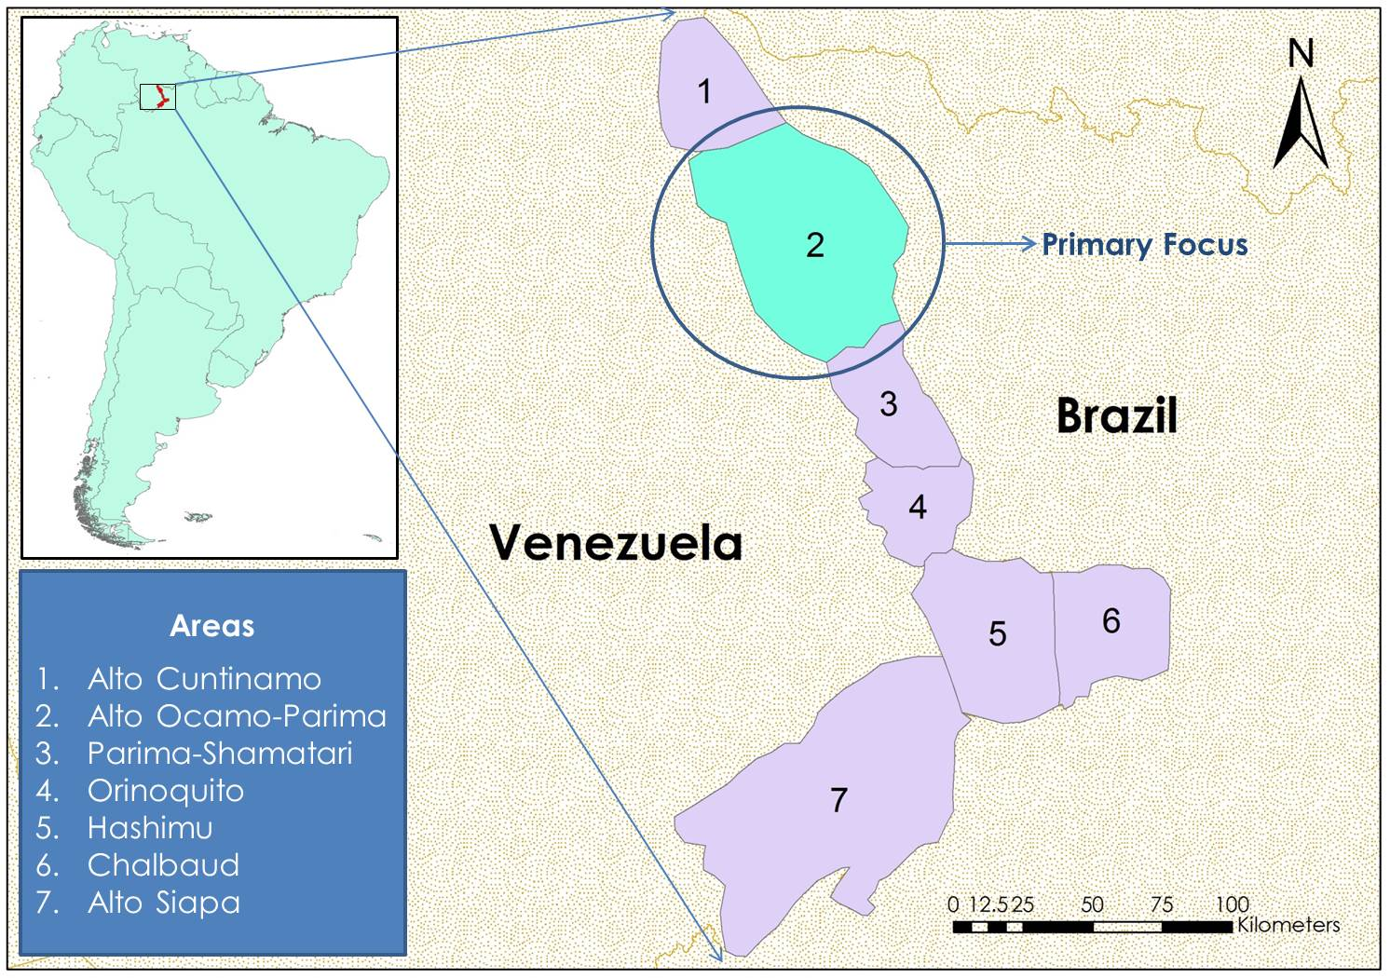
Notes:
Location:
7 sub regions of the Alto Orinoco Municipality in Venezuela
Our Study area is focused on the Venezuela side of the Brazil-Venezuela boarder. As shown here, there are 7 main municipalities that encompass the domain of the Yanomami people. Our main concentration of evaluation is focused on area 2. the Alto Ocamo Parima region, however we have also been able to evaluate the others as well.

Slide 3
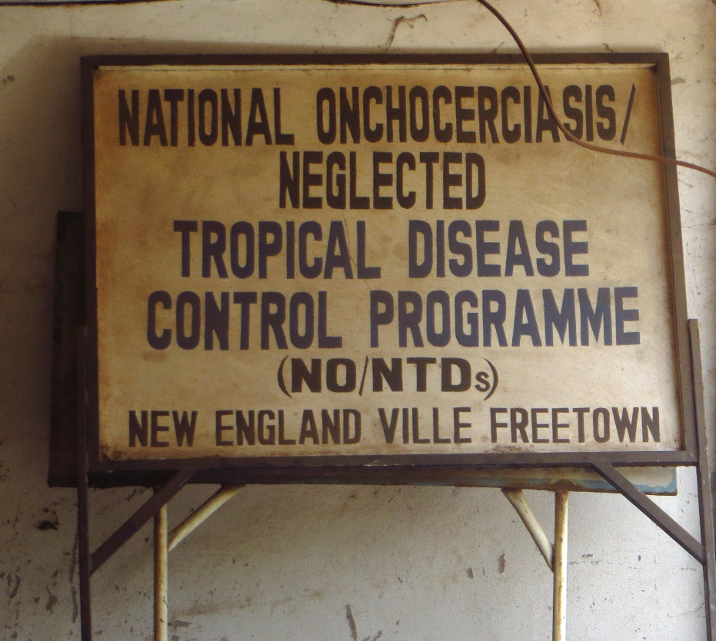
Community Concerns
What is Onchocerciasis (River Blindness Disease)?
  Caused by Onchocera volvulus
  Transmitted through blackfly bite
  Symptoms include rash, skin discoloration, visual impairment and blindness
Who is at Risk in the Region?
  122,282 people are at risk
  20,500 people currently need treatment
Why Is Eradication Important?
  Disease reinforces poverty cycle by impacting quality of life, ability to work, and ability to visually learn survival skills and cultural practices
Notes:
Onchocerciasis, commonly known as river blindness, is a treatable disease caused by the vector-borne parasite Onchocerca volvulus. This parasite is transmitted through bites of infected blackflies from the genus Simulium (Pan American Health Organization, 2014). Once inside the human host, O. volvulus migrates to the skin, various organs, and eyes. As the larvae migrate to the skin and die, they cause debilitating itching, rashes, and skin discoloration (World Health Organization [WHO], 2015). This intense itching has been known to drive people to injure themselves to obtain relief and in some cases even commit suicide (Landau, 2013). Onchocerciasis also has other ill effects, such as elephantiasis type disfigurement, glandular inflammation, “hanging groin”, visual impairment, and eventually complete blindness (Centers for Disease Control and Prevention, 2013). The majority of symptoms diminishes a person's quality of life and reinforces the cycle of poverty in already poverty stricken communities.
Image Credit: https://www.flickr.com/photos/overseas-development-institute/9357039395/in/photolist-4bzojK-bx4UeH-bx4UeX-ffRgPr-fg6uvA-79mSJV-5bPHq9-ffRgEX NTD Control Programme Office in Freetown

Slide 4
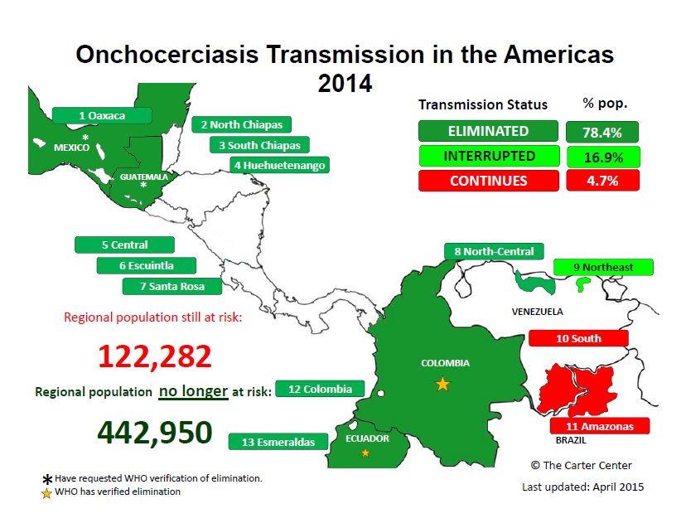
Community Concerns
Notes:
Image from Carter Center: http://www.cartercenter.org/resources/pdfs/health/river_blindness/OEPA-foci.pdf

Slide 5
Objectives
Long Term Objectives
Use NASA Earth Observations and Digital Globe data to locate remote Yanomami villages in densely forested areas
Convey locations and physical characteristics of villages to the Carter Center so that they can provide medical treatment

Slide 6
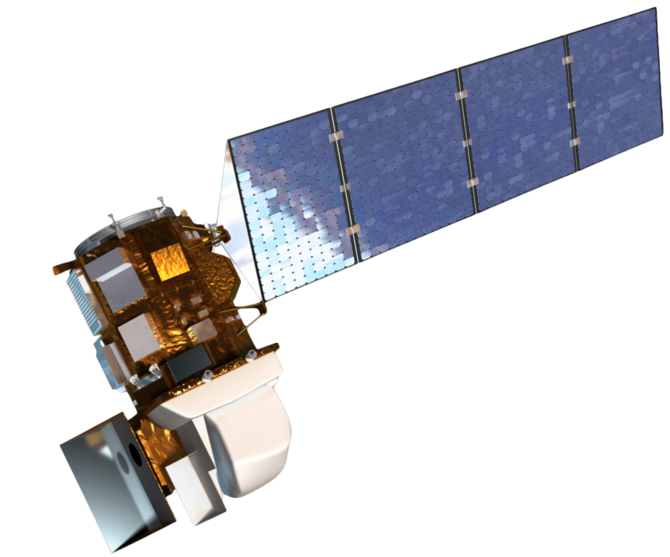
Sensors Used:
NASA Earth Satellites
LANDSAT 8, OLI and TIRS
Digital Globe Satellites
Worldview 1,2,3
IKONOS
GeoEye 1,2
QuickBird

Slide 7
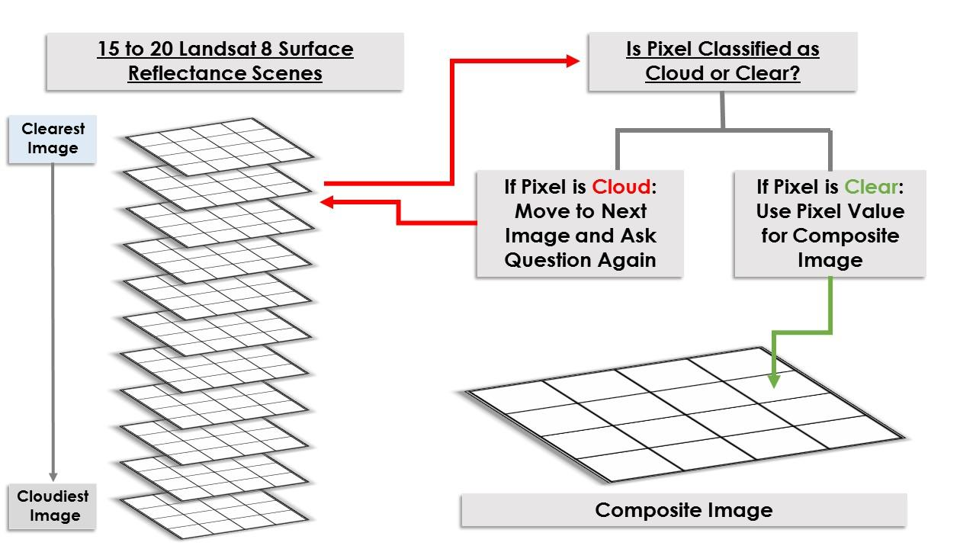
Methodology
Cloud free composite created from Landsat 8 tiles
Notes:
Will include summary of methodology in paper when corrections come back

Slide 8
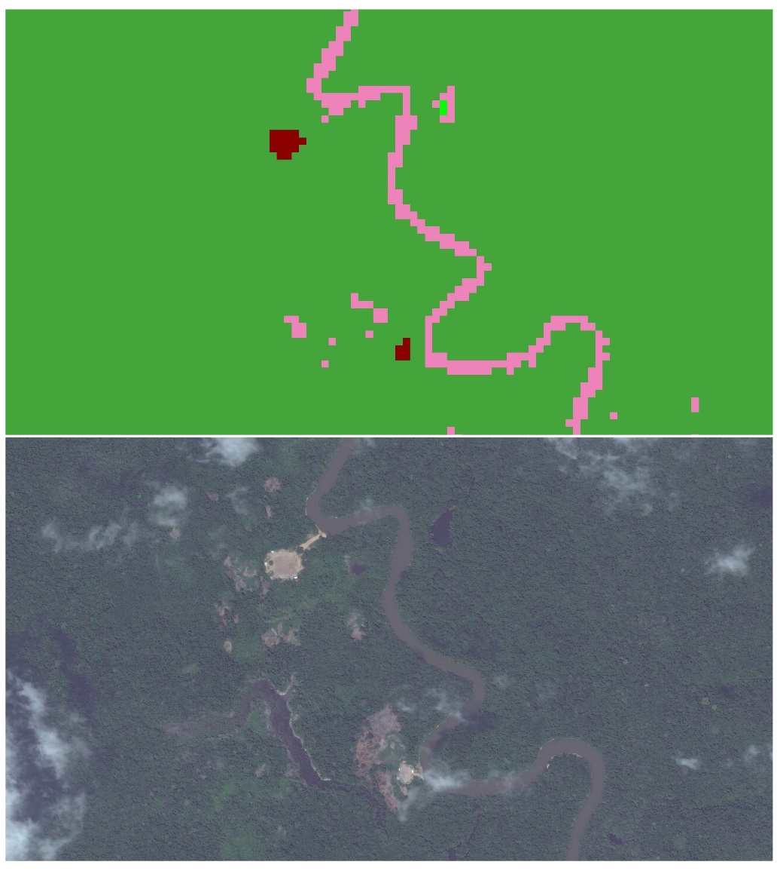
Methodology
Land cover Classification: Unsupervised K-means algorithm
  Classify land as forest, bare soil, rangeland, and open water.
Groupings of soil pixels were then compared to high-res imagery from all of the sensors
Notes:
Image Source: http://commons.wikimedia.org/wiki/File:Claude_Monet_-_The_Magpie_-_Google_Art_Project.jpg
Image: Digital Globe

Slide 9
Villages
Potential Village Identified by classifier
Verify village location using high resolution imagery
Estimate Population based on size and number of structures
Record the coordinates of the village and create an image thumbnail
Assemble all villages into one dataset
Create a map and list of coordinates for The Carter Center

Slide 10
What’s Next?
Carter Center to send medical aid to the region in the next 2-4 months
Be able to reuse our classification parameters in order to easily identify villages using Landsat imagery elsewhere
Notes:
Include specifics on timeline and what they will do with the data.

Slide 11

Data Analysis:
None yet
Image Credit: Monet
Notes:
Image Source: http://commons.wikimedia.org/wiki/File:Claude_Monet_-_The_Magpie_-_Google_Art_Project.jpg

Slide 12
Results
Put them here!
Image Credit: Monet
Notes:
Image Source: http://commons.wikimedia.org/wiki/File:Claude_Monet_-_The_Magpie_-_Google_Art_Project.jpg

Slide 13
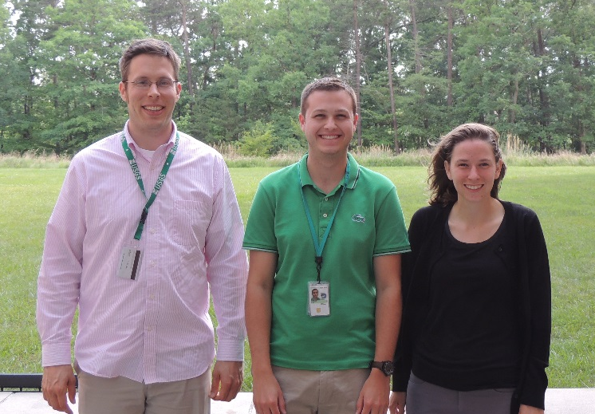
Advisors
Dr. Jim Tucker, GSFC
Dr. John Bolten, GSFC
Partners
Dr. Frank Richards, The Carter Center
Lindsay Rakers, The Carter Center
Others
Katie Melocik, GSFC

