Slide 1
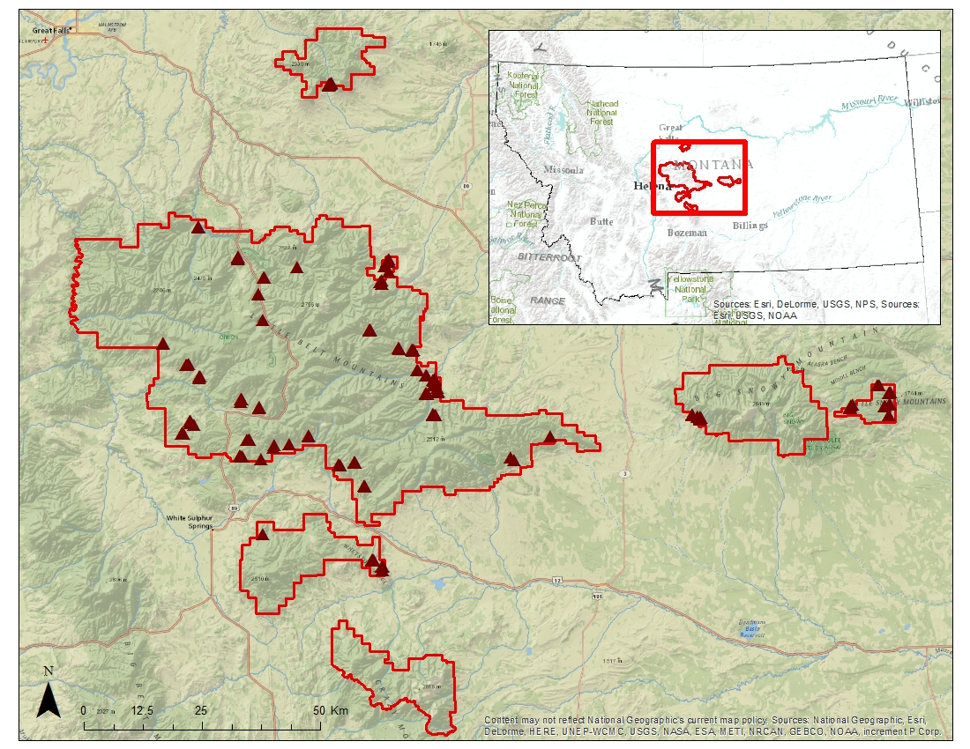
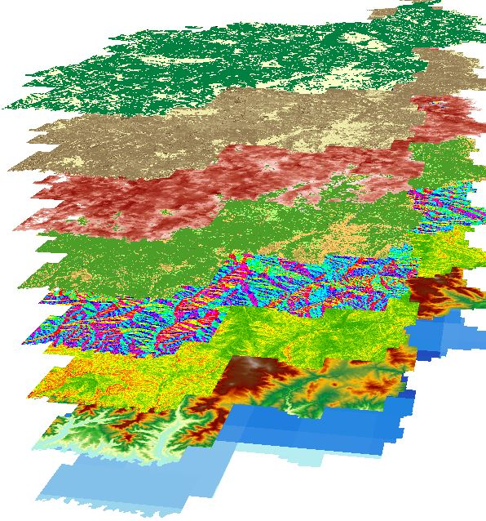
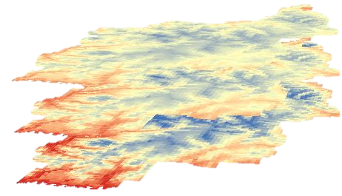
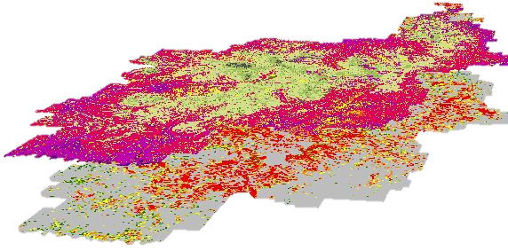

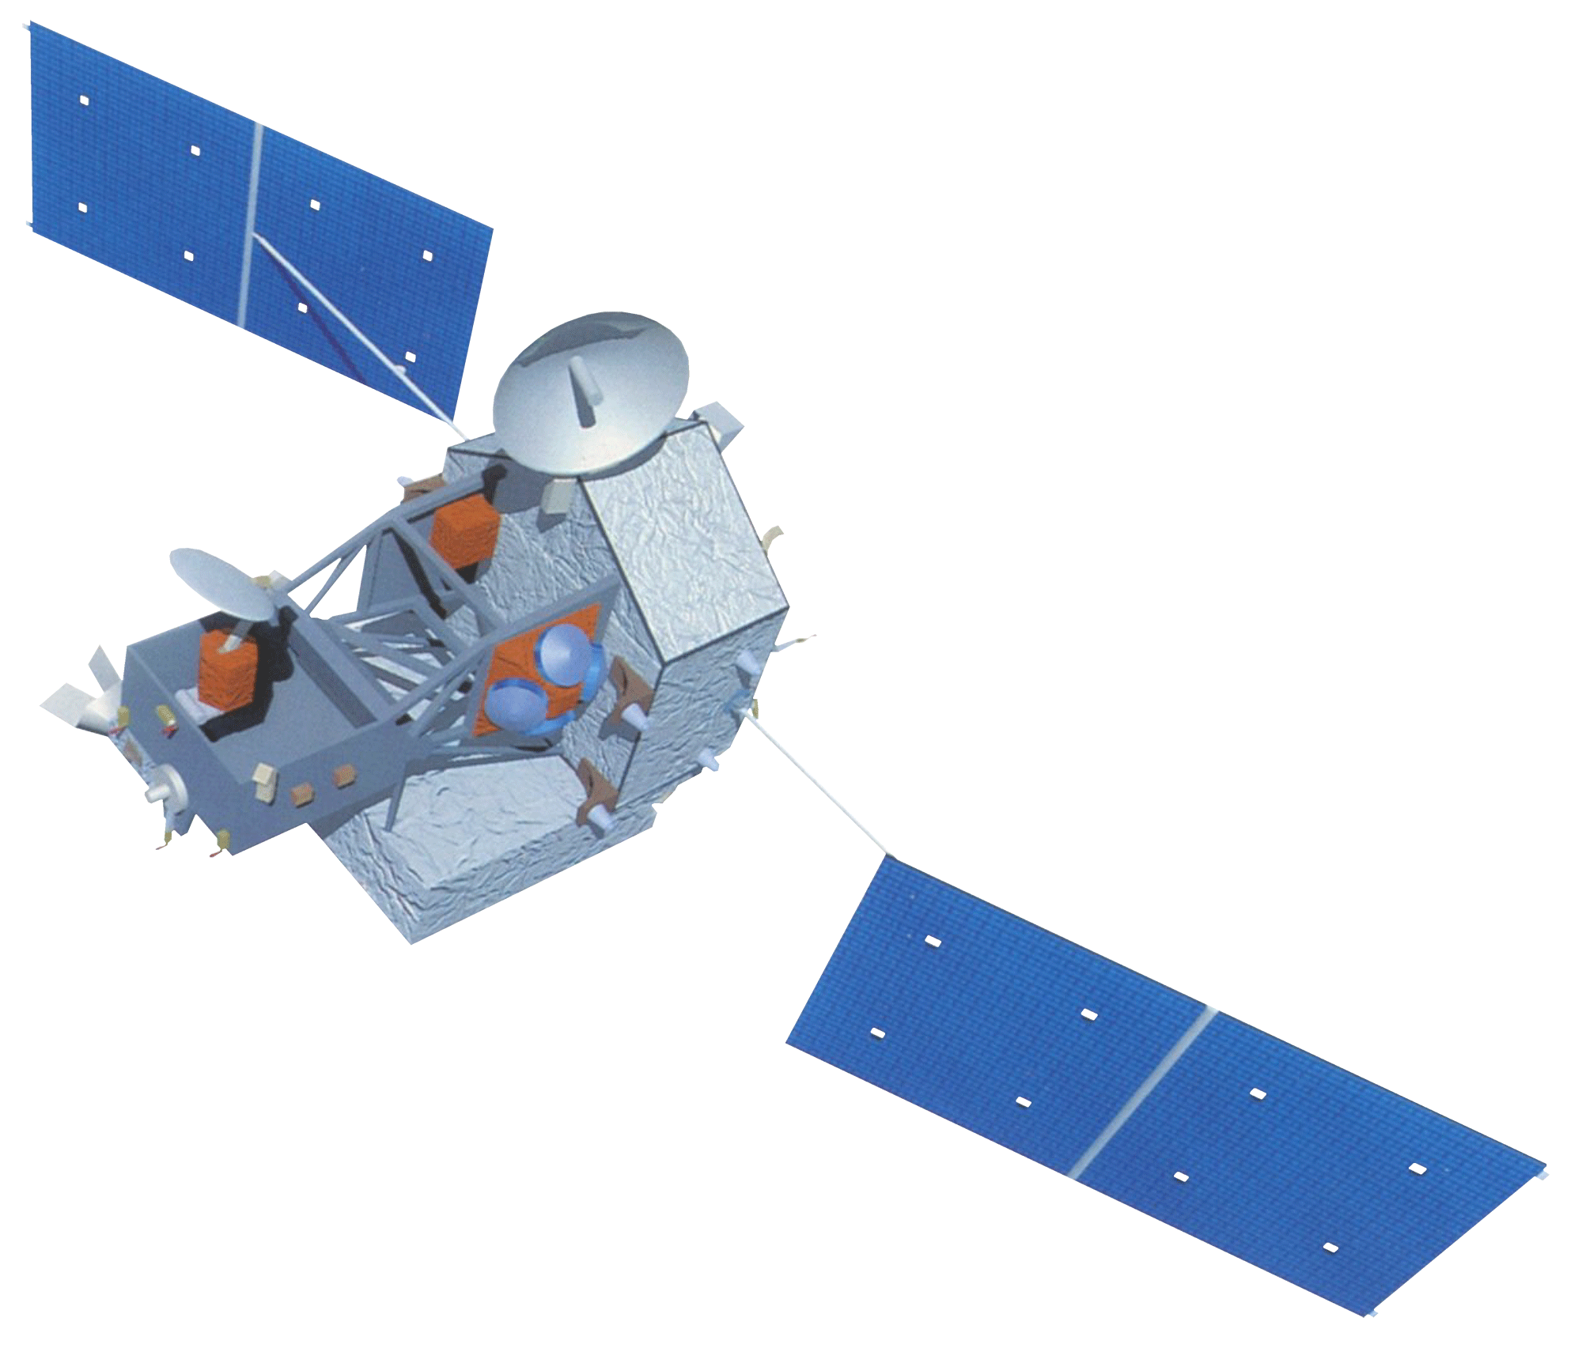
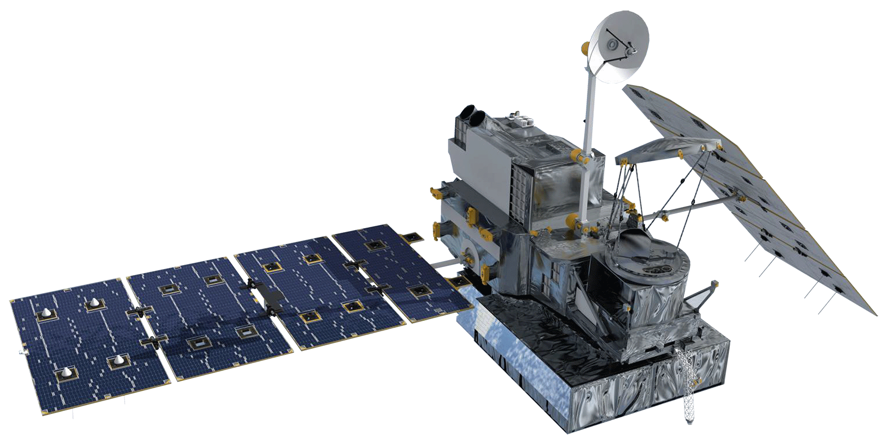
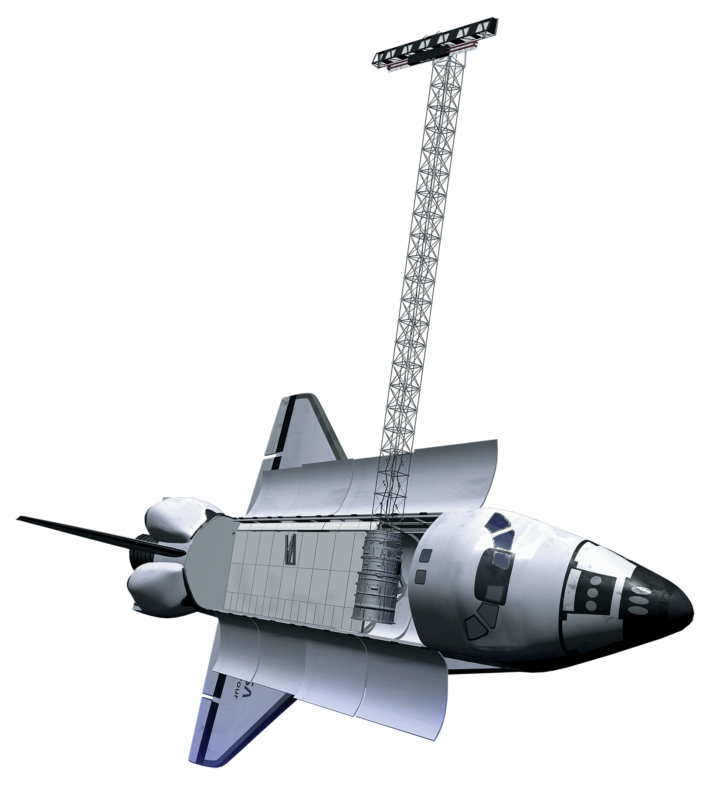
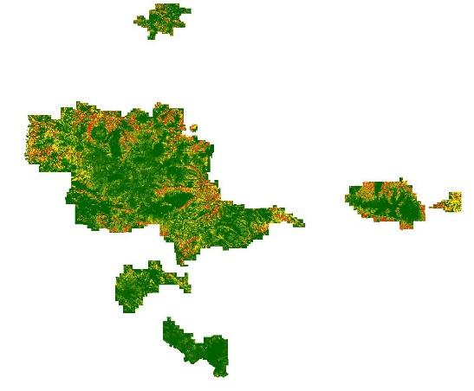
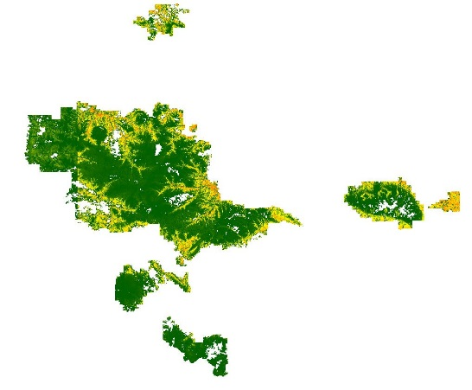
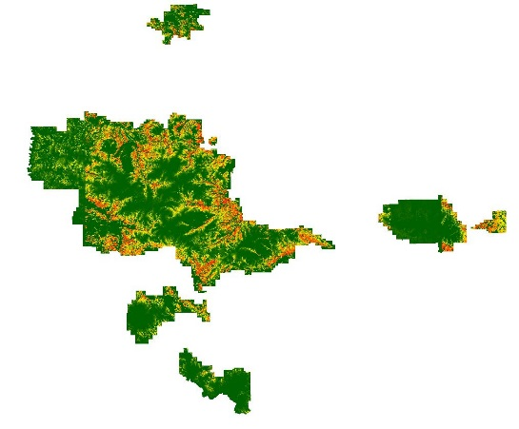
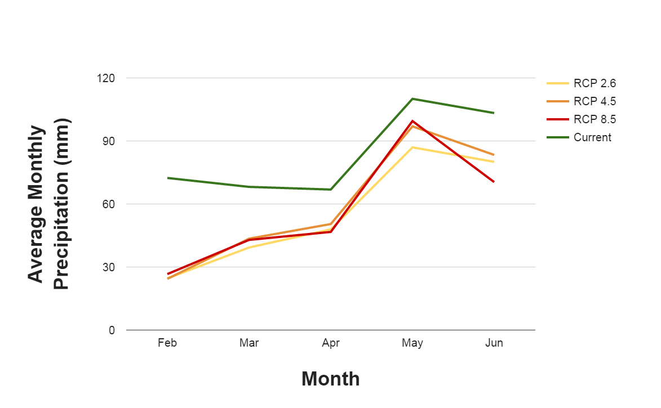
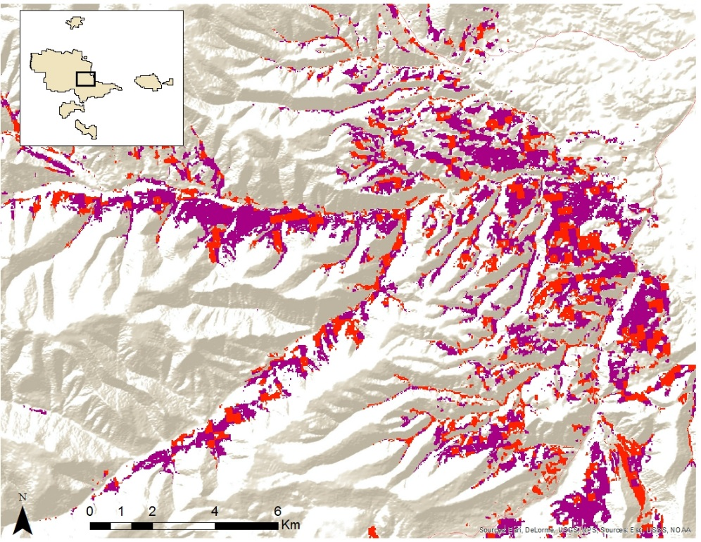
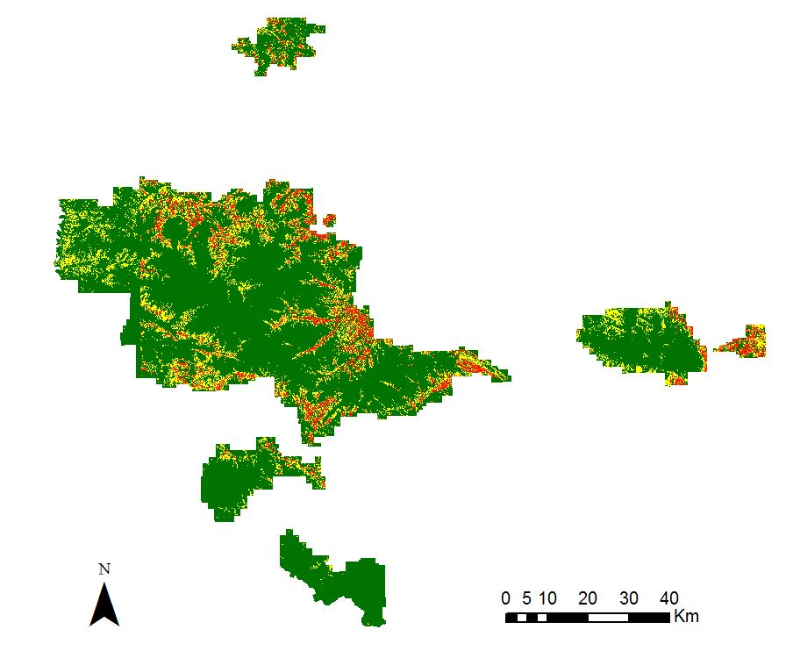
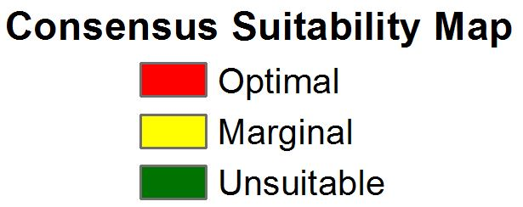

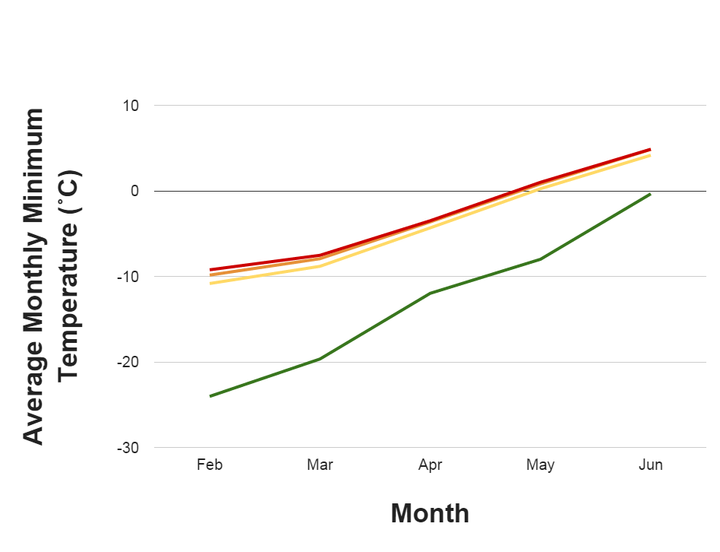
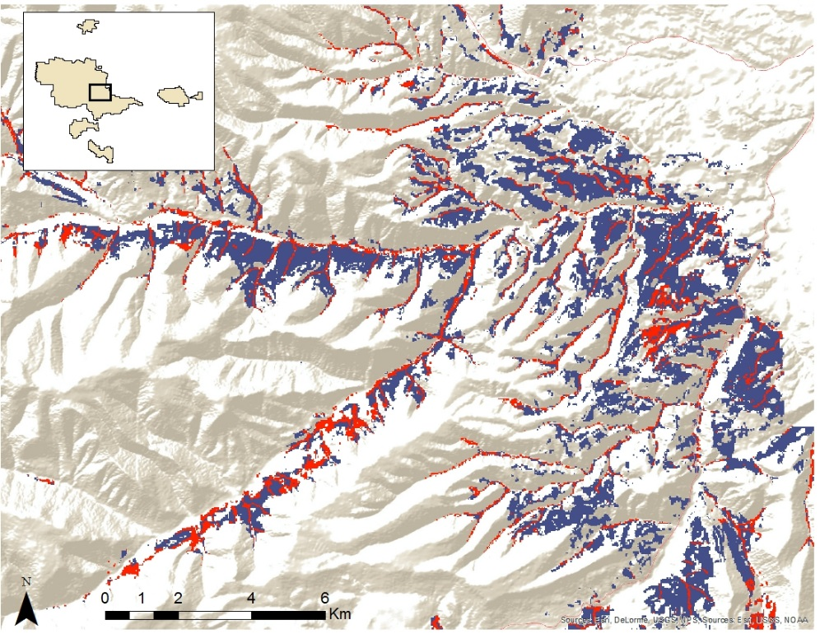
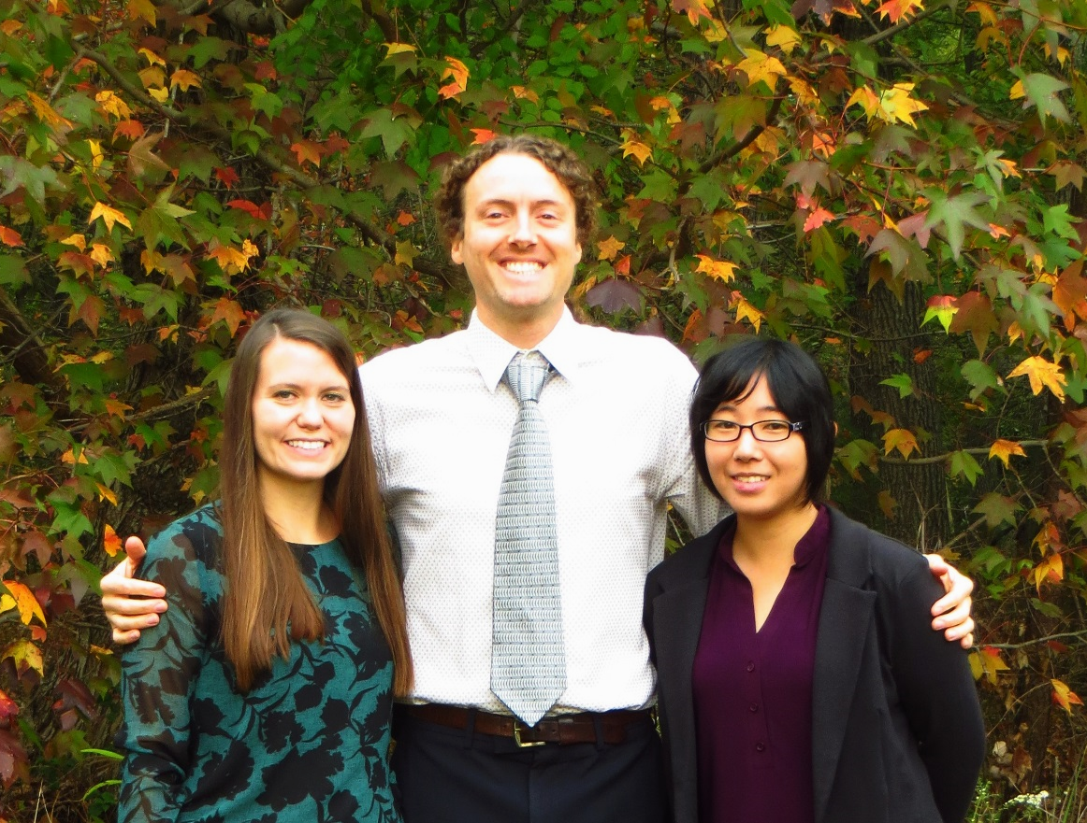
Montana Ecological Forecasting
Utilizing NASA earth observations to forecast the effects of climate change on northern goshawk nesting habitat
Erika Higa (Project Lead), Sean McCartney, Amanda Clayton
DEVELOP National Program at NASA Goddard Space Flight Center
Abstract
Objectives
The northern goshawk (Accipiter gentilis) is currently identified as both a Sensitive Species and a Management Indicator Species in the Lewis and Clark National Forest (LCNF) land and resource management plans. Goshawks are important top-tier predators in the LCNF and changes in the forest habitat greatly affect their survival and population. We examined the potential of using NASA Earth observations to locate and model suitable nesting habitat for the goshawk. Currently, Nate Bickford and the US Forest Service (USFS) do not use remote sensing to identify or forecast goshawk nesting habitat, and the tools they use are limited to topographic maps and in situ data. We identified various environmental variables measured by Landsat 8 Operational Land Imager (OLI), Shuttle Radar Topography Mission (SRTM), Tropical Rainfall Measurement Mission (TRMM) Precipitation Radar (PR), and Global Precipitation Measurement (GPM) Dual-frequency Precipitation Radar/Global Microwave Imager (DPR/GMI). These derived variables, along with ancillary vegetation data, were input into several habitat suitability models, using BioMapper, Maxent, and Mahalanobis Typicality, and a consensus map was made to identify areas of suitable habitat for nesting goshawks. Fire frequency and mountain pine beetle risk were used as ancillary data to determine the likelihood of available nesting habitat for the future under different climate change scenarios. The Goddard Institute for Space Studies ModelE/Russell Model was used in forecasting different climate change scenarios. The results from this project will augment current decision making practices in forest management in the LCNF and assist in understanding how climate change will affect the goshawk nesting habitat in the future.
Assess the role of NASA Earth Observations, along with ancillary data, in creating environmental variables as inputs for habitat suitability modeling
Analyze three different habitat suitability models to form a consensus map for northern goshawk nesting habitat in the Lewis and Clark National Forest
Forecast the impacts of climate change on nesting habitat through the year 2050 by incorporating mountain pine beetle disturbance and fire risk
Study Area
Methodology
Datasets
Data Processing
Analysis
Habitat Suitability Modeling
Land Cover
Tree Canopy Cover
Basal Area
Vegetation Height
Aspect
Slope
DEM
Precipitation
Project Layers to NAD 1983 UTM 12N
Resample layers to 30m resolution
Clip to study area
Input Layers into Habitat Suitability Models
BioMapper
Maxent
Mahalanobis Typicality
Lewis and Clark National Forest
Jefferson Division
Nest Sites
Goddard Institute for Space Studies ModelE/Russell Model (GISS-E2-R)
Earth Observations
Mountain Pine Beetle Risk and Fire Frequency Data
Forecasting
RCP 2.6: greenhouse gas emissions peak 2010 – 2020, then decline
RCP 4.5: emissions peak in 2040, then decline
RCP 8.5: emissions are constant
TRMM
Landsat 8
SRTM
Results
GPM
Habitat Suitability Model
Forecasting
Project Partners
Dr. Nate Bickford (University of Nebraska at Kearney)
Dr. Risto Tornberg (Oulu University, Finland)
Victor Murphy (USDA Forest Service)
BioMapper
Maxent
Mahalanobis Typicality
Acknowledgements
Dr. Ross Nelson (NASA Goddard Space Flight Center)
Dr. John Bolten (NASA Goddard Space Flight Center)
Laura Conway (Lewis and Clark National Forest)
Dr. Lee Vierling (University of Idaho)
Dr. Jeff Hicke (University of Idaho)
Team Members
Conclusions
There are approximately 350 km² of optimal nesting habitat for northern goshawks within the Jefferson Division of the Lewis and Clark National Forest; 52% of modeled optimal habitat may be at risk for mountain pine beetle blight while 66% may be at risk by fires.
Warmer minimum temperatures can increase pine beetle populations and allow the beetles to infect areas where there were no previous outbreaks. The combination of a warmer and drier climate may also lead to an increased frequency of fires by 2050. Overall, mountain pine beetle outbreaks and wildfires can contribute to the loss of goshawk nesting habitat.
Left to Right: Amanda Clayton, Sean McCartney, Erika Higa
NASA Goddard Space Flight Center

