Slide 1

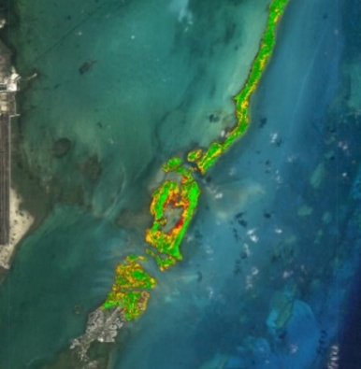
Study Area Water Resources
Project Long Title
Images
For ALL images – make sure all text is legible and add legends separately (so they can be moved or resized). If text is not editable, a team member must be available to make changes with a very short turn-around time (hours, not days) after submission.
Acknowledgements
Team Members
Include anyone who has helped you with the project.
If this is a continuation project, credit the previous team members and contributors.
If you are including affiliations, use DEVELOP as the affiliation for a DEVELOPer or former DEVELOPer—not their school or former school.
List Team Leads first and include their title below their name.
Headshots should include professional business attire.
Images should be cropped to a circle shape at a 1.8” x 1.8” dimension and centered in aperture shape. Instruction on how to do this can be found here.
Project Partners
EXAMPLE
Only use federal logos—no state or local government logos, or NGO logos.
Some logos are on DEVELOPedia.
Images and text should be added separately (not as an image).
Participant Name
Project Lead
Participant Name
Participant Name
Participant Name
Node Location

Slide 2
The Impact Poster
What is the purpose of this poster type?
Unlike the scientific posters that DEVELOP has traditionally produced, this new type is meant to face a public, non-scientific audience. It doesn’t need to include everything about your projects! Consider focusing on the aspects of feasibility and project impact to the partners. Steer clear of jargon, keep things simple, and be creative with how you display information!
Ground Rules
You are creating this type of poster either because (a) your team opted to create an Impact Poster instead of a Scientific Poster, or (b) you want to optionally create one in addition to your required Science Poster.
Avoid large areas of color when possible and keep the background white. Posters can become too expensive to print with so much color!
DO NOT include:
DO include:
Abstract
Detailed, tech-heavy methodology
Overuse of graphs, charts, etc.
Plain language summary (optional)
Study area (map is not required)
Concise highlights of community concerns, project purpose, and/or objectives (does not need to include everything from the project summary)
Limited methodology, if you see fit
Earth observations (satellite illustrations)
Results/Conclusions presented in a simplified and visually-appealing manner (e.g., maps, charts, infographics)
Team members, end users, and other acknowledgements
Formatting Guidelines
Use only Century Gothic (headlines/titles) and Garamond (body text) typefaces.
Font size minimum is 24 point for body text and 16 point for captions, etc.
Stay inside boundaries and retain the template header, footer, and project title on the righthand side
Use the align tool and automatic gridlines
When making your poster colorful, use the application area color the most with 1-2 highlight colors maximum (maps/figures can have more)

Slide 3
The Impact Poster
What should I highlight from my project?
We want to be clear that the examples provided, derived from the Western Montana Ecological Forecasting (Spring 2021) and California Agriculture (Spring 2022) projects, are not “fill-in-the-blank” templates. You might be including totally different things in a different format! Below are some guiding questions that might help your team to determine what to highlight on your poster.
Who is most interested in and impacted by your project? What level of familiarity does this audience have with Earth observations and geospatial sciences?
How would you describe your project findings to a friend or family member?
What is most novel about your project?
Is the study period / timeline notable? (e.g., before and after a hurricane)
Are there exciting quantitative results to share?
Can your main takeaway be summarized in a single sentence?
What might surprise people about your project or findings?
If you want people to learn and remember one thing, what would it be?

Slide 4
Scientific vs Impact
Visual Poster Comparison
The following slides have examples of both the Scientific and Impact posters. Ultimately, everyone’s poster will look different and the examples are meant to be used as inspiration. When making an Impact version, try to keep these tips in mind.
Icons
Charts & Graphs
Use icons to help convey information and use less text (great for lists).
Instead of a circle or rectangle, try using an icon as the frame. (see the Eco Forecasting example)
Avoid using too many icons as this can make the poster feel cluttered.
It is recommended that the icons stay the same color (can be either the application area or highlight from a map).
When using a bar graph, keep the bars skinny to help use less ink for printing.
Experiment with using SmartArt – List, Process, and Cycle are good options.
Information
Highlight about 3-5 parts from your project.
Remember to keep the text short and easy to read.
Proofread and double-check dates, names, descriptions, etc.
Placement
Keep Acknowledgements and Team Members at the bottom of the poster.
Group similar items and information together to help when rearranging.
Avoid having text or graphics go past the margin lines.
Overall Advice
Take breaks and save often – looking at so much information at once can get daunting.
If you decide to try a different layout, make a duplicate of your previous version as back up.
Don’t be afraid to ask for input or feedback from your Node Fellow or the Project Coordination team!
Sizing & Color
Make numbers larger than the body text for emphasis.
For graphs and charts, make sure the Legend is legible.
Other than color, bold and italicized font can also add impact to a section.
Keep most of the poster background white.
Additionally, make sure there is a good amount of blank space available.

Slide 5



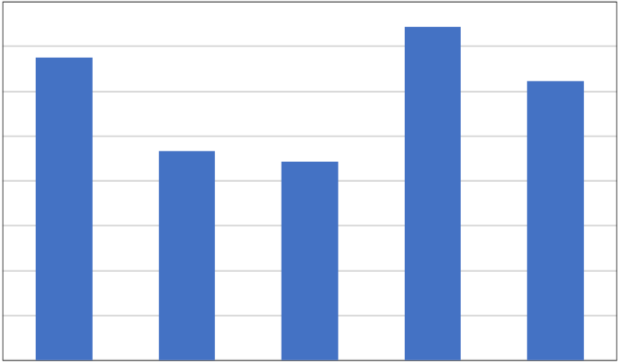
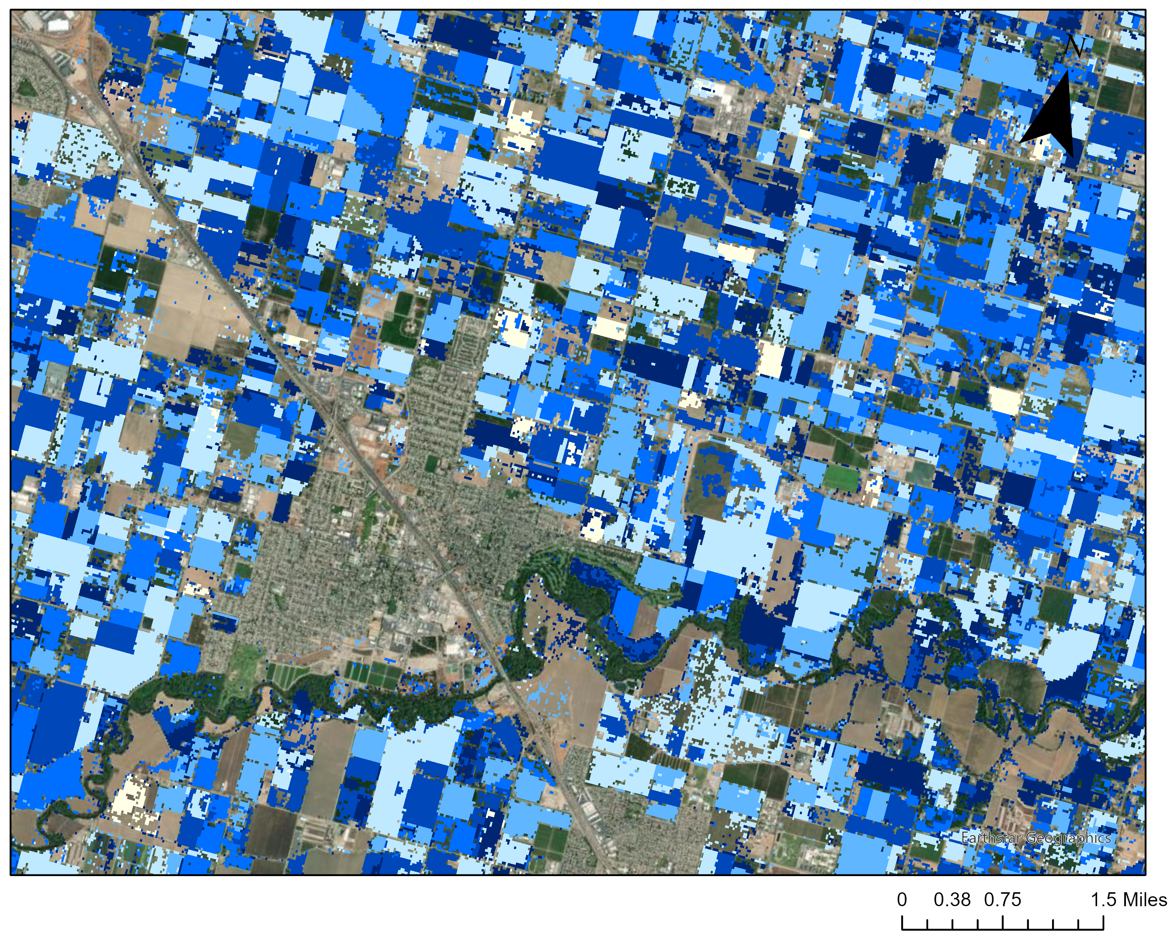
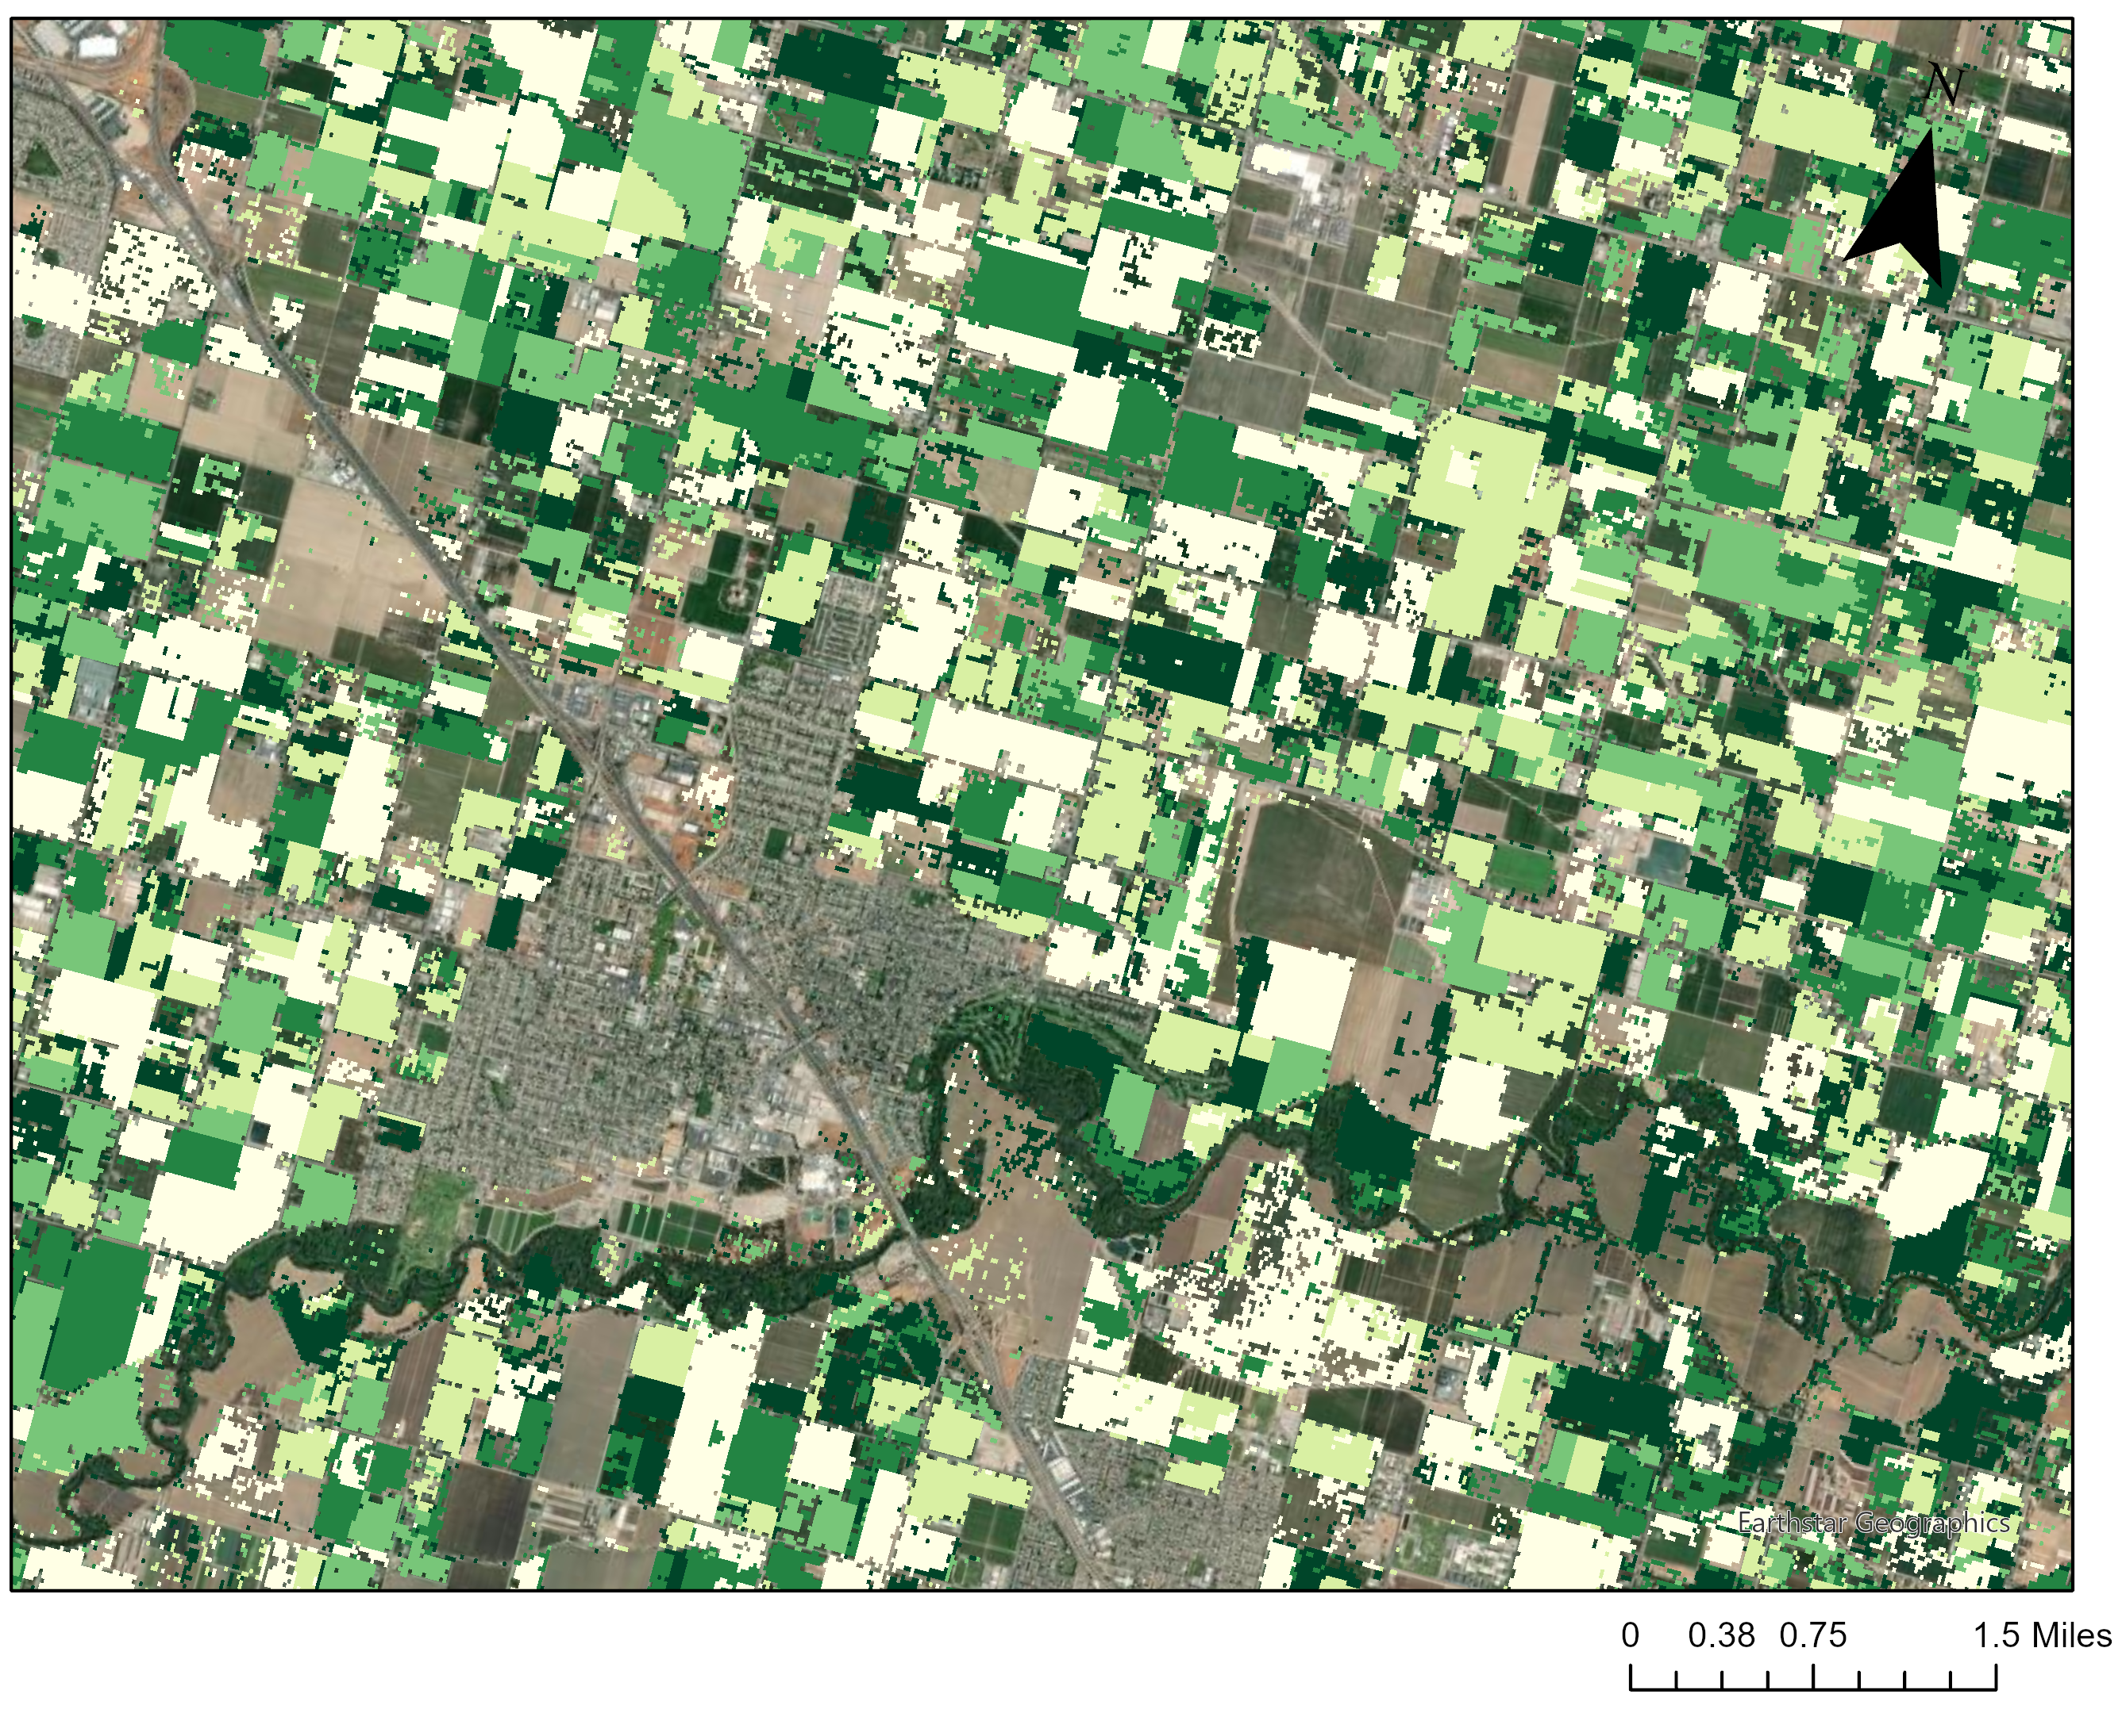


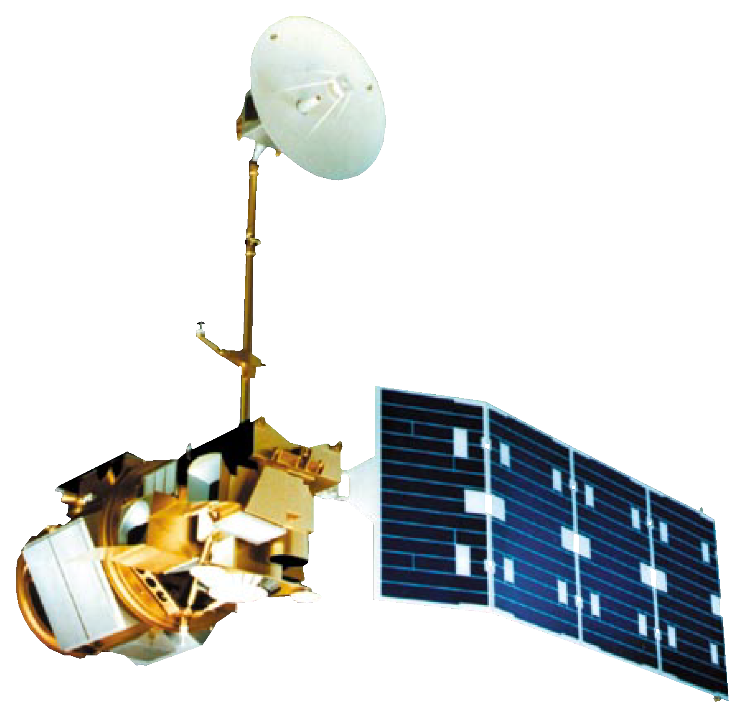
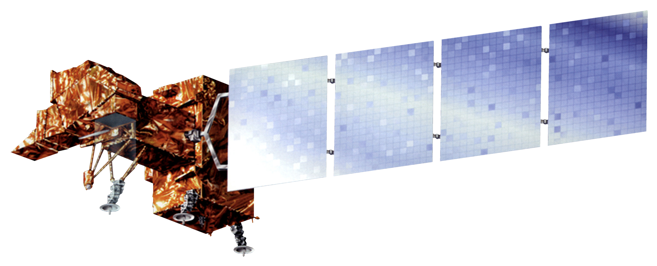

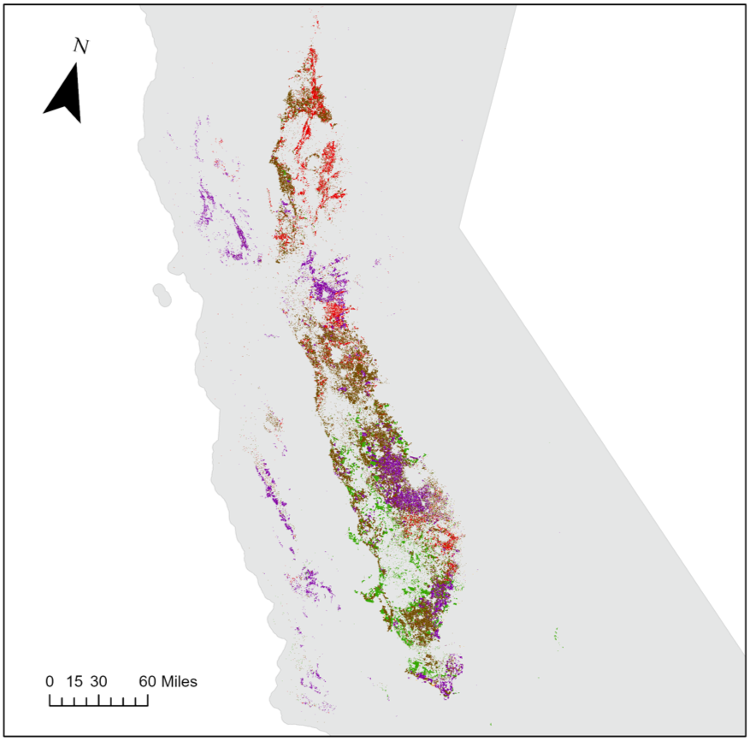
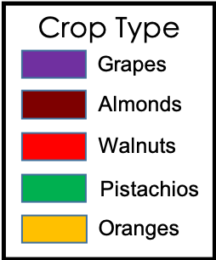


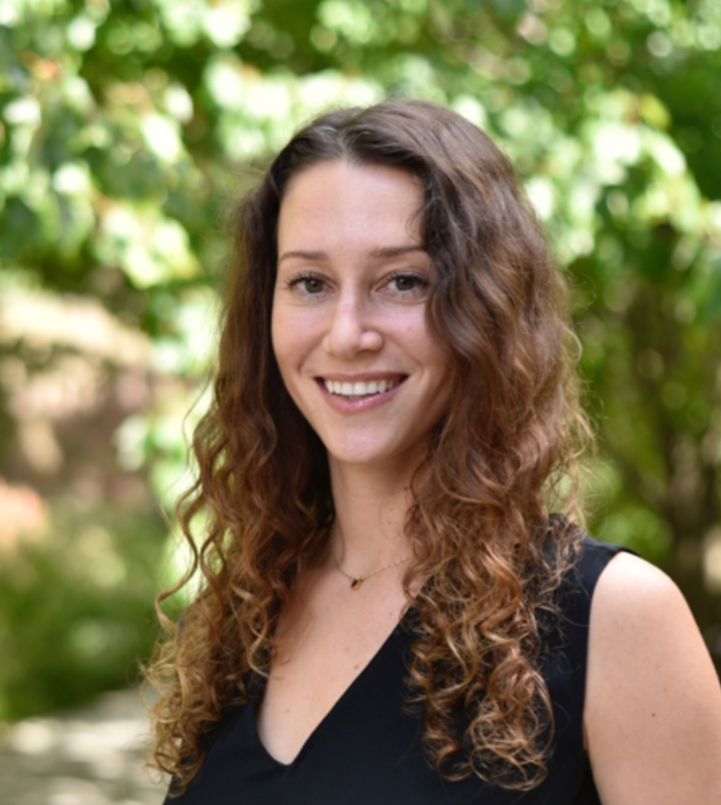


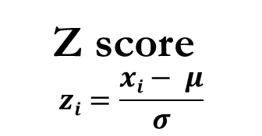
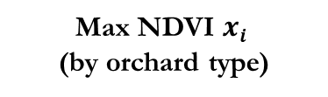
**SCIENTIFIC**
Using Earth Observations to Estimate the Age and Carbon Stock of Perennial Agriculture
Abstract
Methodology
California Agriculture
California seeks to become a carbon neutral state by 2045. To track progress toward this goal, it is important to quantify the amount of carbon stored by various landcover types across the state. Vineyards and orchards make up a large portion of California's agricultural landcover and store considerable amounts of carbon. For this project, NASA DEVELOP partnered with the California Air Resources Board to estimate the age and carbon stock of crop-specific agricultural regions across California between 1984 and 2021. The DEVELOP team created the Perennial Agriculture Age and Carbon Estimation Tool (PAACET), a Google Earth Engine tool that employs Earth observation from the Landsat 5 Thematic Mapper (TM), Landsat 7 Enhanced Thematic Mapper Plus (ETM+), and Landsat 8 Operational Land Imager (OLI) to estimate the age and carbon stock of vineyards and almond, walnut, pistachio, and orange orchards. The team used an ocular sampling accuracy assessment consisting of 53 sample vineyards and orchards and found that on average, PAACET estimated ages within ±4.3 years of their actual age. The tool estimated that vineyards and walnut orchards are the oldest woody croplands, and almond orchards store the largest total carbon.
Time series stack
Landsat 5, 7, & 8
Mean μ
(of max NDVI values over 37 years of study period)
1984
Z score
$$zi=\frac{xi− μ}{σ}$$
Planting Year
Z score < -2
Orchard Age
(Current year – planting year)
2021
Std σ
(of max NDVI values over 37 years of study period)
Max NDVI $xi$
(by orchard type)
Assess accuracy using ocular sampling
Carbon Stock
(Inputting age estimates into allometric equations)
Results
Oranges
0.06 tg C
0.08%
16
Mean Age by Crop Type
Grapes
3.46 tg C
4.89%
Pistachios
9.30 tg C
13.15%
Project Partners
14
The NASA DEVELOP team partnered with the California Air Resources Board (CARB), which is one of six boards, departments, and offices under the umbrella of the California Environmental Protection Agency. CARB is California's lead agency on climate change and is responsible for planning a roadmap to achieve the state's climate change goals and implementing programs to reduce greenhouse gas emissions.
12
10
Walnuts
11.58 tg C
16.38%
8
Almonds
46.32 tg C
65.50%
6
4
2
Objectives
0
Grapes Oranges Pistachios Walnuts Almonds
Develop a Google Earth Engine tool to map crop age and biomass of perennial agriculture in California
Estimate the total carbon stock of California’s vineyards and almond, pistachio, walnut, and orange orchards
Compare the carbon stock and ages of the different crop types
Fig. 2. Distribution of mean age by crop type in 2021.
Fig. 3. Distribution of carbon stock by crop type in 2021.
Age (years)
Carbon stock
(kg/m²)
38
13,000
Earth Observations
1
1,000
Landsat 7 ETM+
1999 – Present
Fig. 4. PAACET cropland age estimates near Modesto, California in 2021.
Fig. 5. PAACET cropland carbon stock estimates near Modesto, California in 2021.
Landsat 5 TM
1984 – 2012
Landsat 8 OLI
2013 – Present
Conclusions
Study Area & Period
PAACET can detect the planting years of most orchards and vineyards in California.
The accuracy of the tool is limited by Landsat data availability (starting in 1984) and the accuracy of the USDA-NASS Cropland Data Layer in defining orchard boundaries.
The accuracy of the tool may be improved by incorporating satellite imagery with better spatial resolution.
Crop-specific agricultural regions of California
March 1984 – December 2021
Acknowledgements
The team would like to thank everyone who made this project possible:
Partners: California Air Resources Board
Advisors: Dr. Juan Torres-Pérez (NASA ARC), Dr. Kenton Ross (NASA LaRC)
Fellows: Britnay Beaudry (DEVELOP ARC), Hayley Pippin (DEVELOP ARC)
Special thanks: Dr. Lee Johnson (NASA ARC), Dr. Forrest Melton (NASA ARC)
Team Members
Rachael Ross
Project Lead
Rachael Ross
Project Lead
Alex Posen
Alex Posen
Shreya Suri
Shreya Suri
Stefanie Mendoza
Fig. 1. Map of study area including vineyards and almond, walnut, pistachio, and orange orchards in 2021.
Stefanie Mendoza
California – Ames

Slide 6




**IMPACT**
Using Earth Observations to Estimate the Age and Carbon Stock of Perennial Agriculture
Model Input Variables
California Agriculture
California seeks to become a carbon neutral state by 2045.
Crop Type
different plants store different amounts of carbon
How much carbon are agricultural lands storing away? Satellites can tell us.
Age
the older the field, the more carbon accumulated
Area
more landcover = more storage space
Landsat 5 TM
Landsat 7 ETM+
Landsat 8 OLI
70.72
TERAGRAMS OF CARBON
Using our model, we estimated
this much stored by California agricultural lands in 2021.
46.32 Almonds
11.58 Walnuts
9.3 Pistachios
3.46 Grapes
.06 Oranges
Taking inventory is a necessary step toward attaining carbon neutrality.
Almonds
Walnuts
Pistachios
Grapes
Oranges
The team would like to thank everyone who made this project possible:​
Partners: California Air Resources Board​
Advisors: Dr. Juan Torres-Pérez (NASA ARC), Dr. Kenton Ross (NASA LaRC)​
Fellows: Britnay Beaudry (DEVELOP ARC), Hayley Pippin (DEVELOP ARC)​
Special thanks: Dr. Lee Johnson (NASA ARC), Dr. Forrest Melton (NASA ARC)​
EXAMPLE
Rachael Ross
Project Lead
Alex Posen
Shreya Suri
Stefanie Mendoza
California – Ames

Slide 7
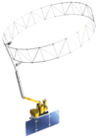



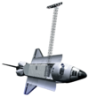
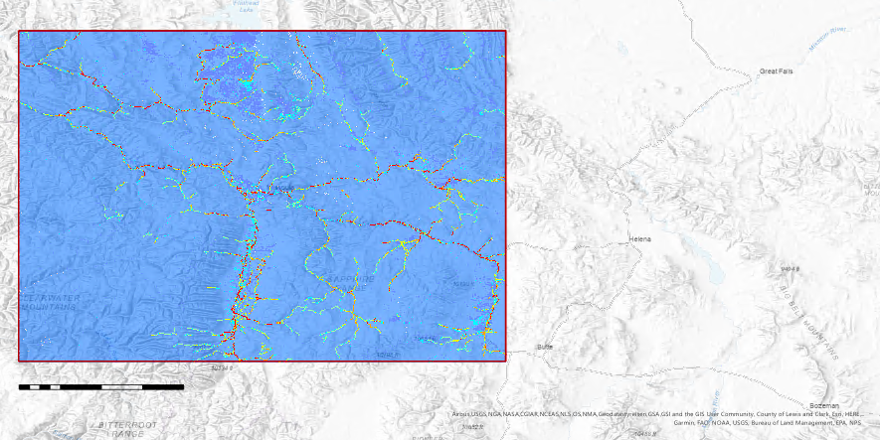

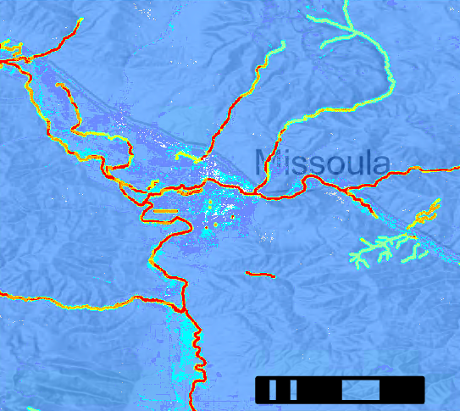
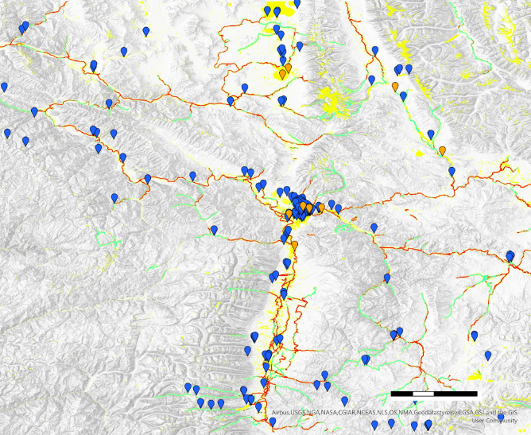

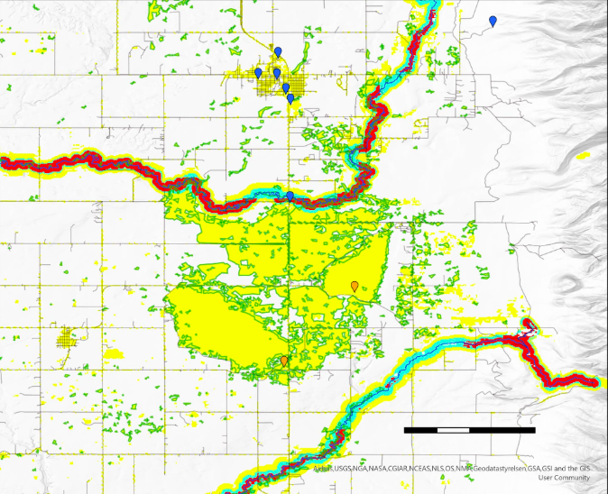

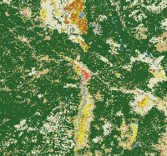
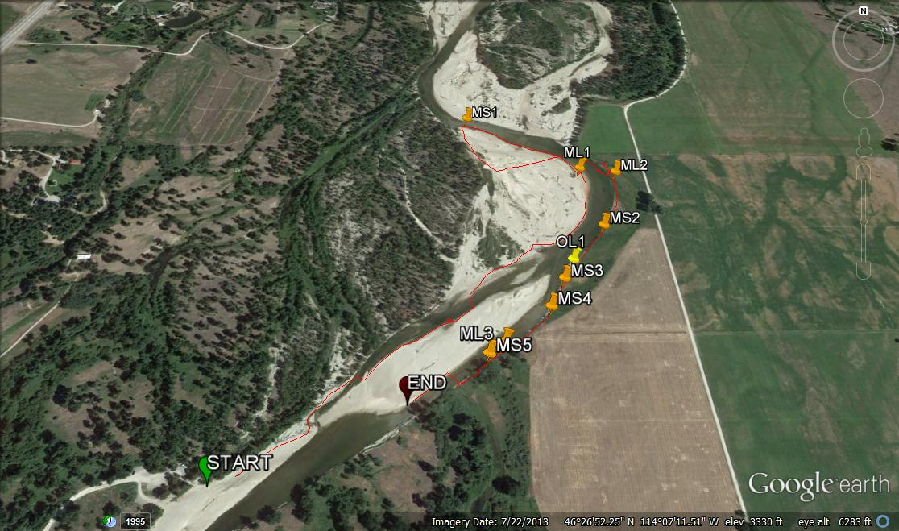

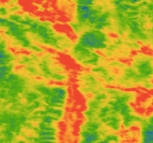

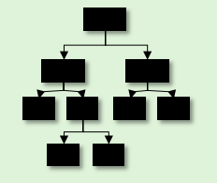

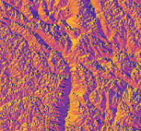
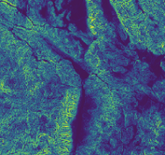
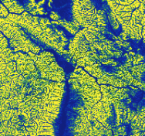
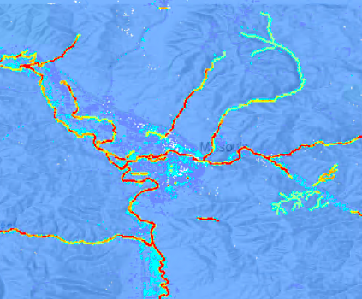
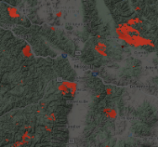

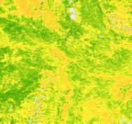
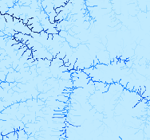
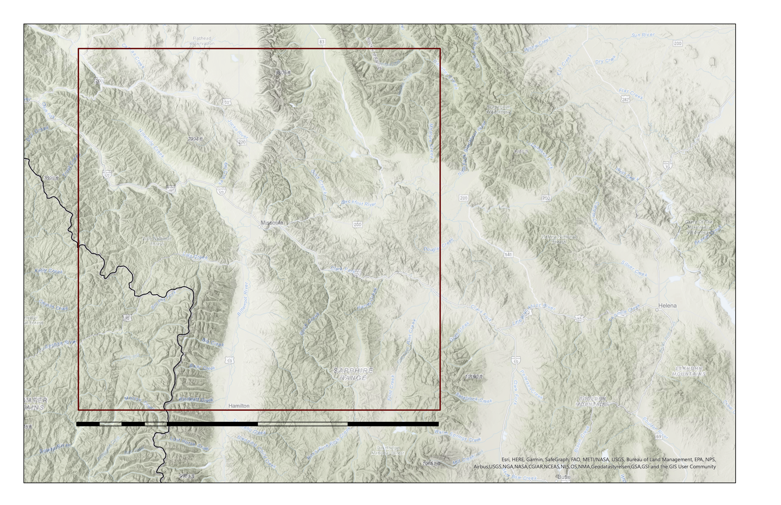
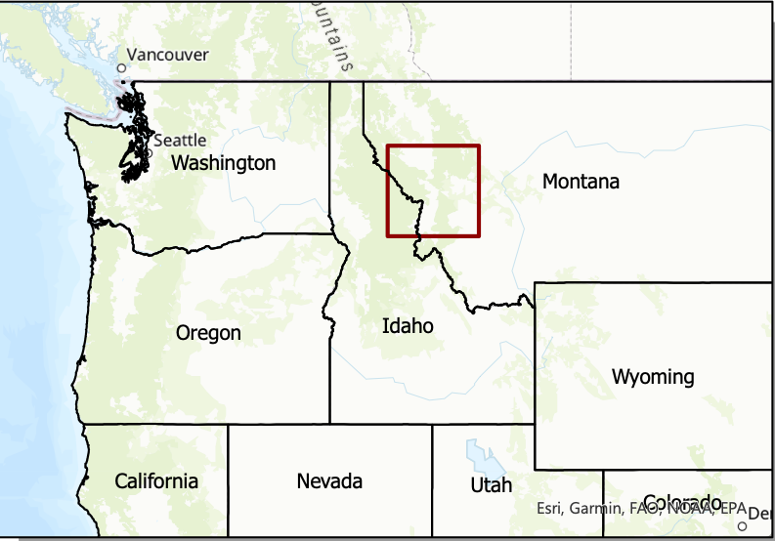





**SCIENTIFIC**
Modeling Habitat Suitability of Mustelid Species to Guide Detection Dog Surveys for Contaminants Monitoring, via Collected Scats, in River Systems in Western Montana
Abstract
Earth Observations
Western Montana Ecological Forecasting
Environmental contaminants are becoming increasingly prevalent in riverine ecosystems. The status of contaminants in western Montana’s relatively pristine river systems is largely unknown. Monitoring for heavy metals, brominated flame-retardants (BFRs), and pharmaceuticals is important due to their negative effects on ecosystems. Exposure to these contaminants can have significant endocrine, neurological, and reproductive effects. Contaminants easily travel up the food chain and bioaccumulate in apex predators. As predators with a largely aquatic diet, American mink (Mustela vison) and North American river otter (Lontra canadensis) serve as reliable indicator species of environmental health and the status of contaminants. Analysis of scat from these species is a noninvasive method to measure contaminant levels, and detection dogs from Working Dogs for Conservation (WD4C) have been used to locate these scat samples. To aid in the search of these samples, habitat suitability models were created for mink and otter for the years 2013-2020 and projected to 2040 using the random forest algorithm in the Software for Assisted Habitat Modeling (SAHM). Predictor variable data were acquired from Landsat 8 Operational Land Imager (OLI), Terra Moderate Resolution Imaging Spectroradiometer (MODIS), Global Precipitation Measurement Integrated Multi-satellite Retrievals for GPM (GPM IMERG), Shuttle Radar Topography Mission (SRTM), and Soil Moisture Active Passive (SMAP). Within these models, the most important variable for mink and otter habitat was distance to river. Suitable habitat also corresponded with emergent herbaceous land cover and deeper river locations. These habitat suitability models will inform sampling site section for further contaminant analysis.
Terra MODIS
SRTM
Landsat 8 OLI
GPM IMERG
SMAP
Results
N
N
Missoula
Objectives
0
20
40 km
Create habitat suitability models for American mink and North American river otter to facilitate contaminant monitoring in Western Montana
Project habitat suitability models to 2040 based on changing climate conditions
Develop tools to determine future survey locations based on proximity to contaminant sources and availability of suitable habitat
Habitat Suitability
0.287-0.466
0
25
100 km
0.000-0.039
0.467-0.639
0.040-0.137
0.640-0.823
0.138-0.286
0.824-1.000
Methodology
Fig. 4. Habitat suitability map focused on Missoula, Montana. Habitat suitability is measured in probability of mink and otter occurrence throughout the study area. Blue indicates low probability and red indicates high probability.
Data Acquisition
Data Analysis
Mapping
N
Google Earth Engine
Current habitat suitability maps
WorldClim
Software for Assisted Habitat Modeling (SAHM)
Preprocessing
Model runs
Missoula
Partner occurrence data
Future habitat suitability maps
0
2.5
5 km
GBIF
0
20
40 km
Survey feasibility maps
Points of Interest
Habitat Suitability
Open Street Map
GBIF Otter Presence
No Habitat
Study Area
Low
Roads
Medium
Rivers
High
Figure 1. General project workflow. GBIF stands for Global Biodiversity Information Facility.
Emergent Herbaceous Wetland
Occurrence data
Predictors
Analysis
Fig. 5. Habitat suitability final model with points of interest (potential contaminant sources) and additional occurrence data. Areas of lowest probability were removed to focus on likely survey areas. The inset map highlights one suggested survey site.
NLCD
Land Cover
1. Random Forest Model
Conclusions
Mink and otter occurrence was most strongly correlated with distance to rivers, river depth, land surface temperature, and land cover, in that order of importance.
We identified multiple regions of Western Montana that WD4C should survey based on availability of habitat, proximity to contaminant sources, and proximity to other known otter sightings.
The habitat suitability maps, research site feasibility maps, and Google Earth package created in this project will help guide WD4C in future survey site selection.
ssm
ppt
Climatic
Image Credit: N. Richards
LST
Species occurrence data
elev
aspect
Topographic
2. Probability Map
slope
HAND
Acknowledgements
burn
NDVI
Other
Dr. Allison Howard – University of Georgia
Dr. John Bolten – NASA Goddard Space Flight Center
Dr. Kenton Ross – NASA Langley Research Center
Dr. Peder Engelstad – Colorado State University
Dr. Nicole Ramberg-Pihl – NASA GSFC Node Fellow
river dist
depth
Figure 2. Workflow for current habitat suitability models. Predictors defined as follows: NLCD- National Land Cover Database, LST- Land Surface Temperature, NDVI- Normalized Difference Vegetation Index , SSM- Surface Soil Moisture
Study Area
N
Study Area Boundary
Project Partners
Dr. Ngaio Richards – Working Dogs for Conservation
Dr. Mark LaGuardia – The Virginia Institute of Marine Science
Missoula
Team Members
0
100
200 km
Anna Winter
Project Lead
Kergis Hiebert
Madeleine Gregory
Kjirsten Coleman
Fig. 3. A depiction of the 200km² study area centered on Missoula, Montana.
Maryland - Goddard
Maryland – Goddard

Slide 8





**IMPACT**
Modeling Habitat Suitability of Mustelid Species to Guide Detection Dog Surveys for Contaminants Monitoring, via Collected Scats, in River Systems in Western Montana
Environmental contaminants, such as heavy metals, brominated flame-retardants (BFRs), and pharmaceuticals, are harming riverine ecosystems. These contaminants bioaccumulate, working their way up the food chain and causing significant endocrine, neurological, and reproductive effects.
Scientists can measure contaminant levels in the scat of American mink (Mustela vison) and North American river otter (Lontra canadensis). Trained detection dogs can sniff out scat, but it can be hard to know where to start looking!
What variables determine habitat suitability?
Western Montana Ecological Forecasting
NLCD
Land Cover
ssm
ppt
Climatic
LST
NASA DEVELOP is using satellite data to help
Working Dogs for Conservation (WD4C)
sniff out scat more efficiently.
elev
aspect
Topographic
slope
HAND
burn
NDVI
Other
river dist
depth
Potential Contaminant Sources
Mink & River Otter Habitat Suitability
N
GBIF Observed Otter Presence
No Habitat
Study Area
Low
Roads
Medium
Distance to rivers
River Depth
Land surface temperature
Land cover
Rivers
High
Emergent Herbaceous Wetland
Missoula
Mink and otter presence is most strongly correlated with:
0
20
40 km
NASA DEVELOP identified multiple regions of Western Montana that WD4C should survey based on availability of habitat, proximity to contaminant sources, and proximity to other known otter sightings.
Partners:
Advisors:
Fellow:
Team Members:
Dr. Ngaio Richards – Working Dogs for Conservation
Dr. Mark LaGuardia – The Virginia Institute of Marine Science
Dr. Allison Howard – University of Georgia
Dr. John Bolten – NASA Goddard Space Flight Center
Dr. Kenton Ross – NASA Langley Research Center
Dr. Peder Engelstad – Colorado State University
Dr. Nicole Ramberg-Pihl – NASA GSFC Node Fellow
0
2.5
5 km
Anna Winter
Project Lead
Kergis Hiebert
Madeleine Gregory
Kjirsten Coleman
Habitat suitability is based on 2013-2020 environmental conditions. Areas of lowest probability were removed to focus on likely survey areas.
The inset map highlights one suggested survey site.
EXAMPLE
Maryland – Goddard

