Slide 1
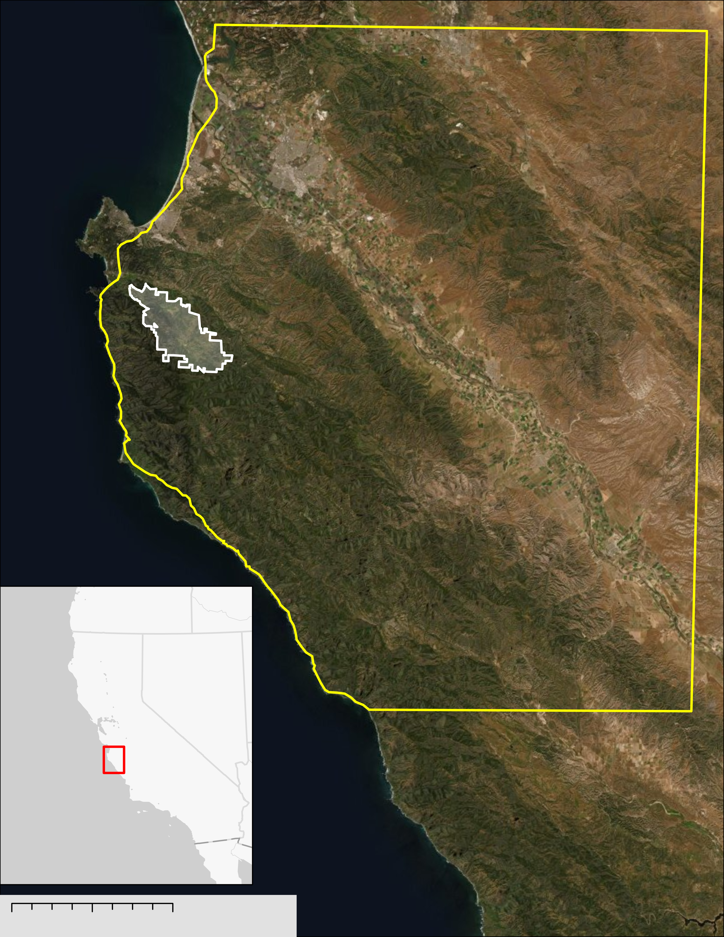
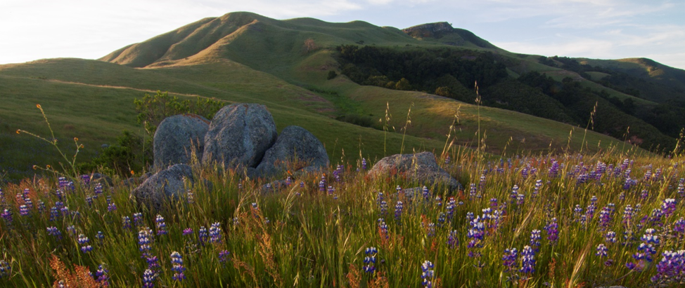
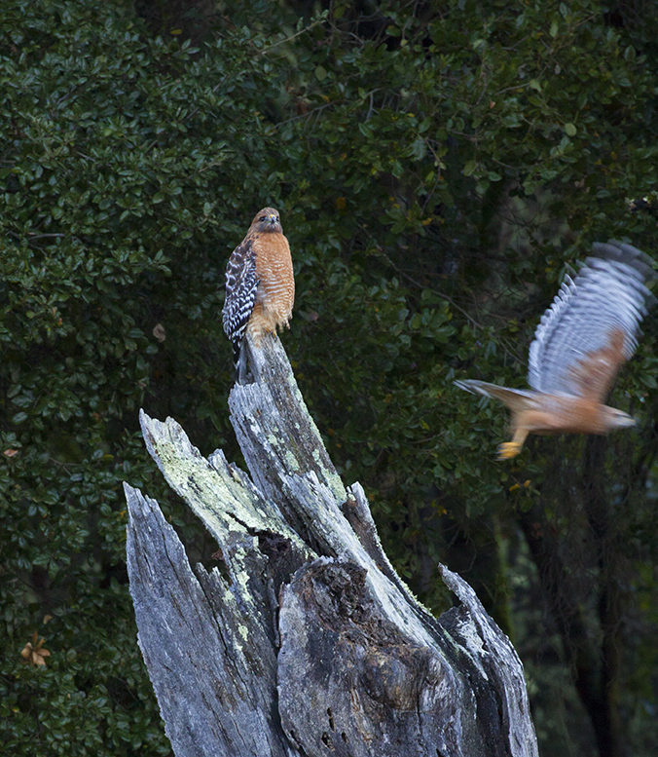
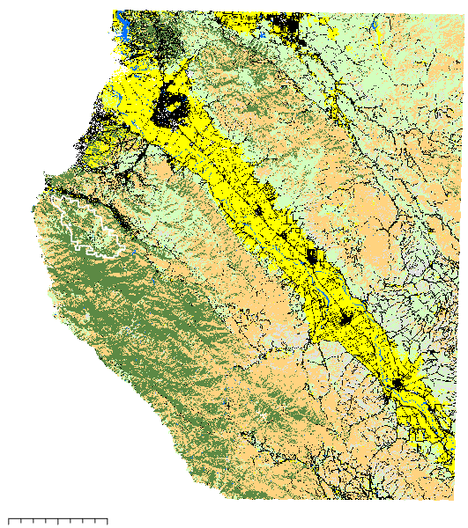
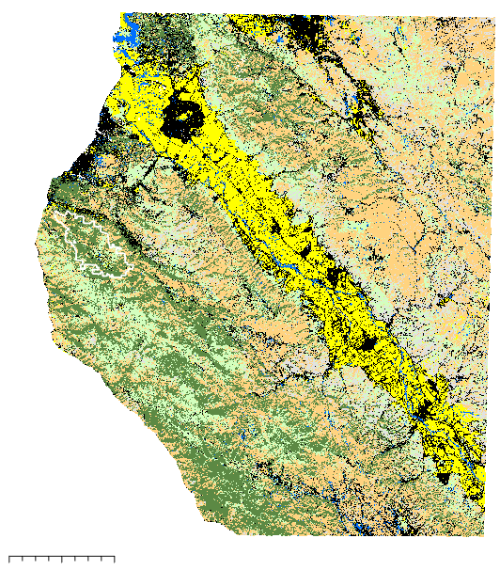
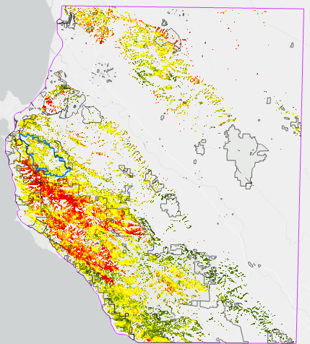
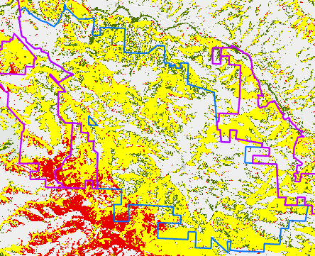
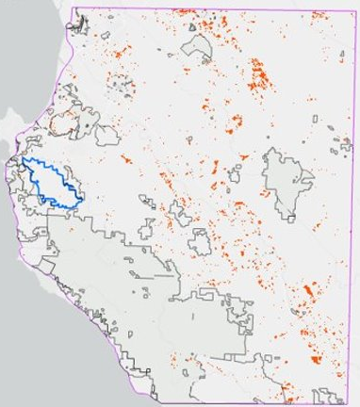
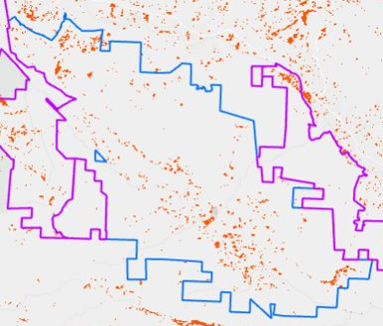
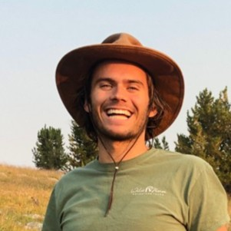
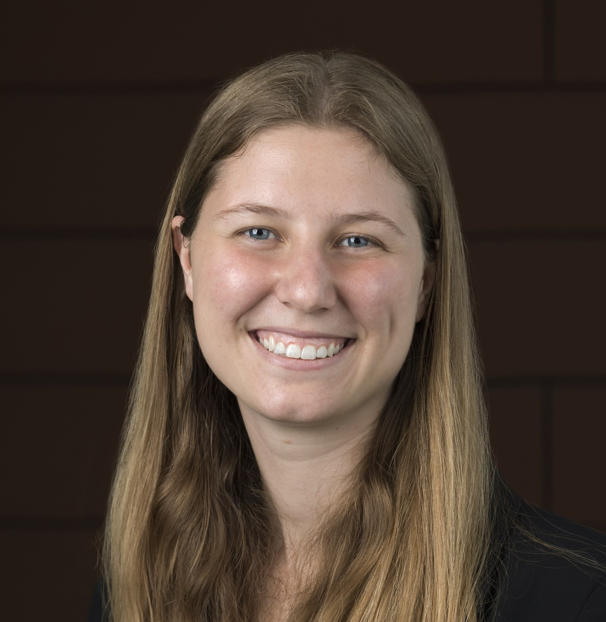
Modeling Land Cover Change to Understand Conservation Outcomes in Coastal California
Abstract
Study Area
Carmel Valley Urban Development
Urban expansion in diverse ecosystems has numerous detrimental impacts, including diminished biodiversity, impaired water quality, and reduced carbon storage potential. In the Carmel Valley region of California’s Central Coast, the Santa Lucia Preserve (SLP) implemented a unique land management plan in the 1990s to allow limited development while conserving the majority of the land. Our goal was to test whether our partner’s (Santa Lucia Conservancy) management plan reduced urban spread and forest cover loss compared to surrounding areas from 1991 to 2019. We used Landsat 5’s Thematic Mapper and Landsat 8’s Operational Land Imager (OLI) to classify land cover into eight classes (agriculture, developed [infrastructure], developed [structures], forest, grasslands, rocks/cliffs, shrubs, water) using a random forest classification in R Studio, then modeled land cover change using IDRISI TerrSet Land Change Modeler (LCM). The best models for both years used all variables and a combined developed class (1991 OOB error = 17.4%, 2019 OOB error = 20.1%). The greatest vegetation loss occurred in grasslands; 11% of grasslands on SLP became developed, along with 14% of public and 12% of private. Throughout the study area, developed and forest land cover increased by 2%, while grasslands decreased by 4% and shrubs by 2%. Approximately 3.5% of privately owned forest was developed, while about 1% of public and SLC-owned forests were. The transition between vegetation classes masked losses within each class, and further analysis of the drivers of land cover change is necessary to fully evaluate the efficacy of the SLC conservation model.
Salinas
Santa Lucia Preserve (SLP):
A conservation community
Monterey
Wildlands (no development) – 10,000 acres
Openlands (privately conserved) – 8,000 acres
Homelands (private development) –2,000 acres
Surrounding region has faced high urbanization, which reduces biodiversity, habitats, and ecosystem services.
San Francisco, CA
Lucia
Los Angeles, CA
Miles
SLP Boundary
Study Area
Objectives
0
3.5
7
Analyze change in vegetation cover in and around Santa Lucia Preserve from 1991 to 2019
Produce land cover change maps of neighboring properties to the Santa Lucia Conservancy
Compare land cover changes and development rates under various conservation models
Figure 1. Map visualizing the overall study area, with the SLP outlined in white (Left). Images of the SLP were provided by the SLP (Middle, Right).
Results
2019
A
1991
B
13%
Agriculture
11%
11%
Developed
13%
Methodology
16%
Forest
18%
22%
Grasslands
18%
Input parameter preparation
5%
Rocks/Cliffs
8%
33%
Shrubs
31%
Extract spring, summer, fall imagery
Generate training points
Spread throughout SLP and entire study area
0.6%
Water
2%
Miles
6
Miles
1991, 2019 Landsat
Calculate indices
~250 per class
Calculate topographic variables
0
6
12
0
12
Figure 2. Final land cover classification for 1991 (A) and 2019 (B) using all input variables.
Slope, landform, aspect, roughness, surface relief ratio, distance to road, soil
A
Forest cover change
B
C
Development change
TCW, TCB, TCG, NDMI, NDVI
0 1 2 Miles
Modeling and classification
Stack rasters, extract training points
Run random forest models
Predict land cover classifications
D
Land change analysis
0 4 8 Miles
0 4 8 Miles
Model land cover change in IDRISI TerrSet
Losses
Persistence
Gains
0 1 2 Miles
Gains
Figure 3. A & B shows forest cover change in the study area (A) and on the SLP (B). The wide expanse of forest loss in the western region was primarily due to the 2016 Soberanes fire. C & D show increases in development in the study area (C) and the SLP (D). Neighboring conserved properties are outlined in gray or purple.
Earth Observations
Conclusions
SRTM
Digital elevation model
Landsat 5 TM
Satellite and spectral data for 1991 (left) and 2019 (right)
Landsat 8 OLI
Due to historic underestimation of their importance, grasslands experienced the greatest conversion to developed or agricultural land.
The SLC experienced the smallest conversion of grassland to other cover types and a large increase in forest.
Modeling land cover in an intermediate year and utilizing disturbance modelers could identify areas of concern and drivers of land changes.
Team Members
Acknowledgements
Sarah Hettema - DEVELOP Fellow
Dr. Tony Vorster - Science Advisor
Dr. Brian Woodward - Science Advisor & Partner
Cooper Campbell
Project Lead
Devina Garcia
Julia Portmann
Audrey Wilson
Project Partner
Santa Lucia Conservancy
Colorado – Fort Collins
Notes:
Image credits: Satellite images: NASA Public Domain: https://www.devpedia.developexchange.com/dp/index.php?title=List_of_Satellite_Pictures All other images: Rodrigo Sierra Corona Santa Lucia Conservancy

