Slide 1
Philadelphia
Health & Air Quality
Assessing Land Surface Temperature, Vegetation Cover, and Compounding Vulnerability Factors to Identify High Priority Areas for Cooling Initiatives in Philadelphia, Pennsylvania
Brandy Nisbet-Wilcox, Samuel Meltzer, Spencer Nelson, Charlotte Wagner
Arizona – Tempe
Notes:
We are the Philadelphia Health & Air Quality team from the Tempe, Arizona DEVELOP location. On our team we have Spencer Nelson, Samuel Meltzer, Charlotte Wagner, and myself, Brandy Nisbet-Wilcox. In our final presentation we will discuss how we created a heat vulnerability index using socioeconomic, health, and NASA Earth observation data, to identify high priority areas for cooling initiatives in Philadelphia, Pennsylvania.

Slide 2
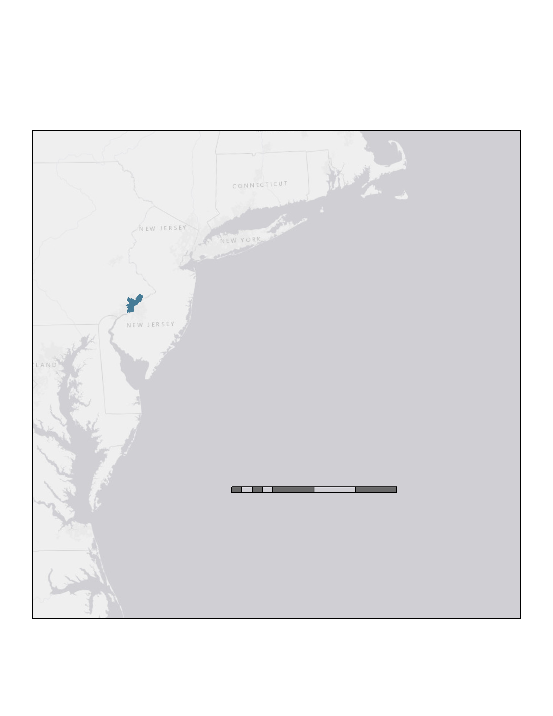


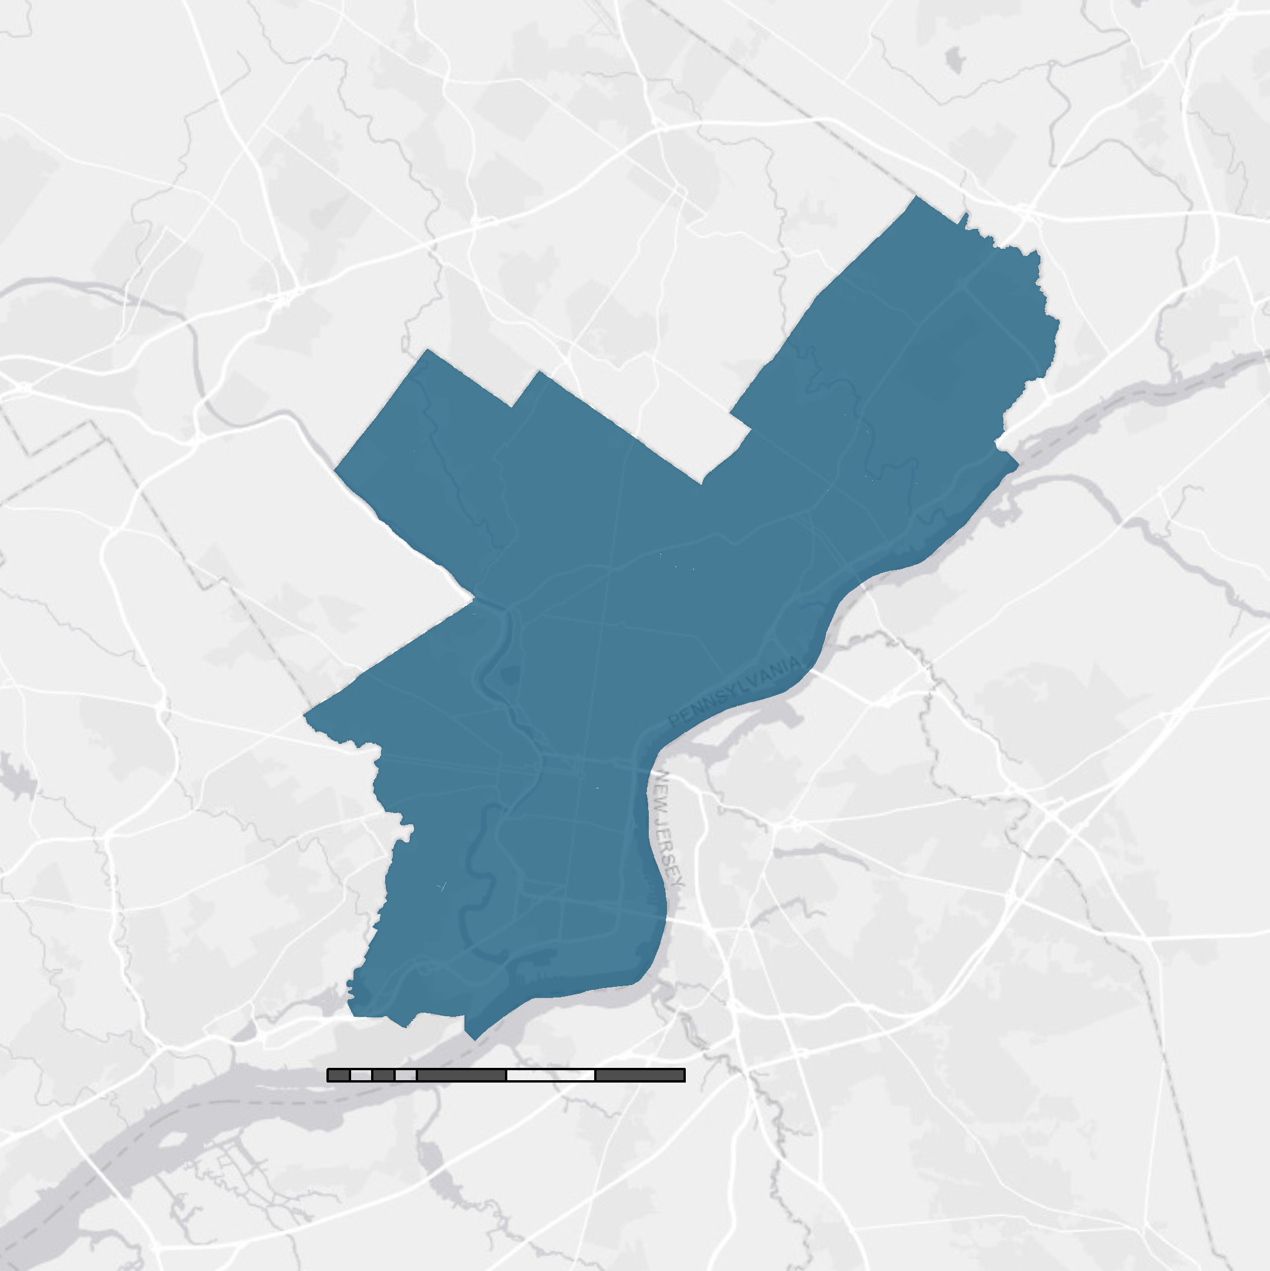




Project Overview
Philadelphia, Pennsylvania, US
Philadelphia, Pennsylvania, US
Socioeconomic
& health data
Summer 2017-2019
LST, NDVI, NDBI, and albedo using NASA Earth observations
0 1 2 4 6 8 miles
Credit: Created by Team
0 20 40 80 120 160 miles
Partners
A heat resilient Philadelphia
Philadelphia Department of Public Health
City of Philadelphia
Office of
Sustainability
Icon Credit: The Noun Project
Notes:
For our project, we partnered with the Philadelphia Department of Public Health and the Philadelphia, Office of Sustainability to assess areas of heat vulnerability in their city. The Department of Health provided us with a list of socioeconomic and health variables that they are interested in examining in relation to heat. We retrieved and processed the most updated iterations of these variables, which was 2018 data, from the American Community Survey and the Center for Disease Control. Since our partners are particularly interested in how extreme heat and the urban heat island effect varies by geography, we decided to look at satellite data for just summer months (June 1 to September 1), from 2017 to 2019, which is centered around the year of our socioeconomic and health data.
Our partners will use the outcomes of our analysis to inform where cooling initiatives and heat mitigation strategies may be best implemented to create a more heat-resilient Philadelphia.
------------------------------Image Information Below ----------------------------
Study Area Map Image Credit: created by team
Icon 1
•Image Credit: Nounproject (Free Use)
•Image Source: Society by David García from the Noun Project https://thenounproject.com/search/?q=society&creator=435388&i=577628
Icon 2
•Image Credit: Nounproject (Free Use)
•Image Source: Satellite by Pedro Ramalho from the Noun Project https://thenounproject.com/term/satellite/5350/
Icon 3
•Image Credit: Nounproject (Free Use)
•Image Source: Sun by Xiaoying Huang from the Noun Project https://thenounproject.com/search/?q=sun&creator=1737973&i=1896190
Icon 4
•Image Credit: Nounproject (Free Use)
•Image Source: family reunion by Chunk Icons from the Noun Project https://thenounproject.com/term/family-reunion/664531/
Icon 5
•Image Credit: Nounproject (Free Use)
•Image Source: City by Made by Made from the Noun Project https://thenounproject.com/term/city/725043/

Slide 3

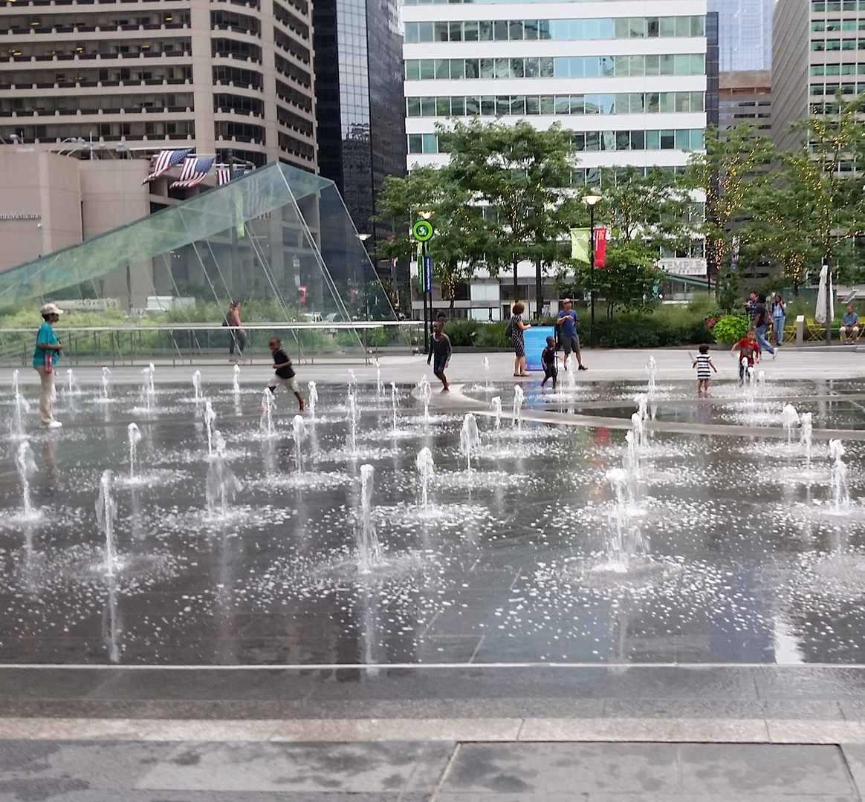

Heat and Human Health
Heat & Human Health
Leading cause of weather related death and hospitalizations
Mild symptoms to death
Urban Heat Island
Image Credit: Bruce Emmerling (Pixabay)
Icon Credit: The Noun Project
Notes:
Heat is a leading cause of weather related death and hospitalizations in the US. Adverse health effects from heat range from minor symptoms like heat cramps, heat syncope and heat exhaustion to death from severe heat stroke. Heat may also aggravate pre-existing health conditions like ischemic heart disease, diabetes, stroke, and respiratory diseases and may ultimately result in death.
------------------------------Image Information Below ----------------------------
•Image Credit: Bruce Emmerling, Pixabay (Free Use Pixabay License)
•Image Source: https://pixabay.com/photos/philadelphia-city-hall-urban-2670598/
Icon 1
•Image Credit: Nounproject (Free Use)
•Image Source: Public Health Clinic by Iconathon, US for Noun Project https://thenounproject.com/search/?q=public%20health&i=6435
Icon 2
•Image Credit: Nounproject (Free Use)
•Image Source: Society by David García from the Noun Project https://thenounproject.com/search/?q=society&creator=435388&i=577628
Icon 3
•Image Credit: Nounproject (Free Use)
•Image Source: Urban Heat Island by Creative Mania from the Noun Project https://thenounproject.com/term/urban-heat-island/1030202/

Slide 4


Heat Sensitivity
Heat & Human Health
Heat Sensitivity
Differs across population groups and neighborhoods
Risk factors are:
  pre-existing health conditions
  demographic and socio-economic factors (i.e. age, income, education)
Credit: Rido (Shutterstock)
Credit: Sabine van Erp (Pixabay)
Icon Credit: The Noun Project
Notes:
The City is interested in heat vulnerability because of heat related morbidity and mortality issues. Although apparent temperature is integral to vulnerability and relatedly morbidity and mortality, it is mediated by other risk factors, which are often referred to as a population's heat sensitivity.
Pre-existing health conditions which will determine heat sensitivity include respiratory or cardiovascular conditions. Further, socio-economic factors such as age, income, race, and education will determine a population's resilience to heat and likelihood to experience heat-related hospitalizations or death.
------------------------------Image Information Below ----------------------------
•Image Credit: Rido (Shuttershock), Retrieved from https://www.shutterstock.com/image-photo/nurse-doctor-hurry-taking-patient-operation-678888472?irgwc=1&utm_medium=Affiliate&utm_campaign=Pixabay+GmbH&utm_source=44814&utm_term=https%3A%2F%2Fpixabay.com%2Fimages%2Fsearch%2Femergency%2F
•Image Source: CC BY-Spotmatik Ltd)
•Image Credit: Sabine van Erp, Pixabay
•Image Source: https://pixabay.com/photos/hand-human-woman-adult-hands-3666963/ (Free Use Pixabay License)
Icon 1
•Image Credit: Nounproject
•Image Source: Public Health Clinic by Iconathon, US for Noun Project https://thenounproject.com/search/?q=public%20health&i=6435
Icon 2
•Image Credit: Nounproject
•Image Source: Society by David García from the Noun Project https://thenounproject.com/search/?q=society&creator=435388&i=577628
Icon 3
•Image Credit: Nounproject
•Image Source: Urban Heat Island by Creative Mania from the Noun Project https://thenounproject.com/term/urban-heat-island/1030202/

Slide 5
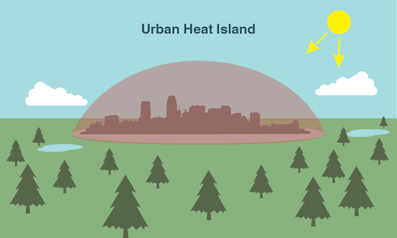
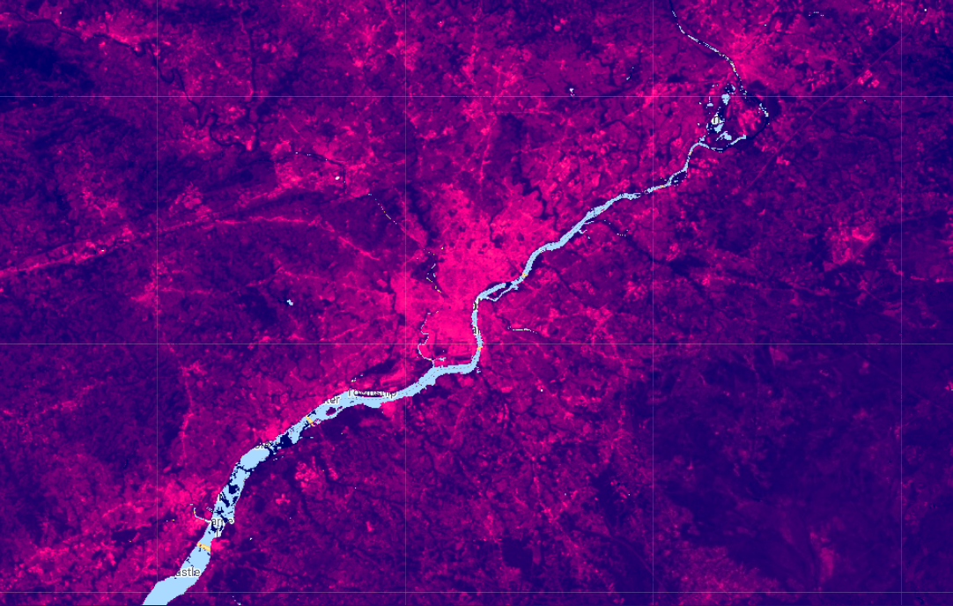

Heat Exposure
Heat & Human Health
Urban Heat Island
Heat Sensitivity
Heat Sensitivity
Differs across population groups and neighborhoods
Risk factors are:
  pre-existing health conditions
  demographic and socio-economic factors (i.e. age, income, education)
Credit: NASA/JPL-Caltech
Heat Exposure
Urban Heat Island: urban areas are warmer than rural areas
Temperature differs by neighborhood
Increasing frequency and intensity of heat waves
Northeastern cities expect greatest increases in heat-related illness
Philadelphia, PA, Land Surface Temperature
Story Map
High LST
Low LST
5 miles
Icon Credit: The Noun Project
Notes:
Urban areas are particularly affected by extreme heat, due to human activity and landscape transformation. The image on the lower right side shows land surface temperatures in Philadelphia, Pennsylvania, over our study time period. Temperatures in the city are significantly elevated compared to surrounding areas, illustrating the urban heat island effect.
However, temperatures are not uniform across an urban area, and will instead differ by neighborhood depending on green space, built-up area, and other factors.
During the coming decade heat waves are projected to increase in frequency and intensity, and cities in the northeastern US are expected to experience the greatest increase in heat related illness. Thus, it is important that the City of Philadelphia be able to identify heat vulnerable areas to plan cooling initiatives and public outreach strategies.
------------------------------Image Information Below ----------------------------
•Image Credit: NASA/ JPL - Caltech,
•Image Source: Retrieved from https://climatekids.nasa.gov/heat-islands/
Image Credit: Prepared by Team, Landsat 8 imagery
Icon 1
•Image Credit: Nounproject
•Image Source: Public Health Clinic by Iconathon, US for Noun Project https://thenounproject.com/search/?q=public%20health&i=6435
Icon 2
•Image Credit: Nounproject
•Image Source: Society by David García from the Noun Project https://thenounproject.com/search/?q=society&creator=435388&i=577628
Icon 3
•Image Credit: Nounproject
•Image Source: Urban Heat Island by Creative Mania from the Noun Project https://thenounproject.com/term/urban-heat-island/1030202/

Slide 6



Community Concerns & Project Objectives
Decision-makers want to identify
highest priority areas for
cooling initiatives and resilience building
LST, NDVI, NDBI, and albedo
Heat
sensitivity index
Heat
vulnerability index
Story Map
Icon Credit: The Noun Project
Credit: S. Madera | City of Philadelphia
Notes:
In Philadelphia, heat is a major public health concern. Since 2010 alone 18 daily temperature records were set. Between 2010 and 2018, 137 heat related deaths were recorded and many more minor health related illnesses have likely occurred. As a result, it is a high priority for decision makers to identify the most important areas of the city to implement cooling initiatives and build resiliency in the community.
Thus, we seek to identify areas with the highest heat sensitivity using socio-economic and health indicators, as well as identify areas with the highest heat vulnerability which is inclusive of not only heat sensitivity, but also heat exposure, as measured by our NASA Earth observation data. These findings will ultimately be communicated to the public via a StoryMap and public ArcGIS Online map.
------------------------------Image Information Below ----------------------------
•Image Credit: S. Madera | City of Philadelphia
•Image Source: Provided by partner (Jason Hammer, Department of Public Health)
Icon 1
•Image Credit: Nounproject
•Image Source: Satellite by Pedro Ramalho from the Noun Project https://thenounproject.com/term/satellite/5350/
Icon 2
•Image Credit: Nounproject
•Image Source: Society by David García from the Noun Project https://thenounproject.com/search/?q=society&creator=435388&i=577628
Icon
•Image Credit: Nounproject
•Image Source: Thermometer by Vectors Market from the Noun Project https://thenounproject.com/search/?q=thermometer&creator=917040&i=2144891
Icon
•Image Credit: Nounproject
•Image Source: Map by Turkkub from the Noun Project https://thenounproject.com/search/?q=map&creator=3300187&i=2268228

Slide 7
Urban Heat
Temperature
Air temperature determines heat exposure
→ Land Surface Temperature
Icon Credit: The Noun Project
Notes:
An important factor in the urban heat island effect is air temperature. In our project, we used land surface temperature, or LST, as a proxy for establishing areas with high air temperatures. LST is the temperature of the surface observed by the satellite, such as the ground, a tree, or a roof.
------------------------------Image Information Below ----------------------------
•Image Credit: Nounproject
•Image Source: Urban Heat Island by Creative Mania from the Noun Project https://thenounproject.com/term/urban-heat-island/1030202/

Slide 8

Urban Heat
Night Temperature
Surfaces absorb heat
during the day and
release it at night
→ Night LST
Icon Credit: The Noun Project
Notes:
Nighttime temperatures are also important factors in heat vulnerability, as places with high nighttime temperatures offer less relief from the heat of the day. We represented nighttime temperature by night LST.
------------------------------Image Information Below ----------------------------
•Image Credit: Nounproject
•Image Source: Urban Heat Island by Creative Mania from the Noun Project https://thenounproject.com/term/urban-heat-island/1030202/

Slide 9
Urban Heat
Reflectivity
Dark surfaces reflect less light and retain more heat
→ Albedo
Icon Credit: The Noun Project
Notes:
Reflectivity is another element of the urban heat island effect, because surfaces that are highly reflective often do not retain temperature as much as those with low reflectance. In our project, we measure reflectivity by albedo, which is the proportion of light and/or radiation that is reflected by a surface.
------------------------------Image Information Below ----------------------------
•Image Credit: Nounproject
•Image Source: Urban Heat Island by Creative Mania from the Noun Project https://thenounproject.com/term/urban-heat-island/1030202/

Slide 10
Urban Heat
Buildings
Impervious surfaces
retain heat
→ Normalized Difference Built-Up Index (NDBI)
Icon Credit: The Noun Project
Notes:
The presence of buildings also has a positive relationship with temperature, because buildings and other impervious surfaces often retain heat well. In our project, we measure buildings and impervious surfaces via the Normalized Difference Built-Up Index, or NDBI. NDBI calculated using near infrared and short-wave infrared satellite bands and ranges from -1 to 1, with higher scores meaning more impervious structures are in that area.
------------------------------Image Information Below ----------------------------
•Image Credit: Nounproject
•Image Source: Urban Heat Island by Creative Mania from the Noun Project https://thenounproject.com/term/urban-heat-island/1030202/

Slide 11
Urban Heat
Vegetation
Shade and water released from plants lowers temperature
→ Normalized Difference Vegetation Index (NDVI)
Icon Credit: The Noun Project
Notes:
Vegetation and greenness are also factors in the urban heat island effect, as the shade provided by trees and water released from plants result in lower temperatures. In our project, we measure vegetation via the Normalized Difference Vegetation Index, or NDVI. NDVI is calculated from red and near infrared satellite bands. Resulting NDVI values range from -1 to 1, with higher scores being more vegetated or green.
------------------------------Image Information Below ----------------------------
•Image Credit: Nounproject
•Image Source: Urban Heat Island by Creative Mania from the Noun Project https://thenounproject.com/term/urban-heat-island/1030202/

Slide 12
Urban Heat
Plant Health
Healthy plants cool air better
→ Normalized Difference Water Index (NDWI)
Icon Credit: The Noun Project
Notes:
Plant health is an indicator inversely related with temperature and the urban heat island effect, as healthy plants tend to cool the air more effectively than unhealthy vegetation. In our project, we measure plant health via the Normalized Difference Water Index, or NDWI. NDWI calculated from near-wave infrared and short-wave infrared satellite bands. Resulting values range from -1 to 1, with higher scores having more water, and thus better plant health.
------------------------------Image Information Below ----------------------------
•Image Credit: Nounproject
•Image Source: Urban Heat Island by Creative Mania from the Noun Project https://thenounproject.com/term/urban-heat-island/1030202/

Slide 13
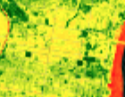




LANDSAT 8 Processing
Red, NIR
NDVI
Red, NIR, Brightness temperature
Day LST
SWIR, NIR
Landsat 8
OLI/TIRS
NDBI
Blue, Green, Red, NIR, SWIR1, SWIR2
Albedo
Image Credit: NASA
Notes:
We used Landsat 8’s Operational Land Imager and Thermal Infrared Sensors for the majority of our processing. In Google Earth Engine, we filtered Landsat 8 Surface Reflectance data by our study area and period, and performed quality and cloud masking. We calculated our environmental variables using the necessary input bands, as displayed in the diagram on this slide. For each variable, we then calculated the temporal median of the pixels, and then the spatial mean for each census tract.
------------------------------Image Information Below ----------------------------
Image Credit: NASA (Public Domain), retrived from DEVELOPedia
Image Source: http://www.devpedia.developexchange.com/dp/index.php?title=List_of_Satellite_Pictures
NDVI, Day LST, NDBI, Albedo Image Credits: created by team

Slide 14
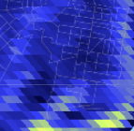


Aqua MODIS Processing
SWIR, NIR
NDWI
Night LST 1km
Night LST
Aqua MODIS
Image Credit: NASA
Notes:
We also used Aqua MODIS for the Night LST and NDWI variables. We chose Aqua MODIS for night LST because it collects daily nighttime data, and for NDWI because it collects data within the necessary band widths. We processed this data in a comparable way to that used for the Landsat 8 imagery.
------------------------------Image Information Below ----------------------------
Image Credit: NASA (Public Domain), retrived from DEVELOPedia
Image Source: http://www.devpedia.developexchange.com/dp/index.php?title=List_of_Satellite_Pictures
NDWI, Night LST Image Credit: created by team

Slide 15
Principal Component Analysis
Input Data
(18)
Select Components
(2-4)
Score by Census Tract
(1)
High
6 Socio-economic variables
6 Health variables
Variables
6 Environmental variables
Components
Low
Identify patterns and summarize complex spatial data
Notes:
We used Principal Component Analysis to identify locations in Philadelphia where heat-related risk factors for adverse health outcomes cluster.
We selected six socioeconomic and and six health variables that have been identified in the literature as risk factors for heat related illnesses, as well as the six environmental variables just discussed. We analyzed these variables using principal component analysis and selected the most important 2-4 components. These components were then used to develop an overall score for each census tract. This heat vulnerability index allows comparison of census tracts across the full variable space.
We also repeated this analysis for the environmental variables and the socio-economic/health variables separately to enable decision makers to implement initiatives focused specifically on these issues. In this presentation we will focus on the overall heat vulnerability index that is based on all 18 variables (note: back up slide at the end with other two index maps).
Image Credit: Middle Figure, Team Created

Slide 16
PCA Results: Heatmap for Loadings
Health
& Income
PC1
Heat Exposure
PC2
Health
& Age
PC3
Education
PC4
Variables cluster into
4 components
4 components explain ~80% of variance
60% of variance in Health& Income and Heat Exposure
(PC1 + PC2)
Education
% English Prof.
% >65yrs, isolated
% CHD
% >65yrs
Albedo
Night LST
NDWI
Day LST
NDVI
NDBI
% < fed. Poverty
% COPD
% non-white
% hypertension
% diabetes
%asthma
% obesity
Loading
-1 0 1
Notes:
Here we show the loading of each selected principal component visually.
We have color coded each variable group on the y-axis, with red indicating socio-economic variables, blue indicating health status variables and green indicating environmental variables. On the heat map itself red indicates a negative loading, whereas blue indicates a positive loading. More intensive colors indicate a stronger loading on the particular component in question (meaning this component is more important for the variance in the specific variable).
The variables cluster into four components indicated on the x-axis, which together explain 80% of the observed variance. The first component summarizes various health, race, and income variables. The second component represents heat exposure and contains strong loadings for four of the environmental variables included in our analysis. Together these two components alone explain 60% of overall variance observed in the data. The third and fourth components are representative of age-related health conditions and education, respectively, and explain an additional 20% of observed variance.

Slide 17
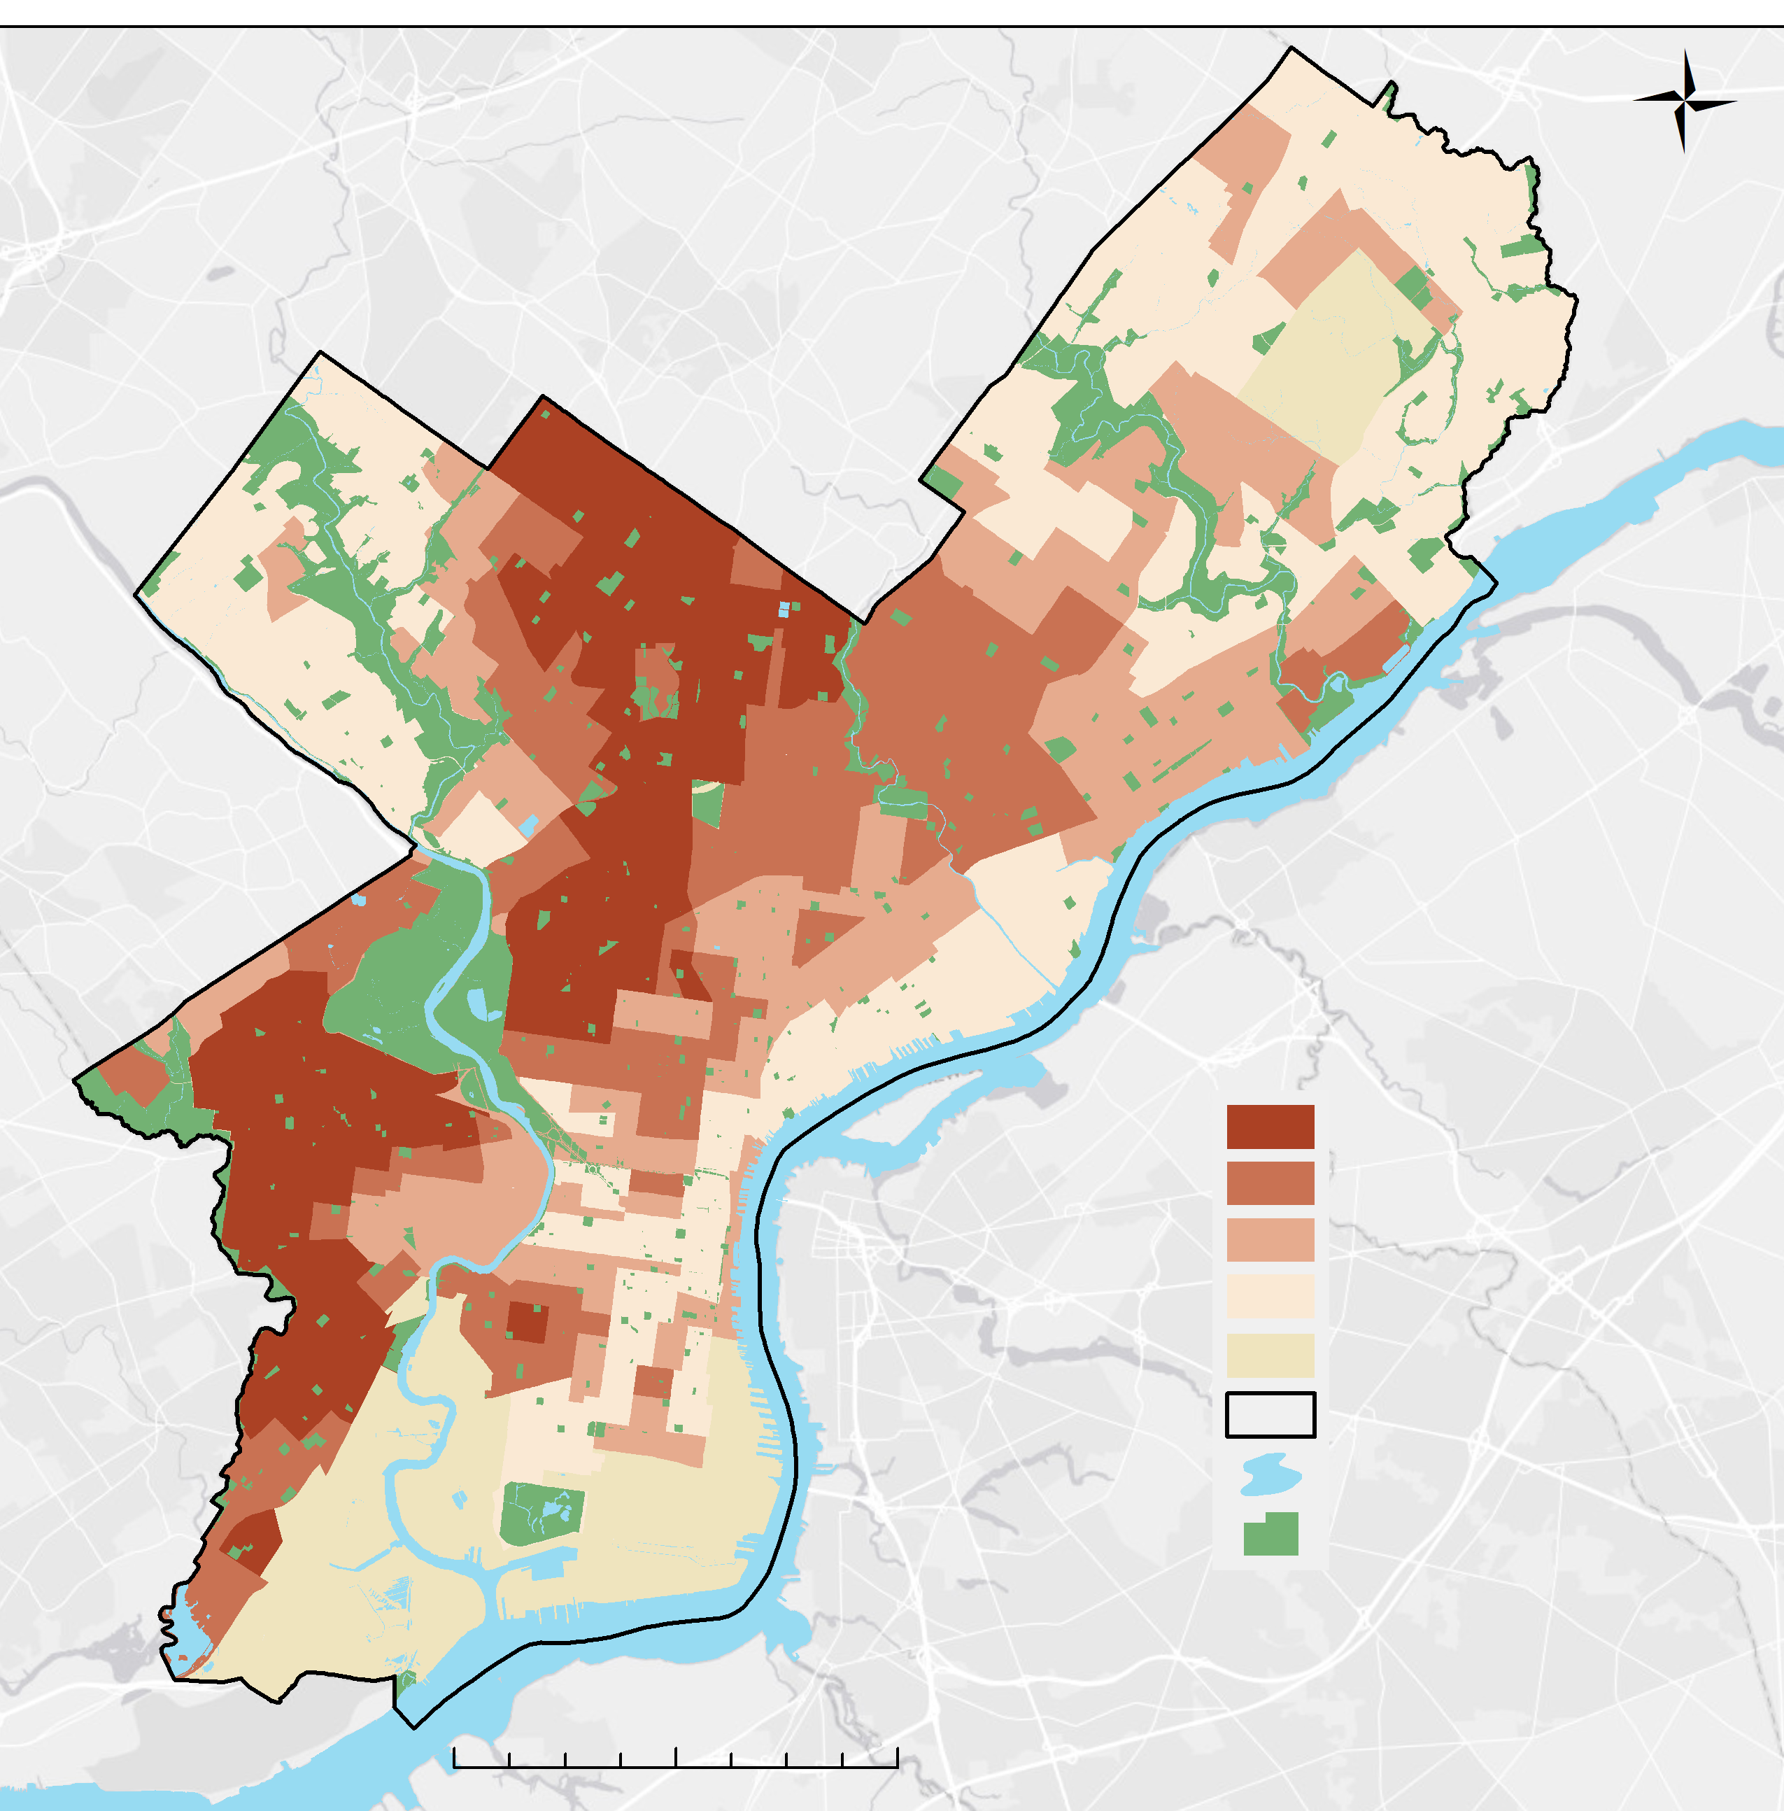
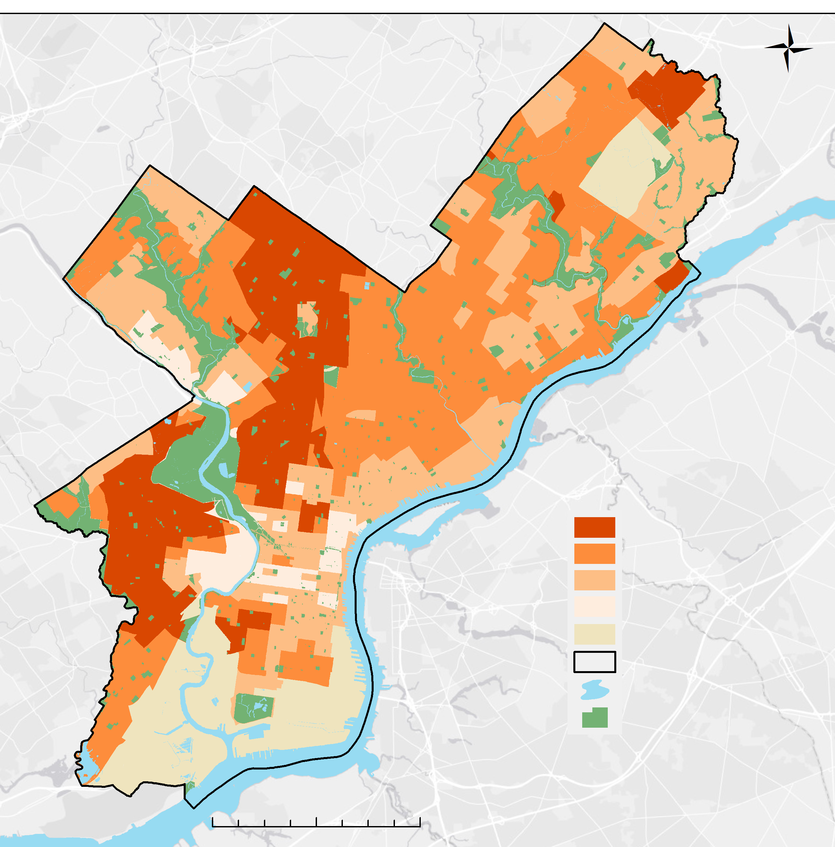
Results: Socio-economic/Health Variables
Non-white Population
Hypertension Prevalence
By Census Tract
By Census Tract
Greater than 40.01%
30.01% to 40%
20.01% to 30%
Less than 20%
No Data
City of Philadelphia
Water
Parks
Greater than 90.01%
60.01% to 90%
30.01% to 60%
Less than 30%
No Data
City of Philadelphia
Water
Parks
0 1.25 2.5 5 miles
0 1.25 2.5 5 miles
Race
∝
Hypertension
Notes:
Inspecting the raw data allows us to confirm that the variable clusters, or components, identified by the PCA are plausible. Here we show two variables important in the first component, percent non-white population on the left, and prevalence of hypertension on the right. Evidently, both of them cluster spatially in similar ways, with highest values observed in census tracts in western Philadelphia.

Slide 18
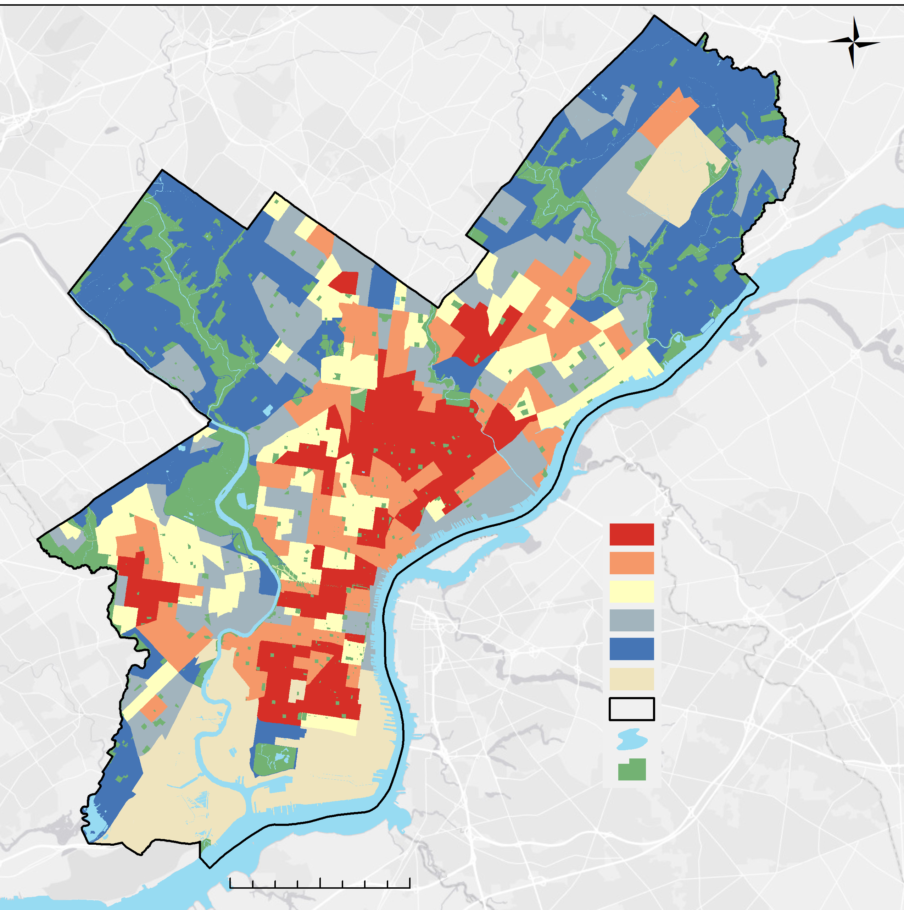
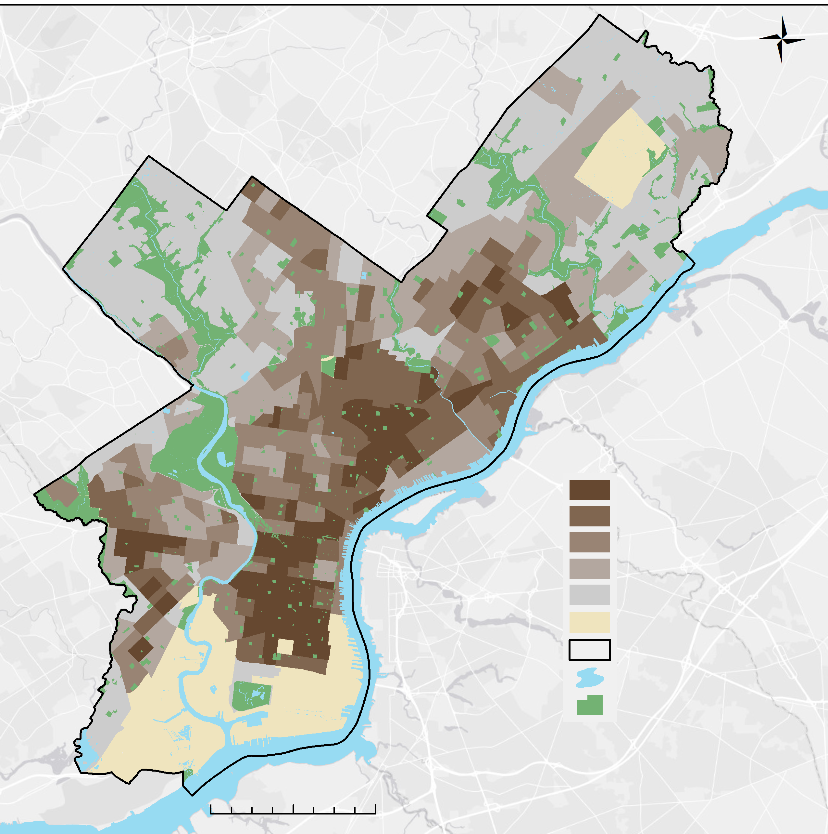
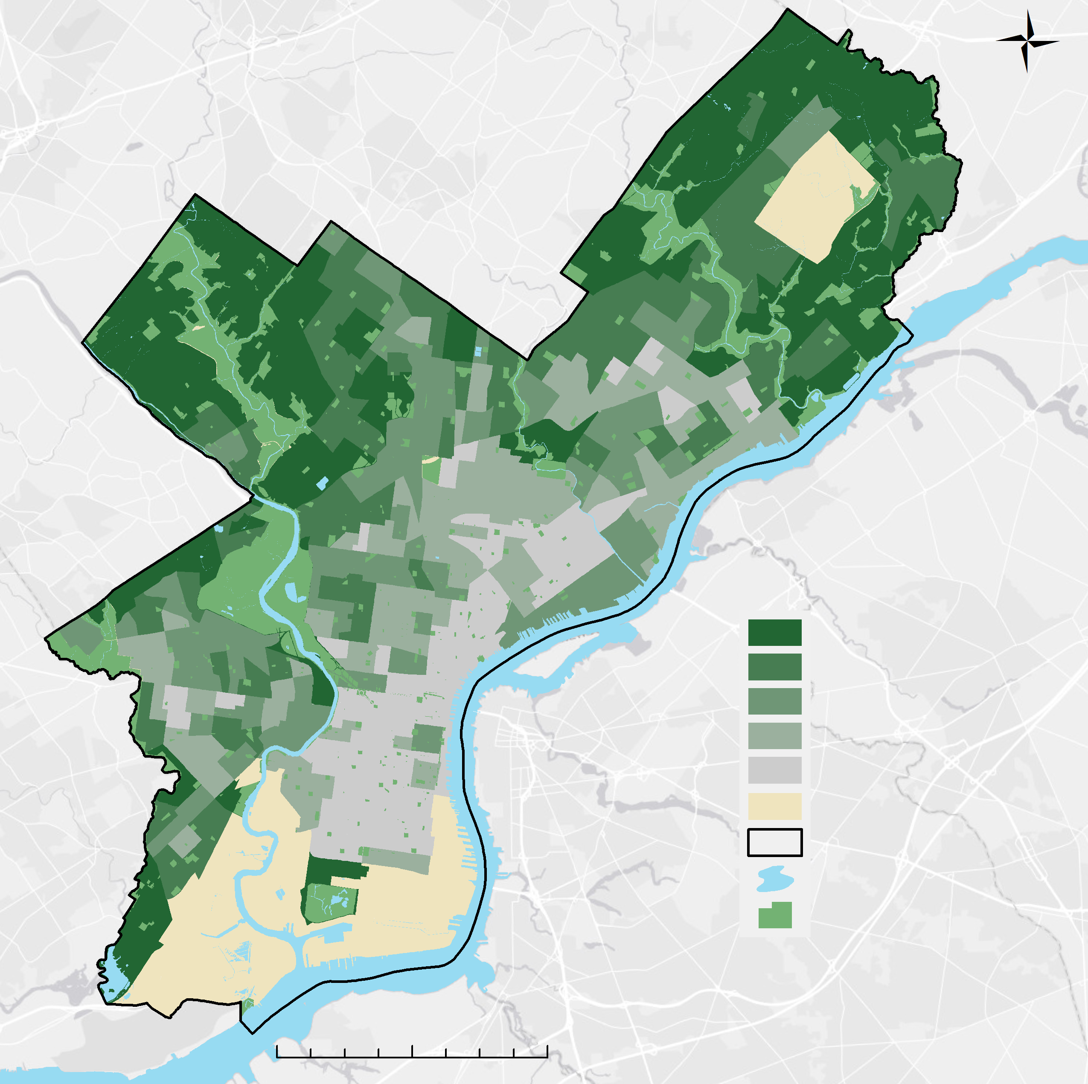
Results: Environmental variables
Daytime LST
NDBI
NDVI
Mean Difference (°F)
by Census Tract
Mean Difference
by Census Tract
Mean Difference
by Census Tract
4.492 to 10.881
2.057 to 4.491
-5.567 to 2.056
-4.191 to -0.568
-18.727 to -4.192
No Data
City of Philadelphia
Water
Parks
0.066 to 0.148
0.032 to 0.065
-0.004 to 0.031
-0.060 to -0.005
-0.301 to -0.06q
No Data
City of Philadelphia
Water
Parks
0.123 to 0.485
0.014 to 0.122
-0.053 to 0.013
-0.119 to -0.054
-0.27 to -0.120
No Data
City of Philadelphia
Water
Parks
0 2 4 miles
0 2 4 miles
0 2 4 miles
Temperature
∝
Building density
∝
1/Vegetation
Notes:
Similarly, we find that variables included in the second principal component, termed the “heat exposure” component, are spatially correlated. Daytime LST is elevated in the densely populated northeastern Philadelphia, where we also observe the highest building density. Vegetation abundance is inversely correlated with these two variables, and highest in the city’s outskirts.

Slide 19
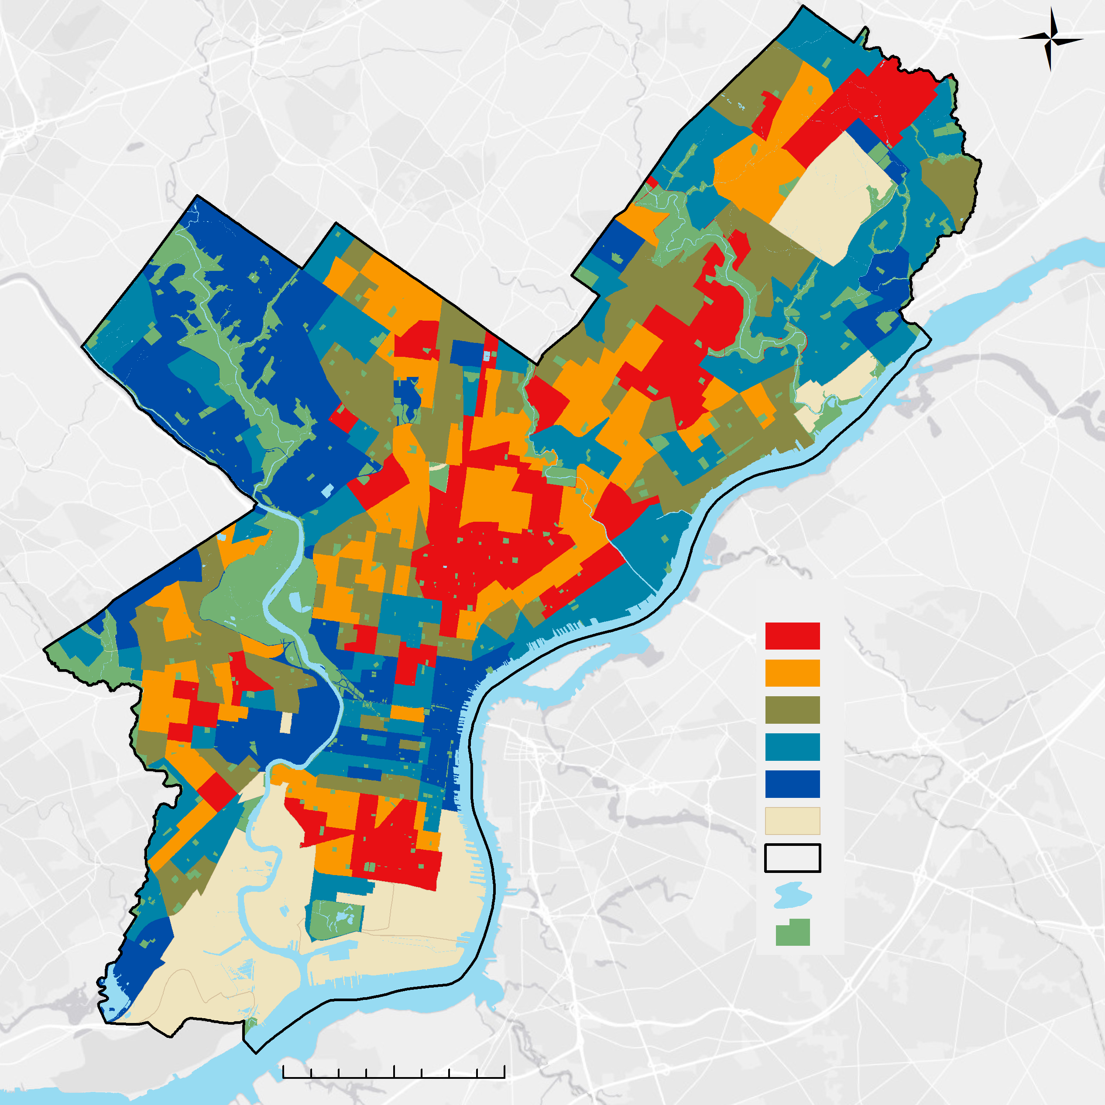
Heat Vulnerability Index (HVI)
74 census tracts with
Very High HVI (top 20%)
High HVI in Northeast, South and Far North Philadelphia
Low HVI in western and downtown Philadelphia
By Census Tract
Very High
High
Medium
Low
Very Low
No Data
City of Philadelphia
Water
Parks
0 2 4 miles
Notes:
Here we show the resulting Heat Vulnerability Index for each census tract in Philadelphia. Categories in the legend are based on quintiles, with the “Very High” category containing the top 20% of census tracts. A total of 46 census tracts are in this category. Highest scores cluster in the Northeast, South and Far North districts of Philadelphia. Low HVI on the other hand are observed in western Philadelphia and downtown.

Slide 20
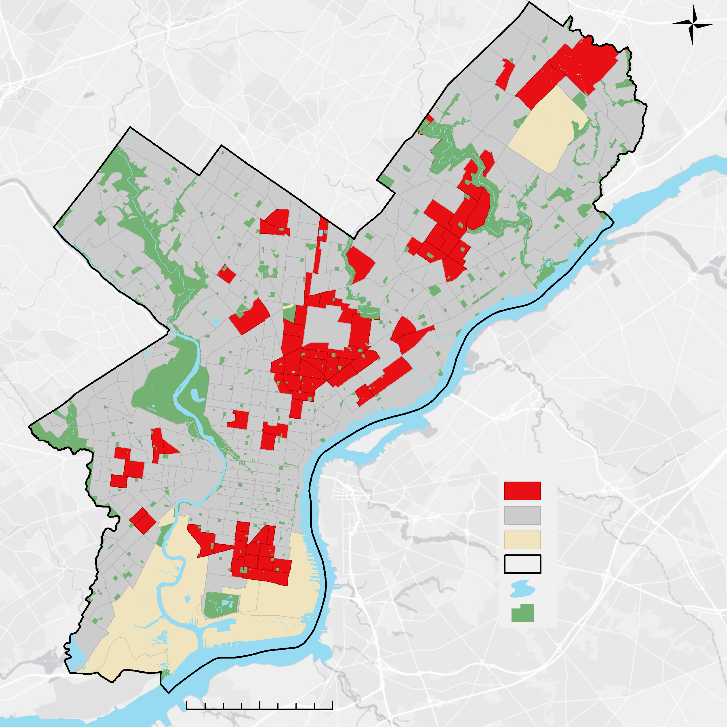
Only Top 20% HVI
74 census tracts with
Very High HVI (top 20%)
High HVI in Northeast, South and Far North Philadelphia
Low HVI in western and downtown Philadelphia
Very High HVI
HVI<Very High
No Data
City of Philadelphia
Water
Parks
By Census Tract
Potential for Street Tree planting initiatives?
∝
1/Vegetation
0 2 4 miles
Notes:
This is even clearer when only displaying the Very High category.
Our partners at the City of Philadelphia have expressed a desire to use tree planting initiatives to reduce heat-related illnesses. In order to better understand where increased vegetation may have the potential to reduce heat exposure and vulnerability, we overlaid the top 74 census tracts with a map of street tree density provided by the Philadelphia Horticultural Society with data collected by the Department of Parks and Recreation

Slide 21
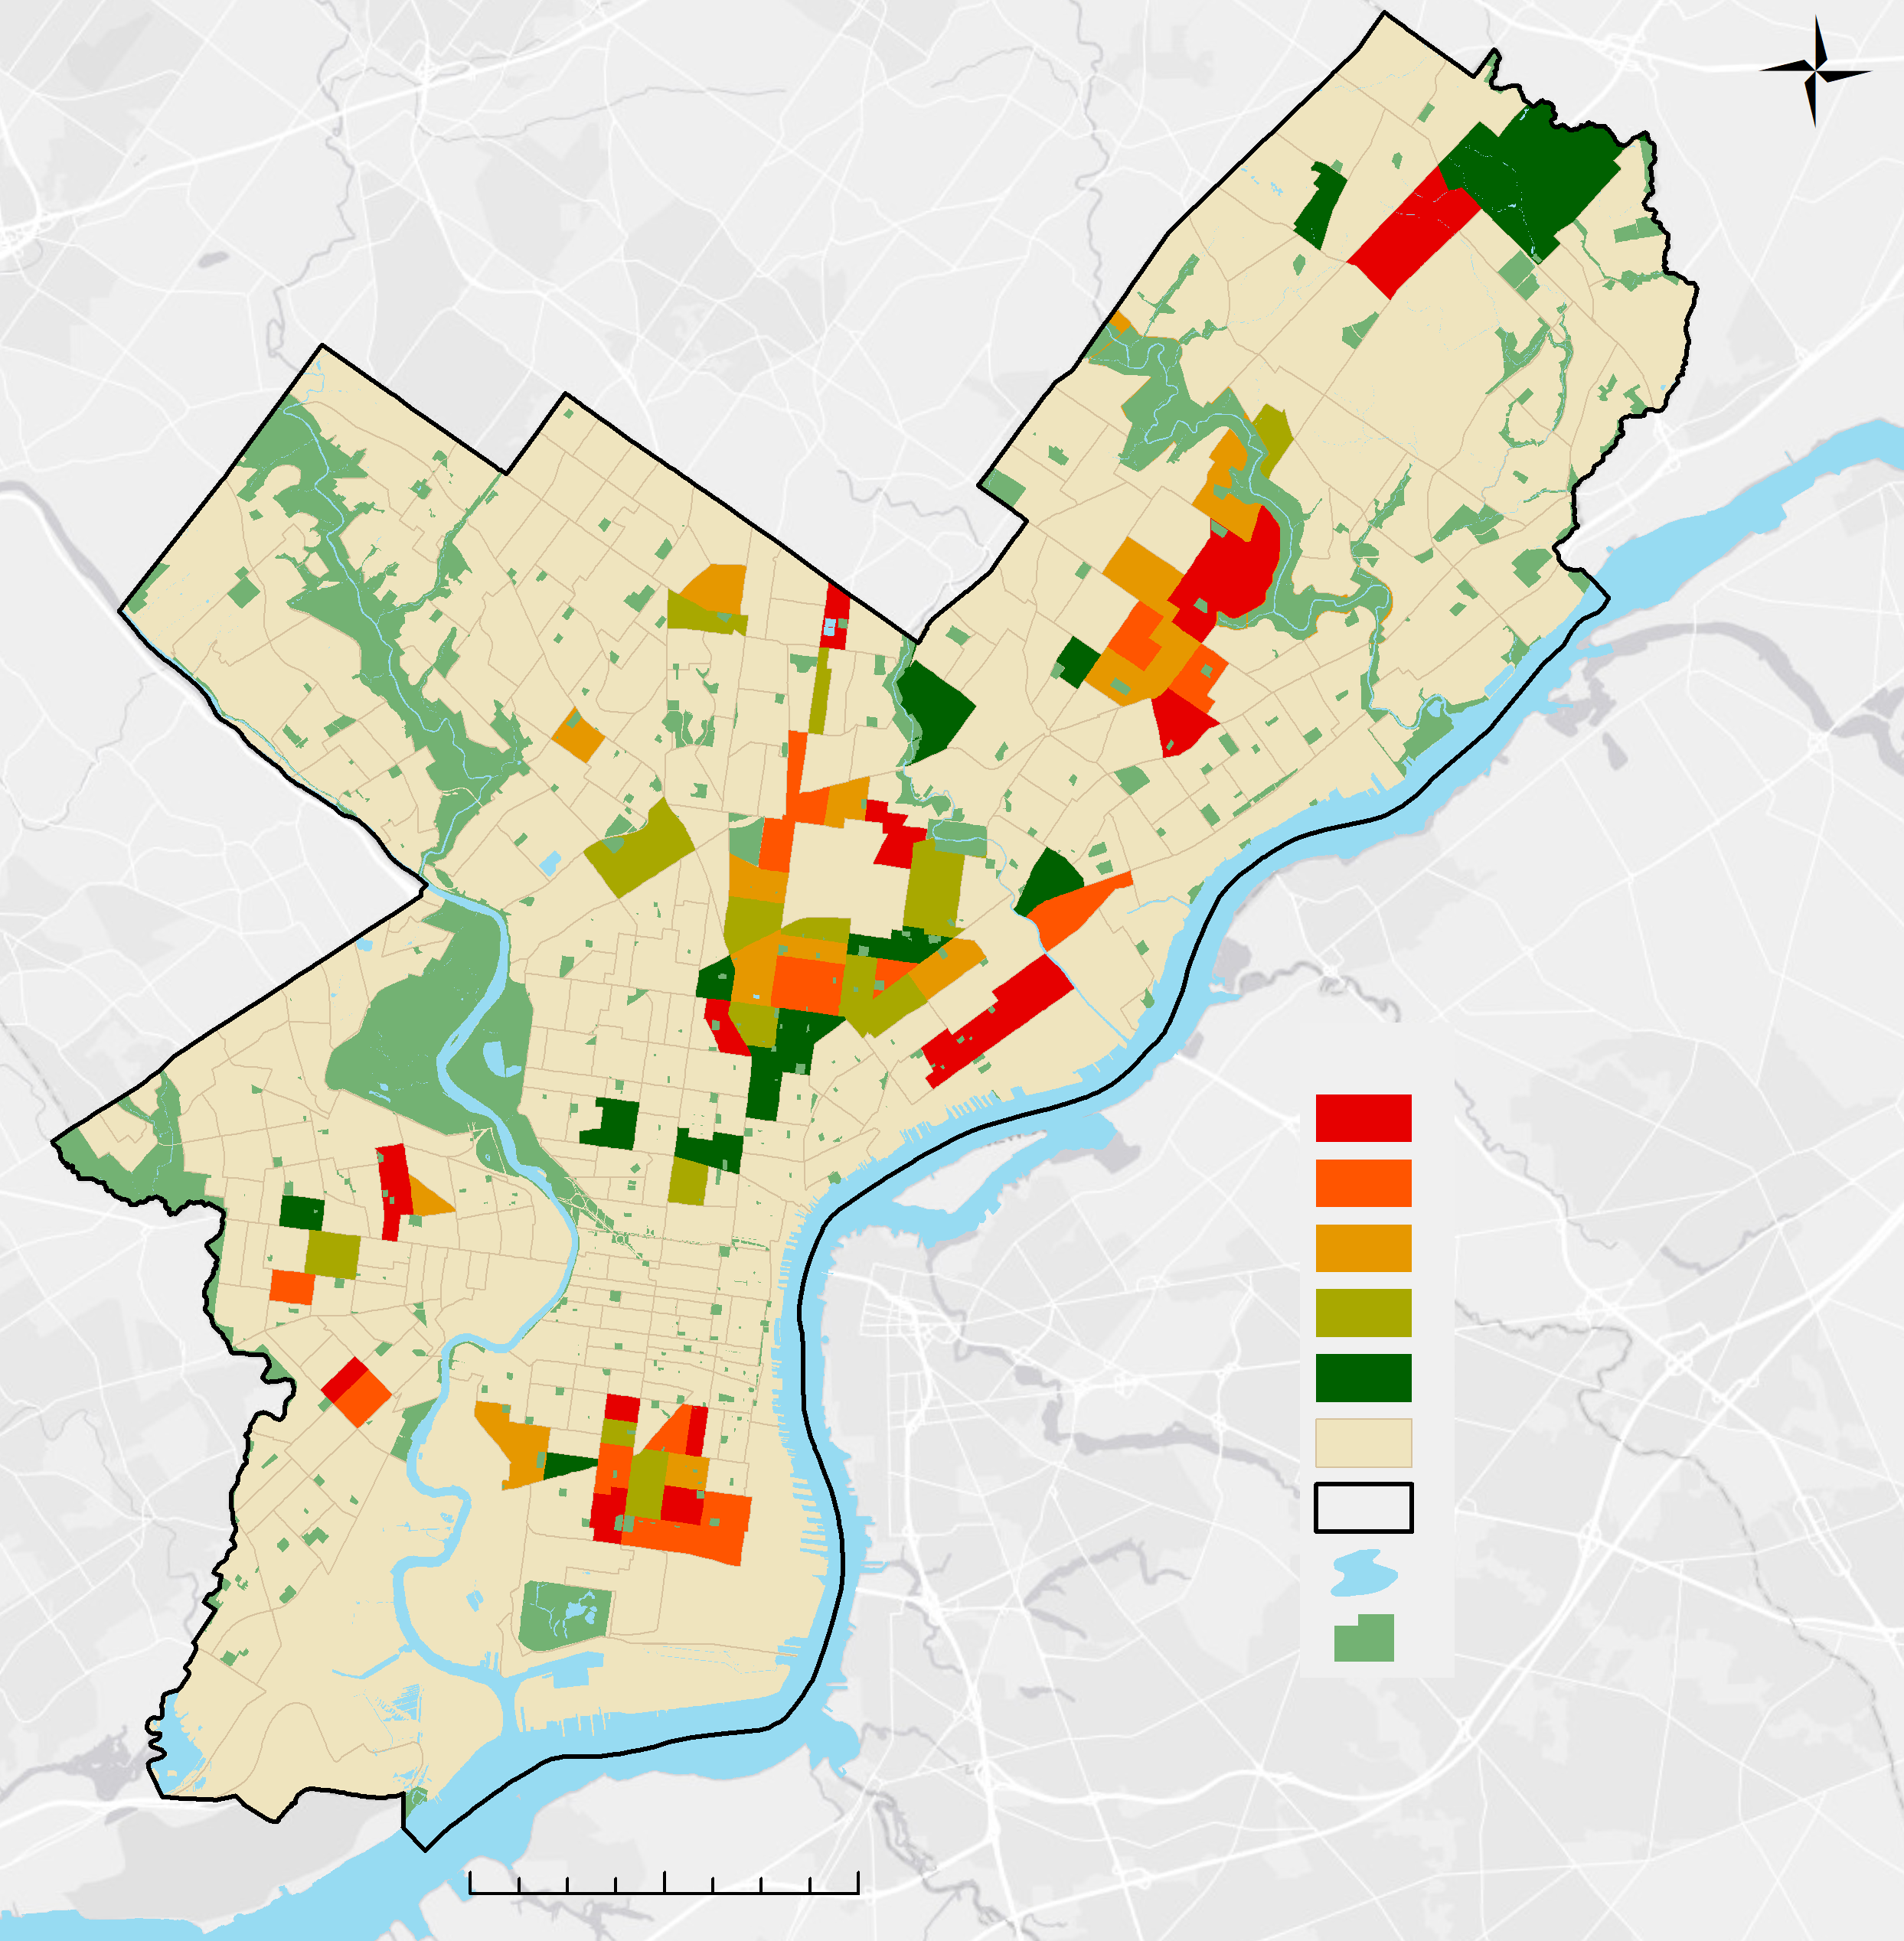
Only Top 20% HVI
Street Tree Priority
Trees per 100yards
0.461 to 1.347
1.348 to 1.804
1.805 to 2.578
2.579 to 4.197
4.198 to 9.909
HVI<Very High
City of Philadelphia
Water
Parks
Very High HVI
HVI<Very High
No Data
City of Philadelphia
Water
Parks
By Census Tract
0 2 4 miles
0 2 4 miles
Notes:
The results of this overlay are shown here. 15 census tracts with very high heat vulnerability also have a very low tree density with less than 1.3 trees per 100 yards of street. While the clusters of census tracts with high heat vulnerability in the Northeast has mixed tree density values, there are 4 census tracts with below average tree density and high HVI clustered in South Philadelphia and 3 in the Central Northeast, potentially providing an ideal target for city-planned tree planting initiatives.

Slide 22
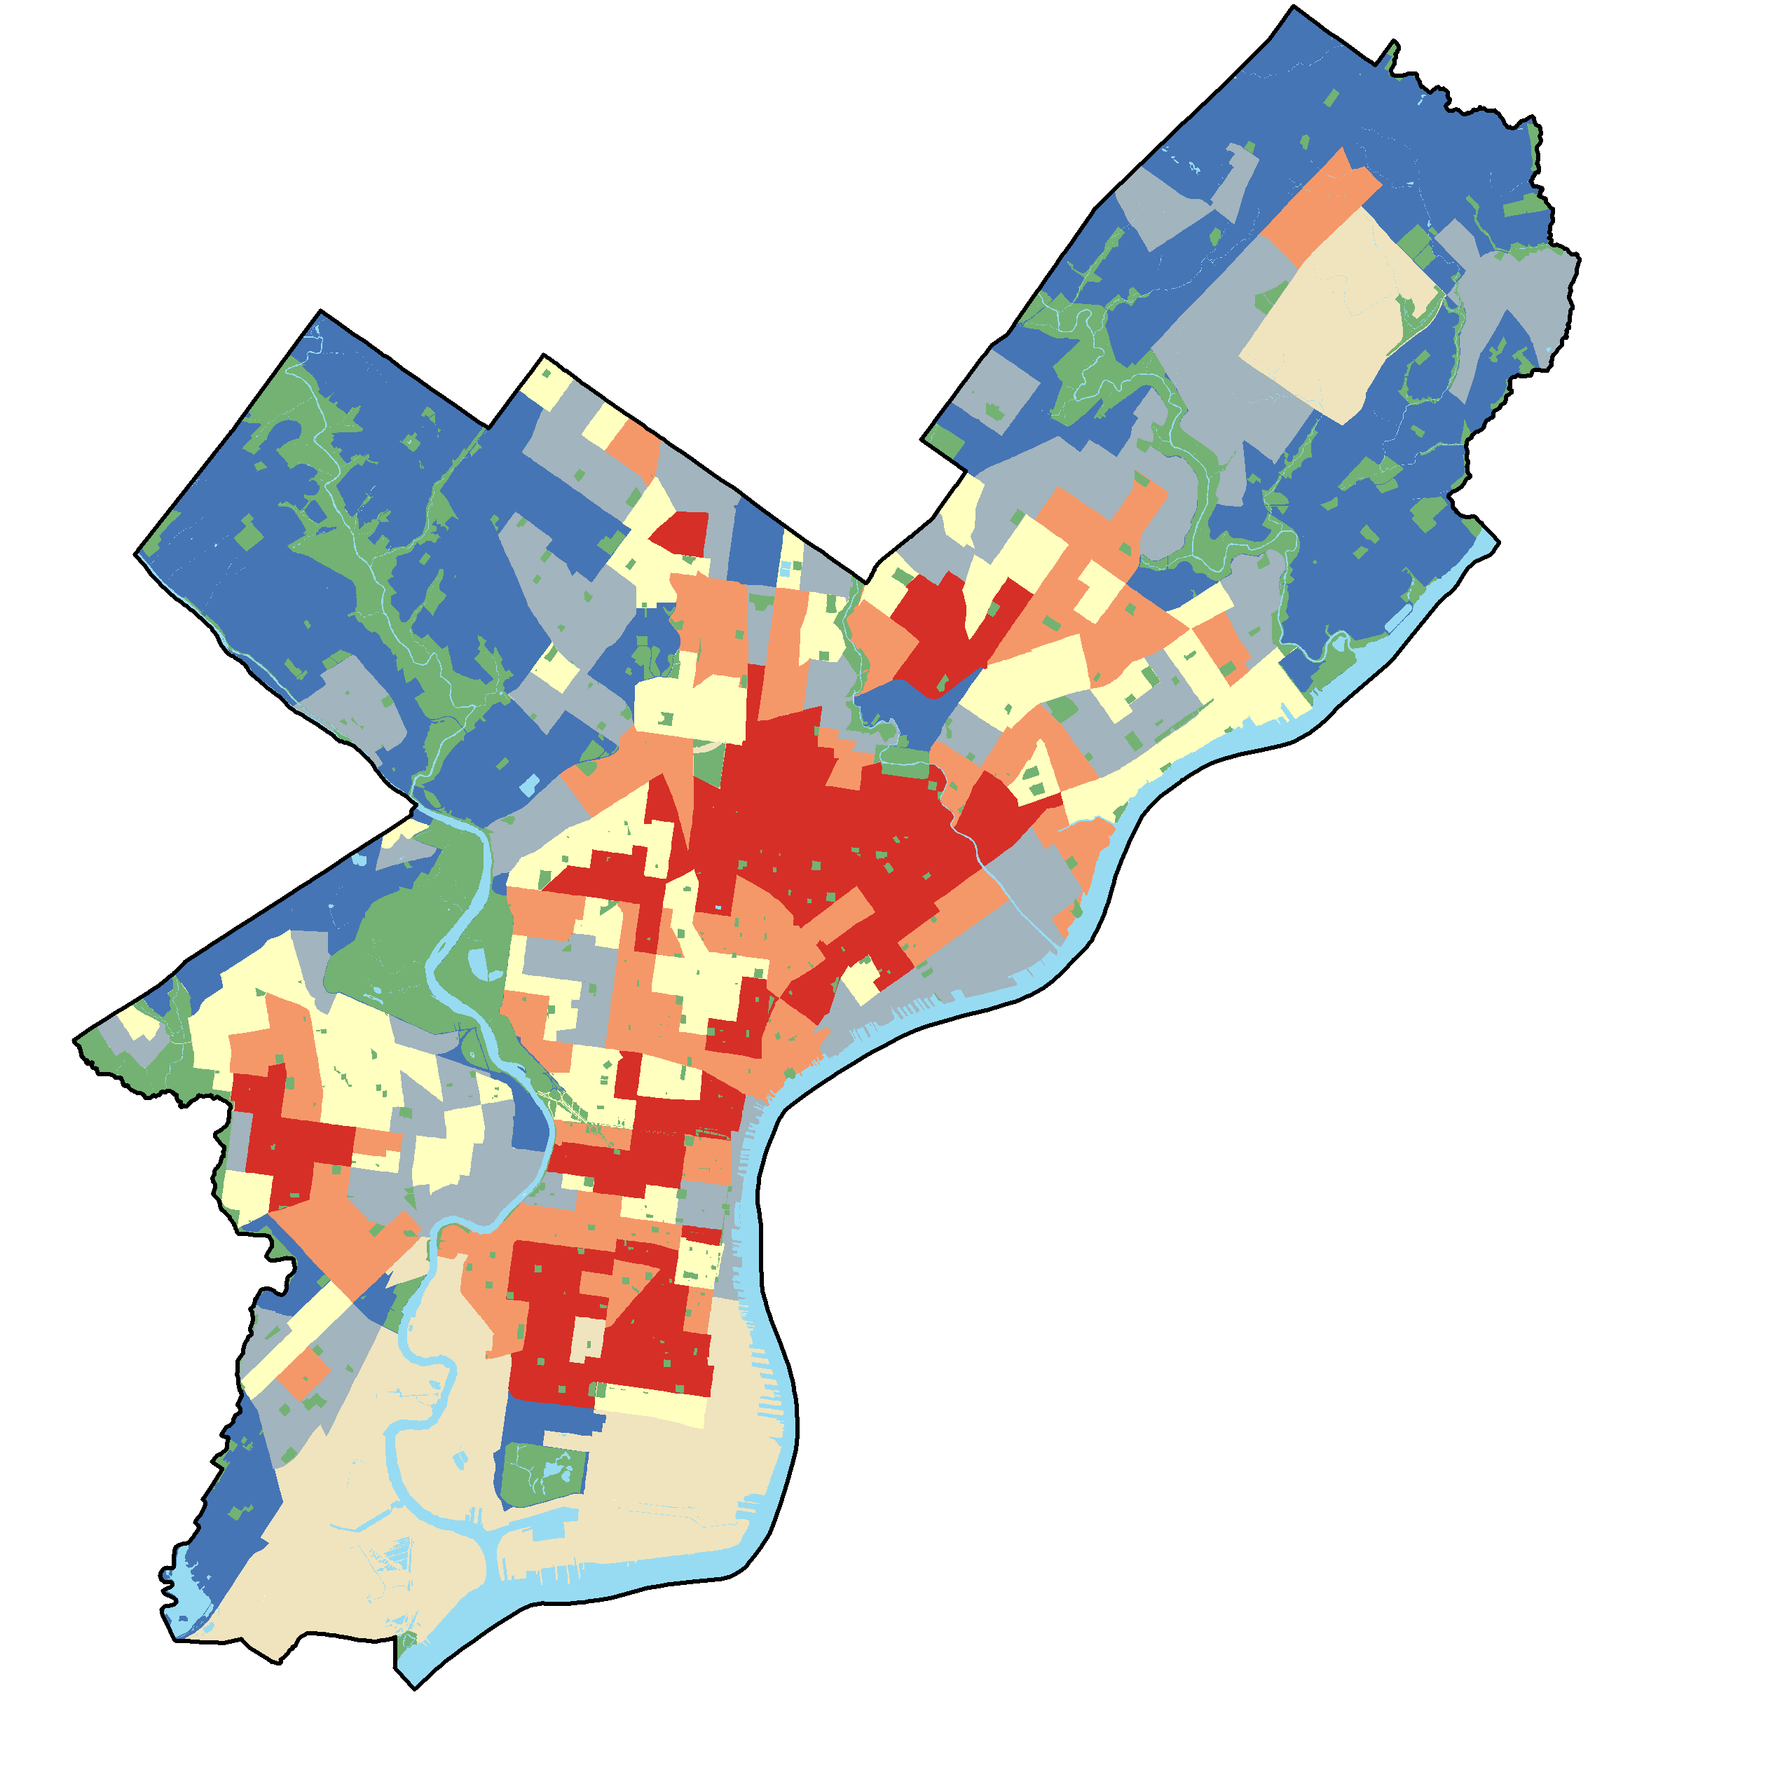
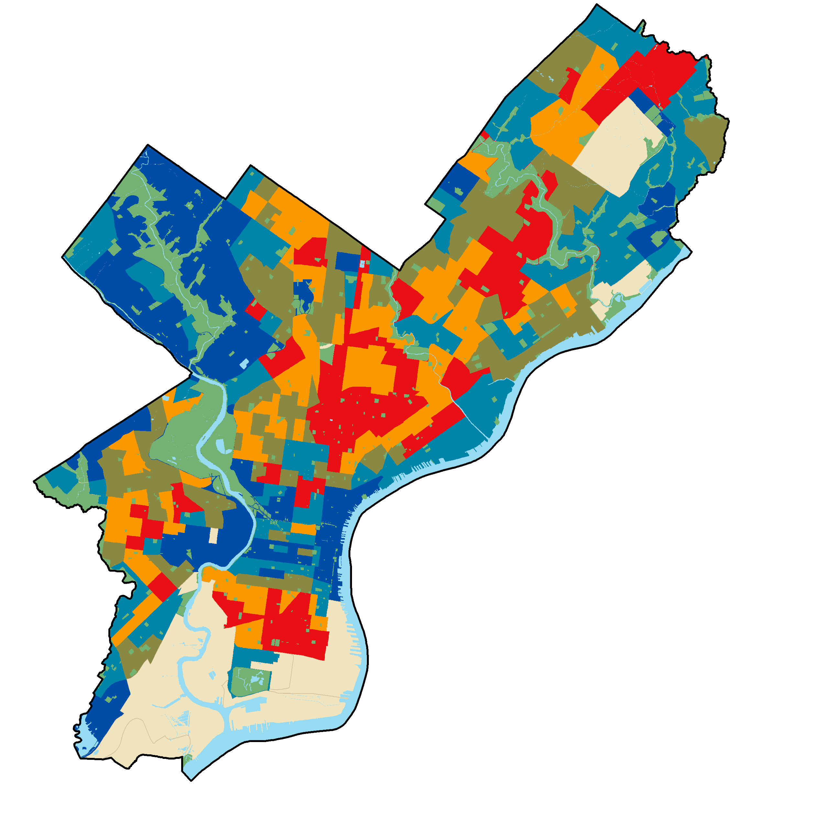
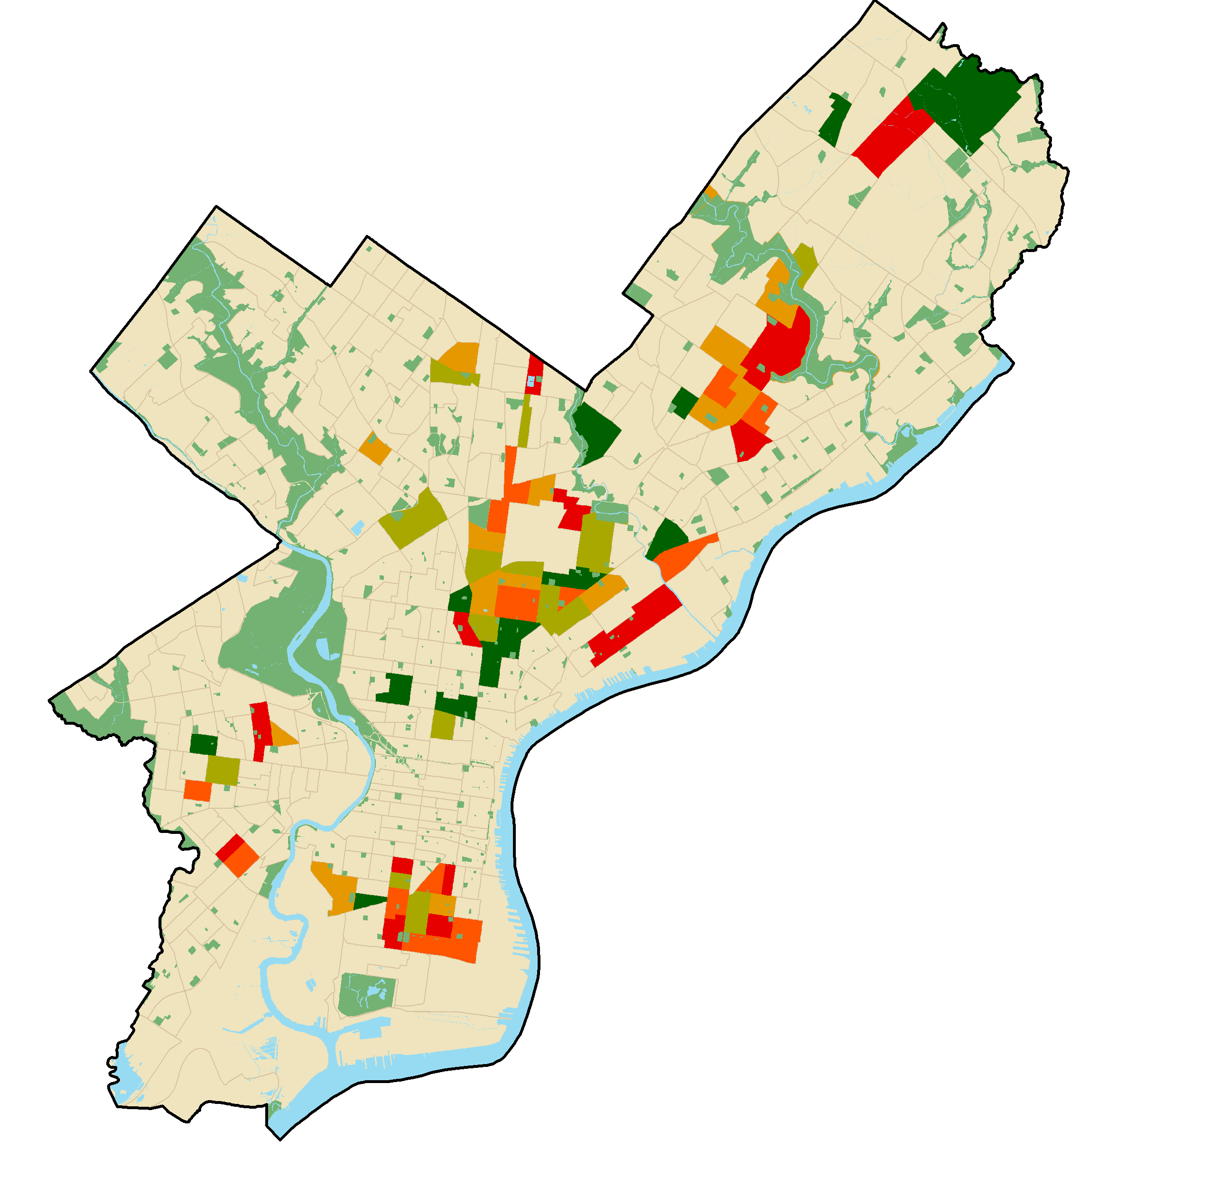
Summary
Heat exposure highest in city center and clusters with other risk factors
Heat vulnerability very high in 74 census tract
Street tree priority identified for 15 census tracts
Planning for a more heat
resilient Philadelphia
Notes:
Our study showed that heat exposure in Philadelphia is highest in the densely populated urban areas, compounding the effect of other socio-economic and health risk factors observed in the population. We identified 74 census tracts with very high heat vulnerability that should be targeted by city planners aiming to reduce heat related illnesses and increase resilience in the population. Finally, in 15 census tracts street tree planting initiatives may be a useful tool to reduce overall heat vulnerability as these census tracts experience high heat vulnerability and have few street trees.
The results of this study can be utilized by the City of Philadelphia to identify areas most exposed to urban heat and the most vulnerable communities. The findings of this project will help target interventions to mitigate heat-related health issues and improve the overall wellness of Philadelphia residents

Slide 23




Errors & Uncertainties
ACS data based on estimates
LST not experienced temperature
Coarse spatial resolution
People are not stationary
Icon Credit: The Noun Project
Image Credit: S. Madera for City of Philadelphia
Notes:
There are of course some uncertainties in our analysis.
LST measures temperatures on the surface of the Earth. A different temperature measurement, such as apparent temperature, would provide a better value for what temperature people in the city experience by considering humidity and wind speed. However, ground-level wind data at ground level across the city was not available for the calculation.
Additionally, Decennial Census data would have provided a finer spatial resolution in our analysis of priority areas, but would have been much less current than the available CDC and ACS datasets.
The CDC health data that we used was only available at the census tract level, which is coarse and does not allow for very accurate distinction between neighborhoods like block-group level data would allow.
People move throughout the city during the day for work, school, or other activities. Therefore, their heat exposure may vary throughout the day, and not directly correspond to their at home experience, which is their assumed location in the census data.
------------------------------Image Information Below ----------------------------
•Image Credit: S. Madera | City of Philadelphia
•Image Source: Provided by partner (Jason Hammer, Department of Public Health)
Icon 1
•Image Credit: Nounproject
•Image Source: Society by David García from the Noun Project https://thenounproject.com/search/?q=society&creator=435388&i=577628
Icon 2
•Image Credit: Nounproject
•Image Source: heat temperature by Kazim Abbas from the Noun Project https://thenounproject.com/search/?q=heat%20temperature&creator=5327689&i=3115226
Icon 3
•Image Credit: Nounproject
•Image Source: distort by Zach Bogart from the Noun Project https://thenounproject.com/search/?q=distort&creator=4129988&i=2068372
Icon 4
•Image Credit: Nounproject
•Image Source: demographic by Nithinan Tatah from the Noun Project https://thenounproject.com/search/?q=demographic&creator=3341063&i=2855555

Slide 24

Future Work
Update socioeconomic layers with 2020
Census data
Include air quality data in analysis for selecting priority areas
Validate data with ground readings and health outcomes
Image Credit: S. Madera for City of Philadelphia
Notes:
It would be beneficial to update this project using 2020 Decennial Census data in order to have a more accurate spatial representation of socio-economic variables. This would also allow for greater confidence in our estimate when determining priority areas based on the vulnerability index.
Air quality data, including ozone and PM2.5, could be added to the study if it were available at a finer resolution. The City is planning to do a large scale air quality analysis in the near future. Once it is completed, these data could be included as an exposure variable in an updated study. Temperature readings from ground stations throughout Philadelphia would help confirm temperature differences between neighborhoods which we estimated through LST.
Finally, monitoring health outcomes, such as mortality rates, would help confirm whether the cooling initiatives based off of this work are having a positive impact on resident wellness. This study will allow decision makers in the City of Philadelphia to increase the heat resilience of Philadelphia residents. And with that we would like to thank our partners for their contributions to the success of this project.
------------------------------Image Information Below ----------------------------
•Image Credit: S. Madera | City of Philadelphia
•Image Source: Provided by partner (Jason Hammer, Department of Public Health)

Slide 25
A special thanks to everyone at the Arizona - Tempe DEVELOP location for their support and guidance in the creation of this project
Dr. David Hondula (Arizona State University)
Crystal Wespestad (NASA DEVELOP, Fellow/Lead)
Thanks also to our project partners who provided us with data and their expertise throughout this project
Philadelphia Department of Public Health: Jason Hammer, Jessica Caum, and Alexandra Skula
City of Philadelphia, Office of Sustainability: Saleem Chapman
Notes:
We would also like to thank our advisors at ASU, Dr. David Hondula and Crystal Wespestad.

Slide 26
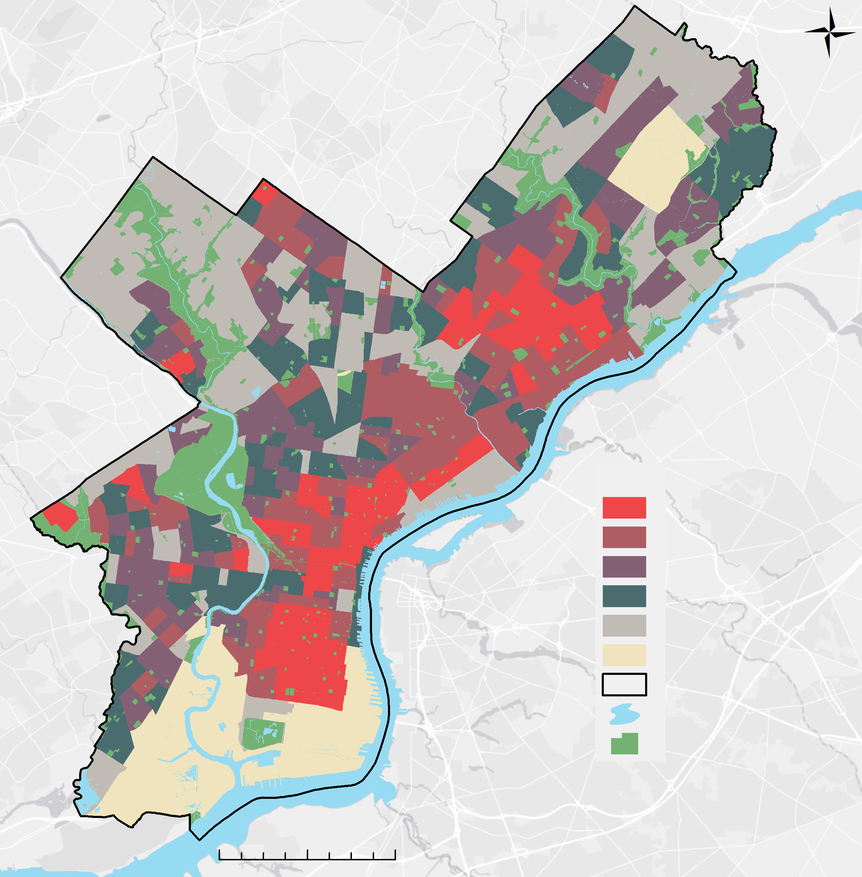
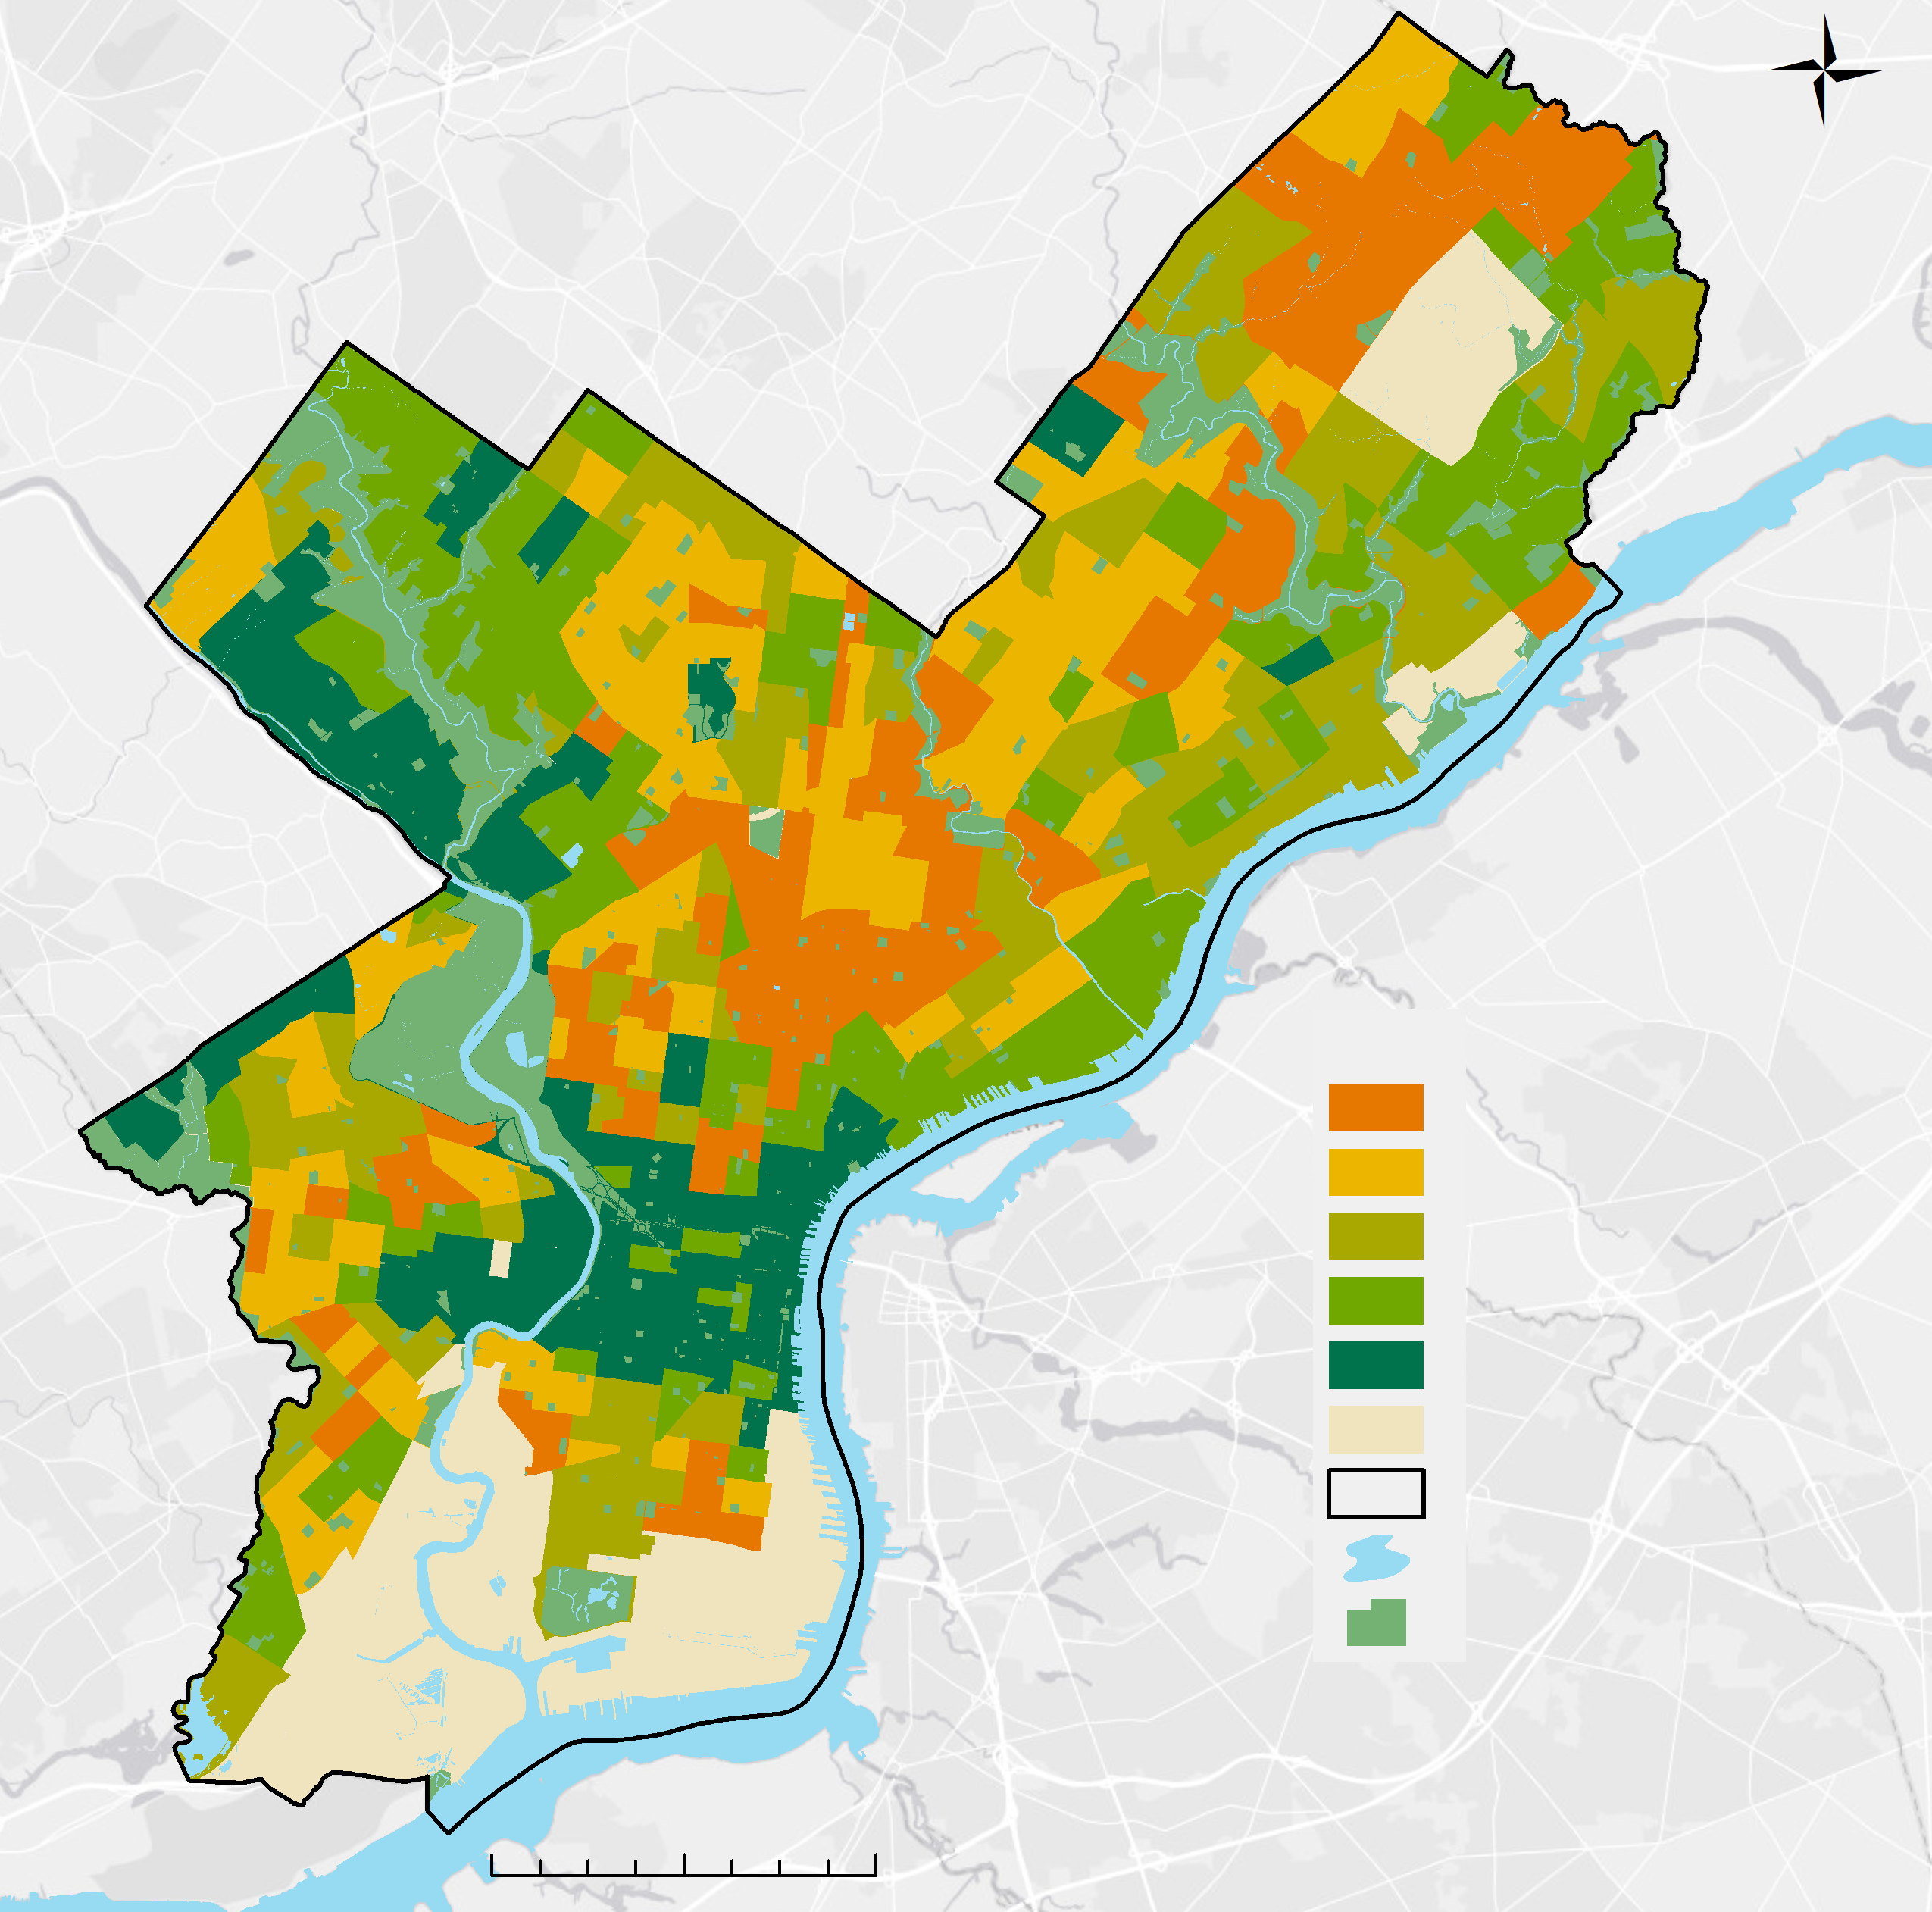
Heat Sensitivity Index (HSI)
Heat Exposure Index (HEI)
Very High
High
Medium
Low
Very Low
No Data
City of Philadelphia
Water
Parks
Very High
High
Medium
Low
Very Low
No Data
City of Philadelphia
Water
Parks
By Census Tract
By Census Tract
0 2 4 miles
0 2 4 miles
Notes:
(This is a backup slide for the questions section.)
Here we show the other two indexes we created for census tracts in Philadelphia: a Heat Sensitivity Index and a Heat Exposure Index. The Heat Sensitivity Index maps the scores from a PCA of just socioeconomic and health variables, while the Heat Exposure Index maps the scores from a PCA of exclusively environmental variables. There are some spatial trends, as Near Northeast Philadelphia and Upper and Lower North Philadelphia (central Philadelphia) tend to be high on both indexes, while Germantown/Chestnut Hill in the northwest tend to be low on both indexes. They also differ spatially, as the Heat Sensitivity Index is noticeably higher in South Philadelphia than the Heat Exposure Index.

