Slide 1

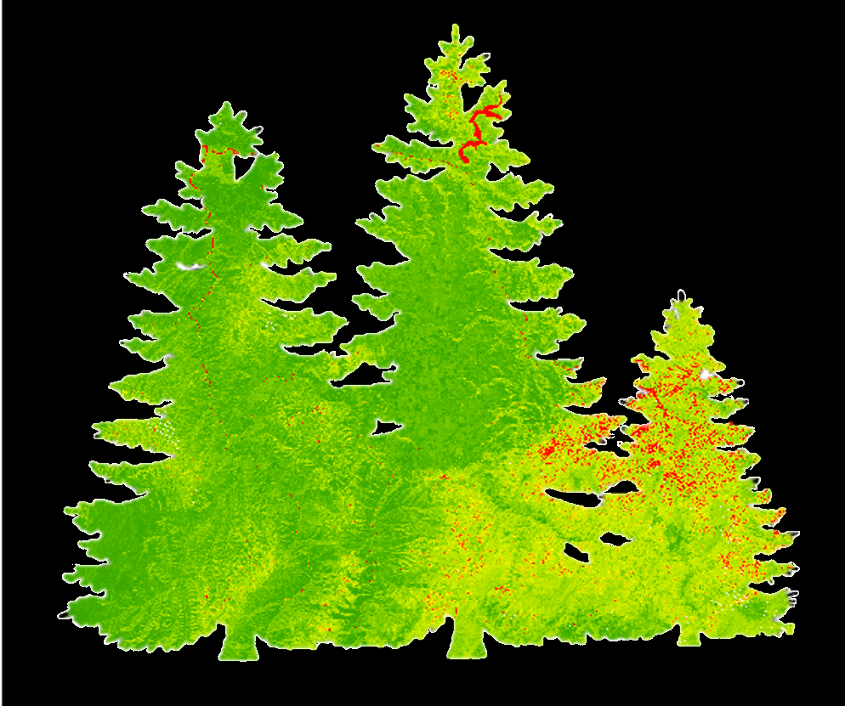
Emily Campbell
(Project Co-Lead)
Nez Perce-Clearwater Energy
Emma Hatcher (Project Co-Lead)
Utilizing NASA Earth Observations to Estimate Dead Aboveground Biomass Following Pest and Disease Outbreaks in Central Idaho Forests
Evan Gohring
USGS at Colorado State University
2017 Spring
Notes:
Hello and thanks to you all for listening to our presentation today! We are the Nez Perce-Clearwater Energy team. My name is Emily Campbell and these are my fellow team members, Emma and Evan. Our project is titled “Utilizing NASA Earth Observations to Estimate Aboveground Biomass Following Pest and Disease Outbreaks in Central Idaho Forests.” This project was carried out in partnership with the Bioenergy Alliance Network of the Rockies (BANR) and the Natural Resource Ecology Laboratory at Colorado State University.

Slide 2
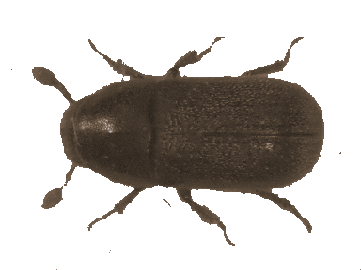
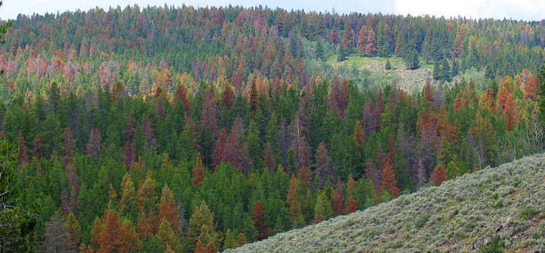

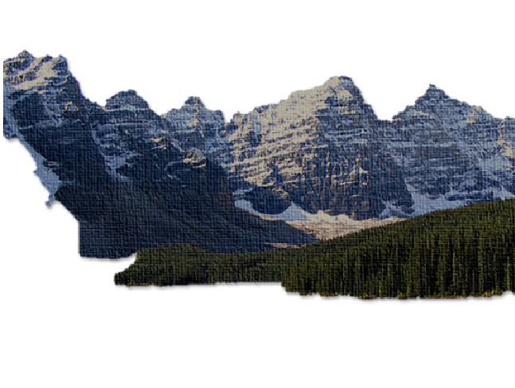

Image Credit: forestrydistributing.com
Community Concerns
Changes in Climate
Bark beetle outbreaks are becoming more severe & frequent
Image Credit: USDA.gov
Forest Health
Increasing pest and disease outbreaks are occurring in Idaho forests
Accessibility
Beetle kill biomass is often located in remote and rugged terrain.
Energy Development
It may be economically and environmentally feasible to use dead biomass as bioenergy feedstock
Image Credit: Lauren Burke
Image Credit: Chuck Coker
Image Credit: Gorgo
Notes:
Bark beetle outbreaks are increasing in severity and frequency. As climate change is expected to progress, these outbreaks are also expected to worsen. Forest health in Central Idaho is being threatened by the increasing pest and disease outbreaks occurring in this area. This beetle kill biomass presents the opportunity to develop a new energy source. Dead biomass has the potential to be extracted for use as bioenergy feedstock. Due to the remote and rugged terrain of these forests, this presents accessibility challenges for researchers. NASA Earth observations provide a method of measuring this dead biomass that can aid our project partners in their feasibility assessment of extracting dead biomass as a biofuel.
Image sources:
Forest Health Leaf: http://forestry.about.com/od/treeidentification/tp/tree_key_id_hardwood.htm, photo credit: Lauren Burke
Energy Development Gasoline Pump: http://hubpages.com/games-hobbies/Gas-Pump-Globes-2, photo credit: Chuck Coker
Climate Change Bark Beetle: http://www.forestrydistributing.com/images/image/insects/Spruce-beetle.gif
Accessibility Rocky Mountains: http://schools-wikipedia.org/images/245/24523.jpg.htm

Slide 3
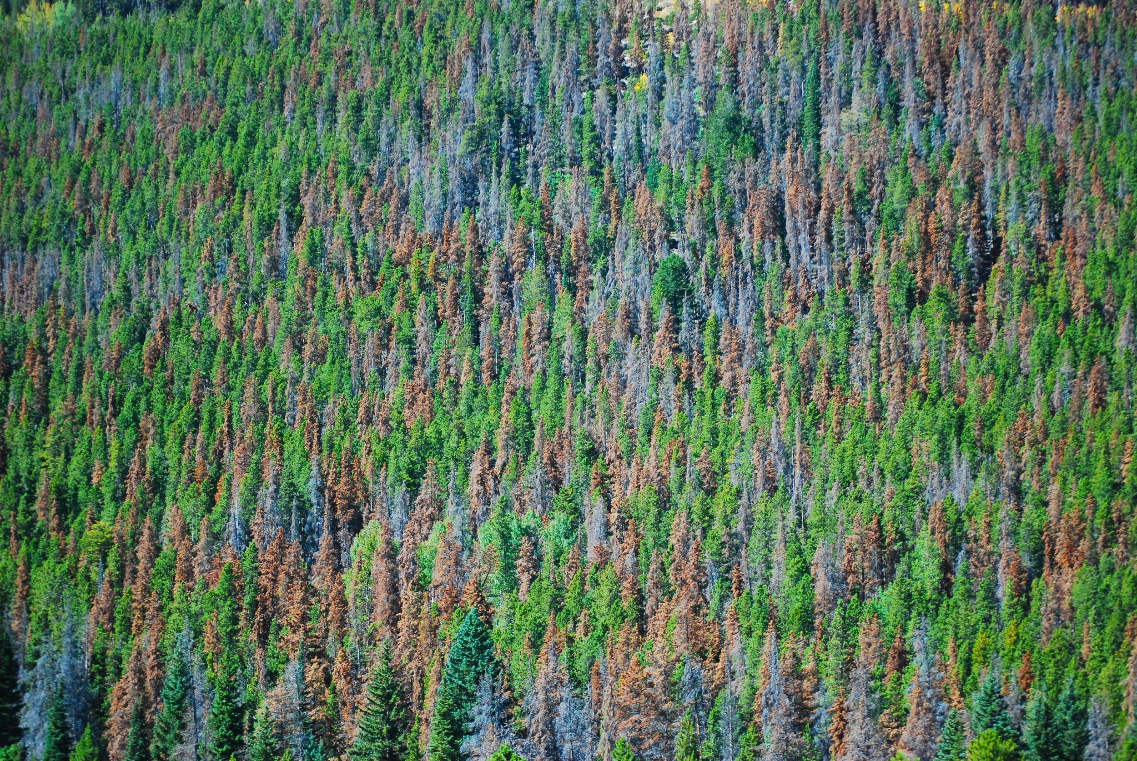
Objectives
Biofuel Feasibility
Resource Availability
Distribution
Cause
Timing
Image Credit: USGS
Partners
Bioenergy Alliance Network of the Rockies
Aboveground Dead Biomass Maps
Forest
Disturbance
Trends
Natural Resource Ecology Lab
Notes:
Our project included 2 main objectives. Using a combination of field data, LiDAR-derived aboveground biomass maps, and satellite imagery as inputs for our model, we aim to estimate dead biomass for our study area. From these estimates, our goal is to identify the distribution of dead biomass, timing of disturbances leading to dead biomass, and the causes behind disturbance events and dead biomass in the forests of Central Idaho. Our second objective is to produce aboveground dead biomass maps. From these maps we hope to provide useful information to our project partners, BANR and NREL, and ultimately help determine the feasibility of extracting this dead biomass as biofuel feedstock.
Image Source: https://www.flickr.com/photos/usgeologicalsurvey/16612752984

Slide 4
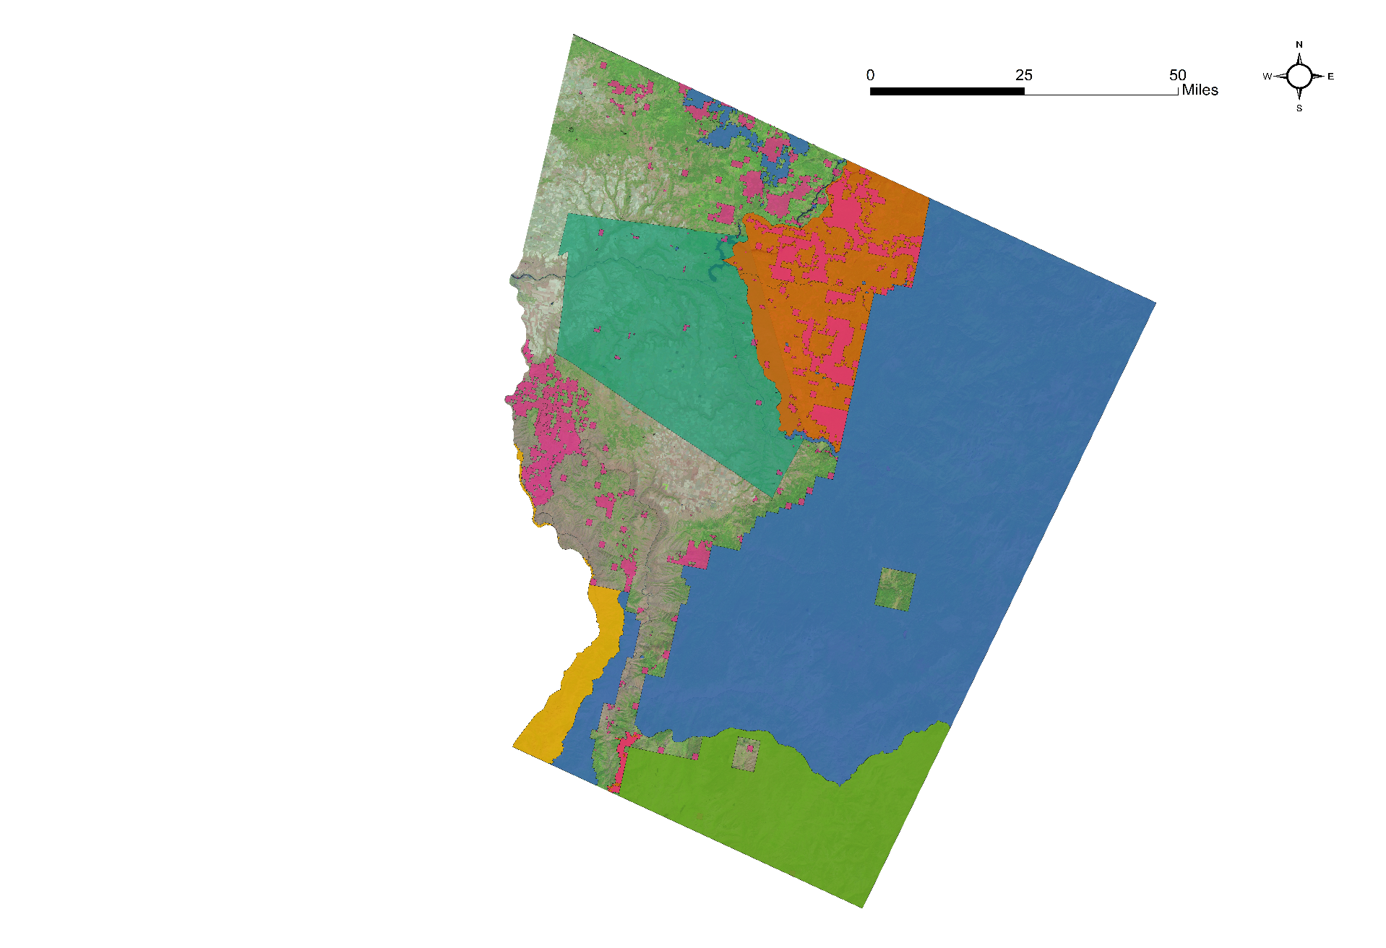
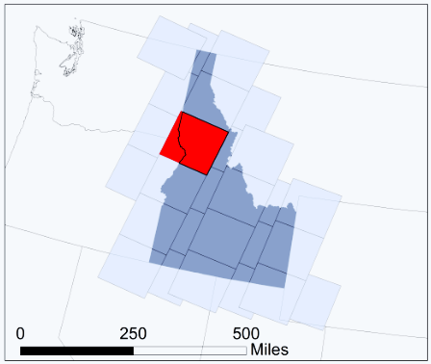
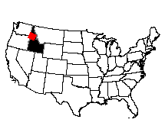
Study Area & Period
42028
Study Area: Central Idaho Forests
Study Period: 1984-2016 (July, August, September)
Land Allocation in Study Area
State Lands
State Forest
Tribal Lands
Nez Perce-Clearwater
National Forests
Payette National Forest
Wallowa-Whitman
National Forest
Notes:
Our study area focuses on the forests of central Idaho that are encompassed within Landsat WRS-2 Path 42 Row 28. The study area map shows the different land ownerships within the scene, consisting primarily of the Nez-Perce Clearwater National Forests, Payette National Forest, and state forest lands. Our study period utilizes satellite imagery from 1984-2016, only for the months of July, August, and September. Our field data occurs during the years from 2004 to 2015.
Image Source: US Forest Service

Slide 5
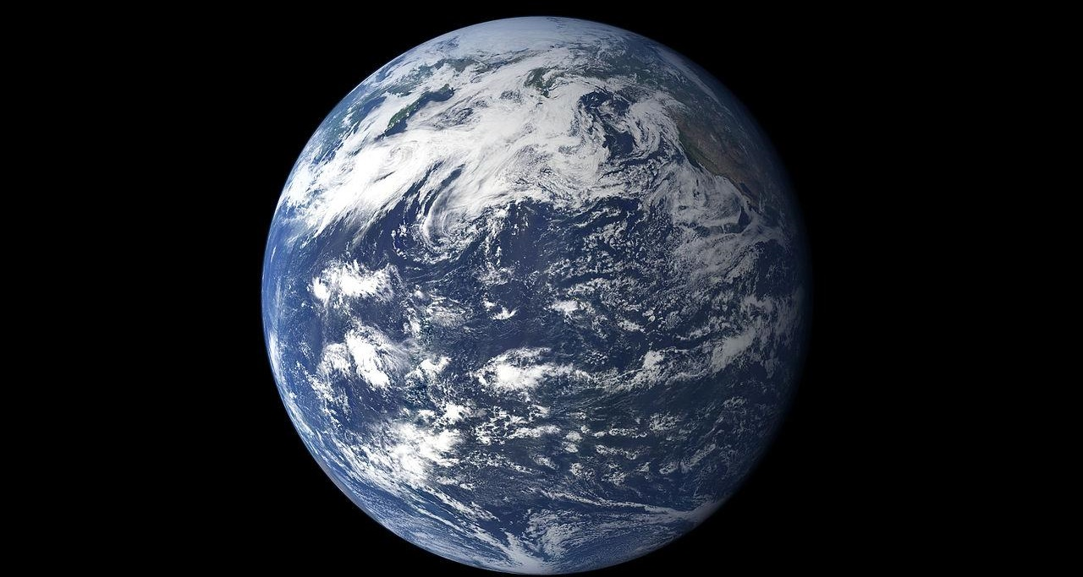
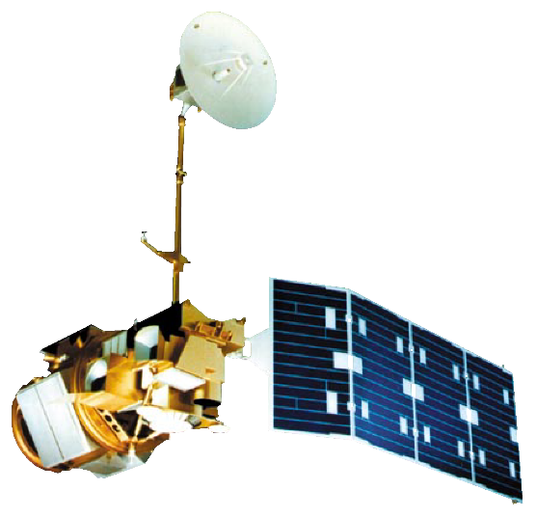
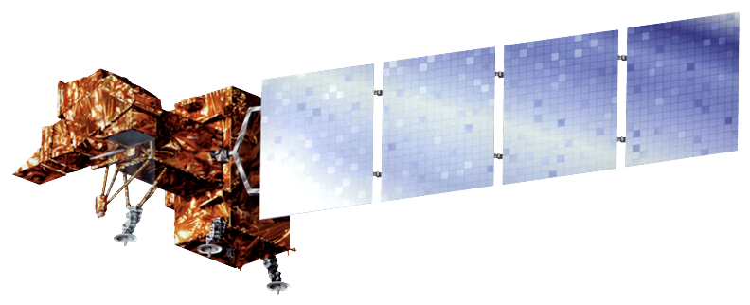
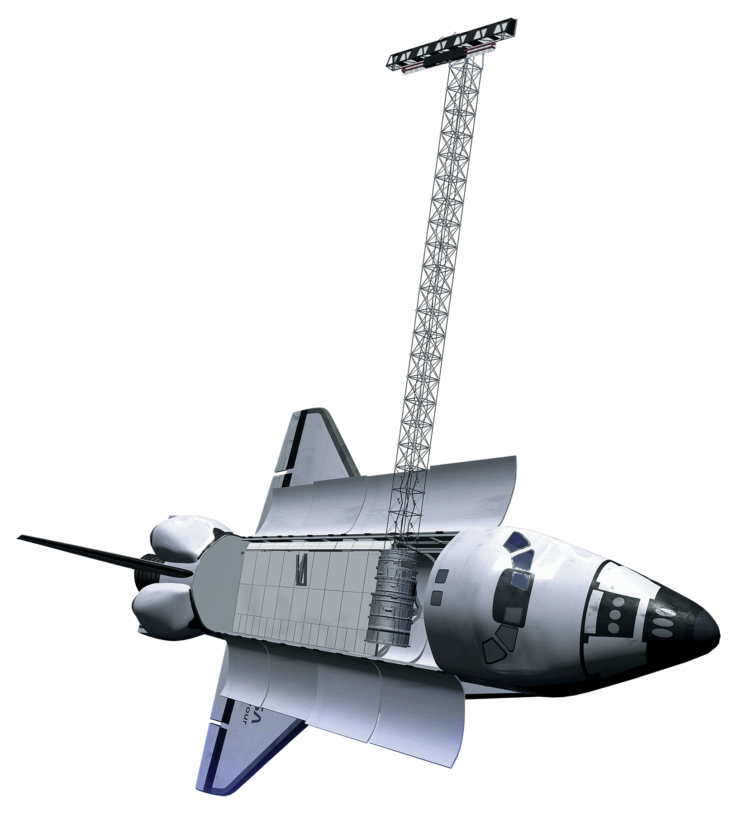

NASA Earth Observations
Landsat 4-5 Thematic Mapper
Landsat 8 Operational Land Imager
Landsat 7 Enhanced Thematic Mapper
Shuttle Radar Topography Mission Version 3
Image credit: Robert Simmon and Marit Jentoft-Nilsen
Notes:
The Earth observations used to create a time series of satellite images from 1984 to 2016 were taken from Landsat 4 and 5 Thematic Mapper, Landsat 7 Enhanced Thematic Mapper, and Landsat 8 Operational Land Imager. We also used a DEM from Shuttle Radar Topography Mission (SRTM) Version 3. All data were taken from Earth Explorer and downloaded through the USGS’s ESPA bulk downloader.
Image Source: http://www.devpedia.developexchange.com/dp/index.php?title=List_of_Satellite_Pictures
Background: https://commons.wikimedia.org/wiki/Category:Earth_from_space#/media/File:Earth_Pacific_jul_30_2010.jpg, image credit: Robert Simmon and Marit Jentoft-Nilsen

Slide 6
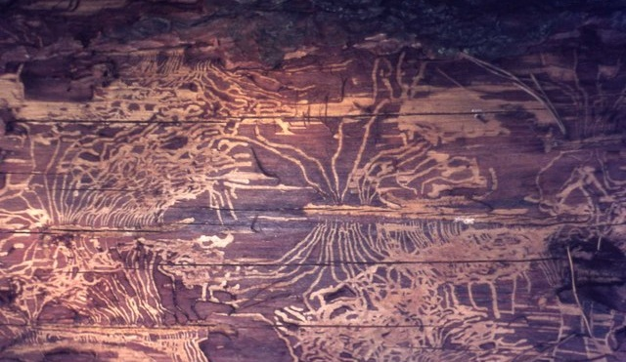
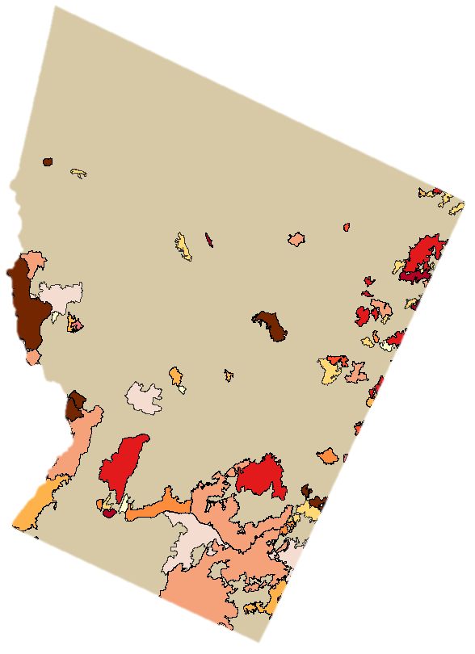
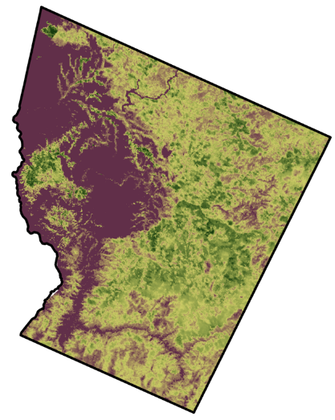
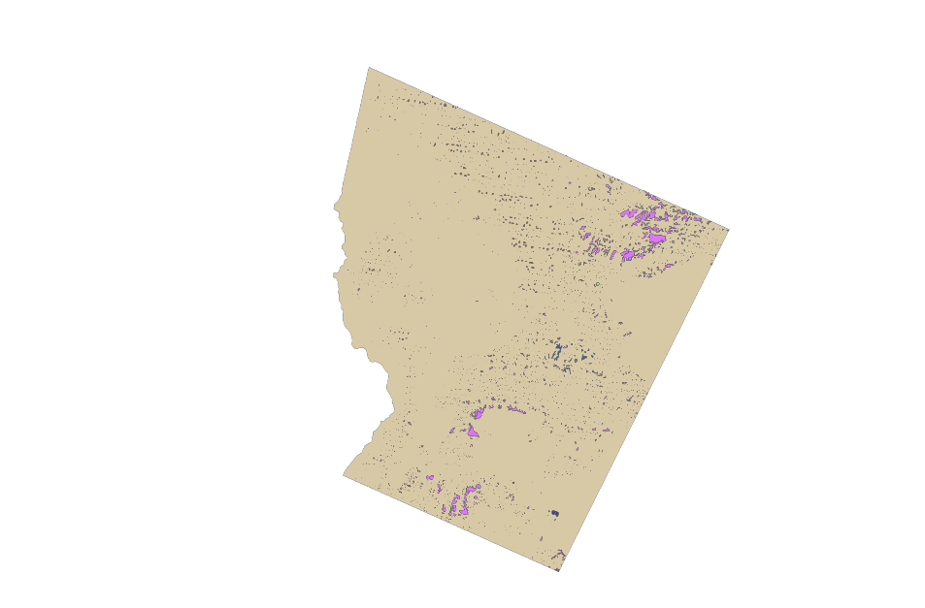
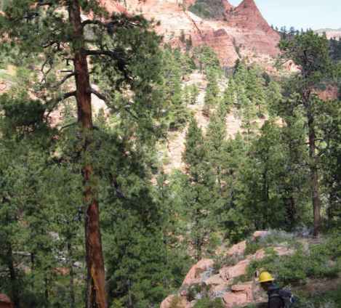
National Forest Service Datasets
Image Credit: M J Richardson
USGS/USFS Monitoring Trends in Burn Severity (MTBS) fire history data
Aboveground biomass maps
Partner field plot data
USFS Aerial Detection Surveys
Image Credit: USFS.gov
Notes:
In addition to our Earth observation data, we used these ancillary datasets. Since we were concerned mainly with bark beetle and disease outbreaks, we used MTBS fire history data obtained through the USGS/USFS to determine the location of fire disturbance events. Our project partner at NREL provided aboveground biomass maps that we used as model inputs. Our other project partner, BANR, obtained field plot data from the USFS Forest Inventory and Analysis National Program, which were also used in our model. We downloaded USFS Aerial Detection Surveys to verify pest and disease disturbances identified by LandTrendr.
Background photo source: https://commons.wikimedia.org/wiki/File:Bark_beetle_galleries_-_geograph.org.uk_-_516322.jpg, image credit: M J Richardson

Slide 7
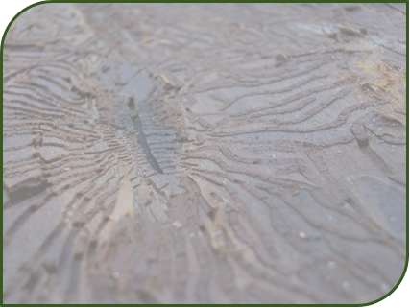
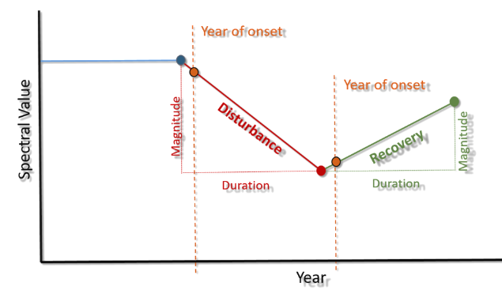
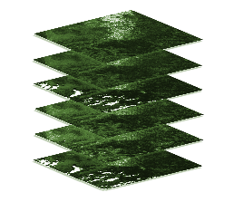
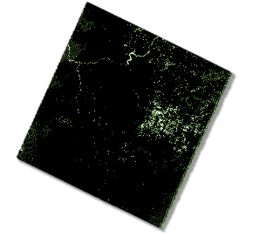
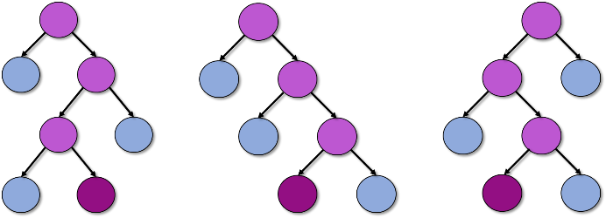
Methods Overview
LandsatLinkr: Composite
LandTrendr: Classify
Random Forests Model:
Predict
Image Credit: Vik Nanda
Notes:
Landsat Linkr was used as our first step to take the surface reflectance data from our time series, and composite it into tasseled cap wetness for each year. These wetness composites were then run through LandTrendr software, which categorizes disturbance using changes in pixel values across a time series. The variable outputs from LandTrendr became inputs for our random forests model.
Image Sources:
Background shape image: https://commons.wikimedia.org/wiki/File:Bark_beetle_burrows_(445594612).jpg

Slide 8
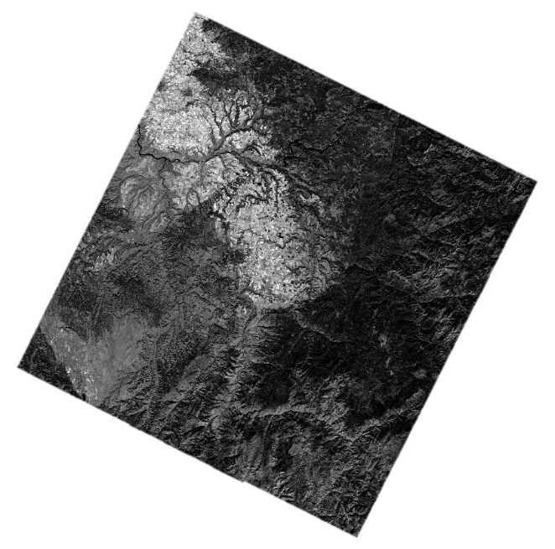
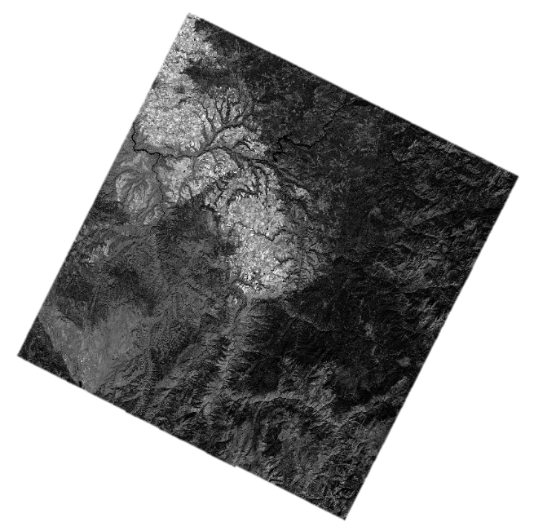
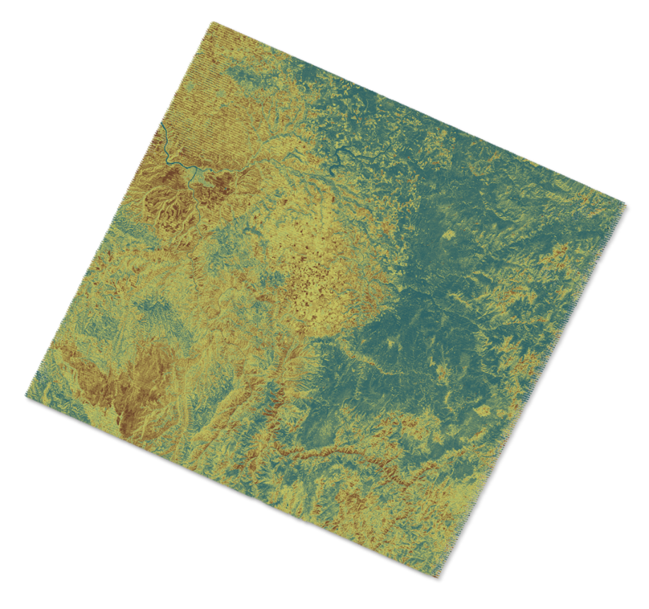
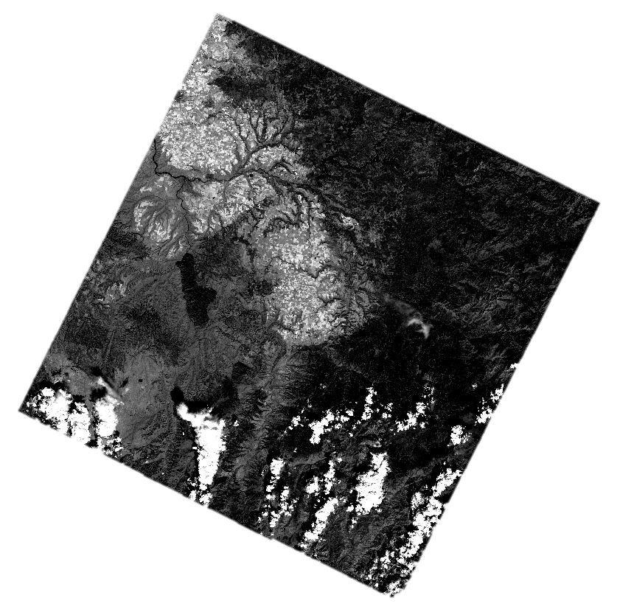
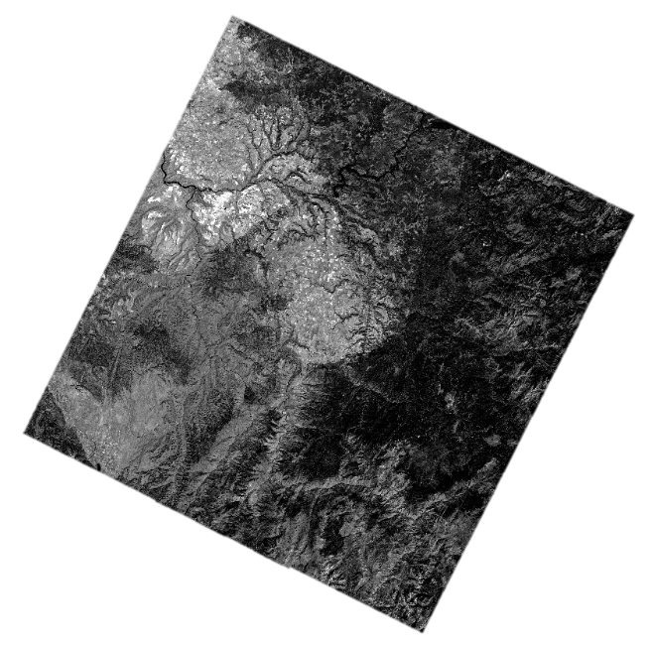
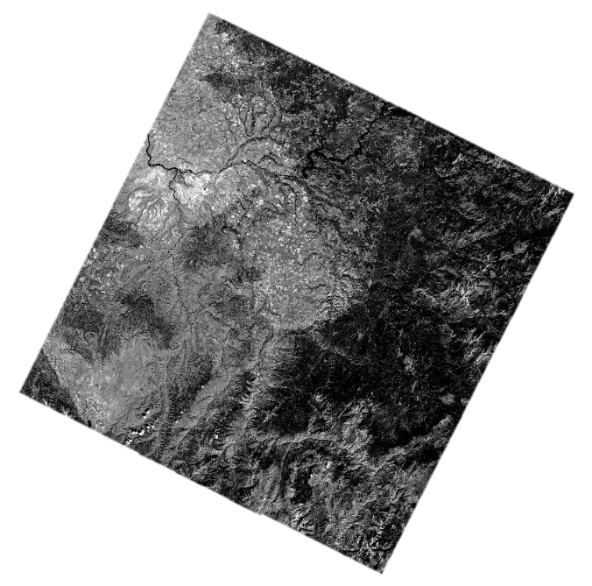
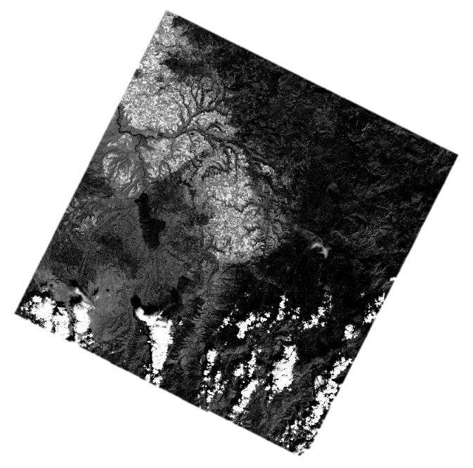
Composite: Landsat Linkr
Tasseled-cap transformations:
TCB/TCG/TCW
MEAN
Surface reflectance products from Landsat, July - September
Annual tasseled cap wetness composites
Notes:
Landsat Linkr is a multi-step process that was performed using R. We first prepared our Landsat TM/ETM+ and OLI images using Landsat Linkr, and then calibrated the sensors. Once they were calibrated, Landsat Linkr created composites of our surface reflectance products using the mean values of the pixels. It generated annual tasseled cap wetness composites that were ready to use in LandTrendr.

Slide 9
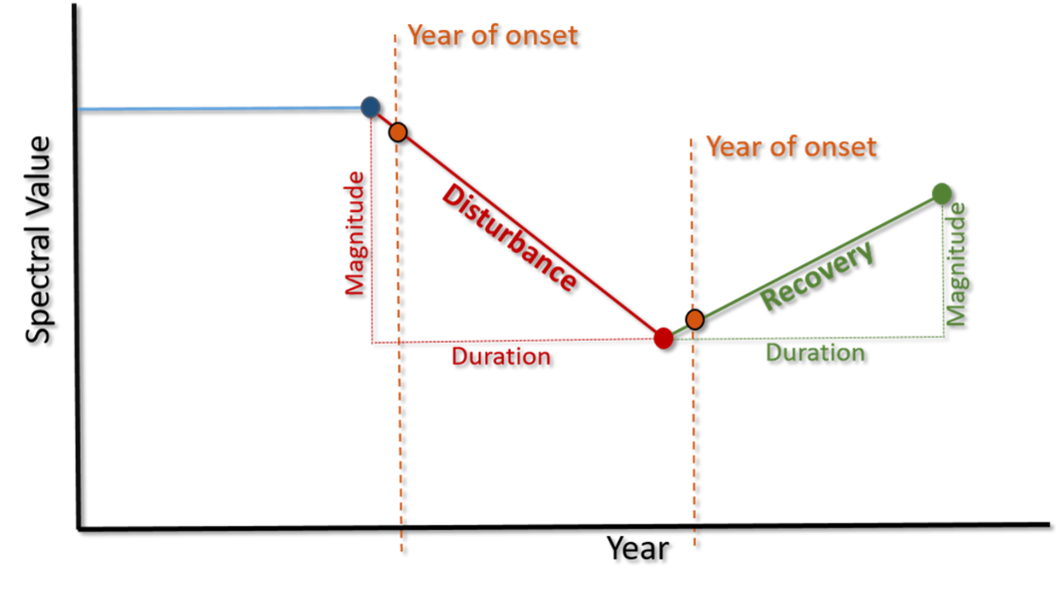
Classify: LandTrendr
Tasseled-cap wetness composites
Greatest recovery
Longest disturbance
Most recent disturbance
Greatest disturbance
First disturbance
Most recent recovery
Longest recovery
First recovery
Image Credit: Emma Hatcher
Notes:
The tasseled-cap wetness composites from the LandsatLinkr outputs were then used as the inputs in LandTrendr software. This software creates spectral curves along segments of change that characterize disturbance at each pixel over the time series. These curve segments are then categorized by the relative magnitude and duration of each disturbance into the outputs that include greatest recovery, greatest disturbance, longest recovery, longest disturbance, etc. as shown here. These characterize spectral change into types of disturbance and recovery that in effect, are potentially predictive variables for defining change that results from bark beetle and disease outbreaks.

Slide 10
Predict: Random Forests & VSURF
Partner provided
plot data
LandTrendr outputs
Dead Aboveground Biomass
Aboveground biomass map
Topographic Data
Notes:
The outputs from LandTrendr, LiDAR-based aboveground biomass maps, and topographic data are then plugged into a random forests model as potential predictor variables of dead aboveground biomass. USFS FIA plot data provides field-based verification of dead biomass to train the model. Random forests then constructs hundreds of decision trees that combine the input variables in various combinations to test their strength at predicting dead aboveground biomass. The trees that generate the lowest mean squared error are then used to determine the strongest predictor variables from the inputs of the dead aboveground biomass outcome.

Slide 11
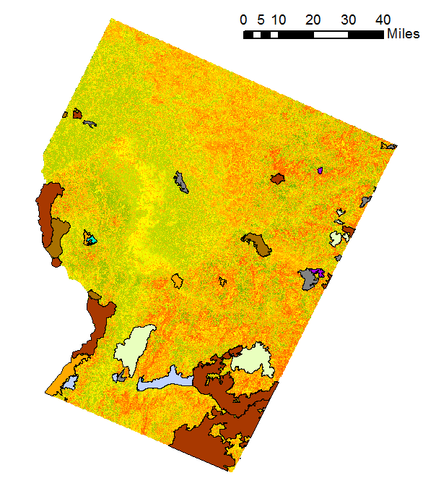
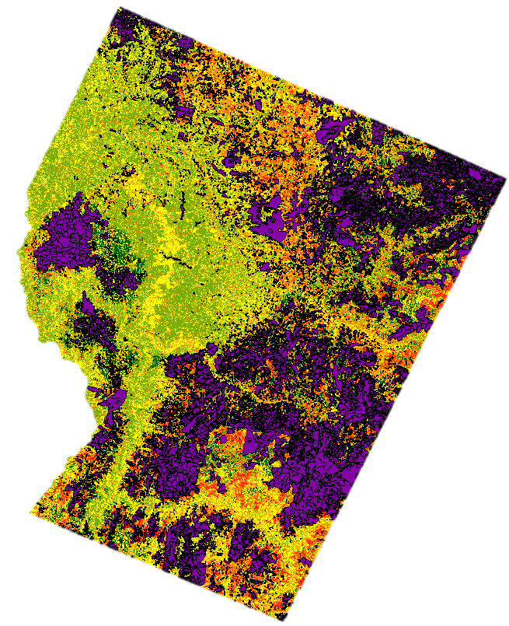

Methods Overview
Aerial Detection Surveys:
Verify
Monitoring Trends in Burn Severity:
Filter
Notes:
Aerial detection survey data were critical to determining the specific bark beetle or disease of documented disturbances to compare to and verify against LandTrendr and random forests outputs. MTBS data were used to eliminate areas that had been recently affected by fire, so that we were able to focus in on disturbance caused by pests and disease.

Slide 12
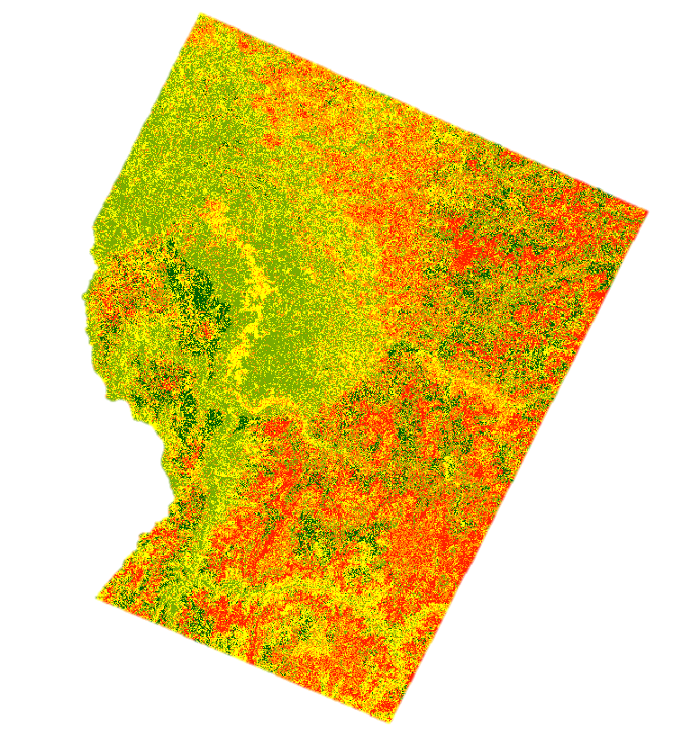
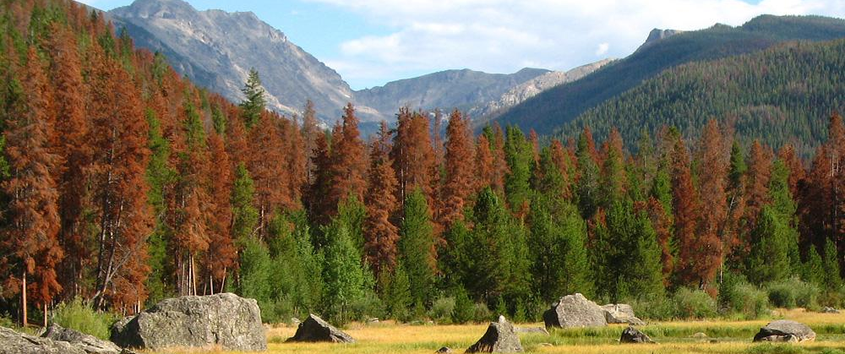
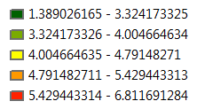

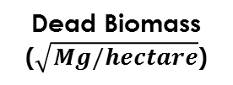
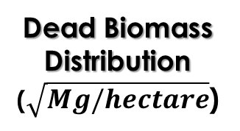
Results
Predictor | Relative Importance
Elevation | 1.0000
Total Biomass | 0.3904
Greatest Disturbance Magnitude (Unfiltered) | 0.1432
Longest Disturbance Magnitude (Unfiltered) | 0.1309
Most Recent Disturbance Pre-Vertex Value (Unfiltered) | 0.0983
Northness | 0.0897
Compound Topographic Index | 0.0683
Longest Disturbance Recovery Segment Duration (Unfiltered) | 0.0589
Greatest Recovery Magnitude (Unfiltered) | 0.0388
Dead Biomass Distribution ($\sqrt{Mg/hectare}$)
RMSE = 2.597
Dead Biomass ($\sqrt{Mg/hectare}$)
1.389 – 3.324
3.324 – 4.005
4.005 – 4.791
4.791 – 5.429
5.429 – 6.811
Notes:
Model outputs suggest that, in order of importance, elevation, total biomass, greatest disturbance magnitude, longest disturbance magnitude, most recent disturbance pre-vertex value, northness, compound topographic index, longest disturbance recovery segment duration, and greatest recovery magnitude most strongly predict standing dead biomass. Consistent with these results, previous research suggests that topographic characteristics along with longest disturbance and greatest disturbance magnitudes are important predictors of dead aboveground biomass. These predictors explain 33.41% of the variance in the model.
Background image:
https://toolkit.climate.gov/image/483, image credit: Carlye Calvin

Slide 13
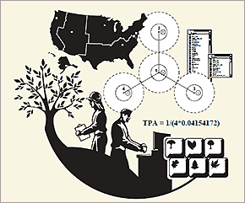
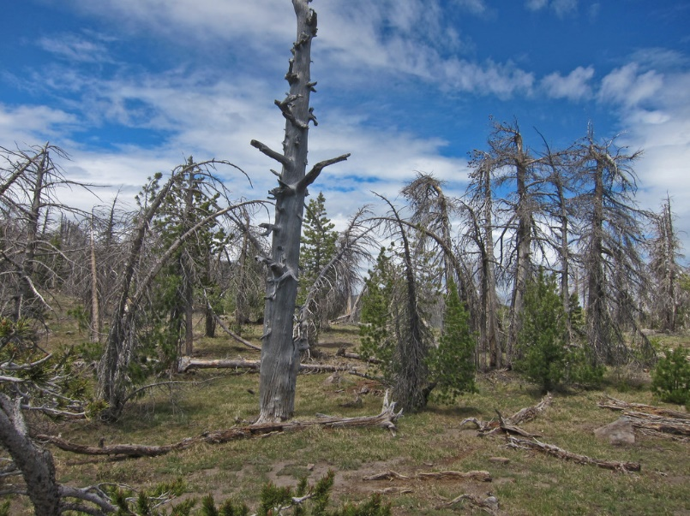

Limitations and Challenges
FIA plot data versus partner in situ plot data
Image Credit: USFS
$$\sqrt{dead biomass}$$
Range of plot-sampled dead biomass values
Image Credit: Michael McCullough
Notes:
The team was presented with a few limitations and challenges through the course of this project. We originally intended to use the Forest Inventory and Analysis forest plot data to use as training data in the random forest model, but due to time constraints, we used a dataset of forest plot points to train the model provided by our project partners at NREL. Another challenge we faced was with our range of plot-sampled dead biomass values. Due to the high number of zero values for dead biomass and the distribution of dead biomass values, we transformed our data by removing outliers and taking the square root of all values.
FIA image source: https://www.fia.fs.fed.us/library/database-documentation/index.php
Dead biomass image source: https://www.flickr.com/photos/ex_magician/7507955778

Slide 14
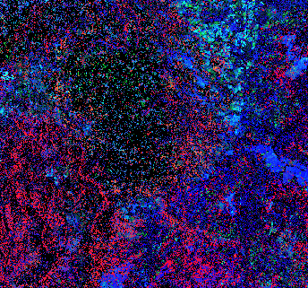
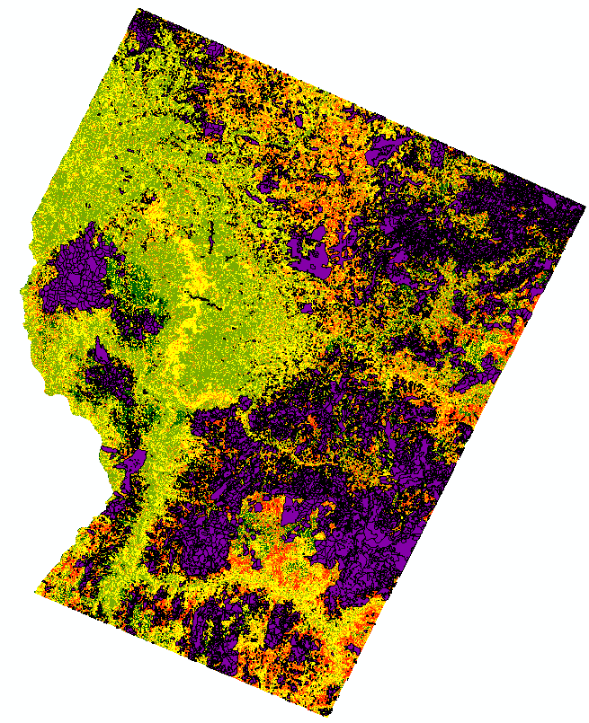
Conclusions
1. Elevation
2. Total Biomass
3. GD Magnitude
4. LD Magnitude
5. MRD Pre-Vertex Value
6. Northness
7. CTI
8. LD Recovery Duration
9. GR Magnitude
Visual Verification
Unfiltered LandTrendr outputs
9 of the 84 predictor variables are important for predicting standing dead biomass
Notes:
The results of the randomForests model following variable selection in VSURF indicates that 9 of our 84 predictor variables are important in modeling dead aboveground biomass. Three of these are topographic, 5 are unfiltered LandTrendr outputs, and the final predictor is total biomass. The modeled result aligns well with ADS data visually. This is a great preliminary model of dead aboveground biomass distribution, however, further analysis is needed to provide final results to be used in feasibility assessments for using this dead biomass for biofuel feedstock. Our results also highlighted that the LandTrendr unfiltered settings best capture disturbance signals resulting from pest and disease.

Slide 15
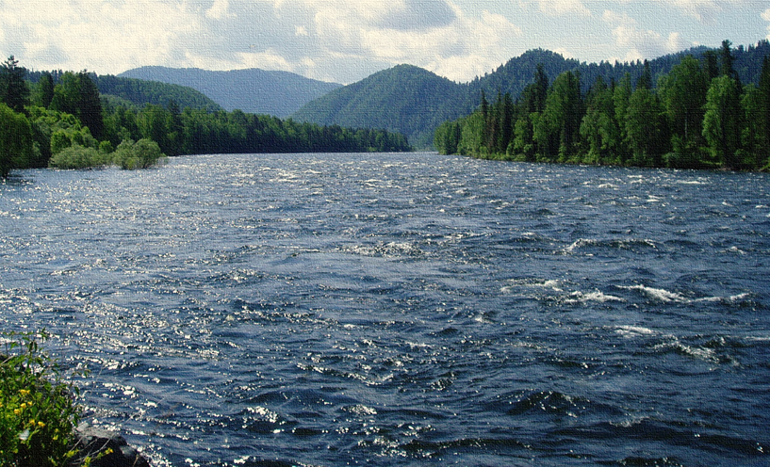
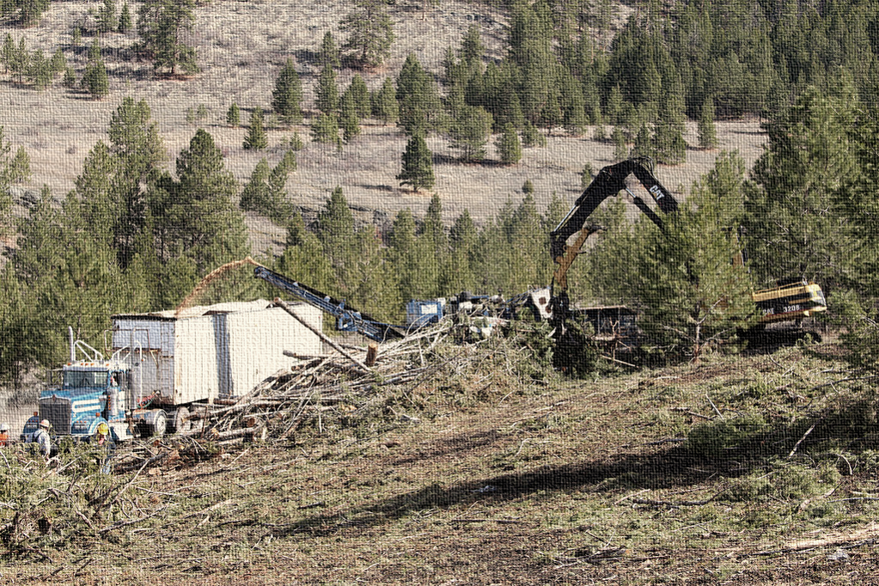
Future Work
Image Credit: Stephanie Pearl
Image Credit: Dmitri Melnikov
Continued feasibility assessments of using dead biomass as biofuel feedstock
Hydrology assessment
Notes:
Future directions from this work includes further research in the water and ecological forecasting application areas. If biofuel is determined to be an economically and environmentally beneficial use of the aboveground dead biomass in the area, the removal of this resource would likely influence the hydrology of the study area, changing surface flows that would affect watershed dynamics. Future research that predicts and characterises this change will be important in quantifying impacts of biofuel feedstock extraction. The predictor variables and environmental and economic assessments that influence feasibility will continue to change as climate changes into the future. This offers the opportunity to predict and monitor change in the area to continue modeling feasibility into the future through methods like agent-based modeling. As with many ecological research programs, revisiting impacts and feasibility into the future would make this project more dynamically sustainable over time.
Image Source:
RIver- https://commons.wikimedia.org/wiki/File:BiyaRiver.JPG, photo credit: Dmitri Melnikov
Biofuel- https://nifa.usda.gov/blog/tribal-partnerships-fuel-sustainable-aviation, photo credit: Stephanie Pearl

Slide 16
The Nez Perce-Clearwater Energy team would like to thank the following individuals for their contributions to this project:
 Dr. Paul Evangelista, Natural Resource Ecology Laboratory, Colorado State University
 Dr. Amanda West, Natural Resource Ecology Laboratory, Colorado State University
 Tony Vorster, Natural Resource Ecology Laboratory, Colorado State University
 Brian Woodward, NASA DEVELOP, Fort Collins Center Lead
 Dr. Michael Falkowski, Natural Resource Ecology Laboratory, Colorado State University
 Patrick Fekety, University of Minnesota
Notes:
We would like to thank these individuals for helping us with our project.

