Slide 1
IDAHO & OREGON AGRICULTURE
Monitoring Vegetation Impacts of Livestock Management Practices Used to Reduce Predator Conflicts on Idaho and Oregon Grazing Allotments​
Garret Weichel
Jack Hagenbuch
Aarushi Jhatro
Hannah Willis
Colorado – Fort Collins |Spring 2024

Slide 2
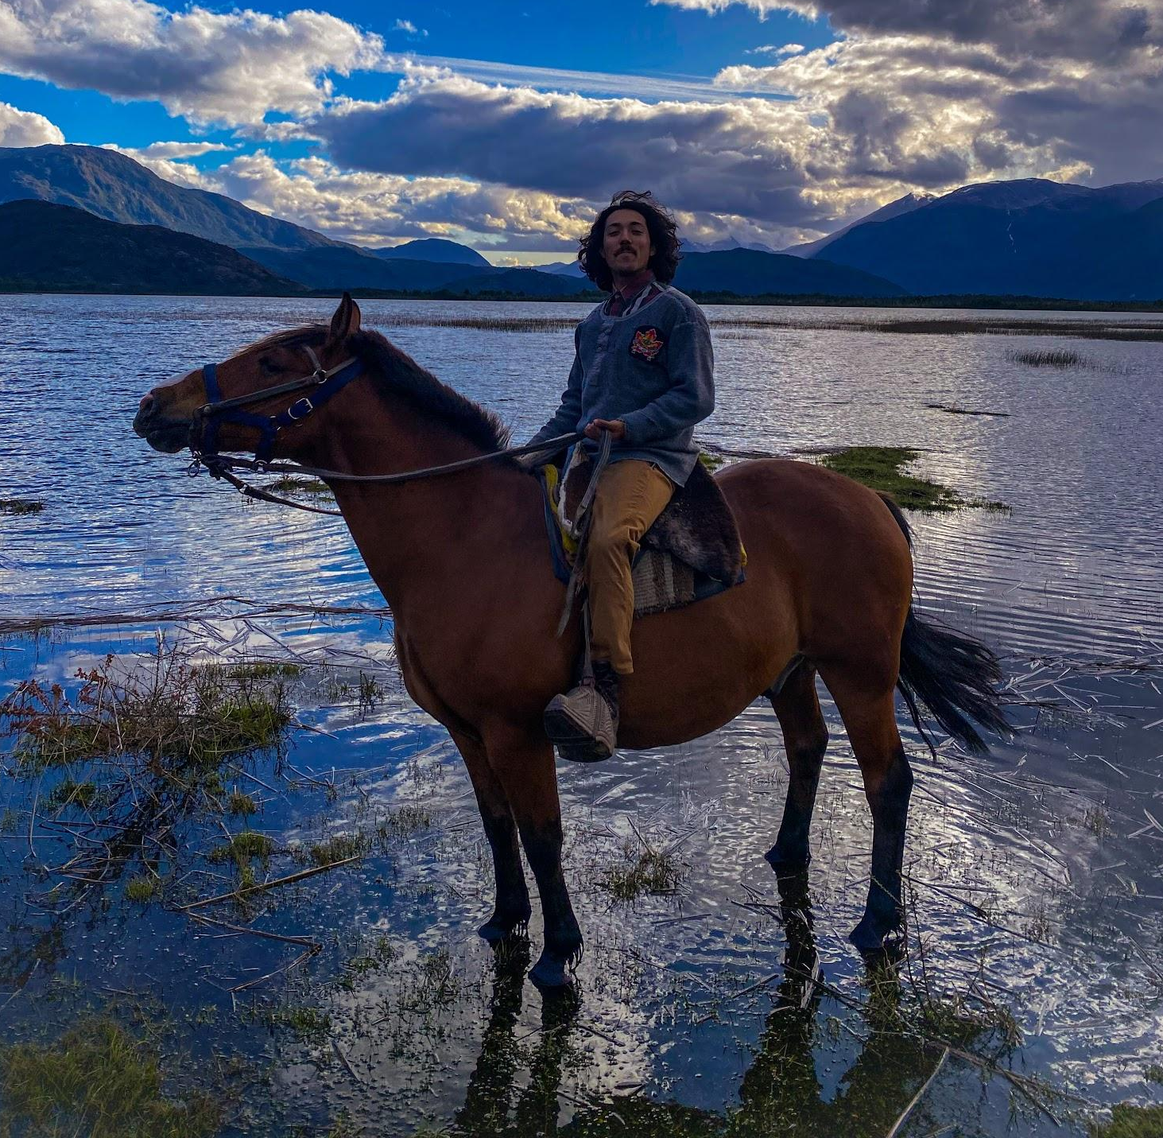
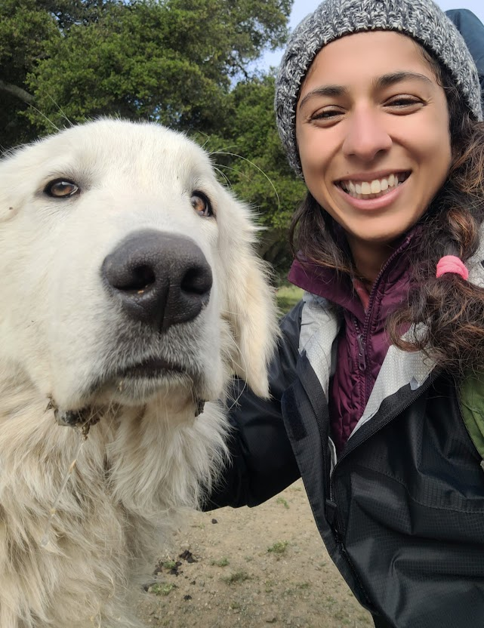
Introductions
DEVELOP Team
Garret Weichel
(Team Lead)
Jack Hagenbuch
Aarushi Jhatro
Hannah Willis
Notes:
A brief introduction of the team.

Slide 3
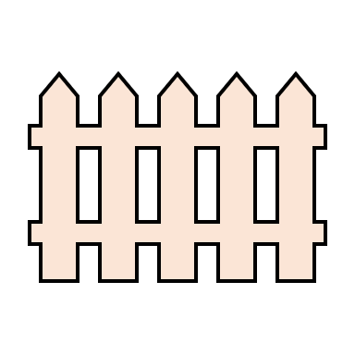
Community Concerns
Reduce Predation via Night Penning
WOLF PREDATION
NIGHT PEN
IMPACTS ON RANGELAND VEGETATION
Understand the Impacts of Night Penning on Rangeland Vegetation
Notes:
Night Penning (concentrating livestock into a fenced, defendable space after a day of grazing) is a strategy used to reduce the predation of livestock on the landscape.
Partners (Ranching Operations- Alderspring Ranch & Krebs Livestock) as well as the USFS, & U.S. Department of Agriculture want to know how this grazing management practice impacts the working landscape (Ranchlands/vegetation). Understanding the impacts of Night Penning will also help to make management decisions moving forward (i.e. selecting future night penning sites).
Our partners are committed to running successful businesses producing food + fiber, defending their livestock from predation, and working to ensure that their land is being managed in a way that is not harmful to the natural environment.
------------------------------Image Information & Citations Below ------------------------------
Image Citation: Icons, Microsoft

Slide 4
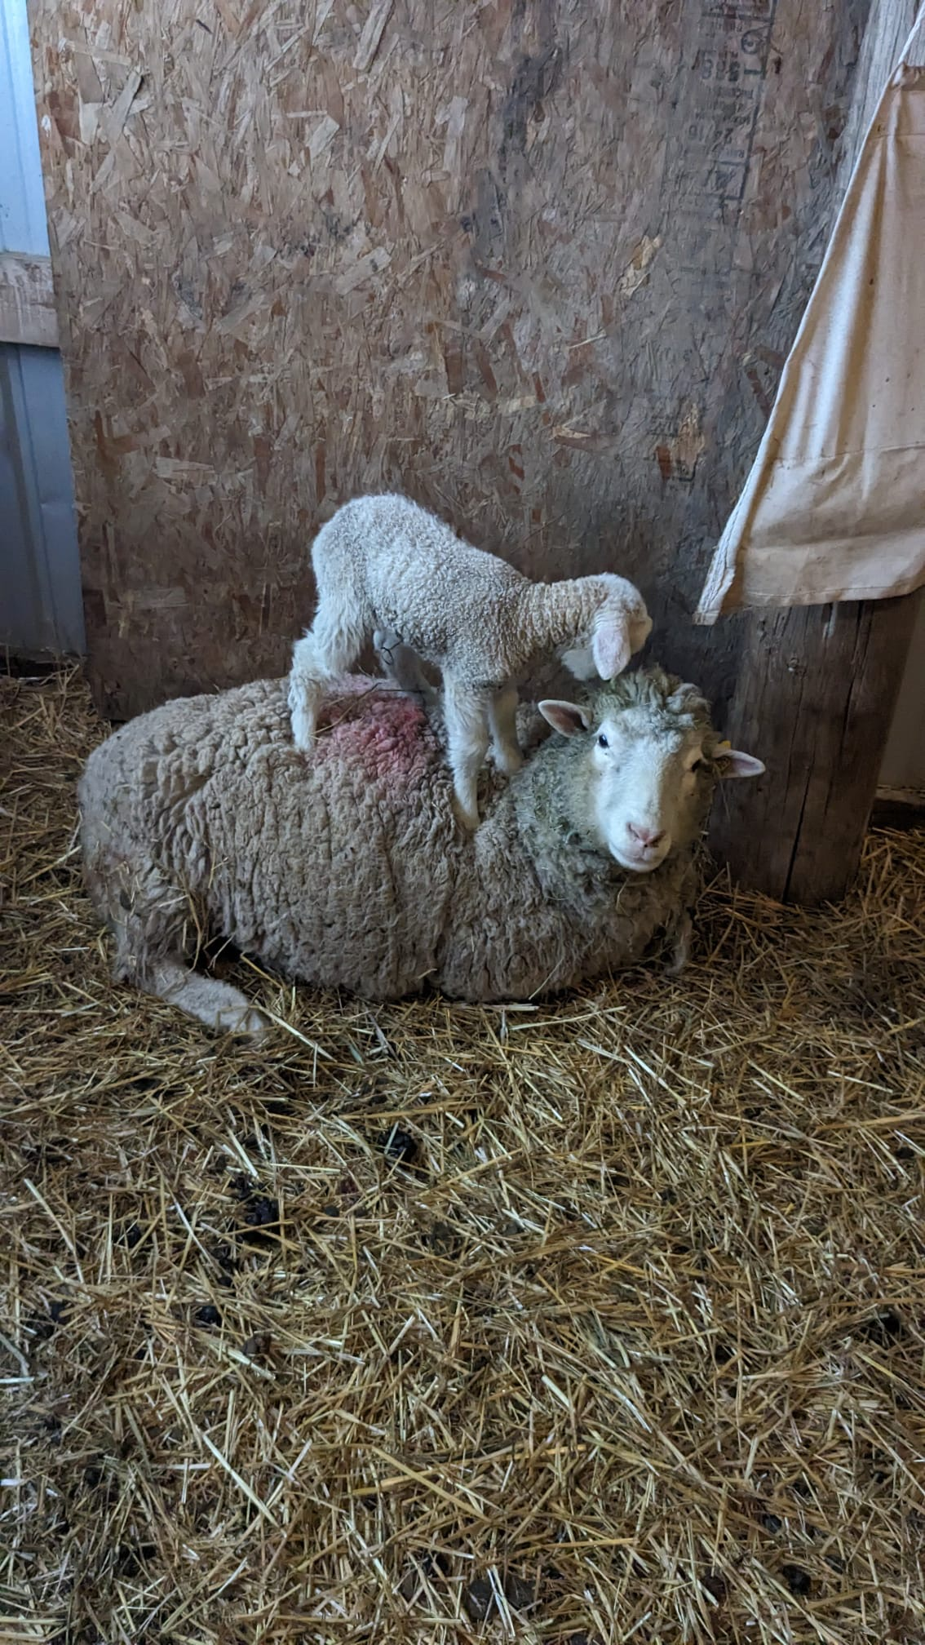
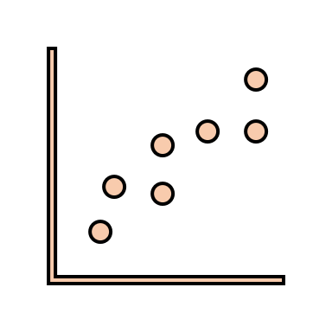
Project Background
Night penning could result in conditions detrimental to vegetation growth.
No evidence that night pens have any significant effect on biomass production or vegetation community composition.
Effectiveness and use case for Rangeland Analysis Platform. This dataset can help inform rangeland managers, research, and conservation objectives.
Source: Garrett Weichel
Notes:
Icon #1: Effects of Sheep Night Penning on Soil Nitrogen and Plant Growth
No significant impact on soil physical properties
Excreta could cause short term phytotoxic conditions
Once ammonium is converted to nitrate, night pens recover biomass
Icon #2: Krebs Report
Report conducted by Jablonski (CSU) on Krebs sites in this study
Report utilized Rangeland Analysis Platform via Google Earth Engine
Icon #3: Innovation in Rangeland Monitoring
RAP platform based on Landsat satellite record, gridded meteorology, abiotic land surface data, and 30,000 field plots
Platform shows per-pixel percent cover of annual forbs and grasses, perennial forbs and grasses, shrubs, and bare ground over the western United States from 1984 to 2017
------------------------------Image Information & Citations Below ------------------------------
Image Citation: Garret Weichel
Icon Citation: Microsoft
Y. J. Zhang , W. L. Jiang & J. Z. Ren (2001) Effects of sheep night penning on soil nitrogen and plant growth, New Zealand Journal of Agricultural Research, 44:2-3, 151-157, DOI: 10.1080/00288233.2001.9513471
Jablonski, Kevin (2021) Krebs Night Pens Remote Sensing Analysis Colorado State University
Jones, M. O., B. W. Allred, D. E. Naugle, J. D. Maestas, P. Donnelly, L. J. Metz, J. Karl, R. Smith, B. Bestelmeyer, C. Boyd, J. D. Kerby, and J. D. McIver. 2018. Innovation in rangeland monitoring: annual, 30 m, plant functional type percent cover maps for U.S. rangelands, 1984–2017. Ecosphere 9(9):e02430. 10.1002/ecs2.2430

Slide 5
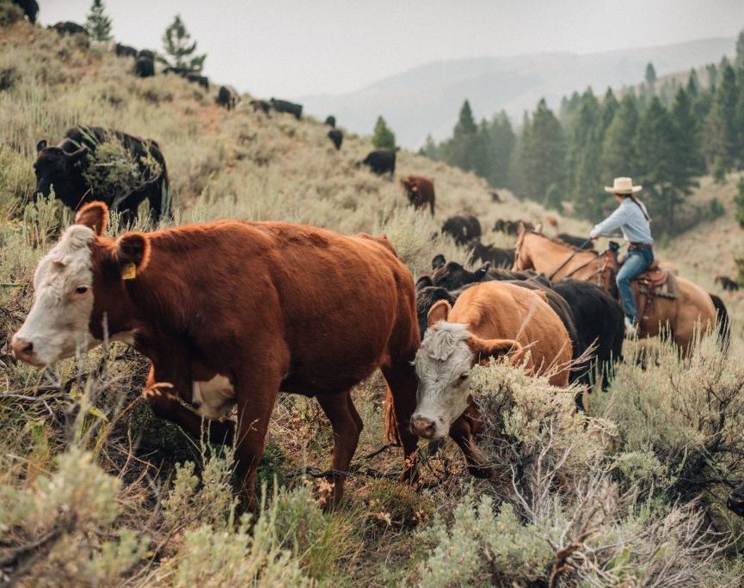
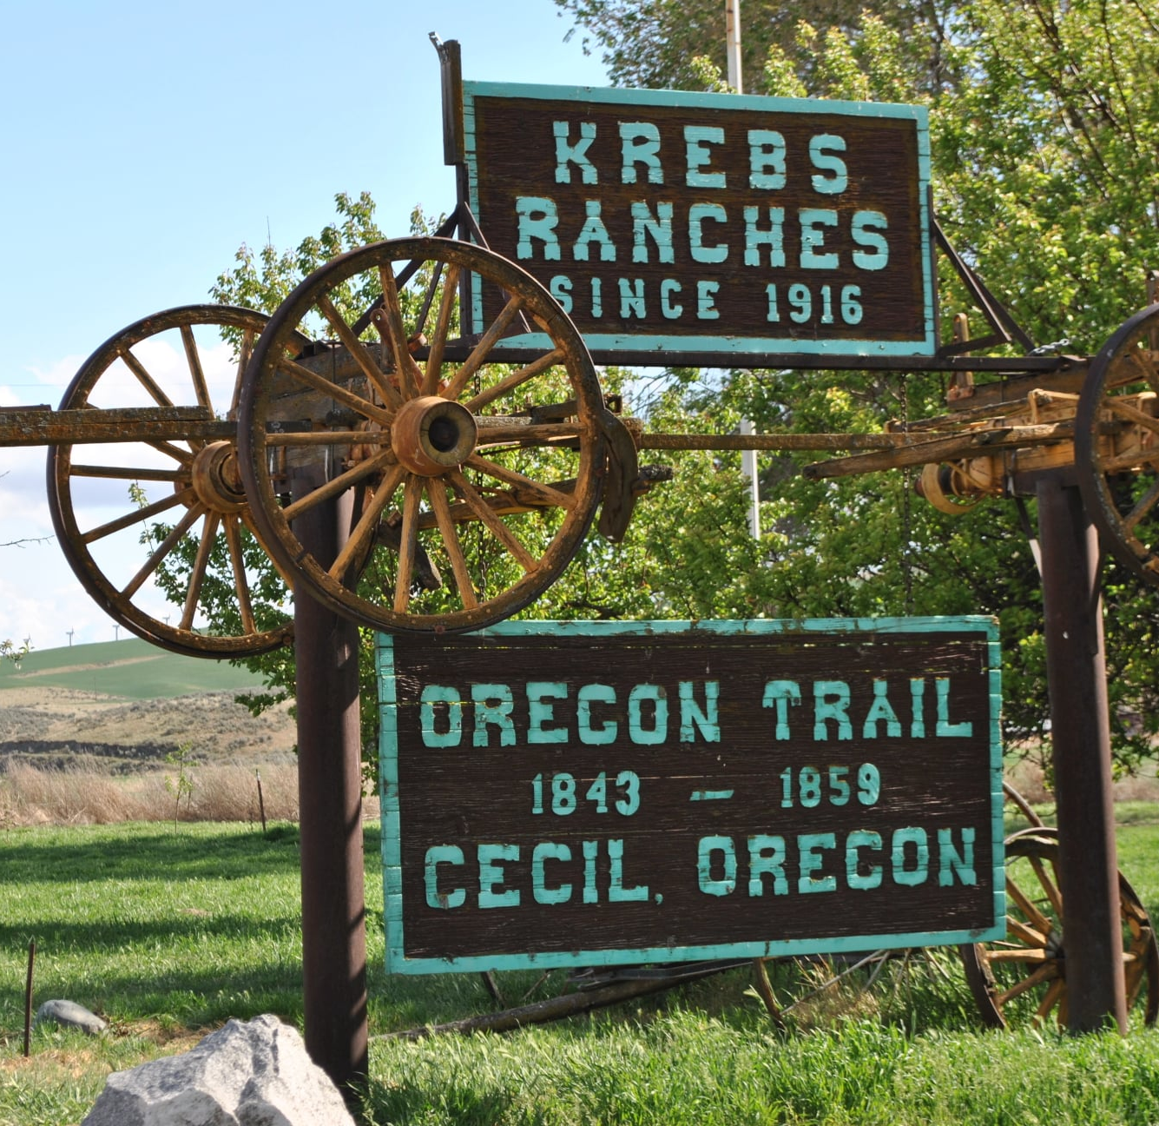
Project Partners
Alderspring Ranch
Glenn Elzinga
Rancher, Ecologist
Krebs Livestock
Cameron Krebs
Rancher
USDA A.P.H.I.S.
Stuart Breck
Wildlife Biologist
Source: westernlandowners.com
Source: Facebook
Source: USDA APHIS
Notes:
Alderspring
Began night penning in 2015
$40,000 in damages from predation
Had successes with night penning, and saw significant pasture recovery within as little as 2 years post night penning
Krebs
Began night penning at this allotment in 2017, but had been night penning for coyotes since 2009
Utilizes similar approaches to Alderspring ranch
USDA APHIS
Animal & Plant Health Inspection Service (A.P.H.I.S.)
Researcher for wildlife services agency
Works on developing non-lethal approaches to predator management
------------------------------Image Information & Citations Below ------------------------------
Western Landowners Alliance. (n.d.). https://westernlandowners.org/alderspring-ranch-idaho-an-excerpt/
Used with Partner Permission
USDA aphis: Social Media, blogs and e-mail. USDA APHIS | Social Media, Blogs and E-Mail. (n.d.). https://www.aphis.usda.gov/aphis/resources/pests-diseases/hungry-pests/partner%20tools/social-media
Log into Facebook. Facebook. (n.d.). https://www.facebook.com/photo/?fbid=485456219523612&set=pcb.485459852856582
Used with Partner Permission

Slide 6
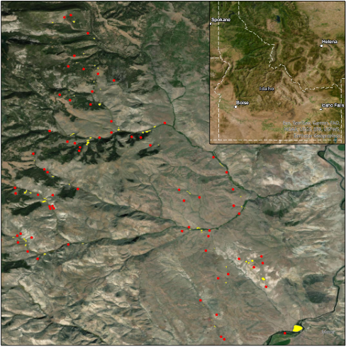
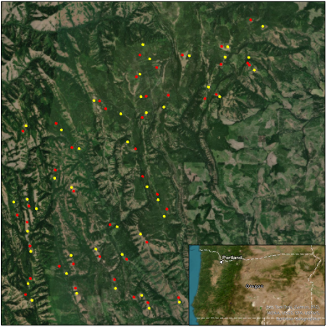
Study Area
Alderspring Ranch
Krebs Livestock
Study Period:
2000 – 2023
Alderspring Control Points
Krebs Night Pens
Alderspring Night Pens
Krebs Control Points
Source: Esri, Maxar, Earthstar Geographics, Esri GIS User Community
Notes:
Krebs (sites on map are enlarged for regerence from 165 ft diameter to 200 m diameter)
Grazing on USFS allotment
Sites feature intense electric fencing at night
Sites picked based on
Defendable spaces
Proximity to camps
Sites are commonly placed on old logging decks
Alderspring
Grazing on USFS allotment
Night penning sights are chosen based on
Near water
Removing thick Sagebrush to get snow back on the ground
Areas with weedy species such as non native mustards
------------------------------Image Information & Citations Below ------------------------------
Basemap Citation: ArcGIS Pro

Slide 7
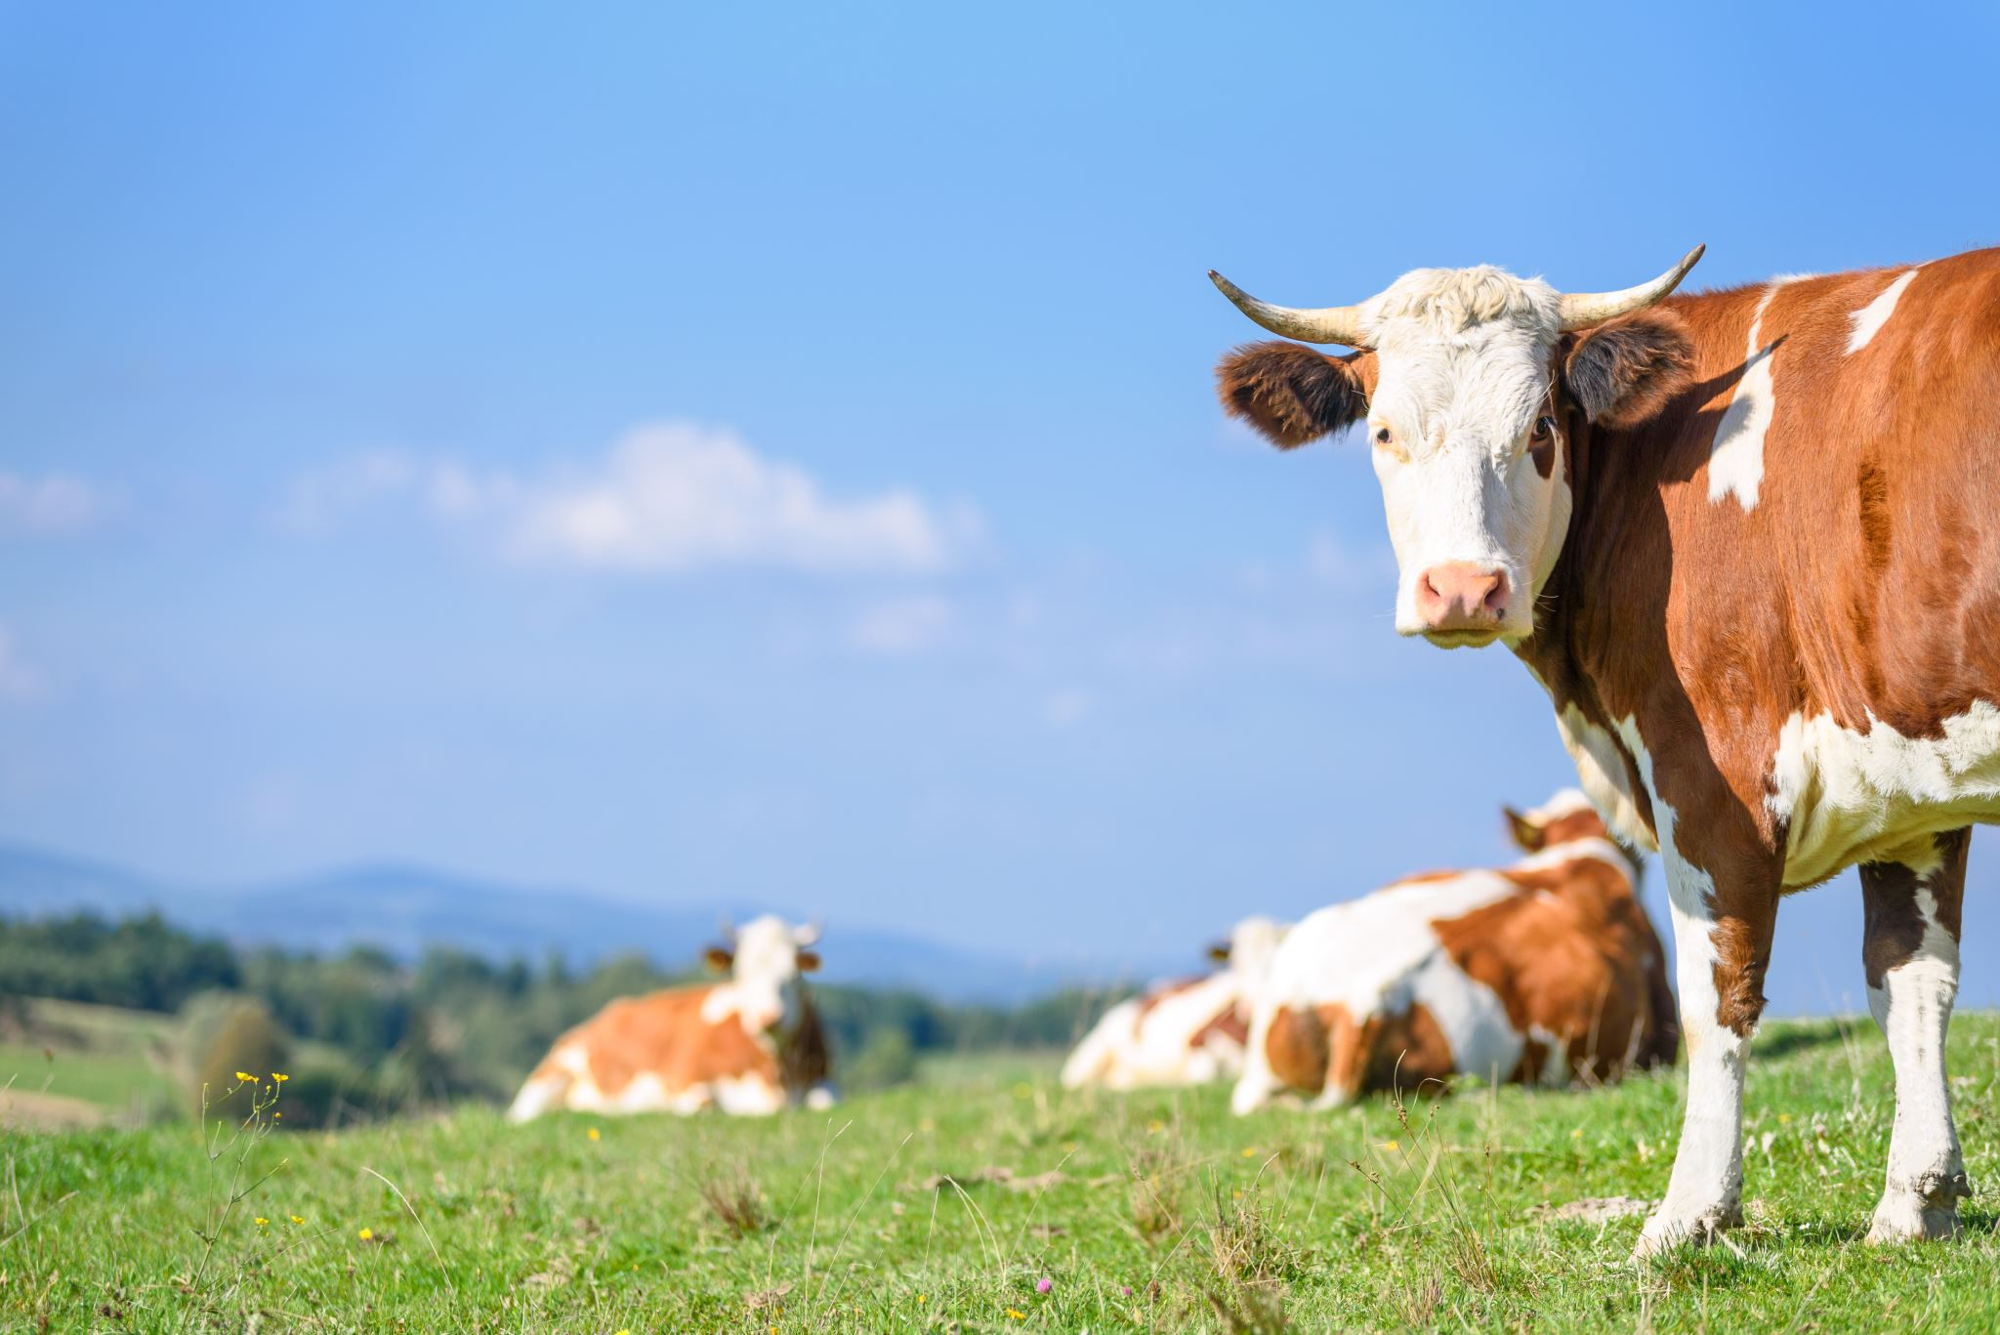
Project Objectives
1. Select control sites that capture topographic characteristics of night pen sites.
2. Quantify and compare changes in vegetation characteristics between night pen and control sites.
Notes:
To begin, our project's objectives were largely focused around selecting control sites that capture topographic characteristics at night penning sites. Initially, we named characteristics that were important to keep consistent when it came to identifying controls- these included Tree Canopy Cover (which was confirmed using NAIP Imagery), Aspect, Slope, Elevation, Disturbance History, minimum and maximum distance from the night penning site and vegetation type. As we dealt with the DEM dataset we had to work with the resolution we were provided (30m) and feedback from partners to adjust our selection criteria. The selection process took quite some time, since we had to reselect several sites as our work flow improved over the course of this process.
After we confirmed that adequate Control sites had been selected we were able to run analysis in R, from outputs that we exported from GEE to quantify and compare the changes in vegetation characteristics between 'night pen' and 'control sites. Initially, we were concerned with comparing both Net Primary Productivity (NPP) and %Cover (data we exported from the Rangeland Analysis Platform), but to fit the scope of our study – we ended up only comparing the NPP between the night pen and control sites.
------------------------------Image Information & Citations Below ------------------------------
Image Citation: Stock Image, Microsoft

Slide 8
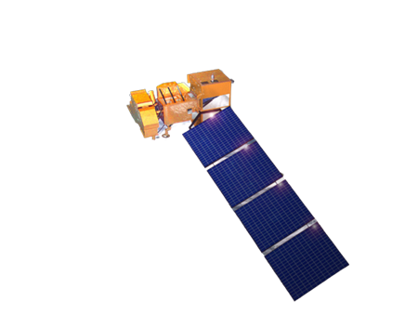
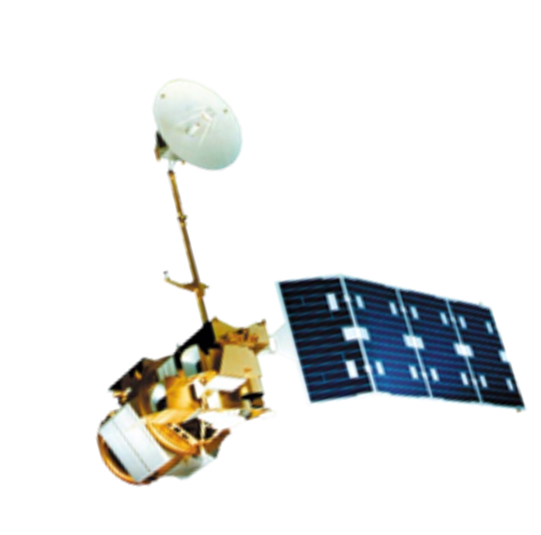
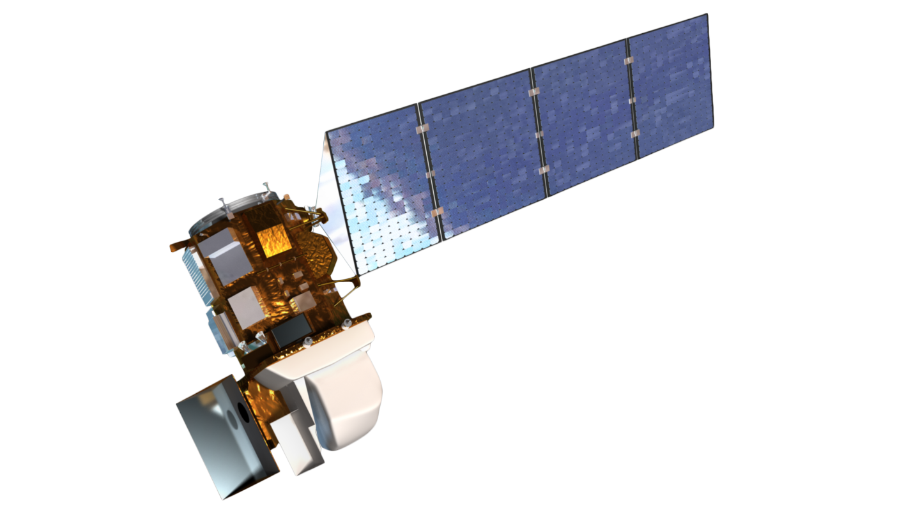
Sensors
Spectral Indices
(Red, Green & Blue)
Landsat 7 ETM
Continuous Vegetation Cover
Landsat 5 TM
Net Primary Productivity (NPP)
Landsat 8 OLI
Notes:
For this project, we utilized three different satellites and sensors. The Landsat 5 Thematic mapper, Landsat 7 Enhanced Thematic Mapper plus, and the Landsat 8 Operational Land Imager. We used these sensors to collect our different observation variables. Those observation variables are spectral indices based off of the red, green, and blue bands, Continuous vegetation cover, and net primary productivity based off of the rangeland analysis platform.
------------------------------Image Information & Citations Below ------------------------------
Landsat 5 TM, public domain: https://www.usgs.gov/media/images/desert-forest
Landsat 7 ETM Image Credit, public domain: https://landsat.gsfc.nasa.gov/article/successful-maneuver-spells-beginning-of-the-end-for-landsat-7/
Landsat 8 OLI Image Credit, public domain: https://landsat.gsfc.nasa.gov/article/landsat-data-continuity-mission/

Slide 9
Software
ArcGIS
RAP
GEE
R
Data Inputs:
DEM (Digital Elevation Model)
Outputs:
CTI (Compound Topographic Index)
HLI (Heat Load Index)
Data Inputs:
Landsat 5-8 Data
Outputs:
Net Primary Productivity (NPP)
Data Inputs:
Night-pen Site Polygons
NPP Dataset
CTI, HLI, Aspect
NAIP Imagery
Outputs:
Average NPP for night-penning sites
Control Sites
Data Inputs:
Outputs from GEE
Outputs:
Time series
Data distribution of vegetation response
Notes:
Here are the different software platforms that the team used for our analysis. In ArcGIS Pro, we input a digital elevation model and derived variables such as the compound topographic index which measures the water flow and accumulation and the heat load index, which is a measure of incident solar radiation. We downloaded our Landsat data from the rangeland analysis platform or RAP. The platform shows per-pixel percent cover of annual forbs and grasses, perennial forbs and grasses, shrubs, and bare ground over the western United States from 1984 to 2017.
This gave us net primary productivity or NPP data. This data shows the amount of energy produced by plant groups minus the amount of energy they expend, and is a good indicator of how productive plant groups are. We used NPP for 4 vegetation groups – perennial forbs and grasses, annual forbs and grasses, shrubs and trees.
In Google Earth Engine, we inputted shapefiles of the known night pen locations as well as rasters for our other variables. We also accessed high resolution NAIP imagery from GEE. We exported the average NPP for each of the night-penning sites as well as the control sites and input them into R Studio. Finally, we conducted our statistical analysis in R.
RAP- Rangeland Analysis Platform.
GEE- Google Earth Engine

Slide 10
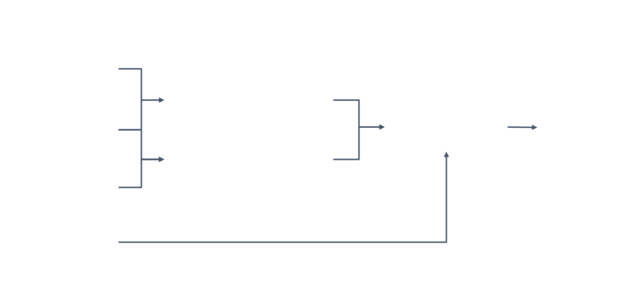
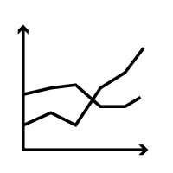
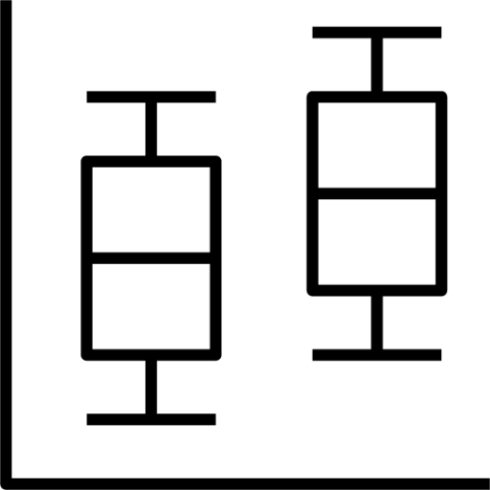
Methodology
Input Data
Data Processing
Data Analysis
Night Pen Polygons
Validate Night Pen Locations
Summarize NPP Data
NAIP
Identify Control Site Locations
CTI, HLI
RAP
Notes:
The field data that was acquired from our partners (Alderspring Ranch- Polygons & Krebs Livestock-points) were imported into ArcGIS, We then created 165ft diameters around the point data to represent the area of the night-pens.
We used Google Earth Engine (GEE) to access aerial imagery for the study sites from National Agriculture Imagery Program (NAIP) dataset. NAIP 2022 for Krebs study sites, and 2021 for Alderspring. Night Pen sites were validated using NAIP imagery
We downloaded 1 arc-second (~30m) digital elevation models (DEM) from the National Map Viewer (USGS) for two distinct regions covering our study sites. DEM Data Includes HLI (Heat Load Index), CTI (Compound Topographic Index), Slope, Aspect & Elevation
NAIP was used in combination with CTI, HLI to identify control locations, and then ground validated by partners.
Night pen and control polygons were pulled into GEE. RAP NPP was accessed through GEE. NPP was summarized for both Night Pen and Control sites and exported as csv for analysis.
------------------------------Image Information & Citations Below ------------------------------
Boxplot Icon : https://iconduck.com/icons/10209/box-plot
Timeseries Icons: https://thenounproject.com/browse/icons/term/time-series/

Slide 11
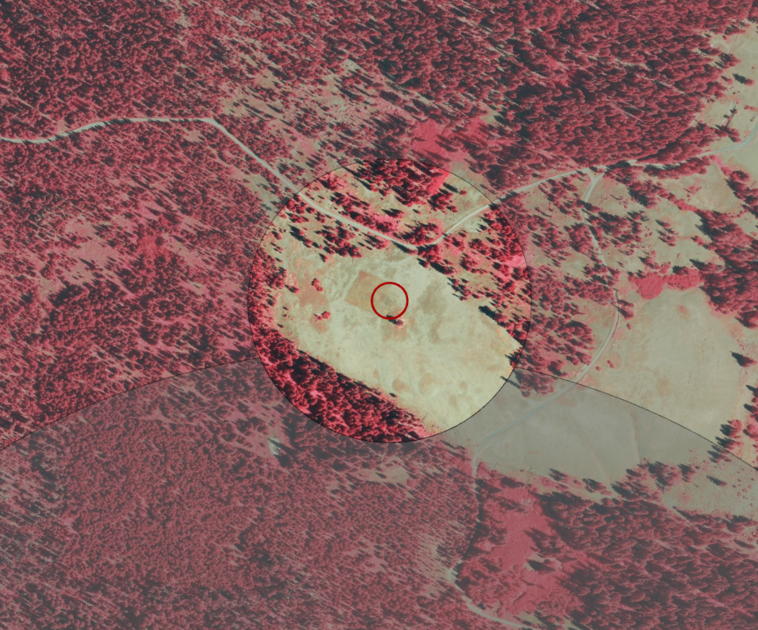
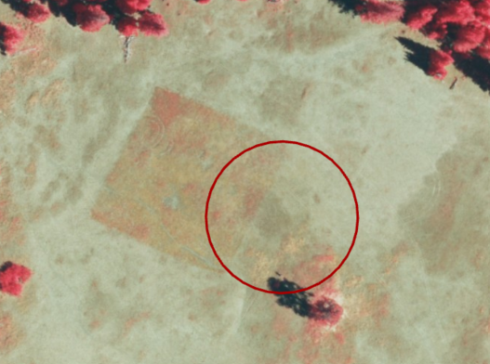
Night Pen Site Validation
Displayed using NAIP Imagery in Infared
Night pen locations were co-validated with partners using NAIP imagery.
NAIP Validation Of Night Pen
Night Pen GPS Location
NAIP Imagery showing night pen site based on field coordinates (red circle), and actual Night-Pen Site (square).
Notes:
To validate the night pen locations, the team met with partners. We used high resolution NAIP imagery and zoomed in on the provided night pen GPS locations to identify areas of vegetation where coloration differences in the size of true night-pens indicated real sites, these areas were confirmed alongside partners who were able to validate the areas from previous knowledge of having visited these sites.
For the Krebs night-penning locations, one GPS point was dropped on the edge of the night penning site, meaning that sometimes our aggregation of the night-pen buffer did not represent the true night penning area. After consulting with Cameron Krebs, we ended up moving 8 night penning locations. We also found that some night-pen areas actually included several different night penning sites that had been used at different periods of time.
The Images provided show a very clear example of an aggregated night pen location based on the provided GPS coordinate, and the true night-penning location.
------------------------------Image Information & Citations Below ------------------------------
Image(s) Citation: National Agriculture Imagery Program Dataset, displayed in Google Earth Engine (GEE) in Infared – Bands ('N','R','G')

Slide 12
Control Site Selection
Displayed using NAIP Imagery in Infared
Control sites were identified using topographic indices and NAIP imagery.
Partners provided ground truthing of selected control sites.
Night Pen Site
Control Site
NAIP Imagery showing night pen site (red circle) and corresponding control site (yellow circle). The darker gray areas indicate the buffer zone (200- 1000m) used for initial control site selection.
Notes:
The Night-Penning Site (Red Circle) is Kreb's Looking Glass Camp 1, given to us as a single GPS location and displayed with a 165ft diameter to account for the area of the whole night penning site.
We created additional buffers around the night pen sites to select for control sites that were 200meters-1000 meters away from the coordinate points (the center of the night pens). Within those buffer regions we toggled between Slope, CTI, HLI, and NAIP as a final comparison (Canopy Cover) to select Control Sites that met and shared similar characteristics.
Project partners mentioned impacts from ingress/egress and did a second run through to ensure control sites were not located in areas of high impacts, and that our methods for sorting through topographic characteristics matched their knowledge of the landscape.
------------------------------Image Information & Citations Below ------------------------------
Image Citation: National Agriculture Imagery Program Dataset, displayed in Google Earth Engine (GEE) in Infared – Bands ('N','R','G')

Slide 13
Data Analysis
Night Pen & Control Polygons
RAP NPP Data (2000 – 2023)
Annual NPP for Study Sites
Notes:
The night pen and control site polygons were pulled into GEE. The polygons covered multiple RAP pixels. We used GEE to summarize the RAP pixel values within each polygon to obtain the mean value of NPP within each polygon. This gave us the Annual NPP at each site between 2000 and 2023. The were exported as csv for analysis in R.
------------------------------Image Information & Citations Below ------------------------------
Plus, and arrow icons: Powerpoint smart art

Slide 14
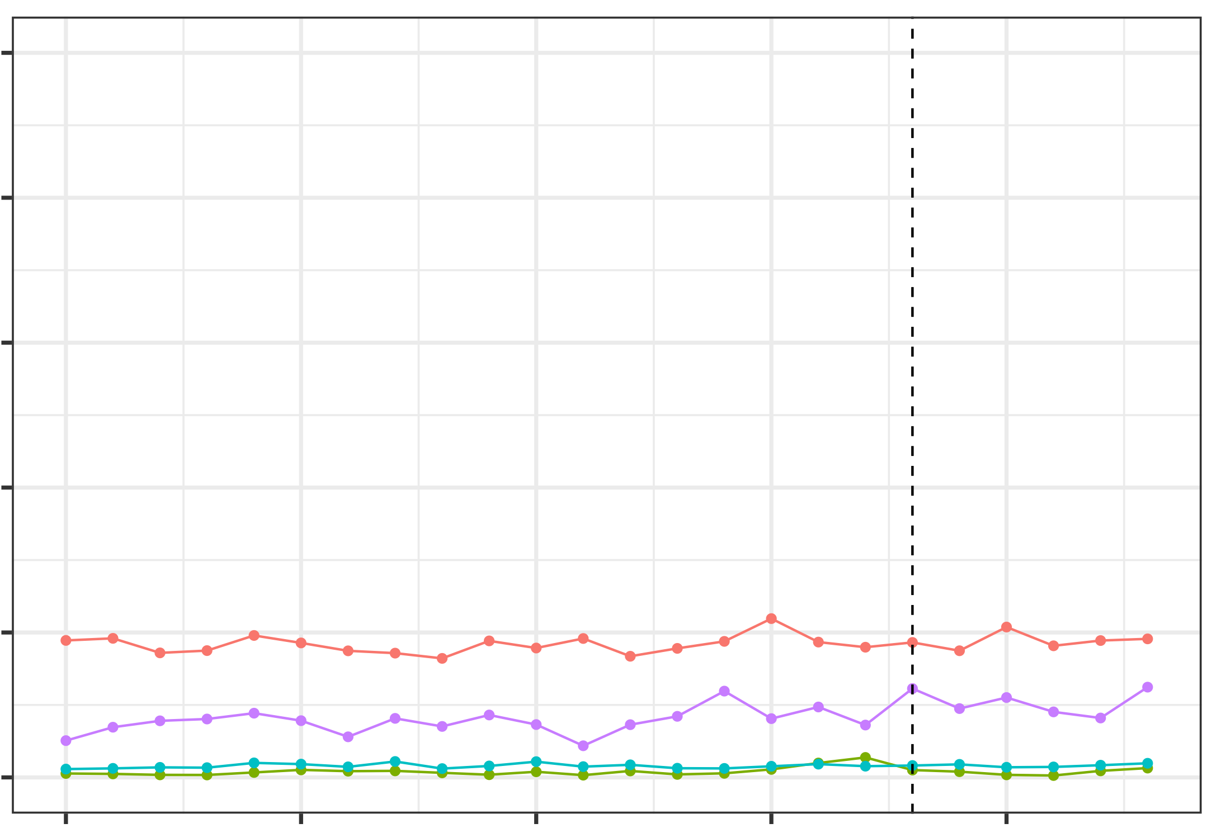
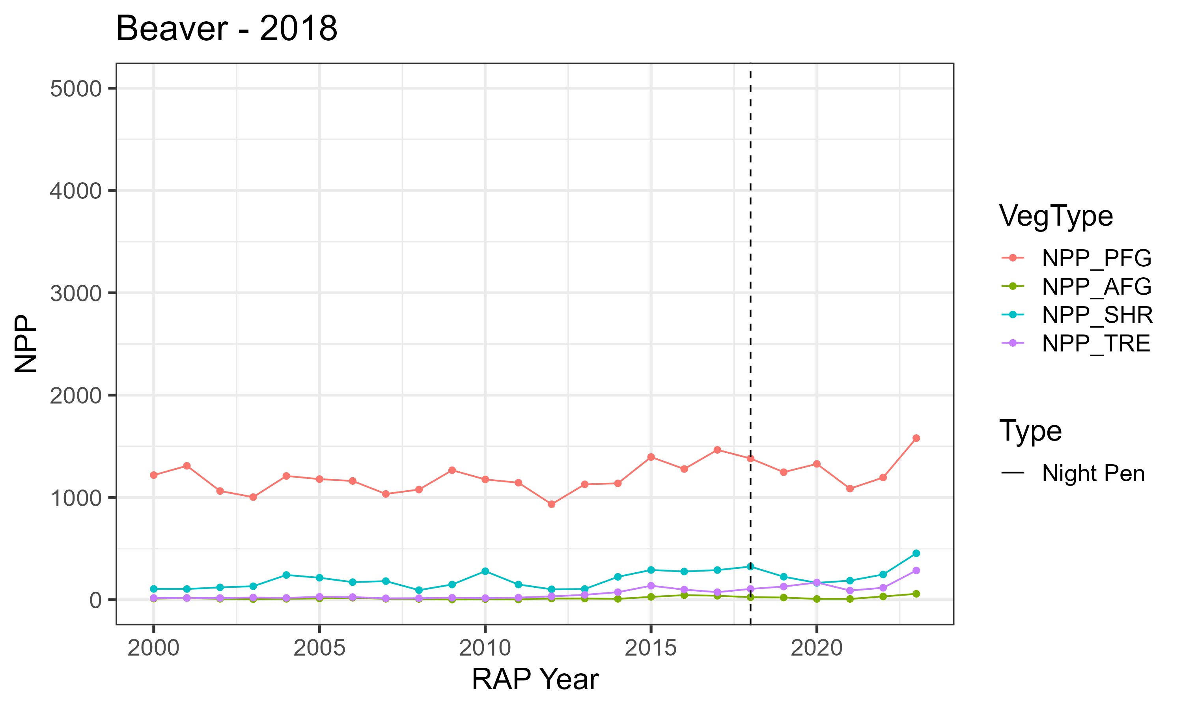
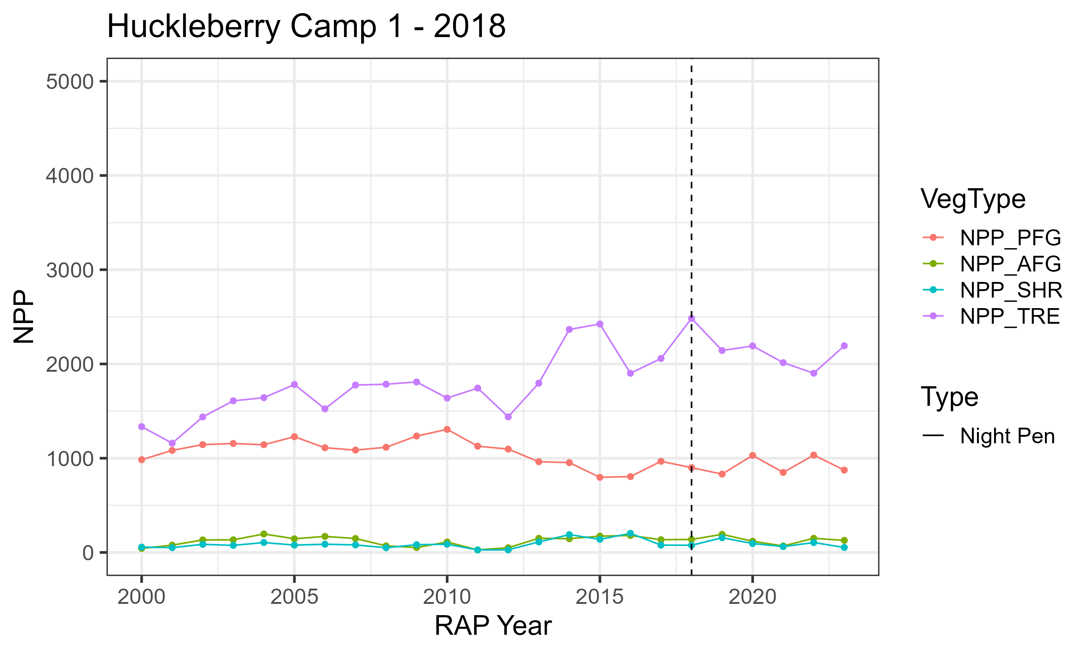
Result: NPP Timeseries
5000
ID Site 1- 2018
ID Site 2 - 2018
4000
3000
2000
Perennial Forbs & Grasses
1000
Annual Forbs & Grasses
NPP (lbs/acre)
Shrubs
0
Trees
5000
OR Site 1 - 2017
OR Site 2 - 2018
Night Penning Year
4000
3000
2000
1000
0
2000
2005
2010
2015
2020
2000
2005
2010
2015
2020
Notes:
We had about 100 night pen sites across the two landbases. Here is an example of NPP trends at 4 different Night Penning sites. Two are from Idaho and two from Oregon. On the y-axis is the NPP in lbs/acre. On the x-axis is time. The different colored lines show NPP for different vegetation groups – perennial forbs and grasses, annual forbs and grasses, shrubs and trees. The vertical dashed line, is the year the night pen was placed.

Slide 15
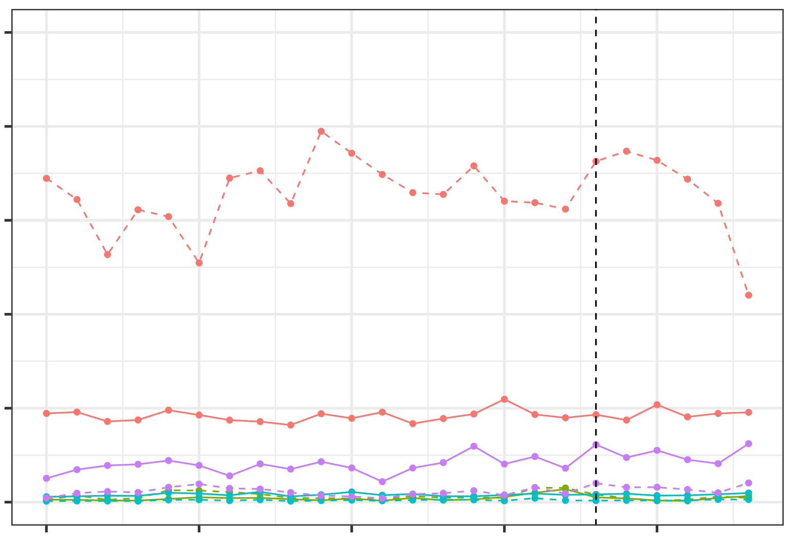
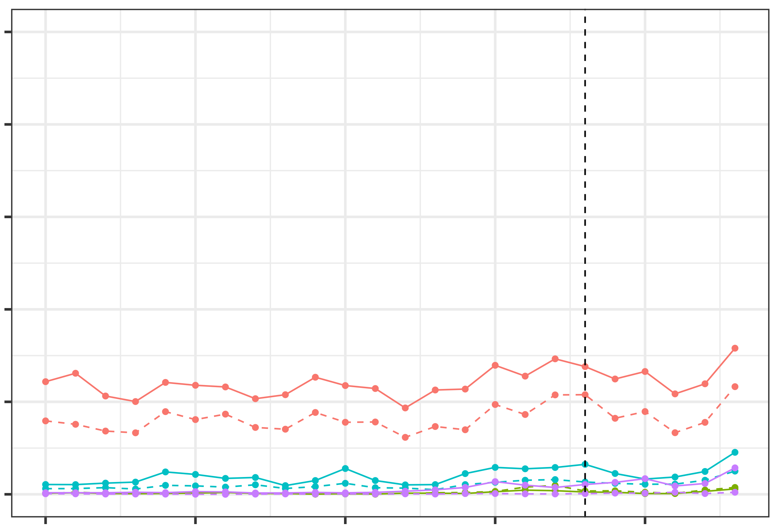
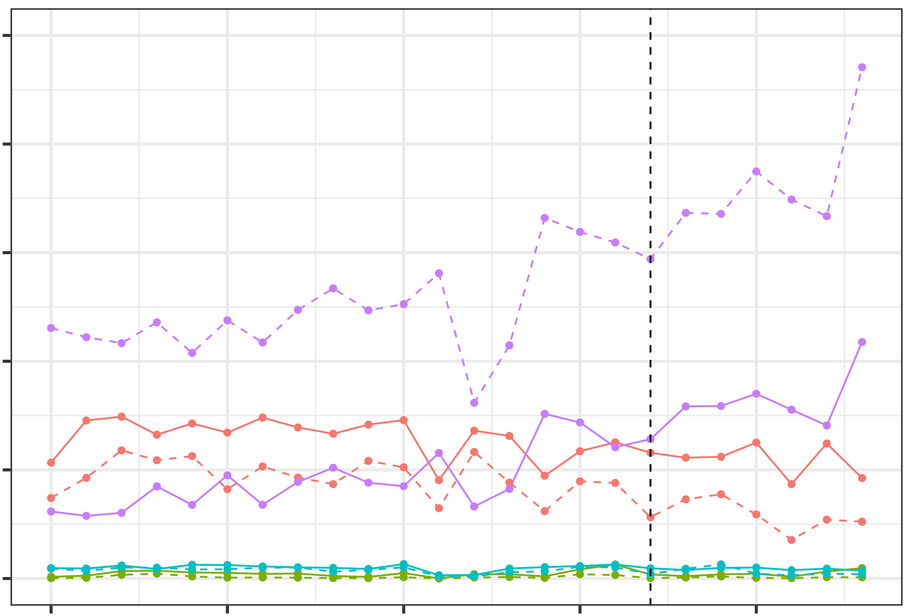
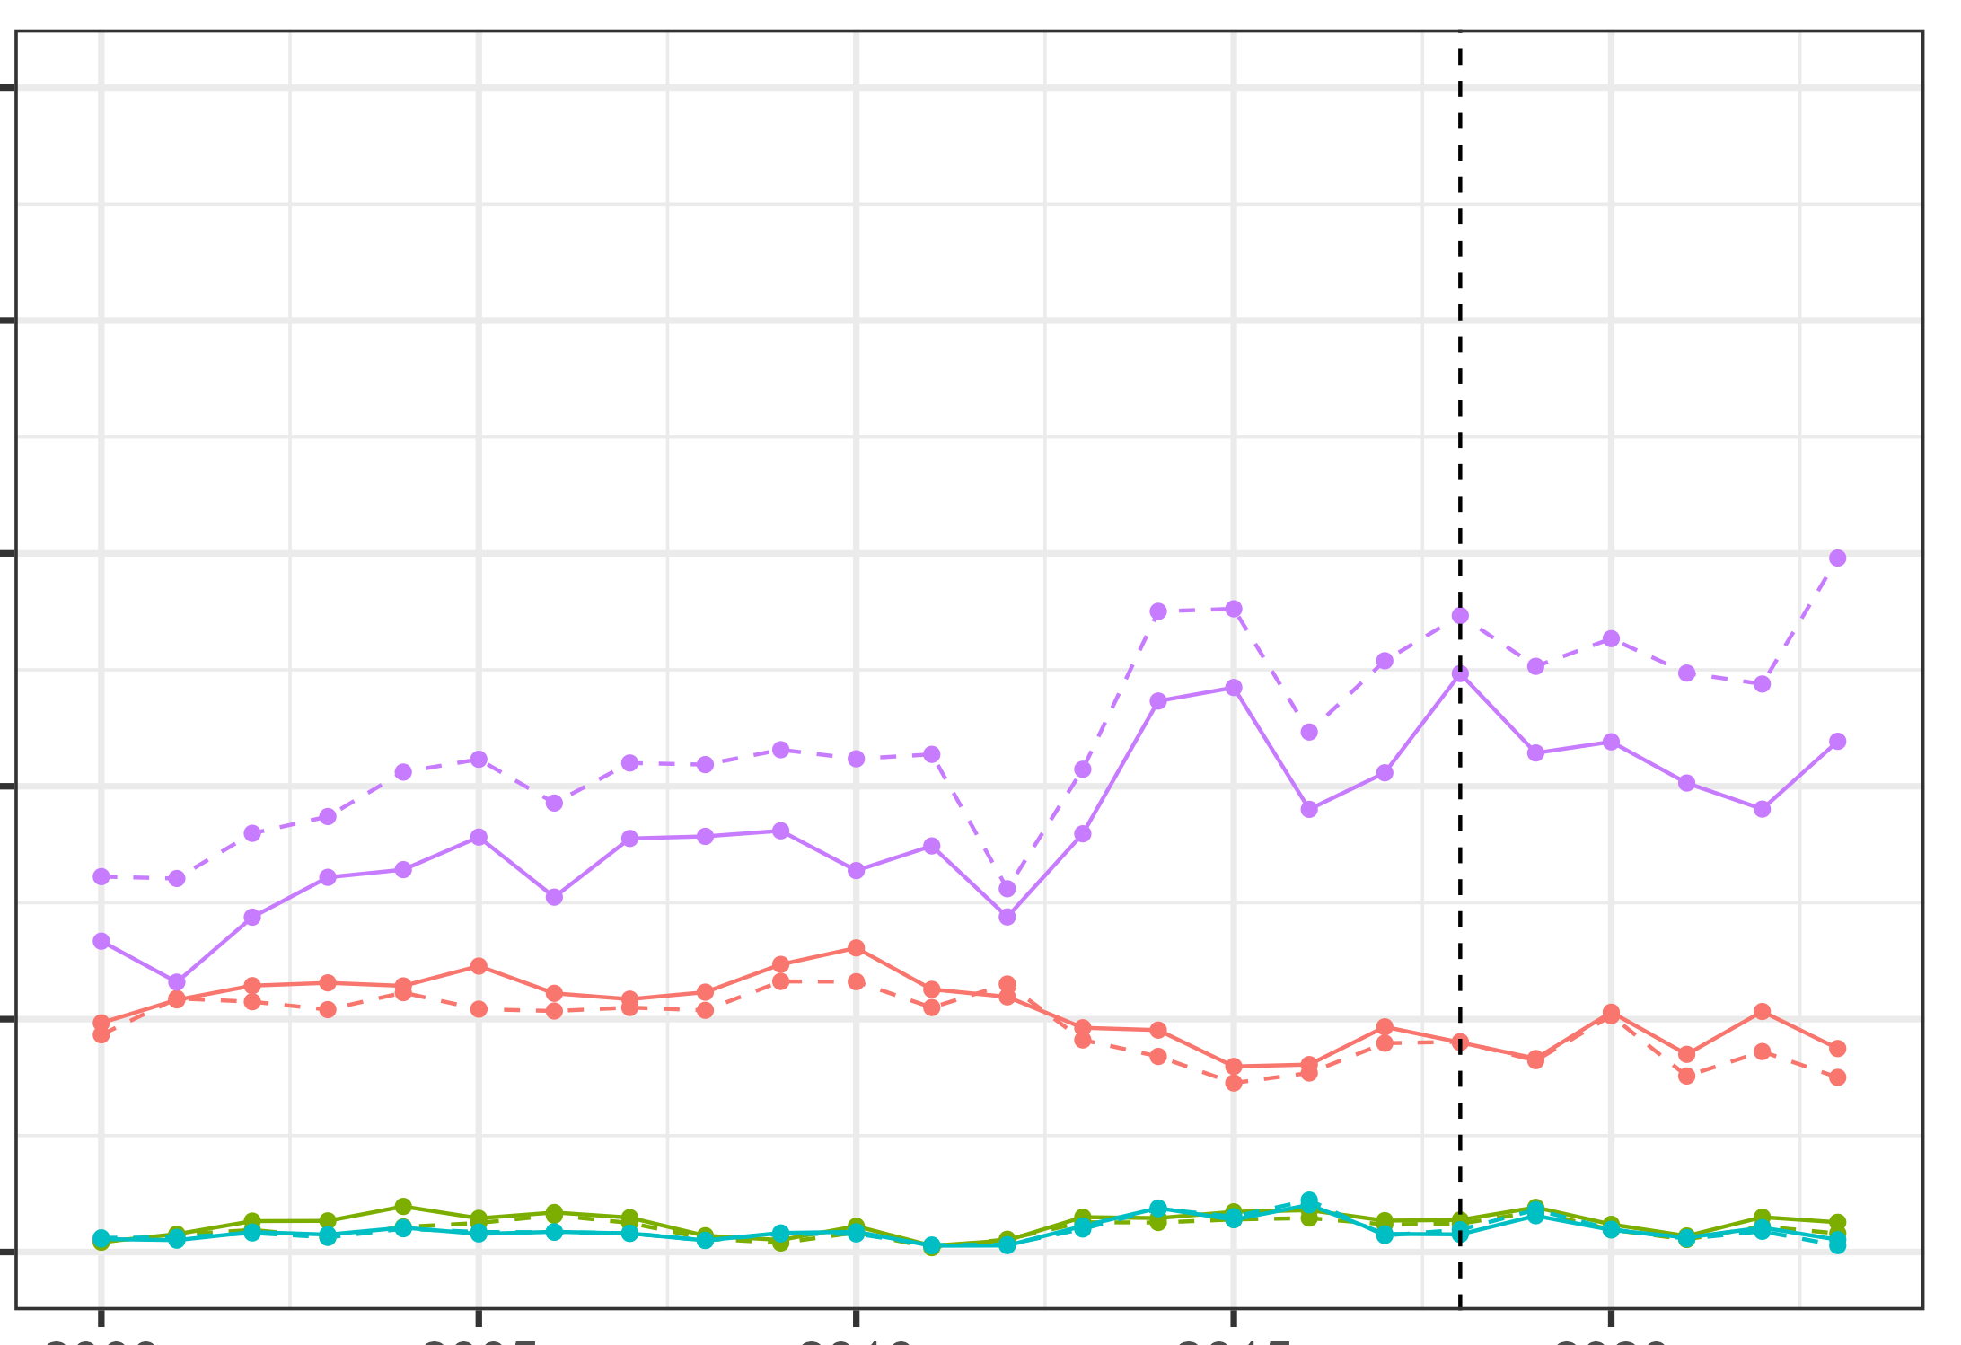
Result: NPP Timeseries
5000
ID Site 1 - 2018
ID Site 2 - 2018
4000
3000
2000
Perennial Forbs & Grasses
1000
Annual Forbs & Grasses
0
Shrubs
NPP (lbs/acre)
Trees
5000
OR Site 1 - 2017
OR Site 2 - 2018
Night Penning Year
4000
Control
Night Pen
3000
2000
1000
0
2000
2005
2010
2015
2020
2000
2005
2010
2015
2020
Notes:
We pulled in control site NPP timeseries. The difference in NPP trends for control and night pen locations varied between sites. For example, at ID Site 1 - Perennial Forbs and Grasses were more productive, and varied in their annual trend between Control and Night Pen Sites. However, this was not the case at ID Site 2. Similarly, for Oregon – we can see that Site 1 had differences in perennial forbs and grass production and trends, whereas Site 2 the control and night pen were quite similar.
To further assess the trends across all night pen and control sites, we quantified the distribution of NPP response across all sites.

Slide 16
Data Analysis
Analysis Timeframes
Baseline
Five Years Before Night Pen Was First Placed
Penning Year
First Year Night Pen Was Placed
Year One
One Year After Night Penning
Year Two
Two Years After Night Penning
Year Three
Three Years After Night Penning
NPP (Response Year)
100
NPP (Baseline Year)
Response Years
Notes:
To further assess the impacts of night penning we quantified the relative value of NPP for each vegetation group, on the year night pen was placed, and 1-3 years after penning, to a baseline period. Baseline period was identified as 5 years before the first year a night pen was placed.

Slide 17
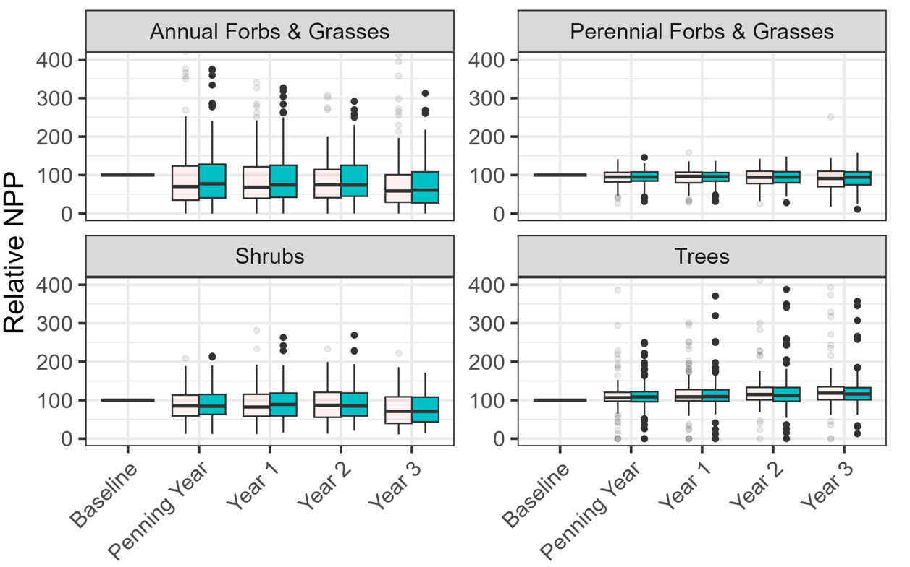
Result: Relative NPP Distribution
Notes:
Explain chart
One subplot per vegetation type
Y axis – relative NPP
X axis – time frames of analysis
Control in white, Night pen in blue
This chart has a limited y-scale to remove outliers
No discernable differences between control and night pen sites

Slide 18
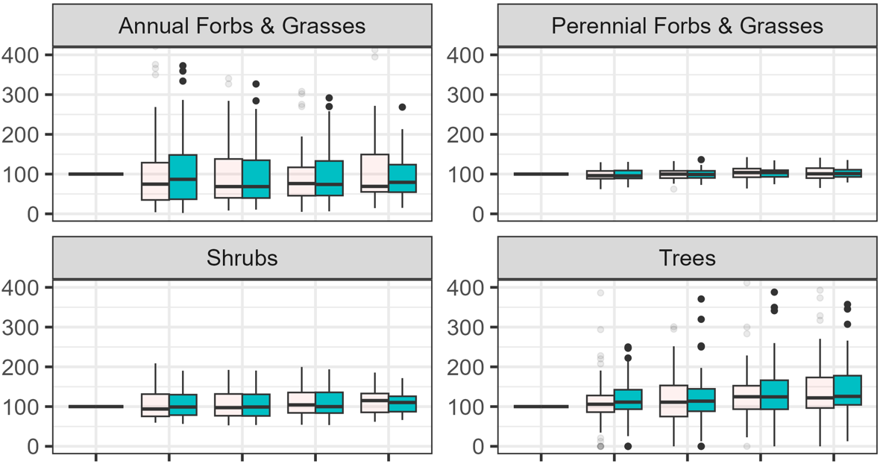
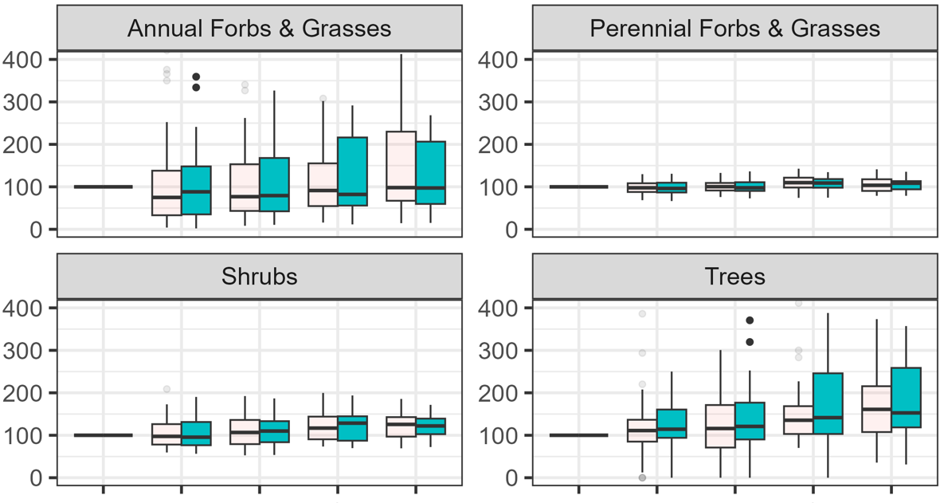
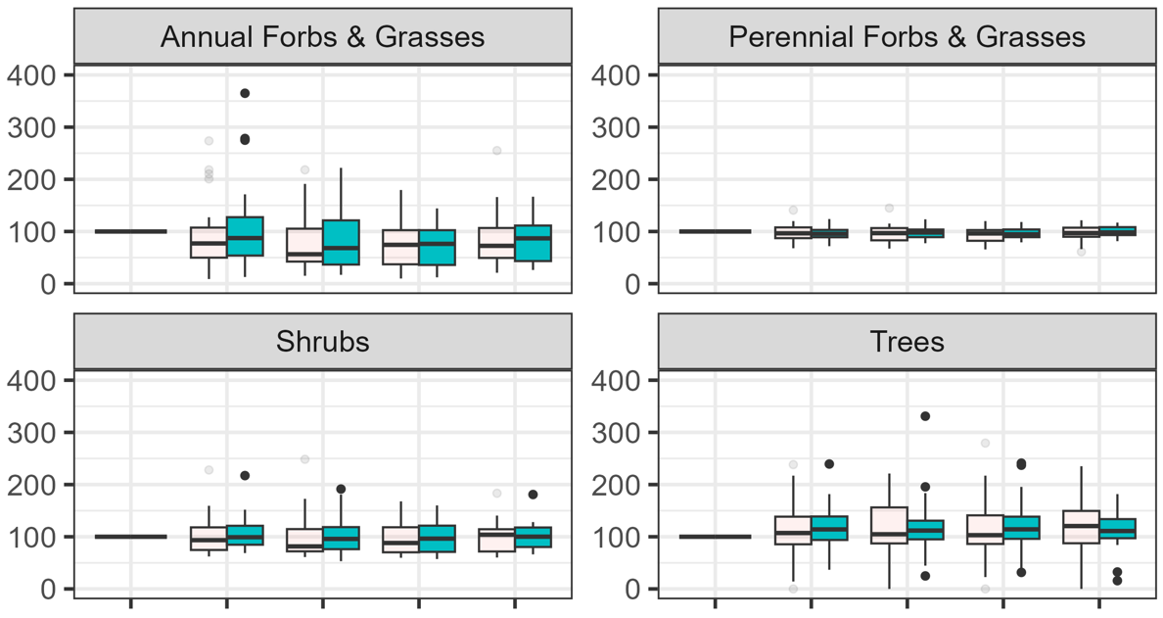
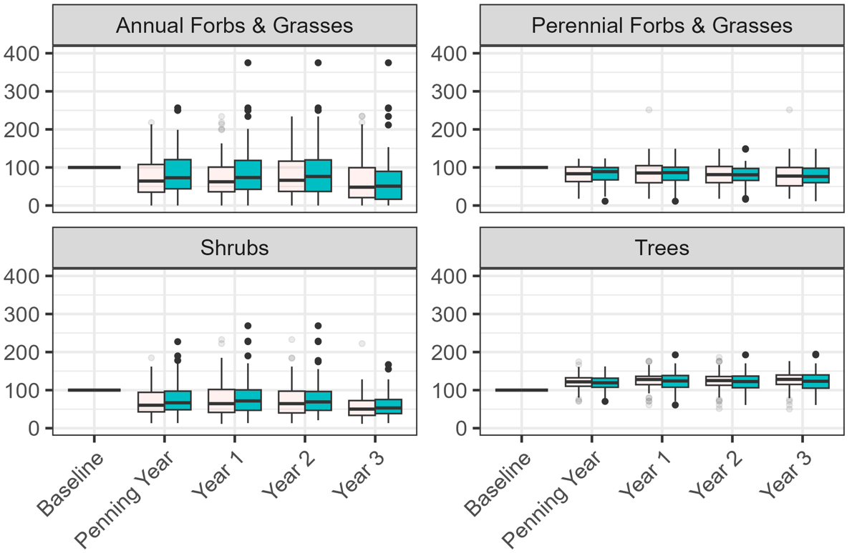
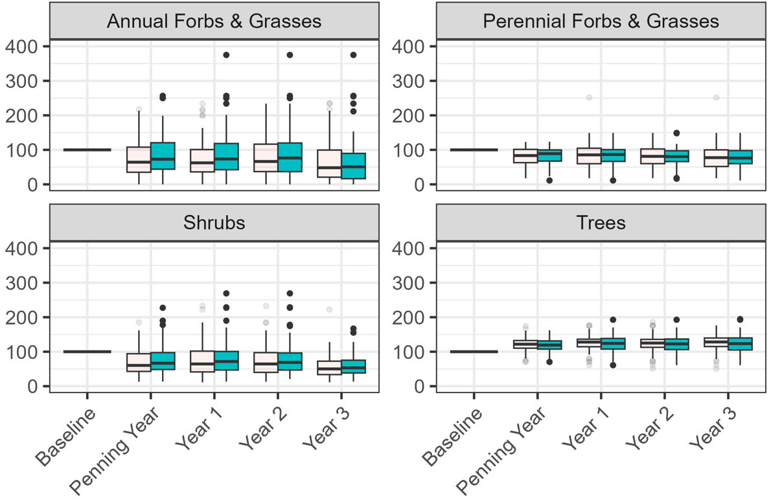
Result: Relative NPP Distribution
All Use
Single Year Use
Multi-Year Use
Idaho
Oregon
Notes:
Explain chart
We did a deeper diver by location and number of times a site was used.
Rows – Idaho and Oregon
Columns – How many times a site was used.
We had some trouble accessing data for certain sites that fell within one-time use category (gray box)
No discernable difference in Control vs NIght Pen

Slide 19
Conclusions
Vegetation group NPP was observed to respond differently across different night pen sites.
However, no differences were observed between Night Pen and Control sites.
Using remote sensing to track vegetation response is promising, but resolution limitations need to be addressed.
Notes:
We saw some variability across night pen sites in how the NPP of vegetation groups (perennial forbs, grasses; annual forbs, grasses; tree; shrubs) changed after night penning.
However, we did not observe differences between the Control and Night Pen sites in change in NPP from before, during, and after night penning, and hence, we did not find that the practice of night penning impacted vegetation.
This supports the findings from the Jablonski report that quantified night pen impacts on vegetation using randomly selected control locations, and found that Night Pennig did not impact vegetation.
While our project did not find evidence to support that night pen impacts vegetation response, this is in no way a conclusive finding. Our project was a feasibility study that used a control-treatment comparison, of one remote sensing derived parameter. We believe that remote sensing is a valuable tool to track vegetation response, however, it is essential to address spatial and temporal limitations. (Continue to errors and uncertainties)
------------------------------Image Information & Citations Below ------------------------------
Boxplot Icon : https://iconduck.com/icons/10209/box-plot
Plant Icon: Powerpoint Icon

Slide 20
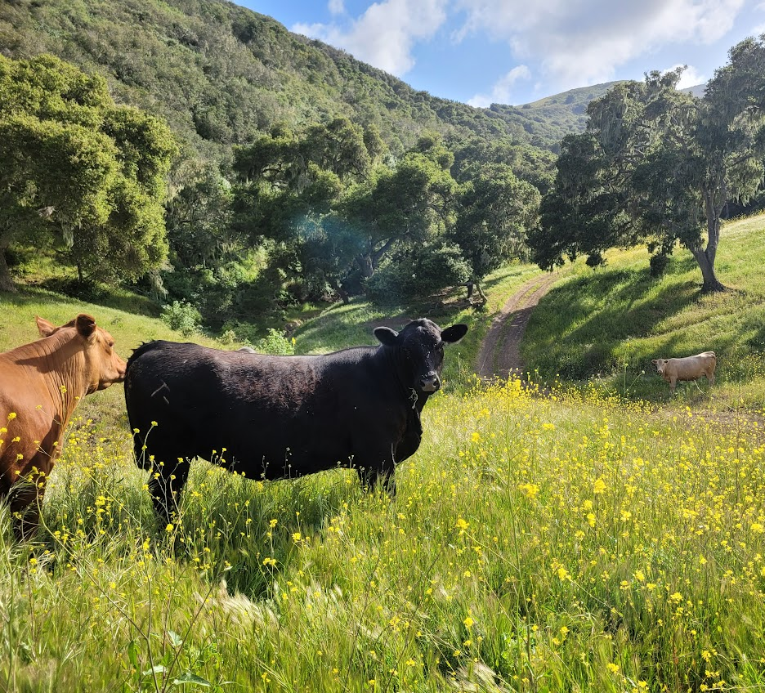
Uncertainties and Errors
Vegetation Mismatch
Night Pens Used Multiple Times
Uncertain Land Use
Data Summarization
Source: Aarushi Jhatro
Notes:
Vegetation Mismatch: the RAP vegetation composition and on-the ground vegetation composition did not always match up.
Night Pen Multiple Use: Due to time constraints we were unable to do a deep dive into the impacts of multiple use of a night pen site on vegetation response. Specifically, if a night pen was placed at the same place for multiple years, how did that impact vegetation response.
Uncertain Landuse: Rock quarries and previous logging disturbances were not identified, and night pens are sometimes placed on previously disturbed sites, to avoid impact on vegetation. Such sites were not identified and flagged, and hence, might add uncertainty to our study.
Data Summarization: We ran into some glitches with summarizing and pulling data for some sites. While these sites were dropped from the analysis, these might add uncertainty to our control vs treatment comparison.
------------------------------Image Information & Citations Below ------------------------------
Question Icon: Powerpoint Icon
Image: Aarushi Jhatro

Slide 21
Future Work
Validate vegetation composition at sites through field work.
Quantify vegetation response on a finer temporal resolution.
Assess vegetation response through alternate parameters such as NDVI.
Notes:
------------------------------Image Information & Citations Below ------------------------------
Plant, Clock & Search Icon: Powerpoint Icons

Slide 22
Fellow
Truman Anarella
Partners
Glenn Elzinga (Alderspring Ranch)
Cameron Krebs (Krebs Livestock)
Stuart Breck (U.S. Department of Agriculture, Animal & Plant Health Inspection Service, National Wildlife Research Center)
Science Advisors
Nicholas Young
Dr. Anthony Vorster
Dr. Catherine Jarnevich
Dr. Paul Evangelista
Christopher Tsz Hin Choi

Slide 23
SUPPORTING SLIDES:

Slide 24
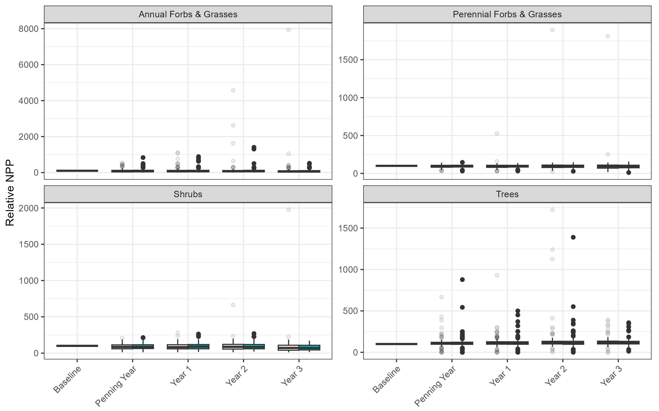
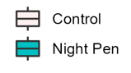
Results
Relative NPP Distribution With Outliers
Notes:
No visible differences between vegetation response through time for Night Pen and Control Polygons.

