Slide 1
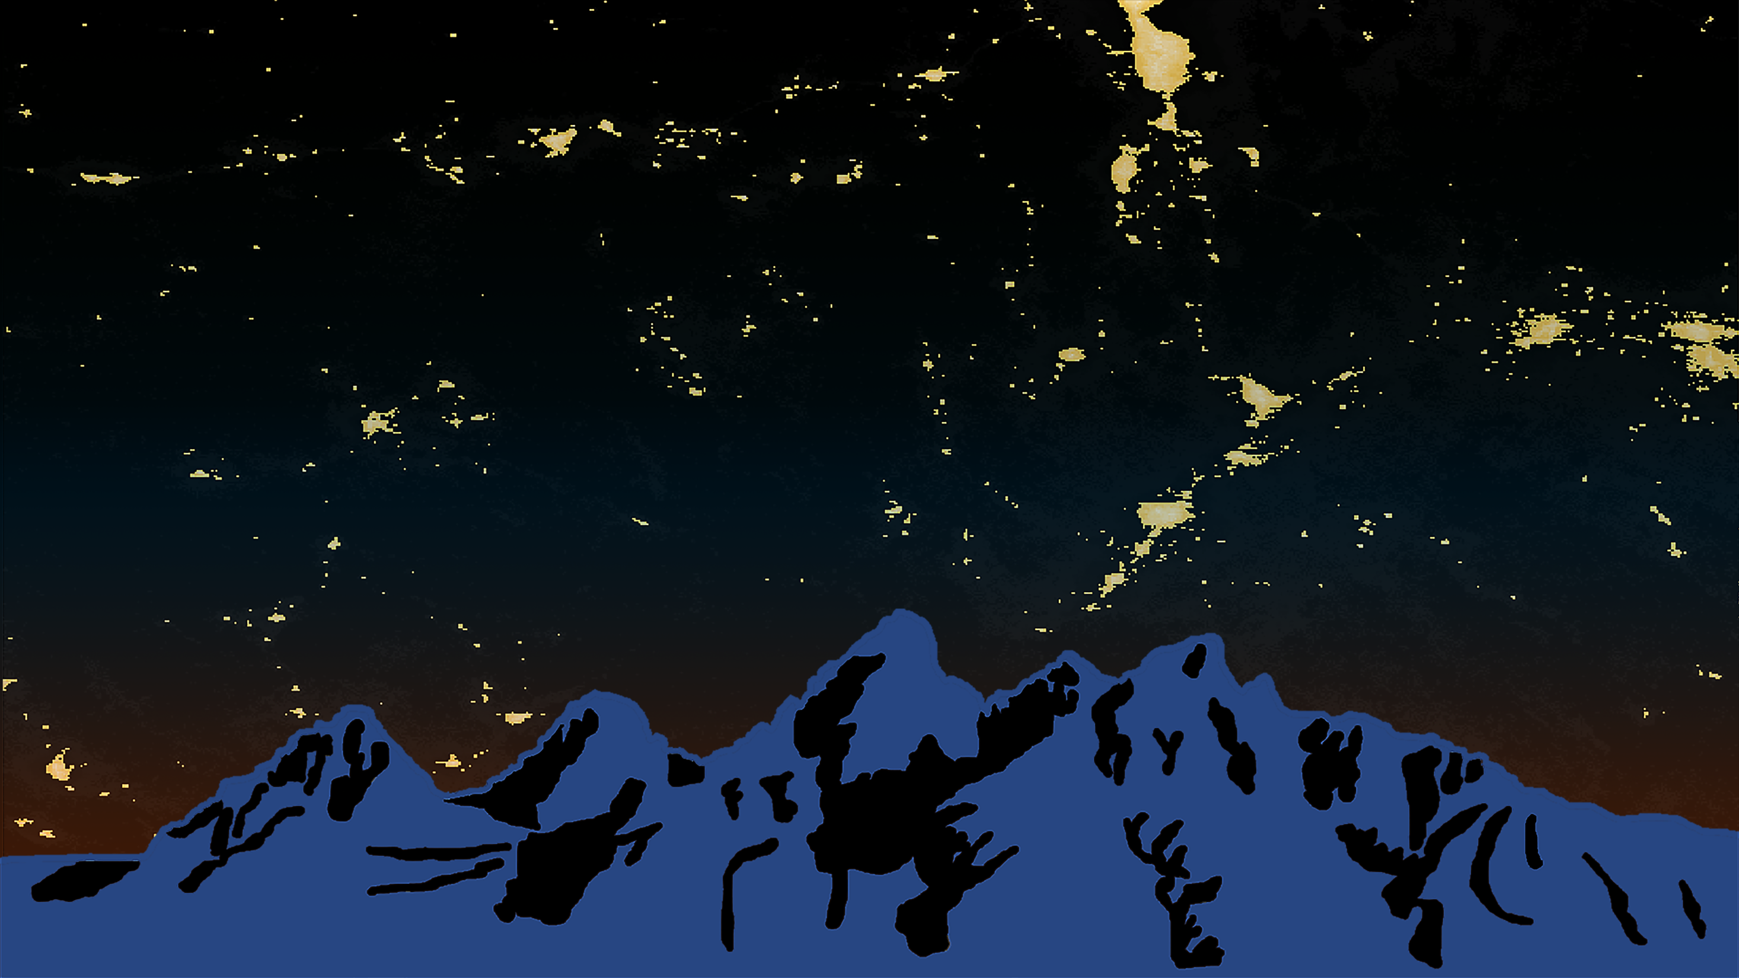


Wyoming
Cross-Cutting II
Detecting Changes in Nighttime Sky Brightness over Grand Teton National Park with the Suomi NPP VIIRS Day/Night Band
Veronica Warda (Project Lead)
Ryan Avery
Steven Chao
Stanley Yu
Wise County Clerk of Circuit Court’s Office
Summer 2017
Notes:
Hello, my name is Steven Chao, and we are the Wyoming Cross-Cutting II team located in Wise County. With me today, I have my team members Veronica Warda and Stanley Yu. Our fourth team member, Ryan Avery, is unable to join us today. This term, we used the NASA VIIRS Sensor to investigate light pollution in Grand Teton National Park (GRTE).
--advance slide--
Image Source: Wyoming Cross-Cutting II Team
**NOTE** Short Script reads in 15 minutes. Long Script reads in 30 minutes.
**NOTE** If no script is defineds they are the same.

Slide 2
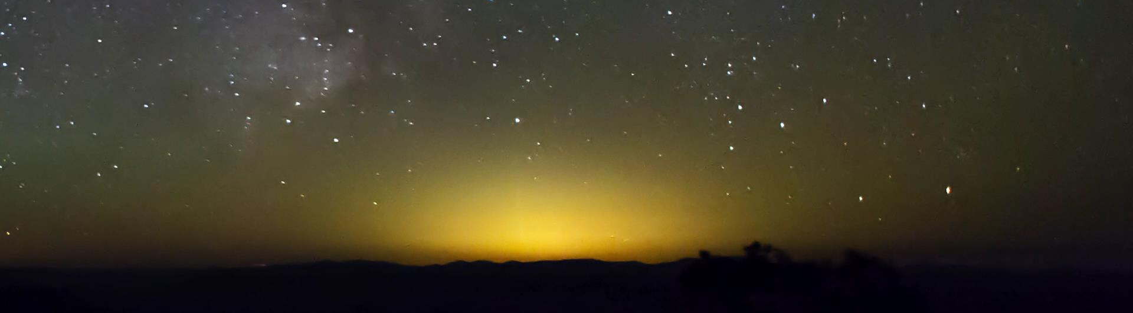
What is light pollution?
Inappropriate or excessive artificial light that obscures the view of the stars
Image Credit: Grand Canyon NPS
Notes:
Short Script
When thinking about environmental pollution, light is not typically the first type of pollutant that comes to mind. Light pollution is defined as any inappropriate or excessive artificial lighting that obstructs the view of the night sky.
Long Script
When thinking about environmental pollution, light is not typically the first type of pollutant that comes to mind. Many people may have never given much thought to the constant brightness that surrounds us.
Light pollution is defined as any inappropriate or excessive artificial lighting that obstructs the view of the night sky. This is mostly caused by artificial lighting fixtures at night, such as building lights, street lights, car headlights, and billboards.
--advance slide--
Sources: Falchi, F., Cinzano, P., Duriscoe, D., Kyba, C. C. M., Elvidge, C. D., Baugh, K., Furgoni, R. (2016). The new world atlas of artificial night sky brightness. Science Advances, 2(6), 1. http://doi.org/10.1126/sciadv.1600377; Cinzano, P., Falchi, F., Elvidge, C. D., & Baugh, K. E. (2000). The artificial night sky brightness mapped from DMSP satellite Operational Linescan System measurements. Monthly Notices of the Royal Astronomical Society, 318(3), 641.
Image Source: GrandCanyonNPS. (2015, March 10). Retrieved June 29, 2017, from https://www.youtube.com/watch?v=NOZlhTCW3gM

Slide 3
Community Concerns
“…as light pollution spreads, we are slowly losing one of the oldest and most universal links to all of human history.”
– Peter Lipscomb
Santa Fe Astronomer
Notes:
Short Script
The dark night sky is important because it is a universal link to our collective past. Today, artificial lighting threatens this history and can impact our quality of life and our surrounding environment in various ways.
Long Script
While talking about our project with other teams and people, one common question we get is: “I’m sorry, but why is light pollution such an important issue?” Well, excessive artificial lighting can impact our quality of life and our surrounding environment in various ways.
--advance slide--
Quote Source: Santa Fe Conservation Trust. (2012). Bring Back the Stars! [Flyer]. Author. Retrieved June 29, 2017, from http://sfct.org/wp-content/uploads/2012/07/Bring-Back-the-Stars-6-steps1.pdf [emphasis added]

Slide 4
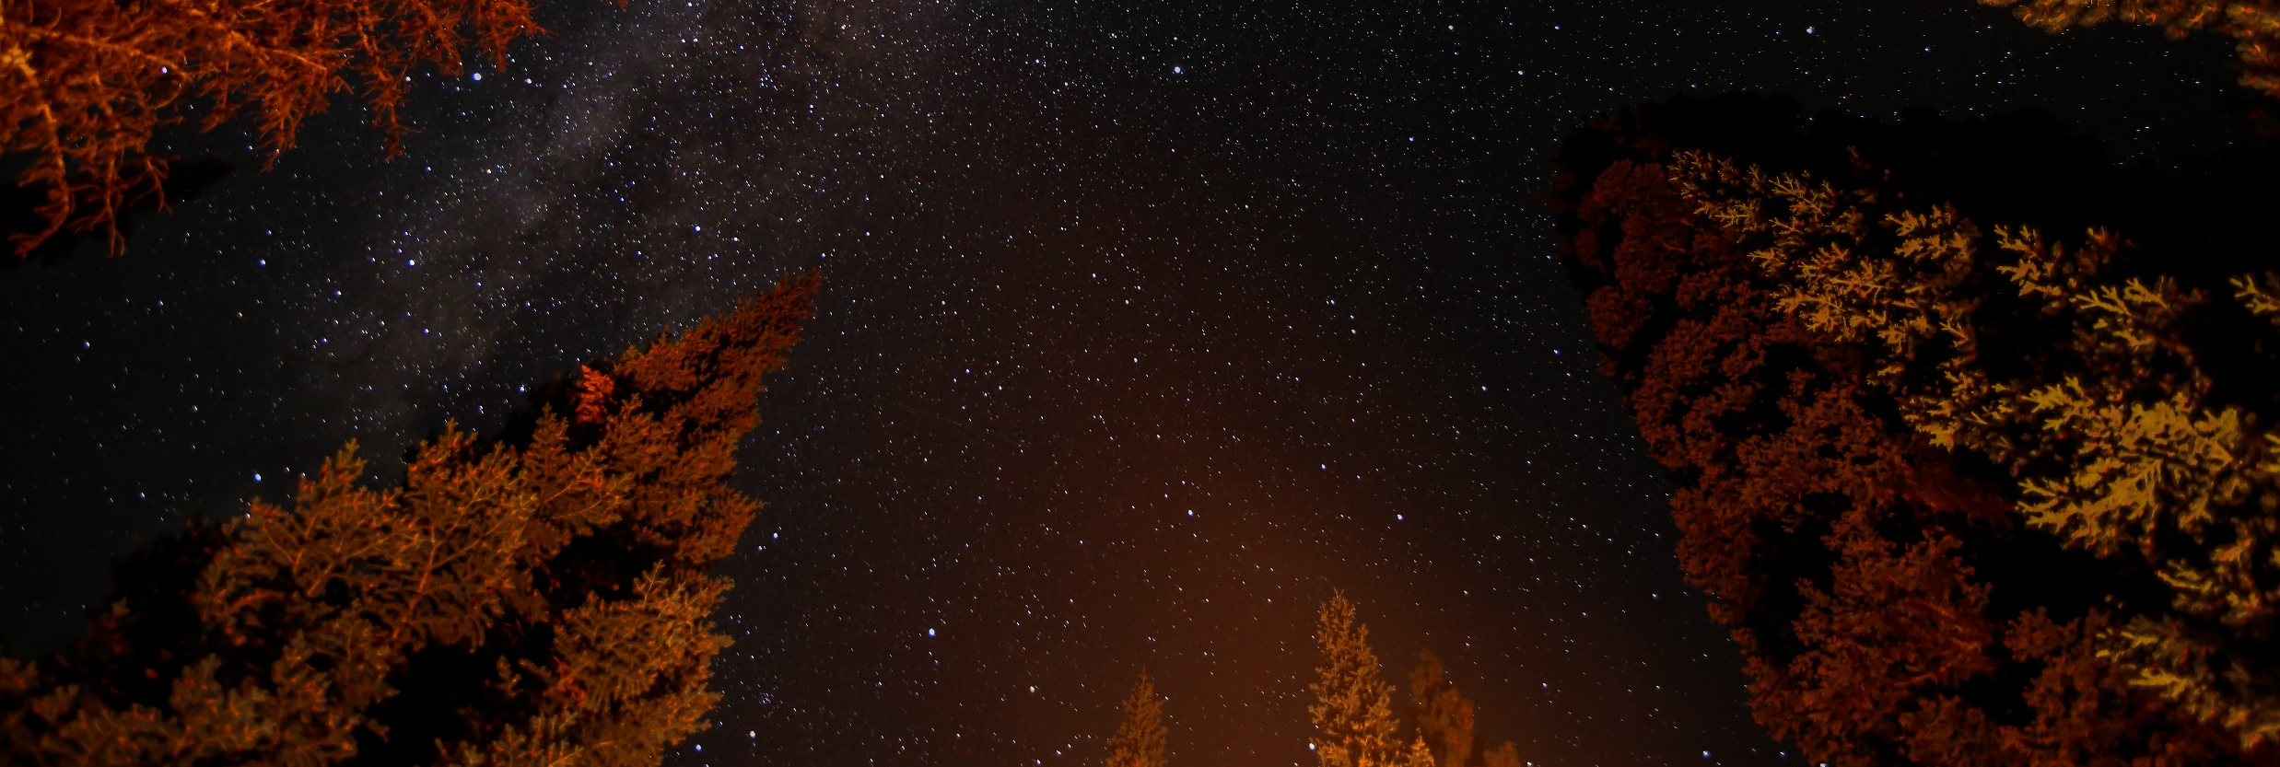
97%
The portion of the U.S. population unable to see the Milky Way at night
Source: Falchi et al. (2016)
Image Credit: © 2016 Jennifer Hipp/Flickr cc by 2.0
Notes:
Short Script
For instance, 97% of Americans are unable to see the Milky Way at night due to these light polluted skies. To put this into perspective, that means over 300 million Americans can’t even see our own galaxy in the night sky.
Long Script
For instance, light pollution affects nearly all Americans, 99% to be exact. And 97% of Americans are unable to see the Milky Way at night due these light polluted skies. To put this into perspective, of the 323,000,000 people living in the US as of 2016, that’s 313,000,000 people who can’t even see our own galaxy in the sky.
--advance slide--
Source: Falchi, F., Cinzano, P., Duriscoe, D., Kyba, C. C. M., Elvidge, C. D., Baugh, K., Furgoni, R. (2016). The new world atlas of artificial night sky brightness. Science Advances, 2(6), 19. doi:10.1126/sciadv.1600377
Image Source: Hipp, J. (n.d.). Milky Way [Photograph found in Grand Teton National Park]. Retrieved June 29, 2017, from https://flic.kr/p/GQuS8x (Originally photographed 2016, August 2)

Slide 5
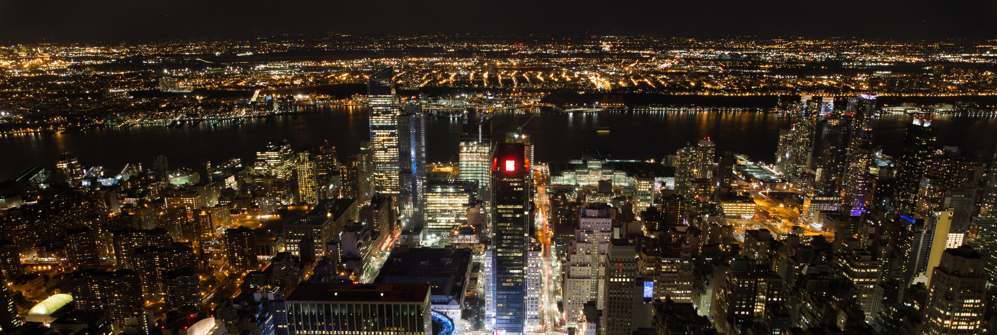
98 million
Number of bird deaths each year from collisions with buildings in North America
Source: Chepesiuk (2009)
Image Credit: © 2017 Jakob Nilsson-Ehle/Flickr cc by-sa 2.0
Notes:
Light pollution also hurts wildlife. Light at night disorients animals and alters wildlife behavior and migratory patterns. In fact, this May (in 2017) in Texas, nearly 500 birds collided with a single lit skyscraper in one night.
--advance slide--
Source: Chepesiuk, R. (2009). Missing the Dark: Health Effects of Light Pollution. Environmental Health Perspectives, 117(1), A24. doi:10.1289/ehp.117-a20
Image Source: Nilsson-Ehle, J. (n.d.). Big Apple From Above 1 [Photograph found in New York]. Retrieved June 29, 2017, from https://flic.kr/p/RT3MU8 (Originally photographed 2017, January 30)

Slide 6
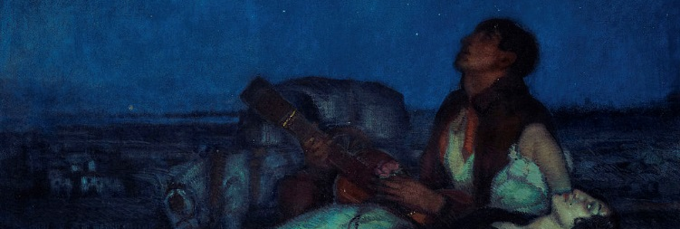
35,000 years
The documented length of influence the night skies have had on cultures around the world
Source: Ruggles & Cotte (2010)
Image Credit: © 1916 Federico Beltran Masses/Wikimedia Commons cc by-sa 4.0
Notes:
Short Script
The link to the historic stargazing culture is disappearing because of light pollution. The earliest known documentation of stargazing was in France 35,000 years ago. Since then, the night sky and the heavens have continued to influence cultures wherever humans have lived. But today, with light associated with economic development and safety, our connection to the stars and the night skies is eroding.
Long Script
The earliest known documentation of stargazing was in France 35,000 years ago. Since then, the night sky and the heavens have continued influence cultures wherever humans have lived. For instance, in North America, the Navajo nation painted stars on the ceilings of caves all across the southwest. The First Nations and other indigenous people relied on the stars for navigation. But today, with light associated with economic development and safety, our connection to the stars and the night skies is eroding.
--advance slide--
Sources: Ruggles, C. L., & Cotte, M. (2010). Heritage Sites of Astronomy and Archaeoastronomy in the context of the UNESCO World Heritage Convention: A Thematic Study. Retrieved July 13, 2017, from http://www.astronomicalheritage.org/index.php?option=com_content&view=article&id=28&Itemid=33; B. VanGundy, Interview, (June 20, 2017).
Image Source: Masses, F. B. (2016, January 13). Under the Stars. Retrieved June 29, 2017, from https://commons.wikimedia.org/wiki/File:Federico_Beltran_Masses_-_Under_the_Stars.jpg (Originally photographed 1916)

Slide 7
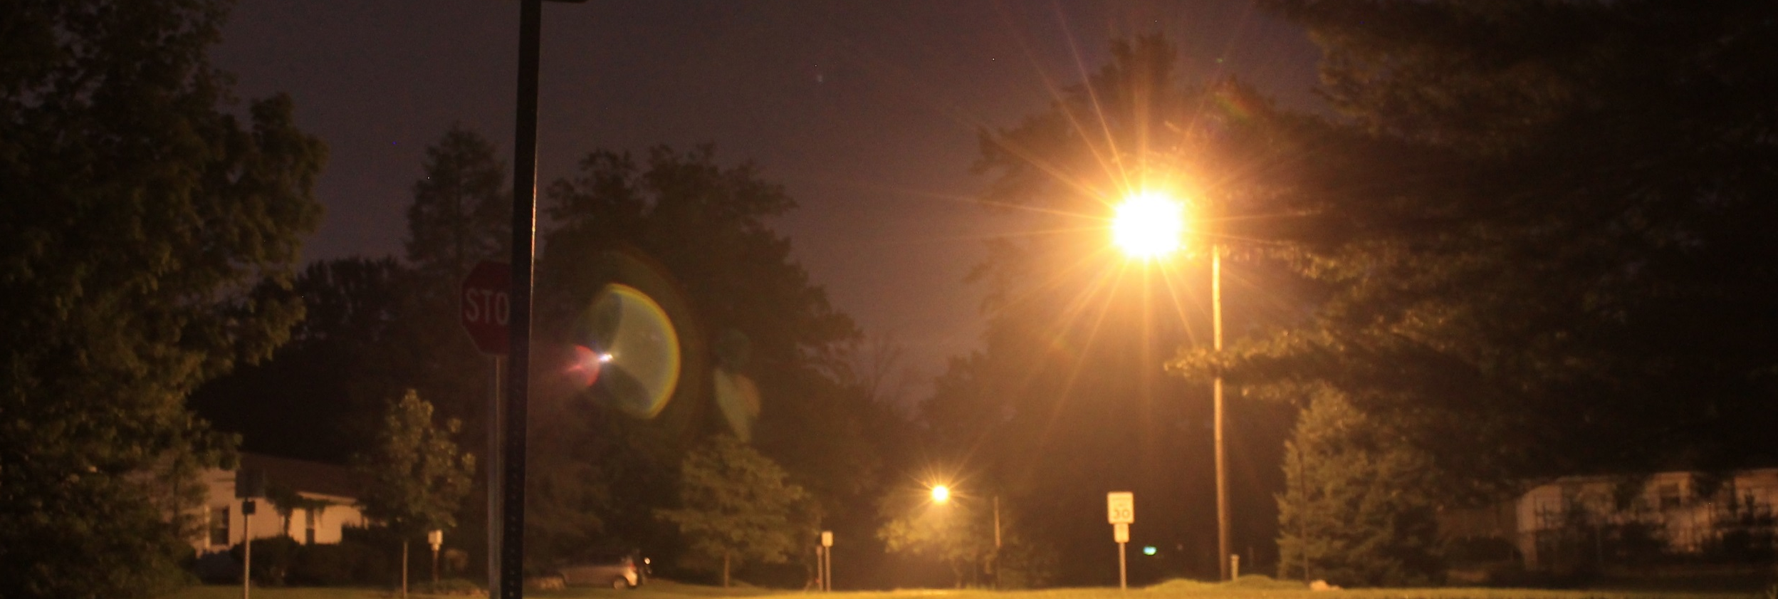
$2 billion
Amount wasted annually in unnecessary energy costs due to poorly-designed outdoor lighting
Source: National Optical Astronomy Observatory (2011);
Pennsylvania Outdoor Lighting Council (2015)
Image Credit: © 2015 Ben Douglas/Flickr cc by 2.0
Notes:
Short Script
Light pollution is not only harmful but expensive. In a typical unshielded light fixture, 50% of light is wasted into the sky, costing more than $2 billion every year in energy costs.
Long Script
Now, one reason why this number is so high is because our outdoor light fixtures are poorly designed and often unshielded. In a typical unshielded light fixture, 60% of light is wasted into the sky, costing more than $2 billion every year in energy costs.
--advance slide--
Sources: National Optical Astronomy Observatory, Office of Education and Public Outreach. (2011, March 17). Wasted Lights and Wasted Nights: Globe at Night Tracks Light Pollution [Press release]. Retrieved June 21, 2017, from https://www.noao.edu/news/2011/pr1101.php; Pennsylvania Outdoor Lighting Council. (2015, October 21). Electricity Cost of Waste Outdoor Lighting, United States - 2014 [Chart]. In Pennsylvania Outdoor Lighting Council. Retrieved June 21, 2017, from http://www.polcouncil.org/polc2/US_Annual_Electricity_Cost_Waste_Outdoor_Lighting_2014.pdf
Image Source: Douglas, B. (n.d.). Nighttime Glow. Retrieved June 29, 2017, from https://flic.kr/p/GQuS8x (Originally photographed 2015, July 3)

Slide 8
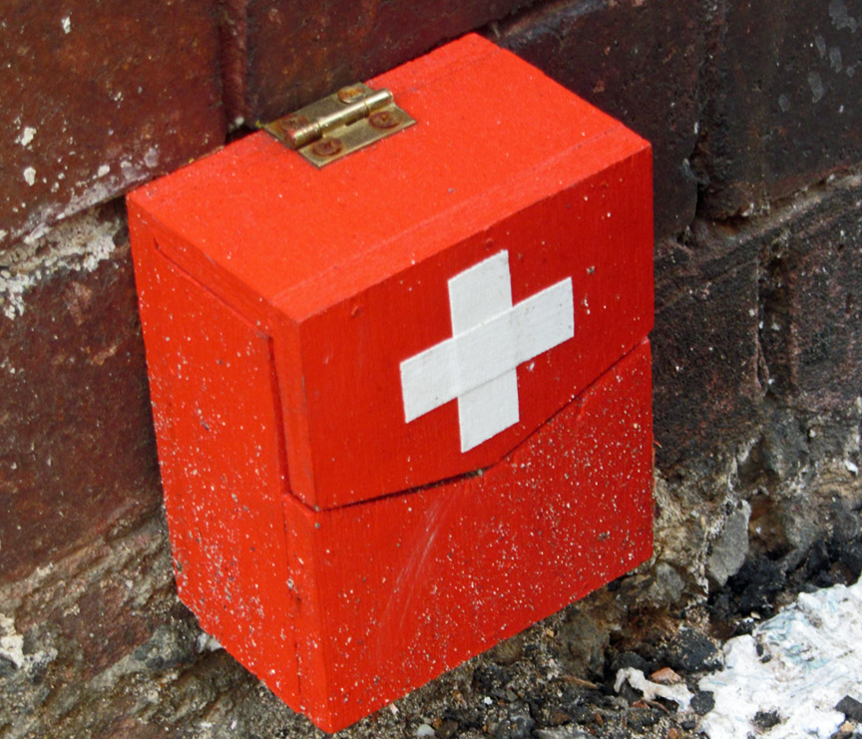
Health Effects
Cancer
Increases risk of breast cancer by elevating estrogen levels
Depression
Affects serotonin conversion, which affects mood
Source: Dominoni et al.(2016);
Chepesiuk (2009);
Haim et al. (2015)
Source: Dominoni et al.(2016);
Chepesiuk (2009);
Nature Bright (2015)
Obesity
Harms metabolism due to melatonin suppression
Insomnia
Disrupts humans’ circadian rhythms
Source: Dominoni et al.(2016);
Chepesiuk (2009);
Korkmaz et al. (2009)
Image Credit:
© 2011 Newtown grafitti/Flickr
cc by 2.0
Source: Dominoni et al.(2016);
Chepesiuk (2009);
Fernandez et al.(2012)
Notes:
Short Script
Light pollution not only is an energy issue and an aesthetic issue but also has serious health effects. Artificial light suppresses melatonin production and alters circadian rhythms, resulting in increased risk of developing many health disorders, a few of which are listed here.
Long Script
Light pollution not only is an energy issue and an aesthetic issue but also has serious health effects. Artificial light suppresses melatonin production and alters circadian rhythms, resulting in increased risk of developing many health disorders, a few of which are listed here. The research connecting light pollution and human health is still in the early stages. Current research has revealed artificial light at night has been shown to increase the risk of developing breast cancer by 30-50%. Researchers are also concerned about the impacts of light pollution and outdoor artificial lighting on indoor exposure to artificial lighting, either due to outdoor lighting directly introduced into people’s homes or as a result of people indoors turning on more lights as a result of outdoor lighting disturbances.
--advance slide--
Sources: Dominoni, D. M., Borniger, J. C., & Nelson, R. J. (2016). Light at night, clocks and health: from humans to wild organisms. Biology Letters, 12(2), 1-2. doi:10.1098/rsbl.2016.0015; Chepesiuk, R. (2009). Missing the Dark: Health Effects of Light Pollution. Environmental Health Perspectives, 117(1), A24-A27. doi:10.1289/ehp.117-a20
Tumor Growth - Haim, A., & Zubidat, A. E. (2015). Artificial light at night: melatonin as a mediator between the environment and epigenome. Philosophical Transactions of the Royal Society B: Biological Sciences,370(1667), 1-7. doi:10.1098/rstb.2014.0121
Obesity - Korkmaz, A., Topal, T., Tan, D., & Reiter, R. J. (2009). Role of melatonin in metabolic regulation. Reviews in Endocrine and Metabolic Disorders, 10(4), 261-270. doi:10.1007/s11154-009-9117-5
Depression - Nature Bright. (2015, June 29). 5 Ways Light Pollution Affects Your Health. Retrieved July 05, 2017, from http://www.naturebright.com/research-news/5-ways-light-pollution-affects-your-health/; Scaccia, A. (2017, May 18). Serotonin: What You Need to Know. Retrieved July 05, 2017, from http://www.healthline.com/health/mental-health/serotonin
Insomnia - Fernandez, M., DG Health and Consumers of the European Commission, & EU SCENIHR. (2012). Health Effects of Artificial Light. Retrieved July 05, 2017, from http://ec.europa.eu/health/scientific_committees/opinions_layman/artificial-light/en/about-artificial-light.htm#7
Image Source: Newtown grafitti. (n.d.). First Aid kit... Retrieved June 29, 2017, from https://flic.kr/p/aixTEk (Originally photographed 2011, September 2)

Slide 9
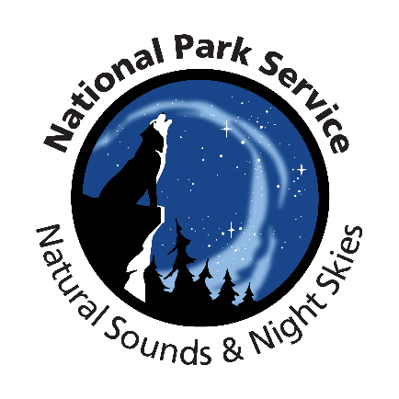

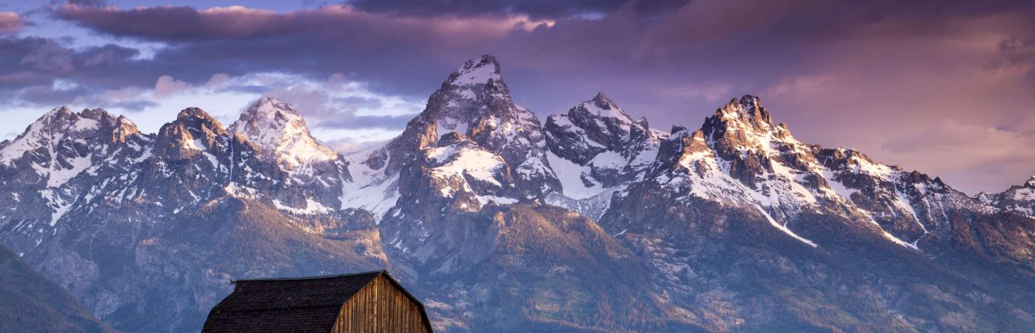
Partners
National Park Service, Grand Teton National Park
National Park Service, Intermountain Region
National Park Service, Natural Sounds and Night Skies Division
Wyoming Stargazing
Image Credit: Monet
Image Credit: 2017 quiquefepe/Flickr Public Domain Mark 1.0
Notes:
Short Script
To further investigate this light pollution issue, our team partnered with Grand Teton National Park; the National Park Service, Intermountain Region; the National Park Service, Natural Sounds and Night Skies Division; and Wyoming Stargazing.
Long Script
Grand Teton National Park is one park that is concerned with the impacts of light pollution. To further investigate this light pollution issue, our team partnered with Grand Teton National Park; the National Park Service, Intermountain Region; the National Park Service, Natural Sounds and Night Skies Division; and Wyoming Stargazing.
--advance slide--
Source: D. Greenblatt, VPS Interview, (March, 2017).
Image Source: Quiquefepe. (2017, May 2017). Wyoming Grand Teton National Park [Photograph found in Grand Teton National Park]. Retrieved June 29, 2017, from https://flic.kr/p/V9Svq6
Logo Source: National Park Service. (n.d.). [Logo of the United States National Park Service, an agency of the United States Department of the Interior]. Retrieved June 29, 2017; National Park Service. (n.d.). [Natural Sounds & Night Skies Logo]. Retrieved June 29, 2017, from https://www.nps.gov/orgs/1050/images/Logo-with-words_350p.jpg

Slide 10
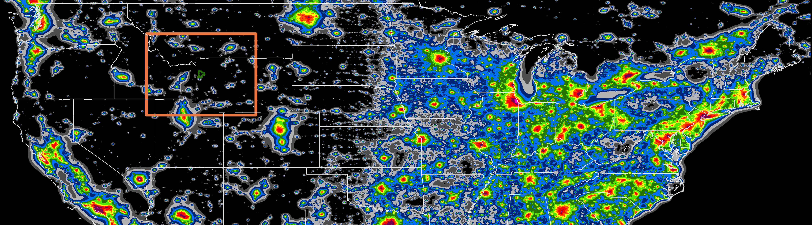
Objectives
Image Credit: Falchi et al. (2016)
Assess changes in artificial skyglow over time
Design a model of light propagation in the atmosphere from different viewing angles and latitudes
Visualize sources of anthropogenic light pollution
Publish an open-source Python program with supporting documentation
Test Python program against previous work in the New World Atlas (Falchi et al., 2016)
Notes:
Short Script
While working with our partners, our objective was to investigate light pollution by creating a Python program called the Skyglow Estimation Toolbox (SET) that models light propagation. We hope to share this with as many people as possible by publishing our code when approved.
Long Script
While working with our partners, we had the following objectives in mind:
Assess ramifications of artificial skyglow over time
Design a model of light propagation in the atmosphere from different viewing angels and latitudes
Visualize sources of anthropogenic light pollution
Publish an open-source Python program with supporting documentation for local communities to derive information about night sky quality
Test Python program against previous work in the New World Atlas of Artificial Night Sky Brightness (New World Atlas) by Falchi et al. (2016)
--advance slide--
Image Source: Falchi, F., Cinzano, P., Duriscoe, D., Kyba, C. C. M., Elvidge, C. D., Baugh, K., Furgoni, R. (2016). The new world atlas of artificial night sky brightness. Science Advances, 2(6), e1600377. doi:10.1126/sciadv.1600377 [modified by the Wyoming Cross-Cutting II Team]

Slide 11
Study Parameters
“…the Grand Teton region is part of the greater Yellowstone ecosystem, [which is] about 12 million acres, [making it] the largest undeveloped area within the contiguous […] United States.”
– Dan Greenblatt
Colter Bay District Interpretive Ranger
Grand Teton National Park
Notes:
Short Script
After we determined the direction of our project, we selected our study parameters to ensure a comprehensive investigation of Grand Teton National Park. Grand Teton is an important place to study light pollution because it is part of the largest undeveloped areas within the lower 48 at about 12 million acres.
Long Script
After we determined the direction of our project, we selected our study parameters to ensure a comprehensive investigation of Grand Teton National Park. Grand Teton was designated a national park in 1912, and it includes the Grand Teton mountain range and the adjacent Jackson Hole valley floor. There is a wide range in elevation. Furthermore, as mentioned by one of our partners Mr. Dan Greenblatt, it’s important to note that the Grand Teton region is part of the greater Yellowstone ecosystem, which is around 12 million acres. This region is thus the largest undeveloped area in the contiguous United States.
--advance slide--
Quote Source: Greenblatt, D. (2017, March). VPS Interview [Personal interview] [emphasis added]
“Well, the Grand Teton Region is part of the greater Yellowstone ecosystem, so this is a very large area, about 12 million acres, that is the largest undeveloped area within the contiguous 48 United States.” [1:00]

Slide 12
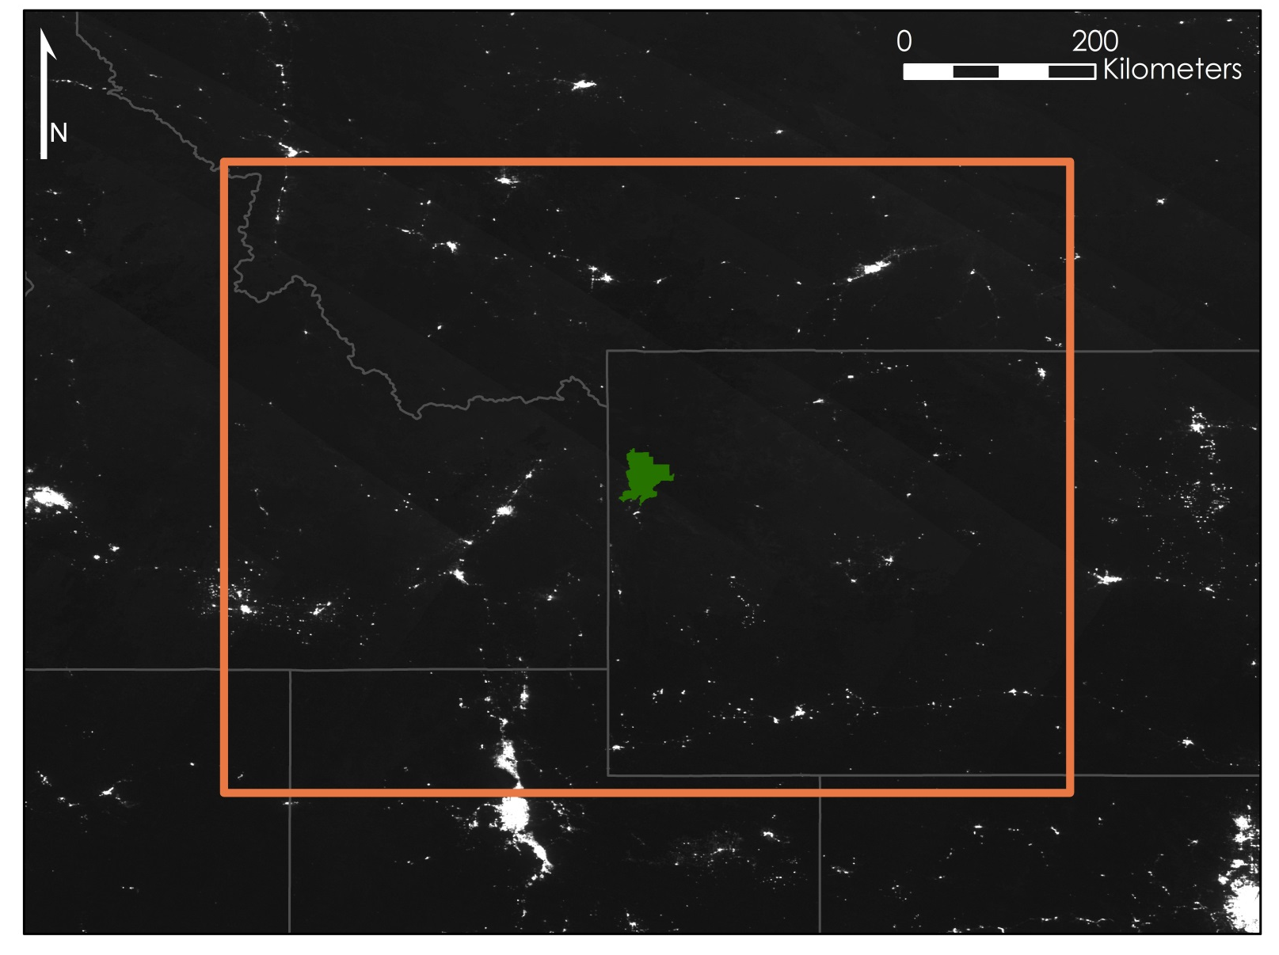
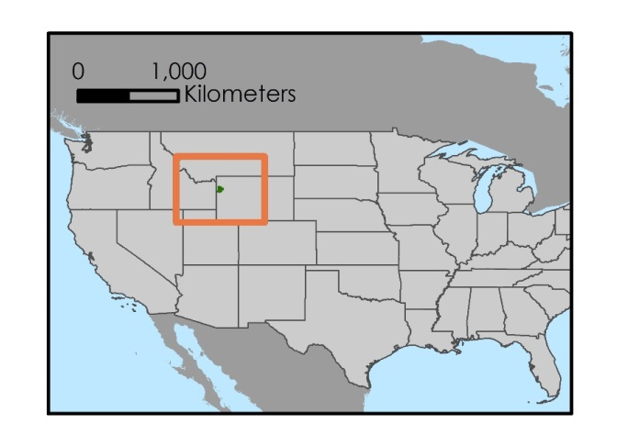

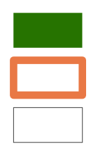
Study Area
Montana
Helena
Bozeman
Billings
Butte
Idaho
Cody
Sheridan
Suomi NPP VIIRS DNB
nanoWatts/cm²/sr
Idaho Falls
Jackson
Riverton
High : 14,000
Low : -2
Twin Falls
Wyoming
Pocatello
Rawlins
Logan
Evanston
Rock Springs
City
Grand Teton National Park
Study Area (300 km buffer)
State Boundary
Nevada
Salt Lake City
Colorado
Utah
Map Credit: Wyoming Cross-Cutting II Team
Study Period: July – September, 2014 – 2016
Notes:
Short Script
To ensure our study was comprehensive, we determined that a 300 km buffer would be necessary to include all possible light sources. Only summer months with low snow cover, July, August, and September, were used because of the brightening effect of snow. In addition, no stray light corrected data over Grand Teton is available before 2014. As a result, a multi-annual composite, seen in this image, of a total nine months from 2014 to 2016 is utilized in the dataset.
Long Script
To ensure our study was comprehensive, we expanded our study area to include all possible light sources, and we determined that a 300 km buffer would be necessary. This includes areas from Colorado, Idaho, Montana, Nevada, and Wyoming. However, there are two temporal restrictions on collecting data for our study area. First, snow coverage increases sky brightness 1.3- to 2.6-fold when partially present on lit roads due to snow’s high. Since snow is usually promptly removed from roads, the brightening effect of snow cover was determined to be unrepresentative of true night sky quality. Therefore, only summer months with low snow cover, July, August, and September, were used. Second, no stray light corrected data over Grand Teton is available before 2014. As a result, a multi-annual composite of a total nine months is utilized in the dataset: July, August, and September from 2014 to 2016. 2017 was not included because composites from the relevant months have not yet been published.
This map shows our study area as taken from the Suomi NPP VIIRS DNB. This is one of the monthly average radiance composite images produced by the National Oceanic and Atmospheric Administration (NOAA) National Centers for Environmental Information (NCEI) Earth Observation Group (EOG). As previously mentioned, before averaging, the data impacted by stray light, lightning, lunar illumination, and cloud cover are excluded, and temporary light sources are filtered. Each composite contains two files, a floating point radiance value GeoTIFF with units of nanoWatts/cm²/sr, shown here, and a GeoTIFF file that contains integer counts of the number of observations that construct the average radiance image.
--advance slide--
Sources: Falchi, F. (2011). Campaign of sky brightness and extinction measurements using a portable CCD camera. Monthly Notices of the Royal Astronomical Society, 412(1), 48. doi:10.1111/j.1365-2966.2010.17845.x
http://doi.org/10.1111/j.1365-2966.2010.17845.x; Falchi, F., Cinzano, P., Duriscoe, D., Kyba, C. C. M., Elvidge, C. D., Baugh, K., Furgoni, R. (2016). The new world atlas of artificial night sky brightness. Science Advances, 2(6), 6. doi:10.1126/sciadv.1600377; Earth Observation Group. (2017). Version 1 Nighttime VIIRS Day/Night Band Monthly Composites. NOAA National Centers for Environmental Information. Retrieved June 21, 2017, from https://www.ngdc.noaa.gov/eog/viirs/download_dnb_composites.html
Map Credit: Wyoming Cross-Cutting II Team
Map Source: DIVA-GIS. Free Spatial Data. Retrieved June 21, 2017, from http://www.diva-gis.org/Data

Slide 13
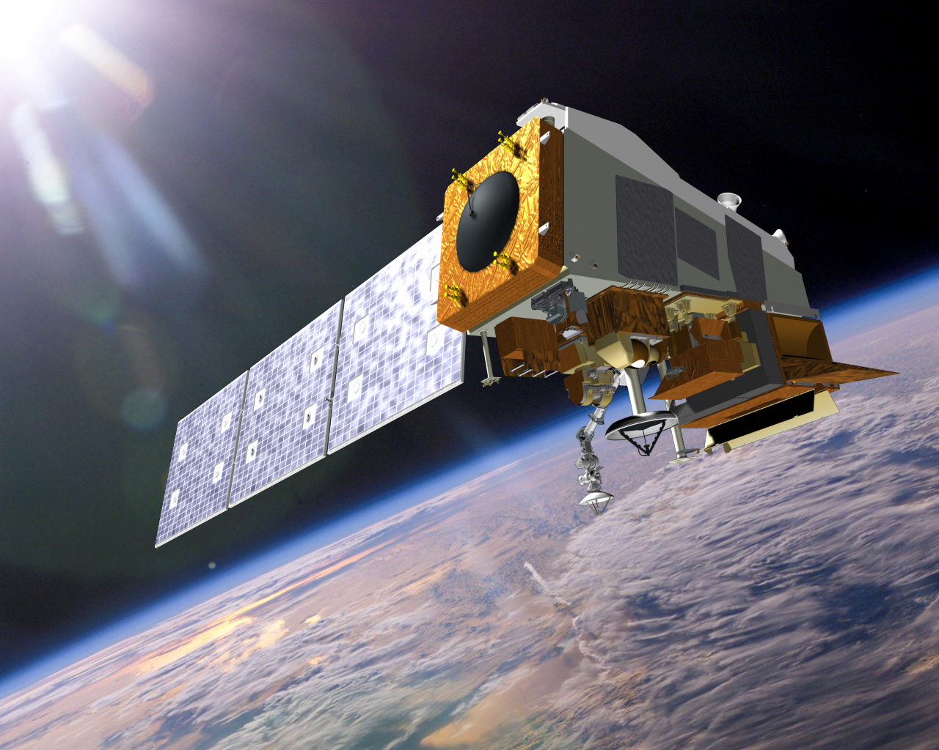
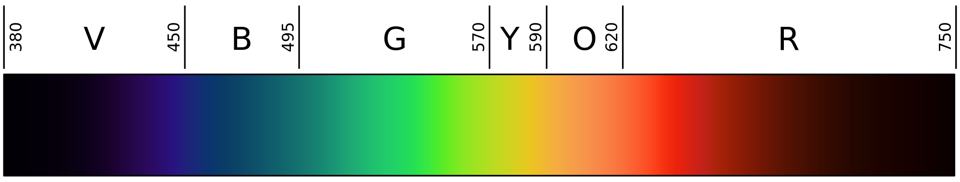
Suomi NPP VIIRS DNB
NCEI Earth Observations Group
  Monthly composite images
  Stray light (striping) removed
  Moonlight removed
Sensitive to 500 nm - 900 nm wavelengths
Image Credit: 2008 Gringer/Wikimedia Commons Public Domain
Image Credit: NASA
Notes:
Short Script
We collected our project data from the Suomi NPP VIIRS Day/Night Band, which senses wavelengths of 500 nm to 900 nm. This does not include light emitted in the blue spectrum. The NCEI Earth Observations Group in NOAA produces clean monthly composite images of VIIRS DNB.
Long Script
We collected our project data from the Day/Night Band, which is on the Visible Infrared Imaging Radiometer Suite Sensor housed on the Suomi National Polar-orbiting Partnership. The Day/Night Band senses wavelengths of 500 nm to 900 nm, this does not include light emitted in the blue spectrum. This satellite is a joint project between NASA and NOAA that was launched in 2011 and started gathering data in 2012. The NCEI Earth Observations Group in NOAA produces monthly composite images of VIIRS DNB and removes cloud cover, stray light, and other temporary light sources. Furthermore, anytime the moon is above the horizon, the data is removed from the compilation.
--advance slide--
Source: Earth Observation Group. (2017). Version 1 Nighttime VIIRS Day/Night Band Monthly Composites. NOAA National Centers for Environmental Information. Retrieved June 21, 2017, from https://www.ngdc.noaa.gov/eog/viirs/download_dnb_composites.html
Image Source: NASA. (n.d.). [Soumi NPP]. Retrieved June 29, 2017, from https://www.nasa.gov/sites/default/files/thumbnails/image/img_press_140106_suomi-npp.jpg; Gringer. (2008, August 27). Linear visible spectrum. Retrieved July 28, 2017, from https://commons.wikimedia.org/wiki/File:Linear_visible_spectrum.svg

Slide 14
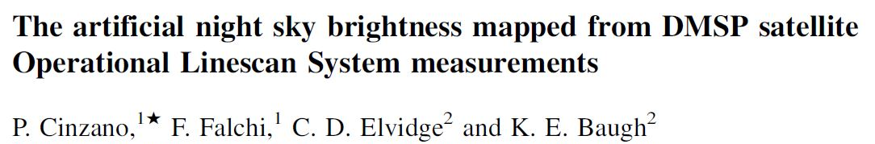
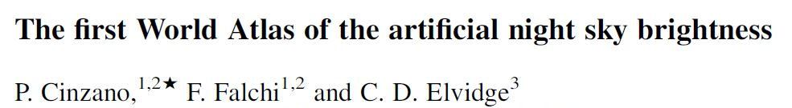
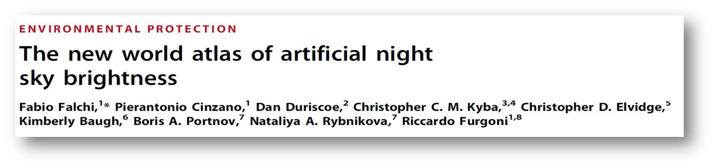
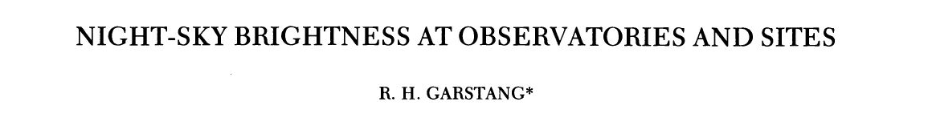
Building a Regional Model
Notes:
After collecting our data, the next step was to build the model. We did so based on methods defined in papers by authors such as Cinzano, Falchi, and Garstang.
--advance slide--
Screenshot Sources: Cinzano, P., Falchi, F., Elvidge, C. D., & Baugh, K. E. (2000). The artificial night sky brightness mapped from DMSP satellite Operational Linescan System measurements. Monthly Notices of the Royal Astronomical Society,318(3), 641-657. doi:10.1046/j.1365-8711.2000.03562.x; Cinzano, P., Falchi, F., & Elvidge, C. D. (2001). The first World Atlas of the artificial night sky brightness. Monthly Notices of the Royal Astronomical Society, 328(3), 689-707. doi:10.1046/j.1365-8711.2001.04882.x; Falchi, F., Cinzano, P., Duriscoe, D., Kyba, C. C. M., Elvidge, C. D., Baugh, K., Furgoni, R. (2016). The new world atlas of artificial night sky brightness. Science Advances, 2(6), e1600377. doi:10.1126/sciadv.1600377; Garstang, R. H. (1989). Night-sky brightness at observatories and sites. Publications of the Astronomical Society of the Pacific, 101(637), 306-329. doi:10.1086/132436

Slide 15
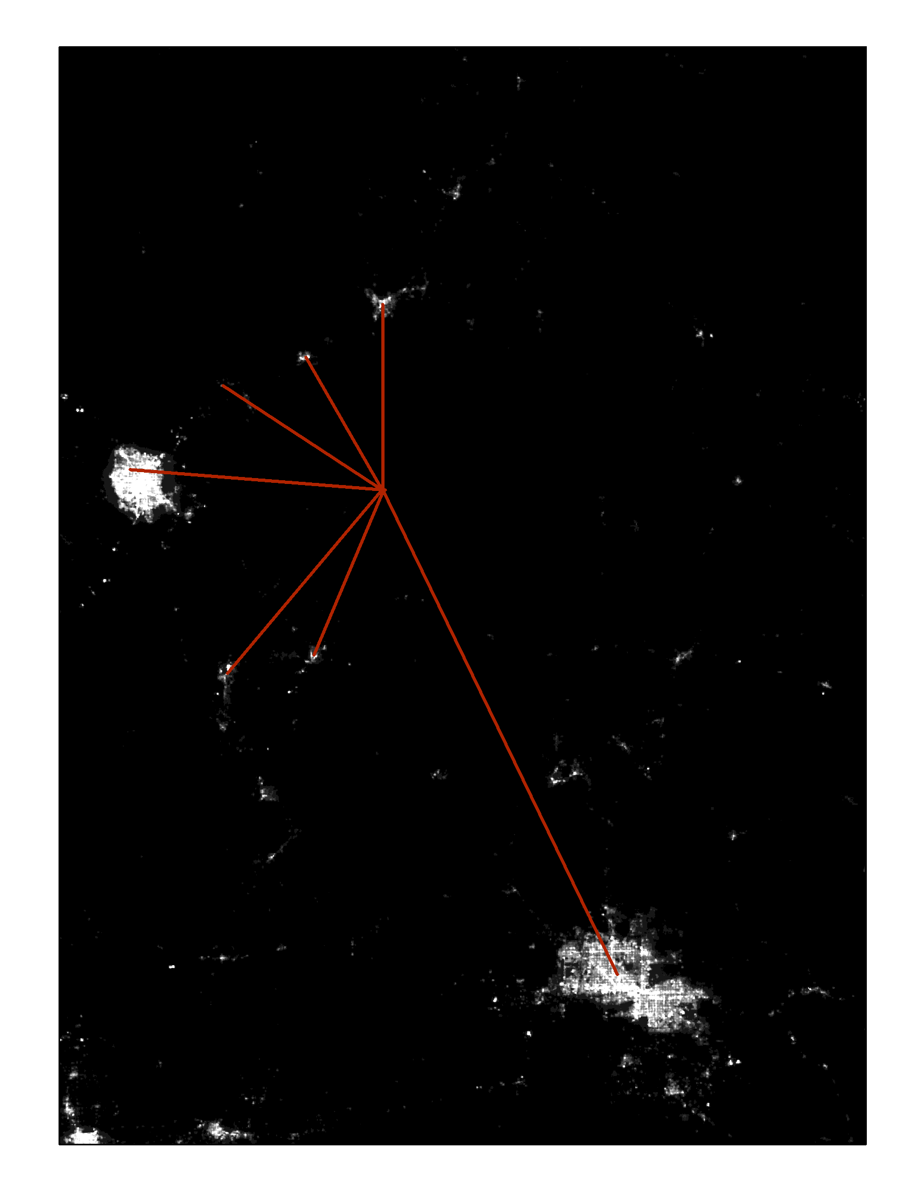

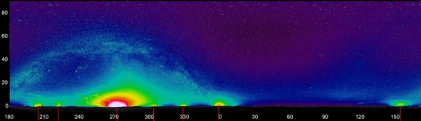

Building a Regional Model
Input: VIIRS image, viewing angle, latitude, atmospheric clarity parameter
Product: goal is to produce skyglow maps
N
Phoenix, AZ
St. George, UT
$$O$$
Kingman, AZ
Moapa, NV
Bullhead City, AZ
Las Vegas, NV
Map Credit: Wyoming Cross-Cutting I & II Teams
Image Credit: National Park Service
N
210
240
270
300
330
0
30
60
90
120
150
Kingman,
AZ
Bullhead
City, AZ
Las Vegas,
NV
Moapa,
NV
Mesquite,
NV
St. George, UT
Phoenix, AZ
Notes:
One major challenge the team faced was to create a model of a 3D object, the sky, with a 2D input, the VIIRS imagery. There are two differences between VIIRS’s measure of radiance, seen in the top image, and the in situ measure of sky-glow seen at the bottom. First, sky-glow spreads out over large areas while VIIRS shows points of light. The physics of the atmosphere mediate what each light source looks like from the ground at different places. The second difference is geometry; sky-glow appears in three-dimensions, and VIIRS can only measure two of those dimensions.
--advance slide--
Map Credit: Wyoming Cross-Cutting I & II Teams
Image Source: National Park Service

Slide 16
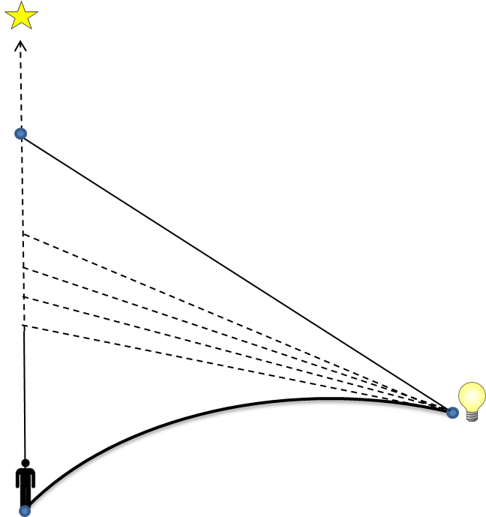
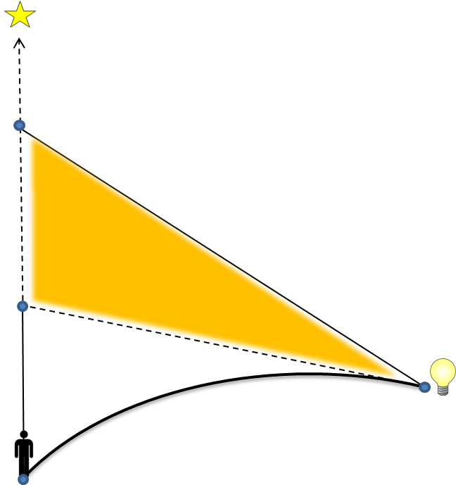
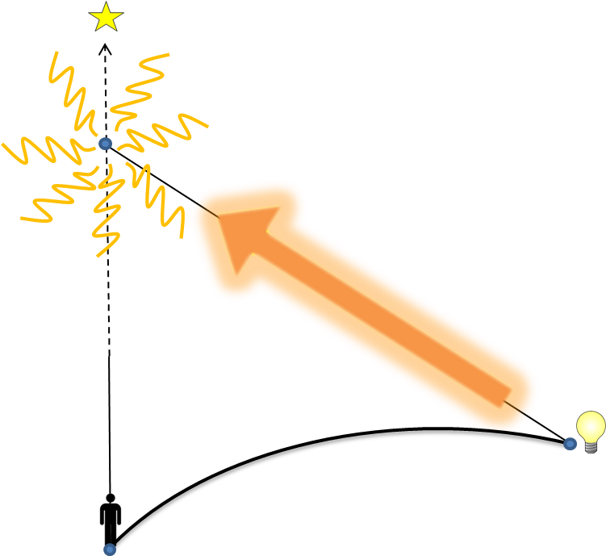
Building a Regional Model
Source
Source
Source
Target
Target
Target
VIIRS gives brightness at the source, source light scatters in all directions
The exact amount scattered by each path can be estimated
Adding up all values estimates the contribution of skyglow from a single point
Graphic Credit: Wyoming Cross-Cutting I & II Teams
Notes:
In order to produce a skyglow map, we first calculated light scattering point-to-point. We consider a target being the area under one VIIRS pixel, and a nearby light source up to 195 kilometers away. We use quantities we can calculate, like distance, angle, and curvature of the Earth to imagine paths for a beam of light to go from the source to the target. There are a lot of different paths that a beam of light can take to reach a target location. We add up all of these paths to see the effect a single light source has on sky brightness at an individual target location.
--advance slide--
Graphic Source: Wyoming Cross-Cutting I & II Teams

Slide 17
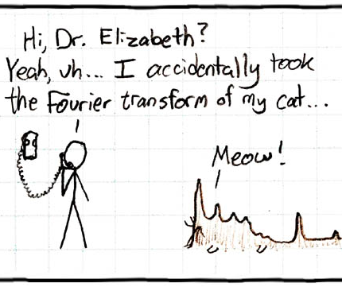
Building a Regional Model
Python function sums up sky brightness for each pixel using Fast Fourier Transform to estimate propagation behavior
Outputs Artificial Skyglow Map as TIFF image
Image Credit: © xkdc cc by-nc 2.5
Notes:
Next, we must add up the impact from all sources of light that affect brightness at an individual target location. We used Fast Fourier Transform to help us estimate light propagation behavior and speed up the process of calculating it. When we add up all these sources nearby, we can look at the areas surrounding our pixel and get an idea of the overall quality of the night sky. We can also tell how much a particular light source is degrading the quality of the night sky.
--advance slide--
Image Source: Xkcd. Fourier. Retrieved July 26, 2017, from https://xkcd.com/26/

Slide 18
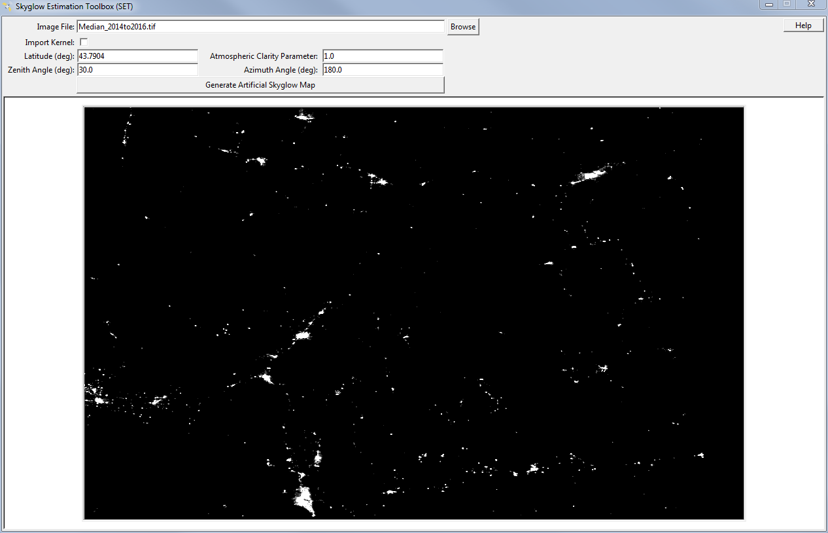
Skyglow Estimation Toolbox
User Interface
implementation of model with user-defined parameters
Image Credit: Wyoming Cross-Cutting II Team
Notes:
In order to make the Skyglow Estimation Toolbox more accessible to our partners and other future end-users, we created a user-friendly graphical interface. The SET is going through the NASA Software Release process and will be an open-source code on the NASA DEVELOP GitHub page once approved. This image is a prototype of what the user interface would look like. As you can see, there are various fields that allow you to change parameters, such as the zenith angle, and to import a VIIRS image of your area of interest.
--advance slide--
Image Source: Wyoming Cross-Cutting II Team

Slide 19
Results & Discussion
“These models will in the future allow us to monitor and look for changes to find out what is happening with light pollution.”
– Sharolyn Anderson, PhD
Research Scientist, National Park Service
Natural Sounds and Night Skies Division
Notes:
Furthermore, our results allowed us to monitor and look for changes in Grand Teton National Park.
--advance slide--
Quote Source: Anderson, S. (2017, July). VPS Interview [Personal interview] [emphasis added]

Slide 20
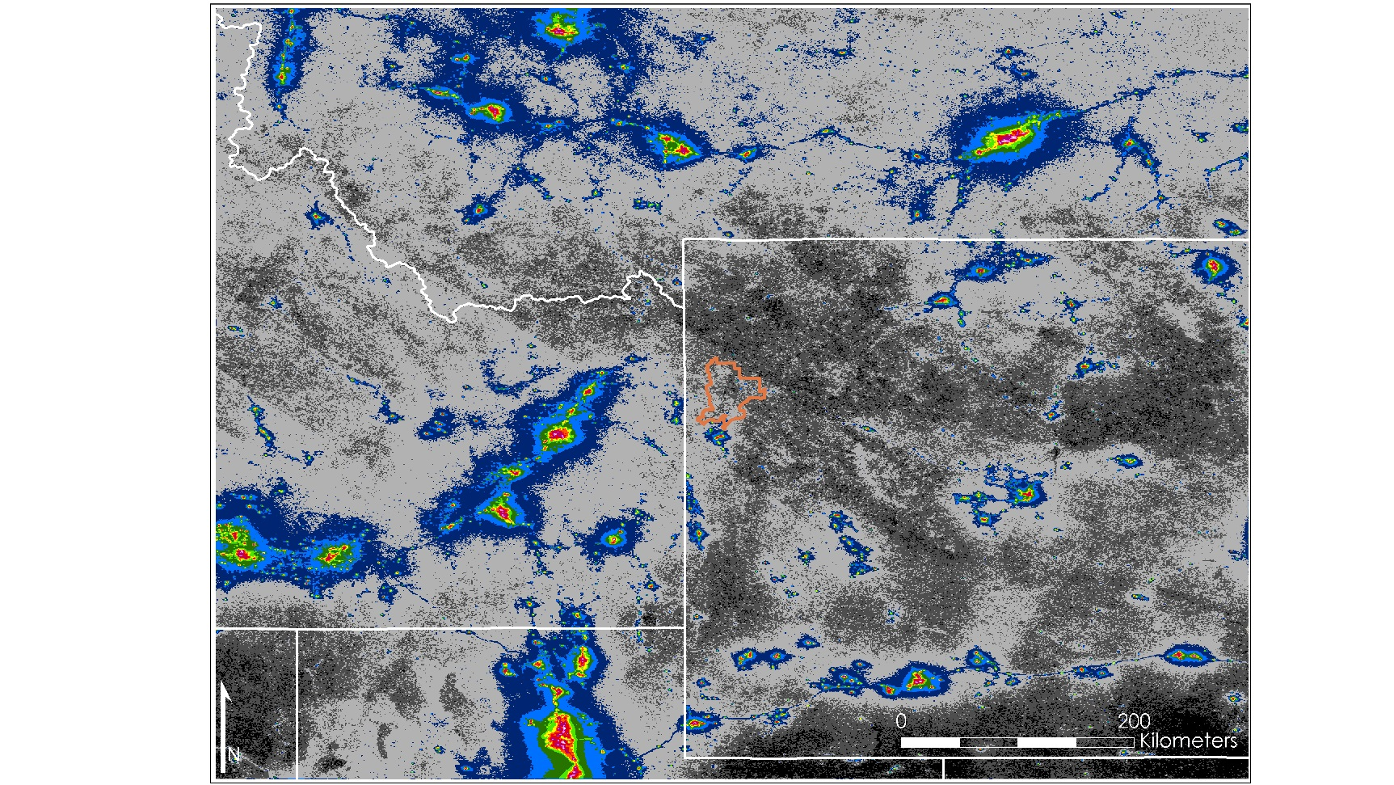
Results
Median Radiance - Summers, 2014 - 2016
Ratio of Artificial Sky Brightness to Natural Sky Brightness
| | | | | | | | | | | | |
0.01 0.02 0.04 0.08 0.16 0.32 0.64 1.28 2.5 6 5.10 10.24 20.50 41.00
Image Credit: Wyoming Cross-Cutting II Team
Notes:
This image depicts the ratio of artificial sky brightness at zenith to natural sky brightness during the study period defined for this project, with cooler colors indicating smaller ratios and darker skies. The median of the months was taken and used as the input image for SET. Looking at the image on the left, we can see significant light pollution coming from cities such as, Salt Lake City, Idaho Falls, Pocatello, and Billings. In the image on the right, we can see Jackson and the villages in Grand Teton National Park.
--advance slide--
Image Source: Wyoming Cross-Cutting II Team

Slide 21

Discussion
Median Radiance
Summers, 2014 - 2016
Ratio of Artificial Sky Brightness to Natural Sky Brightness
0.00 - 0.01
0.01 - 0.02
0.02 - 0.04
0.04 - 0.08
0.08 - 0.16
0.16 - 0.32
0.32 - 0.64
0.64 - 1.28
1.28 - 2.56
2.56 - 5.12
5.12 - 10.24
10.24 - 20.50
20.50 - 41.00
Image Credit: Wyoming Cross-Cutting II Team
Image Credit: Wyoming Cross-Cutting II Team
Notes:
We used the median value rather than the mean in order to dampen the effects of outliers on the overall image. In this case, outliers can be significantly dark values due to the Suomi NPP VIIRS sensor’s inability to measure accurately very dark values. Or, they can be unusually bright values from temporary light sources including wildfires and gas flares. As we previously mentioned, there are two temporal restrictions on collecting data for our study area. This resulted in a composite from July, August, and September from 2014 to 2016 to remove the brightening effect of snow cover. You might note that our summer months are shifted later in the year than is traditionally expected, this is due to the high elevation and latitude of the park.
--advance slide—
Image Source: Wyoming Cross-Cutting II Team

Slide 22
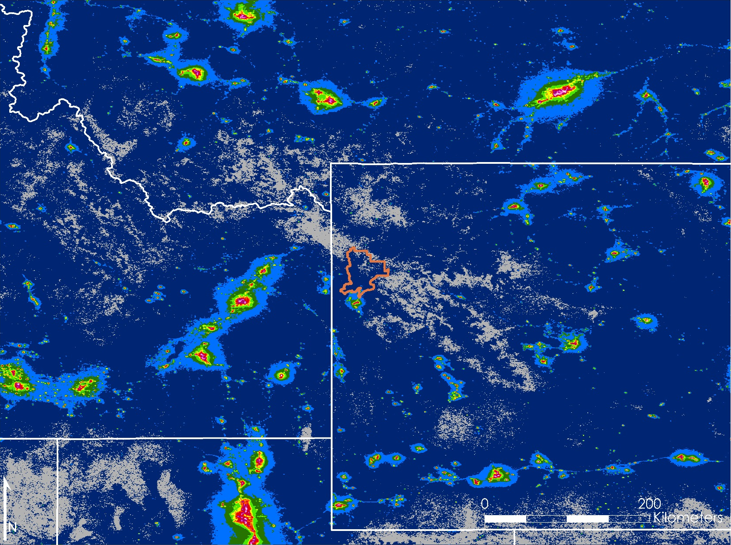
Results
Mean Radiance
6 Months, 2014
Ratio of Artificial Sky Brightness to Natural Sky Brightness
0.00 - 0.01
0.01 - 0.02
0.02 - 0.04
0.04 - 0.08
0.08 - 0.16
0.16 - 0.32
0.32 - 0.64
0.64 - 1.28
1.28 - 2.56
2.56 - 5.12
5.12 - 10.24
10.24 - 20.50
20.50 - 41.00
Image Credit: Wyoming Cross-Cutting II Team
Image Credit: Wyoming Cross-Cutting II Team
Notes:
It was important that we tested SET using the exact parameters used in the New World Atlas in order to validate the math in our model. Therefore, we created a mean composite VIIRS image using data from six months in 2014 and ran it through SET. The image shown here is the ratio of artificial sky brightness produced by SET to the natural sky brightness, estimated to be about 174 micro-candelas (ucd/m2) per meter squared.
--advance slide--
Image Credit: Wyoming Cross-Cutting II Team

Slide 23

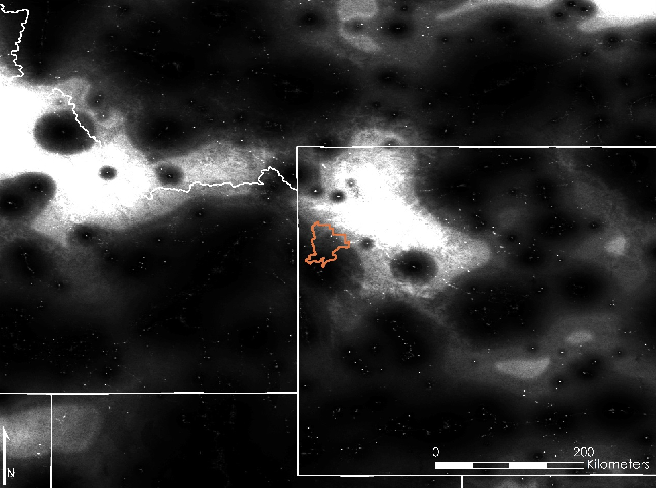
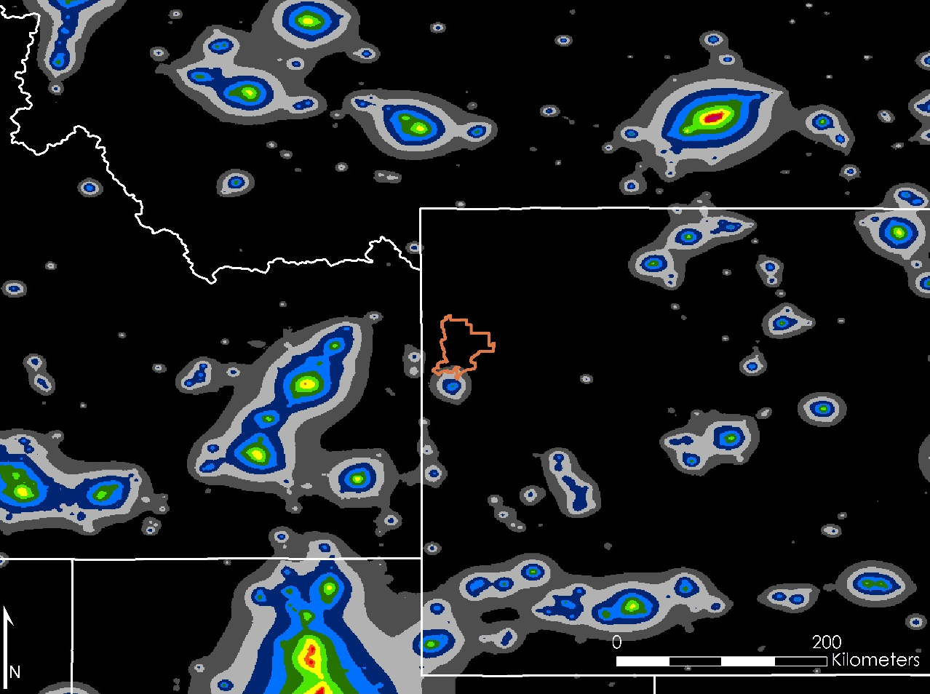
Discussion
SET Model (Mean) vs. New World Atlas – 6 months, 2014
Ratio of Artificial to Natural Sky Brightness
New World Atlas
High Similarity
Low Similarity
| | | | | | | | | | | | |
0.01 0.02 0.04 0.08 0.16 0.32 0.64 1.28 2.5 6 5.10 10.24 20.50 41.00
Image Credit: Wyoming Cross-Cutting II Team
Notes:
The map we produced was divided by the New World Atlas to see how close our model recreates the results. We can see on the right that this recreation was not as close as the previous model and the map we produced was overall much brighter than we expect to see. The image on the left shows where the light sources are and the image on the right shows how similar the two images are.
--advance slide--
Image Source: Wyoming Cross-Cutting II Team

Slide 24
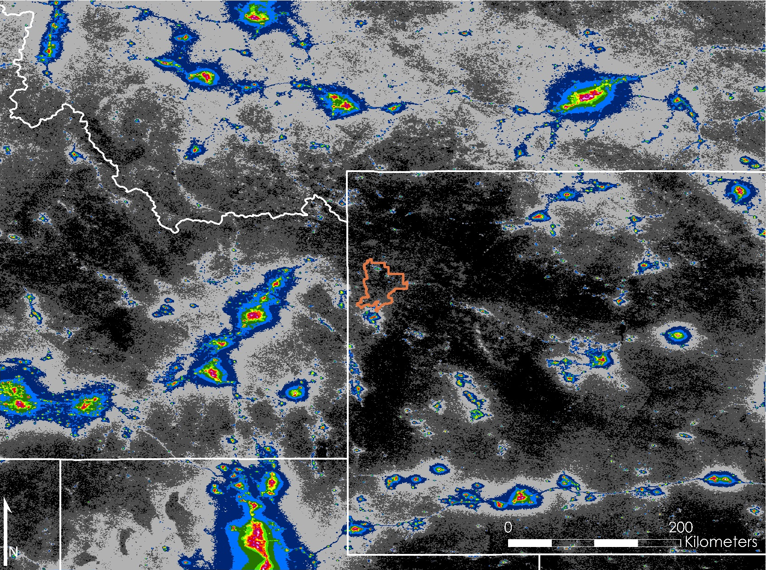
Results
Mean Radiance
Summers, 2014 - 2016
Ratio of Artificial Sky Brightness to Natural Sky Brightness
0.00 - 0.01
0.01 - 0.02
0.02 - 0.04
0.04 - 0.08
0.08 - 0.16
0.16 - 0.32
0.32 - 0.64
0.64 - 1.28
1.28 - 2.56
2.56 - 5.12
5.12 - 10.24
10.24 - 20.50
20.50 - 41.00
Image Credit: Wyoming Cross-Cutting II Team
Image Credit: Wyoming Cross-Cutting II Team
Notes:
This image depicts the ratio of artificial sky brightness at zenith to natural sky brightness using the mean of the summer months of 2014, 2015, and 2016. As you can see, there are dark colors in more rural areas and bright colors in urban areas.
-or-
The image on the left is the Wyoming Cross-Cutting study time frame (July, August, and September of 2014, 2015, and 2016) compiled into a mean image then put into the code to produce a skyglow map. That map was then divided by 174 ucd/m2 to produce a map of artificial sky brightness to natural sky brightness just like in the New World Atlas.
--advance slide--
Image Credit: Wyoming Cross-Cutting II Team

Slide 25
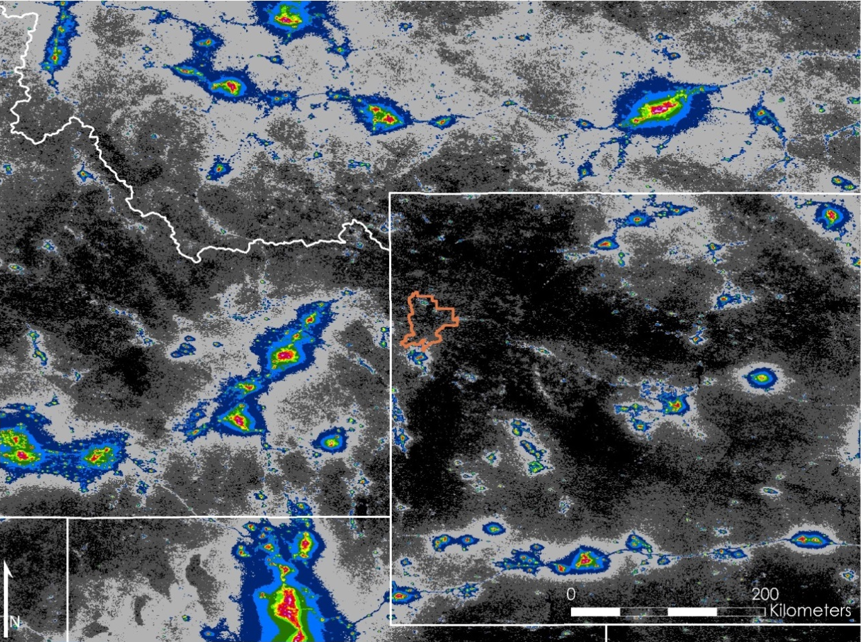
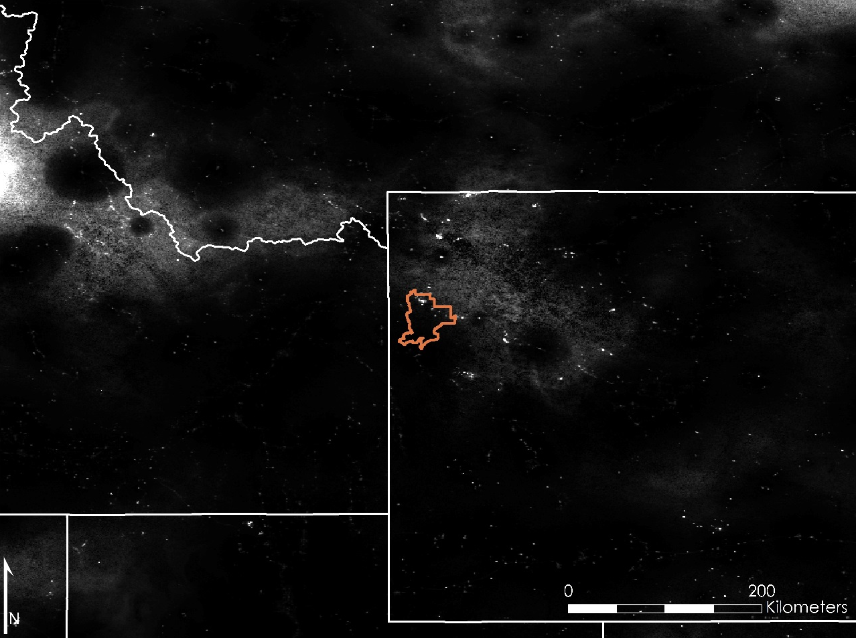
Discussion
SET Model (Mean) vs. New World Atlas – Summers, 2014 - 2016
Ratio of Artificial to Natural Sky Brightness
New World Atlas
High Similarity
Low Similarity
| | | | | | | | | | | | |
0.01 0.02 0.04 0.08 0.16 0.32 0.64 1.28 2.5 6 5.10 10.24 20.50 41.00
Image Credit: Wyoming Cross-Cutting II Team
Notes:
The image on the left is quite similar to the New World Atlas model, which could be because the SET model is using more months than the New World Atlas to account for the New World Atlas’ spatial filtering. The image on the right shows how similar the image on the left is to the New World Atlas.
Because we use the average values, the influence of outliers is greater than that on the median. This means that the high values are higher and the low values are lower, which explains why there is a greater color range than our median radiance map.
--advance slide--
Image Source: Wyoming Cross-Cutting II Team

Slide 26
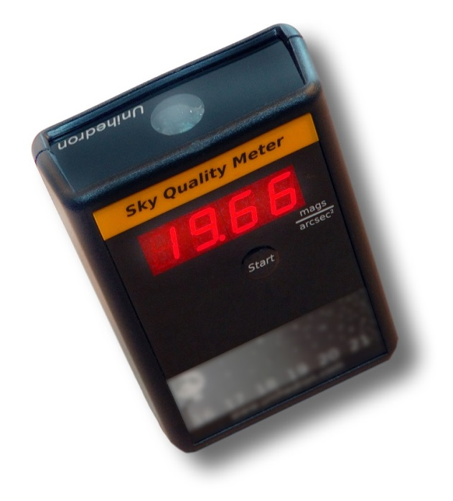
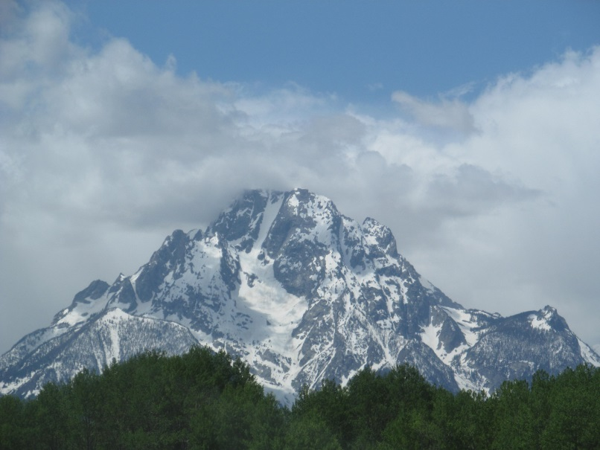
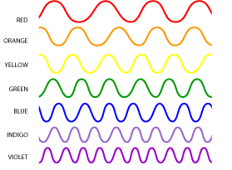
Uncertainties
Validation
Topographic shielding
Blue blindness
Needs verification of model accuracy
Not accounted for in model
VIIRS DNB (500 nm - 900 nm) not sensitive to shorter wavelengths
Image Credit:
© 2010 Lamiot/Wikipedia cc by-sa 3.0
Image Credit:
© 2014 Doug Kerr/Flickr cc by-sa 2.0
Image Credit:
NASA
Notes:
We would also like to discuss some sources of uncertainty in our model. At this point, we have not had the chance to validate our model with ground-based measurements taken by our partners. In addition, even though our study area is in a mountainous region, we have not accounted for the effects of topographic shielding, which could block light from surrounding areas. Finally, as society transitions to LED lights, more emitted light comes from the blue end of the spectrum, which the VIIRS sensor is not sensitive to. This could result in a perceived reduction in skyglow predicted by SET when in reality, the VIIRS sensor is not picking up the increased amount of blue light.
--advance slide--
Image Sources:
Kerr, D. (n.d.). Grand Teton National Park - Wyoming [Photograph found in Grand Teton National Park]. Retrieved June 29, 2017, from https://flic.kr/p/o79hvH (Originally photographed 2014, June 1); Lamiot. (2010, December 11). SkyQualityMeterQM-LFlou [Digital image]. Retrieved June 29, 2017, from https://zh.wikipedia.org/wiki/%E5%A4%9C%E7%A9%BA%E8%B4%A8%E9%87%8F%E4%BB%AA#/media/File:SkyQualityMeterQM-LFlou.jpg; NASA. (2011, February 25). [ROYGBIV Waves]. Retrieved June 29, 2017, from https://science.hq.nasa.gov/kids/imagers/ems/roygbiv_waves.gif

Slide 27
Conclusions
“The Skyglow Estimation Toolbox and the Skyglow Maps are going to be an incredible educational tool for us to use to show people through high quality imagery about the amount of light pollution we have in Jackson.”
– Samuel Singer, PhD
Executive Director
Wyoming Stargazing
Notes:
We hope to conclude this term using these products as an educational tool to show people high quality imagery of light pollution.
--advance slide--
Quote Source: Singer, S. (2017, July). VPS Interview [Personal interview] [emphasis added]

Slide 28
Conclusions
Image Credit: Wyoming Cross-Cutting II Team
SET models light pollution
User interface increases accessibility
SET expands scope of current management practices
Artificial Skyglow Maps identify sources of light pollution
Mean Artificial Skyglow Map is a slightly better representation than the Median when compared to the New World Atlas
Notes:
Our team reached the following conclusions:
The Skyglow Estimation Toolbox (SET) and Suomi NPP VIIRS imagery combined can model light pollution as viewed from the ground.
The graphical user interface will increase accessibility.
SET offers broader, more dynamic capabilities and applications than handheld light meters, allowing park officials to expand the scope of current measurement practices.
Artificial Skyglow Maps identify sources of light pollution and show patterns of light scatter and propagation.
And finally, both the Median and Mean Skyglow Artificial Maps closely resemble the New World Atlas, but the Mean is a slightly better representation than the Median.
--advance slide--
Image Source: Wyoming Cross-Cutting II Team

Slide 29
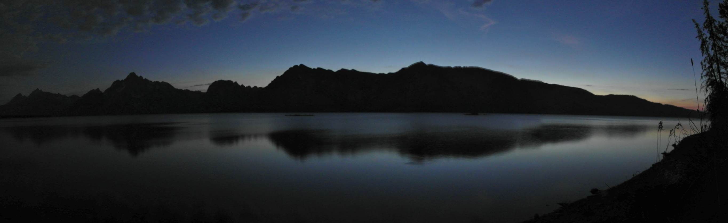
Future Work
Conduct in situ measurements and validate model
Incorporate effects of topographic shielding
Format to automatically update model with new images
Compile maps to analyze long-term lighting trends
Fall 2017: light pollution in the Colorado Plateau
Image Credit: © 2011 Sebastian Werner/Flickr cc by 2.0
Notes:
Short Script
In Fall 2017, a new NASA DEVELOP team is partnering with the National Park Service, Intermountain Region to continue improving our research. Future directions that team could take include conducting in situ measurements, incorporating effects of topographic shielding, accounting for blue light, and enhancing SET to update automatically to analyze long-term trends.
In short, SET would give communities and parks around the world the power to determine the impact of outdoor artificial lighting on their night skies and to use this data to further enhance their decision making process in regards to lighting ordinances.
Long Script
With these uncertainties in mind, we believe that future work on measuring light pollution could further improve on our research. As previously mentioned, the Artificial Sky Glow Map is a model of light propagation, so in situ measurements could be used to validate the model and ensure the accuracy within the study area. SET could also be altered to incorporate the effects of topographic shielding on sky glow. Another potential project could be to format the model to update as new composite images are released from the NOAA NCEI EOG. Lastly, future work could focus on creating more Artificial Sky Glow Maps to analyze long term lighting trends.
This project will continue into the Fall 2017 term. Similar to our project, the Fall project will detect nighttime changes in sky brightness by using SET to produce an Artificial Sky Glow Map, but the study area will be shifted to the Colorado Plateau. This region has various large cities and state and national parks such as the Grand Canyon, so a comprehensive study of sky glow in this region would allow cities and parks to understand the current state of the night sky in their area. As with our project, in situ measurements will also be needed to verify SET’s predicted values. In short, SET would give communities and parks around the world the power to determine the impact of outdoor artificial lighting on their night skies and to use this data to further enhance their decision making process in regards to lighting ordinances.
--advance slide--
Image Source: Werner, S. (n.d.). Teton range [Photograph found in Grand Teton National Park]. Retrieved June 29, 2017, from https://flic.kr/p/aoFecX (Originally photographed 2011, September 19)

Slide 30
Acknowledgements
Partners
Dan Greenblatt | Colter Bay District Interpretive Ranger, Grand Teton National Park
Randy Stanley | Natural Sounds and Night Skies Coordinator, National Park Service, Intermountain Region
Sharolyn Anderson, PhD | Research Scientist, National Park Service, Natural Sounds and Night Skies Division
Li-Wei Hung, PhD | Research Scientist, National Park Service, Natural Sounds and Night Skies Division
Samuel Singer, PhD | Executive Director, Wyoming Stargazing
Notes:
Short Script
We would like to thank our partners for their cooperation, assistance, and enthusiasm.
Long Script
We would like to thank our partners for their cooperation, assistance, and enthusiasm: Dan Greenblatt, Colter Bay District Interpretive Ranger at Grand Teton National Park; Randy Stanley, Natural Sounds and Night Skies Coordinator of the National Park Service, Intermountain Region; Sharolyn Anderson, PhD, Research Scientist of the National Park Service, Natural Sounds and Night Skies Division; Li-Wei Hung, PhD, Research Scientist of the National Park Service Natural Sounds and Night Skies Division; and Samuel Singer, PhD, Executive Director of Wyoming Stargazing.
--advance slide--

Slide 31
Acknowledgements
Science Advisors
Dr. Kenton Ross | Lead Science Advisor, NASA DEVELOP National Program
Dr. L. DeWayne Cecil | Chief Climatologist, NOAA National Centers for Environmental Information & Program Manager, Global Science and Technology, Inc.
Bob VanGundy | Geology Professor, The University of Virginia’s College at Wise
Notes:
Short Script
We are also grateful for the guidance and assistance received throughout the term from our science advisors.
Long Script
We are also grateful for the guidance and assistance received throughout the term from our science advisors: Dr. Kenton Ross, Lead Science Advisor for NASA DEVELOP National Program; Dr. L. DeWayne Cecil, Chief Climatologist at NOAA National Centers for Environmental Information and Program Manager of Global Science & Technology, Inc.; and Bob VanGundy, Geology Professor at The University of Virginia’s College at Wise.
--advance slide--

Slide 32
Acknowledgements
Wise County Clerk of Circuit Court’s Office
Benjamin Marcovitz | Wyoming Cross-Cutting Team, NASA DEVELOP National Program
Aubrey Hilte | Wyoming Cross-Cutting Team, NASA DEVELOP National Program
Eric White | Wyoming Cross-Cutting Team, NASA DEVELOP National Program
Christine Stevens | Acting Center Lead, Assistant Center Lead, Wyoming Cross-Cutting Team, NASA DEVELOP National Program
J. Michael Brooke | Former Center Lead, NASA DEVELOP National Program
Notes:
Short Script
Finally, we would like to acknowledge those at the Wise County node who have helped us make this project successful.
Long Script
Finally, we would like to acknowledge those at the Wise County node who have helped us make this project successful: Benjamin Marcovitz, Aubrey Hilte, and Eric White, Wyoming Cross-Cutting Team members at NASA DEVELOP Wise County Clerk of Circuit Court’s Office; Christine Stevens, Acting Center Lead, Assistant Center Lead, and Wyoming Cross-Cutting Team member at NASA DEVELOP Wise County Clerk of Circuit Court’s Office; and Michael Brooke, Former Center Lead at NASA DEVELOP Wise County Clerk of Circuit Court’s Office.
--advance slide--

Slide 33
Thank you!
Questions?
Notes:
We would like to thank you for listening to our presentation. We can now answer any questions you may have.
--end--

Slide 34
Additional Slides
Notes:
**NOTE** The following are backup slides that can be used as a reference to answer questions from the audience.

Slide 35
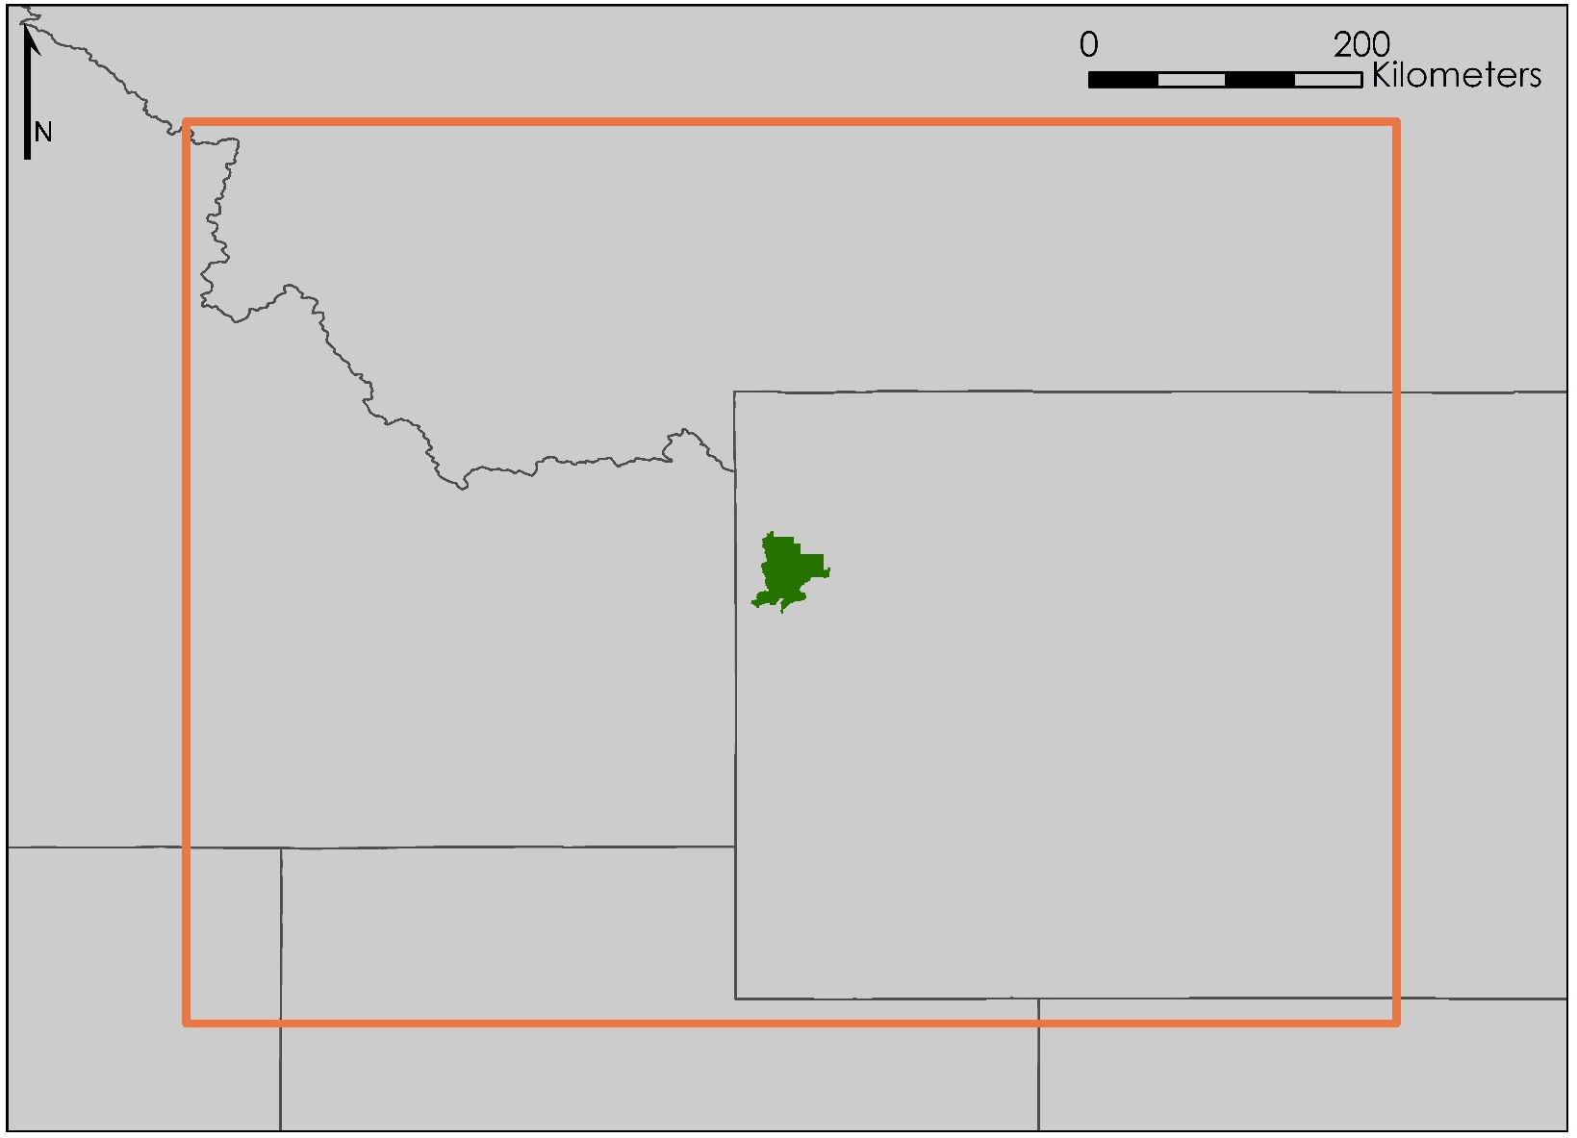
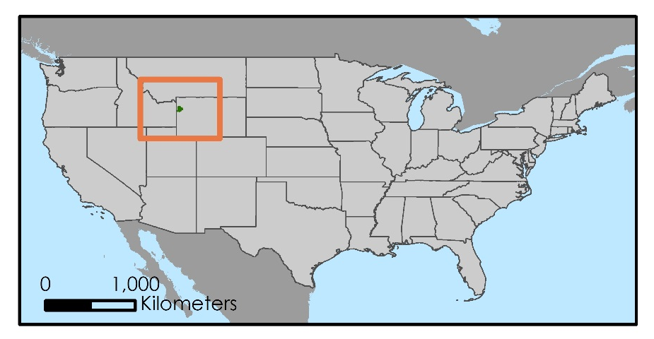
Study Area
Grand Teton National Park
Study Area (300 km buffer)
State Boundary
Montana
Idaho
Wyoming
Map Credit: Wyoming Cross-Cutting II Team
Nevada
Utah
Colorado
Study Period: July – September, 2014 – 2016
Notes:
Here is another version of our study area map. As previously mentioned, to ensure our study was comprehensive, we expanded our study area to include all possible light sources, and we determined that a 300 km buffer would be necessary. This includes areas from Colorado, Idaho, Montana, Nevada, and Wyoming. However, there are two temporal restrictions on collecting data for our study area. First, snow coverage increases sky brightness 1.3- to 2.6-fold when partially present on lit roads due to snow’s high. Since snow is usually promptly removed from roads, the brightening effect of snow cover was determined to be unrepresentative of true night sky quality. Therefore, only summer months with low snow cover, July, August, and September, were used. Second, no stray light corrected data over Grand Teton is available before 2014. As a result, a multi-annual composite of a total nine months is utilized in the dataset: July, August, and September from 2014 to 2016.
----
Sources: Falchi, F. (2011). Campaign of sky brightness and extinction measurements using a portable CCD camera. Monthly Notices of the Royal Astronomical Society, 412(1), 48. http://doi.org/10.1111/j.1365-2966.2010.17845.x; Falchi, F., Cinzano, P., Duriscoe, D., Kyba, C. C. M., Elvidge, C. D., Baugh, K., Furgoni, R. (2016). The new world atlas of artificial night sky brightness. Science Advances, 2(6), 6. http://doi.org/10.1126/sciadv.1600377; Earth Observation Group. (2017). Version 1 Nighttime VIIRS Day/Night Band Monthly Composites. NOAA National Centers for Environmental Information. Available from https://www.ngdc.noaa.gov/eog/viirs/download_dnb_composites.html
Map Credit: Wyoming Cross-Cutting II Team
Map Source: DIVA-GIS. Free Spatial Data. Retrieved June 21, 2017, from http://www.diva-gis.org/Data

Slide 36
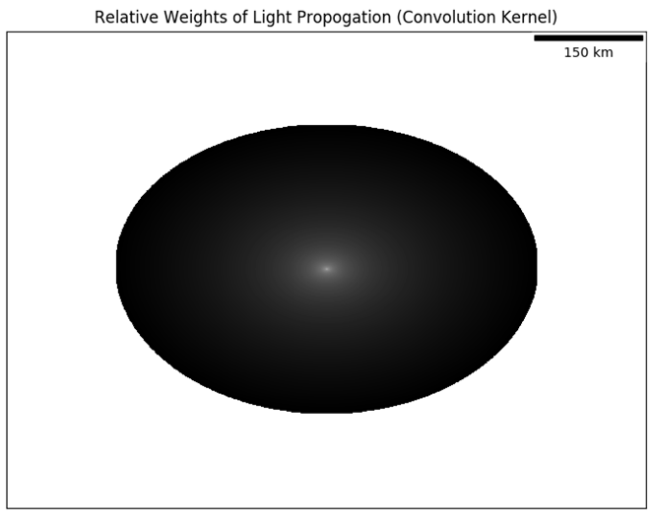
Convolution Kernel
Part of Skyglow Estimation Toolbox
Depends on parameters
Fast Fourier Transform
2-6 hours to create
Image Credit: Wyoming Cross-Cutting II Team
Notes:
The current project focused on integrating the SET into ArcGIS and generating an image visualizing the total skyglow at zenith in and around the park. How it works is that a kernel is created to calculate the amount of scattered light affecting the line of sight at a location. Each pixel value in the kernel represents the relative weight of light propagation, a coefficient determining how much light from neighboring pixels contributes to the pixel of interest. In other words, the farther the pixel is from the center, the dimmer the pixel is since there is less light from that pixel reaching the center. The kernel is not georeferenced to a specific position of the study area. Therefore, it’s valid for a regional range of latitudes and longitudes. However, the kernel does depend on other parameters input by the user when running the code, such as the zenith angle, beta angle, and central latitude of the region. Thus, changing the line of sight would necessitate producing a new kernel. This creation currently takes about 6 hours to do.
To improve the efficiency of the light propagation calculations, a mathematical shortcut known as the Fast Fourier Transform was used. This converts the input VIIRS DNB image and the kernel into frequency space. Because the inverse Fast Fourier Transform of the product of two transformed images is equal to the convolution of two images, using the Fast Fourier Transform to complete this calculation expedited the calculation of the final product: the total amount of skyglow over our study region.
----
Image Source: Wyoming Cross-Cutting II Team

Slide 37
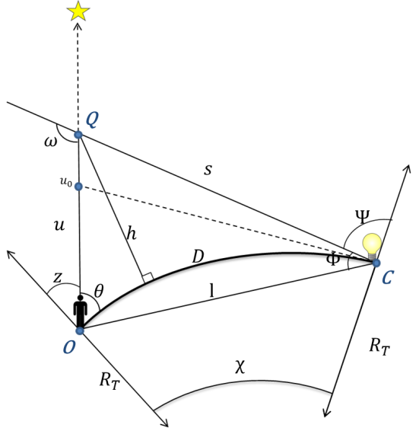
Geometric Relationships
Based on Garstang (1989) and Cinzano et al. (2001)
Graphic Credit: Wyoming Cross-Cutting I & II Teams
Notes:
This model is based on Garstang (1989) and Cinzano et al. (2001). It tells you how and how much light is scattered from that source (C) to the line of sight from the observer (O). The math and physics regarding light propagation found in the code uses these geometrical relationships to construct a kernel.
----
Graphic Credit: Wyoming Cross-Cutting I & II Teams [Adapted from: Garstang, R. H. (1989). Night-sky brightness at observatories and sites. Publications of the Astronomical Society of the Pacific, 101(637), 306. doi:10.1086/132436; Cinzano, P., Falchi, F., & Elvidge, C. D. (2001). The first World Atlas of the artificial night sky brightness. Monthly Notices of the Royal Astronomical Society, 328(3), 689-707. doi:10.1046/j.1365-8711.2001.04882.x]

Slide 38
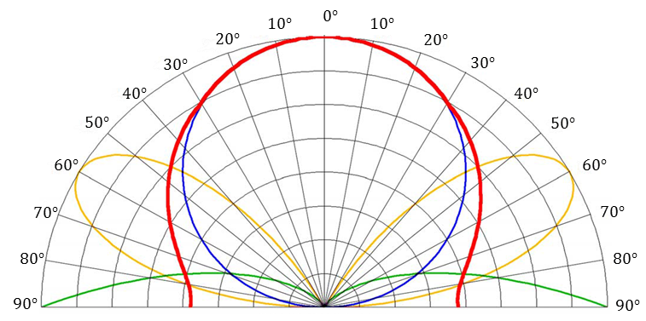
Skyglow Emissions Functions
Graphic Credit: Falchi et al. (2016)
Notes:
These equations describe how light travels through the atmosphere as sky-glow, but we have not yet described the emission of light at the source. Falchi et al. (2016) proposes three models of emission named $A$, $B$, and $C$.
Model A is the blue circle representing emissions due to Lambertian reflectance at the ground, directing the most energy toward the zenith above the light source. Model B, the green curves at the bottom of the figure, represent emissions due to specular reflectance at the ground. Model C, traced by the yellow curves, is a combination of models A and B. Note that with the view of the night sky angled in the above figure, the angle marked on the outside of the chart is $ψ$.
----
Graphic Source: Falchi, F., Cinzano, P., Duriscoe, D., Kyba, C. C. M., Elvidge, C. D., Baugh, K., Furgoni, R. (2016). The new world atlas of artificial night sky brightness. Science Advances, 2(6), e1600377. doi:10.1126/sciadv.1600377

Slide 39
Foundational Papers
Notes:
Here are the four papers that served as the basis for our project and our models. They should be accessible via most online subscription-based research databases.
----
**NOTE** We have this here so don’t have to go back into the presentation to find the articles we used.
Screenshot Sources: Cinzano, P., Falchi, F., Elvidge, C. D., & Baugh, K. E. (2000). The artificial night sky brightness mapped from DMSP satellite Operational Linescan System measurements. Monthly Notices of the Royal Astronomical Society,318(3), 641-657. doi:10.1046/j.1365-8711.2000.03562.x
; Cinzano, P., Falchi, F., & Elvidge, C. D. (2001). The first World Atlas of the artificial night sky brightness. Monthly Notices of the Royal Astronomical Society, 328(3), 689-707. doi:10.1046/j.1365-8711.2001.04882.x; Falchi, F., Cinzano, P., Duriscoe, D., Kyba, C. C. M., Elvidge, C. D., Baugh, K., Furgoni, R. (2016). The new world atlas of artificial night sky brightness. Science Advances, 2(6), e1600377. doi:10.1126/sciadv.1600377; Garstang, R. H. (1989). Night-sky brightness at observatories and sites. Publications of the Astronomical Society of the Pacific, 101(637), 306-329. doi:10.1086/132436

Slide 40
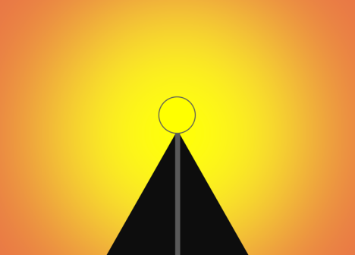
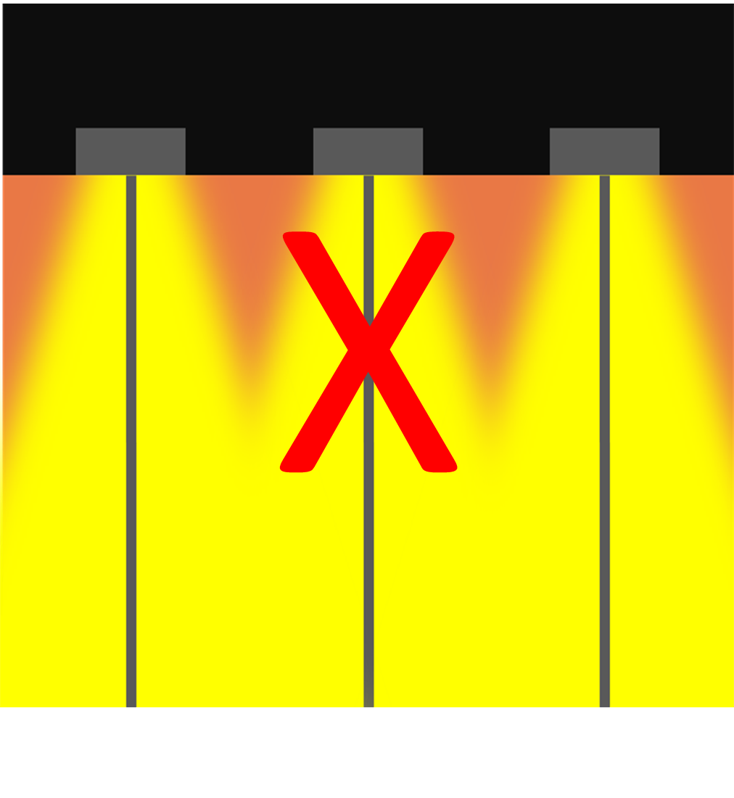
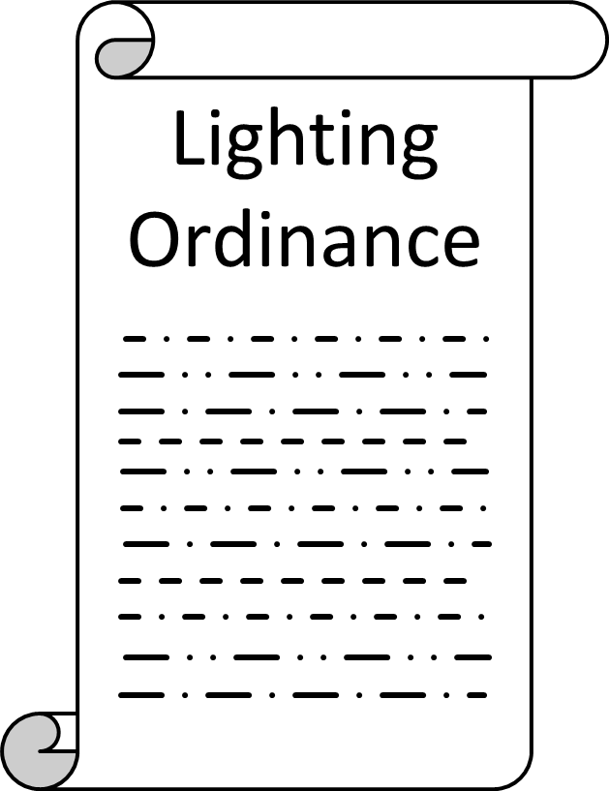
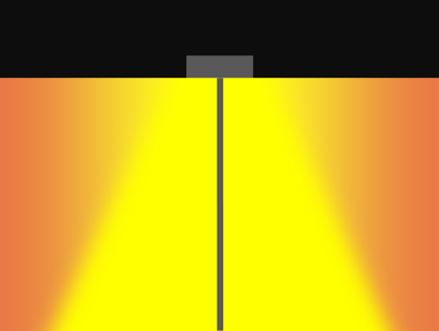
Reducing Light Pollution
Shield Light Fixtures
Light Only What Is Needed
Establish Lighting Ordinances
Graphics Credit: Wyoming Cross-Cutting II Team
Notes:
Although light pollution does have serious ramifications, it is a problem that can easily be reversed. You can easily make a measurable difference in your community by following these guidelines:
Shield light fixtures. In this graphic, the top image shows an unshielded light fixture, and the bottom shows a shielded one. As we mentioned during our presentation, half of the light in an unshielded light fixture is wasted. So by shielding your outdoor light fixtures, you not only save money in energy costs, but also protect the night skies. Light only
Light only what’s needed. Use the minimum amount of lightning needed to illuminate the target area, and turn on lights only for the time is needed. Here, the center fixture is not needed since the outer two fixtures already successfully illuminate the areas covered by the center one.
Finally, work with local governments to establish lighting ordinances that limit light pollution. Our project partner Wyoming Stargazing has been successful in this area, with Teton County and Jackson implementing lighting regulations in January 2017.
---
Graphics Source: Wyoming Cross-Cutting II Team

