Slide 1
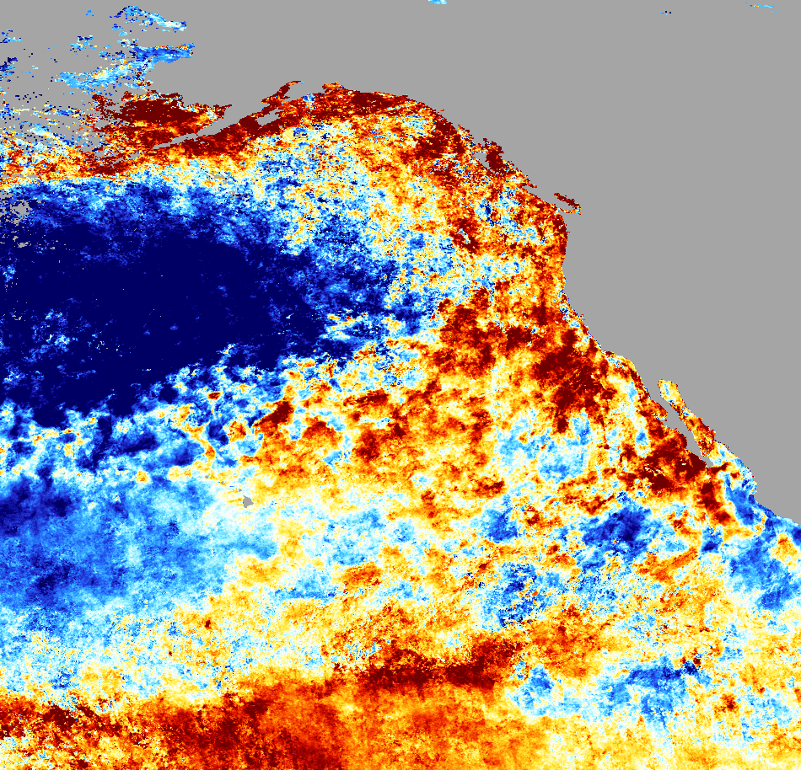
SOUTHERN CALIFORNIA OCEANS
Analyzing NASA Earth Observation Data to Evaluate Grunion Response to Ecosystem Changes Forced by Recent Environmental Conditions in California’s Oceans
Lael Wakamatsu
Sol Kim
Ariana Nickmeyer
NASA Jet Propulsion Laboratory
2017 Summer
Notes:
Thank you for being here today.
My name is Lael Wakamatsu,
I’m Sol Kim,
And I’m Ariana Nickmeyer. We are the Southern California Oceans Team.
Image Source: MUR SST Anomaly April 2003-2016 processed by Team Grunion

Slide 2
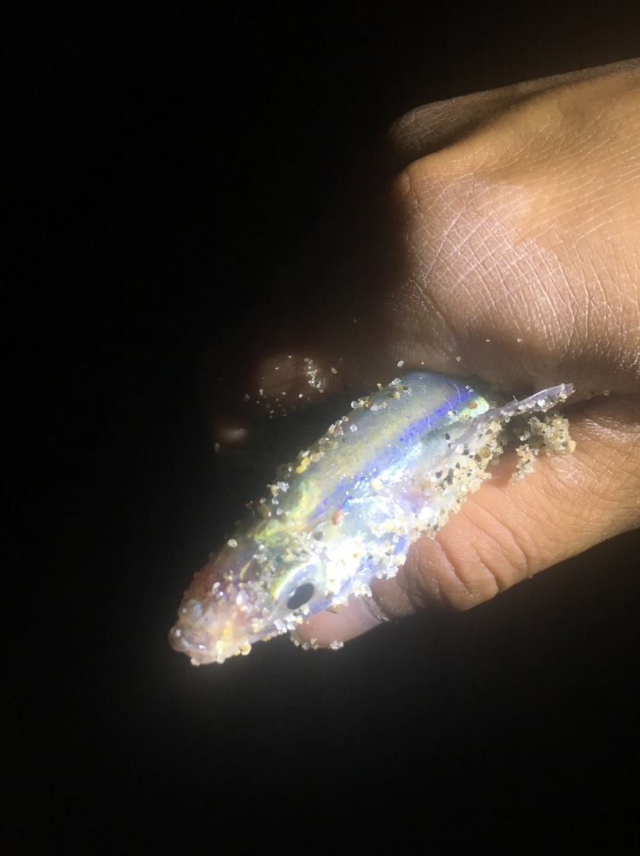
What is a grunion?
Small, silver endemic California fish species
Come onto the beaches to spawn
Spawn during the full and new moon when the tides are the highest
Vulnerable to air and ocean temperature changes
Image Credit: Team Grunion
Notes:
The California grunion is a small, silvery fish found only here in California and Baja California. They are known for their unusual spawning behavior, which follows the lunar cycle.
When the tides are the highest during the new and full moon, the fish come onto the beach to lay their eggs
They are sensitive to air and ocean temperatures which may determine their migration patterns
Image Source: Team Grunion

Slide 3
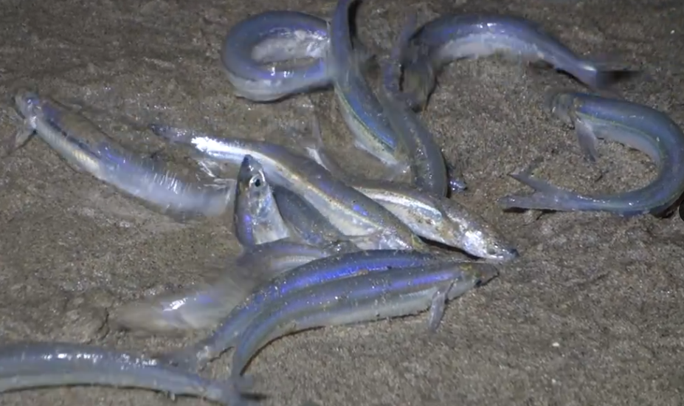
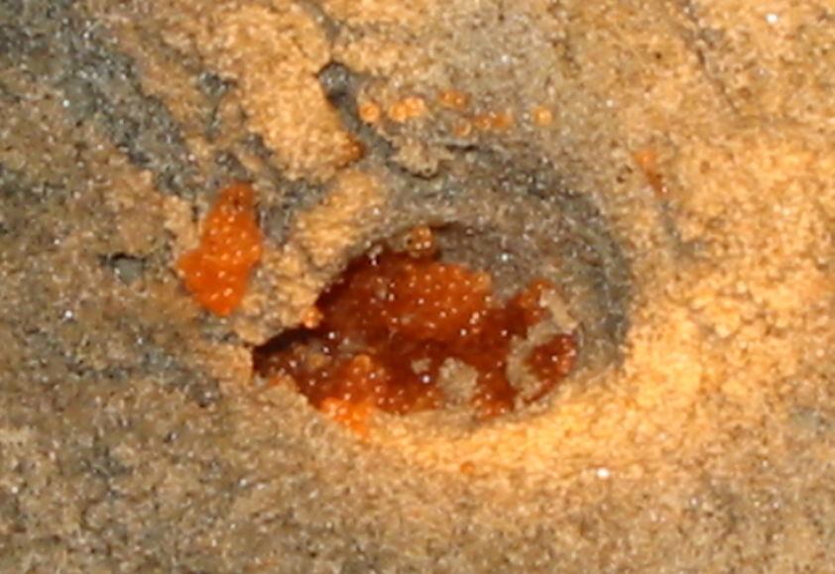
Grunion Run Basics
Appear during months March - August
Prefer sandy and open beaches
Females bury themselves vertically in the sand to lay their eggs
Grunion are fully developed in 2 weeks and are taken out to sea by the high tide
Occur along the California coast and Baja California
Image Credit: Monet
Image Credit: Michael Murrie & Holly Williams
Notes:
During the full and new moon, grunion engage in what is called a “grunion run,” where they come onto the beach with the high tide to mate.
The females will bury themselves backwards in the sand, depositing hundreds of eggs in her nest. Several males will come wrap themselves around her to deposit milt, or fish sperm, which will percolate down to fertilize the eggs.
Then the adults return to the sea with the waves, and the grunion eggs spend the next two weeks maturing under the sand, to return to the ocean with the high tide
Grunion image: Michael Murrie
Egg image: Holly Williams

Slide 4
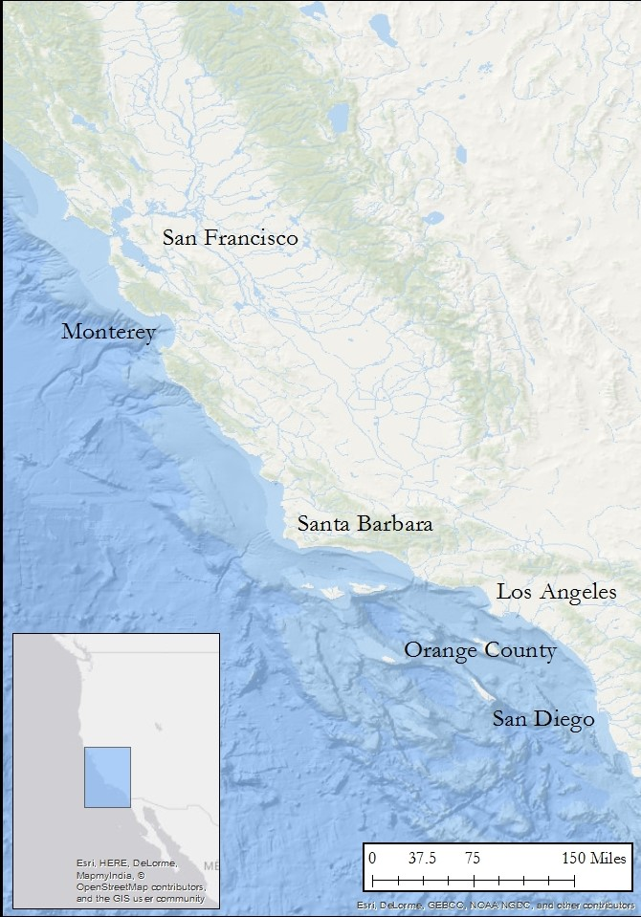
Study Area and Period
2003
April-August
2016
Notes:
April – August are the peak month for grunion spawning
Grunion usually occur in the Southern California coast, however in the last decade they have been appearing north near San Francisco and Monterey Bay
It is being determined by our partner Karen Martin why the fish may have migrated

Slide 5
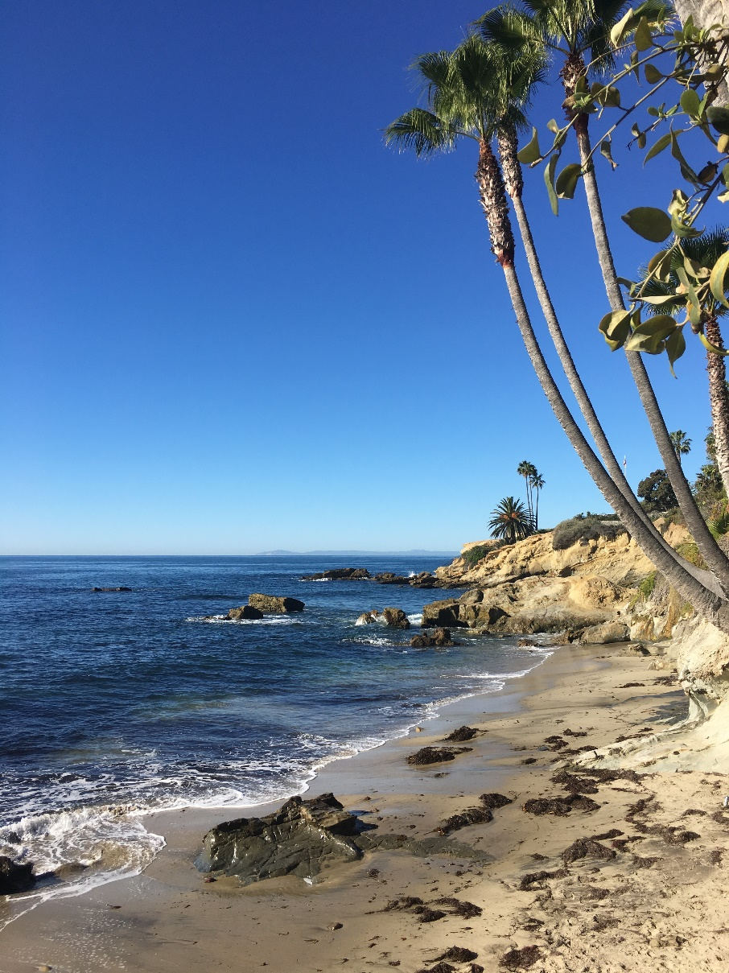
Objectives
Determine potential grunion beaches and factors of presence and magnitude
Analyze Sea Surface Temperature and Chlorophyll-a time series to locate potential future grunion spawning sites
Aid future decision-making to manage seasonal spawning locations and to protect the grunion
Image Credit: Team Grunion
Notes:
Image Source: Team Grunion
This project focuses on grunion migration patterns and trends
With sea surface temperature ,chlorophyll-a concentrations and grunion in situ data we will be able to determine if the grunion follow these variables.
The prediction of grunion spawning sites will help implement management policies to protect the species.

Slide 6
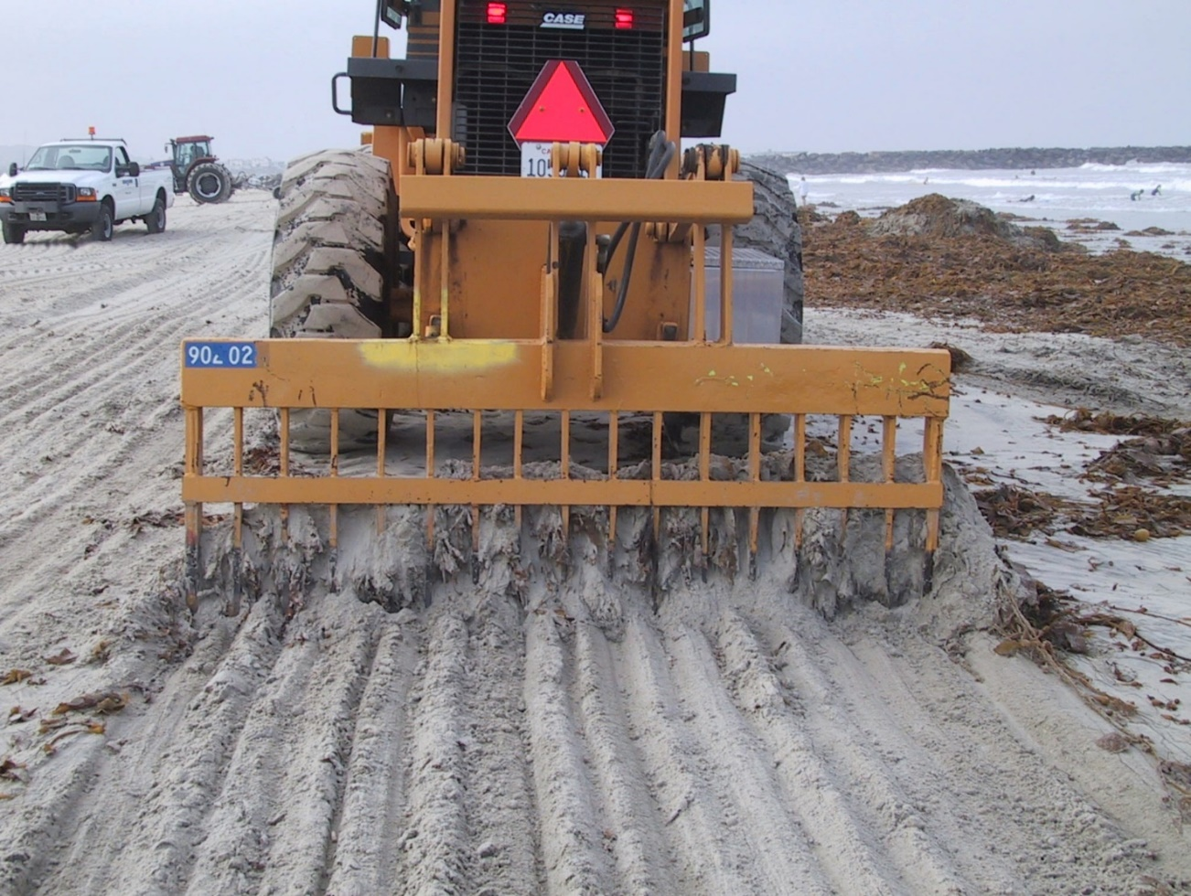
Community Concerns
Plays important ecological role in the marine food web
Human activities have decreased population
Grunion runs foster personal investment in the natural world and help educate the public
Species has migrated north up to San Francisco
Beach Grooming
Image Credit: Michael Murrie
Notes:
Image Source: Michael Murrie
Grunion are food sources to several species including seabirds, mammals and other fish
Human activities such as beach grooming, armoring and pollution.
Grunion runs help educate the public on this endemic species, it gets the community involved
The species has been found up north in San Francisco in the last decade, this is a new phenomenon pushing scientists to look at possible factors
Beach grooming is detrimental to grunion eggs. This tractor digs up thousands of eggs along the beach, making it difficult for any survivors to make it back to the ocean

Slide 7
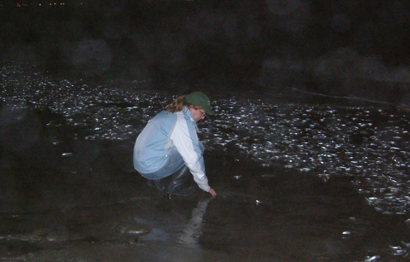
Partners
Grunion Greeters Project – Dr. Karen Martin
Created the Grunion Greeters Project to help educate the public
Organizes grunion runs for the community to collect data along the coast
Studies the fish migration patterns and biology
Promotes protection of the species
Image Credit: Monet
Image Credit: Karen Martin
Notes:
Image Source: https://vimeo.com/122608121
Karen Martin is a biology professor at Pepperdine University in Malibu, California.
She is currently studying temperature affects on grunion eggs and trying to look at migration patterns for the fish.
She puts on the grunion runs along the coast, and mostly attends the Malibu beach ones.
Karen is fighting to get more policies and protection acts for this threatened species.

Slide 8
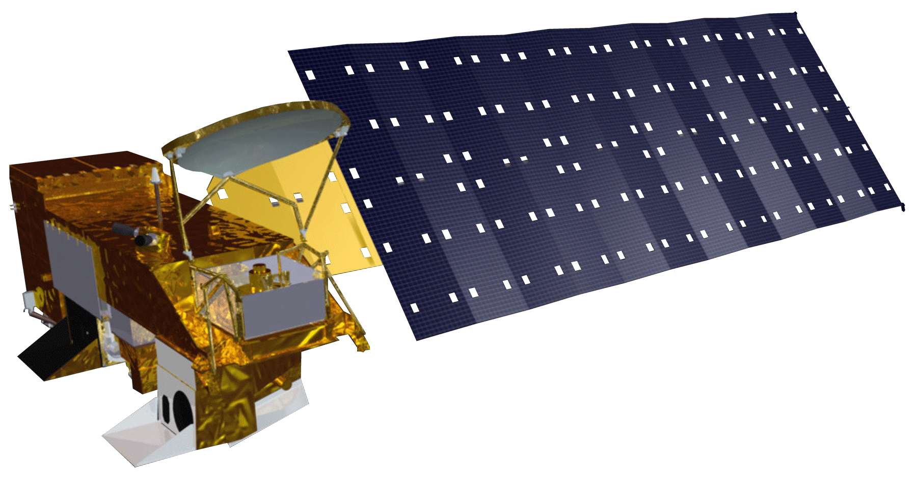
NASA Satellite
AMSR-E
AVHRR
AMSR2
WindSat
Buoys/
Ships
Aqua MODIS
MODderate Resolution Imaging Spectroradiometer
Chl-a
Level 3
8-day composite
1 km resolution
MUR SST
Multi-scale Ultra-high Resolution Sea Surface Temperature
Combination of SST data
Level 4
Daily
1 km resolution
Image Credit: DEVELOPedia
Notes:
Image Source: http://www.devpedia.developexchange.com/dp/Index.php?title=List_of_Satellite_Pictures
Aqua MODIS was the satellite used for the chlorophyll-a concentrations. 8-day composite, 1km resolution data was used – gathered from Ocean Color
MUR consisting of a range of data including SST records from AMSR-E, AMSR2, WindSat, AVHRR, and buoys/ships – gathered from PO.DAAC

Slide 9
Methodology
2003
SST
Chl-a
Apr
Predict grunion migration trends and patterns
Locate grunion run beaches
TIME SERIES MAPS
Aug
In situ
grunion data
2016
Satellite Image Credit: DEVELOPedia
Notes:
Image Source: http://www.devpedia.developexchange.com/dp/index.php?title=List_of_Satellite_Pictures
The satellite and in situ data were both looked at to find any patterns during the grunion spawning season and between the years 2003-2016.
The satellite data consisted of SST and Chl-a concentrations, the in situ data was from out partner Karen Martin on the number of grunion during a grunion run.

Slide 10
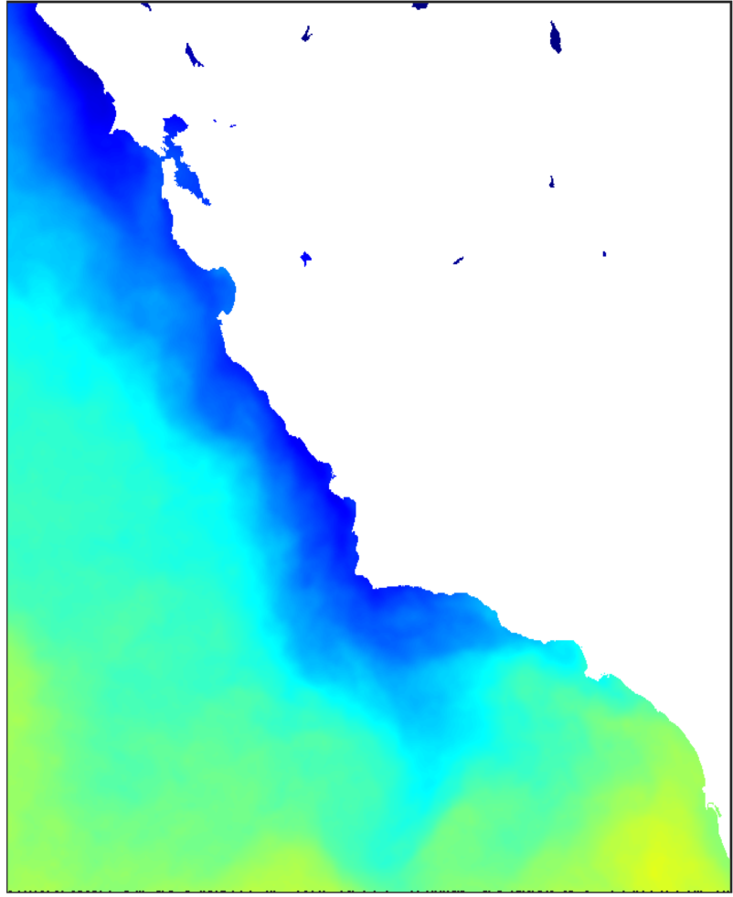
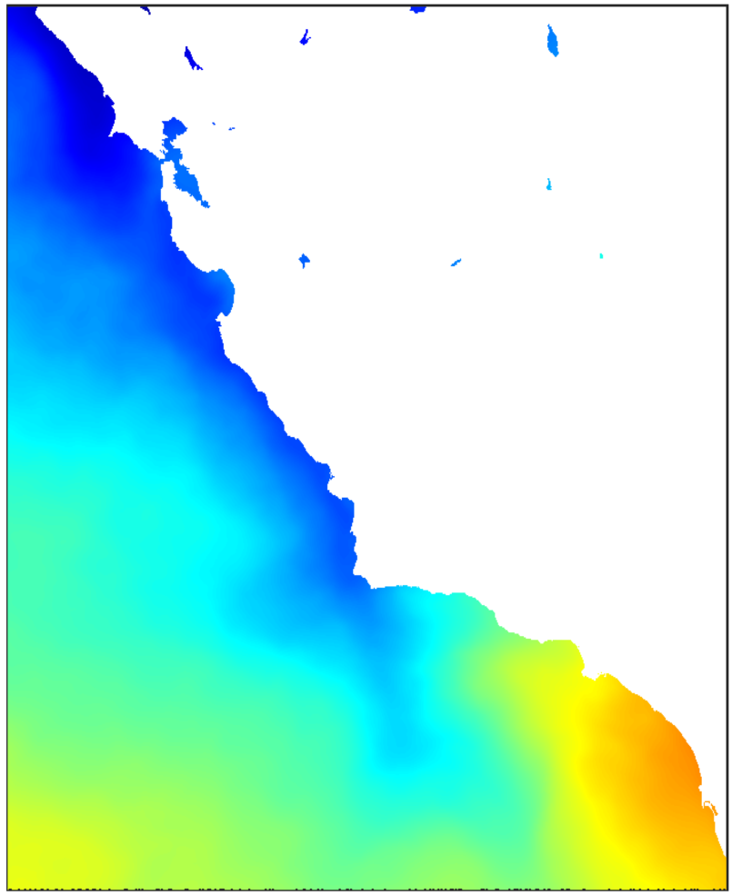
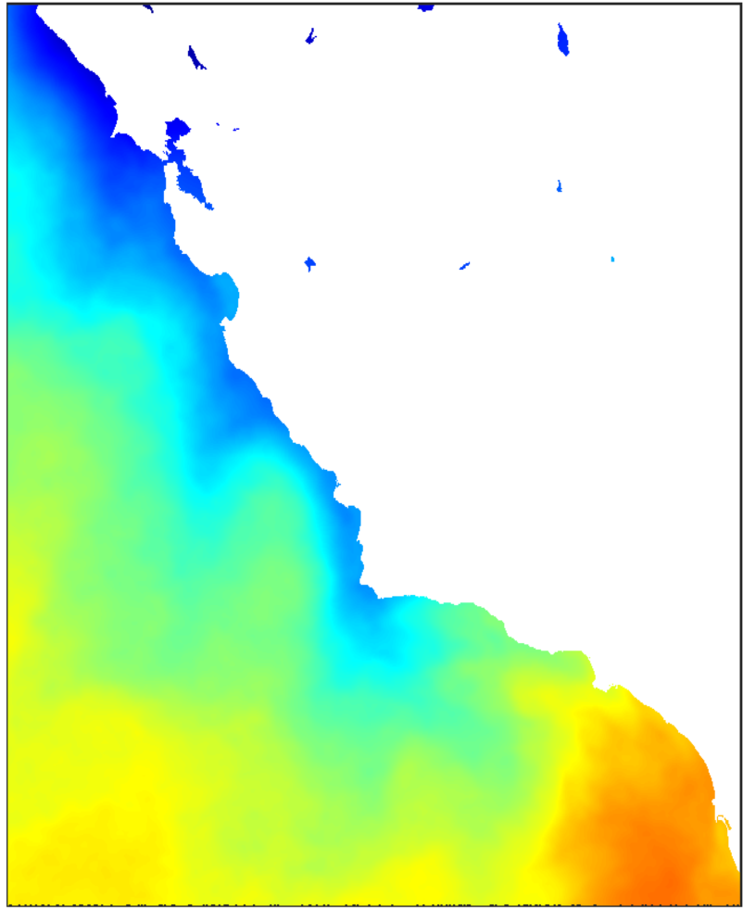
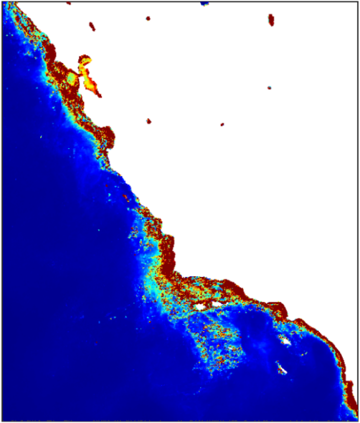
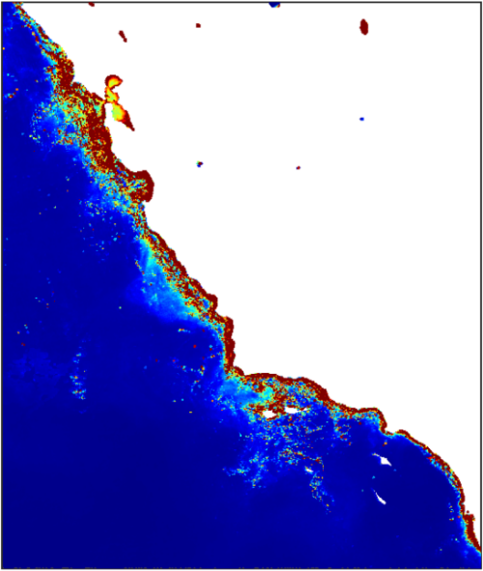
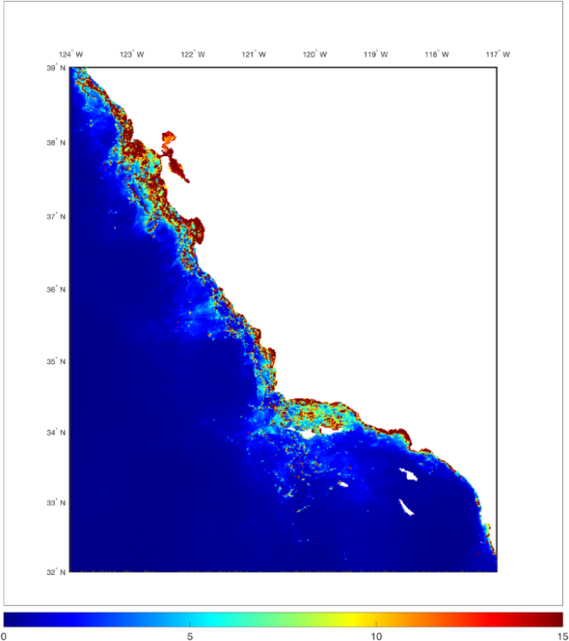
April Monthly Means
10°
Sea Surface Temperature
(Degrees Celsius)
15°
20°
2003
2010
2016
0
Chlorophyll-a Concentration
(mg/m³)
15
30
Notes:
These images were created from our satellite data in MATLAB.
The top row is the sea surface temperature from our MUR data. The is a general warming along the coast during this time period.
The bottom row is the chlorophyll-a concentration from Aqua MODIS. Chlorophyll tends to decrease over time, especially in the south coast.

Slide 11
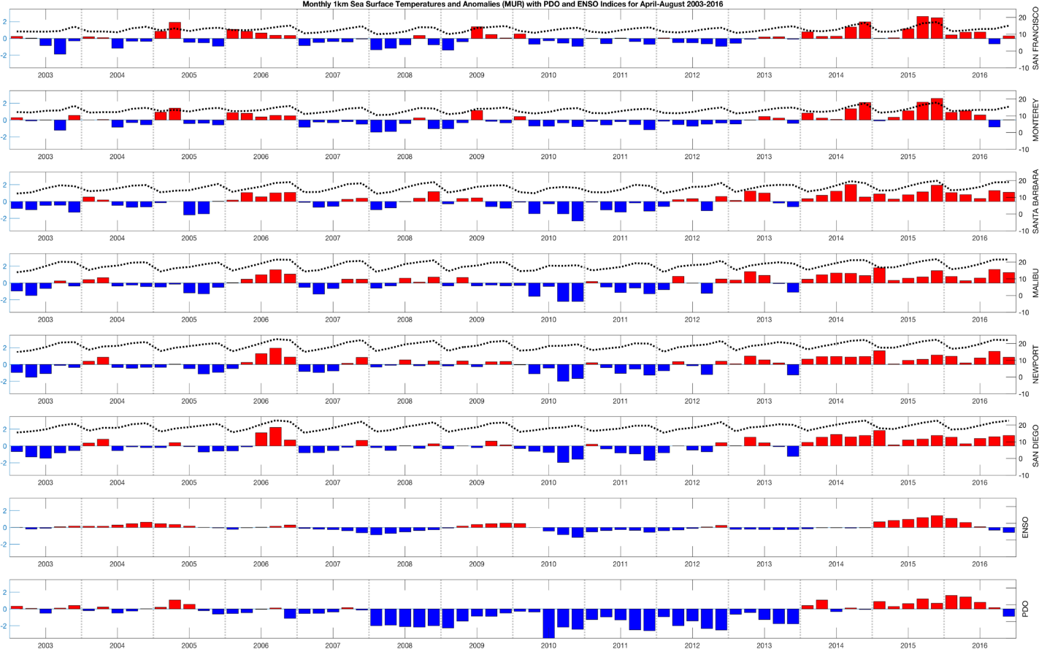
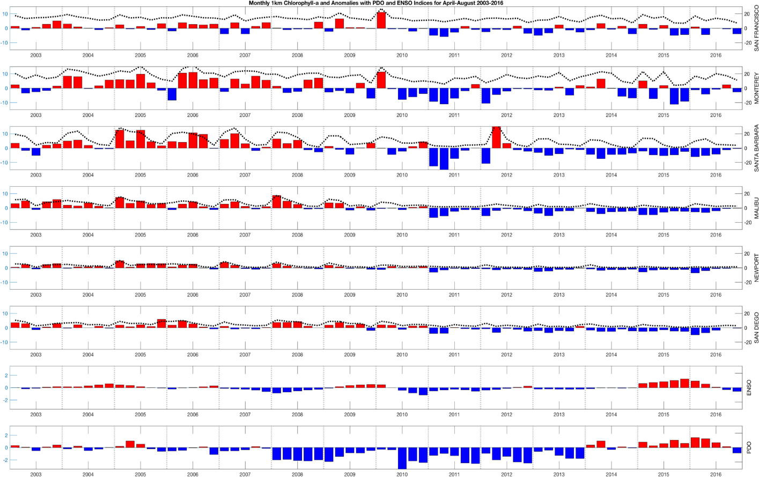
Monthly Anomalies of Beach Locations
Notes:
This slide represents the sea surface temperature anomalies for each of our six locations and the ENSO/PDO indexes for comparison.
The locations are listed from north to south and the dotted black line is the temperature means.
On the right, the chlorophyll-a anomalies are plotted and again the chlorophyll means are represented through the dotted black line.
The ENSO/PDO do not correlate as well with the chl-a as they do with the SST data

Slide 12
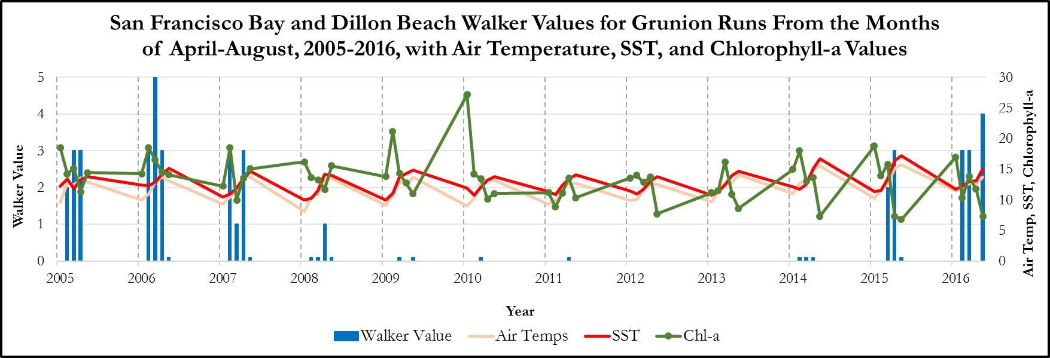
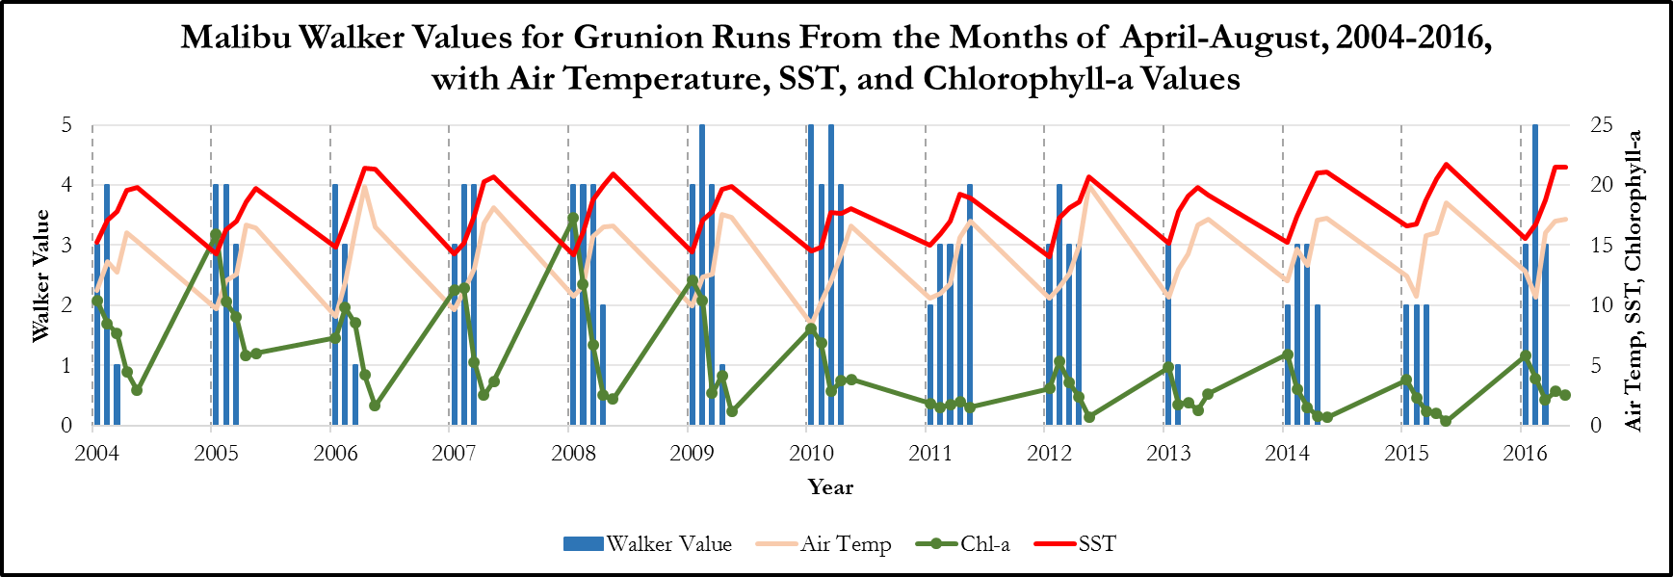
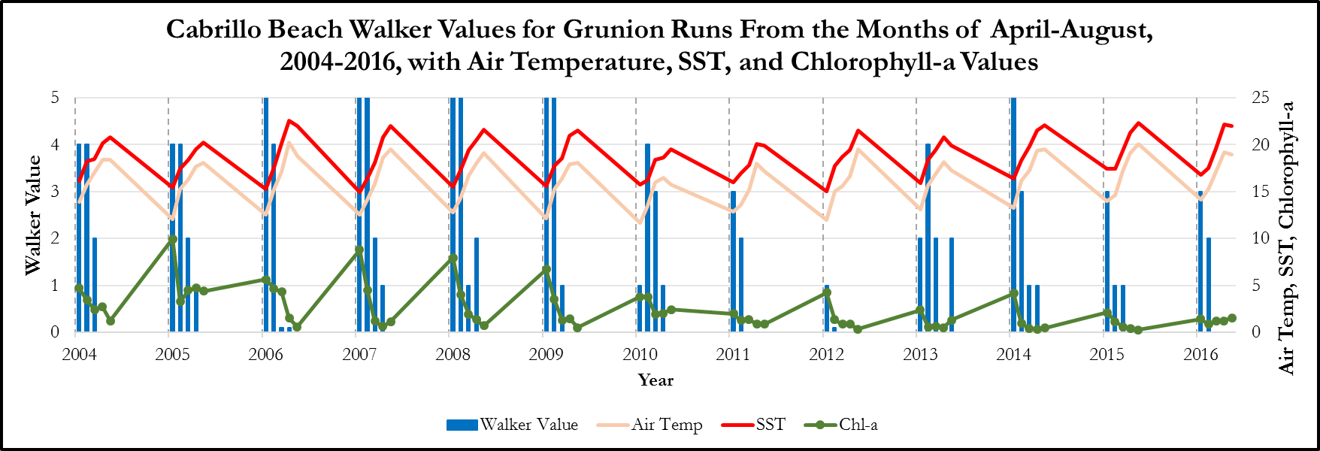
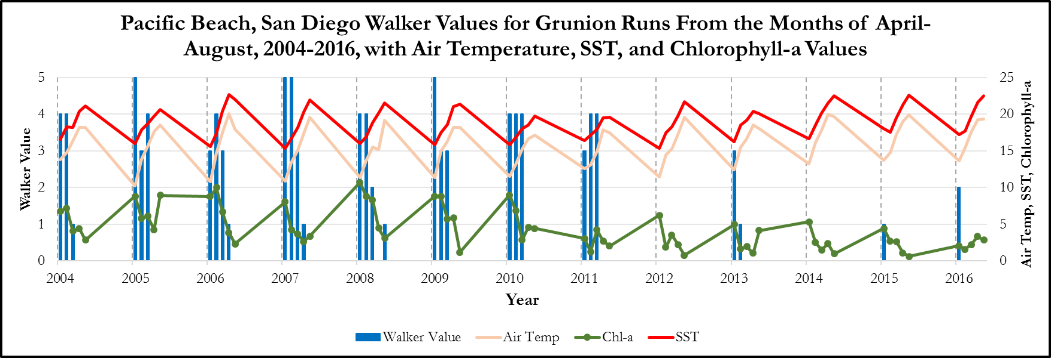
SST, Chl-a and Grunion Run Data Results
Notes:
The data compares satellite sea surface temperature (MUR), chlorophyll-a concentration (Aqua MODIS), in situ air temperature (NOAA NCDC) and in situ grunion run data (Karen Martin)
The Walker values represent the grunion run numbers, the scale is from 0 (no grunion present) to 5 (thousands of grunion covering the entire beach)
The Walker value is plotted for the months April-August, therefore there are five bars for each year.
The data is plotted altogether to determine any trends, if present for the 4 beaches listed
The closest correlation is Pacific Beach’s chlorophyll-a concentration with the grunion numbers. Moving towards 2016, the chlorophyll-a values decrease along with the grunion run numbers.

Slide 13
Conclusions
SST means have increased
Chl-a concentrations have decreased
Grunion population numbers tend to follow Chl-a concentrations
Time series will be utilized by partner to hypothesize trends
Notes:
SST inc. all along the coast of California, especially in the south
Chl-a concentrations have decrease, again strongly in the south
The time series created of the SST, Chl-a and their anomalies will help track the grunion shifts and hopefully predict if the species will continue to travel north due to the increased temperature
Further work can be done to see how the grunion are moving and how they are affected by other variables such as Harmful Algal Blooms (HABs) such as pseudo-nitzschia and Domoic acid.
This could determine the decrease in grunion over time, along with anthropogenic activities.

Slide 14
Errors and Uncertainties
Time series is relatively short; patterns occurring on broader timescales can be hard to determine
Grunion trends are not particularly distinct in comparison to SST/Chl-a
Not all grunion data have been compared to our plots
Gaps in the data
?
Notes:
This timescale from 2003-2016 is a little over a decade. It is harm to determine real large-scale migration patterns
Not all of the grunion data was analyzed and plotted. This could be useful for looking at the rest of the coast to see if the fish follow the same patterns as they did in San Diego, the San Francisco Bay, Malibu, and near Monterey

Slide 15
Future Work and Recommendations
Conduct comparison of harmful algal blooms to the movement of grunion populations
Domoic Acid and pseudo-nitzschia
Compare ocean currents and wind speed and direction to grunion movements along the coast
Standardize collection and storage of Grunion Greeters data
Collect other in situ measurements through Grunion Greeters (air temperature, etc)
Notes:
To also look at grunion movement and decreased population, harmful algal bloom patterns can be compared to see if the algae is affecting the grunion or their food source.
The ocean currents and wind speed can also be looked at to see if the grunion prefer higher tides when spawning
Keeping all the data together with a standardized date, number, and location will make it easier to access and sort through when adding the data to our plots and figures.
Having Grunion Greeters record air temperature and water temperature for each run as well as the Walker value will help add to our partner’s dataset.

Slide 16
Acknowledgements
Advisor
Benjamin Holt, NASA Jet Propulsion Laboratory, California Institute of Technology
Partner
Dr. Karen Martin, Grunion Greeters Project

