Slide 1
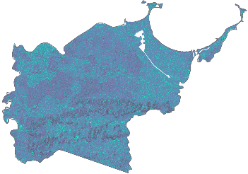
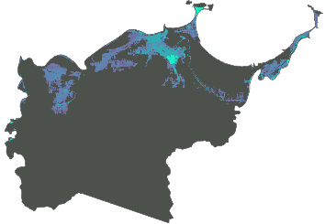
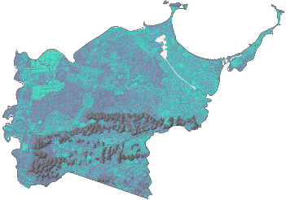
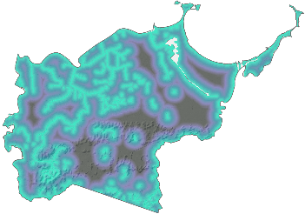
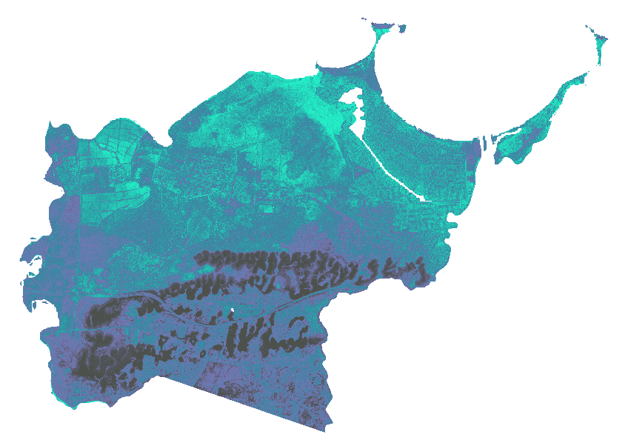
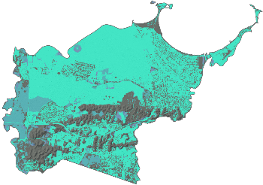
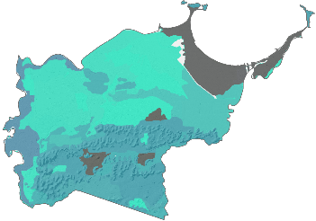
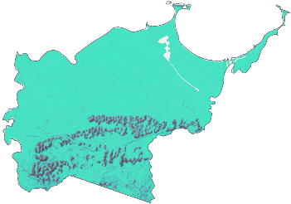
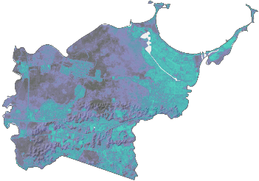
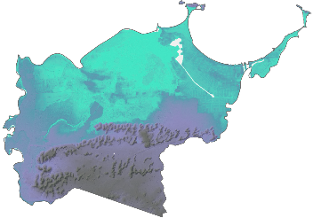
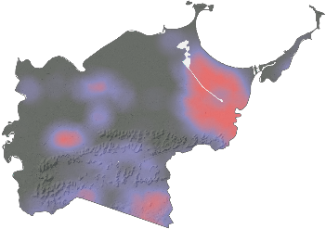
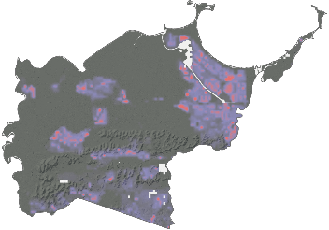
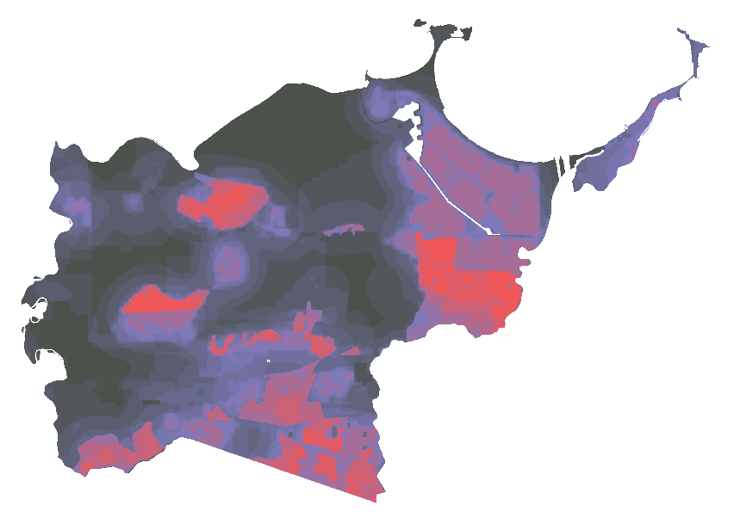
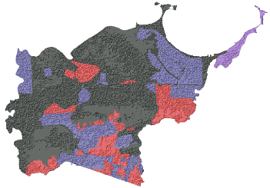
Utilizing Open-Source Earth Observations to Inform the Toa Baja Municipality’s Flood Mitigation Efforts and Educate the Public
Abstract
Study Area
Toa Baja Disasters
Toa Baja, located just west of San Juan in Puerto Rico, is known as “the underwater city” due to its propensity to flood. The city contains the mouth of the island’s longest river, Río de la Plata, which drains into the Atlantic Ocean on the northern edge of the municipality. Proximity to these major water features and the flat, low terrain contribute to the flood-prone nature of the area. During tropical storm events, such as Hurricane Maria in 2017, Toa Baja experienced inundation of up to 20 feet. Changes in the global climate system are causing more intense and frequent tropical storms, making places like Toa Baja subject to irreparable damage. This NASA DEVELOP project collaborated with the Municipio Autonómo de Toa Baja, ResilientSEE, and the Massachusetts Institute of Technology Urban Risk Lab to supplement recent 2018 Federal Emergency Management Agency Hydraulic Engineering Centers-River Analysis System flood maps, which designated 63% of the area as a flood plain. The analysis provides a high-resolution interpretation of flood susceptibility using a variety of factors that collectively influence the likelihood of flooding. Sentinel-1 C-Band Synthetic Aperture Radar (C-SAR) data processed with Google Earth Engine scripting identified historical inundation and was used for validation purposes. Socioeconomic factors were combined with the inundation layer producing a final risk output. These outputs will improve public understanding of exposure to flood risk in Toa Baja and provide scientific evidence for flood mitigation advocacy.
PUERTO RICO
Elevation
North America
High
Low
South America
60% of Toa Baja is designated as flood plain
$1.3 billion dollars in damage from Hurricane Maria
Nearly 14,000 homes were flooded by Hurricane Maria
Results
Objectives
SUSCEPTIBILITY
Build a flood susceptibility map using weighted factors
Build a flood risk map using the flood susceptibility map and additional vulnerability factors
Compare our risk map against historical flooding collected from SAR data
Create an ArcGIS online StoryMap for the Municipality of Toa Baja to educate residents on contributing factors to flood susceptibility and risk
TWI
Storm
Surge
Slope
Distance
From Water
Landcover
KSAT
HAND
NDVI
DEM
Low
High
Earth Observations
VULNERABILITY
Sentinel-2 MSI
Landsat 5 TM
Building
Density
Population
Density
Sentinel-1 C-SAR
Landsat 7 ETM+
Informal
Settlements
Low
High
Methodology
NDVI
Analytical Hierarchy Process
Multi-Criterion Evaluation
Flood Susceptibility
High
Med
Low
Risk
Landcover
Susceptibility
Elevation
Flood Risk
Low Med High
Slope
Standardization
Vulnerability
TWI
Multi-Criterion Evaluation
HAND
Vulnerability
KSAT
Population
Standardization
Conclusions
Distance to Water
Informal Settlements
Storm Surge
Building Density
77% of Toa Baja is medium to highly susceptible to flood
~50% of the Northern quadrant is categorized to have high flood susceptibility
Our analysis aligns with the FEMA flood risk assessment, with 89% of highly susceptible areas falling within designated flood zones and 76% of low susceptibility areas falling outside designated flood zones
Project Partners
Municipio Autónomo de Toa Baja
ResilientSEE
Massachusetts Institute of Technology, Urban Risk Lab
Team Members
Acknowledgements
Dr. Kenton Ross, Science Advisor, NASA DEVELOP National Program
Sydney Neugebauer, Fellow, NASA DEVELOP National Program
Dr. Venkataraman Lakshmi, UVA Engineering Systems & Environment
Dr. John Bolten, Goddard Space Flight Center
Dr. Marangelly Cordero-Fuentes, Goddard Space Flight Center
Perry Oddo, Goddard Space Flight Center
Nara McCray
Project Lead
Scott Harrison
Wilfredo García López
Adriana Le Compte Santiago
Virginia - Langley

