Slide 1
North Carolina Water Resources
Utilizing NASA Earth Observations to Monitor Harmful Algal Blooms in the Albemarle and Pamlico Sounds of North Carolina
Chad Smith (Project Lead)
Jelly Riedel
Keith Benjamin
Daniel Wozniak
Matthew Carter

Slide 2
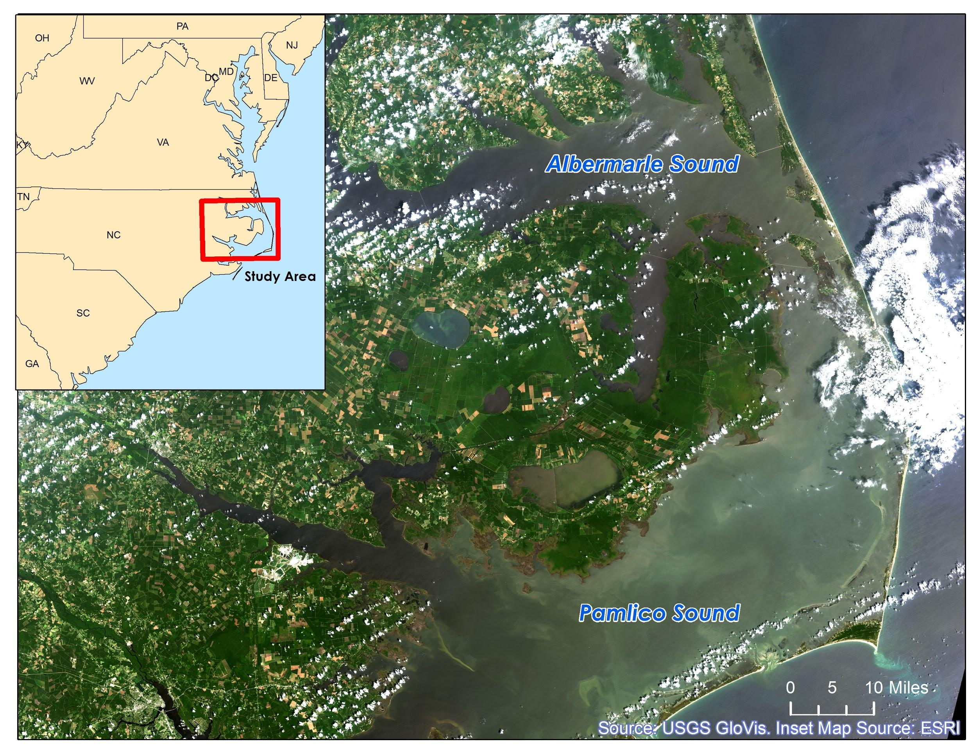
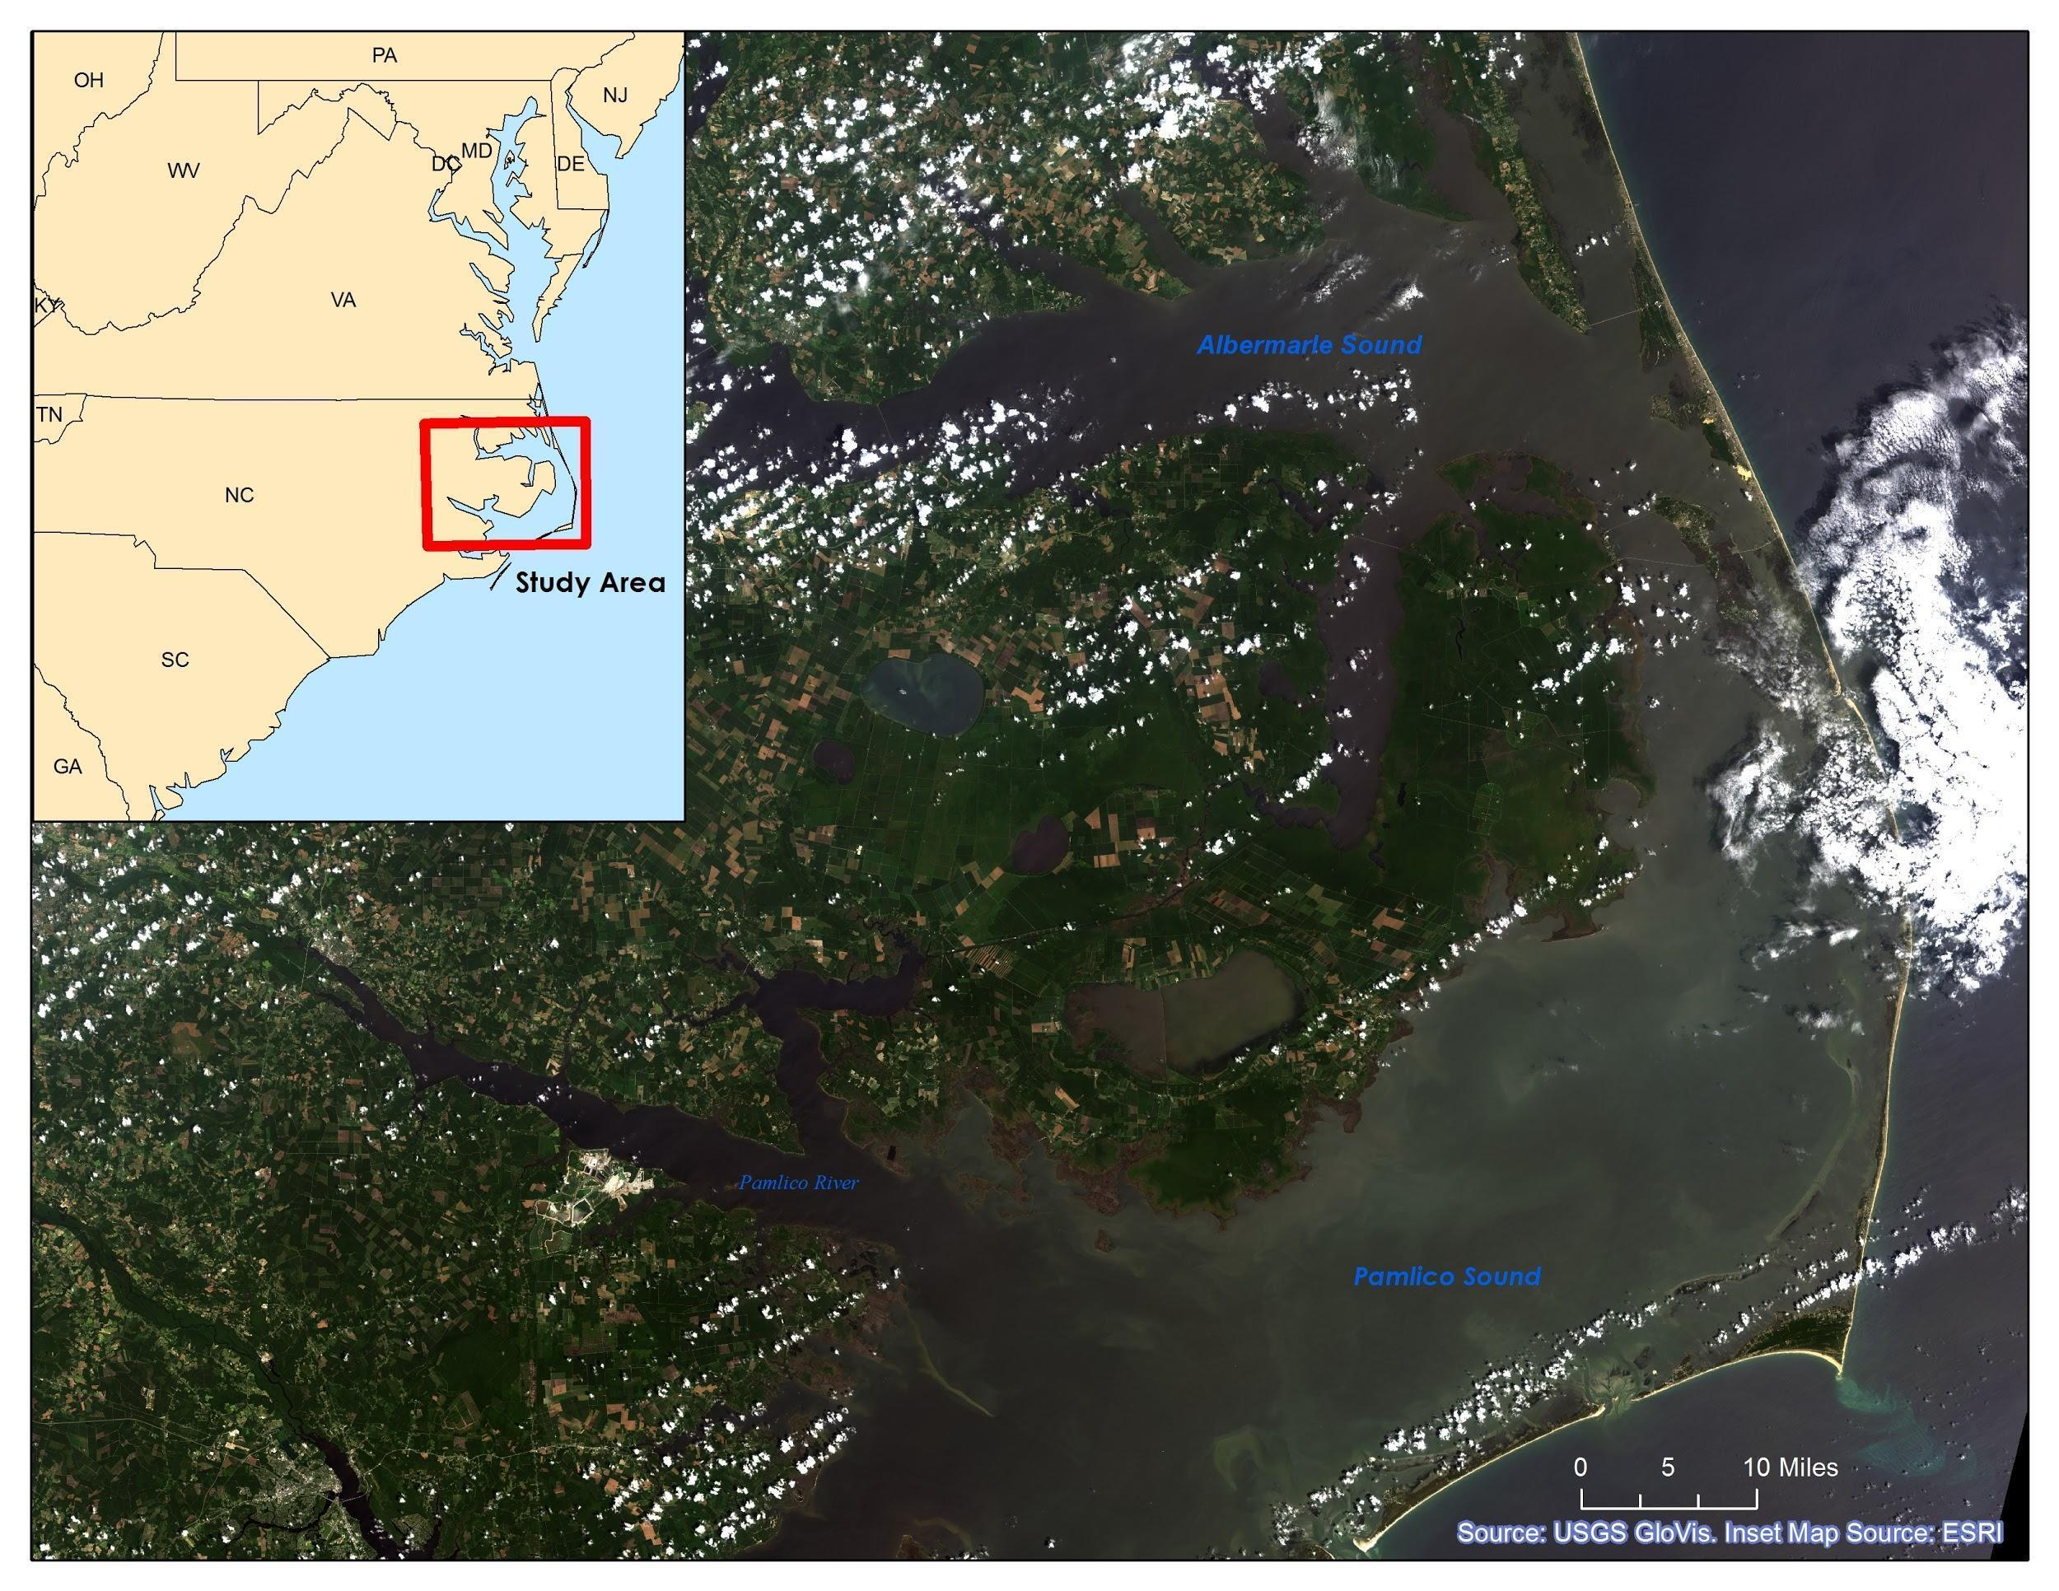
Community Concerns
Why are the Albemarle and Pamlico Sounds so important?
2nd largest estuary in the United States
Contains 99% of the Atlantic coast’s submerged aquatic vegetation (SAV)
Supports one of the nation’s richest fisheries
Valuable to sportsmen and tourists
Notes:
I think this map looks too dark. We can replace it with a lighter image. I can mess with the symbology in the raster to make it appear lighter.
The Albemarle-Pamlico National Estuarine Complex is the 2nd largest estuary in the United States
Contains 99% of the Atlantic coast’s submerged aquatic vegetation outside of Florida
Supports one of the nation’s richest fisheries
Valuable for its appeal to recreational sportsmen and tourists

Slide 3
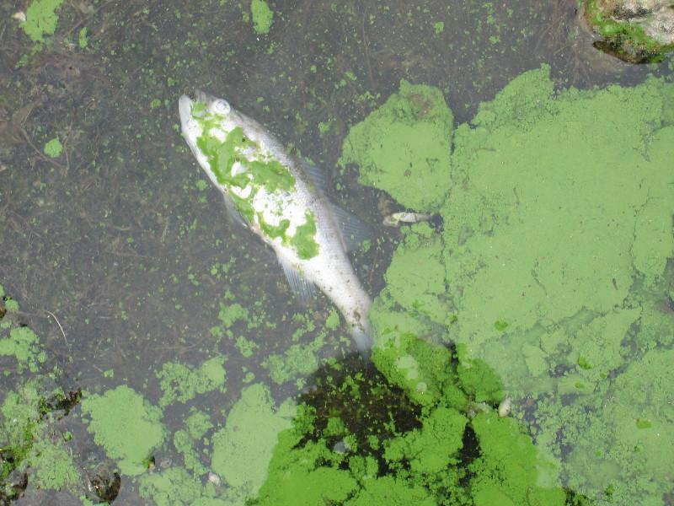
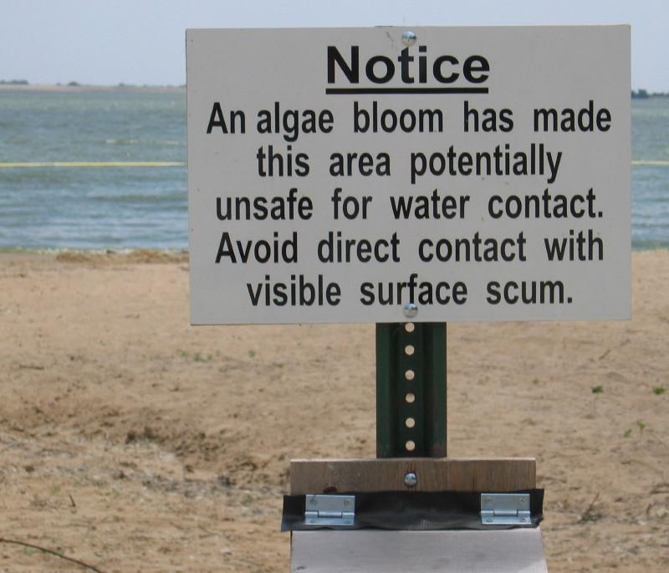
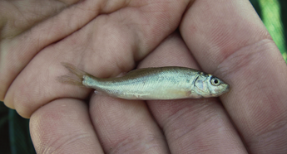
Community Concerns
Dangers of Harmful Algal Blooms (HABs):
Toxins in concentrations lethal to wildlife and domestic animals
Adverse human health effects
Hypoxic zones
Reduced light availability in water column for SAV
Source: USGS
Source: USGS
Source: USGS

Slide 4

Project Partners
Dr. Michelle Mooreman
Sharon Fitzgerald
USGS North Carolina Water Science Center
Jim Hawhee
Dean Carpenter
Dr. Bill Crowell, Director
Albemarle-Pamlico National Estuary Partnership (APNEP)

Slide 5
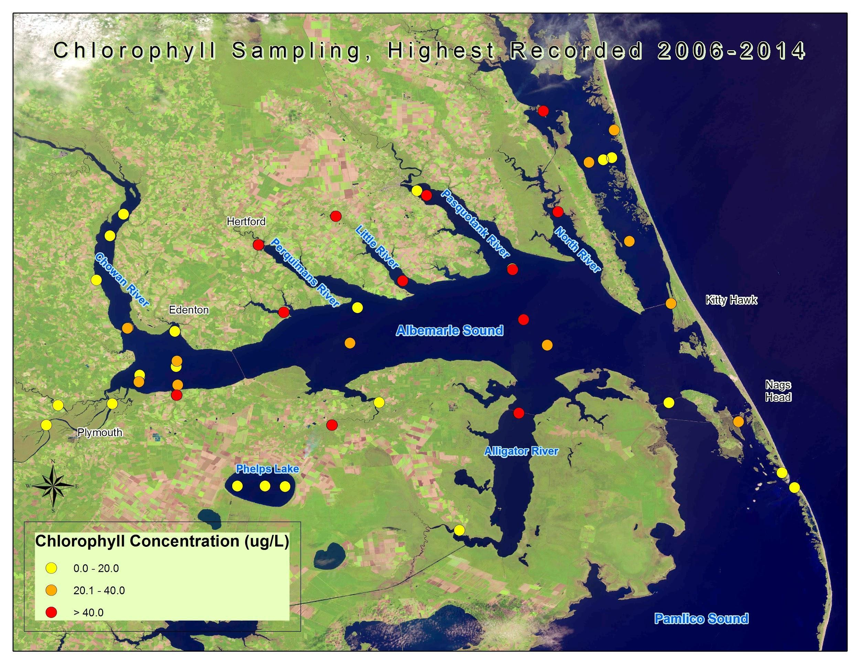
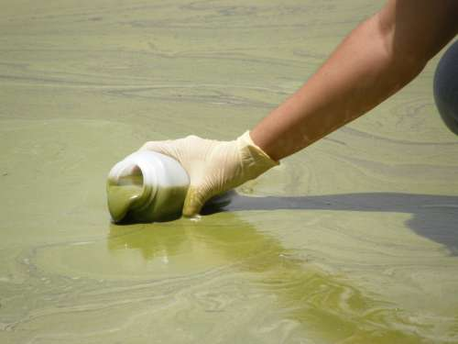
Project Objectives
Create a 10 year time-series representation of HAB extent from 2004 to 2014 using Chl-a as a proxy for algae
Compare MODIS-derived HAB maps with in situ water sample data
Provide end-users with informational maps of large-scale HAB extent
Source: USGS

Slide 6


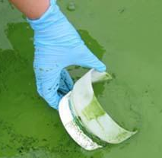

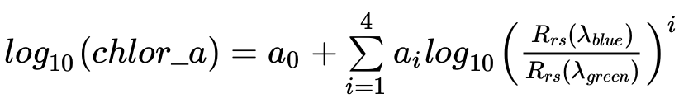
Project Methodology
NASA Earth Observations: | Data Acquisition:
Aqua MODIS Level 2 Data | Sea Wifs Data Analysis System-SeaDAS Goddard Space Flight Center
In situ Data: Water Quality Samples Station Locations
SeaDAS Chl-a algorithm

Slide 7
Project Methodology
MODIS Level 2 Daily Ocean Color Data
NWQMC Monitoring Station Locations
Processing- Reject partial images, etc.
NC Water Science Center Data & NWQMC Point Sample Data
Gridding
Clip to Study Area
Convert Collection Dates to Cardinal Dates
OC3M MODIS derived Chlorophyll (443, 489, 547)
Join Available Data to create XY Event Layers in ArcMap
Extract Raster Values for comparison to in situ data
Point Shapefiles
Calculate Monthly Means of Chl-a Concentration
Cartographic Representations of Point Samples with Landsat Imagery Basemaps
Overlay on Landsat Imagery Basemaps for Time Series Representation
Notes:
add animations for each thing

Slide 8
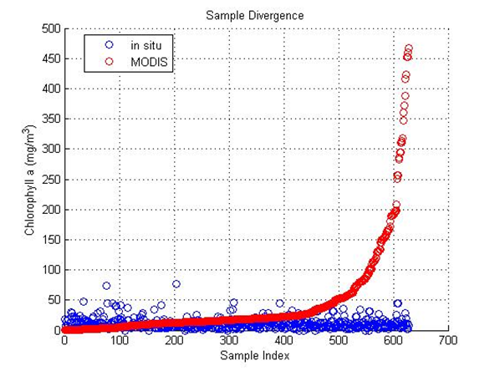
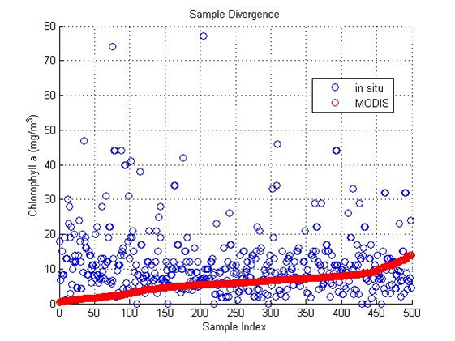
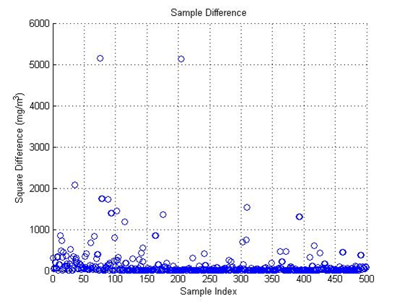
Results
in situ and MODIS diverge
above 22 mg*m^-3
model confidence increases below sample index 400

Slide 9

Time Series Animation

Slide 10
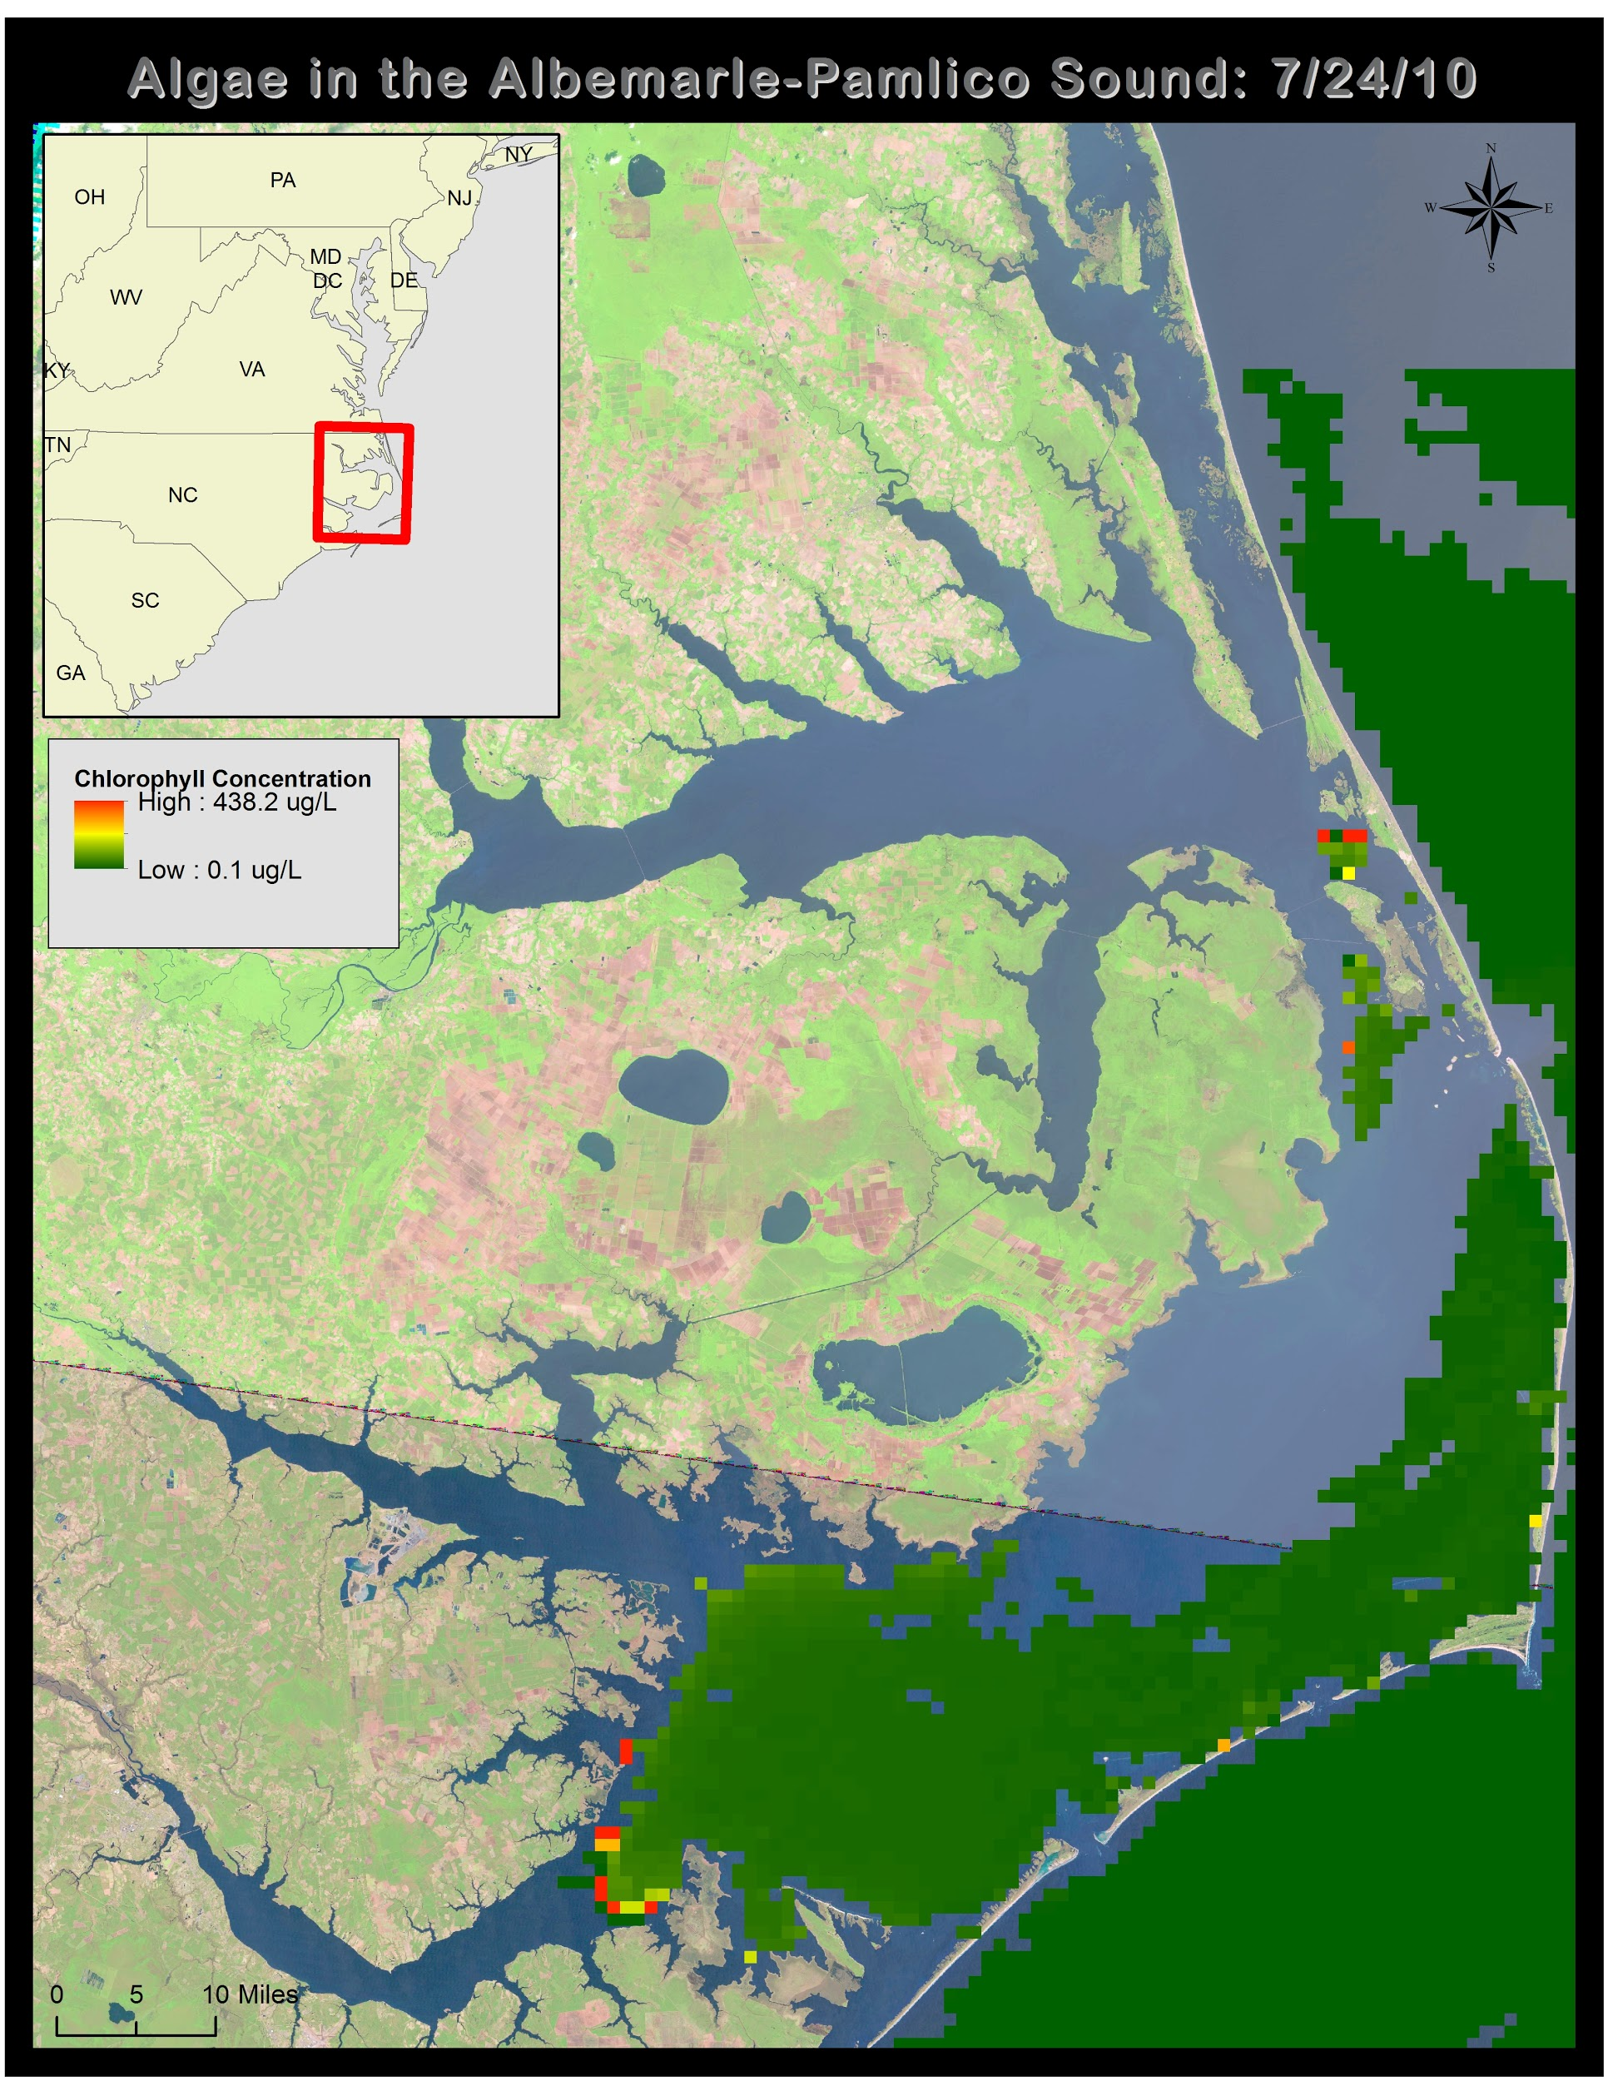
Uncertainty / Error Analysis
OC3M Algorithm use in “Case II,” optically complex waters
MODIS bands not necessarily the best for detecting all types of cyanobacteria
Water sample depth v. surface/near surface algae
Sample point clustering could lead to bias in results

Slide 11
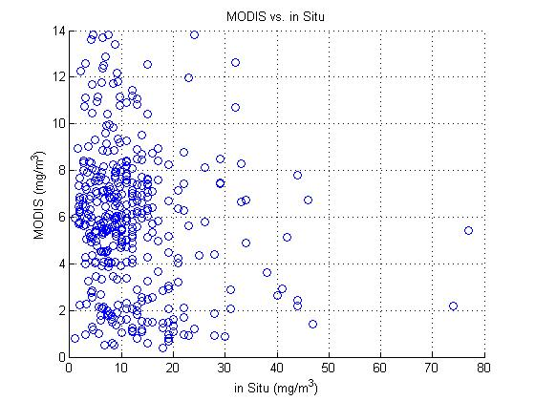
Conclusions
It remains undetermined whether using MODIS sensor data can accurately measure chlorophyll a and, subsequently predict or detect harmful algal blooms.
What is known is that current research has been unable to generate an adequate model for detecting harmful algal blooms.

Slide 12
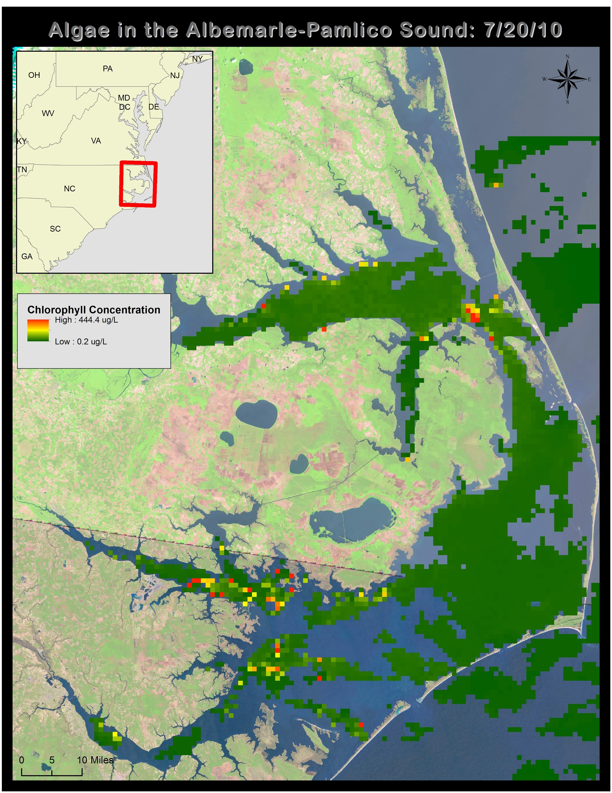
Benefits of Research
Large extent of HAB monitoring
Historical record of HAB behavior
Could be applied to forecast algal blooms

Slide 13
Future Work
Refinement of the regression analysis to validate the model.
Incorporation of estuary-specific algorithms for local area of interest
Investigation of relationships between chl-a concentration and land cover/ land use in the area or other water quality factors (dissolved O2, N, P, etc).

Slide 14
Acknowledgements
Advisors
Dr. Kenton Ross, DEVELOP National Science Advisor
Partners
Dr. Michelle Mooreman & Sharon Fitzgerald,
USGS North Carolina Water Science Center
Jim Hawhee, Dean Carpenter, & Dr. Bill Crowell, Director,
Albemarle-Pamlico National Estuary Partnership (APNEP)
Others
Jeff Ely, Geoinformation Scientist
This material is based upon work supported by NASA through contract NNL11AA00B and cooperative agreement NNX14AB60A.

